Slide 1
SQL Injection

Slide 2
SQL injection is a code injection technique that places malicious code in SQL statements via web page input and might destroy your database. It is one of the most common web hacking techniques.
SELECT * FROM Users WHERE UserId = 105 OR 1=1; -> Returns all user data
SELECT * FROM Users WHERE Name ="" or ""="" AND Pass ="" or ""="" -> Returns all user data
SELECT * FROM Users WHERE UserId = 105; DROP TABLE Suppliers; -> Deletes table

Slide 3

Lets say we have a simple users table and one user entry.

Slide 4
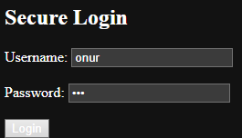
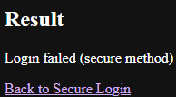
Secure Code
Let's try secure code at this url http://localhost:8080/secure-login
I type the wrong password such as "asd".

Slide 5
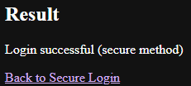
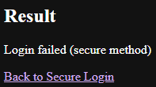

Then I type correct password.
Now let's try to delete entry with sql injection with this query
' OR 1=1; DELETE FROM users WHERE username='onur'; --
It didn't work. We still have the entry in database.

Slide 6
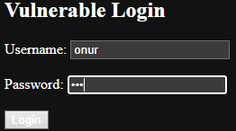
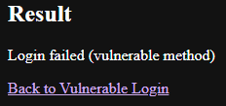

Vulnerable Code
Now let's try vulnerable code at this url http://localhost:8080/vulnerable-login
I typed the wrong password such as "asd".
As we didn't try to delete entry we still have it.

Slide 7
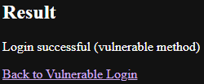
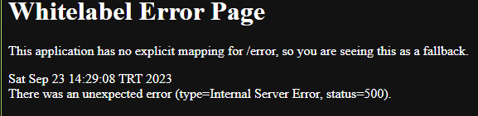

Correct password this time.
Now SQL Injection this time with same query
' OR 1=1; DELETE FROM users WHERE username='onur'; --
Now we have different error that I didnt catch in the code. And we lost our entry.

Slide 8
https://github.com/OnurcanPekgoz/sql-injection

