Slide 1
WEEKS 10–12
MSc. Explainability & Reliability in Medical AI Systems
FracAssist
Y5 Ablation
Thesis Writing
Inference System
FracAssist UI
YOLO 1-1 Y5 mAP@0.5
Writing Introduction
Novelty Approach
LIVE
DEPLOYED
0.536
IN PROGRESS
05 Apr – 19 Apr 2026 · Supervisor Meeting: 16.04.2026

Slide 2
PREVIOUS WORK RECAP
Phase | Period | Outcome
Wk 1–2 | Jan–Feb 2026 | Dataset: FracAtlas. Lit review. Metric: F1 (Fractured). Imbalance 4.69:1.
Wk 3–4 | Feb 2026 | E3 Baseline ResNet-18. F1=57.7%, Recall=77%, AUC=0.857. Overfitting gap 0.27.
Wk 5–6 | Mar 2026 | E4e Final: F1=65.81%, Recall=64.66%, Acc=88.75%, AUC=0.8884. GradCAM applied. SOTA complete.
Wk 7–9 | Mar–Apr 2026 | YOLO Phase (Y0B–Y4). Best: Y1B YOLOv8s 200ep AdamW. mAP@0.5=0.651 (+8.9pp vs paper). ✅ APPROVED.
Wk 10–12 | Apr 2026 | FracAssist deployed (Flask+UI). Y5 ablation run. Chapter 1 writing started. ← CURRENT

Slide 3
WEEK 10–12 OBJECTIVES
Deployable Inference Pipeline
O1
CRITICAL
Y1B + ResNet-18 selective cascade. Confidence + box overlay output.
FracAssist Web UI
O2
CRITICAL
Flask backend + dark-theme frontend. GradCAM toggle, model health tab.
Ensemble: YOLO + ResNet-18
O3
SECONDARY
YOLO-led when box detected; ResNet-led fallback. GradCAM always generated.
Y5 Ablation — 1:1 Negative Ratio
O4
OBJECTIVE 3
635 frac + 635 non-frac. Isolates negative sampling variable. FP rate on healthy images.
Thesis Chapter 1 Writing
O5
OBJECTIVE 2
Clinical context + DL in medical imaging. Intro figures created.

Slide 4
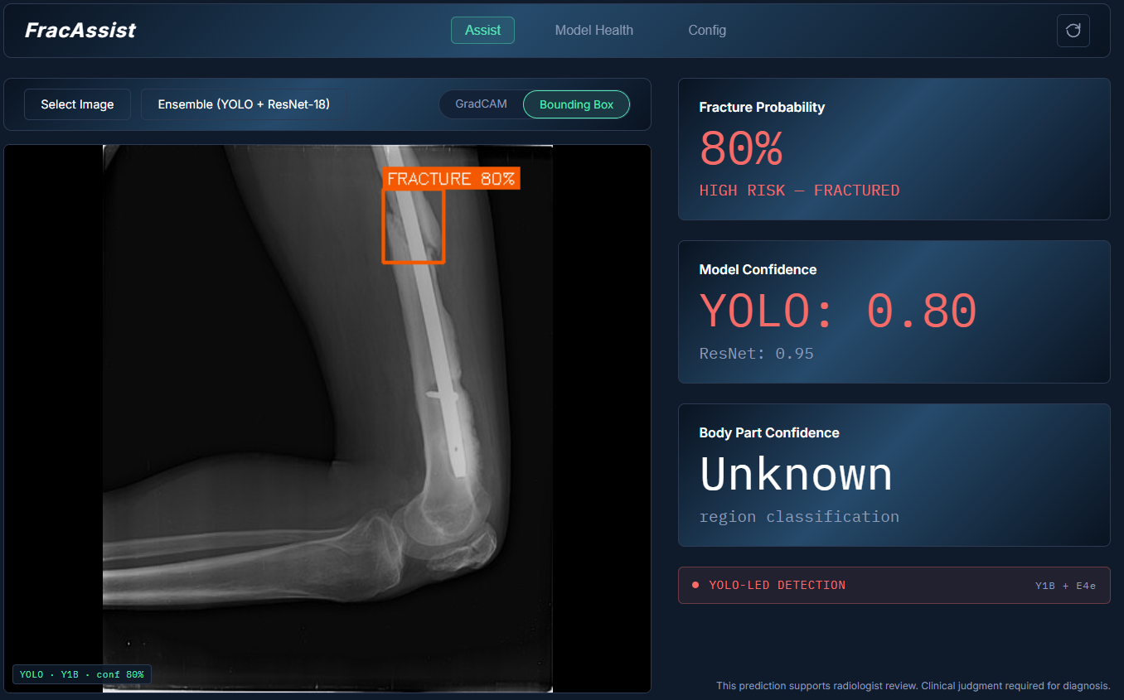
O1 / O2 / O3 — FracAssist: Deployable Clinical Decision Support
🔵 YOLO-LED path
Box detected → fracture confirmed + overlay shown
🟡 CLASSIFIER-LED path
No box → ResNet-18 probability + GradCAM heatmap
🟢 GradCAM always on
Saliency map generated on ResNet branch for every case
⚙️ Model Health tab
Live F1/AUC/threshold display; both models tracked
🔒 Clinical disclaimer
"This prediction supports radiologist review."
Backend: Flask · Frontend: HTML/JS/CSS · Runs locally on GPU · No data leaves machine

Slide 5
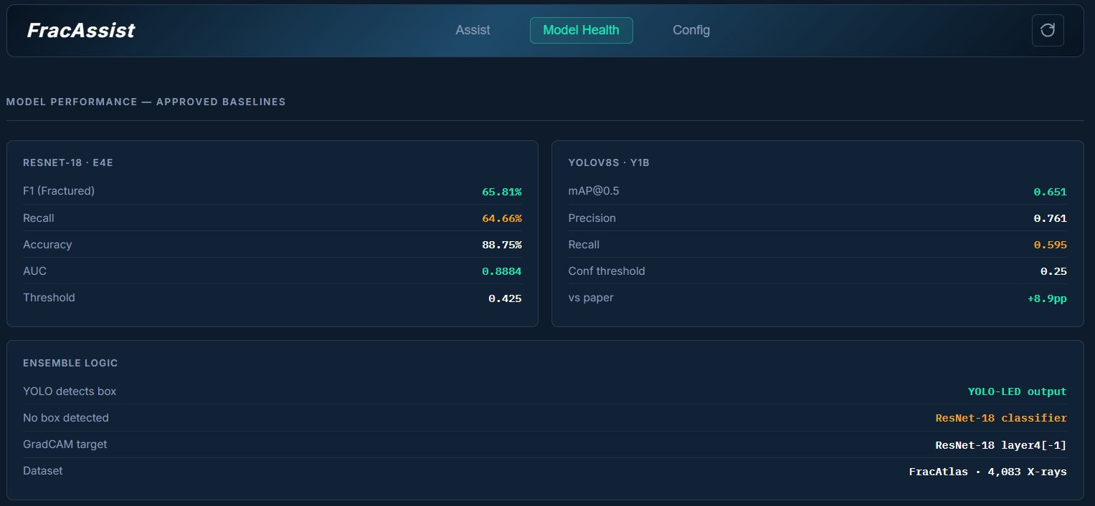
FracAssist — Model Health
ENSEMBLE LOGIC
Condition | Output
YOLO box ≥ 0.25 conf | YOLO-LED Box overlay + YOLO confidence
No YOLO box | CLASSIFIER-LED ResNet-18 prob + GradCAM
GradCAM (always) | layer4[−1] hook alpha=0.4 heatmap overlay

Slide 6
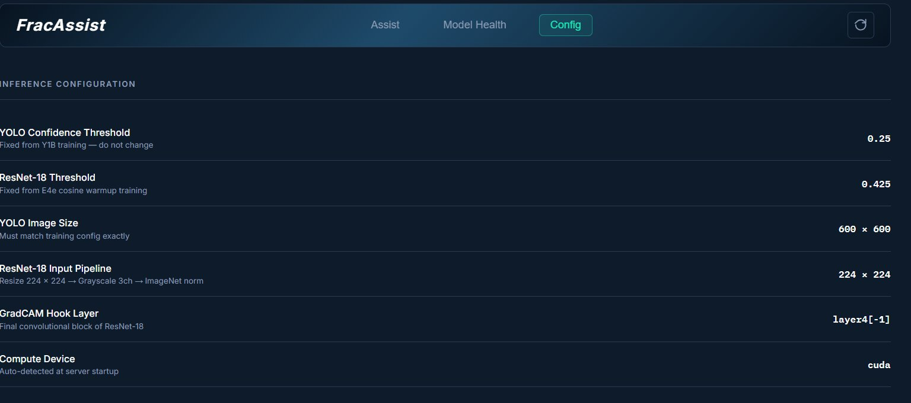
FracAssist — Inference Config
YOLO conf threshold
YOLO imgsz
ResNet input
0.25
600 × 600
224 × 224
INFERENCE CONFIG
ResNet-18 threshold
GradCAM layer
Device
0.425
layer4[−1]
CUDA

Slide 7
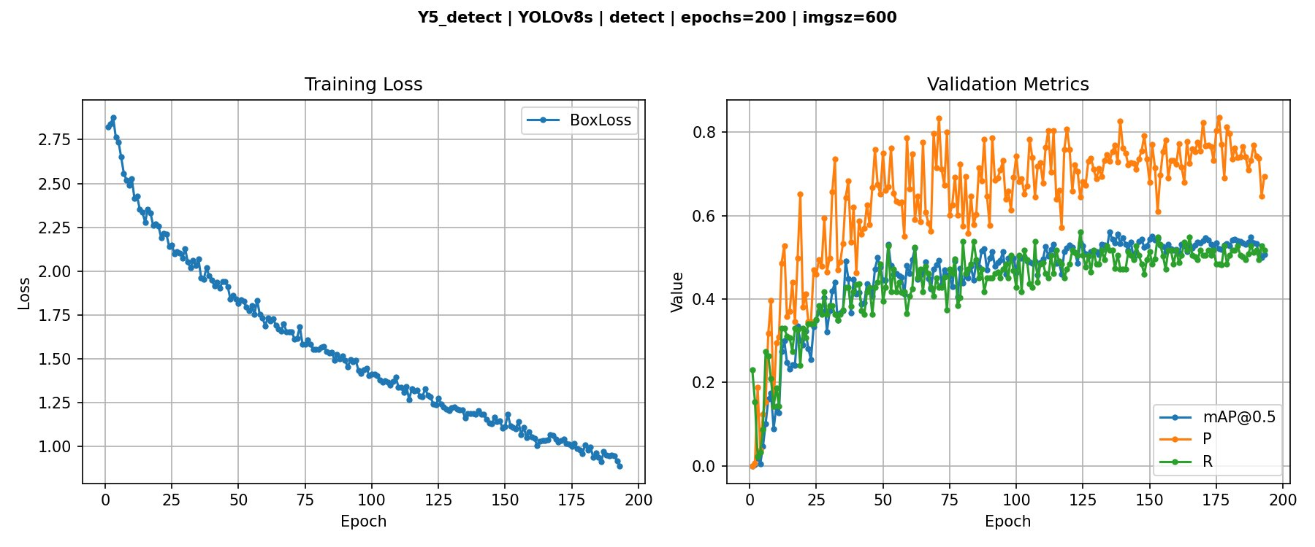
O4 — Y5 Ablation: 1:1 Negative Sampling (Negative Result — Valid Thesis Finding)
Y1B vs Y5 COMPARISON
Metric | Y1B ★ | Y5 (1:1) | Δ
Precision | 0.761 | 0.727 | −0.034
Recall | 0.595 | 0.505 | −0.090
mAP@0.5 | 0.651 | 0.536 | −0.115
mAP50-95 | 0.285 | 0.249 | −0.036
⚠ NEGATIVE RESULT — VALID THESIS FINDING
KEY FINDING
More negatives = lower mAP50. Monotonic degradation:
Y0C (1:6) = 0.29 → Y5 (1:1) = 0.536 → Y1B (0:1) = 0.651
Fractured-only training optimal for this dataset.
Y5 setup: 635 fractured + 635 non-fractured (seed=42), Y1B config.
Y5 early stops at epoch 143 vs Y1B at 200 — negatives disrupt convergence.
Y1B remains approved best detect model. FP rate on healthy images: to be reported.
Ablation gap closed — full ratio sweep documented in thesis.

Slide 8
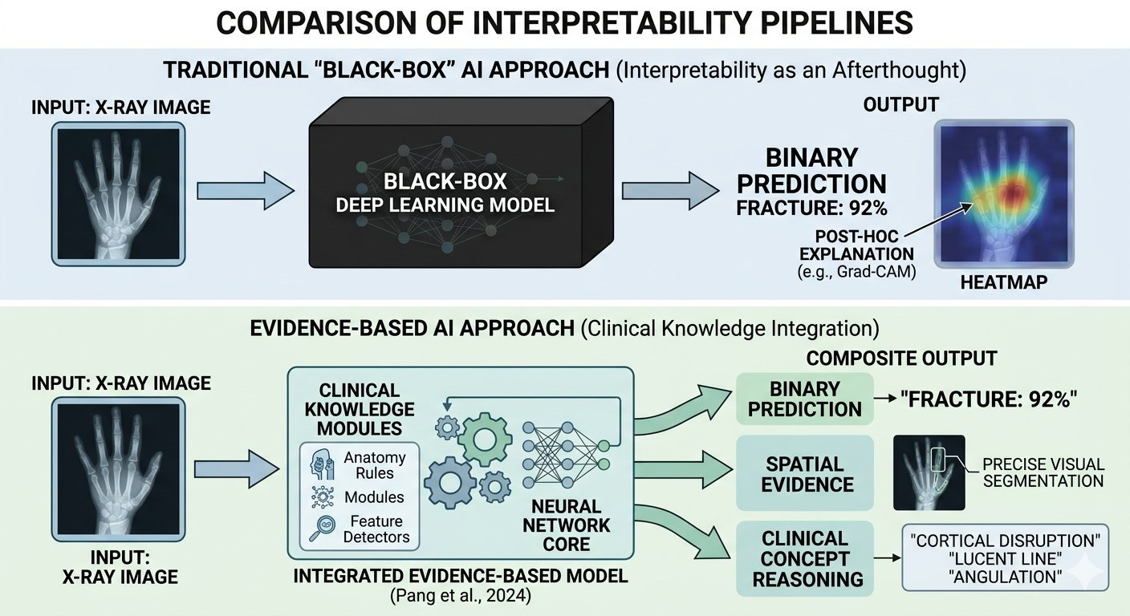
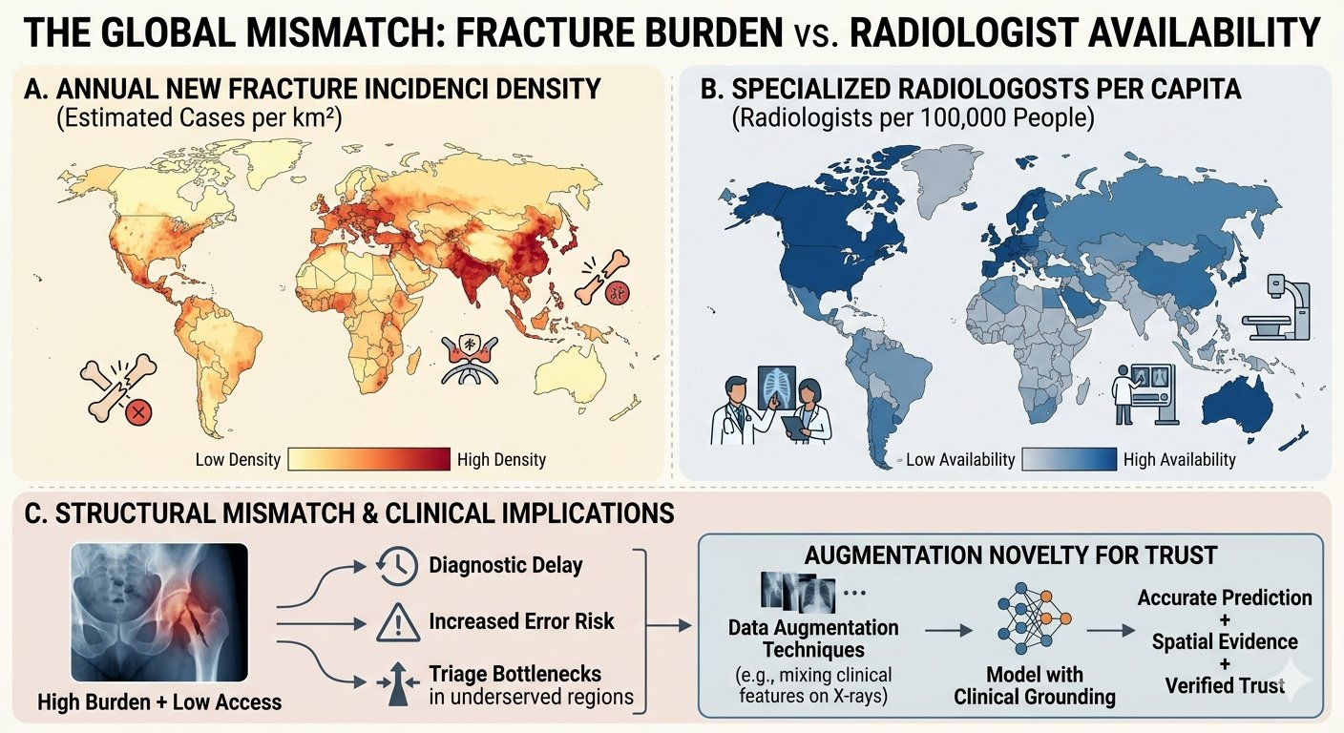
O5 — Thesis Writing: Chapter 1 Introduction (In Progress)
CHAPTER 1 STRUCTURE — LOCKED
KEY CONTENT — 1.1 & 1.2
1.1 Clinical Context & Problem Statement
✅ Draft complete
›
178M new fractures annually — global clinical burden established
›
Missed fracture rates 1–35% depending on region & clinician fatigue
1.2 Deep Learning in Medical Imaging
✅ Draft complete
›
2023 Kahramanmaraş earthquake: mass-casualty AI context
1.3 The Explainability Gap
🔄 In progress
›
AI as teacher model for junior surgeons and medical students
1.4 Research Objectives & Scope
⏳ Pending
›
CNN → Transfer Learning → YOLO → Segmentation field map
›
Core limitation: accuracy without interpretability ≠ clinical use
1.5 Thesis Structure
⏳ Pending
Word doc presented separately. Intro figures created for Chapter 1.

Slide 9
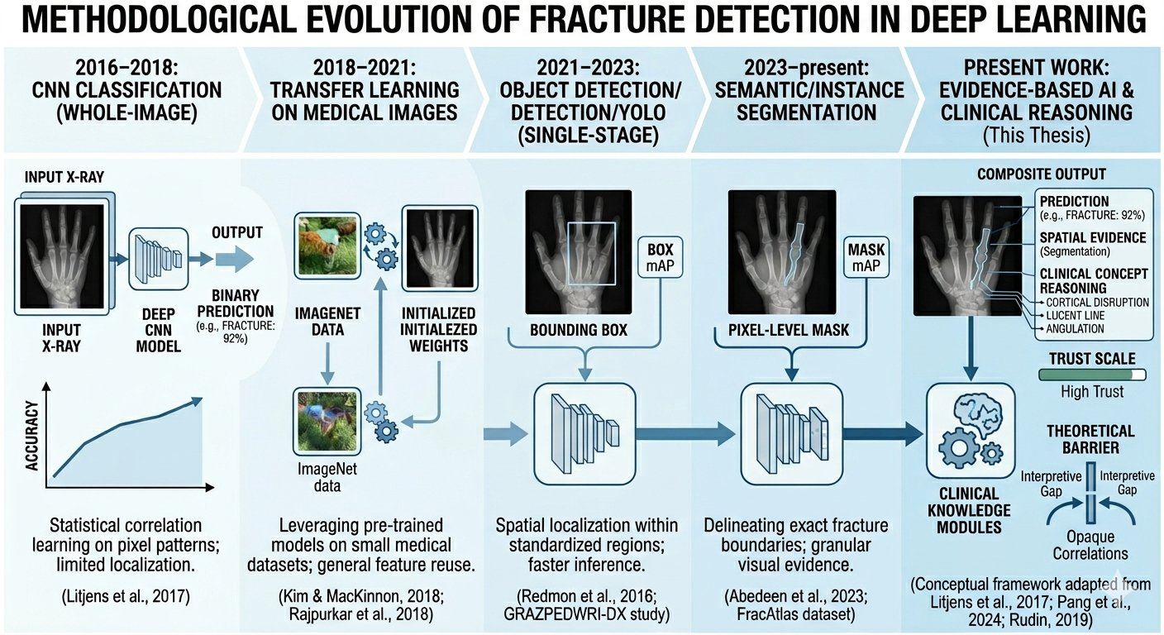
Chapter 1 Introduction Sample Visual — Methodological Evolution of Fracture Detection
Figure created for thesis Chapter 1 — positions this work as the Evidence-Based AI phase (2023–present)

Slide 10
Future Directions & Novelty Roadmap >> (CAALMIX) <<
Contrast Limited Adaptive Histogram Equalization (CLAHE) – Novelty Approach
Y6
Next cycle
Domain-motivated X-ray enhancement. Albumentations.CLAHE(). FracAtlas paper used no preprocessing — this is a clean technical contribution.
Test-Time Augmentation
Y1B-TTA
Next cycle
Zero retraining. augment=True at inference. Avg over 3–5 flipped/scaled versions. Expected +1–3pp mAP free.
AugMix Training
Y7
Next cycle
Robustness against acquisition variability (different scanners/positioning). Available via Albumentations.
DenseNet-169 Ensemble Expansion
DenseNet
Approved
Extend selective ensemble beyond ResNet-18. Cited in FracAtlas paper as strong comparator. Supervisor-approved to try.
XAI Pillars (Post-model)
XAI
Post-model
Pillar 1: CBM/Attributes · Pillar 2: Prototypes · Pillar 3: Counterfactuals. Pending supervisor approval to begin.

Slide 11
Current State & Next Steps
✅ COMPLETE — THIS CYCLE
⏳ NEXT CYCLE PRIORITIES
✅ FracAssist Flask inference system (predict.py)
→ Y6 — CLAHE Preprocessing run
✅ FracAssist dark-theme web UI (3 tabs: Assist / Health / Config)
→ Y1B-TTA — Test-Time Augmentation eval
✅ Selective ensemble: YOLO-LED + ResNet-18 fallback + GradCAM
→ DenseNet-169 ensemble expansion
✅ Y5 ablation completed — negative result documented
→ FP rate table: Y1B vs Y5 on healthy images
✅ Y1B remains approved best detector (mAP@0.5 = 0.651)
→ Chapter 1: Section 1.3 (Explainability Gap)
✅ Chapter 1 writing started — 1.1 & 1.2 drafted
→ Dataset Section (Ch. 3) — GRAZPEDWRI format
✅ 3 Chapter 1 intro figures created
→ Supervisor approval to begin XAI Pillars

