Slide 1
MSc THESIS · HANDOFF
Explainability & Reliability in Medical AI Systems
FracAtlas & FracAssist
Bone Fracture Detection via Calibrated Expert Ensemble
Author Onur Can
Supervisor Prof. Dr. Ayşe Berrin Yanıkoğlu
Meeting
Thesis Handoff Approval
Weeks 13–16 · 12 May 2026
Notes:
Opening line: "This is the handoff meeting — the last working session before writing begins." Call out: GEL was invented this cycle as the primary thesis novelty. Replaces the old cascade entirely. Likely question: "Where are we vs. the original plan?" — Answer: GEL replaces XAI as the novel contribution; XAI is now Future Work. We'll cover the why in slide 3.

Slide 2
EXPERIMENTAL JOURNEY
Sixteen Weeks · One Trajectory
Wk 1–2
Wk 5–6
Wk 10–12
Dataset & Lit Review
E4a Approved · GradCAM
FracAssist v1 · Y5 ablation
FracAtlas · 4,083 X-rays · 4.69:1
F1 = 65.81% · AUC = 0.8884
Flask UI · Cascade · GradCAM
Wk 3–4
Wk 7–9
Wk 13–16
E3 ResNet-18 Baseline
YOLO Y1B Detector
DenseNet · CAALMIX · GEL · EfficientNet, FracAssist v2
F1 = 57.7%
mAP@0.5 = 0.651 · +8.9pp vs paper
GEL val F1 = 73.94% · AUC = 0.9060
Wk 13–16 is the focus of this meeting · everything earlier is project context
FracAssist · MSc Thesis Handoff · Wk 13–16
ACT 1 · WHERE WE ARE
1 / 308
Notes:
Frame: 16 weeks of work, last four weeks are what we're here to discuss. Call out the rightmost node: GEL val F1 = 73.94%, val AUC = 0.9060. Both metric leaders. If asked "did you stick to the plan?" — say no, the plan branched in three productive ways: EfficientNet added for diversity, CAALMIX revealed architecture-selectivity instead of universal gain, GEL was invented to replace the cascade. Each branch was empirically driven.

Slide 3
WHY THIS CYCLE WAS DIFFERENT & CRITICAL
The Wk 13 Concern and the Response
“
At this current form good background work, model implementation, UI – FracAssist Work.
Although it has a SOTA. We need novelty.
Critical Note, 16 April 2026 meeting
1
Architectural Diversity
2
Augmentation as Novelty
3
GEL — Algorithmic Novelty
DenseNet-169 added as second classfier with D- Series – Feature Reuse is the key
EfficientNet-B3 added as third classifier F-series. Compound scaling provides independent failure modes for ensemble.
CAALMIX ablation across three architectures and three depths. The universal-gain hypothesis was falsified selectivity is the finding.
Gated Ensemble Logic invented from scratch. Five novel components, 10,716-combination grid search. Replaces the old cascade.
FracAssist · MSc Thesis Handoff · Wk 13–16
ACT 1 · WHERE WE ARE
2 / 30
Notes:
Open with the quote — the supervisor said this on 16 April. Don't paraphrase, this is the directive. Three-track response: diversity, augmentation finding, algorithmic novelty. Key number to call out: GEL is the primary thesis novelty. Track 3 carries the contribution; tracks 1 and 2 enable it. If asked "is XAI still the contribution?" — answer: no. GEL is. XAI is future work building on GEL. We'll show why on slide 22.

Slide 4
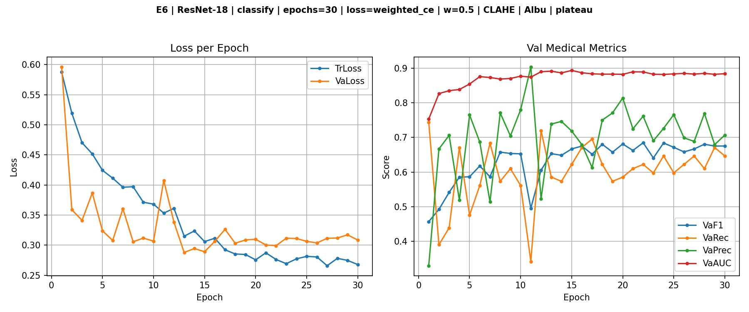
CLASSIFIER 1 OF 3
ResNet-18 · E6 — The ResNet Champion
VAL F1
68.92%
VAL AUC
0.8888
VAL → TEST GAP
0.07pp
Why E6 is the inference anchor
CAALMIX = CLAHE + Albumentations. Train and val losses track within ~0.04 by epoch 30 — overfitting essentially eliminated. Val F1 +3.11pp over E4a baseline.
Configuration: weighted CE (w=0.5) · 30 epochs · plateau LR · threshold 0.525 val / 0.425 test · weights = E6_best.pth
FracAssist · MSc Thesis Handoff · Wk 13–16
ACT 2 · THREE CLASSIFIERS
3 / 30
Notes:
Headline: ResNet-18 + CAALMIX is the cleanest training curve in the project. 0.07pp val→test gap = exceptional generalisation. Number to call out: +3.11pp F1 gain from CAALMIX on this architecture. Likely question: "Why ResNet-18 and not deeper?" — Slide 10 has the depth-scaling ablation. Spoiler: deeper hurts at this dataset size.

Slide 5
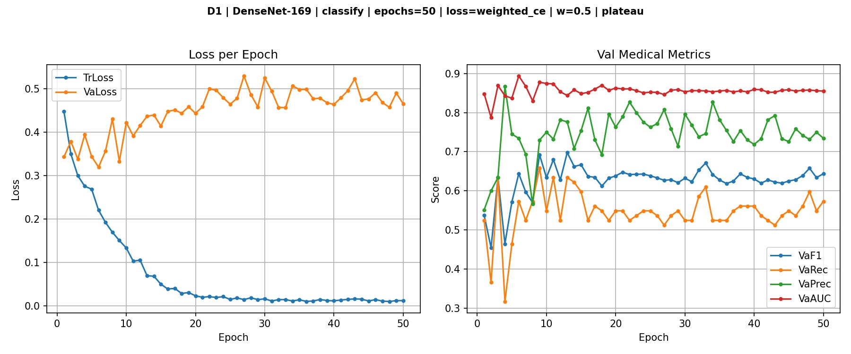
CLASSIFIER 2 OF 3
DenseNet-169 · D1 — Individual F1 Leader
VAL F1 (BEST INDIVIDUAL)
72.39%
VAL AUC
0.8439
OPTIMAL THRESHOLD
0.175
Feature reuse helps fractures — but calibration is off
Dense skip connections preserve early edge/contrast detectors at every depth — ideal for hairline cortical discontinuities. But threshold = 0.175 signals poor probability calibration. Best individual F1, worst AUC — a tension GEL will resolve.
Configuration: full fine-tune · weighted CE (w=0.5) · 50 epochs · plateau LR · weights = D1_best.pth
FracAssist · MSc Thesis Handoff · Wk 13–16
ACT 2 · THREE CLASSIFIERS
4 / 30
Notes:
Two-part story: DenseNet is the best individual F1, but its AUC is the worst and its threshold is pathologically low (0.175). Number to call out: F1 = 72.39% — best individual. But AUC = 0.844 = worst. This sets up slide 11 and the GEL motivation. The calibration mismatch is the reason democratic averaging fails and GEL is needed. Likely question: "Why didn't you fix calibration directly (e.g. temperature scaling)?" — Honest answer: fusion is a structural fix; we get calibration correction and ensemble diversity in one move.

Slide 6
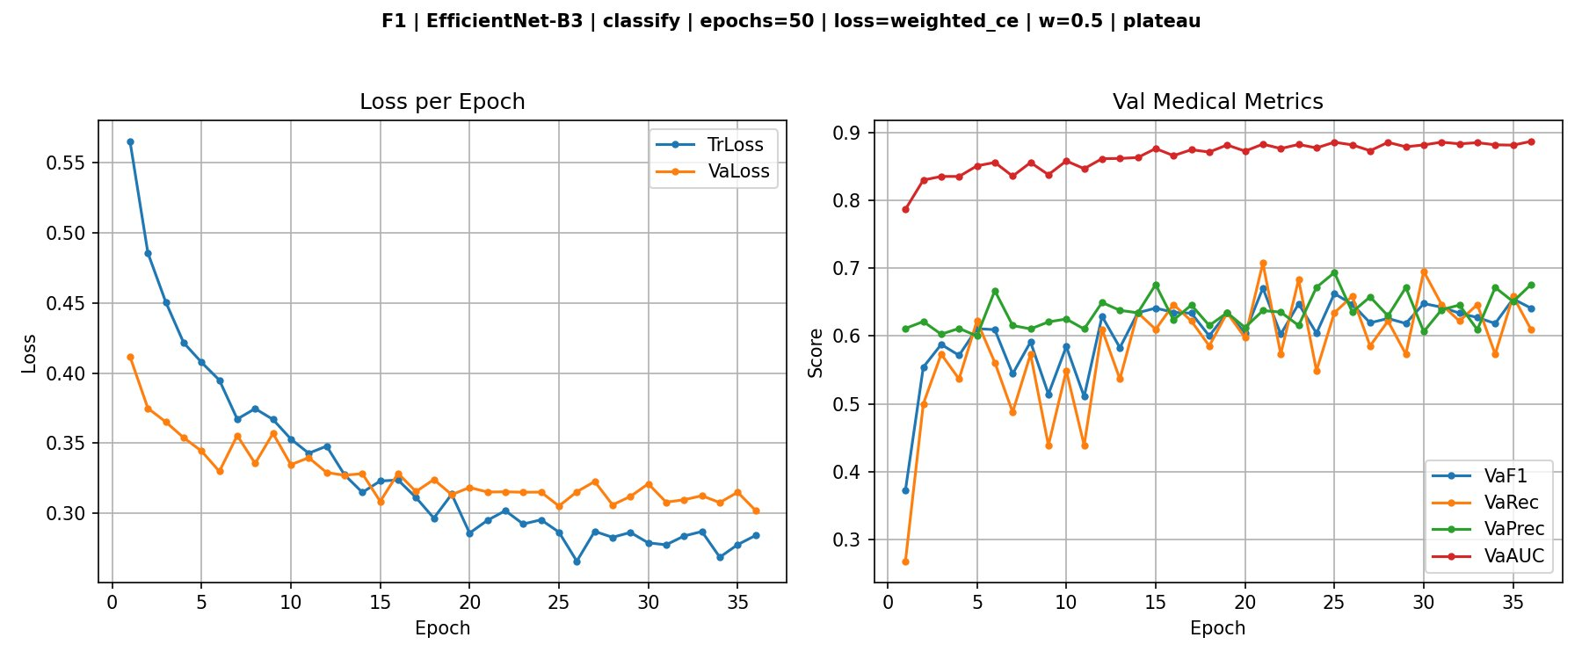
CLASSIFIER 3 OF 3
EfficientNet-B3 · F1 — Architectural Diversity
VAL F1
67.07%
TEST F1
56.34%
VAL → TEST GAP
−10.7pp
Its role is not accuracy — it is diversity
Compound width-depth-resolution scaling. Largest val→test gap of all models (−10.7pp) — depthwise separable convolutions may underperform under distribution shift. Critically, its failure modes are structurally different from ResNet and DenseNet — exactly what GEL needs to error-correct.
Configuration: weighted CE (w=0.5) · 50 epochs · early stop ep36 · weights = F1_best.pth · F2 (+CLAHE) hurt F1 by −3.97pp
FracAssist · MSc Thesis Handoff · Wk 13–16
ACT 2 · THREE CLASSIFIERS
5 / 30
Notes:
Frame upfront: EfficientNet is the weakest individual model. That is OK — its job is diversity, not raw accuracy. Number to call out: val→test gap = −10.7pp, recorded as Finding F12 in the empirical catalogue. Likely question: "If it's the weakest, why include it?" — Answer: correlated failures would defeat GEL. Three architecturally distinct models are a prerequisite for the ensemble to error-correct. EfficientNet brings compound-scaled features that neither ResNet nor DenseNet capture.

Slide 7
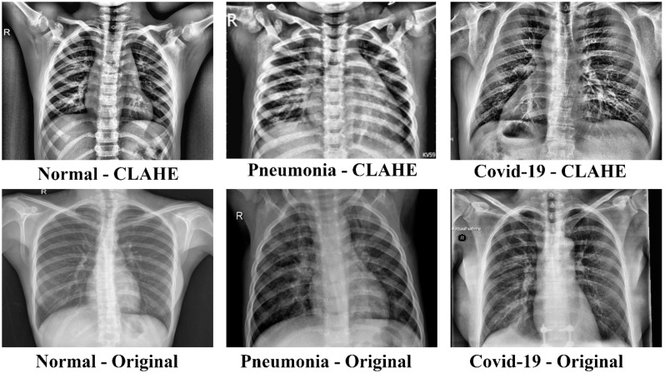
THE ORIGINAL HYPOTHESIS
CAALMIX — The Augmentation Pipeline
Universal-gain hypothesis · expected ≥2pp F1 on every architecture
CLAHE
GRAY
ALBU
AUGMIX
Contrast-Limited
Adaptive Histogram Eq.
Grayscale Enforce
Albumentations
XRay-AugMix
Boost local contrast in low-contrast X-rays
Remove false colour from JPEG artefacts
Geometric + intensity train-only augmentations
Stochastic Beta(1,1) augmentation mixing
TTA (Test-Time Augmentation)
Averages N augmented passes at inference. Originally planned to reduce borderline-case variance.
Planned thesis claim (T1 gate)
CAALMIX yields ≥2pp F1 on both ResNet-18 and DenseNet-169 — primary novelty confirmed.
FracAssist · MSc Thesis Handoff · Wk 13–16
ACT 3 · CAALMIX
6 / 30
Notes:
Set up the surprise. This is the plan, not the finding. Read out the T1 gate explicitly: ≥2pp F1 on both architectures. That's the bar we set ourselves at Wk 13. Next slide shows what actually happened. If asked "why these four components?" — CLAHE for local contrast (X-ray-specific), grayscale to strip JPEG colour noise, Albumentations for geometric robustness, AugMix for distributional robustness on long-tail fracture morphologies.

Slide 8
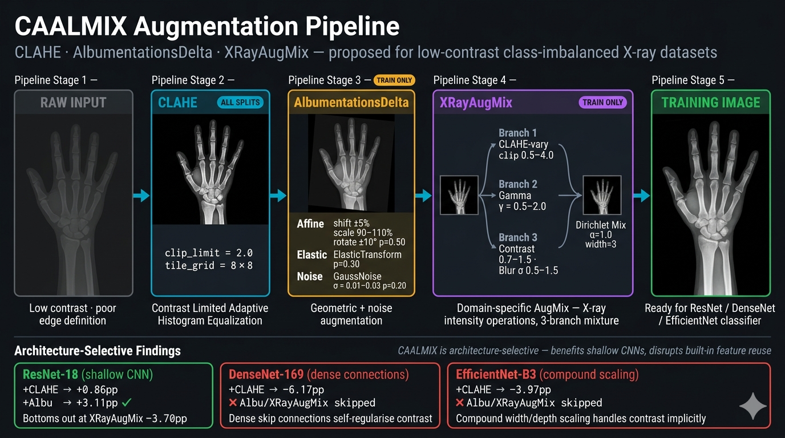
THE ORIGINAL HYPOTHESIS
FracAssist · MSc Thesis Handoff · Wk 13–16
ACT 3 · CAALMIX
7 / 30
Notes:
Set up the surprise. This is the plan, not the finding. Read out the T1 gate explicitly: ≥2pp F1 on both architectures. That's the bar we set ourselves at Wk 13. Next slide shows what actually happened. If asked "why these four components?" — CLAHE for local contrast (X-ray-specific), grayscale to strip JPEG colour noise, Albumentations for geometric robustness, AugMix for distributional robustness on long-tail fracture morphologies.

Slide 9
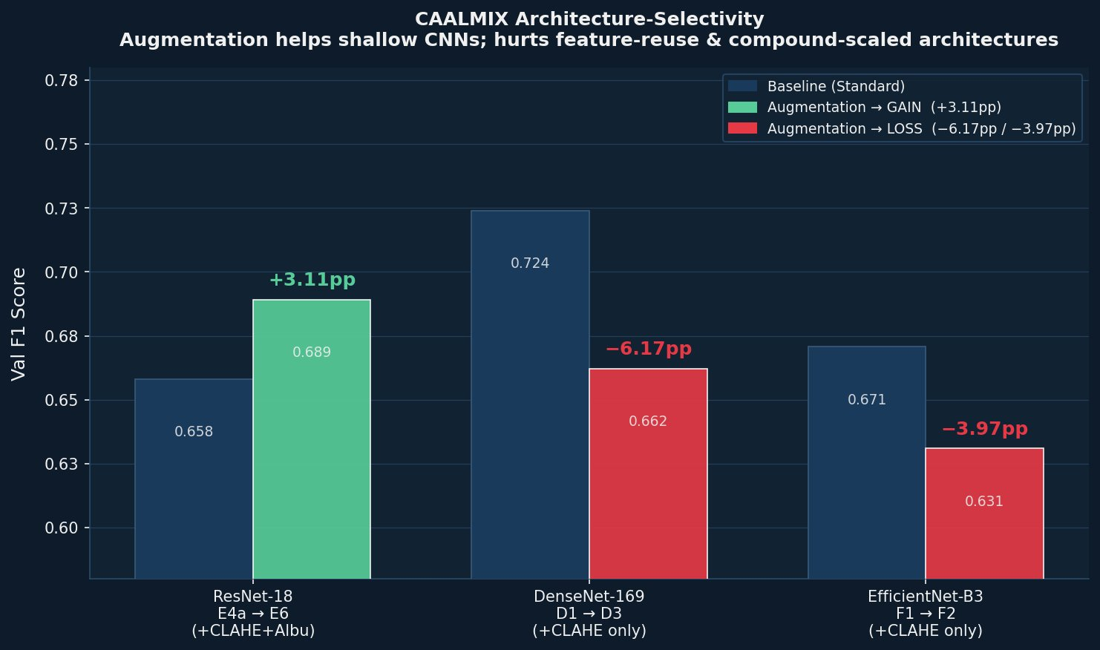
ARCHITECTURE-SELECTIVITY IS THE FINDING
Universal-Gain Hypothesis · Falsified
THE RESULT
ResNet-18
+3.11pp
E6 vs E4a
DenseNet-169
−6.17pp
D3 vs D1 (CLAHE)
EfficientNet-B3
−3.97pp
F2 vs F1 (CLAHE)
Re-framed claim — and a more publishable one
CLAHE+Albumentations is optimal for shallow CNNs (+3.11pp). Architectures with built-in feature reuse or compound scaling self-regularise contrast implicitly and are degraded by explicit CLAHE. The data surprised us — and the surprise is the finding.
FracAssist · MSc Thesis Handoff · Wk 13–16
ACT 3 · CAALMIX
8 / 30
Notes:
Direct framing: T1 gate not met. We are not hiding it. Three architectures, two distinct mechanisms — that pattern is publishable. Number to call out: ResNet +3.11pp green, DenseNet −6.17pp red, EfficientNet −3.97pp red. Likely question: "How is this not a failure?" — Answer: a universal +3pp gain is unsurprising. A systematic architecture-selective pattern across three architectures and two distinct mechanisms is a finding. Next slide explains the mechanism.

Slide 10
THE MECHANISM
Why CLAHE is Architecture-Selective
ResNet-18
Plain residual connections · no implicit contrast propagation
+3.11pp — CLAHE fills a genuine gap
DenseNet-169
Dense skip connections concatenate ALL preceding feature maps · early contrast/edge detectors remain accessible at every depth
Same chart from previous slide — for reference
−6.17pp — CLAHE disrupts the learned low-level filter distribution that dense reuse depends on
EfficientNet-B3
Compound width/depth/resolution scaling · multi-scale features implicitly capture contrast variation
−3.97pp — same mechanism · compound scaling already handles low-contrast X-rays
XRayAugMix isolation (E8 standalone): −2.17pp vs E4a. Confirms harm is intrinsic — not a CLAHE-conflict artefact. Beta(1,1) mixing too aggressive for 717 fractured images.
FracAssist · MSc Thesis Handoff · Wk 13–16
ACT 3 · CAALMIX
9 / 30
Notes:
Three architectures, two structurally different mechanisms produce the same negative effect — that's what makes this publishable. Anchor the explanation in concrete terms: dense skip connections already preserve early contrast detectors; CLAHE shifts the distribution those detectors learned. Number to call out: XRayAugMix standalone E8 = −2.17pp. The isolation rules out a CLAHE-conflict explanation. Likely question: "Could this be a dataset artefact?" — Answer: replicated across three independently trained architectures with different mechanisms. Two distinct architectural reasons (feature reuse, compound scaling), same effect direction. Systematic, not accidental.

Slide 11
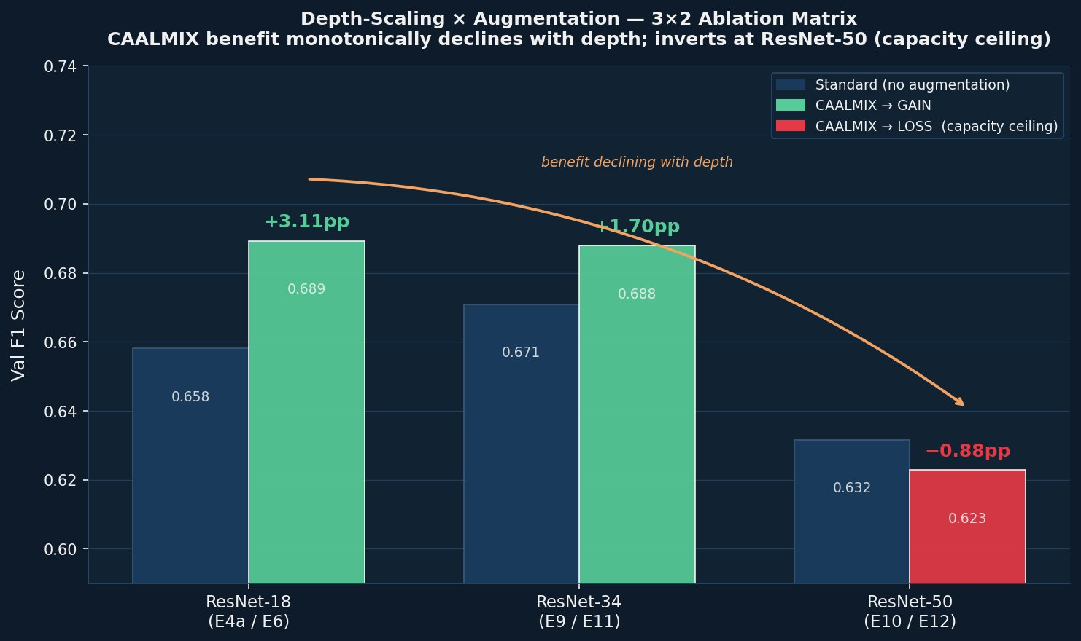
THE CAPACITY CEILING
Depth Cannot Substitute for Augmentation
3 × 2 ABLATION
ResNet-18 / 34 / 50 × Standard / CAALMIX
F1
Useful depth cap without regularisation = ResNet-34.
F2
CAALMIX benefit monotonically declines with depth: +3.11pp → +1.70pp → −0.88pp.
★
Optimal operating point: ResNet-18 + CAALMIX. Augmentation as primary regulariser, not depth.
Why the curve inverts at ResNet-50
~25M parameters cannot be supported by 717 fractured training images. When model capacity substantially exceeds what the dataset supports, augmentation variance compounds the overfitting problem rather than alleviating it.
FracAssist · MSc Thesis Handoff · Wk 13–16
ACT 3 · CAALMIX
10 / 30
Notes:
Headline: depth doesn't rescue augmentation, and augmentation doesn't rescue depth. Number to call out: −0.88pp at ResNet-50 — CAALMIX inverts. Capacity ceiling. This justifies keeping ResNet-18 as the classification anchor going forward. Likely question: "Did you try EfficientNet variants or DenseNet-121 in this matrix?" — Answer: scoped to the ResNet family for clean depth comparison. EfficientNet-B3 is the diversity anchor for GEL, not a depth-scaling subject.

Slide 12
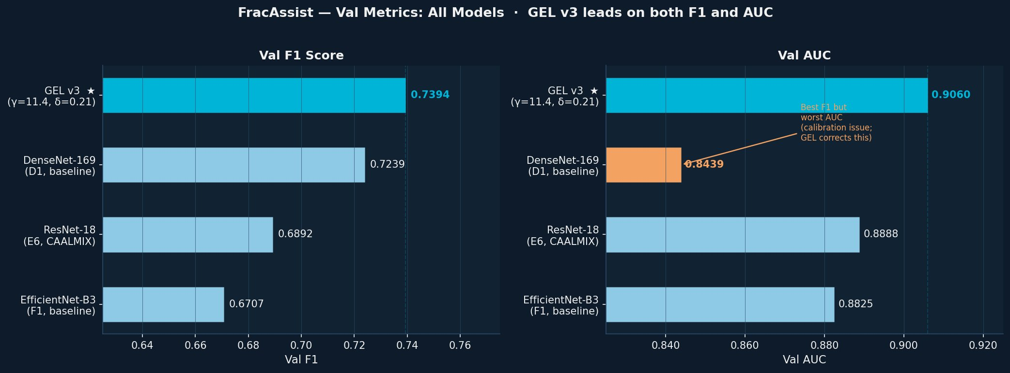
THE PROBLEM THAT DROVE GEL
No Single Model Wins on Both F1 and AUC
THE TENSION
DenseNet
F1 = 72.4% ★
AUC = 0.844 ✗
thr = 0.175
ResNet-18
F1 = 68.9%
AUC = 0.889 ★
thr = 0.525
EfficientNet
F1 = 67.1%
AUC = 0.883
thr = 0.525
Why a simple average fails — and what GEL fixes
Democratic averaging assigns 33% to each model — but DenseNet outperforms by F1 while being miscalibrated (threshold 0.175 indicates probabilities are systematically too low). GEL solves both: Expert-Dominant RC weights by performance, PDWF fusion corrects calibration through diversity, the OAM guard handles dissent. Reliability through calibrated expert complementarity — not majority vote.
FracAssist · MSc Thesis Handoff · Wk 13–16
ACT 4 · GEL
11 / 30
Notes:
Set up the GEL motivation. The point: no single model wins both F1 and AUC, and DenseNet's threshold = 0.175 reveals calibration trouble. Number to call out: DenseNet F1=72.4% best, AUC=0.844 worst. ResNet inverts: AUC=0.889 best, F1=68.9%. This is the tension. GEL resolves it by fusion, not by choosing. Likely question: "Couldn't you just temperature-calibrate DenseNet?" — Acknowledge yes for calibration alone, but fusion gives calibration correction AND ensemble diversity simultaneously. Single move, two benefits.

Slide 13
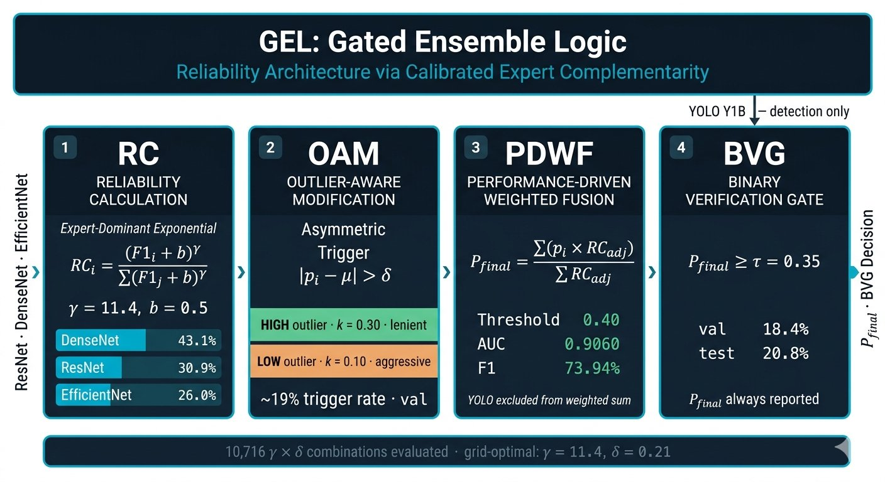
RELIABILITY ARCHITECTURE VIA CALIBRATED EXPERT COMPLEMENTARITY
GEL — Gated Ensemble Logic
Five novel components, each with a principled design choice
(1) Expert-Dominant RC (2) Direction-Aware Asymmetric OAM (3) PDWF probability fusion (4) BVG gate (5) Joint γ×δ grid search (10,716 combos)
FracAssist · MSc Thesis Handoff · Wk 13–16
ACT 4 · GEL
12 / 30
Notes:
This is the headline slide for the primary novelty. Walk left-to-right through the diagram. Open with: "GEL is not an averaging method. It's a four-stage reliability pipeline with five principled novel components." Numbers to call out: γ=11.4, δ=0.21, val AUC=0.9060, val F1=0.7394. Grid-optimal. Likely question: "Why not just average?" — Slide 11 answered that motivation. This slide is the architecture. The next four slides (13–16) detail each stage. Don't get into RC formula here, just the overview.

Slide 14
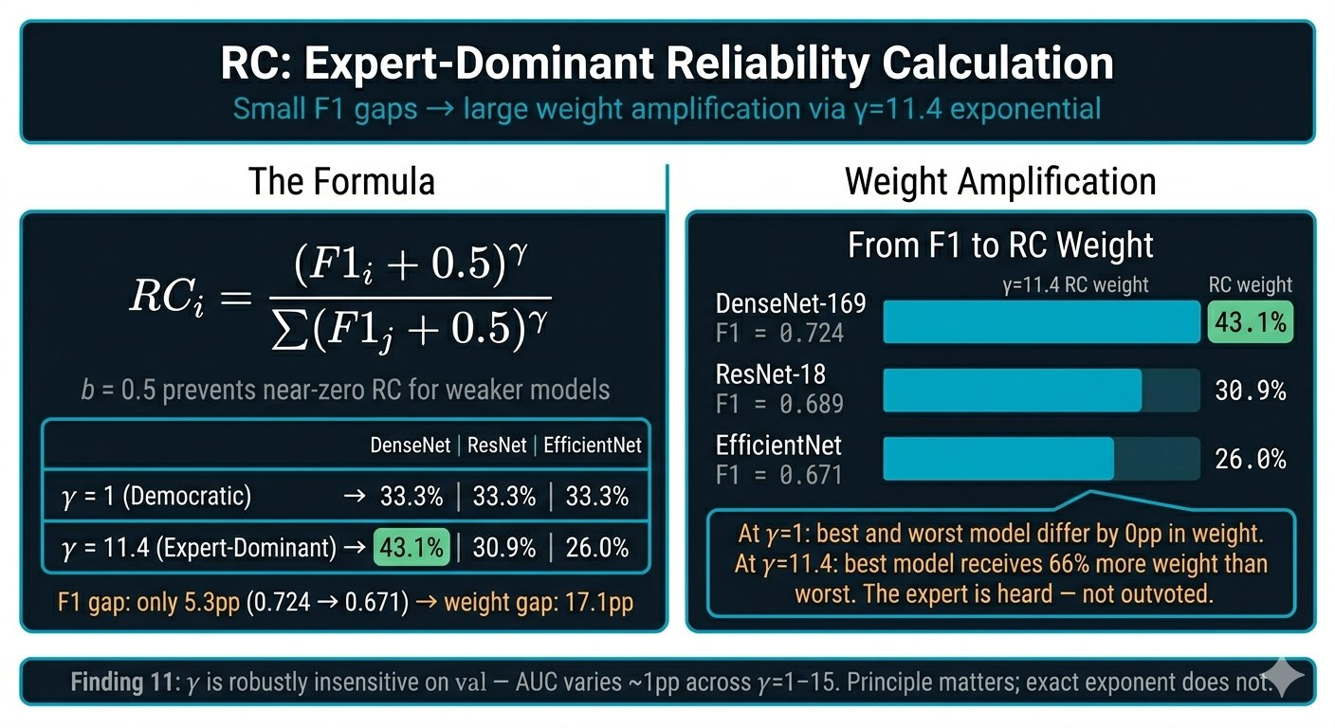
STAGE 1 OF 4 · RC
Expert-Dominant Reliability Coefficient
RC
OAM
PDWF
BVG
→
Reliability Architecture · γ=11.4 · δ=0.21
At γ=11.4: DenseNet 43.1% · ResNet 30.9% · EfficientNet 26.0%. F1 gap of 5.3pp → weight gap of 17.1pp. The expert is heard — not outvoted.
FracAssist · MSc Thesis Handoff · Wk 13–16
ACT 4 · GEL
13 / 30
Notes:
RC formula on the left, weight curves on the right showing how γ amplifies the F1 gap. Key principle: at γ=1, democratic average (33/33/33). At γ=11.4, DenseNet leads at 43.1% but never monopolises — preserves ensemble diversity. Number to call out: 5.3pp F1 gap becomes 17.1pp weight gap — that's the expert-dominant principle. Likely question: "Why γ=11.4 and not a round number?" — From grid search. Robustness shown next: γ is essentially insensitive (~1pp AUC range across γ=1–15). Principle matters; exact exponent does not. That's Finding F11.

Slide 15
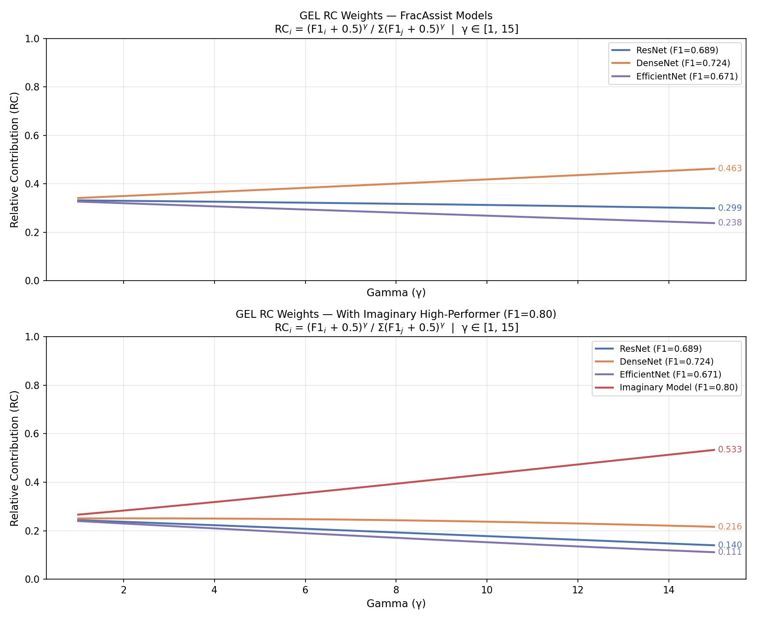
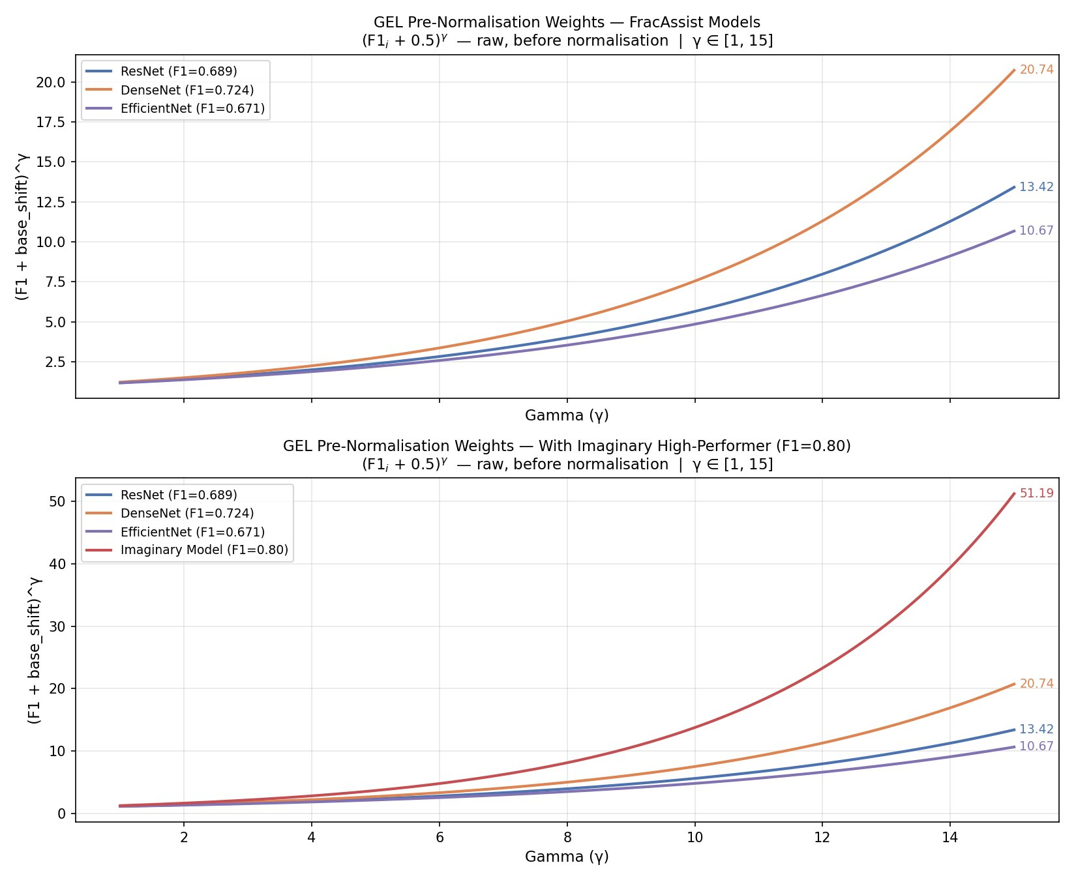
STAGE 1 OF 4 · RC
RC Normalization
Normalized RCs
Pre-normalisation RC weight curves · why normalisation is required
All artefacts available in the GitHub repo · FracAssist-Explainability-Reliability-in-Medical-AI-Systems
FracAssist · MSc Thesis Handoff · Wk 13–16
14 / 30
Notes:
Appendix slide — only used if the supervisor asks. Left: γ robustness from 1 to 15. AUC ~1pp range. Principle (differentiation) matters; exact value does not. That's Finding F11. Right: pre-normalisation raw values. Without softmax-style normalisation, raw values balloon — why the denominator in RC is not optional. If asked nothing about robustness, skip this slide.

Slide 16
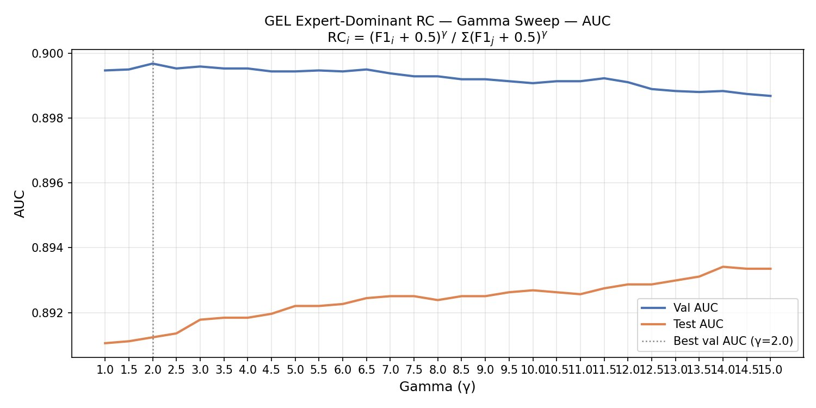
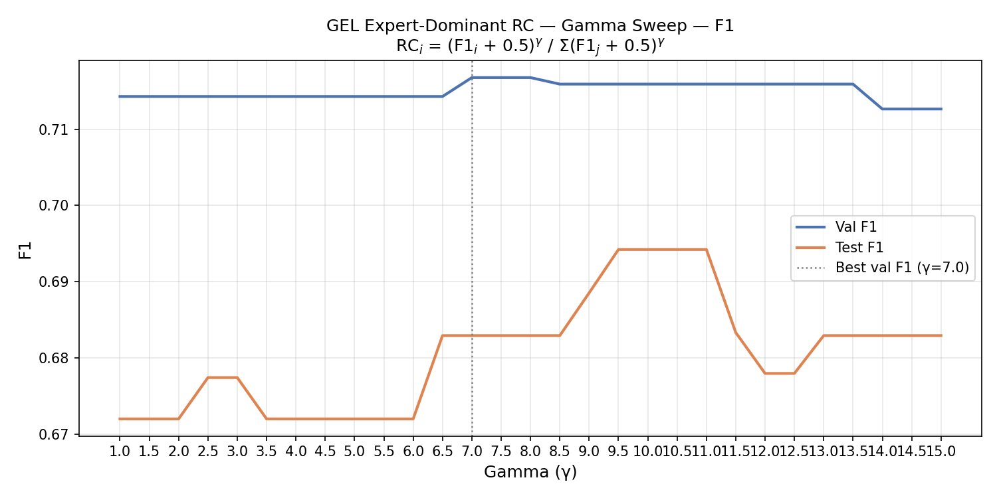
STAGE 1 OF 4 · RC
Robustness Sweep Search for RC
γ robustness · Finding F11 — exponent insensitive across γ=1–15
All artefacts available in the GitHub repo · FracAssist-Explainability-Reliability-in-Medical-AI-Systems
FracAssist · MSc Thesis Handoff · Wk 13–16
15 / 30
Notes:
Appendix slide — only used if the supervisor asks. Left: γ robustness from 1 to 15. AUC ~1pp range. Principle (differentiation) matters; exact value does not. That's Finding F11. Right: pre-normalisation raw values. Without softmax-style normalisation, raw values balloon — why the denominator in RC is not optional. If asked nothing about robustness, skip this slide.

Slide 17
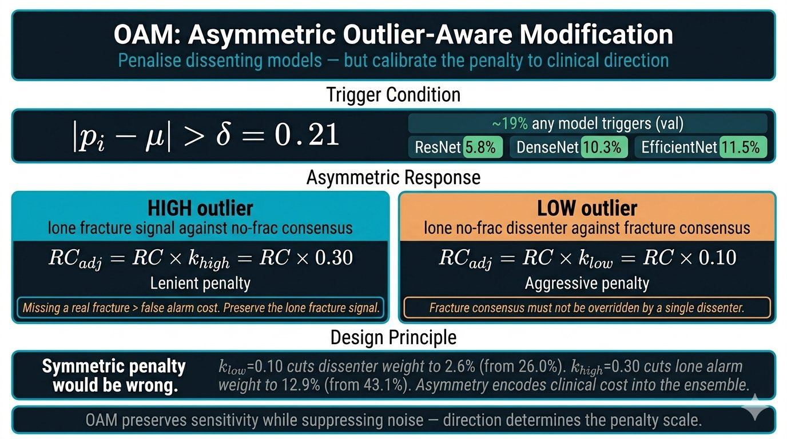
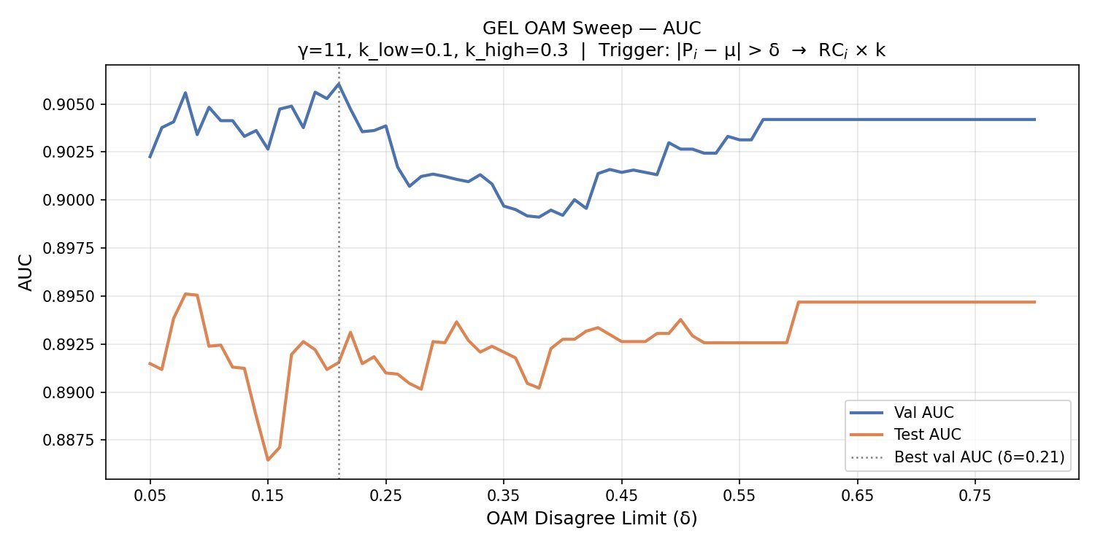
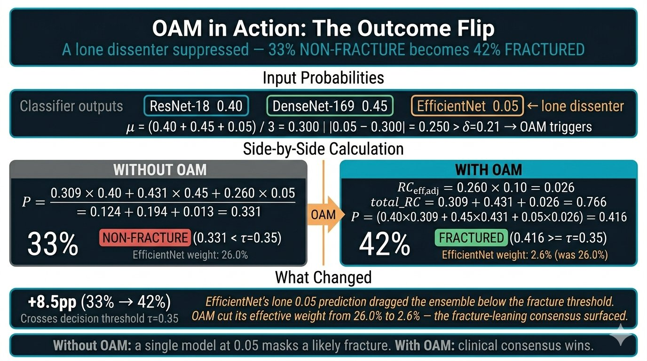
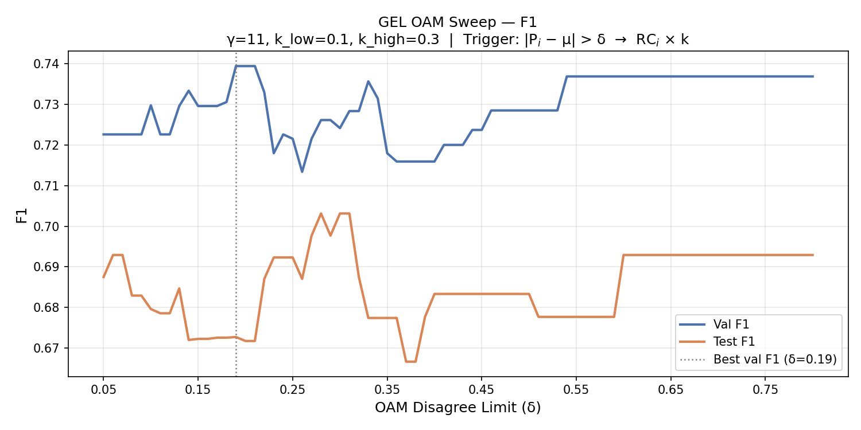
STAGE 2 OF 4 · OUTLIER-AWARE MODIFICATION
Direction-Aware Asymmetric OAM
Reliability Architecture · γ=11.4 · δ=0.21
RC
OAM
PDWF
BVG
→
Empirical evidence — 1D δ sweeps
~19% any-model trigger rate on val · active correction, not safety net
FracAssist · MSc Thesis Handoff · Wk 13–16
ACT 4 · GEL
16 / 30
Notes:
The asymmetry is the clinical insight. HIGH outlier = lone fracture signal, k=0.30 lenient (don't suppress potential catches). LOW outlier = lone non-fracture dissent against fracture consensus, k=0.10 aggressive (don't let one dissenter mask a fracture). Numbers to call out: k_low=0.10 vs k_high=0.30. ~19% trigger rate on val. The outcome-flip example: 33% non-fracture → 42% fractured after OAM. Likely question: "Why asymmetric and not symmetric?" — Clinical cost asymmetry. Missing a fracture costs more than over-referring. The asymmetry encodes clinical cost into the algorithm.

Slide 18
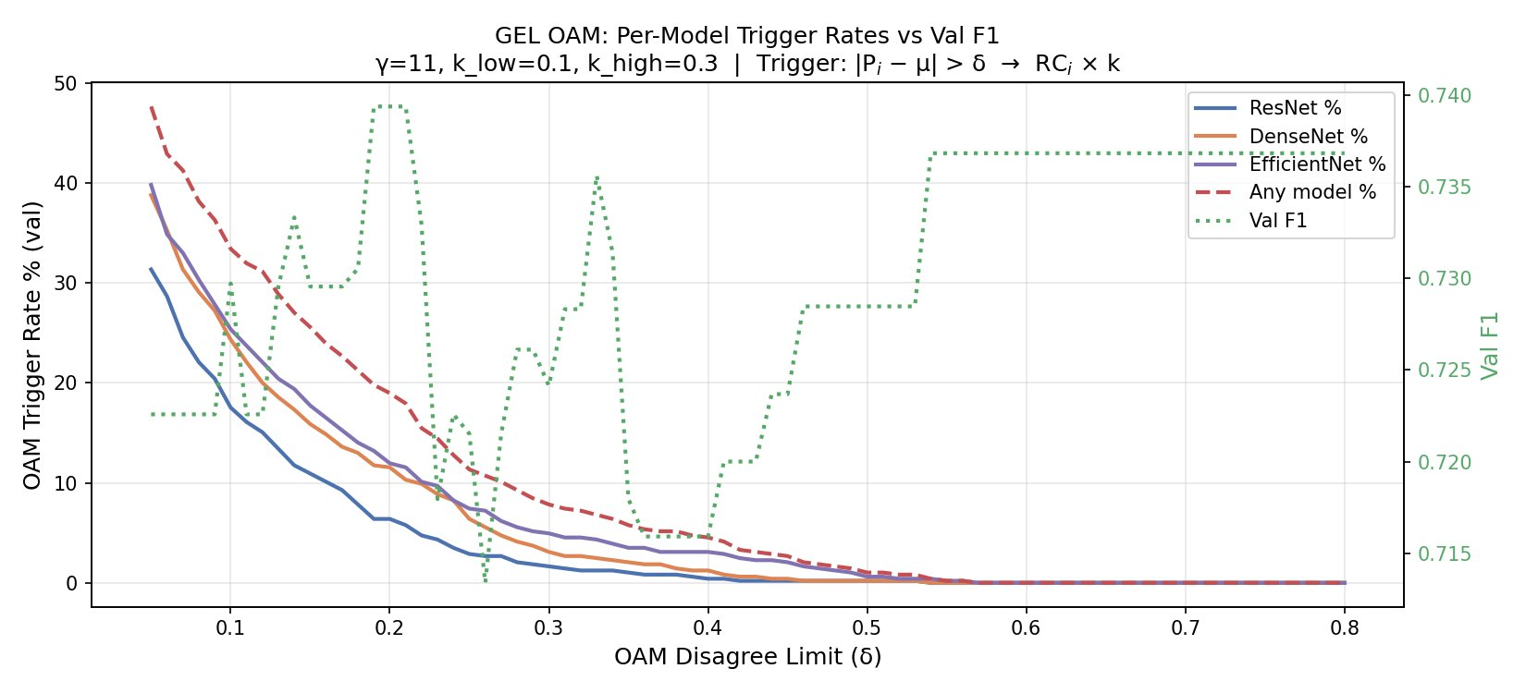
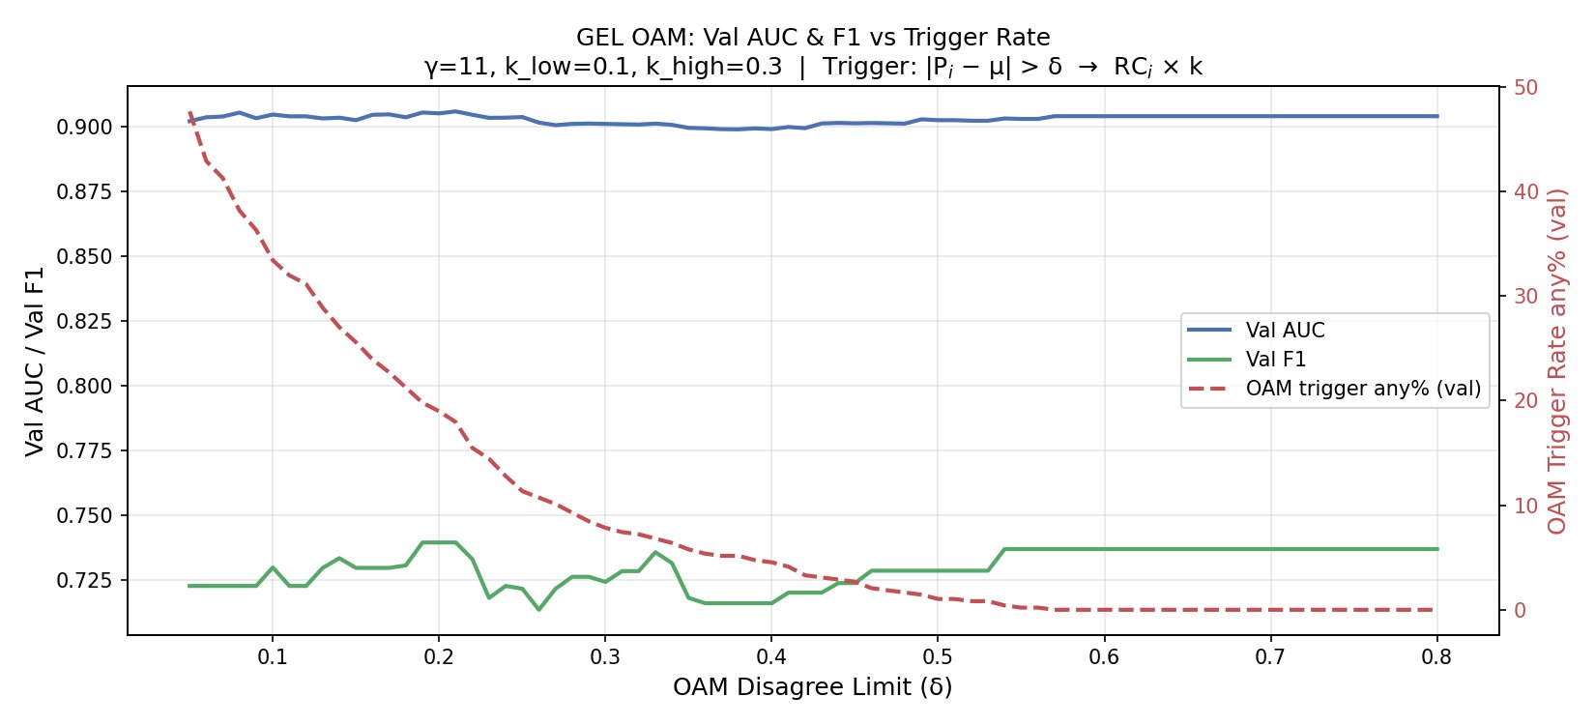
STAGE 2 OF 4 · OUTLIER-AWARE MODIFICATION
Direction-Aware Asymmetric OAM
Reliability Architecture · γ=11.4 · δ=0.21
RC
OAM
PDWF
BVG
→
Empirical evidence — Per trigger rates tell the story
~19% any-model trigger rate on val · active correction, not safety net
FracAssist · MSc Thesis Handoff · Wk 13–16
ACT 4 · GEL
17 / 30
Notes:
The asymmetry is the clinical insight. HIGH outlier = lone fracture signal, k=0.30 lenient (don't suppress potential catches). LOW outlier = lone non-fracture dissent against fracture consensus, k=0.10 aggressive (don't let one dissenter mask a fracture). Numbers to call out: k_low=0.10 vs k_high=0.30. ~19% trigger rate on val. The outcome-flip example: 33% non-fracture → 42% fractured after OAM. Likely question: "Why asymmetric and not symmetric?" — Clinical cost asymmetry. Missing a fracture costs more than over-referring. The asymmetry encodes clinical cost into the algorithm.

Slide 19
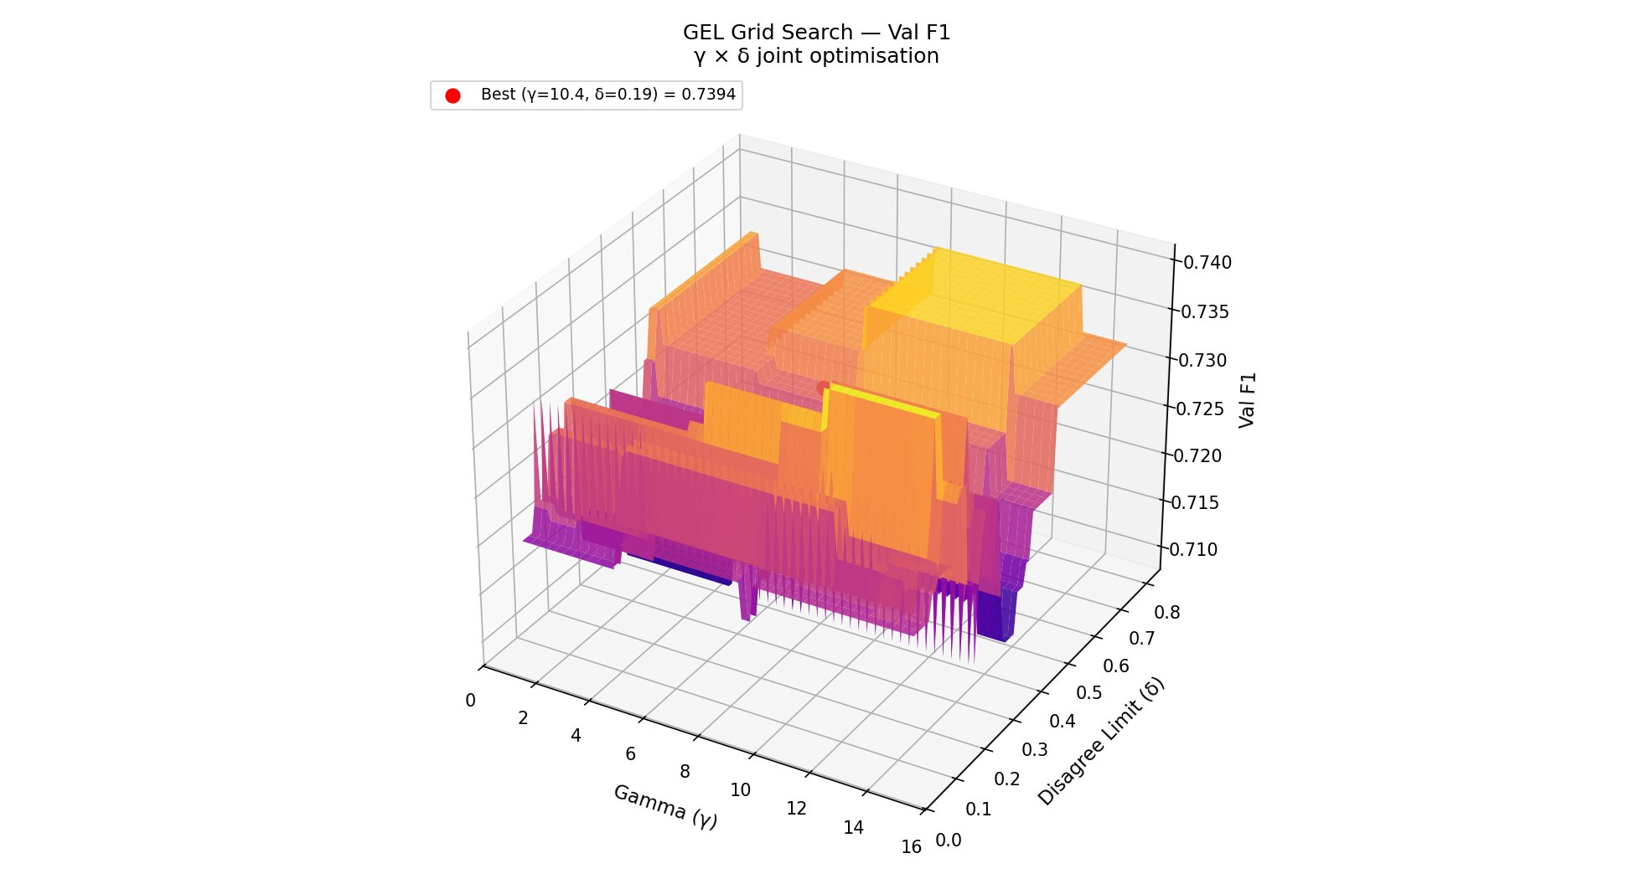
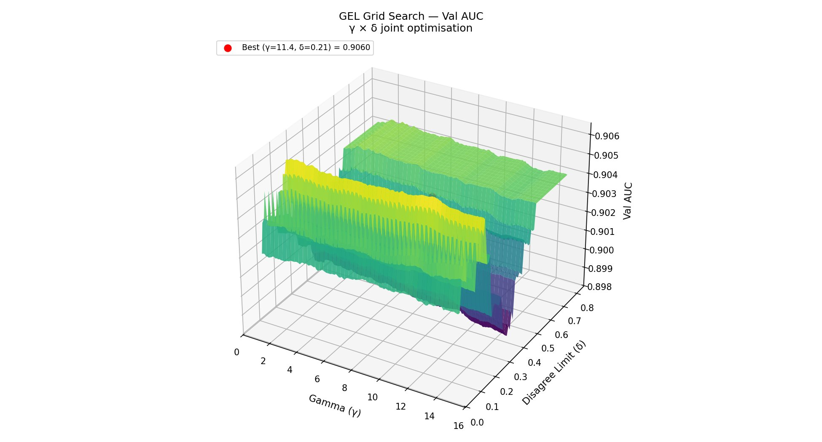
JOINT OPTIMISATION · GRID SEARCH
10,716 Combinations · Joint γ (1,15) × δ Optimisation (0.05-0.80)
γ > (1,15) × δ > (0.05-0.80) Grid
RC
OAM
PDWF
BVG
→
Reliability Architecture · γ=11.4 · δ=0.21
Val F1 surface · best (γ=10.4, δ=0.19) = 0.7394
Val AUC surface · best (γ=11.4, δ=0.21) = 0.9060
Methodological contribution — 1D sweeps produce a false dilemma when parameters interact
Prior 1D sweeps suggested δ=0.55 maximised F1 vs δ=0.20 maximised AUC — an artefact of fixing γ. Joint optimum (γ=11.4, δ=0.21) satisfies both objectives at a strictly better operating point. AUC-optimal config = canonical.
FracAssist · MSc Thesis Handoff · Wk 13–16
ACT 4 · GEL
18 / 30
Notes:
Two heatmaps, identical bright spot — that's the visual takeaway. Joint optimum is a real region, not a knife-edge. Number to call out: 10,716 combinations. γ ∈ [1, 15] step 0.1 × δ ∈ [0.05, 0.80] step 0.01. Both optima give identical val F1 = 0.7394, so AUC-optimal strictly dominates. That's why γ=11.4, δ=0.21 is canonical. Likely question: "Aren't you overfitting val with such a fine grid?" — Robustness response: γ is essentially insensitive (Finding F11, ~1pp AUC range), and δ has a wide stable region (visible in heatmap plateaus). Best test AUC at this config = 0.8916.

Slide 20
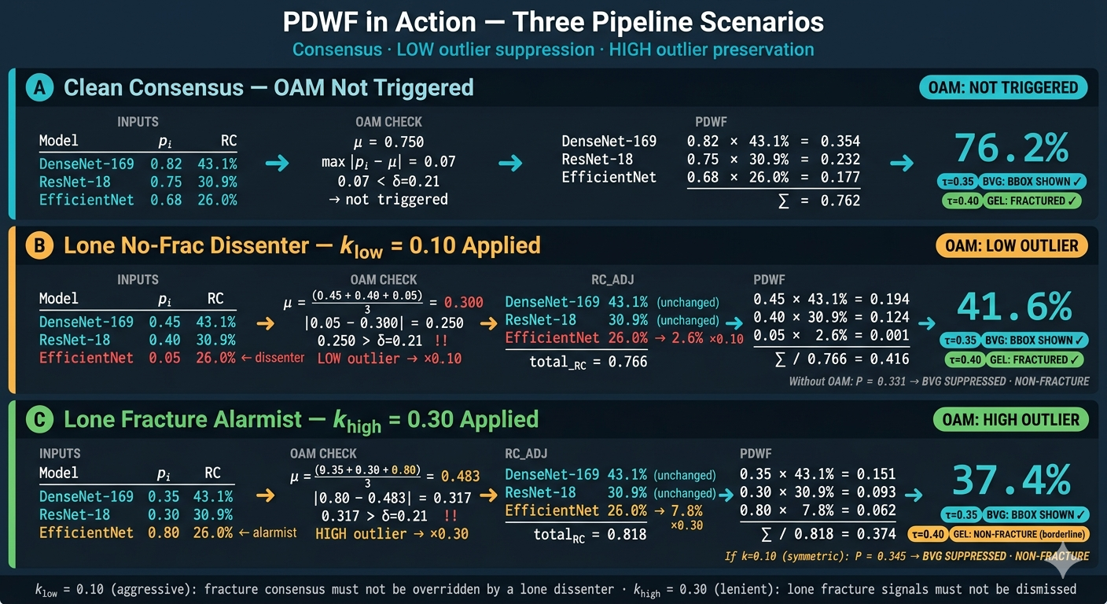
FracAssist · MSc Thesis Handoff · Wk 13–16
ACT 4 · GEL
19 / 30
Notes:
Two heatmaps, identical bright spot — that's the visual takeaway. Joint optimum is a real region, not a knife-edge. Number to call out: 10,716 combinations. γ ∈ [1, 15] step 0.1 × δ ∈ [0.05, 0.80] step 0.01. Both optima give identical val F1 = 0.7394, so AUC-optimal strictly dominates. That's why γ=11.4, δ=0.21 is canonical. Likely question: "Aren't you overfitting val with such a fine grid?" — Robustness response: γ is essentially insensitive (Finding F11, ~1pp AUC range), and δ has a wide stable region (visible in heatmap plateaus). Best test AUC at this config = 0.8916.

Slide 21
STAGE 4 OF 4 · BVG · GEL FINAL RESULTS
Radiologists miss approximately 20% of fractures radiographic interpretation in emergency settings (Guly, 2001; Petinaux et al., 2011).
GEL Leads Both Val Metrics — Across All Models
RC
OAM
PDWF
BVG
→
Reliability Architecture · γ=11.4 · δ=0.21
MODEL
VAL F1
VAL AUC
TEST F1
TEST AUC
THR
NOTES
ResNet-18 (E6)
68.92%
0.8888
68.85%
0.8987
0.525
CAALMIX
DenseNet-169 (D1)
72.39%
0.8439
68.38%
0.8467
0.175
Best ind. F1
EfficientNet-B3 (F1)
67.07%
0.8825
56.34%
0.8179
0.525
Diversity
GEL v3 ★
73.94%
0.9060
67.18%
0.8916
0.400
γ=11.4, δ=0.21
BVG GATE
PRIMARY VAL CLAIMS
P_final ≥ τ=0.35 · val pass 18.4% · test pass 20.8% — bbox shown only if both YOLO detects and GEL agrees
+1.72pp AUC over best individual · +1.55pp F1 over DenseNet (prior F1 leader)
FracAssist · MSc Thesis Handoff · Wk 13–16
ACT 4 · GEL
20 / 30
Notes:
Read the GEL row: it wins both val F1 and val AUC. That's the headline. Number to call out: val AUC 0.9060 (+1.72pp), val F1 73.94% (+1.55pp). Threshold 0.400 — a sensible operating point that DenseNet alone (0.175) couldn't provide. Likely question: "Test F1 dropped a bit vs ResNet alone (67.18% vs 68.85%)" — Acknowledge it. The val→test gap is largely driven by EfficientNet (−10.7pp gap, Finding F12). Val AUC on test is still strong at 0.8916. GEL is tuned on val by design; test reported for completeness. Likely question: "Could you have tuned on test?" — That would be data leakage. We don't.

Slide 22
STAGE 4 OF 4 ·GEL FINAL RESULTS
GEL Guidance
USE GEL & STRENGTHS
DO NOT USE GEL & WEAKNESSES
True Estimator
Dominant Expert Models
Each model is a true estimator (F1 ~0.65–0.80)
One model at ~0.90+ F1 Weaker models dilute the expert
Don't hold a committee vote when one member knows the answer
Architectural Diversity
Correlated Failures
Architecturally diverse models with different inherent & inductive biases
All models fail on the same samples,
OAM sees false "consensus",
Ensemble becomes overconfident in the wrong direction
Error Independence
Low Prediction Diversity
Failures don't cluster on the same samples
All models predict same labels, PDWF reduces to a constant multiplier
Mixture of Similar Non-Dominant Experts
Homogeneous Architectures
Cluster of (F1 ~0.65–0.80) Models & No single model dominates above ~0.85–0.87
e.g. three ResNets with different seeds
FracAssist · MSc Thesis Handoff · Wk 13–16
ACT 4 · GEL
21 / 30
Notes:
Read the GEL row: it wins both val F1 and val AUC. That's the headline. Number to call out: val AUC 0.9060 (+1.72pp), val F1 73.94% (+1.55pp). Threshold 0.400 — a sensible operating point that DenseNet alone (0.175) couldn't provide. Likely question: "Test F1 dropped a bit vs ResNet alone (67.18% vs 68.85%)" — Acknowledge it. The val→test gap is largely driven by EfficientNet (−10.7pp gap, Finding F12). Val AUC on test is still strong at 0.8916. GEL is tuned on val by design; test reported for completeness. Likely question: "Could you have tuned on test?" — That would be data leakage. We don't.

Slide 23
THE DELIVERY LAYER
FracAssist System Architecture
YOLO Y1B
P_final fracture probability
imgsz=600 · conf=0.25
DETECT
GEL Pipeline
3 classifiers fused
YOLO consumed for bbox only
YOLO bbox overlay (if gated)
X-ray
Input
ResNet-18 E6
→
CLAHE · thr=0.525 (val)
→
→
GradCAM heatmap (DenseNet)
CLASSIFY
RC
OAM
PDWF
BVG
DenseNet-169 D1
γ=11.4 · δ=0.21 · τ=0.35
Per-model breakdown
JPEG / PNG
thr=0.175
CLASSIFY
P_final + bbox decision
EfficientNet-B3 F1
thr=0.525
CLASSIFY
Codebase ~9,300 lines · 79 files · 26 Python Modes GEL (default) · YOLO-only · ResNet-only Stack Flask · PyTorch · Ultralytics
FracAssist · MSc Thesis Handoff · Wk 13–16
ACT 5 · FRACASSIST
22 / 30
Notes:
Four models in parallel, GEL fuses three classifiers, YOLO is consumed for the bbox only (excluded from PDWF — its mAP-confidence is not a calibrated probability). Number to call out: ~9,300 lines of code, 79 files. Non-trivial engineering. Three inference modes — GEL is default but YOLO-only and ResNet-only modes remain available for debugging/comparison. Likely question: "Why doesn't YOLO contribute to P_final?" — Methodological correctness. Detection objectness × class probability isn't a calibrated fracture probability. Mixing it with classifier softmax outputs would be a methodological error.

Slide 24
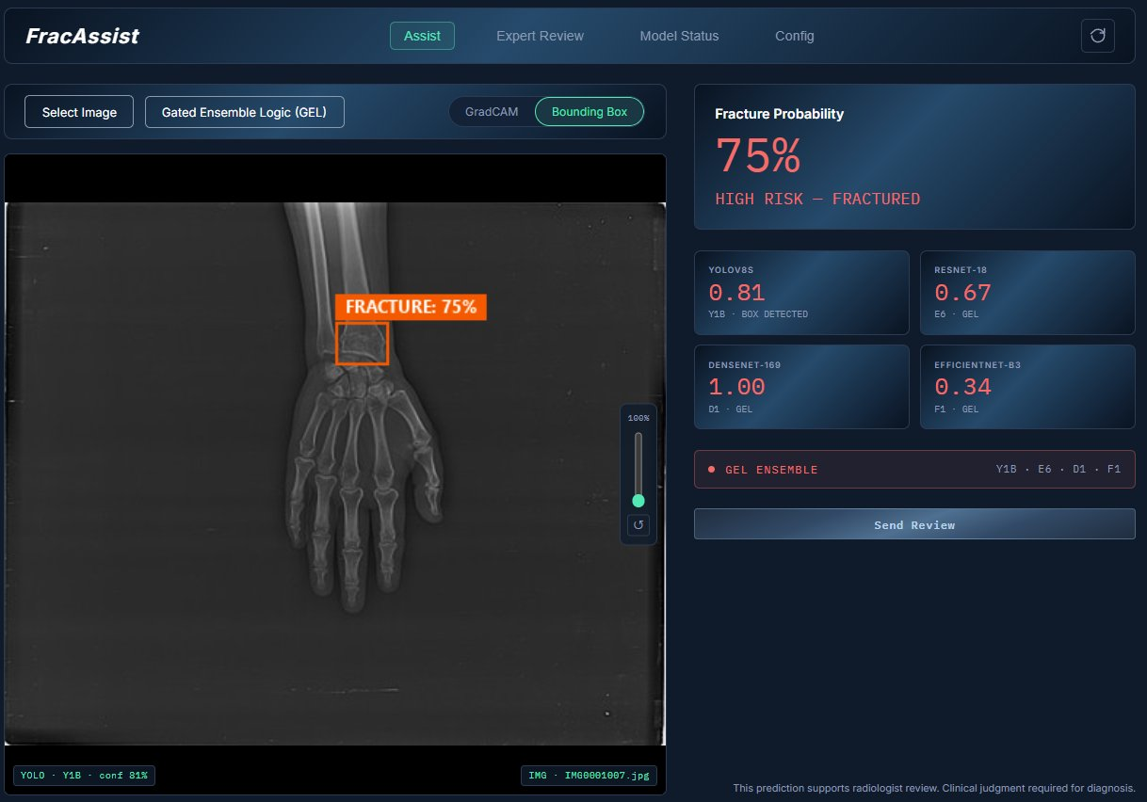
LIVE CLINICAL DECISION SUPPORT
FracAssist UI · Assist Tab
WHAT THE CLINICIAN SEES
P_final headline
Large fracture probability + risk label (HIGH RISK · FRACTURED). The number that drives decisions.
Per-model breakdown
YOLO · ResNet · DenseNet · EfficientNet — all four scores visible, with the inference source flagged (e.g. "BOX DETECTED").
Mode selector
Gated Ensemble Logic (GEL) · YOLO-only · ResNet-only. Default = GEL.
Overlay toggle
GradCAM heatmap or Bounding Box — clinician chooses the visual explanation type.
Zoom utility
Right-side slider · scroll wheel · reset (up to 140%).
Review handoff
Send Review button → Expert Review queue (next slide).
FracAssist · MSc Thesis Handoff · Wk 13–16
ACT 5 · FRACASSIST
23 / 30
Notes:
Live UI screenshot. Walk through what the clinician sees, in order of attention: the big number top right, the bounding box on the X-ray, the four model scores, the mode selector. Number to call out: 75% probability shown — that's a real inference run on a real wrist X-ray. Likely question: "How does the clinician know the bbox is reliable?" — BVG gate. The bbox only appears when YOLO detected AND P_final ≥ τ=0.35. If GEL disagrees with YOLO, the bbox is suppressed and only P_final is shown.

Slide 25
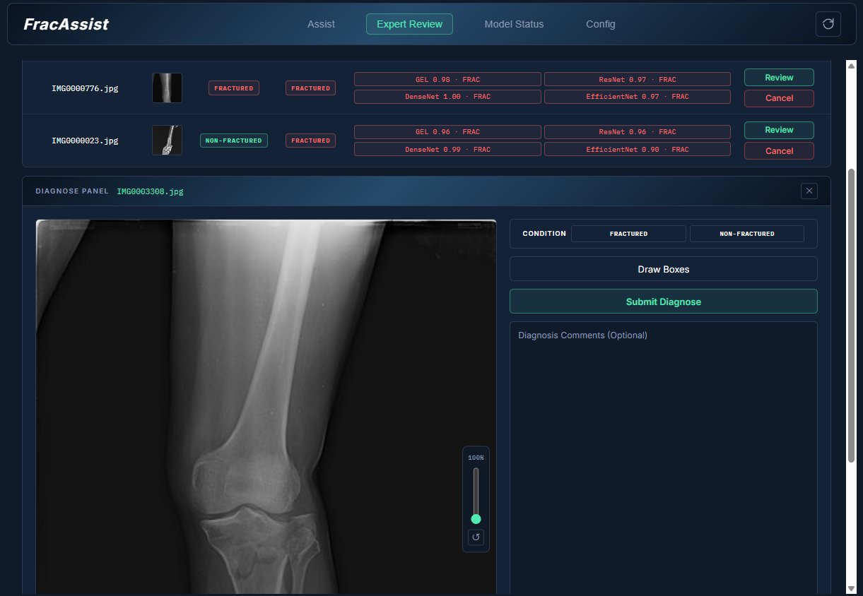
BEYOND THE WK 13 PLAN
Expert Review Tab — Ground Truth Pipeline
RADIOLOGIST WORKFLOW
1 · Review queue
Cases sent for review collect in a CSV-backed queue with thumbnails and prior GEL predictions.
2 · Condition tagging
Radiologist marks FRACTURED / NON-FRACTURED ground truth.
3 · Bounding box drawing
Manual annotation for cases where YOLO missed or mislocalised.
4 · Diagnosis submission
Comments + final label saved with the image ID for future training.
Why it matters
This is the data collection foundation any future XAI work (CBM, prototypes, counterfactuals) needs to learn from radiologist labels.
FracAssist · MSc Thesis Handoff · Wk 13–16
ACT 5 · FRACASSIST
24 / 30
Notes:
Frame: not in the Wk 13 plan. Added because it's the data infrastructure XAI will need. Pipeline: queue → tag → annotate → submit. CSV-backed for portability. Number to call out: 4-step workflow, fully wired. Likely question: "Was this asked for?" — No, but it's the bridge to future XAI work. The expert labels collected here are exactly what CBM/prototypes/counterfactuals need to train on. Slide 25 reinforces this.

Slide 26
INTEGRATION STATUS
GEL is Live — Not Just Evaluated
Every inference runs the full 4-stage GEL pipeline. The Model Status tab surfaces the internals.
STAGE 1 · RC
STAGE 2 · OAM
STAGE 3 · PDWF
STAGE 4 · BVG
Reliability Coefficients
Outlier Trigger Per Inference
Probability-Driven Fusion
Bounding Box Gate
DenseNet-169
Any-model trigger rate (val)
P_final (per image)
Val pass rate
43.1%
~19%
[0, 1]
18.4%
ResNet-18
k_high (lenient)
Operating threshold τ
Test pass rate
30.9%
0.30
0.35
20.8%
EfficientNet-B3
k_low (aggressive)
Source
Rule
26.0%
0.10
RC-weighted sum
P_final ≥ τ
Computed once · γ=11.4 · base_shift=0.5
Per-call status surfaced in UI · clinical asymmetry encoded
Single calibrated probability replaces three threshold systems
Bbox shown ⇔ classifier consensus agrees with detector
All four stages execute on every prediction · all values logged · all values surfaced in the Model Status tab
FracAssist · MSc Thesis Handoff · Wk 13–16
ACT 5 · FRACASSIST
25 / 30
Notes:
GEL is in production for FracAssist — not a research artefact you have to opt into. Numbers to call out: 18.4% val / 20.8% test BVG pass rates. ~19% OAM trigger rate. These are the lived stats, not theoretical. The "all stages execute on every prediction" line is the audit guarantee. Likely question: "Can you turn GEL off?" — Yes. ResNet-only and YOLO-only modes are kept for ablation/debugging, but the default is GEL.

Slide 27
EACH SUPPORTED BY SPECIFIC EXPERIMENT IDS
12 Confirmed Empirical Findings
ARCHITECTURE & DEPTH
AUGMENTATION SELECTIVITY
F1
Depth doesn't help small fracture datasets. ResNet-18+CAALMIX = 68.9% > ResNet-50+CAALMIX = 62.3%. (E6/E11/E12)
F3
CLAHE helps shallow CNNs (+0.86pp on ResNet) · hurts feature-reuse (−6.17pp DenseNet) and compound scaling (−3.97pp EfficientNet).
F2
CAALMIX benefit declines monotonically with depth · inverts at ResNet-50 (−0.88pp). (E4a→E6 / E9→E11 / E10→E12)
F4
XRayAugMix intrinsically harmful — E8 standalone −2.17pp confirms harm is not a CLAHE-conflict artefact.
F5
TTA consistently negative for CLAHE-trained models · only positive without CLAHE (E10 +1.32pp) · distribution-mismatch diagnosis confirmed.
YOLO DETECTION
GEL & GENERALISATION
F6
600px optimal for FracAtlas · resolution increase monotonically hurts. Y1B 65.1% > Y2 60.7% > Y3 60.1%.
F9
DenseNet is the individual F1 champion (72.4%) but has the worst AUC (0.844) · calibration signal. (D1)
F7
Explicit 1:1 negative sampling hurts YOLO by −11.5pp · background regions already provide implicit negatives. (Y5)
F10
GEL fusion corrects DenseNet's calibration · threshold shifts from 0.175 → 0.400 · explains the F1 gain.
F11
γ (RC exponent) is robustly insensitive · val AUC essentially flat across γ=1–15 (~1pp range).
F8
Training patience matters: patience=10 stops too early on small noisy datasets · +14.3pp gained by patience=50. (Y1A vs Y1B)
F12
EfficientNet has the worst val→test gap (−10.7pp) · ResNet-18 0.0pp · DenseNet −4.0pp.
FracAssist · MSc Thesis Handoff · Wk 13–16
ACT 6 · THESIS READINESS
26 / 30
Notes:
Don't read every finding — highlight 2 or 3 the supervisor will most want to see. Suggested: F2 (CAALMIX capacity ceiling), F8 (+14.3pp from patience alone), F10 (GEL fixes DenseNet calibration), F12 (EfficientNet gap as honesty about generalisation). These are the seeds of the Results & Analysis chapter. Likely question: "Are these in any kind of priority?" — Tier 1: F2, F3, F10 (architecture × preprocessing × fusion). Tier 2: F6, F7, F8 (YOLO). Tier 3: F11, F12 (robustness/limits).

Slide 28
WHAT THE THESIS ACTUALLY ARGUES
Confirmed Novel Contributions
PRIMARY · ALGORITHMIC
GEL · Gated Ensemble Logic
A reliability architecture via calibrated expert complementarity
1
2
3
4
5
Expert-Dominant RC
Asymmetric OAM
PDWF Fusion
BVG Gate
Joint γ×δ Grid Search
SECONDARY · EMPIRICAL
CAALMIX Architecture-Selectivity
Preprocessing-architecture compatibility is non-trivial · replicated across three architectures and two distinct mechanisms (feature reuse, compound scaling) · practical result for medical imaging practitioners.
XAI ARCHITECTURE
GEL is the validated novel algorithmic contribution; XAI (CBM, Prototypes, Counterfactuals) builds naturally on a reliable ensemble.
GradCAM explainability and the Expert Review data collection pipeline are already live in FracAssist UI — XAI builds on this foundation.
FracAssist · MSc Thesis Handoff · Wk 13–16
ACT 6 · THESIS READINESS
27 / 30
Notes:
Top tile: primary contribution. Five components, name each one briefly. Middle tile: secondary contribution. The CAALMIX finding earns its place because it's replicable and explainable. Bottom: XAI pivot. Don't apologise, frame as foundation. GradCAM is already live, Expert Review pipeline is ground-truth infrastructure for future XAI training. Likely question: "If GEL is the contribution, what was the original XAI work for?" — XAI was the planned contribution at Wk 1. Supervisor concern at Wk 13 was novelty. GEL emerged as the validated algorithmic novelty — empirically stronger because we have AUC/F1 evidence, whereas XAI without ground-truth labels would have been speculative.

Slide 29
WHAT EACH CHAPTER WILL CARRY
Thesis Chapter Structure · Ready to Write
CH
TITLE
CONTENT
STATUS
1
Introduction
Clinical context · AI as decision support · research objectives crystallised around GEL
READY
Drafted 1.1–1.2 · 1.4 unblocks now
2
Literature Review
Fracture detection · ensemble methods · augmentation in medical imaging
READY
Outline complete
3
Dataset & Experimental Setup
FracAtlas · seed=42 clean splits · FracAtlas paper test-leak noted
QUEUED
Awaits Ch. 4
4
Model Development
YOLO Y-series · ResNet E-series · DenseNet D-series · EfficientNet F-series · CAALMIX
READY
All results confirmed
5
GEL · Gated Ensemble Logic
Architecture · v1→v3 ablation · 12 empirical findings · full evaluation tables
READY
All evidence in place
6
Discussion
GEL applicability conditions · CAALMIX selectivity implications · limitations · Future Work
QUEUED
Outline available · awaits Ch. 5
7
Conclusion
Summary of contributions · clinical framing
QUEUED
After Ch. 5–6
FracAssist · MSc Thesis Handoff · Wk 13–16
ACT 6 · THESIS READINESS
28 / 30
Notes:
Five chapters are READY (intro outline drafted, lit review outlined, model dev done, GEL fully evidenced, conclusion ready after Ch.5–6). Two are QUEUED behind dependencies (Ch. 3 awaits Ch. 4 model descriptions, Ch. 6 awaits Ch. 5 results writeup). Number to call out: 5 of 7 chapters ready to write today. Likely question: "What's blocking?" — Nothing technical. Writing time. Next slide is the timeline.

Slide 30
PATH TO 15 JULY 2026
Writing Timeline · Wk 17 → Jury
Modeling phase closed. All evidence in place. Nine weeks to jury · five chapters ready to start today.
Wk 17–18
Wk 21–22
Wk 25
May 12–25
Jun 9–22
Jul 7–15
Ch. 4 (Models) + Ch. 5 (GEL)
Ch. 1 finalise · Ch. 7 · Ch. 2
Final polish · defence prep
First substantive draft
Full draft
Jury · 15 July
Wk 19–20
Wk 23–24
May 26–Jun 8
Jun 23–Jul 6
Ch. 3 (Dataset) + Ch. 6 (Disc.)
Supervisor review · revisions
Mid-draft review
Submission-ready
Buffer: 1 week absorbed in revision phase · supervisor review cycle planned twice (mid + full draft)
FracAssist · MSc Thesis Handoff · Wk 13–16
ACT 6 · THESIS READINESS
29 / 30
Notes:
Nine weeks from this meeting to the jury date (15 July 2026). Strategy: write the strongest chapters first (Ch. 4, Ch. 5) where evidence is freshest, then bracket with Ch. 3 and Ch. 6, then close with introduction/conclusion. Two supervisor review cycles planned: mid-draft (after Ch. 4–5) and full-draft (Wk 23). Likely question: "Is this realistic?" — Five chapters are READY status. Two are queued. The blocker is writing time, not research.

Slide 31
A SYSTEM · NOT A ROADMAP
What Thesis & FracAssist Delivers
SOTA DETECTION
NOVEL RELIABILITY ARCHITECTURE
+8.9pp vs FracAtlas paper
GEL v3 · Val AUC 0.9060 · F1 73.94%
YOLO Y1B · mAP@0.5 = 0.651. Patience finding alone worth +14.3pp. 600px imgsz optimal. Y5 1:1 negative ratio falsified.
Four principled stages (RC → OAM → PDWF → BVG). Five novel components. 10,716-combination joint γ×δ grid search.
Provides best VAL F1 & AUC Scores of 3 different Deep CNN architectures with Reliability component
12 EMPIRICAL FINDINGS
WORKING CLINICAL TOOL
Each backed by specific experiment IDs
FracAssist UI v2 · 4-model · live
Architecture-selectivity · depth-scaling capacity ceiling · TTA distribution-mismatch diagnosis · YOLO ablation · GEL calibration correction.
GradCAM heatmap overlay (XAI delivered today). Expert Review tab = ground-truth infrastructure for future XAI (CBM · Prototypes · Counterfactuals).
9,300 lines · 79 files · 12 findings · 5 novel components · 1 working system (FracAssist)
FracAssist · MSc Thesis Handoff · Wk 13–16
FINISHER
30 / 30
Notes:
Capstone. Four tiles, one stat line. Read the bottom line: "Nine thousand three hundred lines, seventy-nine files, twelve findings, five novel components, one working system." Reinforce: this exists and works. Not a plan, a delivery. Close on the bottom-right tile: GradCAM is XAI delivered today; Expert Review is the foundation for future XAI. The descope is not a gap — it's a handoff to the next phase. End: "Ready to write."

