Slide 1
PHASE 2
YOLOv8 Localization
& Segmentation
Bone Fracture Detection on FracAtlas · Reproduction + Systematic Ablation
65.1%
+8.9pp
54.6%
Y0–Y4
mAP@0.5 Detect
vs Paper
Mask mAP@0.5
Experiments
Weeks 7–8–9 · March 12 – April 2, 2026

Slide 2
RECAP
Previous Work — Phase 1 ResNet 18 Complete
Phase | Milestone | Key Result
Wk 1–2 | Dataset & Literature Review | FracAtlas selected · 4,083 X-rays · F1 defined as primary metric
Wk 3–4 | E3 Baseline — ResNet-18 | F1=57.7% | Recall=77.0% | Acc=79.2% | AUC=0.857
Wk 5–6 | Resnet-18 Final Model | E4e cosine warmup · threshold=0.425 · F1=65.81% | AUC=0.8884
Wk 5–6 | GradCAM + SOTA Checks | GradCAM · SOTA table completed
Wk 7-8-9 → | YOLO Phase - SOTA | YOLO localization & segmentation on FracAtlas
Benchmark to beat:
FracAtlas paper (Abedeen et al., 2023) — YOLOv8s · Detect mAP@0.5 = 56.2% · Recall = 47.3% · Seg Mask mAP@0.5 = 58.9%
MSc. Explainability & Reliability in Medical AI | April 2026
Slide 2 / 16

Slide 3
OBJECTIVES
YOLO Objectives & Approach
O1
O2
O3
Reproduce Paper Baseline
Systematic Ablation
Clinical Framing
Exact YOLOv8s reproduction of Abedeen et al. (2023). Must match within ±2pp mAP@0.5 before any improvements.
training length (Y1),
resolution (Y2, Y3),
model capacity (Y4).
Primary metric: mAP@0.5.
Every metric improvement framed as clinician impact. Recall = missed fractures. Each +5pp mAP = fewer missed cases.
GitHub repo created: Explainability-Reliability-in-Medical-AI-Systems · Single entry point (main.py) · YAML-driven configs · xai/ placeholder ready for Phase 3
MSc. Explainability & Reliability in Medical AI | April 2026
Slide 3 / 16

Slide 4
FINDING
Methodological Finding: Paper Reproducibility Investigation
635 vs 574
Training Images
v8.0.49
vs v8.4.27
Ultralytics Version
Paper text states 574 fractured images. Notebook inspection reveals 635 were actually used — the difference of 61 equals exactly the FracAtlas test set size.
Our version includes erasing=0.4, rle=1.0, and sem_loss augmentations absent in their version — altering training dynamics.
117 vs 91
Val Instances (Seg)
±2pp
Reproduction Tolerance
Their COCO-to-polygon conversion captured 117 validation instances vs our 91. This enriches their mAP denominator and inflates apparent performance.
Detection gap fully closed: Y0B achieves mAP=0.547, within −1.5pp of paper (0.562). Reproduction confirmed despite discrepancies.
These discrepancies are documented as a methodological thesis contribution — not a failure of reproduction.
MSc. Explainability & Reliability in Medical AI | April 2026
Slide 4 / 16

Slide 5
Y0 BASELINE
Three-Way Baseline Reproduction Results
DETECTION
Run | Train Images | Optimizer | mAP@0.5 | P | R
Paper | 635 | SGD | 0.562 | 0.807 | 0.473
Y0A | 574 (paper text) | SGD | 0.484 | 0.597 | 0.484
Y0B ✓ | 635 (paper notebook) | AdamW | 0.547 (−1.5pp) | 0.669 | 0.512
Y0C ✗ | 3,940 (all negatives) | AdamW | 0.290 (−0.257) | 0.333 | 0.297
SEGMENTATION
Run | Box mAP@0.5 | Mask mAP@0.5 | Mask P | Mask R
Paper | 0.627 | 0.589 | 0.830 | 0.499
Y0A | 0.531 | 0.495 | 0.677 | 0.505 ↑
Y0B ✓ | 0.560 | 0.507 | 0.627 | 0.548 ↑
→ Y0B within −1.5pp of paper → reproduction CONFIRMED. Y0B becomes the controlled baseline.
→ Y0C (6:1 neg ratio) drops mAP by −25.7pp → negative flood hypothesis confirmed. Skipped for seg.
→ Mask Recall in both Y0A & Y0B exceeds paper (0.505/0.548 vs 0.499) — augmentation pipeline advantage.
→ All Y0 curves still descending at epoch 30 → primary motivation for Y1 extended training.
MSc. Explainability & Reliability in Medical AI | April 2026
Slide 5 / 16

Slide 6
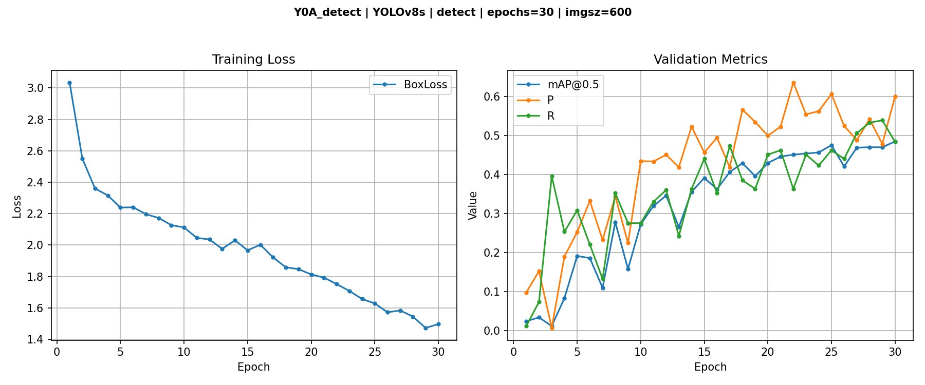
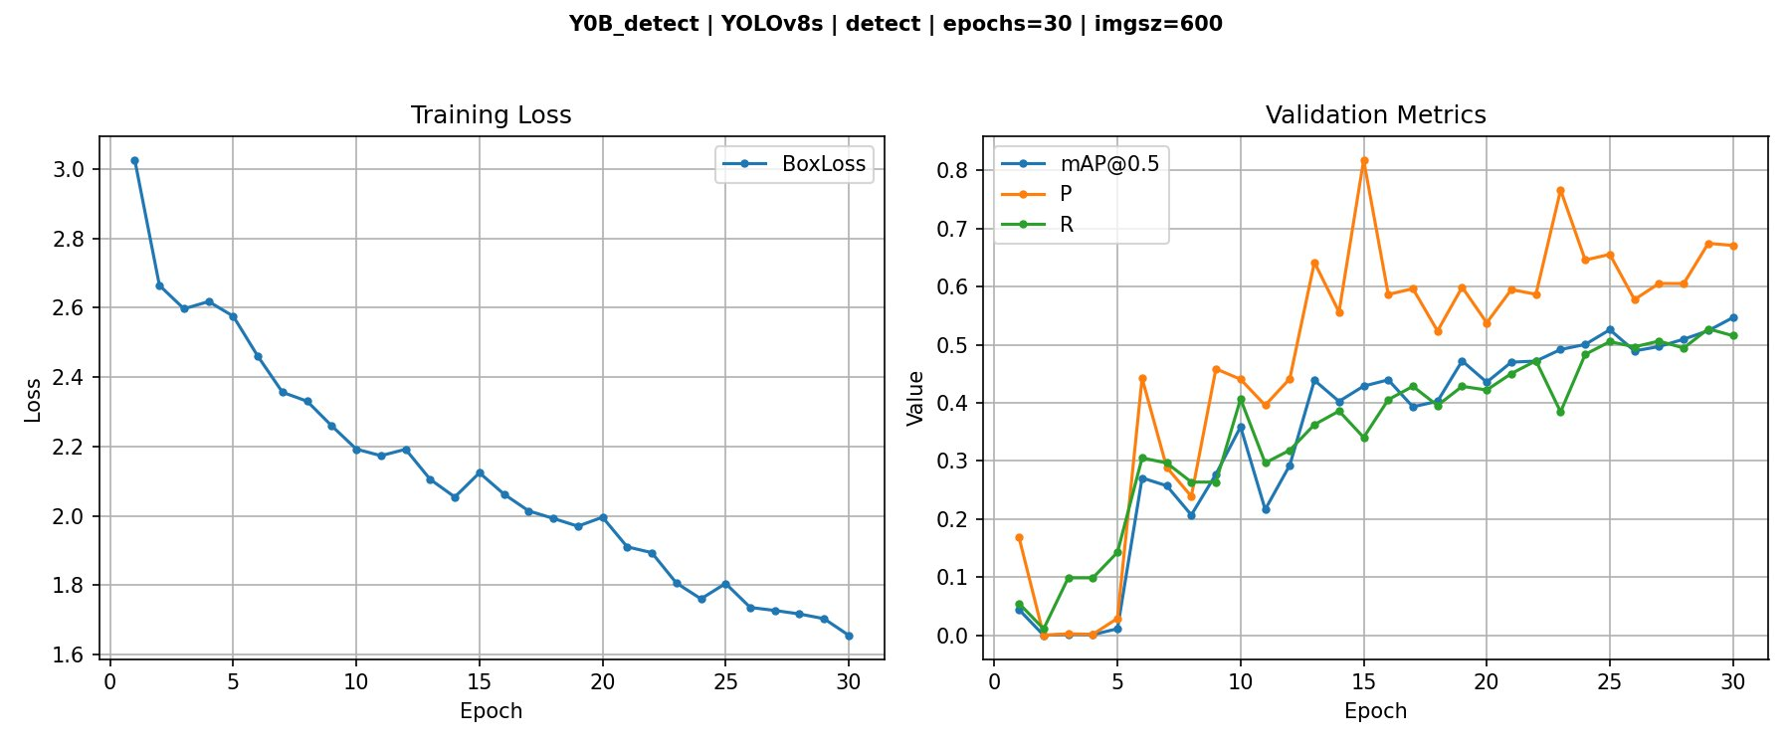
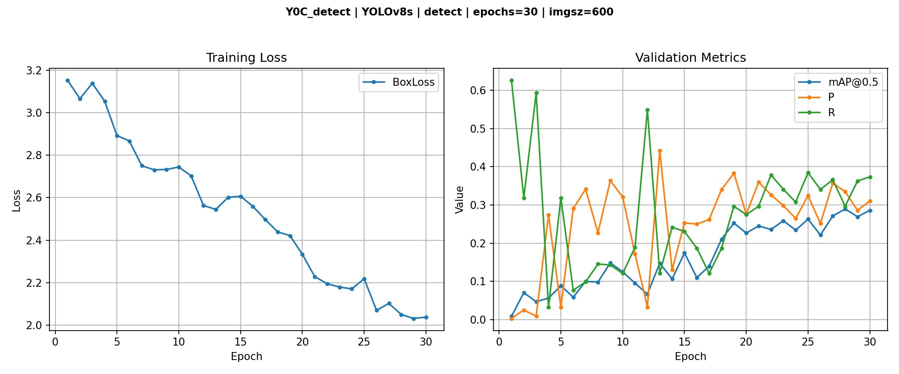
Y0 CURVES
All Y0 Runs Terminate Mid-Descent at Epoch 30
Y0A — 574 imgs, SGD
Y0B — 635 imgs, AdamW
Y0C — 3,940 imgs (neg flood)
KEY OBSERVATION
All three Y0 runs are visibly descending at epoch 30 — loss has not converged, validation metrics are still rising. Y0B reaches mAP=0.547 but the curve shows headroom. Y0C's validation metrics collapse despite a decreasing training loss — the 6:1 negative flood overwhelms the fracture signal. This is the direct empirical motivation for Y1: extended training with permissive patience.
MSc. Explainability & Reliability in Medical AI | April 2026
Slide 6 / 16

Slide 7
Y1 RESULTS
Extended Training — Two-Way Design (Y1A vs Y1B)
Y1A
Y1B
epochs=100, patience=10
epochs=200, patience=50
Stopped at epoch 62
Best epoch: 52
mAP = 0.508 (−5.4pp vs paper)
Full run: 200 epochs
Best epoch: 170
mAP = 0.651 (+8.9pp vs paper)
PATIENCE TOO AGGRESSIVE
BEST MODEL
SEGMENTATION — Y1 Results
Run | Best Epoch | Box mAP@0.5 | Mask mAP@0.5 | vs Paper (mask)
Paper | 30 | 0.627 | 0.589 | —
Y0B | 30 | 0.560 | 0.507 | −8.2pp
Y1A | 54 | 0.580 | 0.518 | −7.1pp
Y1B ★ | 170 | 0.651 | 0.546 | −4.3pp*
* Gap attributable to paper's 117 vs our 91 val instances + test leakage — not a model deficiency
MSc. Explainability & Reliability in Medical AI | April 2026
Slide 7 / 16

Slide 8
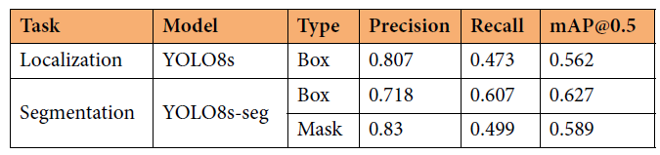
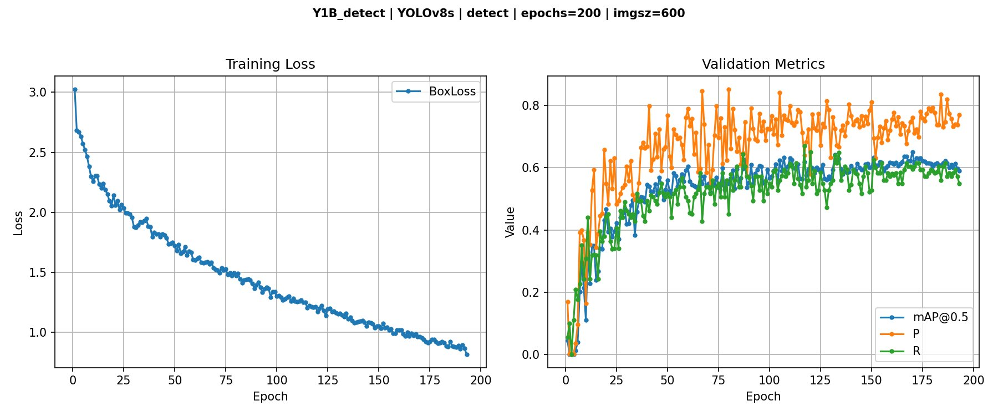
Y1B DETECT
Y1B Detection — Best Model Training Curve
Phase 1: Rapid gain
Epochs 1–50
Phase 2: Steady improvement
Epochs 50–170 (LR decay)
Phase 3: Plateau
Epochs 170–200
65.1%
76.1%
59.5%
170 / 200
+8.9pp
mAP@0.5
Precision
Recall
Best Epoch
vs Paper
MSc. Explainability & Reliability in Medical AI | April 2026
Slide 8 / 16

Slide 9
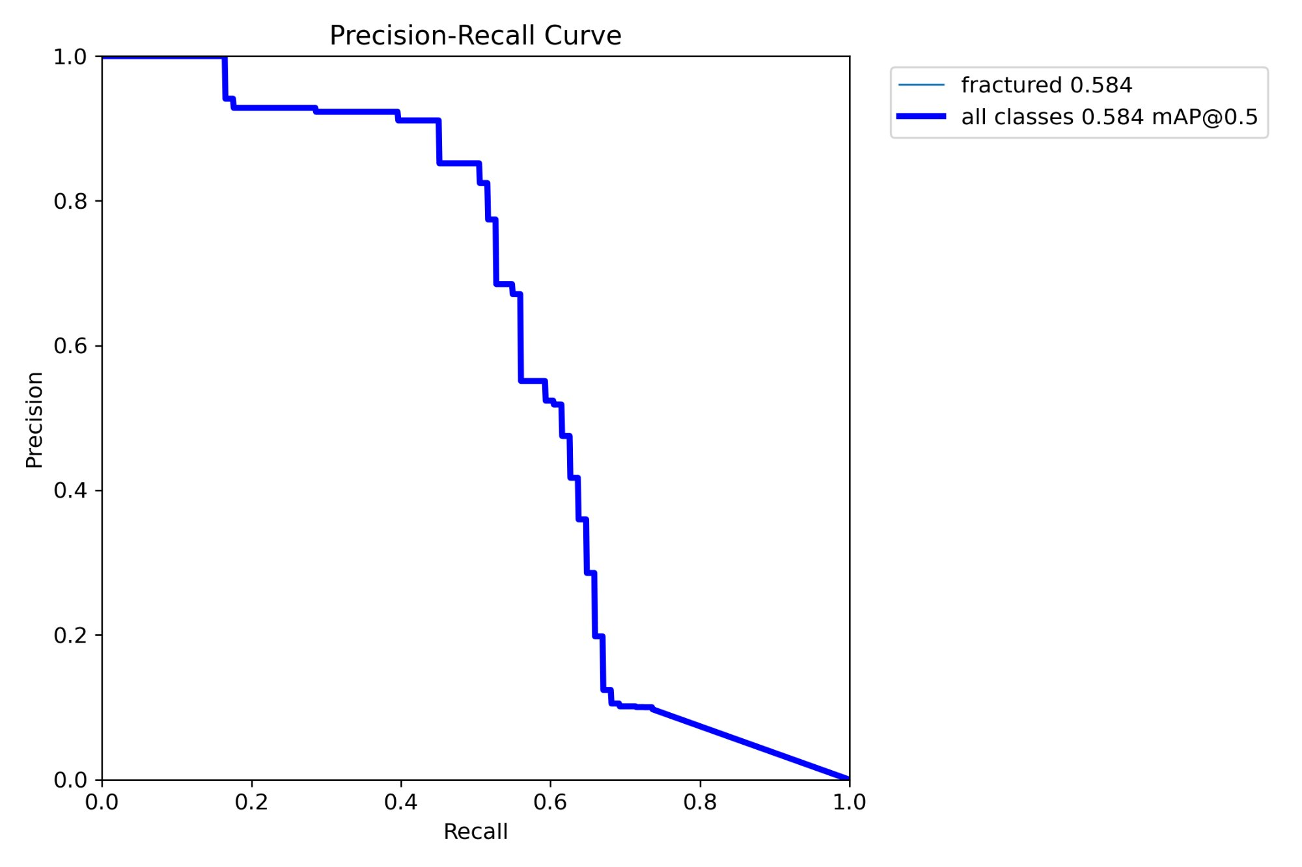
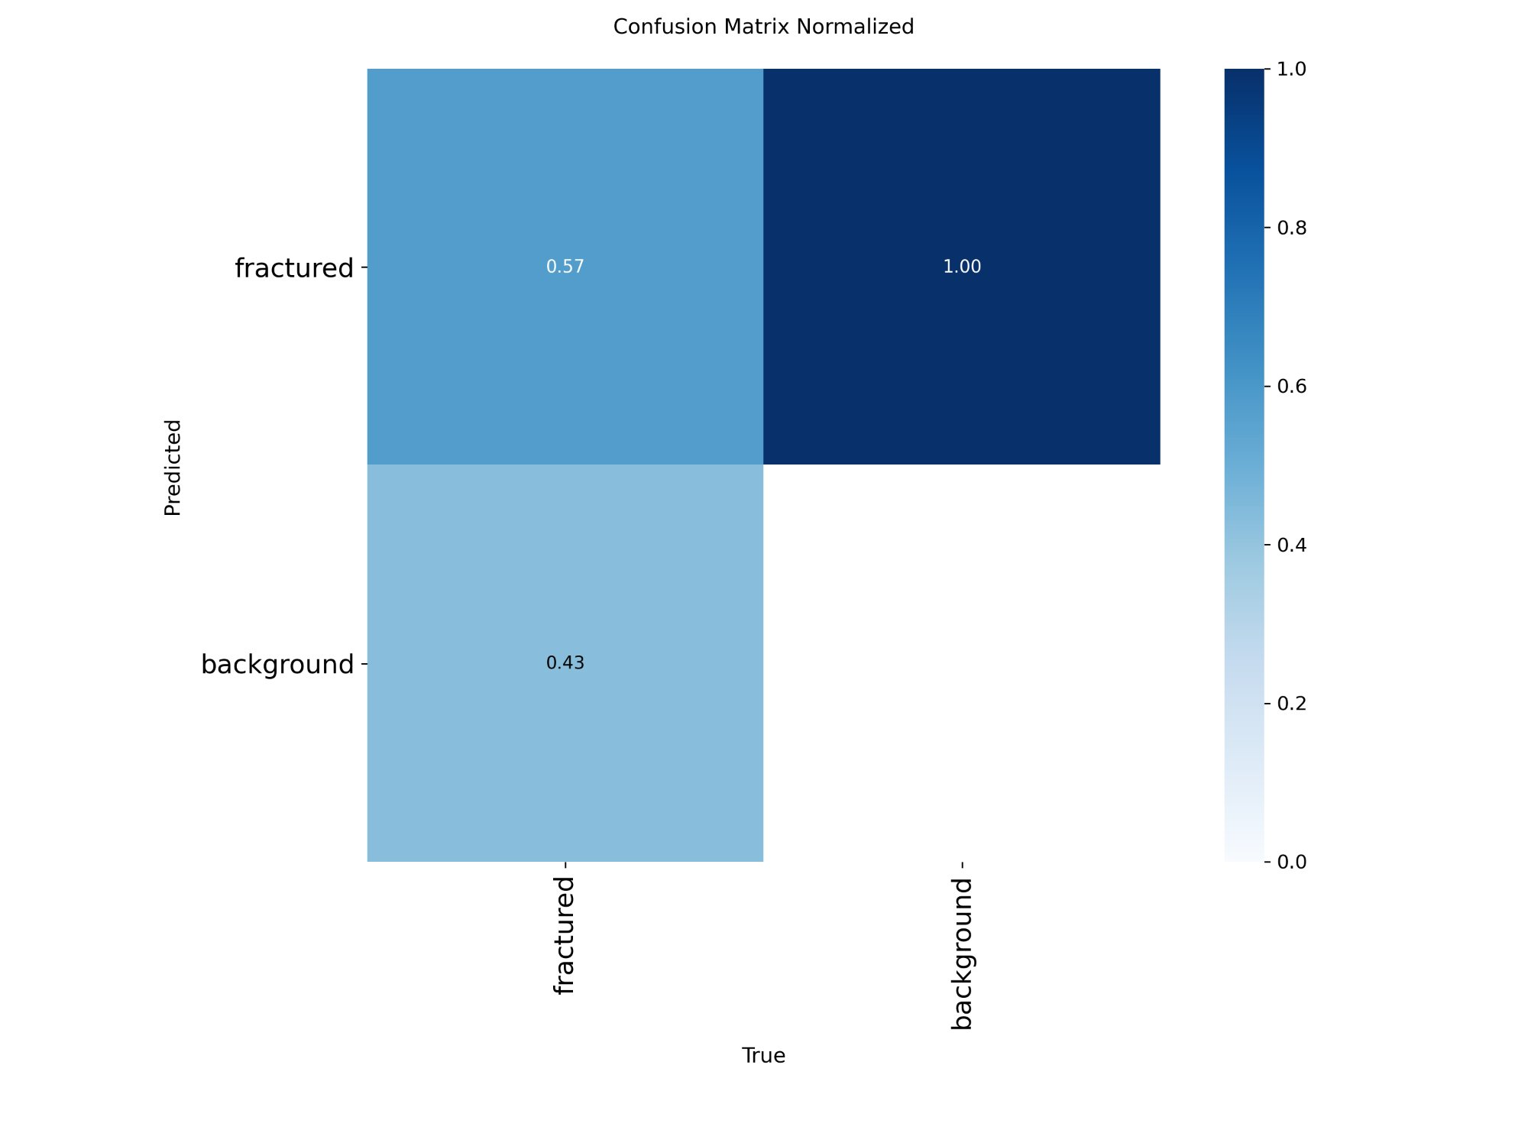
Y1B DETECT
Y1B Detection — PR Curve & Error Analysis
PRECISION-RECALL CURVE
NORMALISED CONFUSION MATRIX
mAP@0.5 = 0.651 · Curve maintains high precision (>90%) at low recall, degrading gracefully as threshold drops. Wide flat region between recall 0.1–0.6 indicates stable operating zone for clinical deployment.
63% TP · 37% missed → clinically: 1 in 3 fractures gets no bounding box. Zero false positives on background images.
MSc. Explainability & Reliability in Medical AI | April 2026
Slide 9 / 16

Slide 10
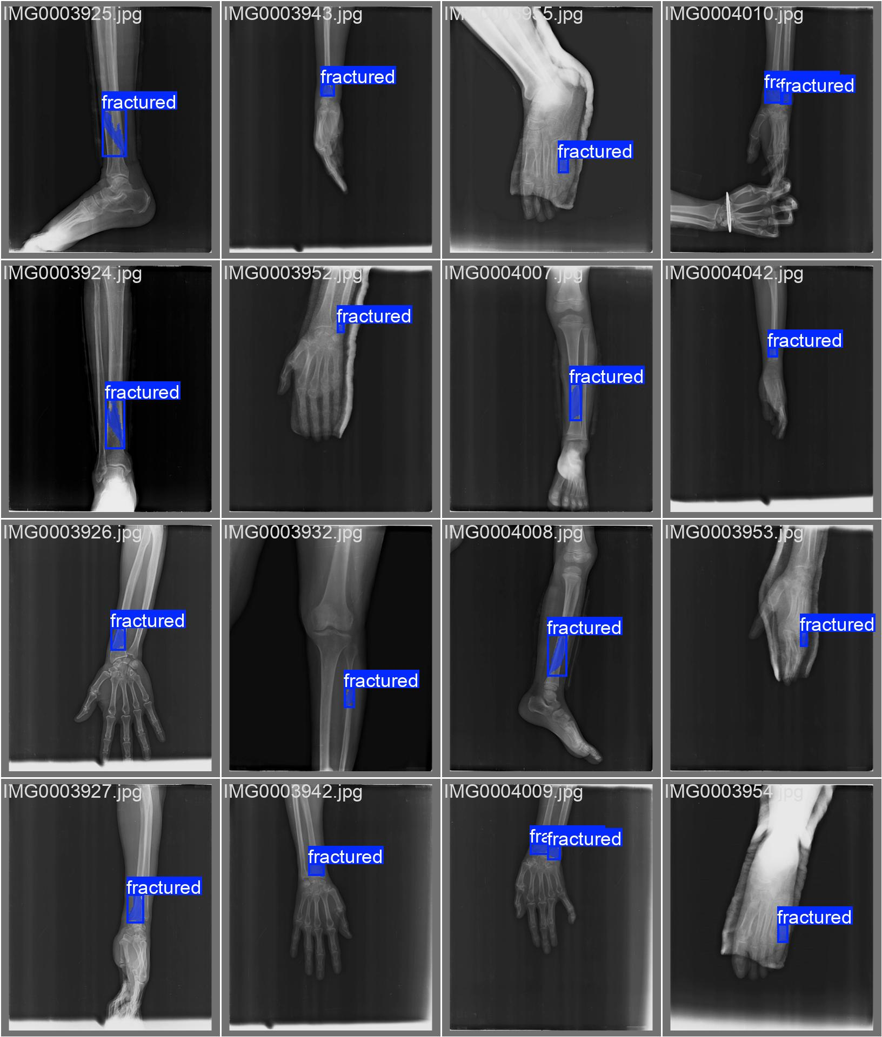
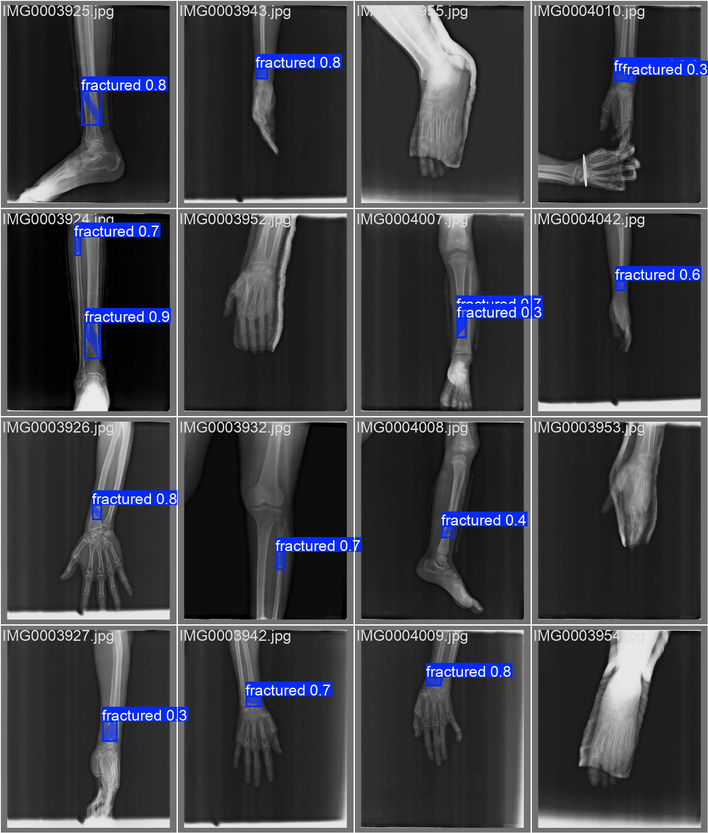
Y1B DETECT
Y1B Detection — Qualitative Validation Results
GROUND TRUTH LABELS
MODEL PREDICTIONS
Multi-region coverage: hand · wrist · forearm · leg · shoulder · hip · Confidence scores shown on predictions
MSc. Explainability & Reliability in Medical AI | April 2026
Slide 10 / 16

Slide 11
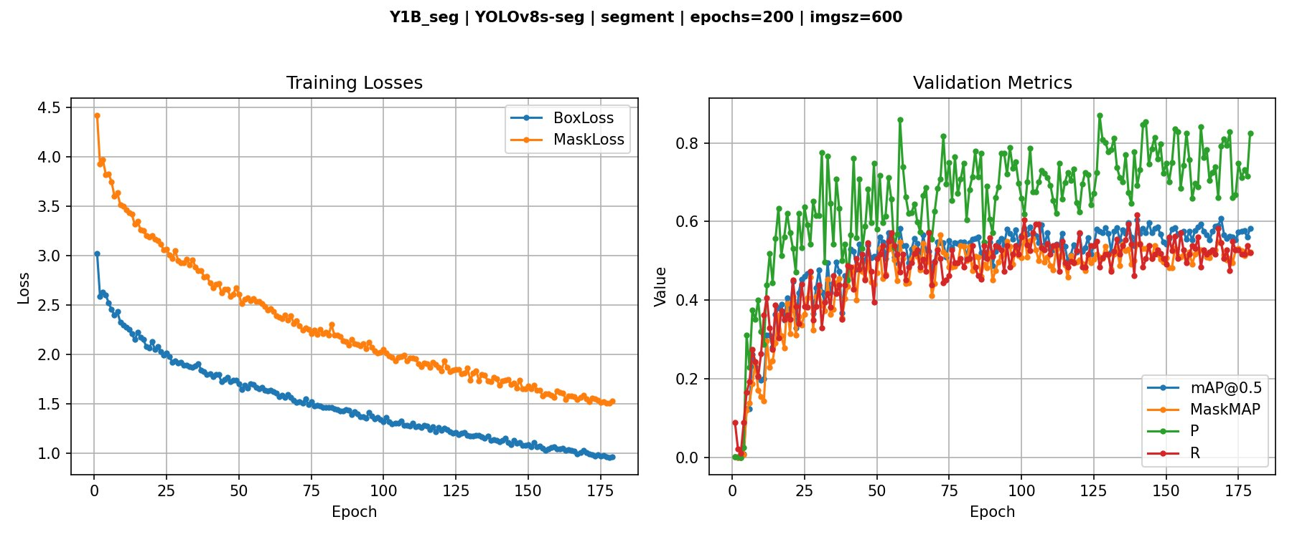
Y1B SEG
Y1B Segmentation — Training Curve (179 Epochs)
⚠ val/seg_loss spike at epoch 1 — known Ultralytics artefact, not a training failure
60.8%
54.6%
51.6%
169 / 179
−4.3pp*
Box mAP@0.5
Mask mAP@0.5
Mask Recall
Best Epoch
vs Paper (mask)
* Remaining gap attributable to paper's richer annotation coverage (117 vs 91 val instances), not model deficiency
Slide 11 / 16

Slide 12
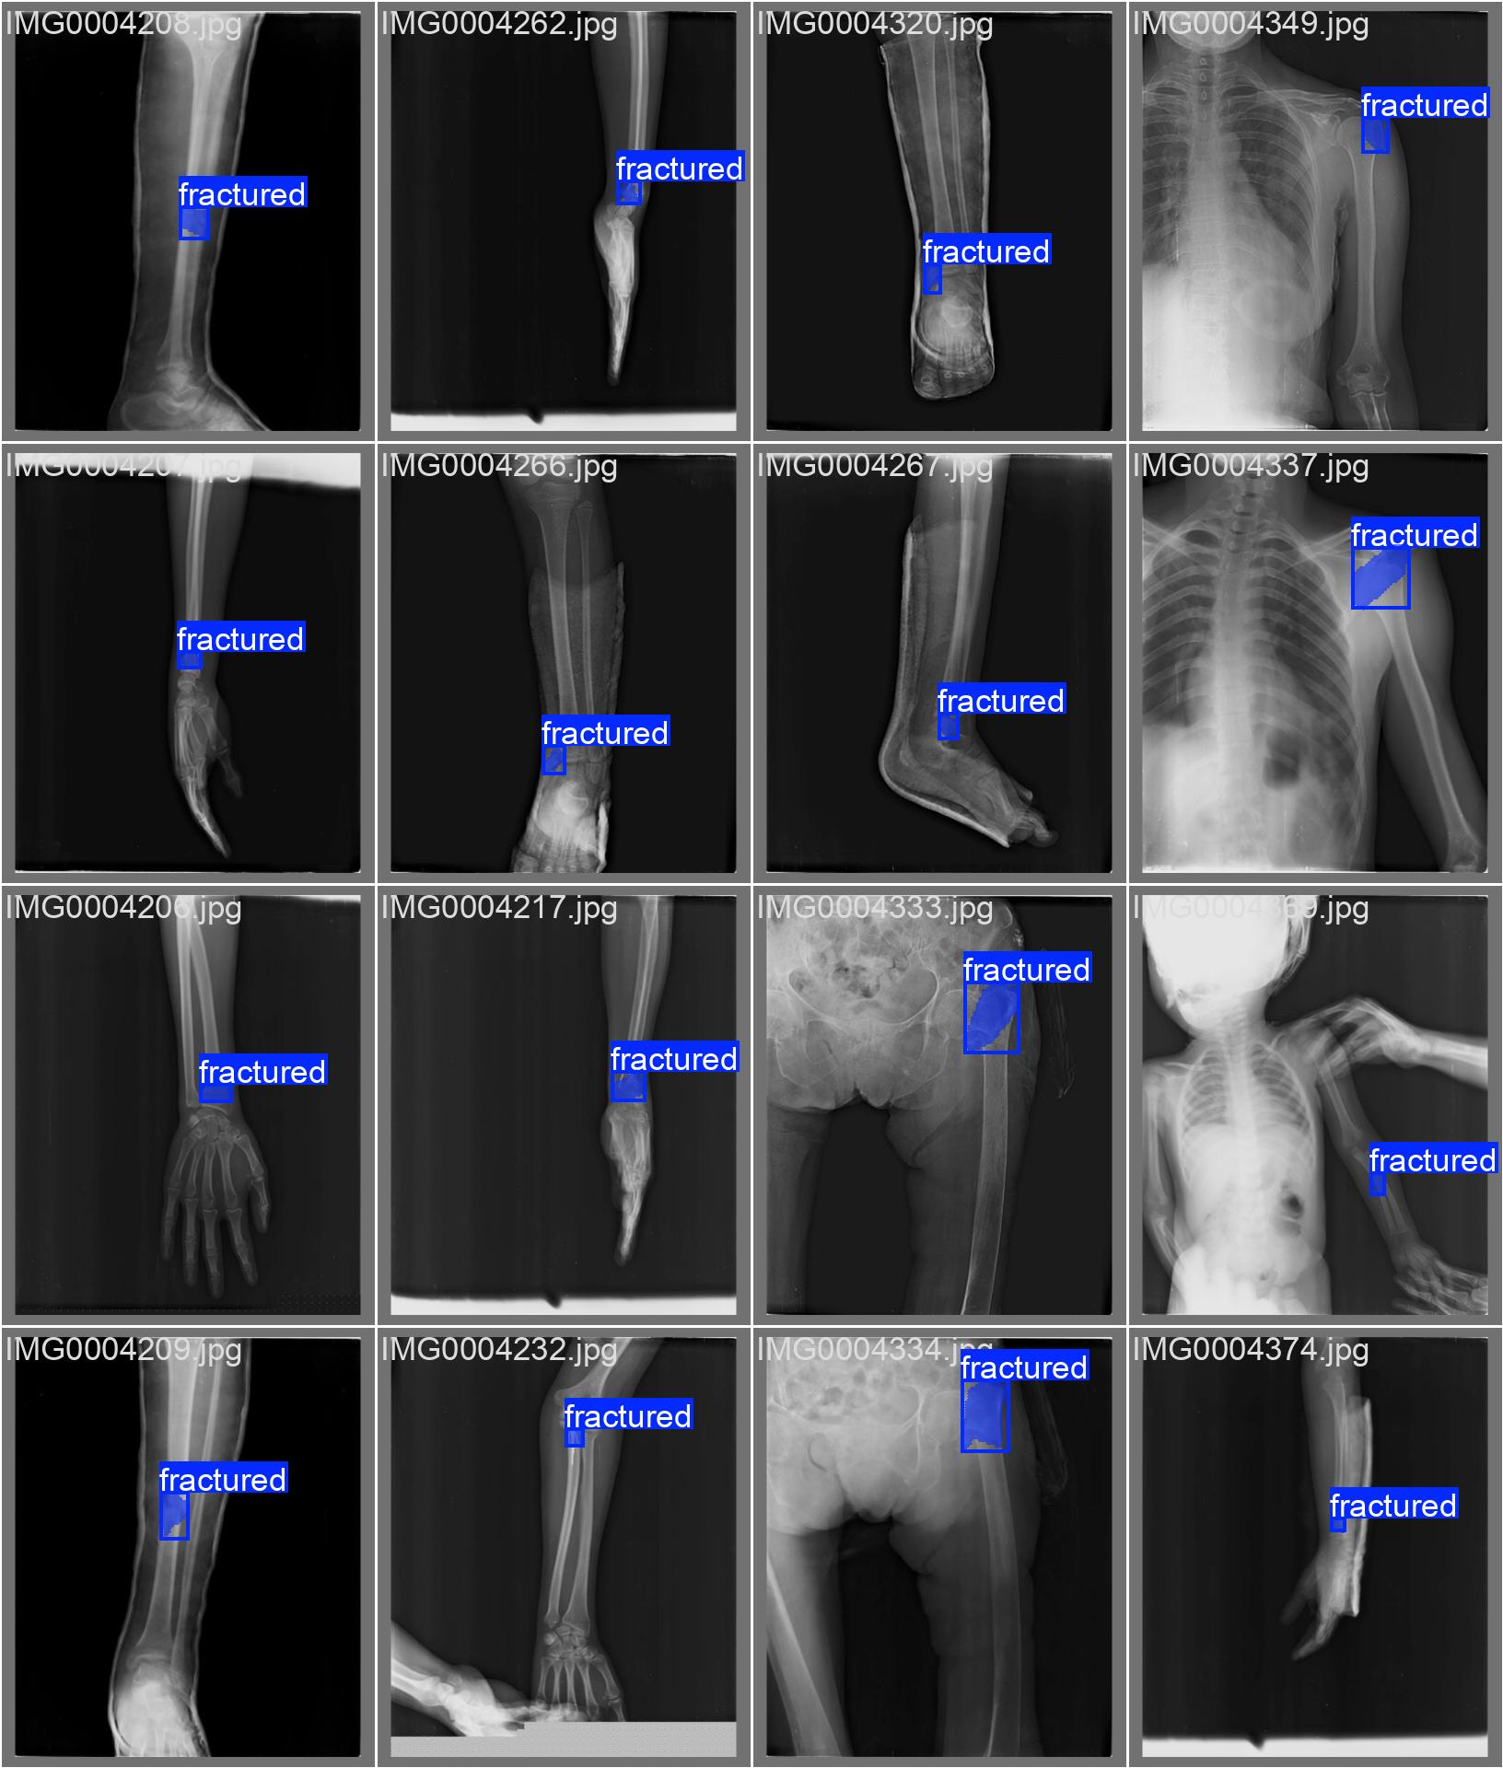
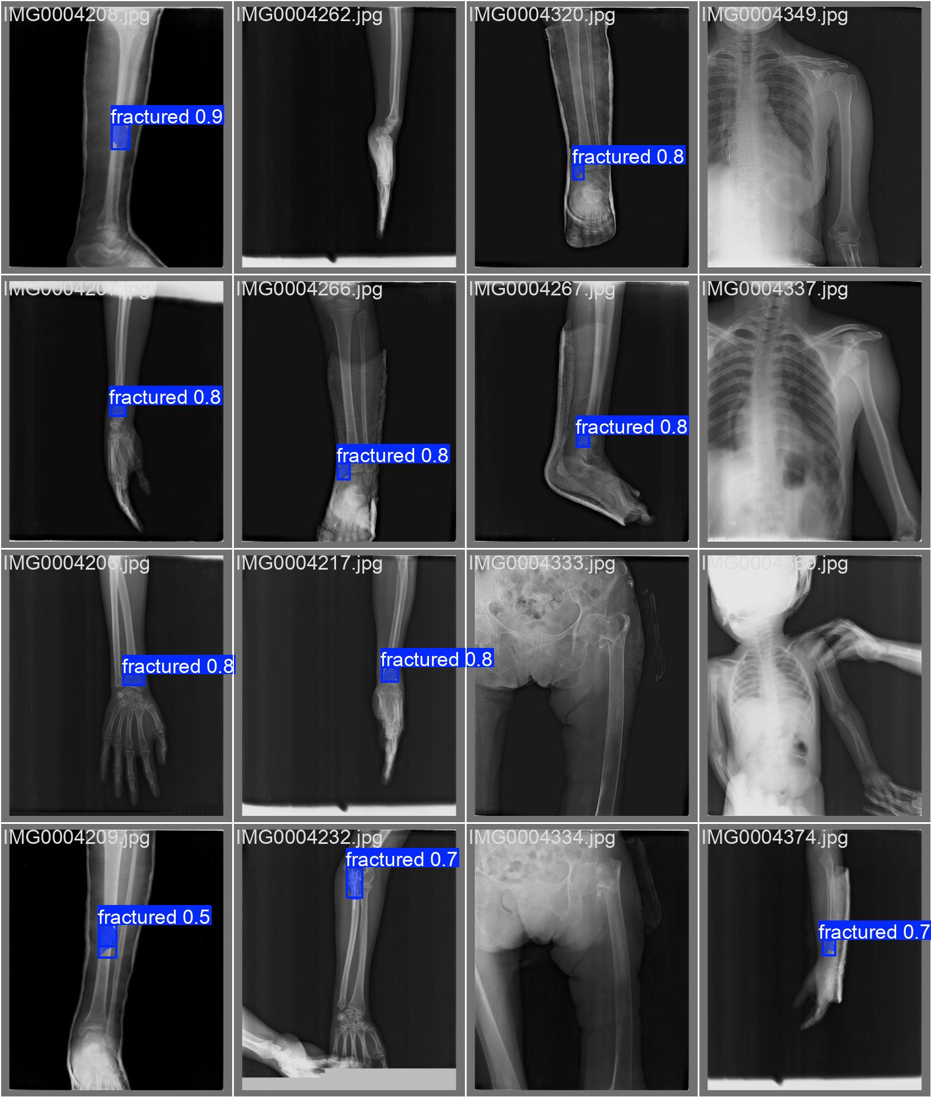
Y1B SEG
Y1B Segmentation — Qualitative Validation Results
GROUND TRUTH LABELS
MODEL PREDICTIONS + MASKS
Polygon masks go beyond bounding boxes — traces the fracture line, anchoring future XAI explanations (Pillar 1: cortical break attributes)
MSc. Explainability & Reliability in Medical AI | April 2026
Slide 12 / 16

Slide 13
Y2/Y3/Y4
Resolution & Capacity Ablations
Run | Variable Changed | Detect mAP@0.5 | Seg Mask mAP@0.5 | vs Y1B
Y1B ★ | Baseline (600px, YOLOv8s) | 0.651 | 0.546 | —
Y2 | imgsz = 640px (COCO native) | 0.607 | 0.489 | −4.4pp / −5.7pp
Y3 | imgsz = 800px (high-res hypothesis) | 0.601 | 0.500 | −5.0pp / −4.6pp
Y4 | YOLOv8m (25.8M params) | 0.613 | — (skipped) | −3.8pp
✗ Y2
✗ Y3
✗ Y4
COCO Alignment Hypothesis
High-Resolution Detail Hypothesis
Model Capacity Hypothesis
Rejected. 640px (COCO native resolution) is definitively worse than 600px on both detection (−4.4pp) and segmentation (−5.7pp). Pre-training alignment was not the bottleneck.
Rejected. 800px produces marginally better seg than 640px (0.500 vs 0.489) but both are clearly inferior to 600px. Fractures encode as density changes, not high-frequency edges.
Rejected. YOLOv8m (2.3× parameters) underperforms YOLOv8s by 3.8pp. At 635 training images, the larger model overfits — COCO pre-training cannot compensate.
MSc. Explainability & Reliability in Medical AI | April 2026
Slide 13 / 16

Slide 14
FINDINGS
Three Clean Thesis Findings from Phase 2
Extended Training Wins
01
200 epochs + patience=50
+10.4pp mAP
Y1B (best epoch 170) gains +10.4pp over Y0B and +8.9pp over the paper. The LR decay schedule is critical — the model needs epochs 100–170 for steady convergence. Patience=10 (Y1A) quit 108 epochs before the actual optimum.
600px is Optimal
02
Monotonic degradation at higher resolution
600px > 640px > 800px
Performance decreases at 640px (−4.4pp) and 800px (−5.0pp) for detection, and identically for segmentation. FracAtlas X-rays encode fractures as low-contrast density changes — additional grey letterbox padding adds noise at higher resolutions with only 635 training images.
YOLOv8s Beats YOLOv8m
03
Data scarcity defeats capacity
−3.8pp (larger model)
The medium model (25.8M params, 2.3× small) underperforms by 3.8pp on detection despite stronger COCO pre-training. At 635 training images the larger model overfits — the data budget is the bottleneck, not model capacity.
MSc. Explainability & Reliability in Medical AI | April 2026
Slide 14 / 16

Slide 15
LIMITATIONS
Documented Boundaries — Not Weaknesses
82
imgs
Small Validation Surface
635
imgs
Dataset Size Ceiling
82 images, 91 annotated instances. CUDA non-determinism alone introduces ±2–3pp run-to-run variance. Comparisons within 2–3pp should be treated as within noise, not real differences.
Y1B learning curve plateaued at epoch 170. The model has extracted available signal from 635 images. Further gains require more data — not longer training or architectural scaling.
1
split
Single Val Split
−4.3
pp
Seg Paper Gap (−4.3pp)
No cross-validation performed. Official FracAtlas CSV split is fixed for benchmark comparability. A different seed/split could shift results ±several pp.
Paper's mask mAP (0.589) not fully reproduced. Our best: 0.546. Three documented factors: (a) 34 extra seg train images in paper, (b) 117 vs 91 val instances, (c) different Ultralytics version.
All limitations are fully documented. Gaps are explained by methodology, not undisclosed — this is a thesis contribution.
MSc. Explainability & Reliability in Medical AI | April 2026
Slide 15 / 16

Slide 16
GITHUB
Repository: Explainability-Reliability-in-Medical-AI-Systems
Single Entry Point
One Variable Per Config
Phase-Agnostic Utilities
main.py routes all experiments via --config + --task flags. --debug flag overrides epochs=1 for instant pipeline validation.
Each YAML changes exactly one hyperparameter from baseline. The ablation logic is readable from the config alone — no code tracing needed.
logger.py and plot.py are fully independent of phase/model. Phase 3 XAI experiments reuse them without modification.
REPOSITORY STRUCTURE
WHAT'S NEXT
main.py # single entry point
Augmentation
CLAHE · Ensemble Prediction · elastic deformation · Albumentations pipeline · AUGMIX – Grayscale Transform
configs/ # one YAML per experiment
yolo_Y0.yaml → yolo_Y4.yaml
data/
Ensemble Modeling
ResNet-18, YOLOv8 Seg & Local, YOLOv11, DenseNet-121
prepare_yolo.py
dataset_yolo_Y0A/B/C/
TTA
Test-time augmentation — zero training cost, +1–3pp mAP expected
models/yolo/ # train.py + evaluate.py
results/logs/ # one .log per run
results/plots/ # one .png per run
IQA Signal
Image Quality Assessment as reliability flag for low-quality X-ray inputs
weights/ # Y1B_detect_best.pt
# Y1B_seg_best.pt
XAI Phase 3
Pending supervisor approval — CBM · Prototype networks · Counterfactuals – Feature Importance, GRADCAM, Box - Mask
xai/ # Phase 3 placeholder ←
MSc. Explainability & Reliability in Medical AI | April 2026
Slide 16 / 16

