Slide 1
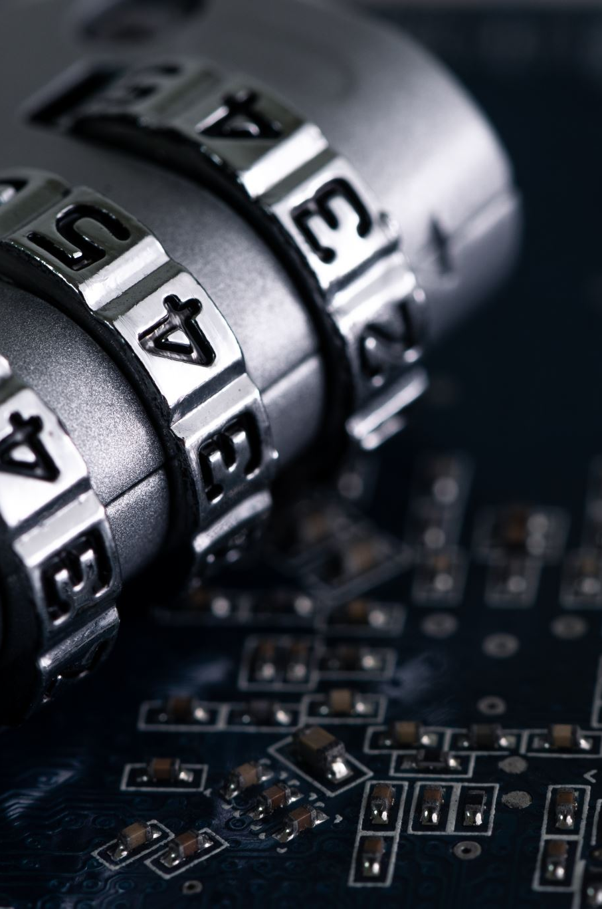
Real-Time Credit Card Fraud Detection System
An Explainable Machine Learning System for Fraud Detection
Presented by:
Sylvia Obiageli Onwuanabile
3MTT Data Science Mentorship Capstone
Notes:
What did I build?

Slide 2
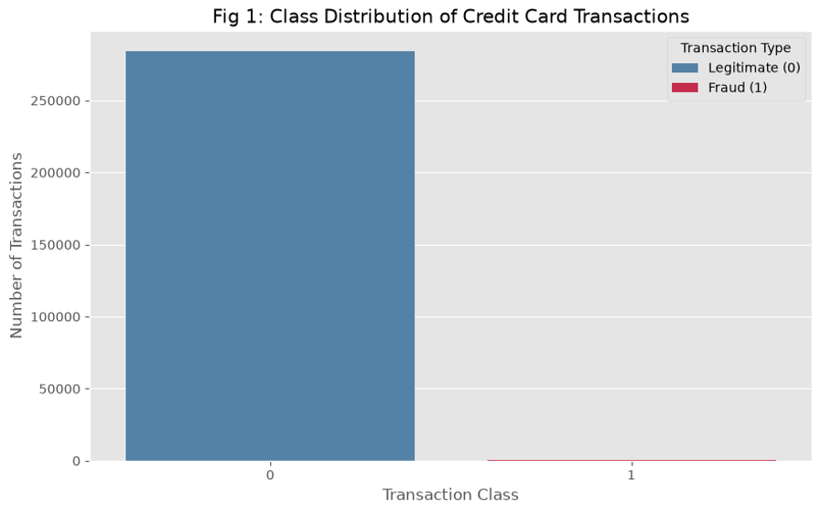

PROBLEM & OBJECTIVES
The Problem
Credit-card fraud detection presents a major machine-learning challenge because fraudulent transactions are extremely rare compared with legitimate transactions.
Dataset imbalance:
284,807 total transactions
284,315 legitimate
492 fraudulent
Fraud rate ≈ 0.17%
Objectives
Build a reliable fraud-detection pipeline
Compare multiple machine-learning models
Optimize the final model for fraud detection
Explain predictions using SHAP
Deploy the model through FastAPI + Streamlit
Notes:
Why is it difficult?

Slide 3
DATASET & DATA PREPARATIONPREPARATION
Preprocessing Pipeline
Raw Data
↓
Train/Test Split
80% / 20%
Stratified
↓
Feature Scaling
Time + Amount
↓
Class Imbalance Experiments
Class weighting
Random undersampling
SMOTE
Dataset
ULB/Kaggle Credit Card Fraud Detection dataset
284,807 transactions
30 predictor variables
Target: Class
No missing values
V1–V28 are anonymized features
Notes:
What data did I use?

Slide 4
MODEL DEVELOPMENT & COMPARISON
Model | Precision | Recall | F1 | PR-AUC
Logistic Regression | 0.061 | 0.918 | 0.114 | 0.716
Random Forest | 0.906 | 0.786 | 0.842 | 0.863
XGBoost | 0.781 | 0.837 | 0.808 | 0.863
CatBoost | 0.527 | 0.888 | 0.662 | 0.807
Tuned XGBoost | 0.880 | 0.827 | 0.853 | 0.880
Model Development & Comparison
I evaluated five models:
Logistic Regression
Random Forest
XGBoost
CatBoost
Tuned XGBoost
Tuned XGBoost achieved the strongest overall performance.
Notes:
Which model worked best?

Slide 5
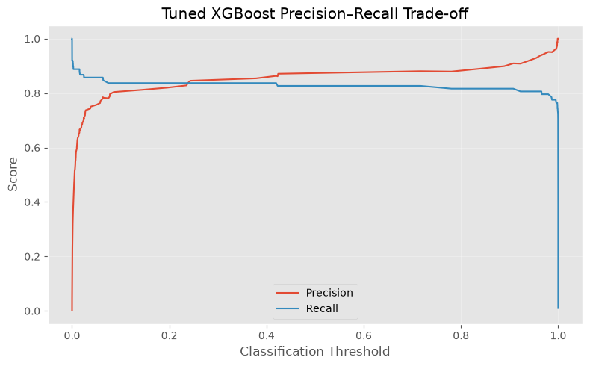
OPTIMIZATION: TUNING & THRESHOLD
From Model Selection to Optimization
Hyperparameter tuning
RandomizedSearchCV
5-fold cross-validation
Optimized for PR-AUC
10 parameter combinations
Best parameters:
  n_estimators = 200
  max_depth = 6
  learning_rate = 0.2
  subsample = 1.0
  colsample_bytree = 0.8
Threshold optimization
Default threshold:
0.50
↓
Optimized threshold:
0.89
 | Threshold 0.50 | Threshold 0.89
Precision | 0.8804 | 0.9091
Recall | 0.8265 | 0.8163
F1 | 0.8526 | 0.8602
Notes:
How did I optimize it?

Slide 6
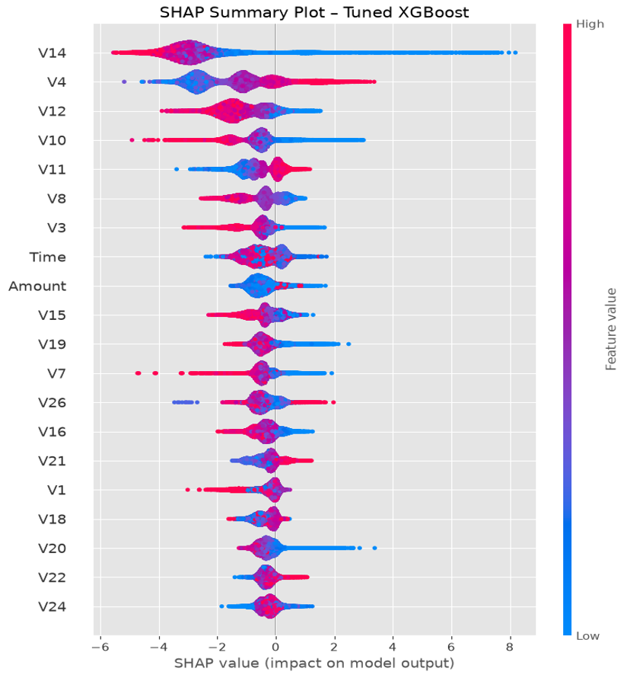
EXPLAINABLE AI
SHAP workflow
Transaction
↓
XGBoost Prediction
↓
SHAP Values
↓
Top Feature Contributions
↓
Human-readable Explanation
Explainable AI with SHAP
Why?
A fraud prediction should not simply say:
FRAUD
The system should also help answer:
“Why was this transaction flagged?”
The system identifies:
Features increasing fraud risk
Features reducing fraud risk
Relative contribution of each feature
Important distinction
XGBoost → makes the prediction
SHAP → explains the prediction
LLM → optionally converts the explanation into plain language
Notes:
Can I explain the prediction?

Slide 7
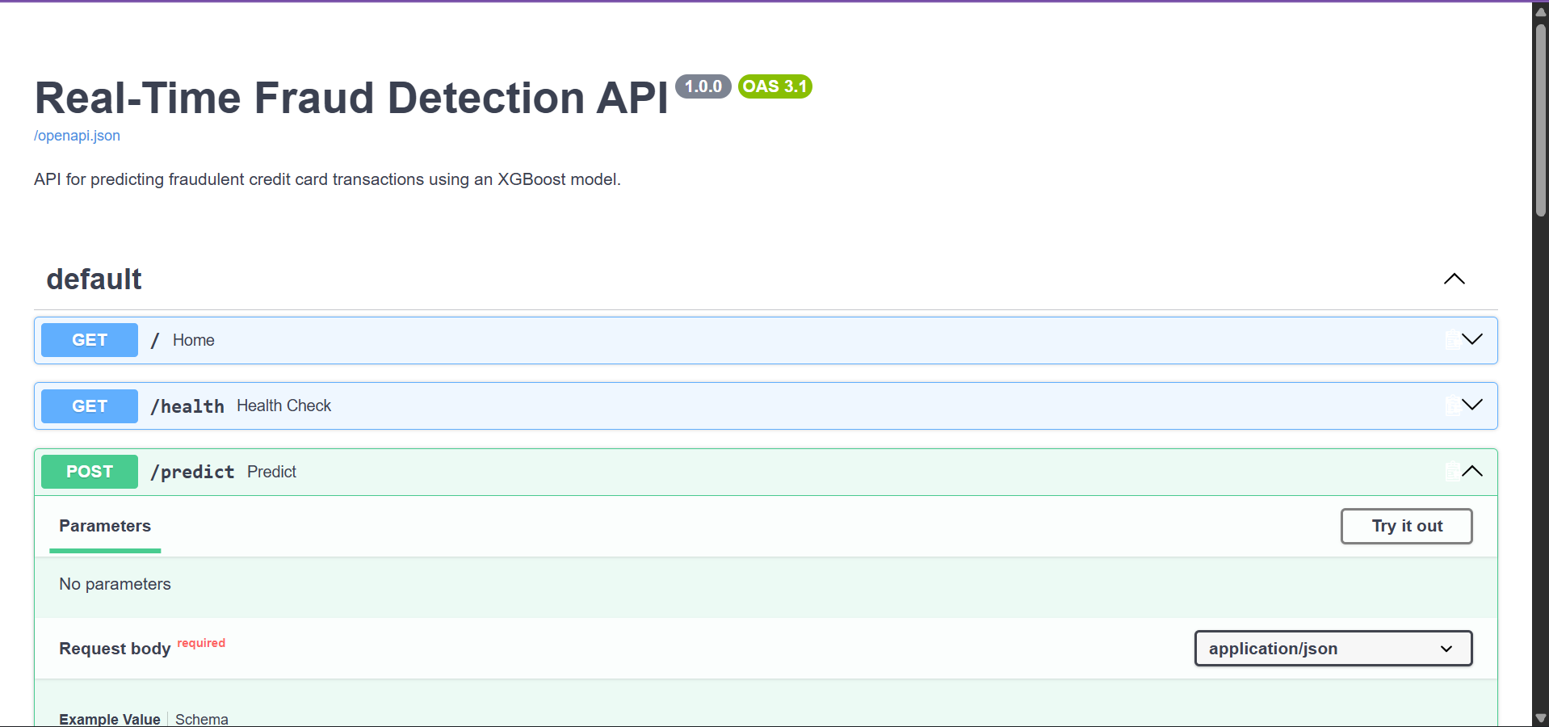
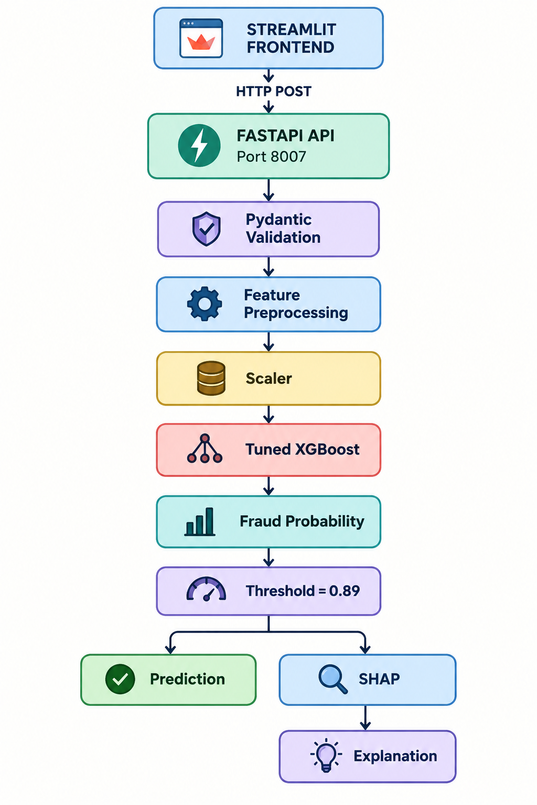
SYSTEM ARCHITECTURE & API
API endpoints
GET /
GET /health
POST /predict
From Machine Learning Model to Application
Notes:
How did I deploy it?

Slide 8
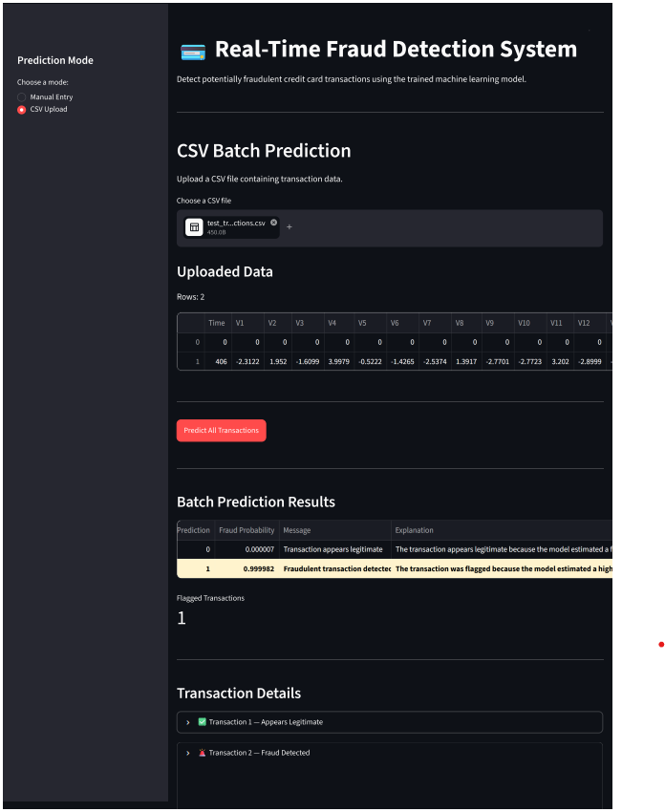
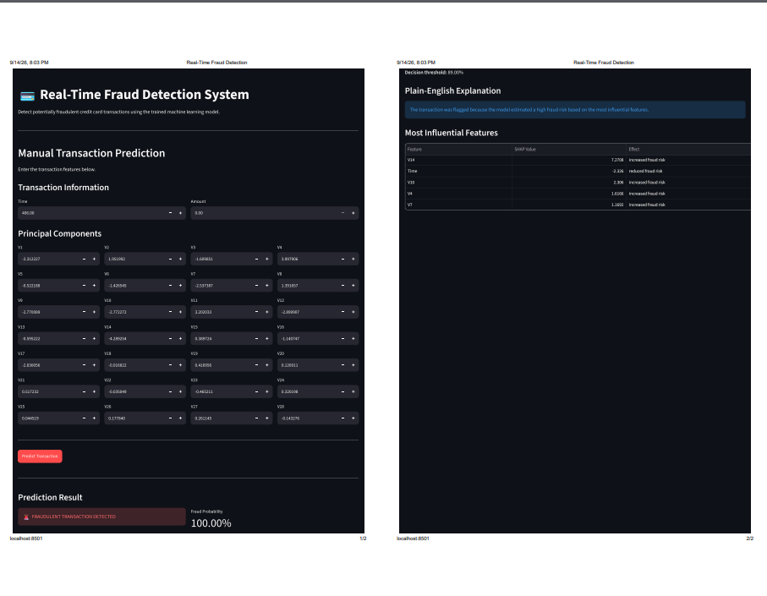
STREAMLIT APPLICATION & VALIDATION
Validation
Show these three numbers prominently:
1:1
Notebook vs API prediction
0.999982
Same probability
62.98 ms
Average API response time
Then:
10/10 requests completed successfully
Working Application
Manual prediction
Input → Prediction → Probability → Explanation
CSV batch prediction
CSV Upload → Predictions → Fraud Count
Notes:
Does the application actually work?

Slide 9
MODEL DEVELOPMENT & COMPARISON
What was achieved?
✅ Machine-learning fraud detection
✅ Class imbalance investigation
✅ Hyperparameter tuning
✅ Threshold optimization
✅ SHAP explainability
✅ FastAPI REST API
✅ Streamlit frontend
✅ Manual + CSV prediction
✅ Deployment validation
Results & Conclusion
Final model
Tuned XGBoost + threshold 0.89
Precision: 90.91%
Recall: 81.63%
F1: 86.02%
Limitations
Historical public dataset
Anonymized features
No continuous monitoring/retraining
Distribution shift may affect real-world performance
Optional external LLM dependency
Final takeaway
From an imbalanced dataset to an explainable, deployable fraud-detection application.
Notes:
What did I achieve?

Slide 10
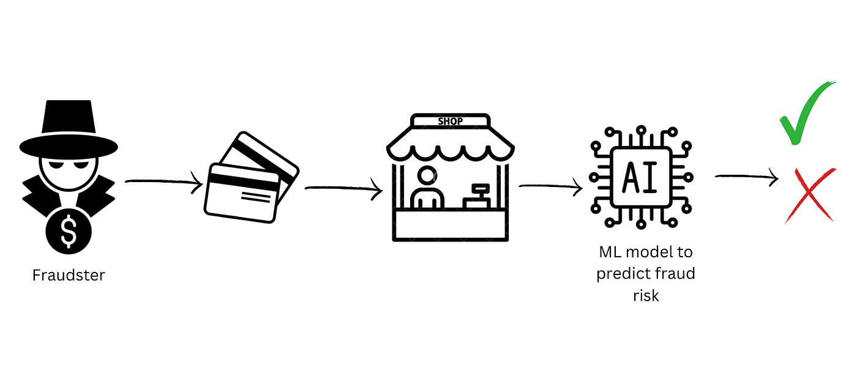
THANK YOU

