Slide 1
Synchrotron Radiation
Parameter studies

Slide 2
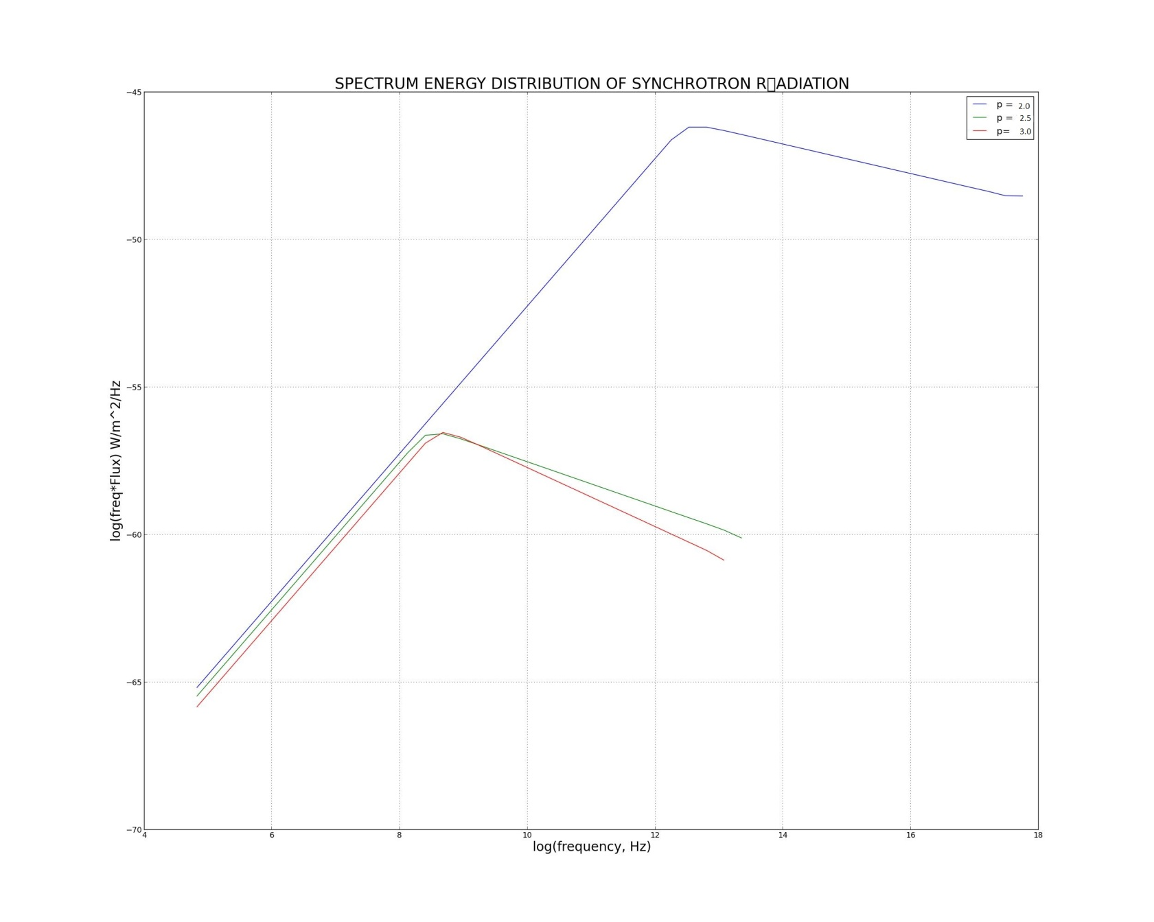
Various Energy Index values

Slide 3
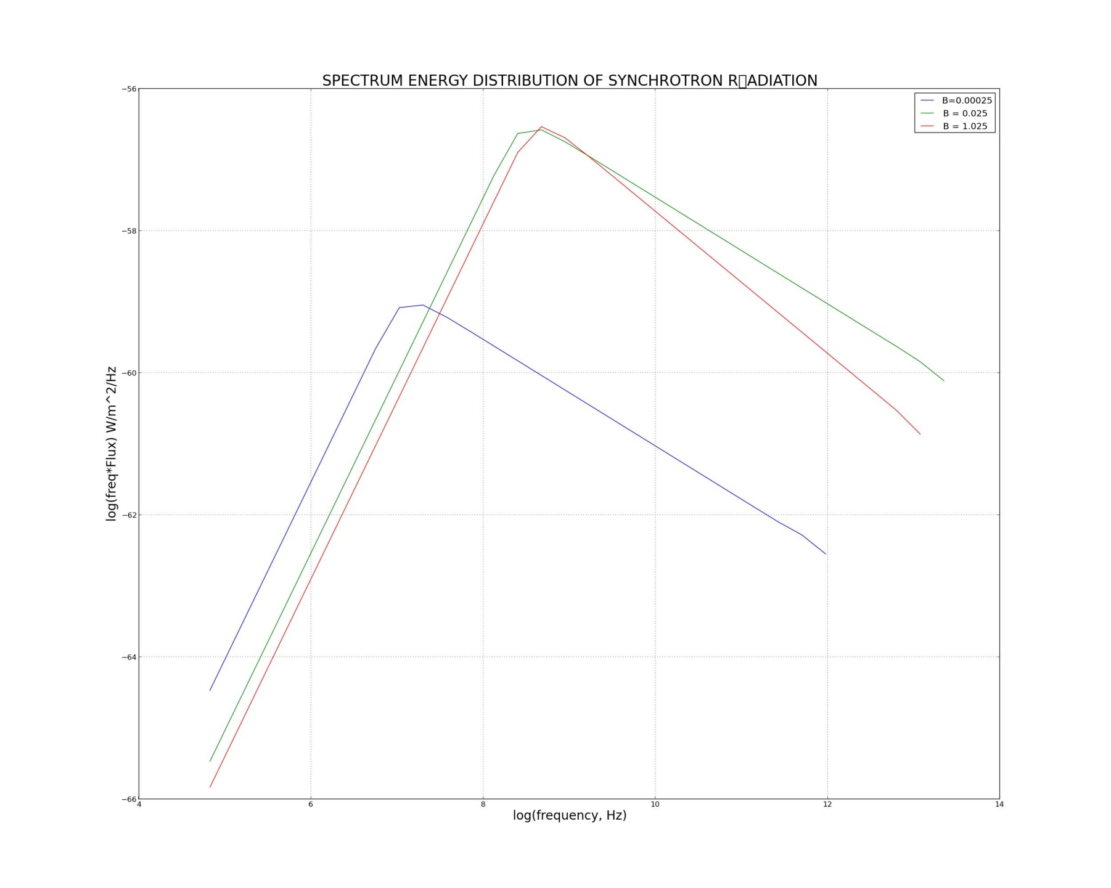
Various Magnetic field strength

Slide 4
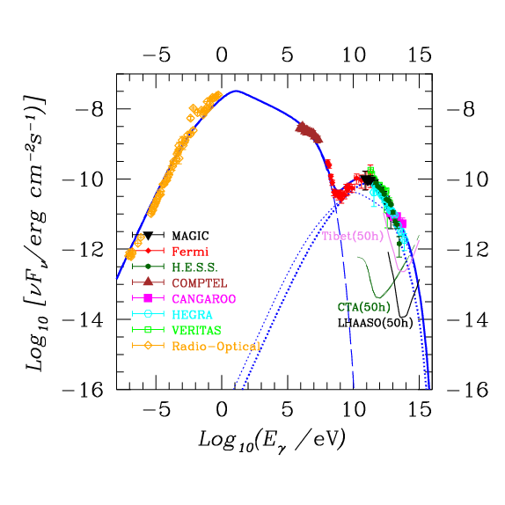
Data from Telescopes

