Slide 1
Theoretical Modelling of Synchrotron Emission
1st Astro JEDI in Namibia, windhoek 2014
Wilhelmina Nekoto
Kleopas Shiningayamwe
Isak Davids
Hambeleleni Ndiyavala
Edmund Seibeb

Slide 2
Theoretical background
Electrons
Mass
Charge
Velocity
Magnetic field, B
Force on e due to B
F=qv×B
Change direction
Charge accelerates and spirals around magnetic field
Accelerated charges radiate
Detected by telescopes
Model this radiation to get:
Spectral energy distribution (SED)
which is Intensity of radiation as a function of frequency

Slide 3
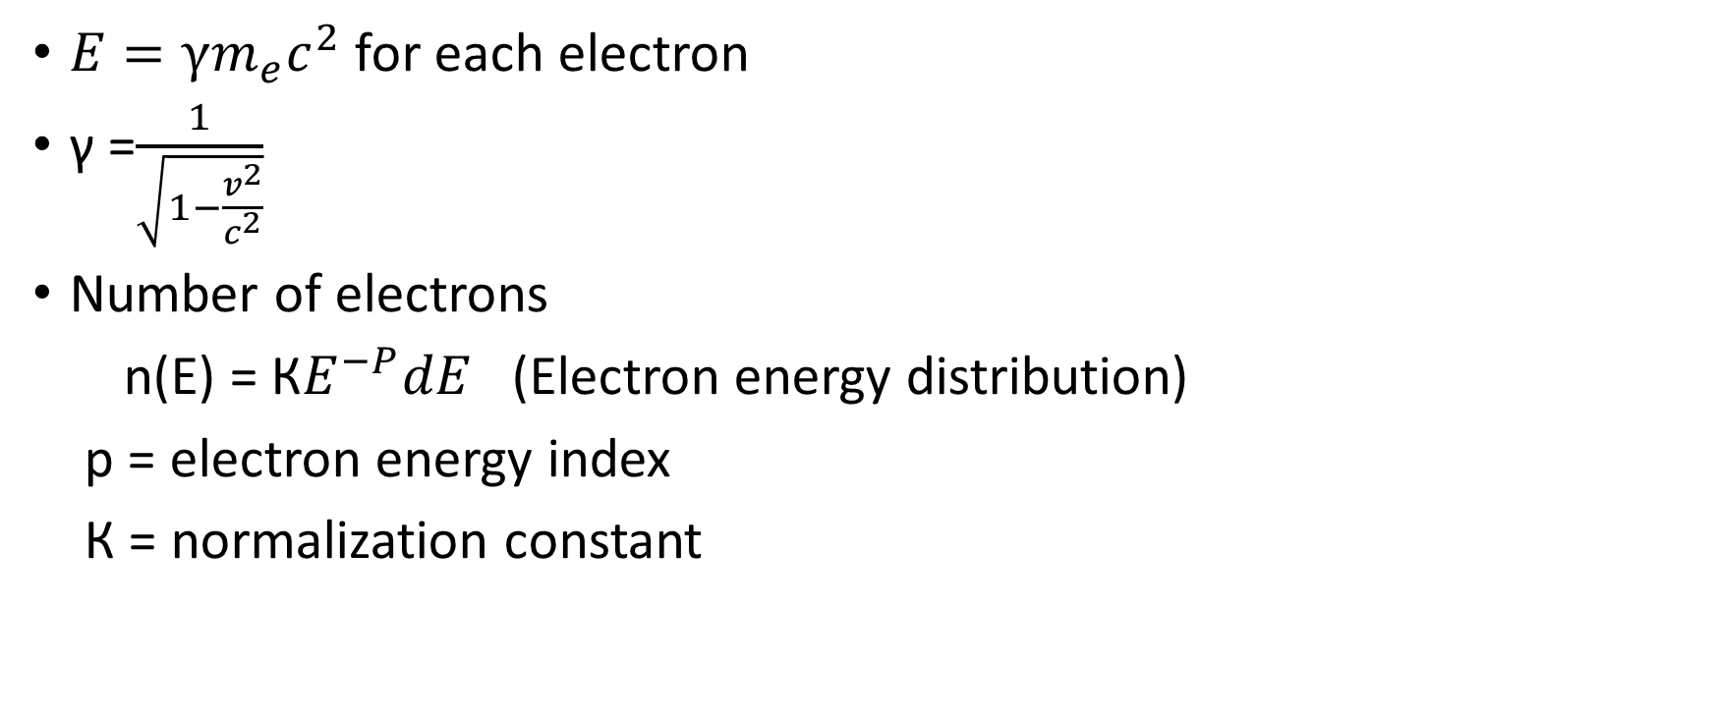
Electrons

Slide 4
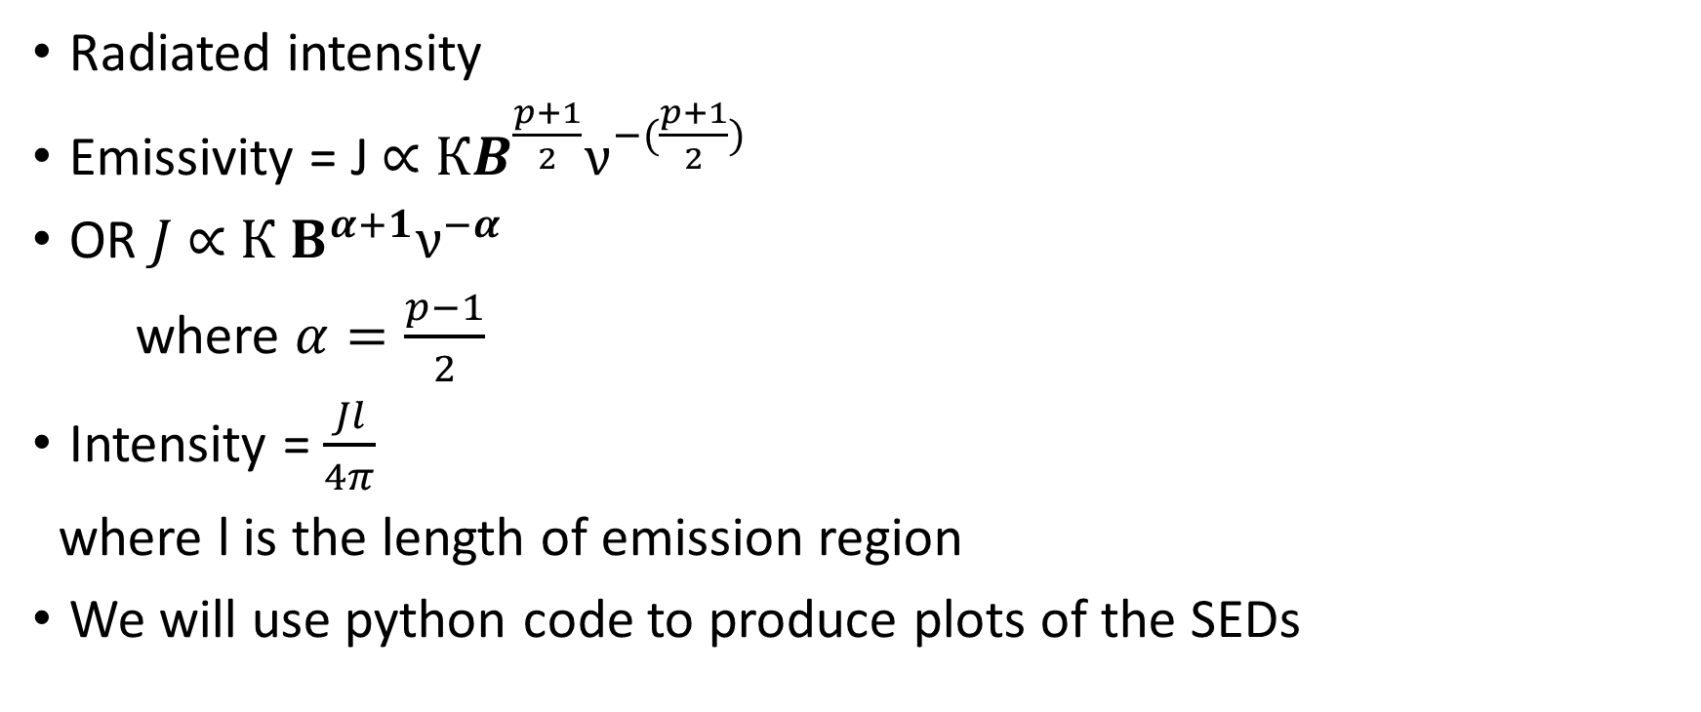
continued

Slide 5
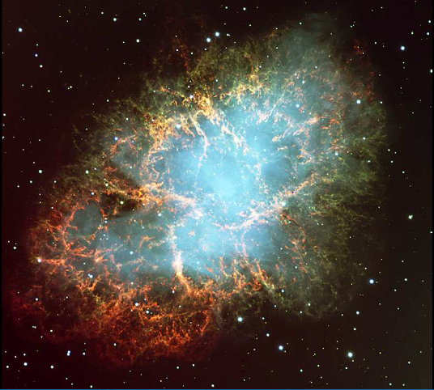
SR source-crab nebula

Slide 6
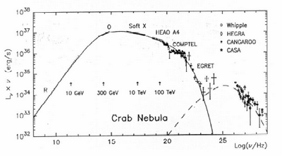
Observed Spectral Energy Distribution

Slide 7
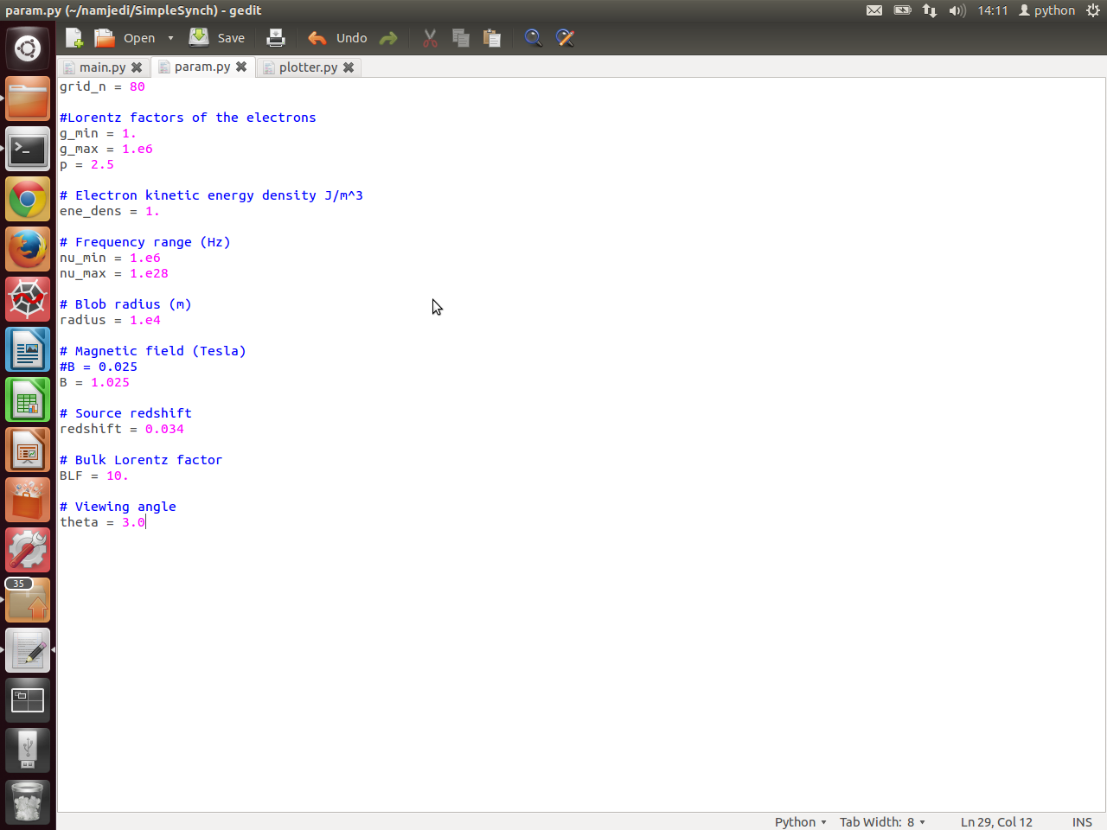
Python Numerical Code
Different classes :
Electron.py
Parameter.py
Main.py
Photons.py
Plotter.py
Synchrotron.py
Electrons.py

Slide 8
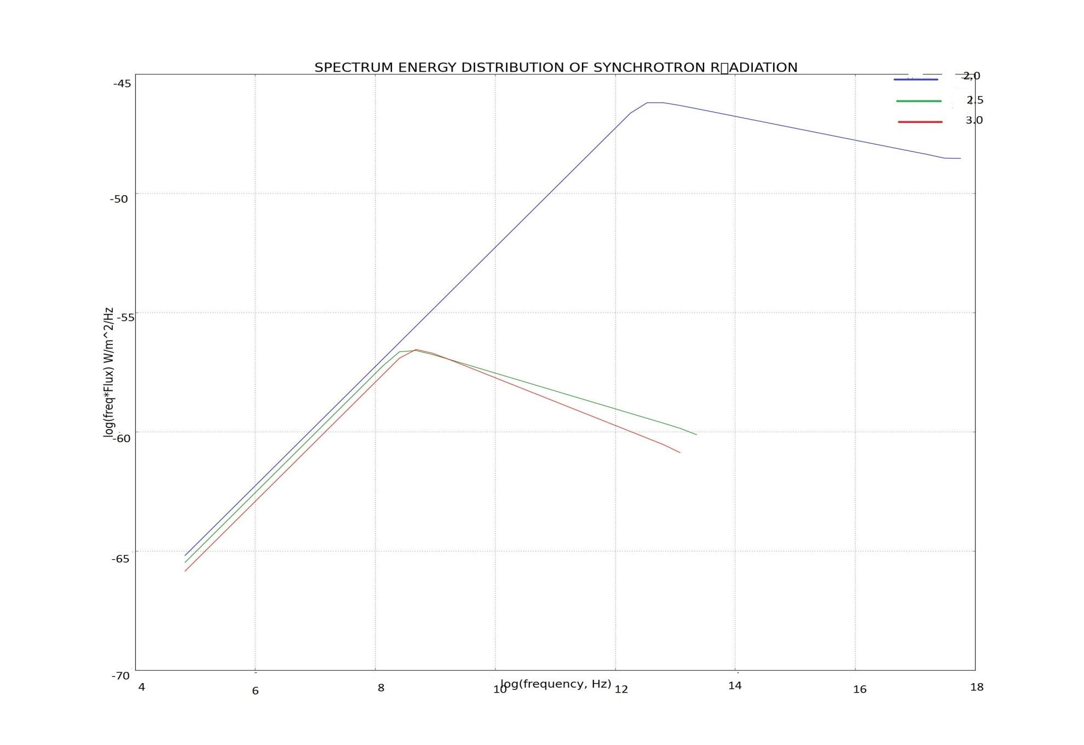
Results- various Energy index values

Slide 9
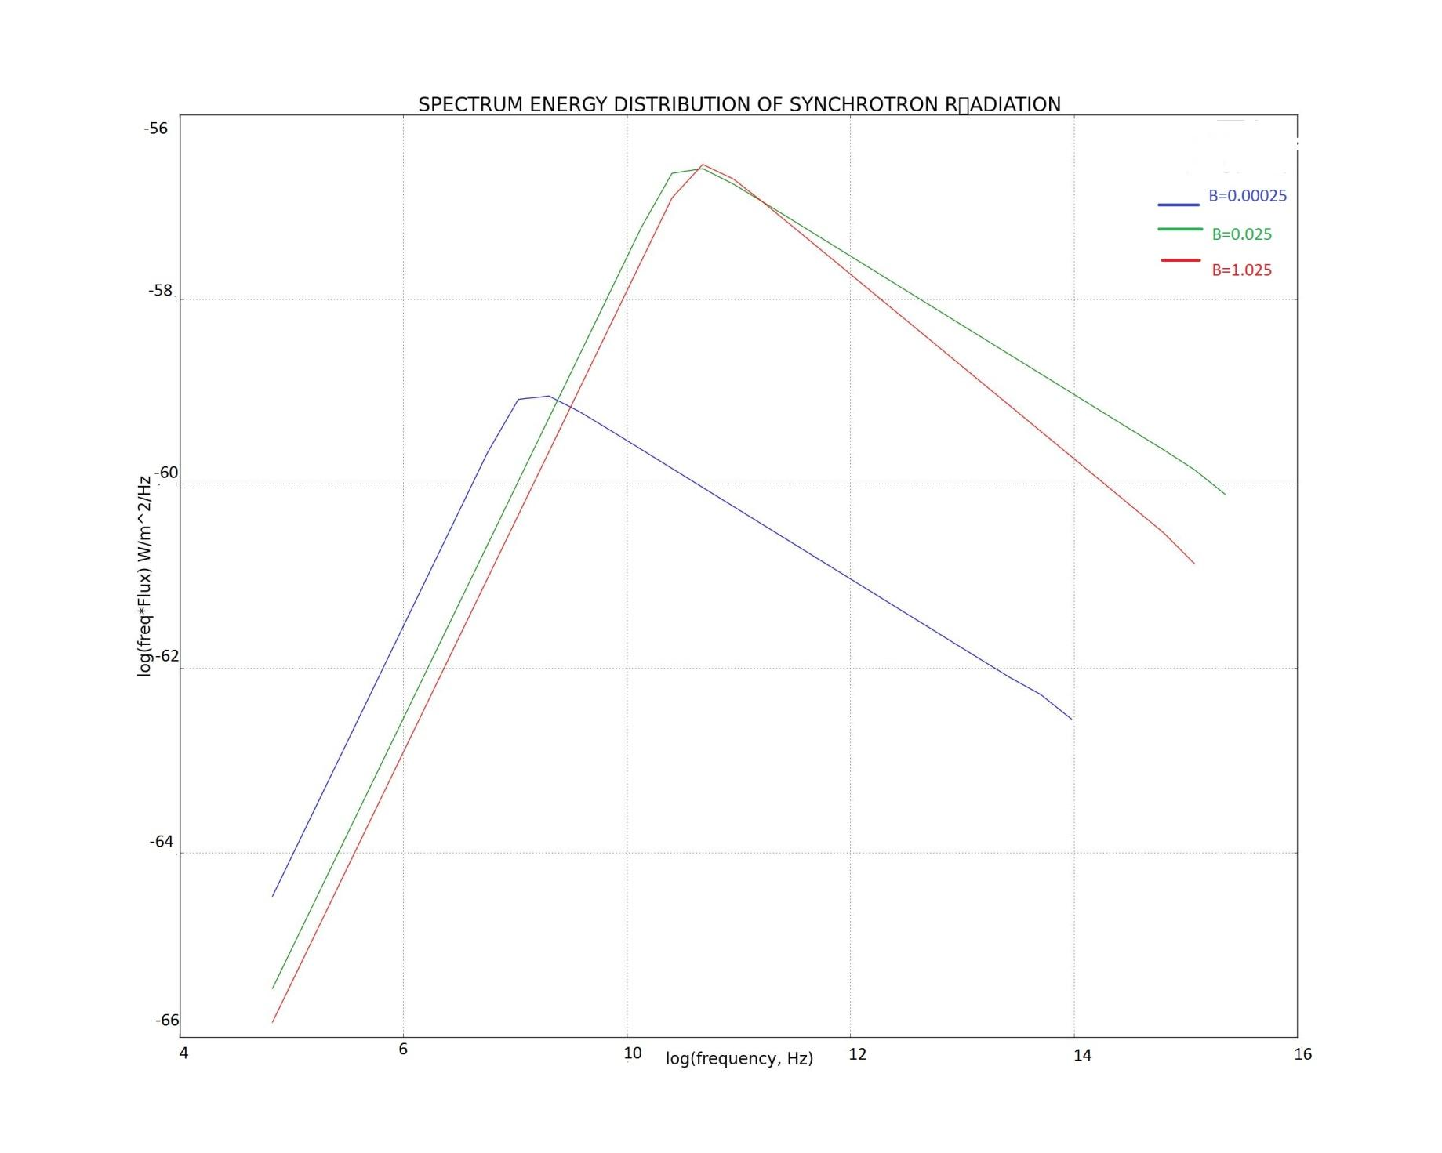
Results – various B values

Slide 10

Relation to earth

Slide 11
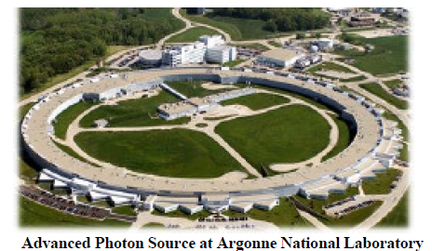
Synchrotron Facility
Size of a football field
Produce light with extreme brightness
Analyze biological samples with higher accuracy.

Slide 12
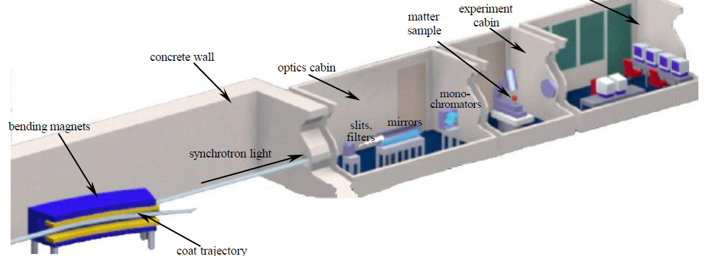
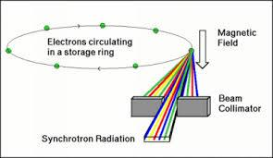
Relation to earthly application

Slide 13
Artificial Synchrotron radiation
Properties
Uses & Application
Emerging beams-Very fine
Intensity of light radiated is very high and bright
It is broadband
Material science(cosmetics)
Medicine
Chemistry (chemical reactions & compounds)
Earth science(process forming the earth, concentration of metals, minerals etc. In crust)

Slide 14
Conclusion
By understanding the Physics of the process, we can apply it in various fields : medicine, cosmetics, material science.
Change in p & B values, will have an effect on the critical frequency.
Lower the P value the higher the critical frequency.
The higher the magnetic field the higher the critical frequency.

Slide 15


Questions ? & Comments

