Slide 1
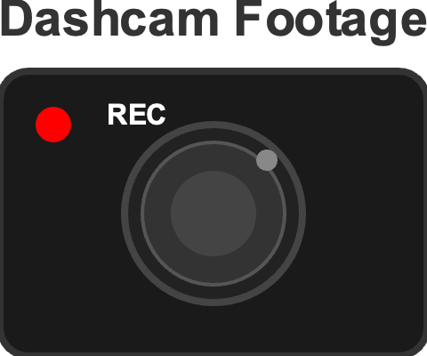




Slide 2


Base Optimizer
Model
(Mesa Optimizer)
Base Objective
Optimizes
Mesa Objective
Acts
Outer Alignment
Minimize binary classification loss: correctly predict hazard/no-hazard at each timestamp t
Big objects = hazardous
Things in center=important
Fast movement = danger
Inner Alignment

Slide 4
Minimize binary classification loss: correctly predict hazard/no-hazard at each timestamp t

