Slide 1
LOAN APPLICATION ANALYSIS
What Decides
Who Gets Approved?
A review of 614 loan applications
Prepared for the loan management team
Notes:
Opening line: we looked at 614 real applications to find out what actually decides approval. The answer turned out to be one single thing.

Slide 2
1
The Goal
What we set out to answer
“Which applicant details actually decide whether a loan is approved — and which ones only look like they do?”
1
Find what really matters
Separate the details that genuinely move the decision from the ones we only assume matter.
2
Check the data is trustworthy
Confirm the numbers are complete and no application was counted twice before drawing conclusions.
3
Measure it, don't guess it
Put an actual number on how much each detail affects approval, instead of relying on instinct.
4
Turn it into policy
Give the loan team something they can act on immediately.
SUMMARY
We wanted one clear answer: what separates an approved application from a rejected one? Everything that follows builds to that.
Notes:
Keep this short. The goal is to find the real driver of approval and turn it into policy. Four objectives, the last one is the one that matters to this room.

Slide 3
2
The Insights
Four findings — the headlines before the detail
1
Credit history decides almost everything
2
Income does not decide approval
Applicants with a clean credit record are approved 79.6% of the time. Without one, just 7.9%. That is 10 times more likely — no other detail comes close.
Approved and rejected applicants earn practically the same (3,812 vs 3,833). Income decides how much is lent, not whether it is lent at all.
3
Location makes a small difference
4
Our 'average' applicant does not exist
Semiurban applicants are approved most often (76.8%), rural least (61.5%). Real, but far too small to build a rule around.
A few very high earners pull the average income to 5,403, while the typical applicant earns 3,812 — a 41% overstatement.
SUMMARY
One detail decides approval: credit history. Income, education and location are far weaker than most people assume.
Notes:
This is the whole deck on one slide. If they only remember one thing, it is finding number 1. Findings 2 and 4 are the counter-intuitive ones worth pausing on.

Slide 4
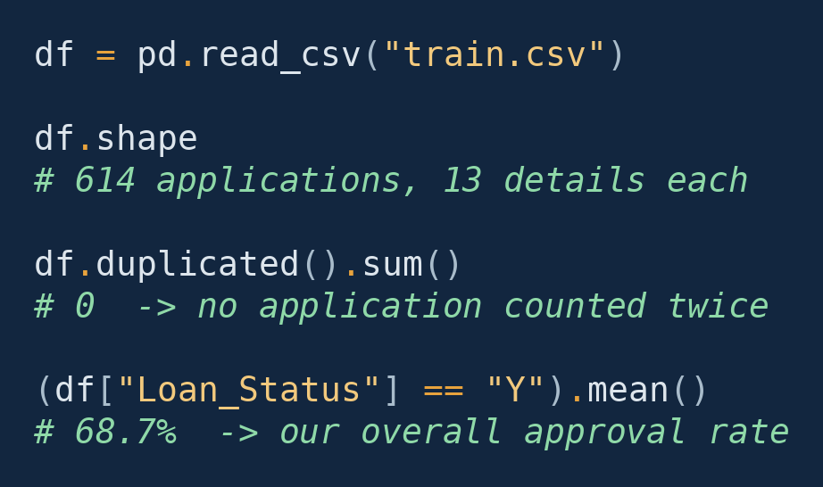
3
The Data
What we looked at
THE CODE
614
13
Applications reviewed
Details per application
0
68.7%
Counted twice
Were approved
68.7% is our benchmark. Any group approved near that rate tells us nothing new. Only groups far above or far below it are real findings.
Every figure in this deck comes from one file of 614 completed loan applications, each with 13 recorded details — income, credit history, property area, marital status and so on — plus the final decision.
SUMMARY
614 clean applications, none duplicated, and roughly 7 in every 10 were approved. That 68.7% is the yardstick for everything that follows.
Notes:
614 applications, no duplicates. The key number to hold onto is 68.7% - the baseline. Every later percentage gets compared against it.

Slide 5
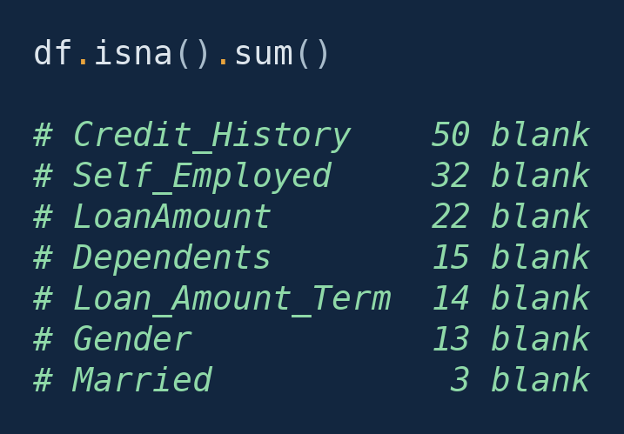
4
Cleaning the Data
The gaps we found, and what we did about them
THE CODE
Detail | Blank | Share | Does it matter?
Credit history | 50 | 8.1% | Yes — this is the detail that decides approval
Self employed | 32 | 5.2% | Minor
Loan amount | 22 | 3.6% | Minor
Dependents | 15 | 2.4% | Minor
Loan term | 14 | 2.3% | Minor
Gender | 13 | 2.1% | Minor
Married | 3 | 0.5% | No
What we did: we never guessed a missing value. Where a detail was blank, that application was simply left out of that particular comparison — so every number here comes from real records only.
SUMMARY
Nothing was invented to fill a gap. The one real concern: the detail that matters most — credit history — is also the one most often left blank, on 1 in every 12 files.
Notes:
The headline here is the irony: credit history is both the most important field and the most incomplete one. That is an intake problem, and it is fixable.

Slide 6
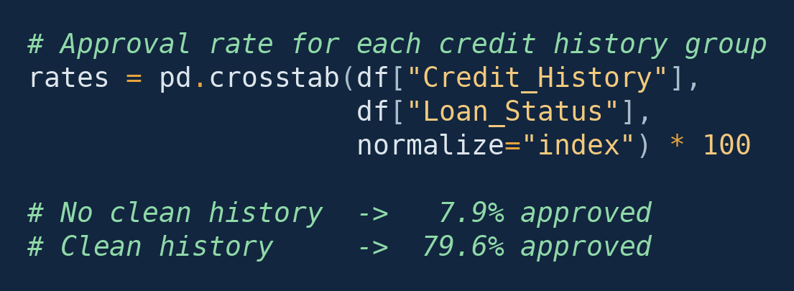
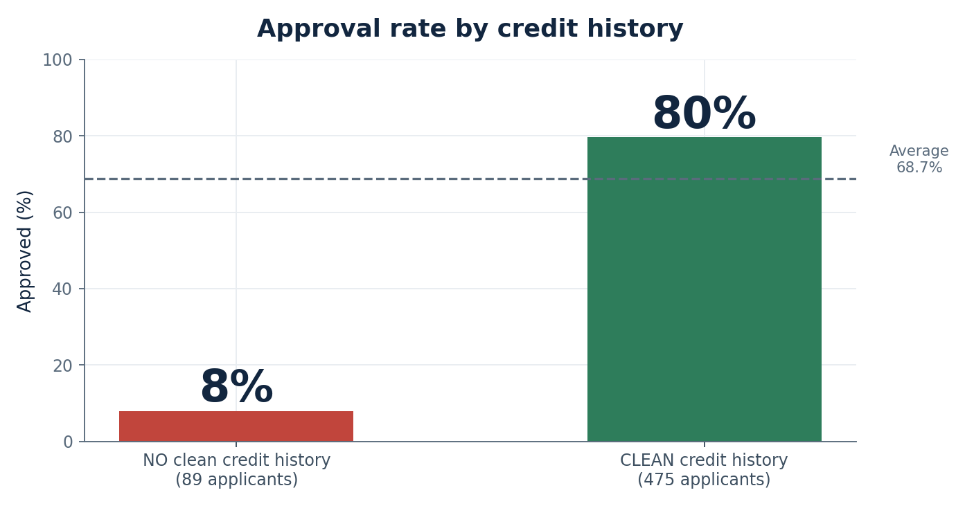
5
Insight 1 — Credit History Decides
Explaining the biggest finding
THE CODE
WHAT THE CODE PRODUCED
79.6%
7.9%
Approved WITH clean history
Approved WITHOUT one
Credit history is a simple yes/no record of whether an applicant has met their past repayment commitments. It is the single strongest signal in the entire dataset — stronger than income, education, location and marital status combined.
Only 7 of 89 applicants without a clean record were approved.
SUMMARY
An applicant with a clean credit record is 10 times more likely to be approved. This one detail explains more than everything else we measured put together.
Notes:
The headline. 79.6 versus 7.9 percent. Ten times. Only 7 of 89 people without a clean record got through. If they remember one slide, this is it.

Slide 7
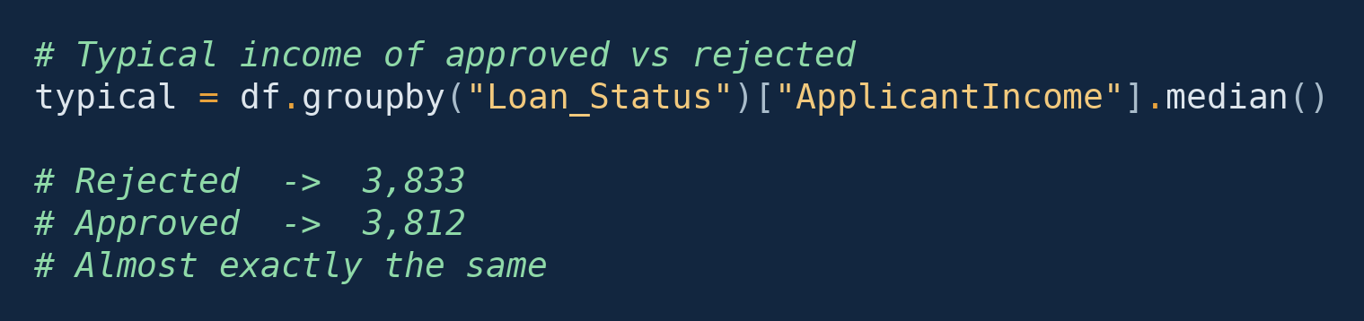
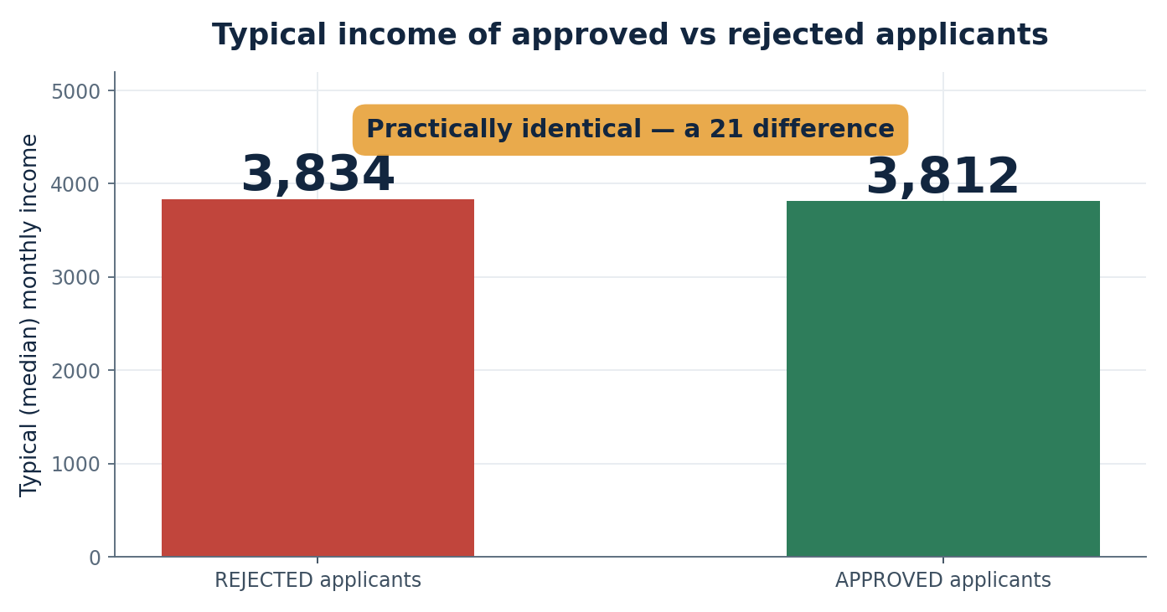
6
Insight 2 — Income Does Not Decide
The finding most people get wrong
THE CODE
WHAT THE CODE PRODUCED
Two different questions
How much do you get? Income answers this well — higher earners do request and receive larger loans.
But not this one
Do you get it at all? Income answers this badly. Rejected applicants actually earn slightly more than approved ones.
If income decided approval, the green bar would tower over the red one. It does not — the two are within 21 of each other. A wealthy applicant with no credit record is still rejected.
SUMMARY
Earning more gets you a bigger loan, not a better chance of approval. Income should size the offer — it should never screen the applicant.
Notes:
This is the counter-intuitive one. Rejected applicants earn 3,833; approved earn 3,812. Rejected applicants earn MORE. Income tells you how much to lend, not whether to lend.

Slide 8
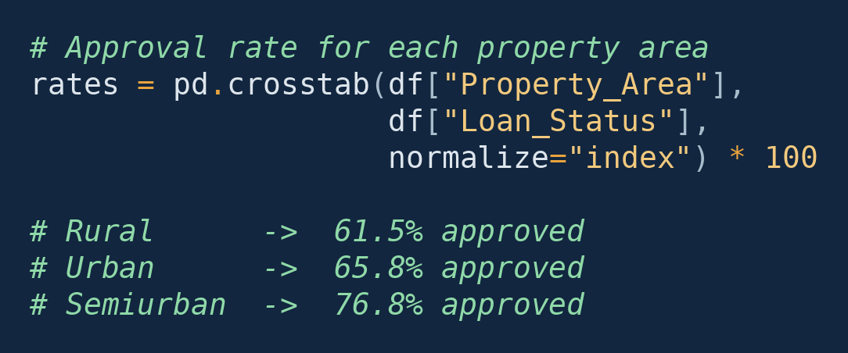
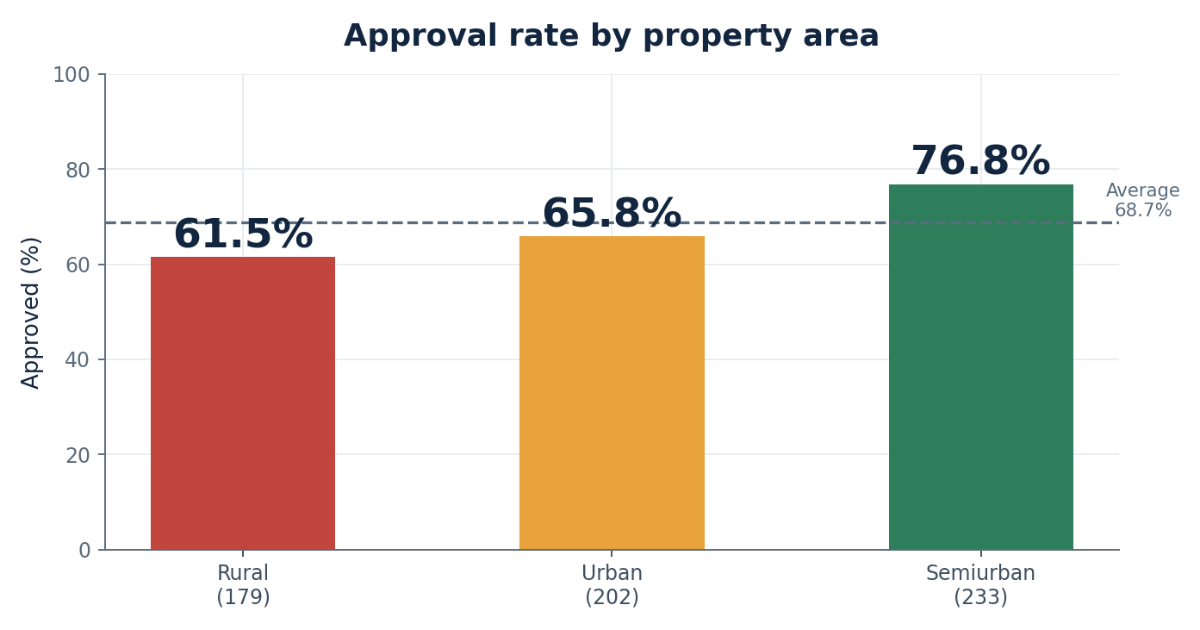
7
Insight 3 — Location Nudges, It Doesn’t Decide
A real difference, but a small one
THE CODE
WHAT THE CODE PRODUCED
Small ≠ nothing
A 15-point spread between semiurban and rural applicants is genuine, not chance. But next to credit history it is a whisper against a shout. Worth watching; not worth writing into a rule until we understand why.
All three areas sit reasonably close to our 68.7% benchmark. Semiurban applicants edge above it, rural applicants fall below — but every area still has a solid majority approved.
SUMMARY
Semiurban applicants do best and rural applicants worst, but the gap is modest. Location is worth monitoring — it is not worth a policy change.
Notes:
Real but small. 76.8 versus 61.5. Everything is still near the 68.7 benchmark. Do not let anyone leave here thinking we should treat rural applicants differently - we do not know the cause yet.

Slide 9
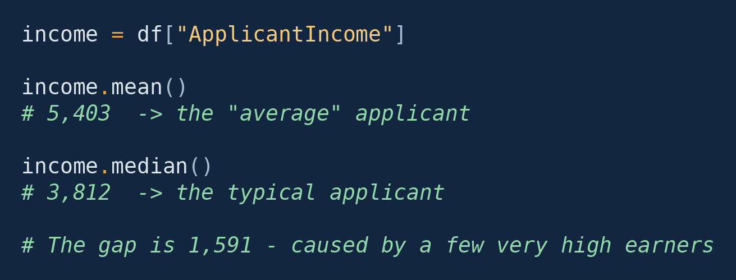
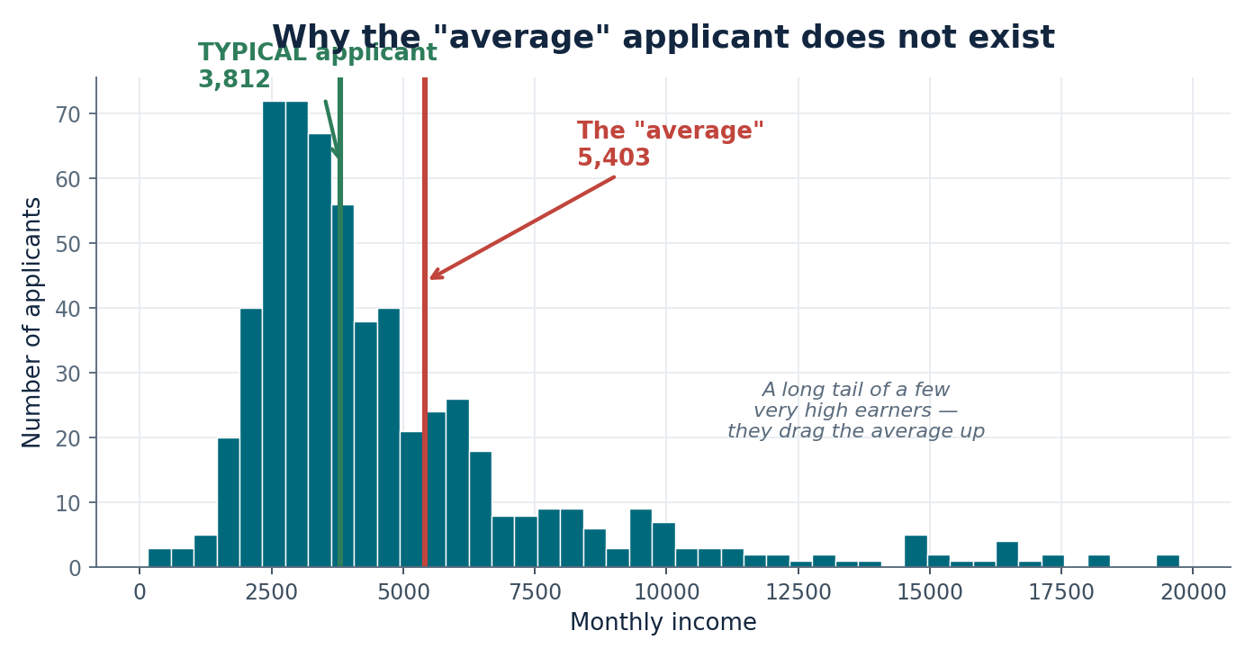
8
Insight 4 — The “Average” Applicant Doesn’t Exist
Why we report the typical figure, not the average
THE CODE
WHAT THE CODE PRODUCED
5,403
3,812
The “average” income
The typical income
Most applicants are bunched on the left. The long tail stretching right is a small number of very high earners — and they are enough to drag the average away from almost everybody.
The average overstates our typical applicant by 41%.
SUMMARY
A handful of very wealthy applicants pull the average up until it describes nobody. Set a threshold on the average and you calibrate it to an applicant who barely exists.
Notes:
Practical point: if you set an income cut-off using the average of 5,403, you have built policy around someone who does not exist. The typical applicant earns 3,812.

Slide 10
9
Summary
The three things worth remembering
1
Can we trust the data?
2
What surprised us?
3
What should we act on?
Yes.
Income barely matters.
Credit history.
614 completed applications, no duplicates, and no invented figures. Seven details had gaps — credit history was blank on 50 files (8.1%), self-employment on 32, loan amount on 22. Where a detail was missing we left that application out of that comparison rather than guessing. The findings rest on real records only.
Approved and rejected applicants earn almost exactly the same (3,812 vs 3,833). We also found the average income is misleading: a few very high earners lift it to 5,403, while the typical applicant earns 3,812. Every income figure in this review is therefore the typical figure, not the average.
It is by far the strongest signal we found. Applicants with a clean record are approved 79.6% of the time; those without, 7.9% — ten times more likely. Education and property area do make a small difference, but nowhere near enough to base a decision on.
SUMMARY
Of everything we measured — income, education, location, marital status, employment — only credit history meaningfully separates an approval from a rejection.
Notes:
Read this slide almost as written if the room is non-technical. Three questions: can we trust it, what surprised us, what do we do. Then move to recommendations.

Slide 11
10
Recommendations
In priority order
Fast-track clean credit records
They are approved 79.6% of the time anyway. Route them to a quick lane and free your reviewers for the applications that actually need judgement.
1
DO THIS FIRST
Make credit history mandatory at intake
It is blank on 50 files — the one detail that decides the outcome, missing on 1 in 12 applications. Fix the form before automating anything.
2
DO THIS FIRST
Stop screening on income
Rejected applicants earn slightly more than approved ones. Use income to size the loan, never to filter the applicant.
3
CHANGE OF PRACTICE
Report typical figures, not averages
The average income overstates our typical applicant by 41%. Any threshold set on it is aimed at someone who does not exist.
4
CHANGE OF PRACTICE
Watch the rural gap — don’t act on it yet
Rural applicants are approved 61.5% against 76.8% semiurban. Real, but small. Understand the cause before making it a rule.
5
MONITOR
Based on 614 loan applications · train.csv
Notes:
Close on the top two - they are the only ones that change anything this quarter. If asked what to do first: make credit history mandatory at intake, then fast-track the clean ones.

