Slide 1
Judge Frog
Senior Capstone Project 2014-2015
TCU Computer Science
Brice Boula
Collin Duncan
David Tomlinson
Landon Westrom

Slide 2

Clients
Vanessa Bouché, Ph.D.
TCU Department of Political Science
Michael Bachmann, Ph.D.
TCU Department of Criminal Justice
National Institute of Justice

Slide 3
Background
Clients proposed application to NIJ for grant which required a database for storage and retrieval of information pertaining to human trafficking cases.

Slide 4
Overview
The database is structured according to client specification, designed using the Extended Entity Relationship model, and developed in MySQL 5.
An CakePHP Web application which interfaces with the database and allows users to search, analyze, and maintain it

Slide 5
Technologies Used
Database
MySQL 5
MySQL Workbench 6.2
phpMyAdmin 4
Web Application
CakePHP 2.6.1
Microsoft IIS
GitHub

Slide 6
Goals For Break
Learn Unit Testing Methodologies
ASP.NET
Graphing Libraries
Test Upload Controller

Slide 7
Iteration 1
December 15, 2014
Complete Project Database
Upload to database via prototype
Website Skeleton Complete
Complete Documents
Begin Unit test development

Slide 8
Iteration 2
February 8, 2015
Web application completed (including database update mechanism)
Web application unit tests complete
Web application integration test development has begun
Website design finalized
First round of analytics prototyped along with beginning unit tests

Slide 9
Iteration 3
March 8, 2015
Second round of analytics prototyped along with beginning unit tests
First round of analytics finalized along with integration tests

Slide 10
Iteration 4
April 8, 2015
Second round completed along with integration tests
Finish unit/integration/end-to-end tests and complete testing

Slide 11
Problems Encountered
Difficulties With New Technology
.NET Framework
GitHub
Host Verification
Miscommunication
Scheduling

Slide 12
Use Cases

Slide 13
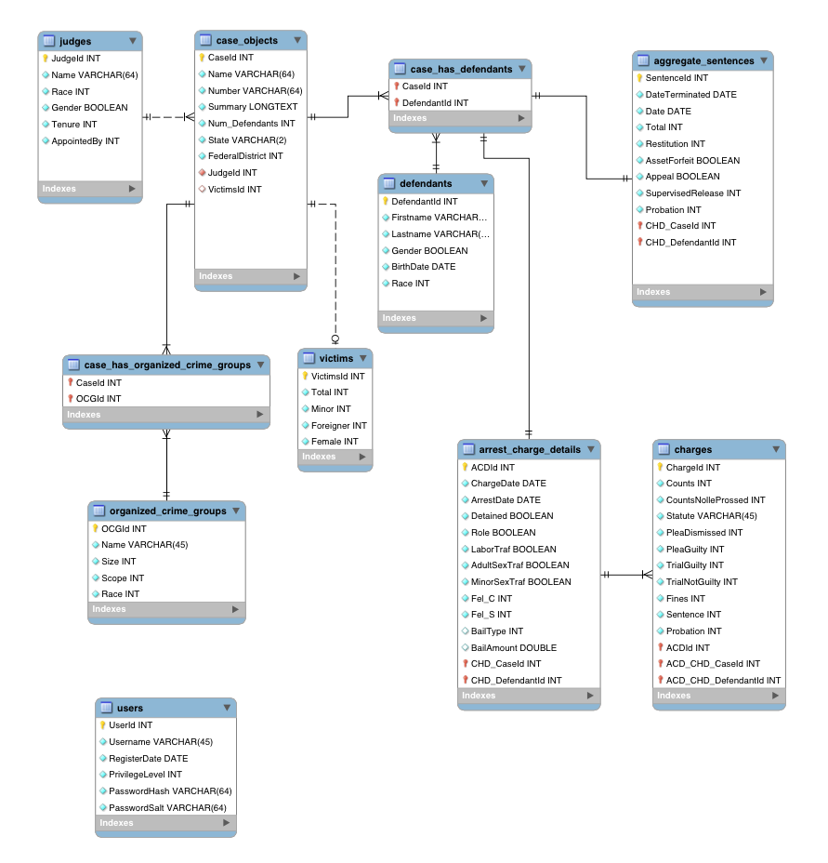
Database Design

Slide 14
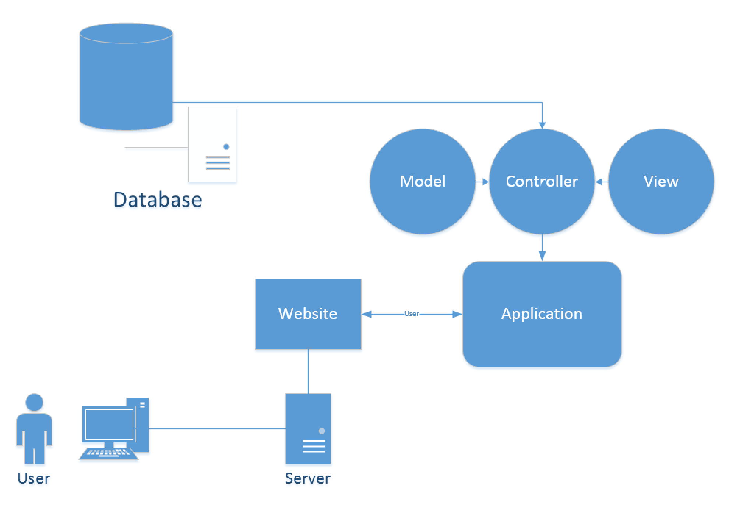
System Architecture

Slide 15
DEMO

