Slide 1


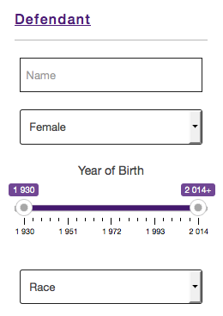

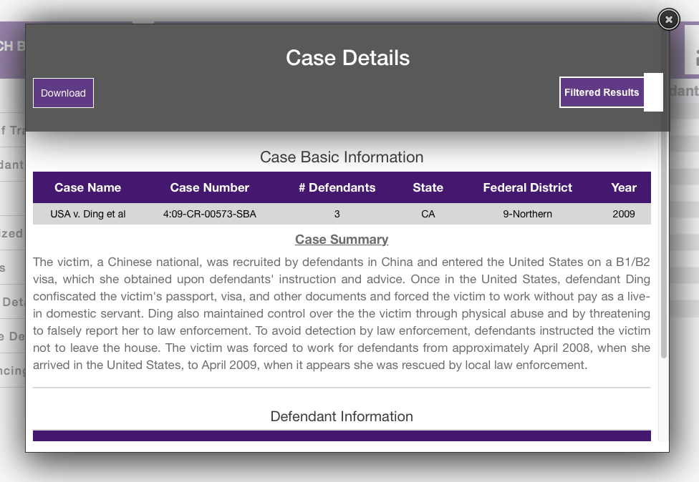
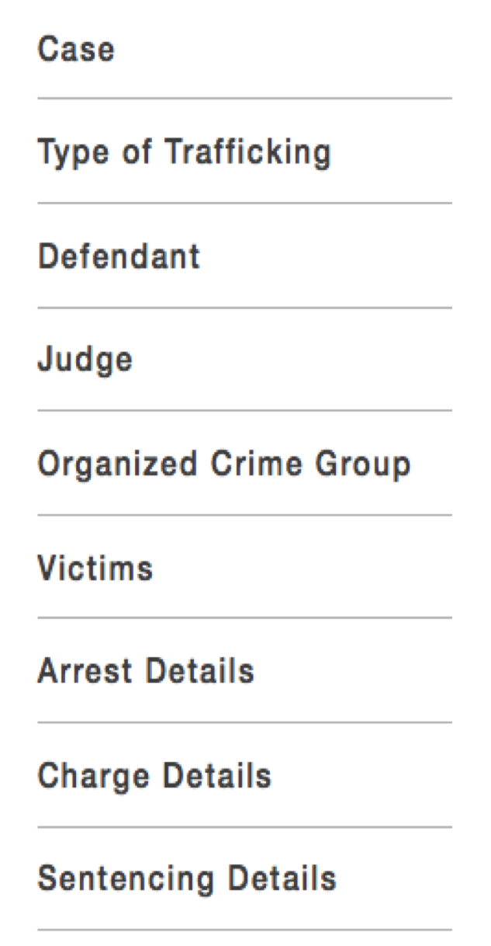
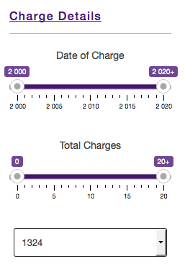
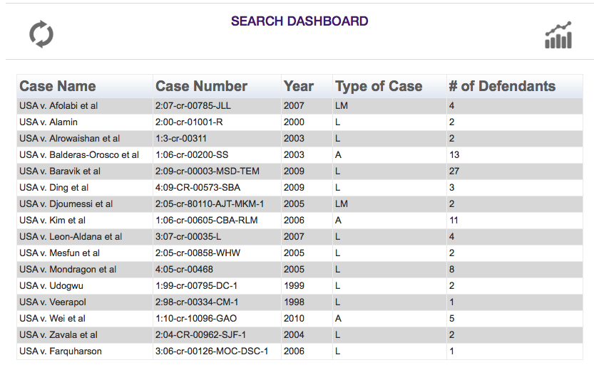
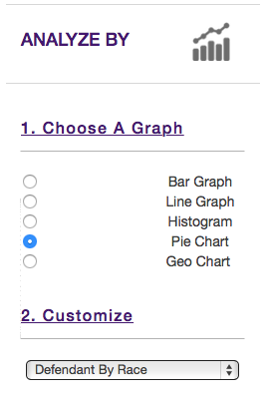
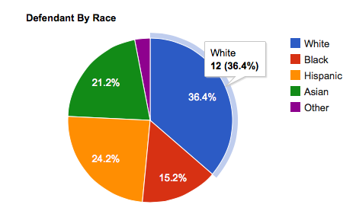
Judge Frog:
Comprehensive Human Trafficking Data Search and Analysis
Brice Boula, Collin Duncan, David Tomlinson, Landon Westrom
Advisors: Dr. Vanessa Bouché, Dr. Donnell Payne
Problem
The issue of human trafficking has sparked interest from the government, academicians, non-government organization, and the private sector
With today’s available resources on human trafficking there are no resources to examine:
  How interconnected is organized crime with human trafficking in the United States
  What types of organized crime groups engage in human trafficking
  The possibility to prevent individuals from engaging in organized crime, and specifically human trafficking
The web application provides the user the ability to search using 47 case variables, e.g.; “female” defendant that is charged with statute “1324”
Search Panel
Allows user to search the database for thousands of cases
Search by 47 different case specific variables
Step
1
Step
3
The user can select any of the 13 cases to review all details or filtered details based on the search criteria inserted. The modal window will display various case details based on the case selected.
Background
Clients proposed application to NIJ for grant
This proposal require a database pertaining to human trafficking cases An interface to the database to access the data
Analyze Panel
Provides multiple graphing options
Allows user to visualize specified data from all or selected cases
Admin Panel
User management
  Two user levels: admin, RA’s
Case entry by batch upload or single case insert
Administrator review of RA’s case data entry
Case revision
Overview
The database is designed using the Extended Entity Relationship model and developed in MySQL 5.
CakePHP Web application which interfaces with the database and allows users to search, analyze, and maintain the database.
Solution
Our project addresses the issues stated in the problem by:
Creating a comprehensive database to store information on federal human trafficking cases
Developing tools for administrators to maintain the database
Developing tools for administrators to maintain users
Providing a robust search function allowing users to query and filter the database
Displaying dynamically generated graphs which provides analyses to be performed on these cases
Step
2
Step
4
Results & Conclusion
Successfully developed a highly efficient tool to search thousands of cases
Designed a comprehensive application for client’s requirements
Experienced real world interactions with clients and working with clients’ requirements
Acknowledgments
The Judge Frog team would like to thank Dr. Vanessa Bouche for taking her time in assisting the project.
We would also like to give a special thanks to Dr. Payne for her incredible patience and guidance.
The user is given 13 cases that involve a “Female” defendant charged with statute “1324”
Once the user has reviewed the desired cases, they will have the option of analyzing the cases received from the search results.
Database Structure
Comprehensive database developed with MySQL
Stores case information consisting of judge, federal district location, defendant, and victims information
Each defendant contains information regarding their arrest, charges, sentencing and organized crime involvement
Database contains multiple tables allowing assistants to insert cases and receive administrator approval before appending new information to the working dataset
Acknowledgments
This project was developed in support of grant NIJ-2013-3457 from the National Institute of Justice to TCU faculty members Dr. Bouche and Dr. Bachmann in order to study organized crime's involvement in human trafficking in the United States. We would like to especially thank Vanessa Bouché for her time spent defining the project requirements and providing the human trafficking data used in the project. We would also like to give a special thanks to Dr. Payne for her incredible patience and guidance throughout the span of the project.
References
Albanese, Jay S., et al. Organized crime in America. Anderson Publishing Company, 1996.
CakePHP Cookbook – http://book.cakephp.org/2.0/en/index.html
Gozdziak, Elzbieta M., and Elizabeth A. Collett. "Research on human trafficking in North America: A review of literature.” International Migration 43.1‐2 (2005): 99-128.
MySQL Developer Zone – http://dev.mysql.com/
National Institute of Justice – http://www.nij.gov/topics/crime/human-trafficking/pages/welcome.aspx
Richard, Amy O. International trafficking in women to the United States: A contemporary manifestation of slavery and organized crime. BUREAU OF INTELLIGENCE AND RESEARCH (STATE) WASHINGTON DC, 1999.
Web Application
Provides a user friendly web interface for the user to search thousands of human trafficking cases
Interfaces with MySQL database to search, analyze, and maintain it
Will provide public access at no cost

