Slide 1
JUDGE FROG
COMPREHENSIVE HUMAN TRAFFICKING DATA
SEARCH AND ANALYSIS
Brice Boula, Collin Duncan,
David Tomlinson, Landon Westrom
TCU Computer Science
Capstone Project 2014-2015
North Texas Area Student Conference
Notes:
- Mention Senior Design Capstone project in presentation

Slide 2
Human Trafficking Facts
600 to 800 thousand people across international borders
80% female
50% children
Gross violation of human rights
One of the most profitable criminal activities worldwide
A need for studies to understand and address problem
Notes:
Landon

Slide 3
Origin of Judge Frog
NIJ grant awarded to TCU professors
Goals of grant
Publicly available centralized database of HT data
Support study for government, NGOs, researchers, etc.
Others…
Professors approached TCU CS of summer 2014
Student project possibilities
Selected from 1 of 3 senior capstone projects
Notes:
Landon
That could lead to three answers to this problem.
1. How interconnected are these Organized crime groups involved in these crimes
2. What types of Organized crime groups take part in human trafficking
3. What is the possibility to prevent human trafficking

Slide 4
Topics
Judge Frog Project Requirements
System Overview
Database Structure
Technologies Used
Web Application
Demo
Results
Notes:
Landon

Slide 5





System Overview
Client
Search
Analyze
Admins
Data
Notes:
Brice

Slide 6
Database
Developed using MySQL5
MySQL Workbench
Stores denormalized case information
Conforms to client standard
Notes:
Collin

Slide 7
Database
Case
Judge
Defendant
Victims
Organized crime
Personal
Arrest, charge, sentencing
Notes:
Collin

Slide 8
Why MySQL?
Scalability, flexibility, and performance
Availability from web hosting providers
MySQL Workbench
Notes:
Collin

Slide 9
Web Application
Developed using:
PHP
CakePHP Framework
Javascript + JQuery
Google Charts
Bootstrap
Comprised of three sections
Notes:
Brice

Slide 10

Why PHP/CakePHP?
PHP
Popular
Flexible
MySQL
Available for Windows and *nix
CakePHP
MVC framework
Simple configuration
Built-in securities
Notes:
Brice

Slide 11
Web Application
Admin Panel
Search
Analyze
maintains
refines
visualizes
Notes:
Brice
- Here are the basic functions

Slide 12
Admin Panel
Maintain database and users
Two classes of users:
Admin: full permissions
Research Assistant (RA): insert/edit permissions
Case insertion
Single-case
Batch upload (admin only)
Case review
Administrators verify inserted/updated data
Notes:
David

Slide 13
Search
47 variables in 9 categories
Displays results of search in table
Each row displays modal with more details
Modal contains visible filtering function
Displays most relevant data first
Option to display all data
Notes:
David

Slide 14
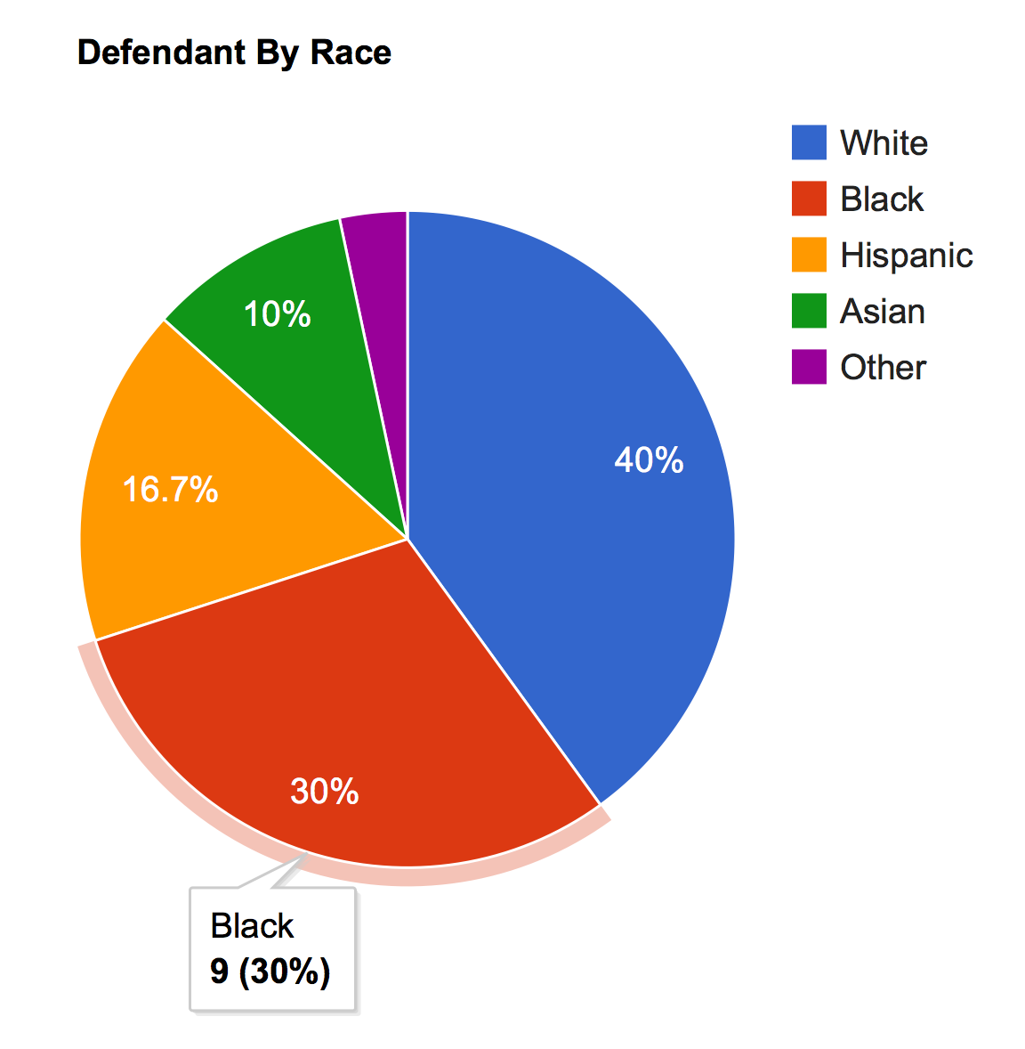
Analyze
Visualize data received from Search
5 types of graphs
Line
Bar
Histogram
Pie
Geographic
Multiple independent and dependent options
Notes:
David

Slide 15
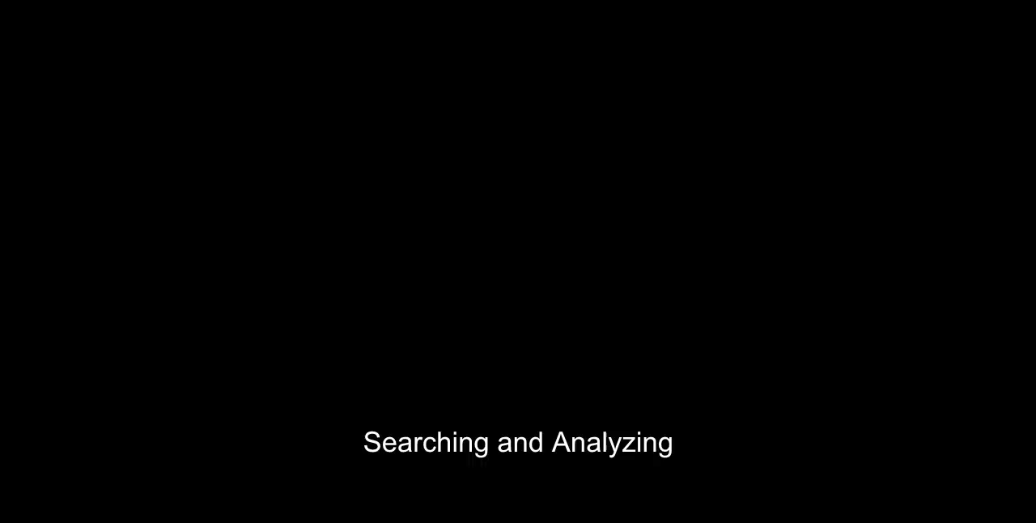
Demo
Notes:
collin

Slide 16
Results
Developed resource for gathering information on human trafficking
Provided clients with ability to maintain dataset
Experienced working on high-profile project
Understood how effective communication aids overall progress
Notes:
Landon

Slide 17
Questions

