Slide 1



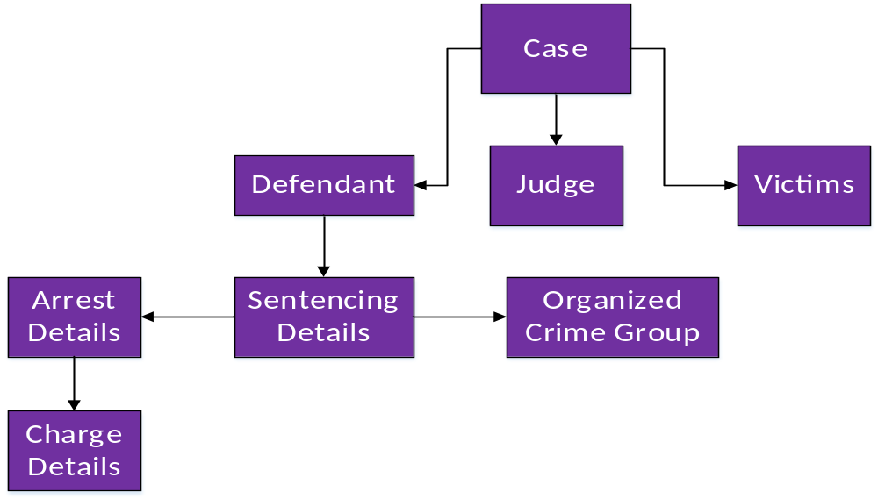
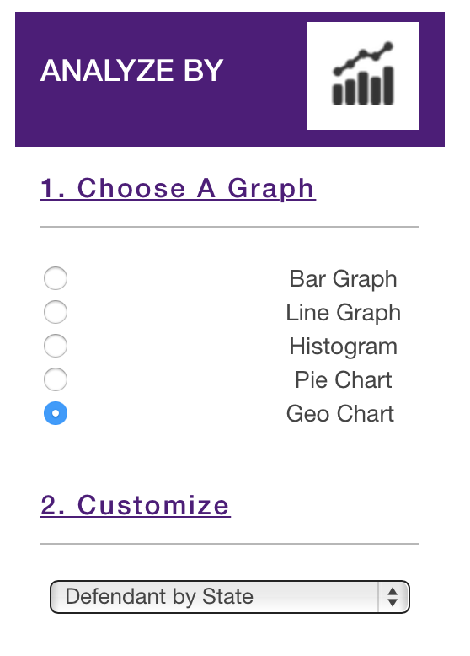
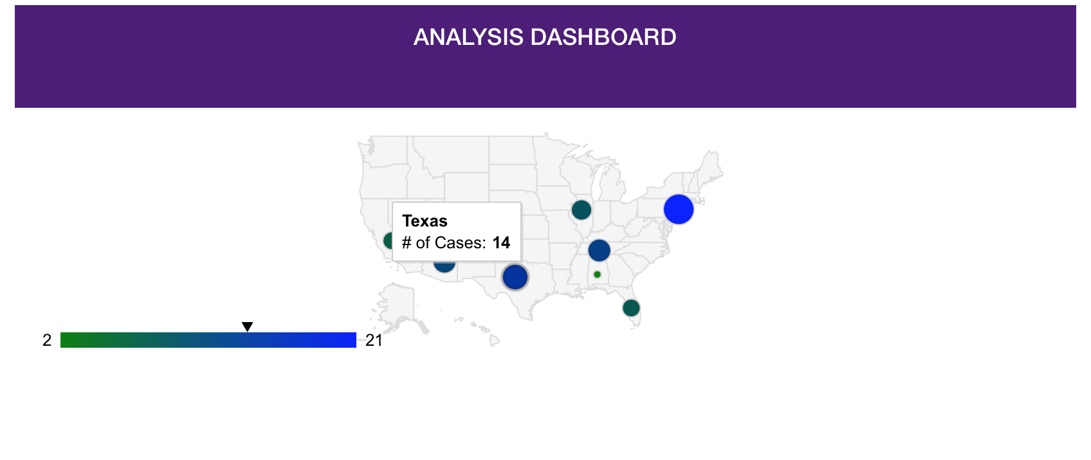
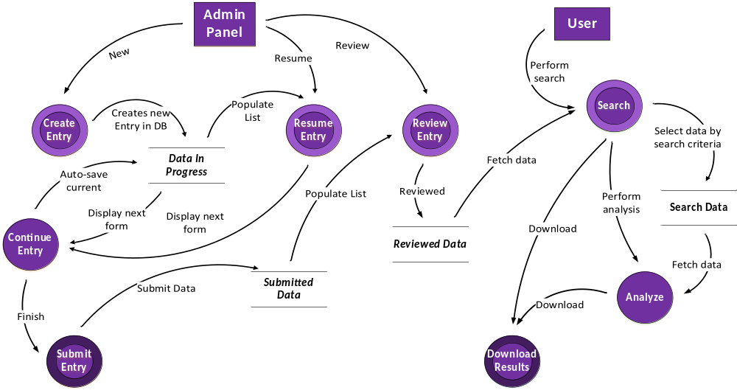
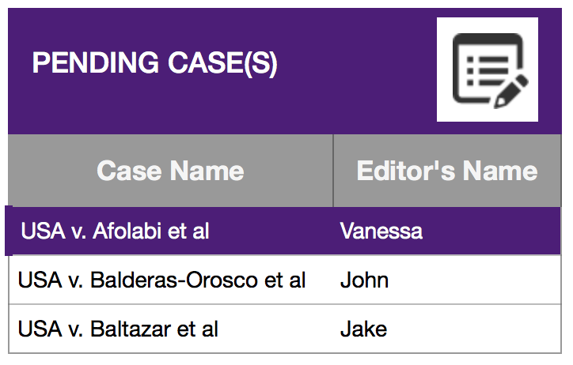
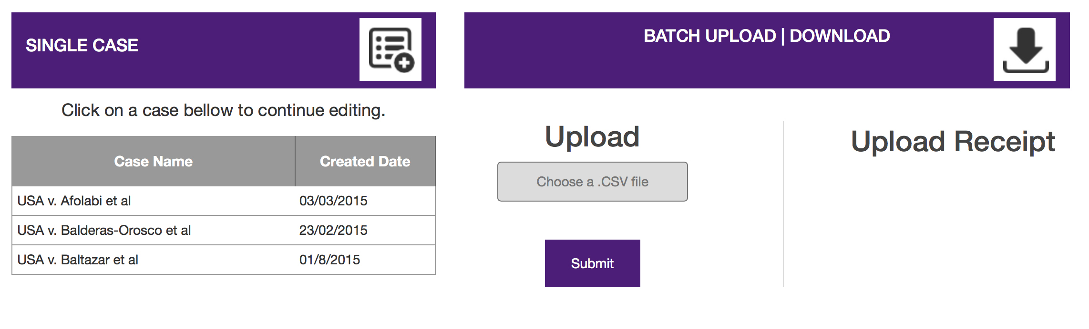
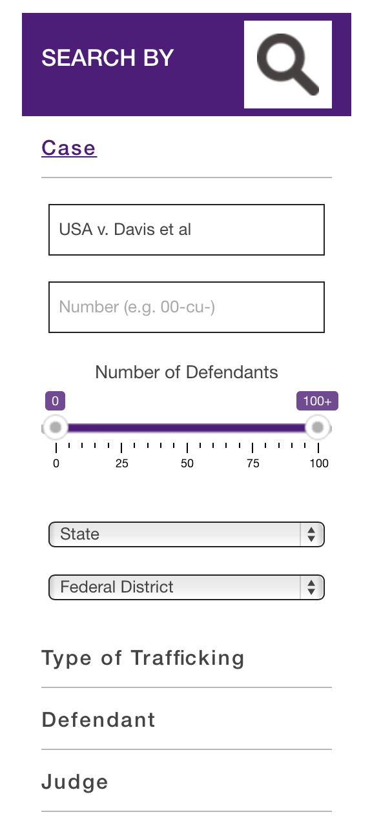
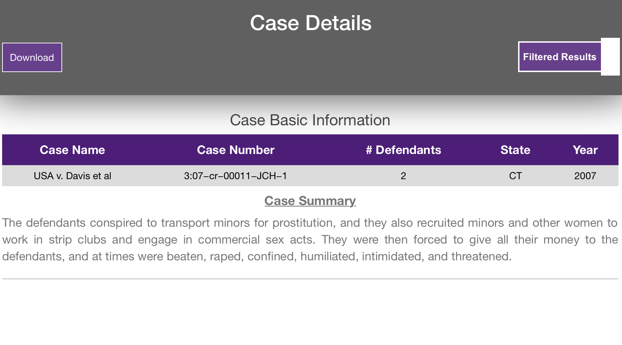
Judge Frog:
Comprehensive Human Trafficking Data Search and Analysis
Brice Boula, Collin Duncan, David Tomlinson, Landon Westrom
Advisors: Dr. Vanessa Bouche, Dr. Donnell Payne
Human Trafficking Facts
There are approximately 20 to 30 million slaves in the world today.
According to the U.S. State Department, 600,000 to 800,000 people are trafficked across international borders every year. More than 70% are female and half are children.
The United States is one of the top three destination points for trafficked victims. California, New York, Texas and Nevada are the top destination states within the country.
Human trafficking has been identified as the largest human rights violation in the history of mankind.
Database
The database is structured according to client specification, designed using the Extended Entity Relationship model, and developed in MySQL 5.
Analyze Panel
Allows user to visualize all or selected case data
Background
Clients proposed application to NIJ for grant
This proposal require a database pertaining to human trafficking cases An interface to the database to access the data
Overview
The database is designed using the Extended Entity Relationship model and developed in MySQL 5.
CakePHP Web application which interfaces with the database and allows users to search, analyze, and maintain the database.
Abstract
Every year, there are thousands of cases involving human trafficking in federal courts across the United States. Faculty in the Political Science and Criminal Justice departments at TCU have been awarded a grant from the National Institute of Justice (NIJ) in order to study the scope and scale of organized crime's involvement in human trafficking in the US. With case data scattered across different judicial districts and various databases, one stated goal of that study was the creation of a comprehensive human trafficking database searchable from the web.
The Judge Frog senior capstone project was created for that purpose. The Judge Frog project is composed of a MySQL database and a CakePHP MVC web application. The web application contains two major components: the administrator control panel which provides an interface for administrators to insert data, review data, and submit data to the database, and the search functionality which allows users to search through the reviewed data based on a robust querying system and download results. Analysis of the data is provided as well with dynamic graph generation. With the combination of nationwide human trafficking data and a comprehensive case searching interface, Judge Frog will help facilitate the study of human trafficking and its relation to organized crime.
Data Flow
Admin Panel
Two different users: administrator, RA’s
Case entry by mass upload or single case entry
Data revision
User management
Administrator review of RA’s user case creation.
Search Panel
Allows user to query the database for case information
Search by 47 different options
References
MySQL Developer Zone – http://dev.mysql.com/
CakePHP Cookbook – http://book.cakephp.org/2.0/en/index.html
National Institute of Justice – http://www.nij.gov/topics/crime/human-trafficking/pages/welcome.aspx
National Human Trafficking Resource Center – http://www.traffickingresourcecenter.org
Federal Bureau of Investigation – http://www.fbi.gov/about-us/investigate/organizedcrime
Web Application
Provide a user friendly web interface for the user to search thousands of human trafficking cases.
Interfaces with MySQL database to search, analyze, and maintain it.
Will provide public access at no cost.
Acknowledgments
The Judge Frog team would like to thank Dr. Vanessa Bouche for taking her time in assisting the project.
We would also like to give a special thanks to Dr. Payne for her incredible patience and guidance.

