Slide 1
JUDGE FROG
COMPREHENSIVE HUMAN TRAFFICKING DATA
SEARCH AND ANALYSIS
Brice Boula, Collin Duncan,
David Tomlinson, Landon Westrom
TCU Computer Science
Capstone Project 2014-2015
North Texas Area Student Conference
Notes:
- Mention Senior Design Capstone project in presentation

Slide 2

Clients
Vanessa Bouché, Ph.D.
TCU Department of Political Science
Funded by National Institute of Justice
Notes:
Landon

Slide 3
Topics
Background
Project overview
System overview
Database Structure
Web application
Results & conclusions
Notes:
Landon

Slide 4
Background
Human trafficking crimes are on the rise
Few unified resources containing case info
Vanessa Bouché, Ph.D.
TCU Department of Political Science
Funded by National Institute of Justice
Notes:
Landon

Slide 5
Project Overview
Client approached TCU Computer Science Department
Build a comprehensive database
Design a Web application to interface with database
Notes:
Landon
Database – Need a well structured database to store HT case data that was collected by the NIJ
Web Application – A well designed web application that interfaces with the database to provide
searching,
analyzing,
and maintenance to the database
That could lead to three answers to this problem.
1. How interconnected are these Organized crime groups involved in these crimes
2. What types of Organized crime groups take part in human trafficking
3. What is the possibility to prevent human trafficking

Slide 6
Overview
Main components:
Database
Web application
Search functionality
Analyze functionality
Administrator panel
Notes:
Landon

Slide 7
System Overview
Clients
Analyze
Search
Data
Admins
Notes:
Brice

Slide 8





System Overview
Client
Search
Analyze
Admins
Data
Notes:
Brice

Slide 9
Database
Developed using MySQL5
MySQL Workbench
Stores denormalized case information
Conforms to client standard
Notes:
Collin

Slide 10
Database
Case
Judge
Defendant
Victims
Organized crime
Personal
Arrest, charge, sentencing
Notes:
Collin

Slide 11
Why MySQL?
Scalability, flexibility, and performance
Availability from web hosting providers
MySQL Workbench
Notes:
Collin

Slide 12
Web Application
Developed using:
PHP
CakePHP Framework
Javascript + JQuery
Google Charts
Bootstrap
Comprised of three sections
Notes:
Brice

Slide 13
Web Application
Admin Panel
Search
Analyze
maintains
refines
visualizes
Notes:
Brice

Slide 14

Why PHP/CakePHP?
PHP
Popular
Flexible
MySQL
Available for Windows and *nix
CakePHP
MVC framework
Simple configuration
Built-in securities
Notes:
Brice

Slide 15
Admin Panel
Maintain database and users
Two classes of users:
Admin: full permissions
Research Assistant (RA): insert/edit permissions
Case insertion
Single-case
Batch upload (admin only)
Case review
Administrators verify inserted/updated data
Notes:
David

Slide 16
Search
47 variables in 9 categories
Displays results of search in table
Each row displays modal with more details
Modal contains visible filtering function
Displays most relevant data first
Option to display all data
Notes:
David

Slide 17
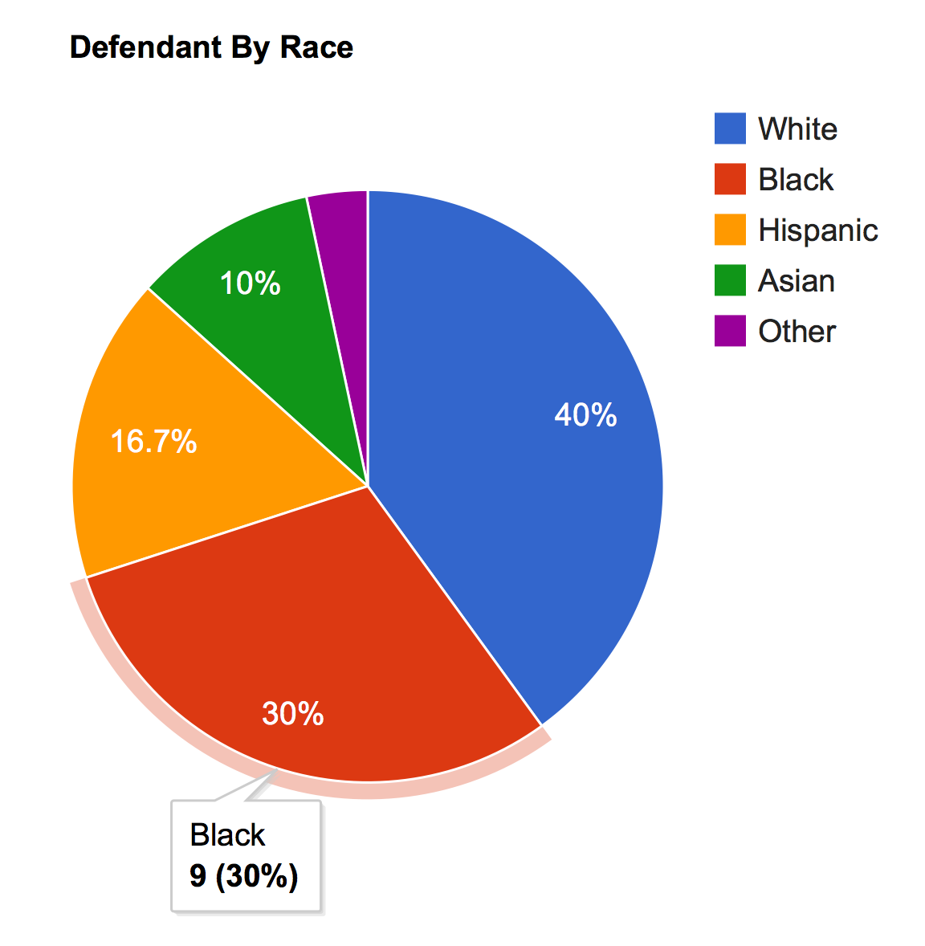
Analyze
Visualize data received from Search
5 types of graphs
Line
Bar
Histogram
Pie
Geographic
Multiple independent and dependent options
Notes:
David

Slide 18
Results
Developed resource for gathering information on human trafficking
Provided clients with ability to maintain dataset
Experienced working on high-profile project
Understood how effective communication aids overall progress
Notes:
Landon

Slide 19
Demo
Embed demo into slide
Notes:
Collin (searching) /
David (Analyzing)

Slide 20
Questions

