Slide 1

onyxwebsystems
SALES TRAINING
CREATE. CONNECT. CONVERT.
Salesperson
training
Who we are. What we build. How each module works.
How we price: 13% of the annual salary for that role, plus a monthly retainer sized to the project.
onyxwebsystems.co.za · confidential · september 2026

Slide 2
onyxwebsystems
SALES TRAINING
AGENDA
What you will leave knowing
01
Who we are
Founders, philosophy, how we think
02
What we sell
BOS, websites, applications
03
How we price
13% module fee + monthly retainer
04
The modules
What is inside each, how it works
05
How you sell
Discovery, language, checklist
onyxwebsystems · create. connect. convert.
02

Slide 3
onyxwebsystems
SALES TRAINING
01 · COMPANY
We’re building the systems
behind modern businesses.
Onyx Web Systems is a technology partner. We build Business Operating Systems, custom applications, and premium web experiences.
Businesses don’t need more tools. They need better systems.
FOUNDED
TAGLINE
HOURS
EMAIL
16 November 2025
CREATE. CONNECT. CONVERT.
Mon–Fri 09:00–17:00 SAST
onyxwebsystems@gmail.com
onyxwebsystems · create. connect. convert.
03

Slide 4

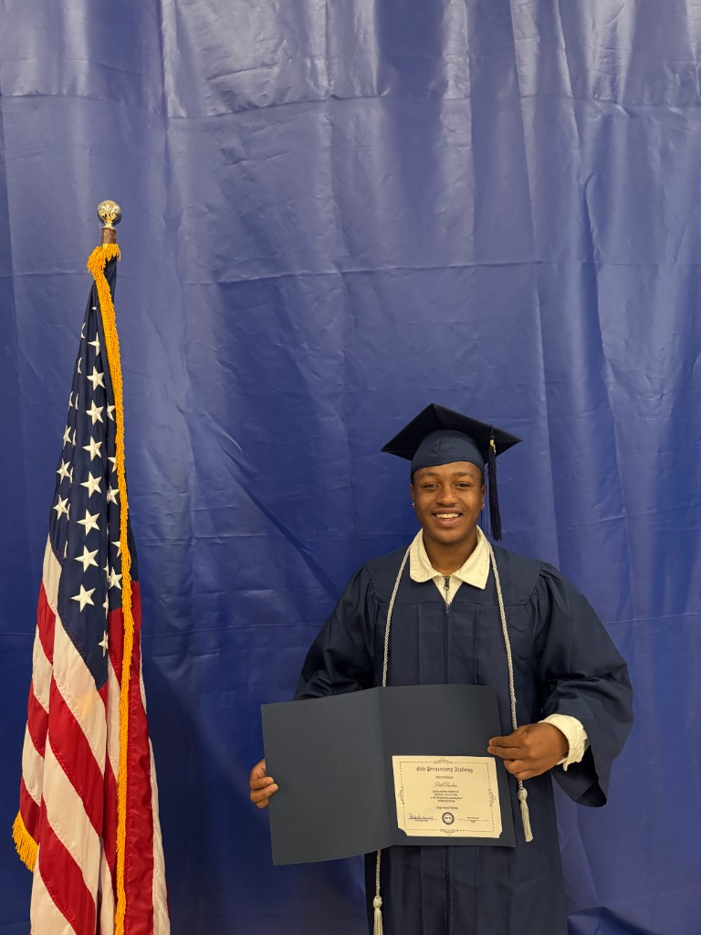
onyxwebsystems
SALES TRAINING
01 · COMPANY
Two brothers. One vision.
Sihle founded Onyx while studying Computer Science at Emeris. The company started with websites, then expanded into systems that connect operations, automate repetitive work, and help businesses grow.
Lihle joined to grow the business — relationships, client needs, partnerships.
“Don’t just build what a business needs today. Build what it needs to become tomorrow.”
Sihle Nathi Simelane
Lihle Simelane
Founder · builds the technology
Growth & Partnerships
onyxwebsystems · create. connect. convert.
04

Slide 5
onyxwebsystems
SALES TRAINING
01 · PHILOSOPHY
CREATE. CONNECT. CONVERT.
CREATE.
CONNECT.
CONVERT.
We build digital experiences, applications, and systems that solve real business problems.
We connect people, processes, data, and technology so the different parts of a business can work together.
We turn complexity into efficiency, opportunities into customers, and systems into growth.
The Onyx standard: Simple · Intelligent · Connected · Scalable · Human
Automation should empower people, not remove judgment where it matters.
onyxwebsystems · create. connect. convert.
05

Slide 6
onyxwebsystems
SALES TRAINING
01 · HOW WE THINK
We don’t start with technology.
We start with the business. If you cannot answer these, you are not ready to quote.
How do leads enter?
How are customers managed?
Where is time being wasted?
What tasks are repetitive?
Where are teams losing information?
What systems are disconnected?
What could be automated?
What could be improved?
onyxwebsystems · create. connect. convert.
06

Slide 7
onyxwebsystems
SALES TRAINING
02 · WHAT WE SELL
Three ways we work with you
01
Business Operating Systems
Connected modules that run sales, customers, finance, people, operations, and reporting as one system.
02
Websites
Premium sites that carry a brand and convert. Proof: Thrift Rotate and about.secnightlife.com.
03
Applications
Custom web and mobile software around how they actually operate. Proof: SEC Nightlife.
onyxwebsystems · create. connect. convert.
07

Slide 8
onyxwebsystems
SALES TRAINING
02 · WHAT WE SELL
Your job is not “sell a website.”
Find where people, time, and money are leaking. Sell the system that replaces that leak.
01
02
03
04
Discovery
Strategy
Architecture
Design
Understand the business
Identify opportunities
Map workflows and tech
Design the experience
05
06
07
08
Development
Testing
Launch
Optimization
Build the system
Test real workflows
Deploy
Keep improving
onyxwebsystems · create. connect. convert.
08

Slide 9
onyxwebsystems
03 · PRICING
Two numbers.
Never one.
A 13% module fee. Then a monthly retainer sized to the project.
onyxwebsystems · create. connect. convert.
09

Slide 10
onyxwebsystems
SALES TRAINING
03 · PRICING
Every BOS deal has two layers
LAYER 1
LAYER 2
Module fee
13%
Monthly
retainer
Price to put that function into the operating system.
13% of what that role would cost as an employee for one year.
Ongoing run, improve, support, keep it alive.
Calculated from how big the project is — not a flat fee, and not 13% again.
onyxwebsystems · create. connect. convert.
10

Slide 11
onyxwebsystems
SALES TRAINING
03 · THE 13% FEE
Price the module against the human.
1. Name the job the module is doing.
2. Get the annual salary for that seat.
3. Charge 13% of that annual amount.
Charge = annual salary of that role × 0.13
SALES MODULE
FINANCE MODULE
R240,000 × 0.13 = R31,200
R180,000 × 0.13 = R23,400
onyxwebsystems · create. connect. convert.
11

Slide 12
onyxwebsystems
SALES TRAINING
03 · THE 13% FEE
How to say it
“Instead of hiring another person to run this all year, we put that function in the system. The module fee is 13% of what that seat would cost you annually. Then there is a monthly retainer to keep it running, sized to the size of the build.”
SEVERAL MODULES
PUBLIC LINE
Calculate 13% per module, then add. A full OS is a stack, not a mystery lump sum.
Custom Solutions. Custom Pricing. Do not publish 13% on the website, ads, or social.
onyxwebsystems · create. connect. convert.
12

Slide 13
onyxwebsystems
SALES TRAINING
03 · MONTHLY RETAINER
Sized to how big the project is
The retainer is not 13% again. It is not the same for every client. Score size first — then the monthly follows.
Signal | Smaller | Bigger
Modules | One module | Several connected modules
Team | 1–10 people | 11–50 / 51–200 / 200+
Channels | One form | Phone, WhatsApp, IG, Facebook, email
Workflows | One simple path | Approvals, payments, multi-location
Custom | Standard module | Custom agents and specialised systems
onyxwebsystems · create. connect. convert.
13

Slide 14
onyxwebsystems
SALES TRAINING
03 · MONTHLY RETAINER
What the retainer pays for
Keeping the system live
Improving workflows as the business changes
Support when staff get stuck
Channel monitoring (WhatsApp, web, Instagram…)
Knowledge updates and small scope that is not a new module
Reporting the client actually uses
onyxwebsystems · create. connect. convert.
14

Slide 15
onyxwebsystems
SALES TRAINING
03 · MONTHLY RETAINER
Size bands — then confirm the number
SMALL
MID
LARGE
One module · small team · one channel
Two or three modules · 11–50 staff · WhatsApp + web
Full OS · many locations · many channels · custom
Lower monthly
Mid monthly
Highest monthly
Until leadership gives exact retainer bands, size the project correctly. Do not invent a rand amount on the call.
onyxwebsystems · create. connect. convert.
15

Slide 16
onyxwebsystems
SALES TRAINING
03 · PRICING
Websites and apps are different
BOS MODULES
WEB · APP
13% + retainer
Scope, then quote
Use the employee-salary method. One 13% per module. Retainer from project size.
Do not apply 13% of a designer’s salary to a brochure site unless leadership says so. Budget ranges on the site are signals, not published fees.
onyxwebsystems · create. connect. convert.
16

Slide 17
onyxwebsystems
SALES TRAINING
03 · GUARDRAILS
Never do this
Quote 13% and forget the retainer — or a retainer with no module fee
Use the same monthly for a one-module shop and a full operating system
Publish 13% or retainers on the website, ads, or social captions
Invent discounts, timelines, features, or website/app prices
Let the front desk or AI invent numbers
Quote before you know the job the module replaces
onyxwebsystems · create. connect. convert.
17

Slide 18
onyxwebsystems
04 · MODULES
One business.
One connected system.
Always name the job it replaces, what is inside, and how work flows.
onyxwebsystems · create. connect. convert.
18

Slide 19
onyxwebsystems
SALES TRAINING
04 · ONYX OS
Seven modules
01
Sales
05
Office Operations
Capture, qualify, CRM, follow-ups, appointments, pipeline
Tasks, scheduling, documents, internal admin
02
Customer Experience
06
Reporting
Communication, support, onboarding, feedback, workflows
Dashboards, KPIs, reports, performance
03
Finance
07
Custom
Invoices, payments, approvals, financial workflows
Custom workflows, AI agents, integrations
04
HR
Recruitment, onboarding, employee workflows, documents
onyxwebsystems · create. connect. convert.
19

Slide 20
onyxwebsystems
SALES TRAINING
04 · MODULE 01
Sales
Turn more opportunities into revenue.
13% job: salesperson, sales admin, or junior closer
Lead capture
Qualification
Web, WhatsApp, Instagram, Facebook, forms — one place
Need, budget signal, timeline, team size
CRM
Follow-ups
Identity, history, notes, stage
Automatic and human so leads do not go cold
Appointments
Pipeline
Book the meeting from the same thread
First contact to closed — what is moving, what is stuck
Ask: Who follows up leads today, and what would that person cost for the year?
onyxwebsystems · create. connect. convert.
20

Slide 21
onyxwebsystems
SALES TRAINING
04 · MODULE 01 · SALES
How Sales works
01
02
03
04
05
06
CAPTURE
QUALIFY
FOLLOW UP
BOOK
CONVERT
REPORT
If they tick Lead Management & Speed-to-Lead, Follow-Ups, or Sales & CRM on the booking form — that is this module.
Speed-to-lead is the promise: the business answers fast, in one system, not three hours later on someone’s WhatsApp.
onyxwebsystems · create. connect. convert.
21

Slide 22
onyxwebsystems
SALES TRAINING
04 · MODULE 02
Customer Experience
The digital front desk — how the business talks to people.
13% job: receptionist, front-desk admin, or all-day customer-service seat
Communication
Support
One inbox: web, WhatsApp, SMS, voice, Instagram, Facebook
Approved knowledge; misses become tickets + human
Onboarding
Feedback
Identify, create the record, next step
What customers said — not what staff remember
Workflows
After hours
Greet, hours, book, reschedule, remind, escalate
Still captures the lead and books the next slot
Ask: Who answers customers all day, on which channels, and what does that seat cost per year?
onyxwebsystems · create. connect. convert.
22

Slide 23
onyxwebsystems
SALES TRAINING
04 · MODULE 02 · CUSTOMER EXPERIENCE
This is the live Onyx product
When you demo CX, you are showing Conversations, Calendar, Customers, Appointments, Tickets, Knowledge, and Live Activity.
1
Customer messages or calls
2
System identifies them — or creates them
3
Answers from knowledge, books, or captures the request
4
Angry / legal / billing / safety / “a person” → handoff
5
Staff see the same thread. They do not start from zero.
onyxwebsystems · create. connect. convert.
23

Slide 24
onyxwebsystems
SALES TRAINING
04 · MODULE 03
Finance
Money in, money out, approvals, and a clean trail.
13% job: bookkeeper, finance admin, or the owner invoicing at midnight
Invoices
Payments
Create, send, paid vs overdue
Tied to the customer and the job
Approvals
Workflows
Spend, discount, refund, payout — a path
Quote → invoice → payment → receipt → reminder
Reporting
Connection
In, outstanding, stuck in approval
Uses the same customer record as Sales / CX
Ask: Who chases invoices and payments today? What would that person cost for a year?
onyxwebsystems · create. connect. convert.
24

Slide 25
onyxwebsystems
SALES TRAINING
04 · MODULE 04
HR
People in, people through, documents and internal processes.
13% job: HR admin, office manager, or whoever onboards staff on WhatsApp
Recruitment
Onboarding
Applications, screening, interviews, status
Documents, access, how the company works
Employee workflows
Documents
Leave, role changes, repeat HR tasks
Contracts, IDs, policies on the person
Internal processes
Flow
This company’s rules — not generic HR
Apply → stages → hire → onboarding → employee record
Ask: Who runs hiring and staff paperwork, and what is that annual salary?
onyxwebsystems · create. connect. convert.
25

Slide 26
onyxwebsystems
SALES TRAINING
04 · MODULE 05
Office Operations
The running of the office — work that lives in the owner’s head.
13% job: office admin, operations coordinator, or PA
Tasks
Scheduling
Assigned, tracked, closed — not a forgetful group chat
Internal who / where / due (customer bookings sit in CX)
Documents
Internal workflows
SOPs and files the office needs every day
When X happens, do Y
Admin processes
Form labels
Repetitive work that still eats a salary
Operations, Internal Comms, Document / Data Processing
Ask: If you hired an office admin for a year, what would you pay them?
onyxwebsystems · create. connect. convert.
26

Slide 27
onyxwebsystems
SALES TRAINING
04 · MODULE 06
Reporting & Analytics
See the business. Don’t guess.
13% job: analyst, ops spreadsheet owner, or Sunday CSV exports
Dashboards
KPIs
Live view of whatever modules they bought
Speed-to-lead, show-up, conversion, outstanding
Reports
Performance
Weekly / monthly packs leadership can use
Channels, staff, modules that are working
Intelligence
Rule
Where leads die and time is wasted
Do not sell a dashboard of nothing — it reads other modules
Ask: Who builds the reports today? What would that seat cost per year?
onyxwebsystems · create. connect. convert.
27

Slide 28
onyxwebsystems
SALES TRAINING
04 · MODULE 07
Custom
The thing their industry needs that a standard module does not cover.
13% job: specialist seat or the contractor they keep hiring
Custom workflows
AI agents
Their process — nightlife, HVAC, drop commerce
Front desk, qualifier, follow-up — scoped, not a buzzword
Integrations
Specialized systems
Official APIs only — WhatsApp, Meta, calendar, payments
A module named for them
Retainer
Form labels
Almost always bigger — unique and still changing
Custom Agents / Workflows, Custom module, often Marketing
Ask: Show me the workflow no off-the-shelf tool has got right. Who runs it today?
onyxwebsystems · create. connect. convert.
28

Slide 29
onyxwebsystems
SALES TRAINING
04 · HOW THEY CONNECT
Sell the system, not a shopping list
CX
Sales
Finance
Catches the person
Moves the pipeline
Takes the money
Ops + HR
Reporting
Custom
Runs the company
Shows if it works
Their industry engine
onyxwebsystems · create. connect. convert.
29

Slide 30
onyxwebsystems
SALES TRAINING
05 · HOW YOU SELL
Discovery script
01
How do leads enter?
02
Who answers, and on which channels?
03
How are customers managed today?
04
Where is time wasted / what is repetitive?
05
Which modules match that waste?
06
For each module: annual salary of that role → 13%.
07
Size the project: modules × team × channels × custom → retainer.
08
Book the 30-minute consultation. Proposal after scope.
onyxwebsystems · create. connect. convert.
30

Slide 31
onyxwebsystems
SALES TRAINING
05 · HOW YOU SELL
The motion
1
Open
“Walk me through how a lead becomes a paying customer today.”
2
Find the expensive human
Every BOS sale lands on a role.
3
Show the OS
One system. Connected modules. Not another app.
4
Book /book
Lane, modules, timeline, team size, budget signal.
5
Quote after scope
13% per module + retainer from size. Web/app separate.
onyxwebsystems · create. connect. convert.
31

Slide 32
onyxwebsystems
SALES TRAINING
05 · HOW YOU SELL
Language
Use | Avoid
We build the systems behind modern businesses. | Our packages start at…
We don’t start with technology. We start with the business. | The AI will give you a price.
Businesses don’t need more tools. They need better systems. | Fake discounts, dates, or features
Custom solutions. Custom pricing. | “Just a web design company”
13% of that seat for the year, plus a retainer sized to the project. | Publishing 13% or retainers in ads
onyxwebsystems · create. connect. convert.
32

Slide 33
onyxwebsystems
SALES TRAINING
05 · HOW YOU SELL
Quote only when
Module(s) named
Role named per module
Annual salary (or agreed estimate) per role
13% calculated per module
Project size scored (team, channels, modules, custom)
Retainer band confirmed with leadership (until official bands exist)
Website / app quoted separately if needed
Consultation booked
onyxwebsystems · create. connect. convert.
33

Slide 34
onyxwebsystems
SALES TRAINING
05 · PROOF
Know these cold
onyxwebsystems.co.za
/services
Company story and services
BOS modules and project intake
/about
/book
Founders and philosophy
30-minute consultation
Thrift Rotate
SEC Nightlife
Website proof — Pretoria streetwear
App + website proof — secnightlife.com
Dashboard Conversations
@onyxwebsystems
Read the thread before you call
Instagram and TikTok
onyxwebsystems · create. connect. convert.
34

Slide 35
onyxwebsystems
SALES TRAINING
STILL TO LOCK WITH LEADERSHIP
Do not invent these three
01
Is 13% once-off, year-one, or charged again each year?
02
What are the actual retainer bands in rand?
03
Does “salary” mean basic pay or cost to company?
onyxwebsystems · create. connect. convert.
35

Slide 36
onyxwebsystems
Let’s build
what’s next.
onyxwebsystems.co.za · onyxwebsystems@gmail.com · /book
onyxwebsystems · create. connect. convert.
36

