Slide 1

ONYX
ACCOUNTING GROUP
Bookkeeping, Controller & CFO Services
Bank-ready financials. Clean portfolios. Faster approvals.
PREPARED FOR
PRESENTED BY
Steven Nikolov
Founder, Principal & CFO
steven@onyxcfo.com
Josephine Mack
Chief of Staff
jmack@onyxcfo.com
14614 N Kierland Blvd, Suite N220 · Scottsdale, AZ 85254 · (480) 442-3119 · onyxcfo.com
Notes:
Target: 10-15 minutes total including Q&A. Keep energy up, stories over specs. Open with the Scottsdale connection: Lauren and the TrustBank team are neighbors, just up Scottsdale Road. Her email set the agenda: how we support privately held businesses, who is a best-fit client and how the process works, and where TrustBank and Onyx complement each other. One sentence on Onyx: we keep your borrowers lendable and your portfolio clean.

Slide 2
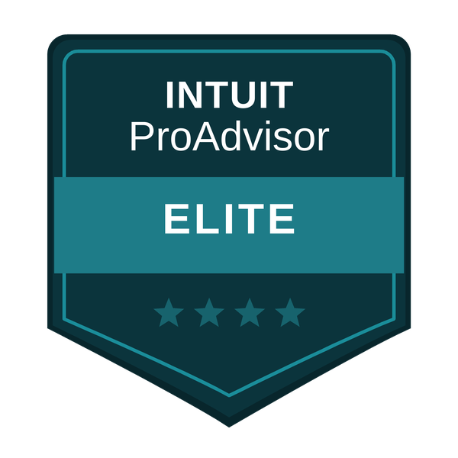



WHO WE ARE · THE FIRM
One firm, two continents, big-firm experience
Kierland neighbors: across the street from TrustBank’s Scottsdale office
TOP 10 FIRM EXPERIENCE
MULTI-INDUSTRY
PRIVATE EQUITY
Directors and Managers from top 10 national accounting firms — the tier above regional practices. You get that review discipline: schedules that tie and support assembled up front.
Construction · real estate · property management · professional services · distribution. We already know the schedules your credit team asks for in each one.
PE-backed and private-industry operating experience: reporting packages, covenant tracking, and the lender-facing detail underwriting runs on.
Highest QuickBooks partnership tier
LEADERSHIP
Steven Nikolov
Josephine Mack
Founder · Outsourced CFO
Chief of Staff · Client Relations
SCOTTSDALE · CONTROLLER & CFO
EUROPE · STAFF ACCOUNTING & GLOBAL IT
Month-end close, reporting, budgets, forecasts and financing support.
Leadership and the client relationship sit here.
Transaction detail, reconciliations and the close support behind every engagement.
A distributed team across multiple European cities, on our systems and our review process.
Every accountant on the team carries 10+ years. Partner-level work, delivered by the people you actually talk to.
2
Notes:
Brief and human, 30 seconds each. The point: this is a professional accounting firm, not a bookkeeping shop. Confirm Josephine’s exact title before presenting. Lead with the neighborhood: boutique firm across the street from their Scottsdale office, built on Top 10 firm training.

Slide 3



OUR ROLE
Not another bookkeeper or fractional firm
Onyx Accounting Group is an outsourced bookkeeping, controller & CFO firm in Scottsdale. We sit on the clients’ side of the table and we build books that banks can lend on.
THE QUARTERBACK
TrustBank
Fluent in bank
We know what credit teams need to see, and we build the books to show it.
CPA firm
Your client
ONYX · your quarterback
Insurance
Big-firm quality, not big-firm price
Tailored monthly packages for startups through multi-state businesses.
Legal
We protect relationships
Most clients already have the partners. The missing piece is the quarterback who connects them, so the client stays profitable and the bank gets repaid safely.
We work alongside the client’s CPA, insurance, and legal partners, and we keep those relationships strong.
3
Notes:
The missing piece: most clients already have the partners. What they lack is the quarterback connecting them. TrustBank sits first among the partners. Do not oversell: Onyx coordinates, the partners lead their lanes.

Slide 4


WHAT WE DO
The right level of support, scaled to the client
CFO
STRATEGIC
Controller
MONTH-END
Budgets, forecasts & cash-flow planning
Board participation & KPIs
Margin & pricing analysis
Financing, treasury & credit requests
M&A, succession & system selection
Staff Accountant
TRANSACTIONAL · DAY-TO-DAY
More complex close & reconciliations
Financial reporting
BBC, covenant & compliance packages
Support schedules, incl. WIP
AP / AR & billing
Payroll support
Clean, current books
Transaction feed entry & review
Most clients blend all three: one firm, scaled to the need and the budget. That range is what separates us from a bookkeeping shop or fractional firm.
4
Notes:
The staircase is the differentiator: bookkeepers stop at step one. Onyx runs transactional, month-end, and strategic, through M&A, succession planning, and system selection. Bankers should hear: whatever level the client needs, one firm covers it.

Slide 5
WHO WE SERVE
Built for owner-led businesses
Startups through multi-state operations
The books need handling
Reporting can’t keep up
The owner wants a partner
Dependable bookkeeping and a monthly close that actually happens every month, without the owner chasing it.
Growth has outrun the setup: statements run late, schedules are missing, and decisions wait on the numbers.
CFO-level reporting and a partner in the numbers, so the owner never has to negotiate the business alone.
INDUSTRY DEPTH
Construction
WIP schedules & job costing
Real estate
lender-ready reporting
Property management
clean monthly closes
Professional services
CFO-level reporting
Distribution & retail
bank-ready books
5
Notes:
Lauren asked who fits best: owner-led small and mid-size businesses. Three doors in: the books need handling, the reporting has been outgrown, or the owner wants a partner. Land the last line: nobody should have to negotiate their business alone.

Slide 6
HOW IT WORKS
From first call to strategic partner
PRE-ENGAGEMENT
WORK PHASE
06
05
04
01
02
03
Free consultation
Needs assessment
Custom engagement
Catch-up & cleanup
Reporting rhythm
Strategy & growth
Every engagement starts with a conversation, on us.
We listen, then document the needs and requests in writing.
A scoped monthly package built around the business.
Usually weeks to a few months to get the books current.
Routine reporting and management, on a dependable calendar.
Budgets, forecasts, and CFO-level guidance as the business scales.
One goal from day one: numbers the owner can run the business on, and a bank can lend on.
6
Notes:
Second ask from Lauren’s email: how the process works. Free consultation, document the needs, custom engagement, cleanup usually weeks to a few months, then the monthly rhythm, and from there strategy and growth. Reassure: we do the heavy lifting, the client keeps running the business.

Slide 7

WHAT WE DELIVER
Cleanup, ongoing support, and strategic growth
Every engagement covers three jobs; in whatever mix the business needs:
01
02
03
Cleanup & catch-up
Ongoing support
Growth & strategy
Historical catch-up and clean-up: reconciled balance sheets, support schedules, and books a credit team can spread.
A documented monthly close, on-time reporting, and covenant & compliance packages, on a dependable calendar.
Budgets, forecasts, and CFO-level guidance on margins, financing, and what comes next.
One liaison in both directions: we keep the bank current, support the client’s partners, usually the CPA firm, on statements and reporting, and keep the owner focused on the business.
7
Notes:
The combined services slide. Three layers: cleanup gets them bankable, the monthly rhythm keeps them bankable, strategy grows them. Then the differentiator: we communicate, to the bank, and to the client’s partners, usually the CPA firm for reporting. One liaison, both directions.

Slide 8
WORKING TOGETHER
Referrals that work in both directions
Send Onyx in when you see
We send TrustBank in when we see
A loan request sitting on messy books: we make the file underwritable instead of letting it walk
An existing borrower with reporting gaps or messy books heading into a renewal
A growing client that needs additional funding or operational build-out, and books that keep pace
Clients who need lending, deposit, or treasury solutions: we prep the numbers and the introduction
Owners approaching a sale, retirement, or succession: early looks for your wealth management team
New businesses choosing their first banking partner in the Valley
Same client, both teams in the loop: collaborative support, not handoffs.
8
Notes:
The collaborative-support slide. Their triggers: messy books plus a loan request, reporting issues at renewal, growth that needs more funding. Ours back: banking, treasury, and wealth management on liquidity events. Make it concrete with one shared-client scenario, then ask for one or two names.

Slide 9

NEXT STEPS
A partnership that wins three ways
Your clients
ONYX
ACCOUNTING GROUP
A CFO-level finance function on a tailored monthly package, at a fraction of a full-time hire.
Timely reporting, clean covenants, faster underwriting, and early introductions for your wealth management team.
We grow when your referrals grow. Your portfolio’s health is our business model.
Standing offer: quarterly accounting & treasury reviews with you and your client, plus a complimentary accounting consultation for any business you refer.
Steven Nikolov
Founder, Principal & CFO
steven@onyxcfo.com
Josephine Mack
Chief of Staff
jmack@onyxcfo.com
Onyx Accounting Group · (480) 442-3119 · onyxcfo.com · 14614 N Kierland Blvd, Suite N220, Scottsdale, AZ 85254
As TrustBank grows in the Valley, we’d love to grow with you.
Notes:
Land the standing offer: free consultation for anything they refer, quarterly reviews as the ongoing rhythm. Make the ask concrete: one or two names, one intro call. Leave the handout behind. For TrustBank: referrals flow both ways. Wealth management, retirement planning, and liquidity event planning are where our work hands clients to their team, and clean books are where their referrals land with us.

