Slide 1
Personality Prediction Using Social & Behavioral Traits
Aristo Ayako
5/09/2025
Notes:
1

Slide 2
Project Overview
1
Goal:
Predict Personality Type (Introvert vs Extrovert) from behavioral and social traits
3
Tools & Libraries:
2
Dataset Features:
Python (Pandas, Seaborn, Matplotlib, Statsmodels, Scikit-learn, ipywidgets)
Personality Type (Introvert/Extrovert)
Drained after socializing (Yes/No)
Stage fear (Yes/No)
Social event attendance (0–10)
4
Approach:
Exploratory Data Analysis (EDA)
Going outside (0–7)
Statistical Analysis (Chi-square, t-tests, correlations)
Time spent alone (0-11)
Predictive Modeling (Regression & Logistic Regression)
Friends circle size (0–15)
Interactive Personality Prediction Dashboard
Post frequency (0–10)
Notes:
2

Slide 3
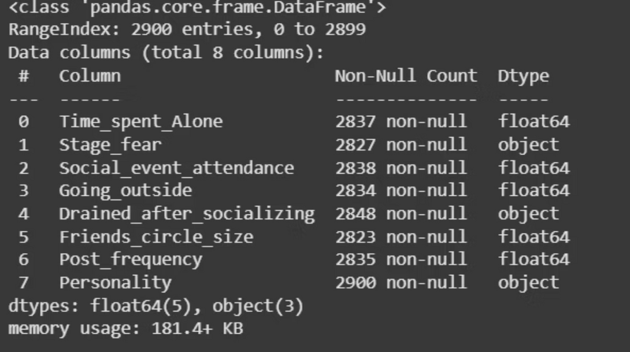
Dataset Overview
Target Variable: Personality Type (Introvert / Extrovert)
Feature Categories:
Numerical:
Time_spent_Alone (0–11 hours/day)
Social_event_attendance (0–10)
Going_outside (0–7)
Friends_circle_size (0–15)
Post_frequency (0–10)
Data Quality:
Categorical:
Missing values handled by dropping rows
Stage_fear (Yes/No)
Converted float columns to integer for consistency
Checked for outliers (notably in numerical features vs Personality)
Drained_after_socializing (Yes/No)
Notes:
3

Slide 4
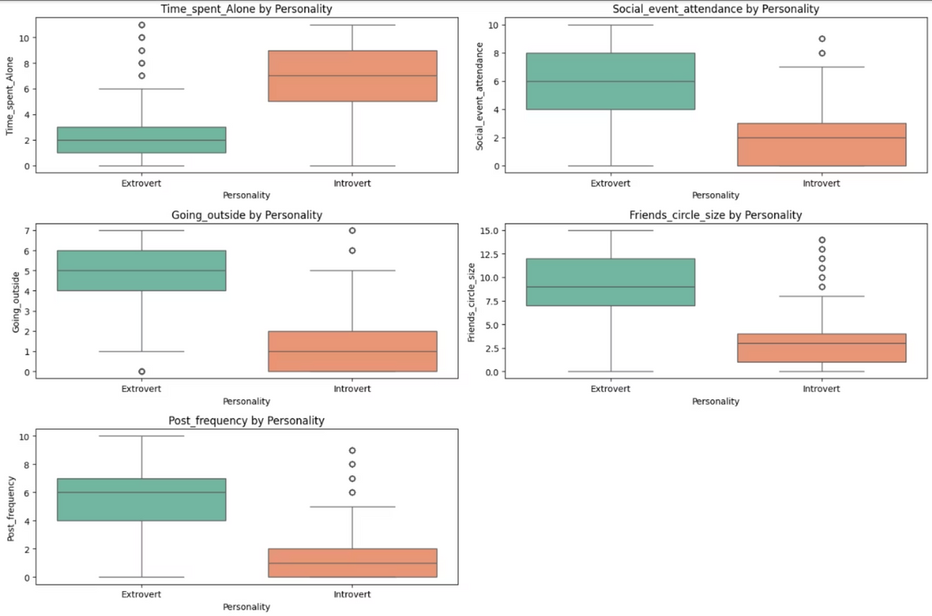
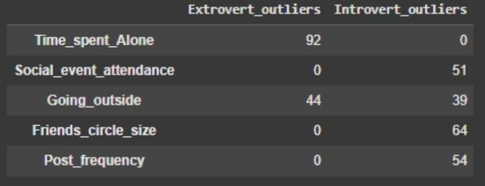
Dataset Overview
Outliers (Numerical vs Personality):
Time_spent_Alone: Extroverts with unusually high alone-time - possible Ambiverts.
Social_event_attendance: Introverts attending unusually many events -social introverts.
Going_outside: Outliers present in both groups -wide variation.
Friends_circle_size: Introverts with very large friend circles.
Boxplots of numerical features by Personality
Post_frequency: Some introverts highly active online.
Notes:
4

Slide 5
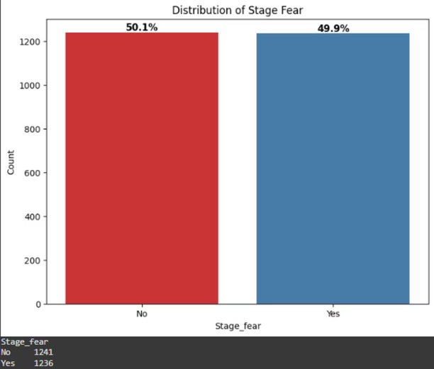
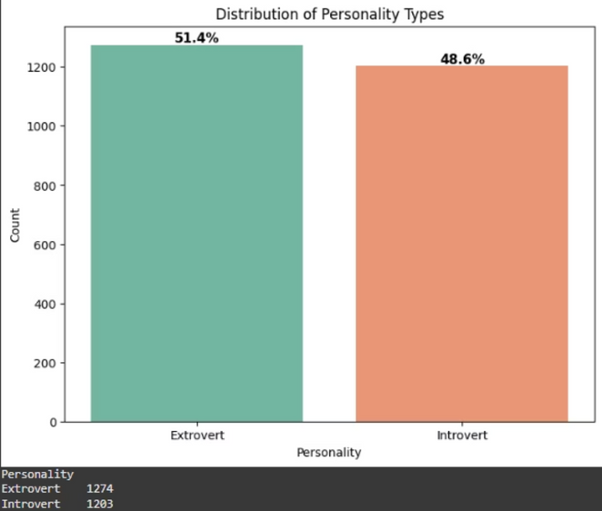
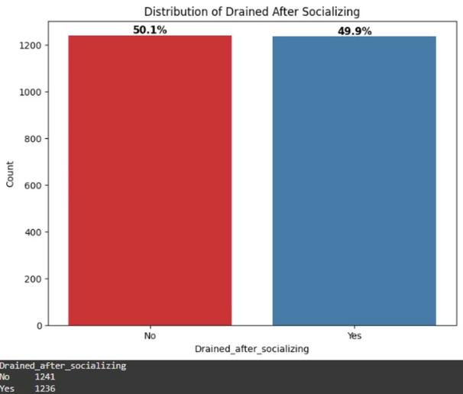
Univariate Analysis (Categorical Features)
Majority don't have stage fear but the difference of 0.2% suggests the difference is not that significant
Extroverts were more than Introverts by 2.8%
Majority don't feel drained after socializing but the difference of 0.2% suggests the difference is not that significant
Notes:
5

Slide 6
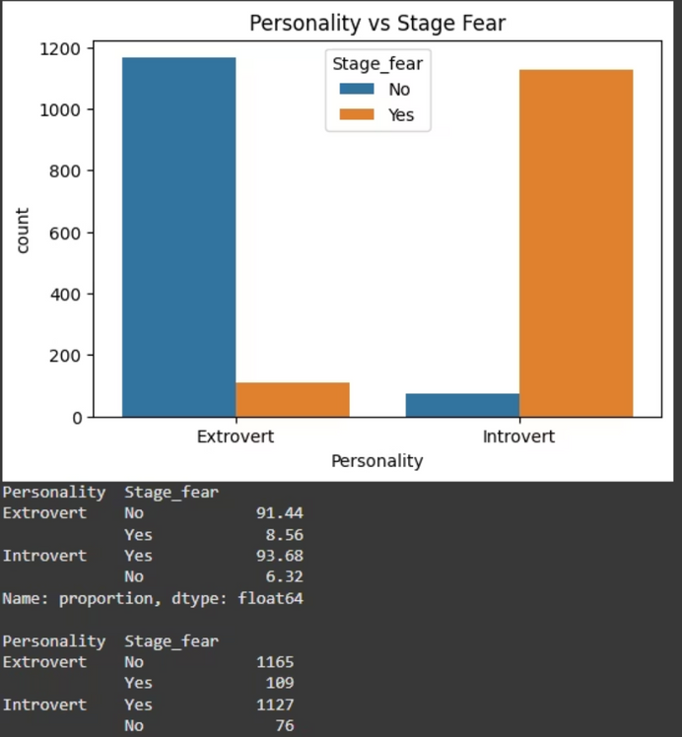
Bivariate Analysis
Categorical Vs Categorical
The number of Extroverts that don't have stage fear are 1165 (91.44%) and those that have stage fear are 109 (8.56%).
The number of Introverts that have stage fear are 1127 (93.68%) and those that have stage fear are 76 (6.32%).
This suggests that introverts are more likely to have stage fear than extroverts.
These values were also same with feeling drained after socializing
Notes:
7

Slide 7
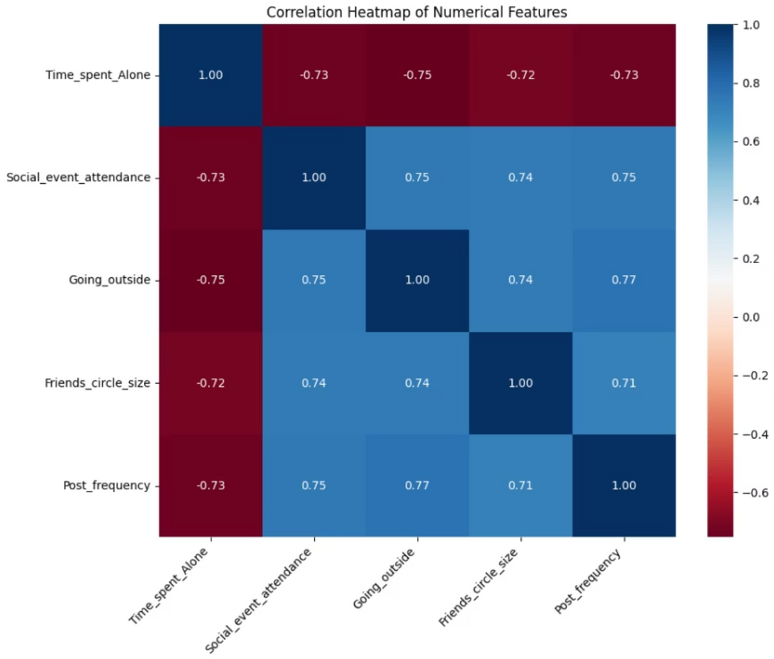
Bivariate Analysis
Numerical Vs Numerical
Correlation Analysis – Key Findings
Time Spent Alone is strongly negatively correlated with:
Social Event Attendance (r = -0.73)
Going Outside (r = -0.75)
Friends Circle Size (r = -0.72)
Post Frequency (r = -0.73)
More alone time = less social engagement.
Strong positive correlations (r > 0.70) among:
Event Attendance, Going Outside, Friends Circle, Post Frequency.
Notes:
8

Slide 8
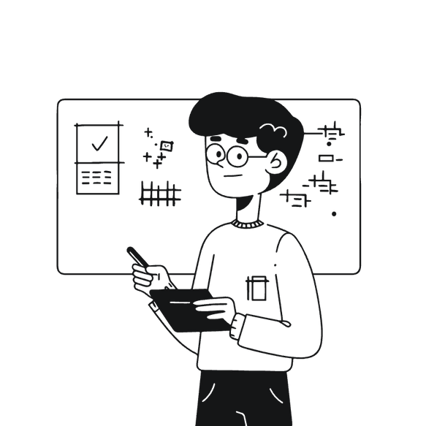
Inferential Statistics
Chi-Square Test
Independent t-Test
Check if there is an association between personality and stage fear and drained after socializing.
Check if there is a difference in average scores between introverts and extroverts.
Result:
Result:
Introverts (avg = 2.96) and Extroverts (avg = 5.48) indicates that there is significant differences in numerical features (Time Spent Alone, Social Event Attendance, Friends Circle Size, Post Frequency).
A p-value of 0.0 suggests there was a strong association between Personality and Stage Fear and Drained After Socializing.
Reason for 0.0 suggests the number was to small to compute that SciPy rounded it 0.
The difference (2.52) suggests numeric features don't significantly determine your personality type.
Notes:
10

Slide 9
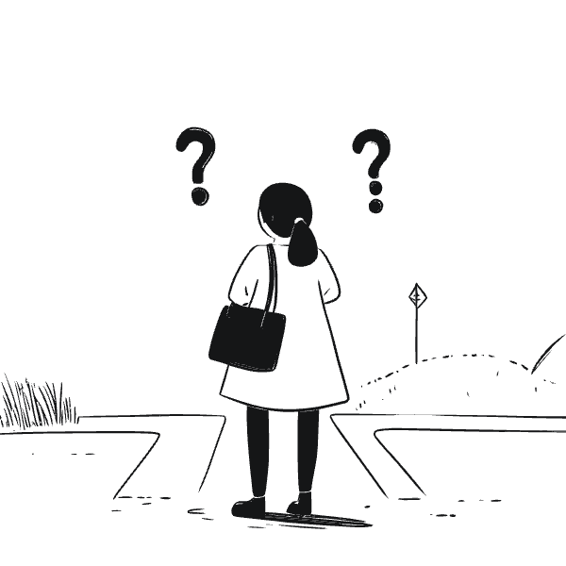
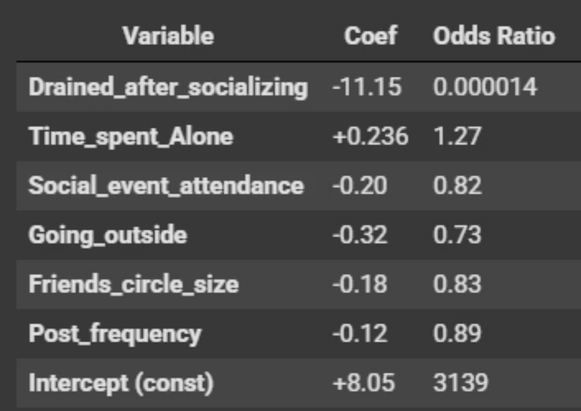
Logistic Regression - Predicting Personality
Interpretation of Results
Drained After Socializing was a strong predictor determining your personality type
Other features contribute your personality type but they are small
Odd Ratios show the relative likelihood of being and Extrovert or Introvert. Odds less than 1 - introvert otherwise extrovert
Using Logistic Regression to determine which feature determines your personality type
Notes:
12

Slide 10
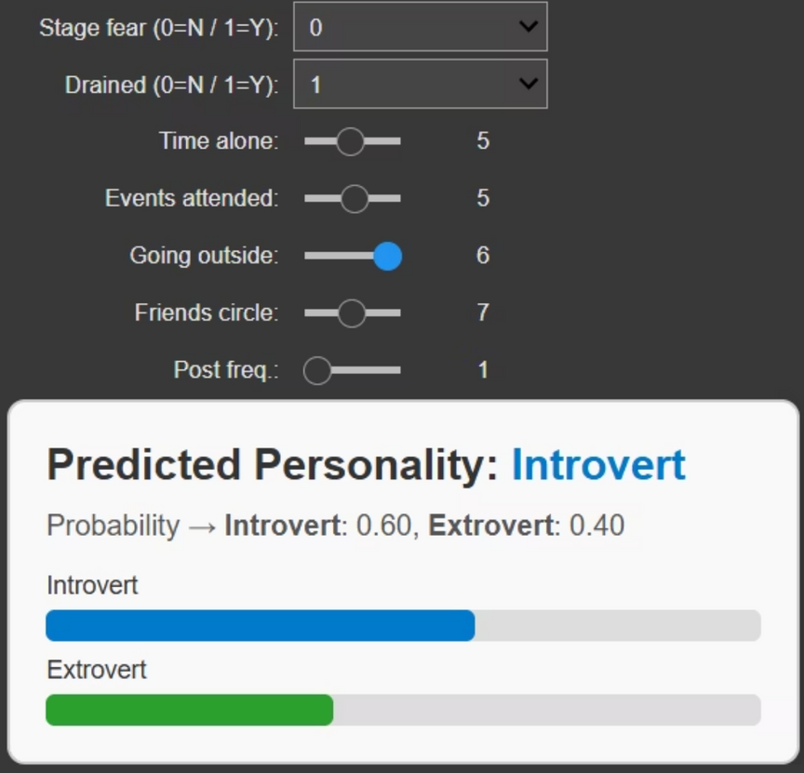
Prediction Model (Simple Dashboard)
Simple interactive tool with sliders and dropdowns that users can input personal traits
The model outputs the predicted personality type (Introvert/Extrovert) and probability scores for each class
The dashboard allows real-time personality predictions based on individual inputs, making the analysis dynamic and interactive.
The model gives clear, easy-to-understand predictions, but it leans too much on a few key factors and may miss more complex patterns.
Notes:
13

Slide 11
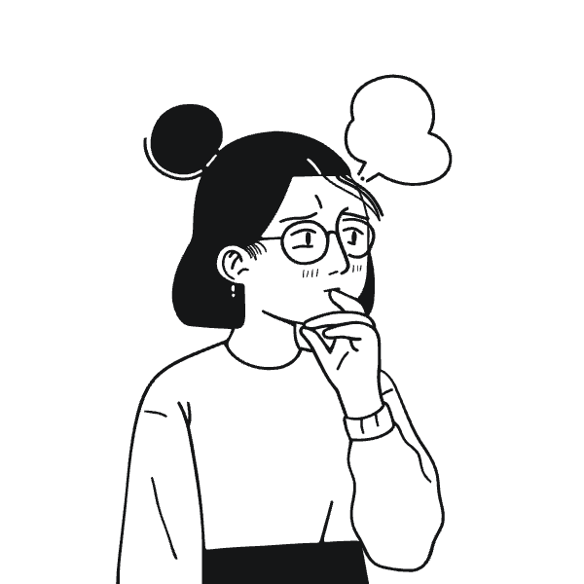
Conclusions
Introverts and extroverts show clear differences in social behavior, with time spent alone, social event attendance, and posting habits being strong separators.
Stage fear and feeling drained after socializing emerged as the most powerful indicators of personality type.
The logistic regression model provides an accessible and interpretable way to predict personality type with reasonable accuracy.
Outliers in numeric features remind us that personality is not always binary — some individuals display ambivert traits.
Notes:
14

Slide 12

Notes:
15

