Slide 1

Health Insurance Analysis in Kenya
An Analysis by Gender, Region, and Time
Peter Moseti
Elizabeth Kagecha
Aristo Ayako
Gideon Maingi
Notes:
1.7.2013
1
‹#›

Slide 2

Analysis Objectives
01
Which regions have the highest and lowest health insurance coverages overall?
02
How has the gap between the best and worst performing regions changed between 2008 and 2014?
03
Which location had the highest percentage of men or women without health insurance per year?
04
Did the number of uninsured women increase over time?
05
Did the number of uninsured men change over time?
Notes:
1.7.2013
2
‹#›

Slide 3
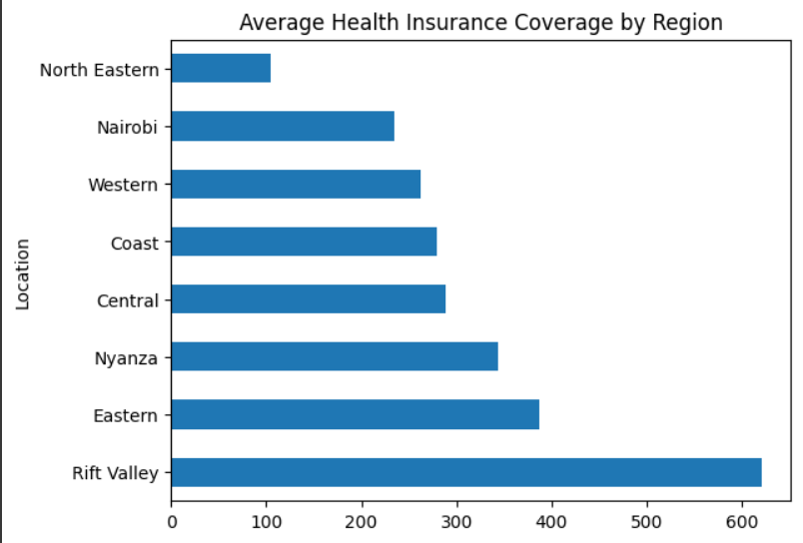
Health Insurance Coverage by Region
Insights
Region with the highest coverage was Rift Valley while the lowest was North Eastern
Notes:
1.7.2013
RV
High Population Density
Socio-economic factors – wealth, education
NE
Poverty and Limited Financial Resources
Limited Access to Healthcare
Low Awareness and Understanding
‹#›

Slide 4
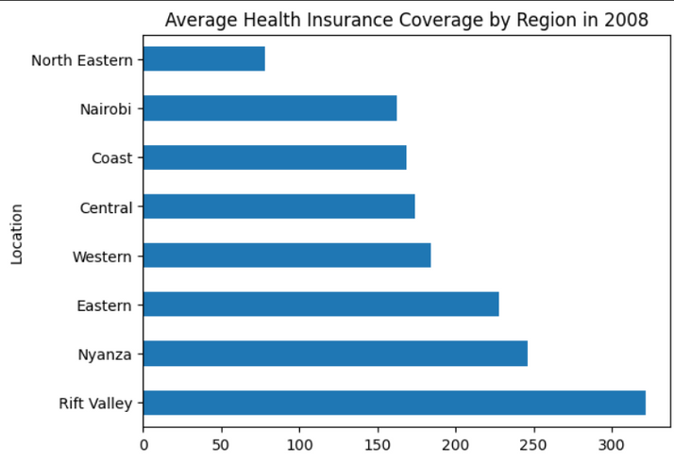
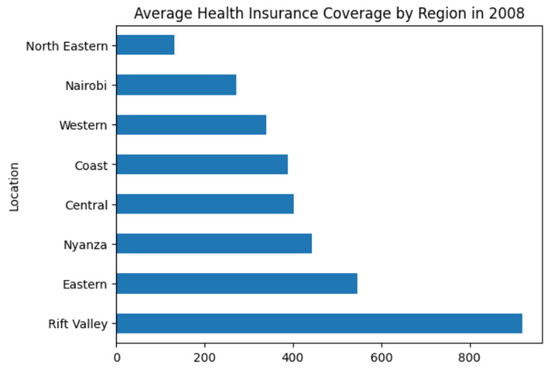
Health Insurance Coverage by Region in 2008 and 2014
Insights
Highest and Lowest Region Coverage in 2008 and 2014 were Rift Valley and North Eastern respectively
Notes:
1.7.2013
RV
High Population Density
Socio-economic factors – wealth, education
NE
Poverty and Limited Financial Resources
Limited Access to Healthcare
Low Awareness and Understanding
‹#›

Slide 5
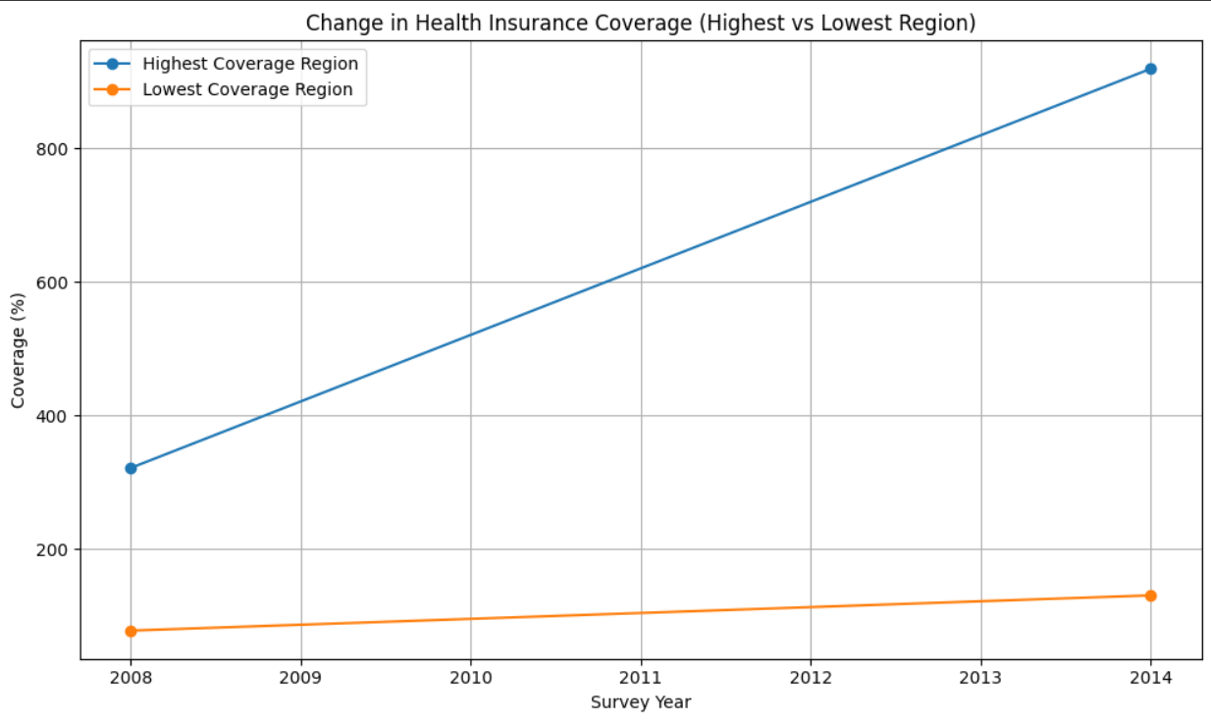
Health Insurance Coverage by Region
Insight:
Rift Valley increased by 40.22%
North Eastern increased by 65.01%
Notes:
1.7.2013
4
‹#›

Slide 6
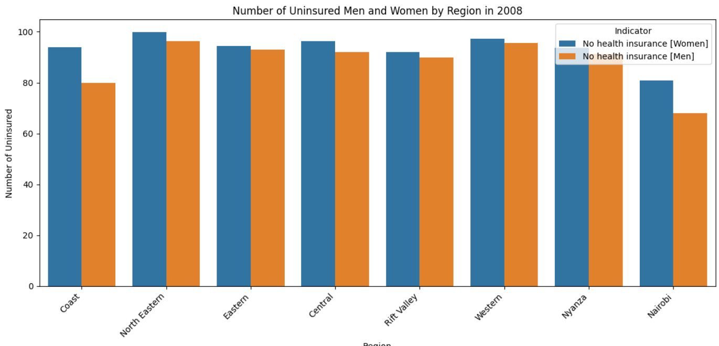
Uninsured Men & Women by Region in 2008
Insight:
North Eastern Region has the highest uninsured rates in 2008
Nairobi Region has the lowest rate of men and women with no insurance
Notes:
1.7.2013
5
‹#›

Slide 7
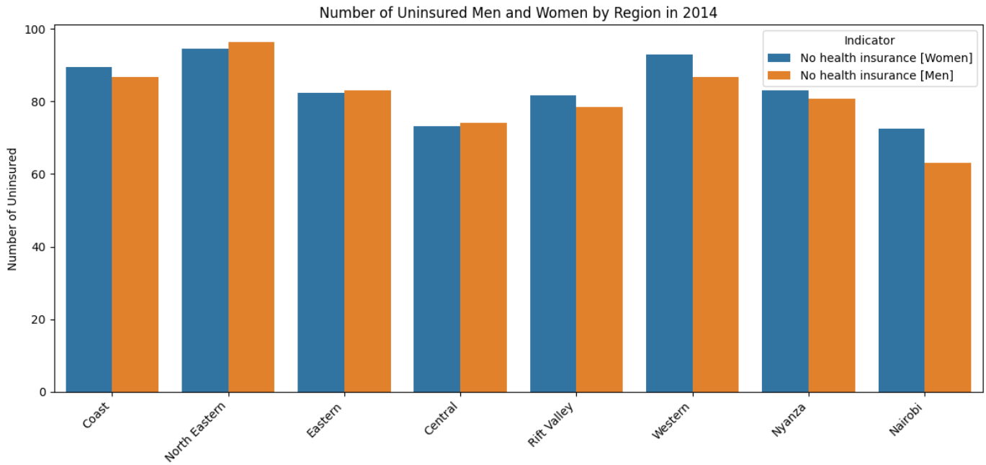
Uninsured Men & Women by Region in 2014
Insight:
01
North Eastern Region still has the highest number of uninsured rates.
02
Nairobi Region has the lowest rate of men and women with no insurance.
Notes:
1.7.2013
5
‹#›

Slide 8
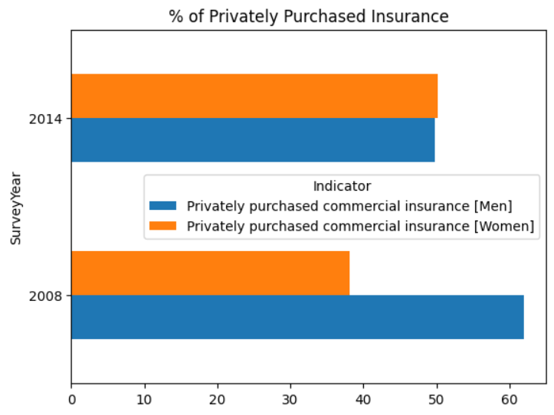
Privately purchased commercial insurance between Men and Women
Insight:
Men decreased from 61.95% to 49.76%
Women increased from 38.05% to 50.24%
Notes:
1.7.2013
5
‹#›

Slide 9
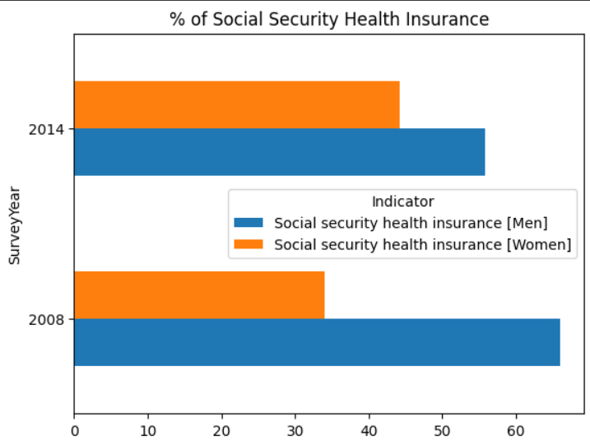
Social Security Health Insurance between Men and Women
Insight:
01
Men decreased from 65.96% to 55.85%
02
women increased from 34.04% to 44.15%
Notes:
1.7.2013
5
‹#›

Slide 10
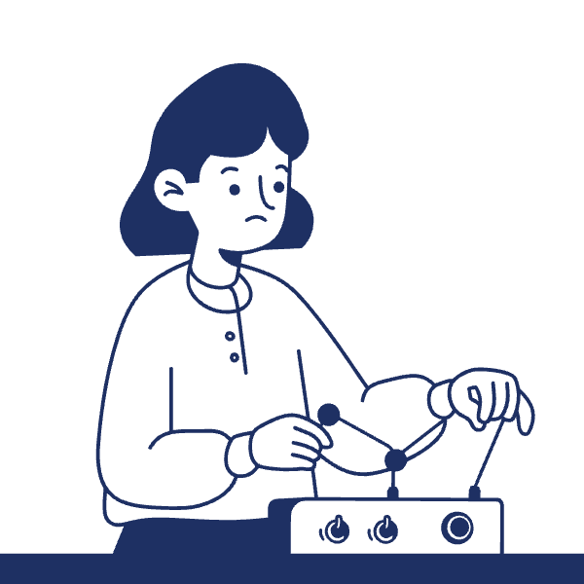
Takeaways
North Eastern region consistently lags behind due poverty level
Employer based insurance is the most popular insurance
Notes:
1.7.2013
6
‹#›

Slide 11

Recommendations
Targeted policy interventions for worst-performing regions.
Create Awareness on the importance of health insurance
Notes:
1.7.2013
7
‹#›

Slide 12
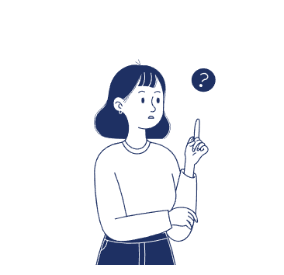
Why this Dataset?
This dataset helps us explore who is left out, where, and why—crucial questions for improving access and shaping better
Notes:
1.7.2013
7
‹#›

