Slide 1
Kenya Literacy Trends & Insights
A data-driven analysis of literacy trends by gender, region, and year
01
Peter Moseti
02
Gideon Maingi
03
Elizabeth Kagecha
04
Aristo Ayako
Notes:
1

Slide 2

Project Overview
Purpose:
Analyze literacy trends in Kenya over time
Compare literacy levels between genders
Identify top & bottom performing regions
Explore correlations between literacy and other factors
Dataset Source:
Literacy Data for Kenya
Notes:
2

Slide 3
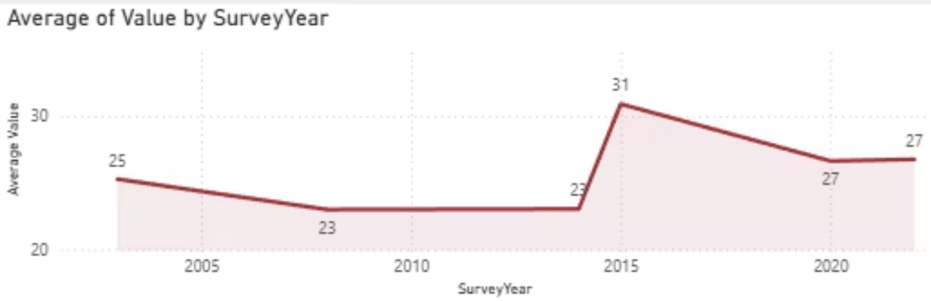
Literacy Trends Over Time
Insight:
Literacy rates fluctuated over time, with peaks in 2015, where only women took the survey.
Reason was to focus on understanding the challenges women face in literacy.
Noticeable progress over the years.
Notes:
3

Slide 4
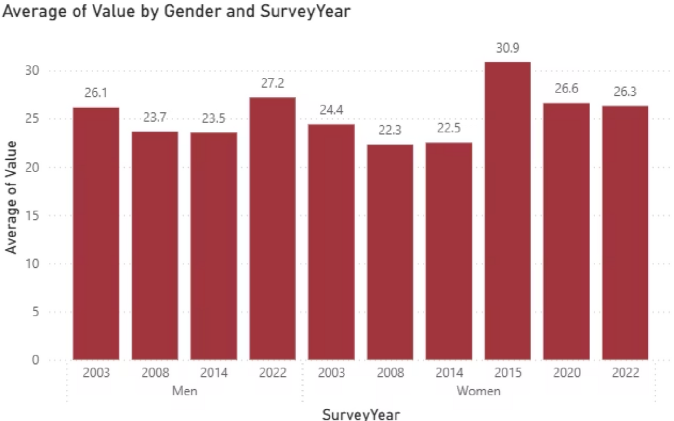
Gender Literacy Trend
Insight:
Men consistently have slightly higher literacy levels than women.
Correlation between men’s and women’s literacy: 0.99 (very strong). (Men’s and women’s literacy patterns move almost identically)
Notes:
4

Slide 5
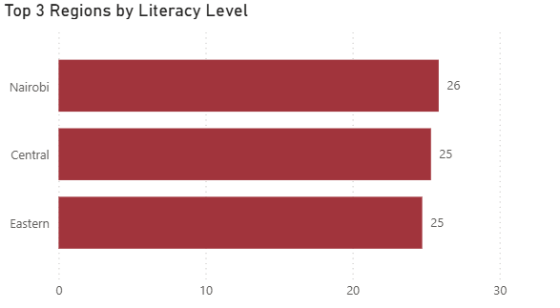
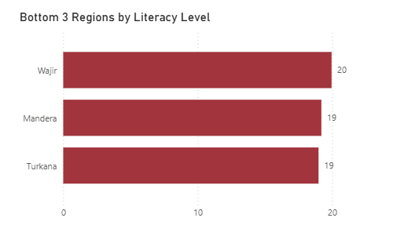
Top & Bottom Performing Provinces
Insight:
Top regions: Nairobi, Central and Eastern.
Lowest regions: Wajir, Turkana and Mandera.
Large regional disparities exist.
Notes:
5

Slide 6
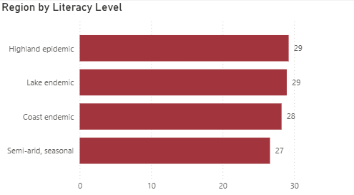
Performing Regions
Insight:
Highland Epidemic and Lake Endemic were the highest regions with a value of 29.
Semi-arid was the lowest region with a value of 27.
Notes:
5

Slide 7
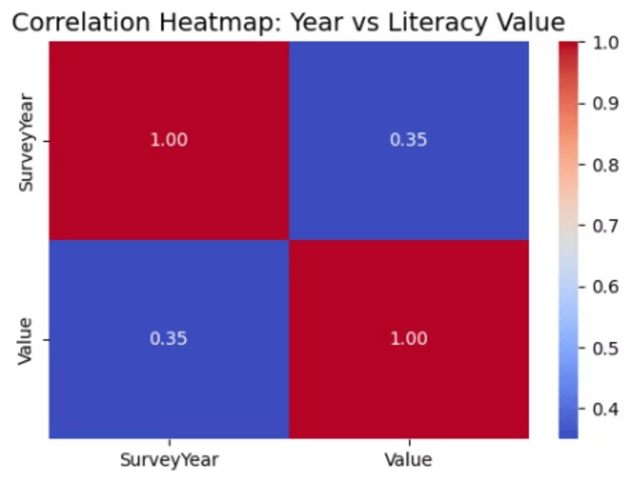
Correlation Analysis
Insight:
Men’s and women’s literacy levels strongly linked (0.99 correlation).
Year-to-literacy correlation of 0.35 indicates a moderate positive correlation between SurveyYear and Literacy Value.
As the years increase, literacy levels tend to slightly increase.
0.35 is not a strong correlation — it suggests the increase over time is not very strong, meaning other factors also influence literacy
Notes:
6

Slide 8

Conclusions
Literacy has improved overall but with fluctuations.
Gender gap is small but consistent.
Significant regional inequalities remain.
Policy efforts should focus on low-performing counties.
Notes:
7

Slide 9

Recommendations
Target literacy programs in Turkana, Mandera, Wajir.
Strengthen female literacy initiatives.
Invest in rural education infrastructure.
Notes:
8

