Slide 1
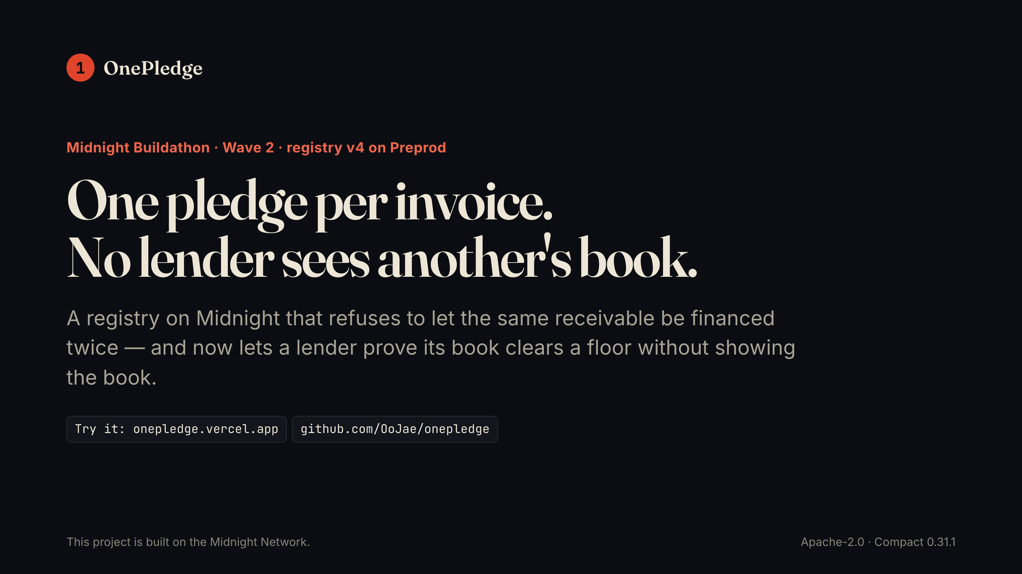
Notes:
1 OnePledge Midnight Buildathon · Wave 2 · registry v4 on Preprod One pledge per invoice. No lender sees another's book. A registry on Midnight that refuses to let the same receivable be financed twice — and now lets a lender prove its book clears a floor without showing the book. Try it: onepledge.vercel.app github.com/OoJae/onepledge This project is built on the Midnight Network. Apache-2.0 · Compact 0.31.1

Slide 2
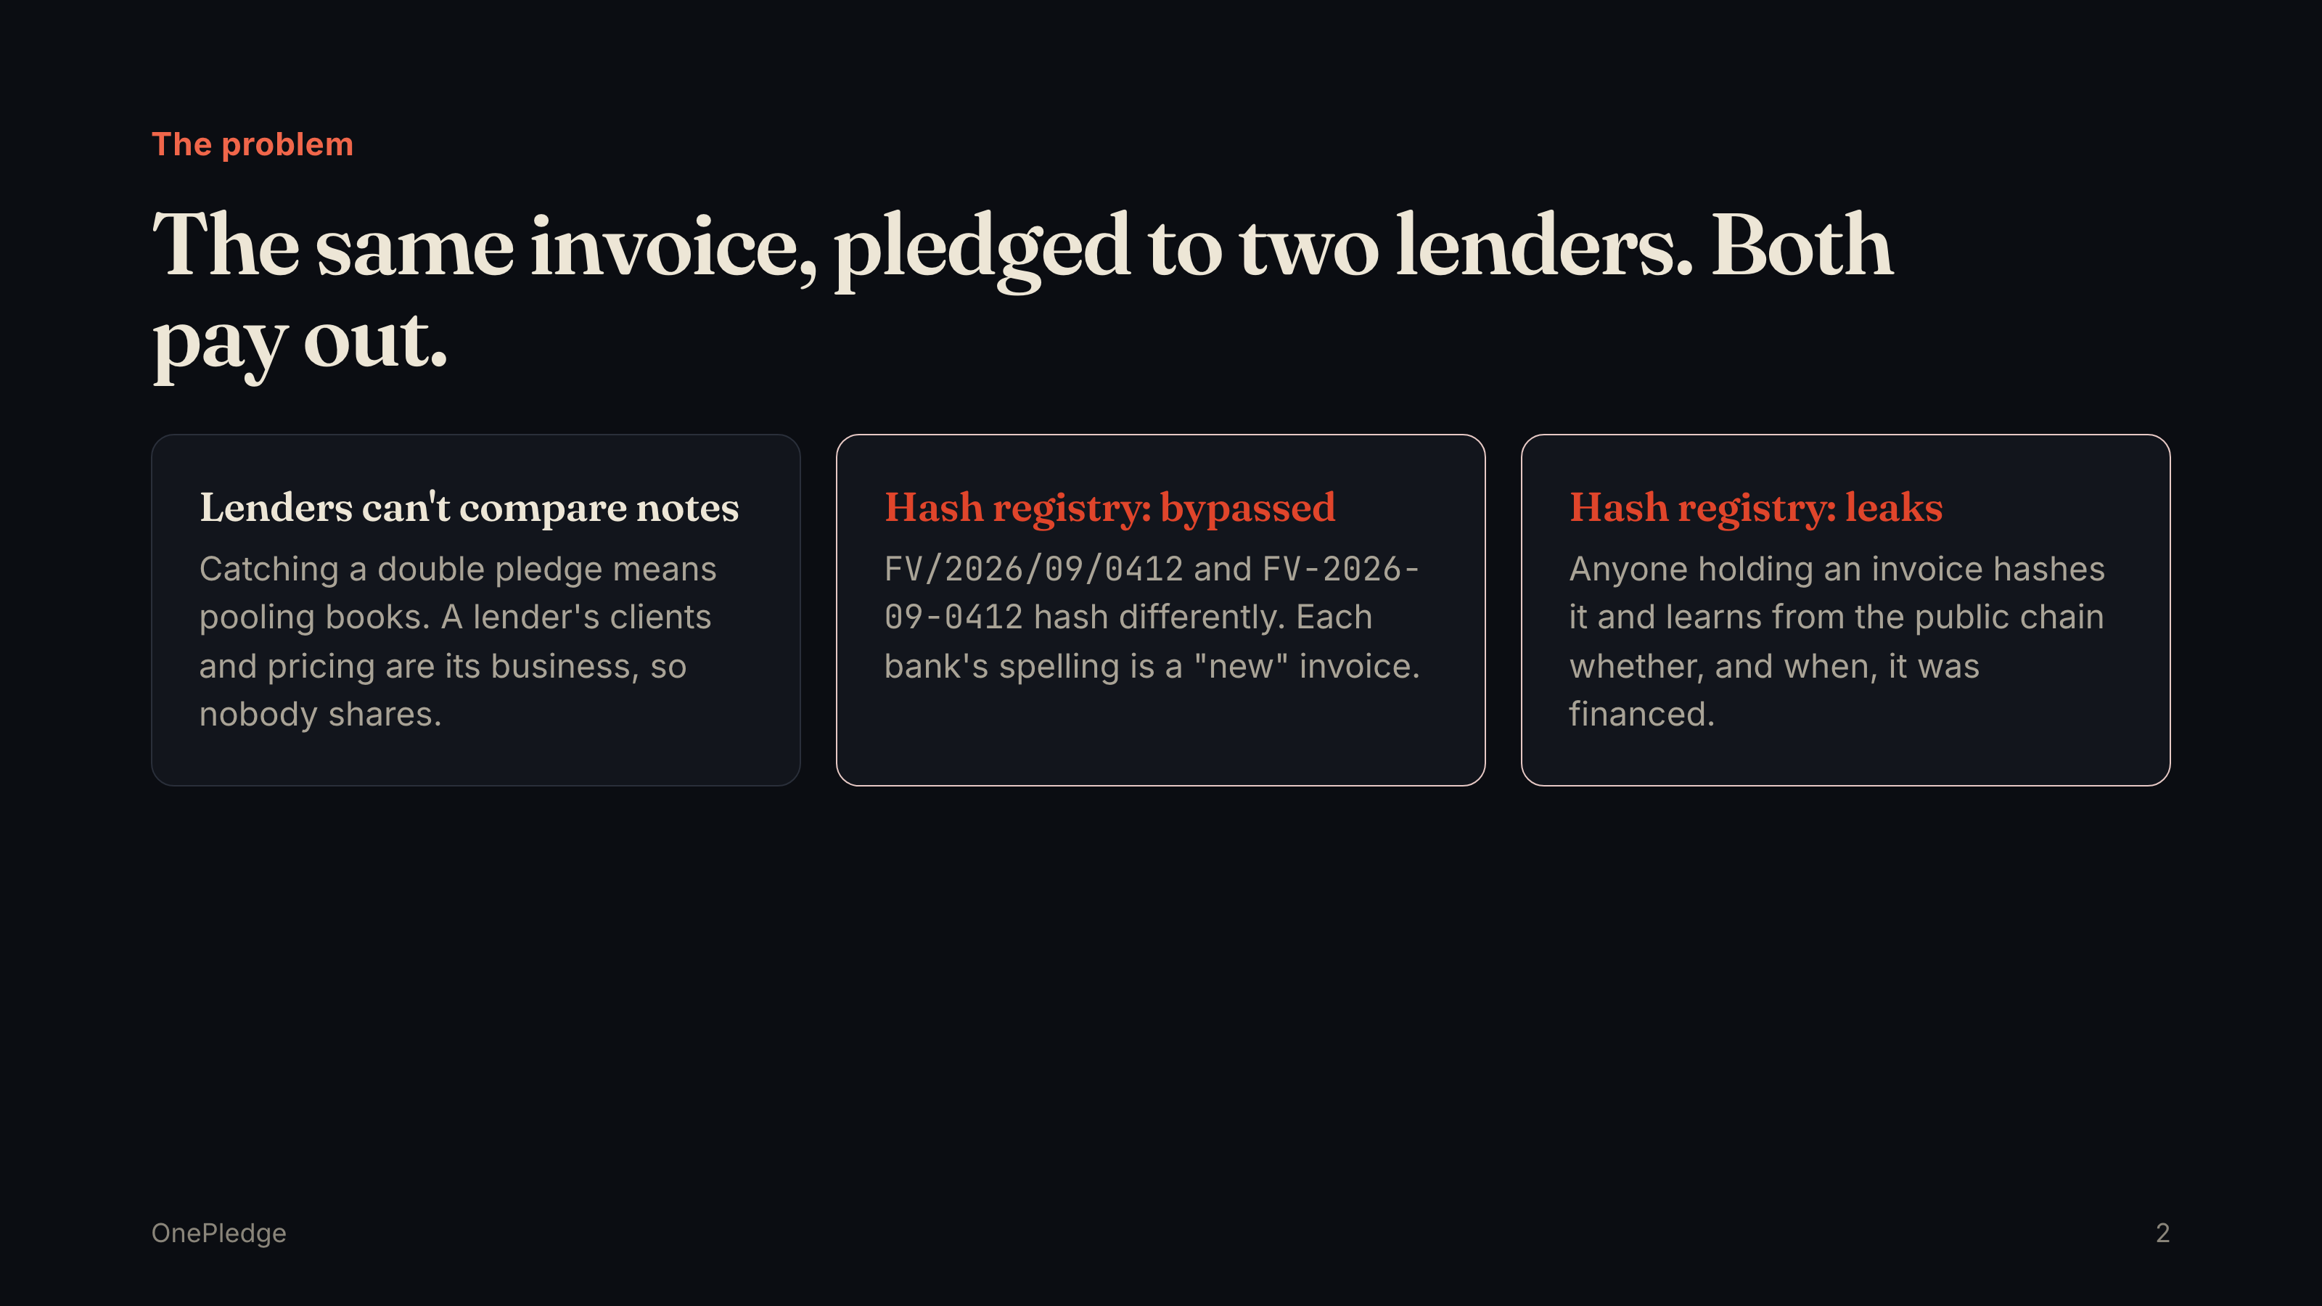
Notes:
The problem The same invoice, pledged to two lenders. Both pay out. Lenders can't compare notes Catching a double pledge means pooling books. A lender's clients and pricing are its business, so nobody shares. Hash registry: bypassed FV/2026/09/0412 and FV-2026-09-0412 hash differently. Each bank's spelling is a "new" invoice. Hash registry: leaks Anyone holding an invoice hashes it and learns from the public chain whether, and when, it was financed. OnePledge 2

Slide 3
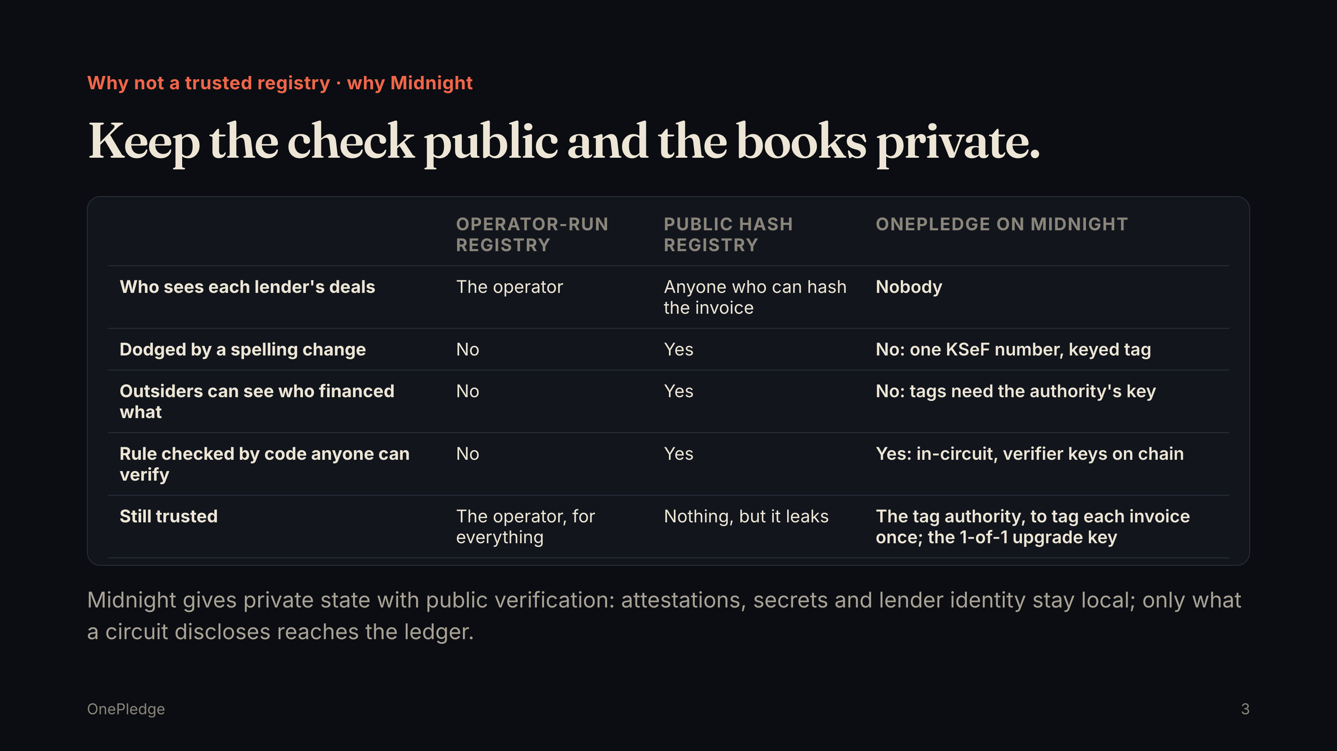
Notes:
Why not a trusted registry · why Midnight Keep the check public and the books private. Operator-run registry Public hash registry OnePledge on Midnight Who sees each lender's deals The operator Anyone who can hash the invoice Nobody Dodged by a spelling change No Yes No: one KSeF number, keyed tag Outsiders can see who financed what No Yes No: tags need the authority's key Rule checked by code anyone can verify No Yes Yes: in-circuit, verifier keys on chain Still trusted The operator, for everything Nothing, but it leaks The tag authority, to tag each invoice once; the 1-of-1 upgrade key Midnight gives private state with public verification: attestations, secrets and lender identity stay local; only what a circuit discloses reaches the ledger. OnePledge 3

Slide 4
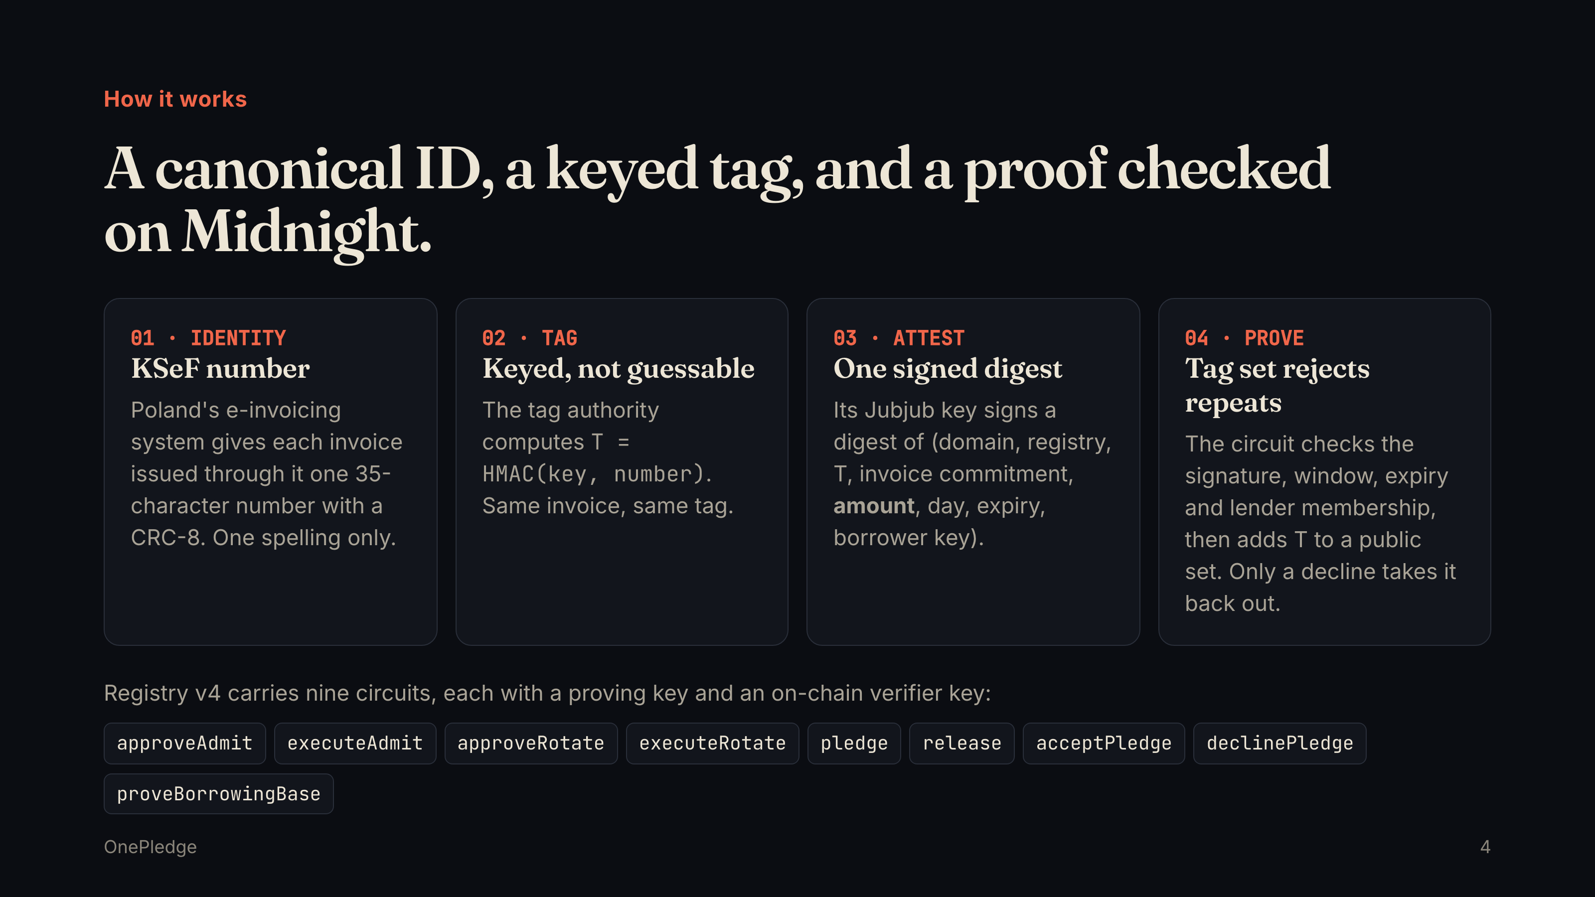
Notes:
How it works A canonical ID, a keyed tag, and a proof checked on Midnight. 01 · IDENTITY KSeF number Poland's e-invoicing system gives each invoice issued through it one 35-character number with a CRC-8. One spelling only. 02 · TAG Keyed, not guessable The tag authority computes T = HMAC(key, number) . Same invoice, same tag. 03 · ATTEST One signed digest Its Jubjub key signs a digest of (domain, registry, T, invoice commitment, amount , day, expiry, borrower key). 04 · PROVE Tag set rejects repeats The circuit checks the signature, window, expiry and lender membership, then adds T to a public set. Only a decline takes it back out. Registry v4 carries nine circuits, each with a proving key and an on-chain verifier key: approveAdmit executeAdmit approveRotate executeRotate pledge release acceptPledge declinePledge proveBorrowingBase OnePledge 4

Slide 5
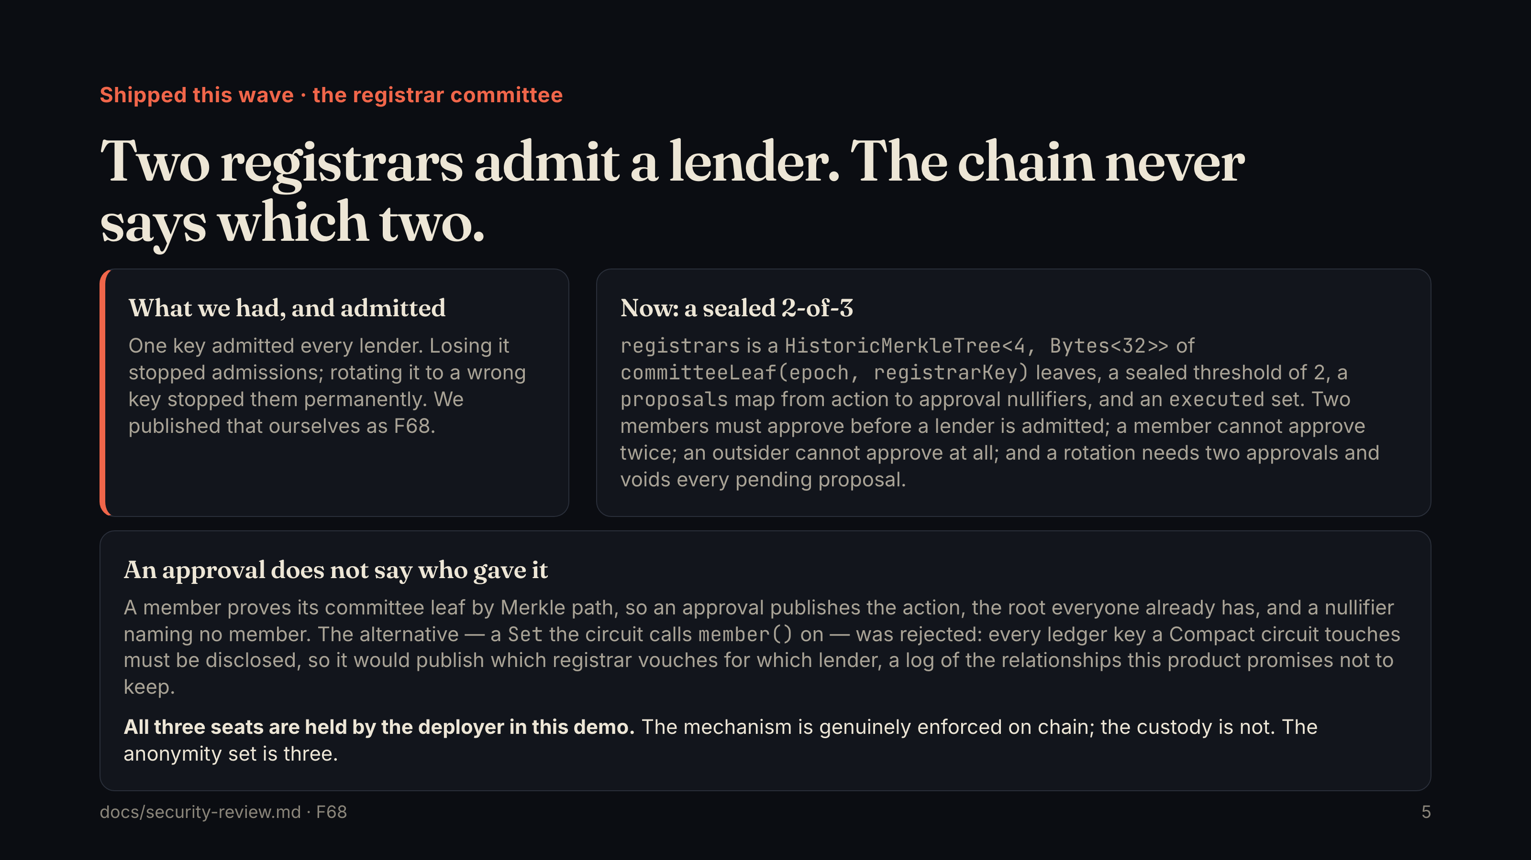
Notes:
Shipped this wave · the registrar committee Two registrars admit a lender. The chain never says which two. What we had, and admitted One key admitted every lender. Losing it stopped admissions; rotating it to a wrong key stopped them permanently. We published that ourselves as F68. Now: a sealed 2-of-3 registrars is a HistoricMerkleTree<4, Bytes<32>> of committeeLeaf(epoch, registrarKey) leaves, a sealed threshold of 2, a proposals map from action to approval nullifiers, and an executed set. Two members must approve before a lender is admitted; a member cannot approve twice; an outsider cannot approve at all; and a rotation needs two approvals and voids every pending proposal. An approval does not say who gave it A member proves its committee leaf by Merkle path, so an approval publishes the action, the root everyone already has, and a nullifier naming no member. The alternative — a Set the circuit calls member() on — was rejected: every ledger key a Compact circuit touches must be disclosed, so it would publish which registrar vouches for which lender, a log of the relationships this product promises not to keep. All three seats are held by the deployer in this demo. The mechanism is genuinely enforced on chain; the custody is not. The anonymity set is three. docs/security-review.md · F68 5

Slide 6
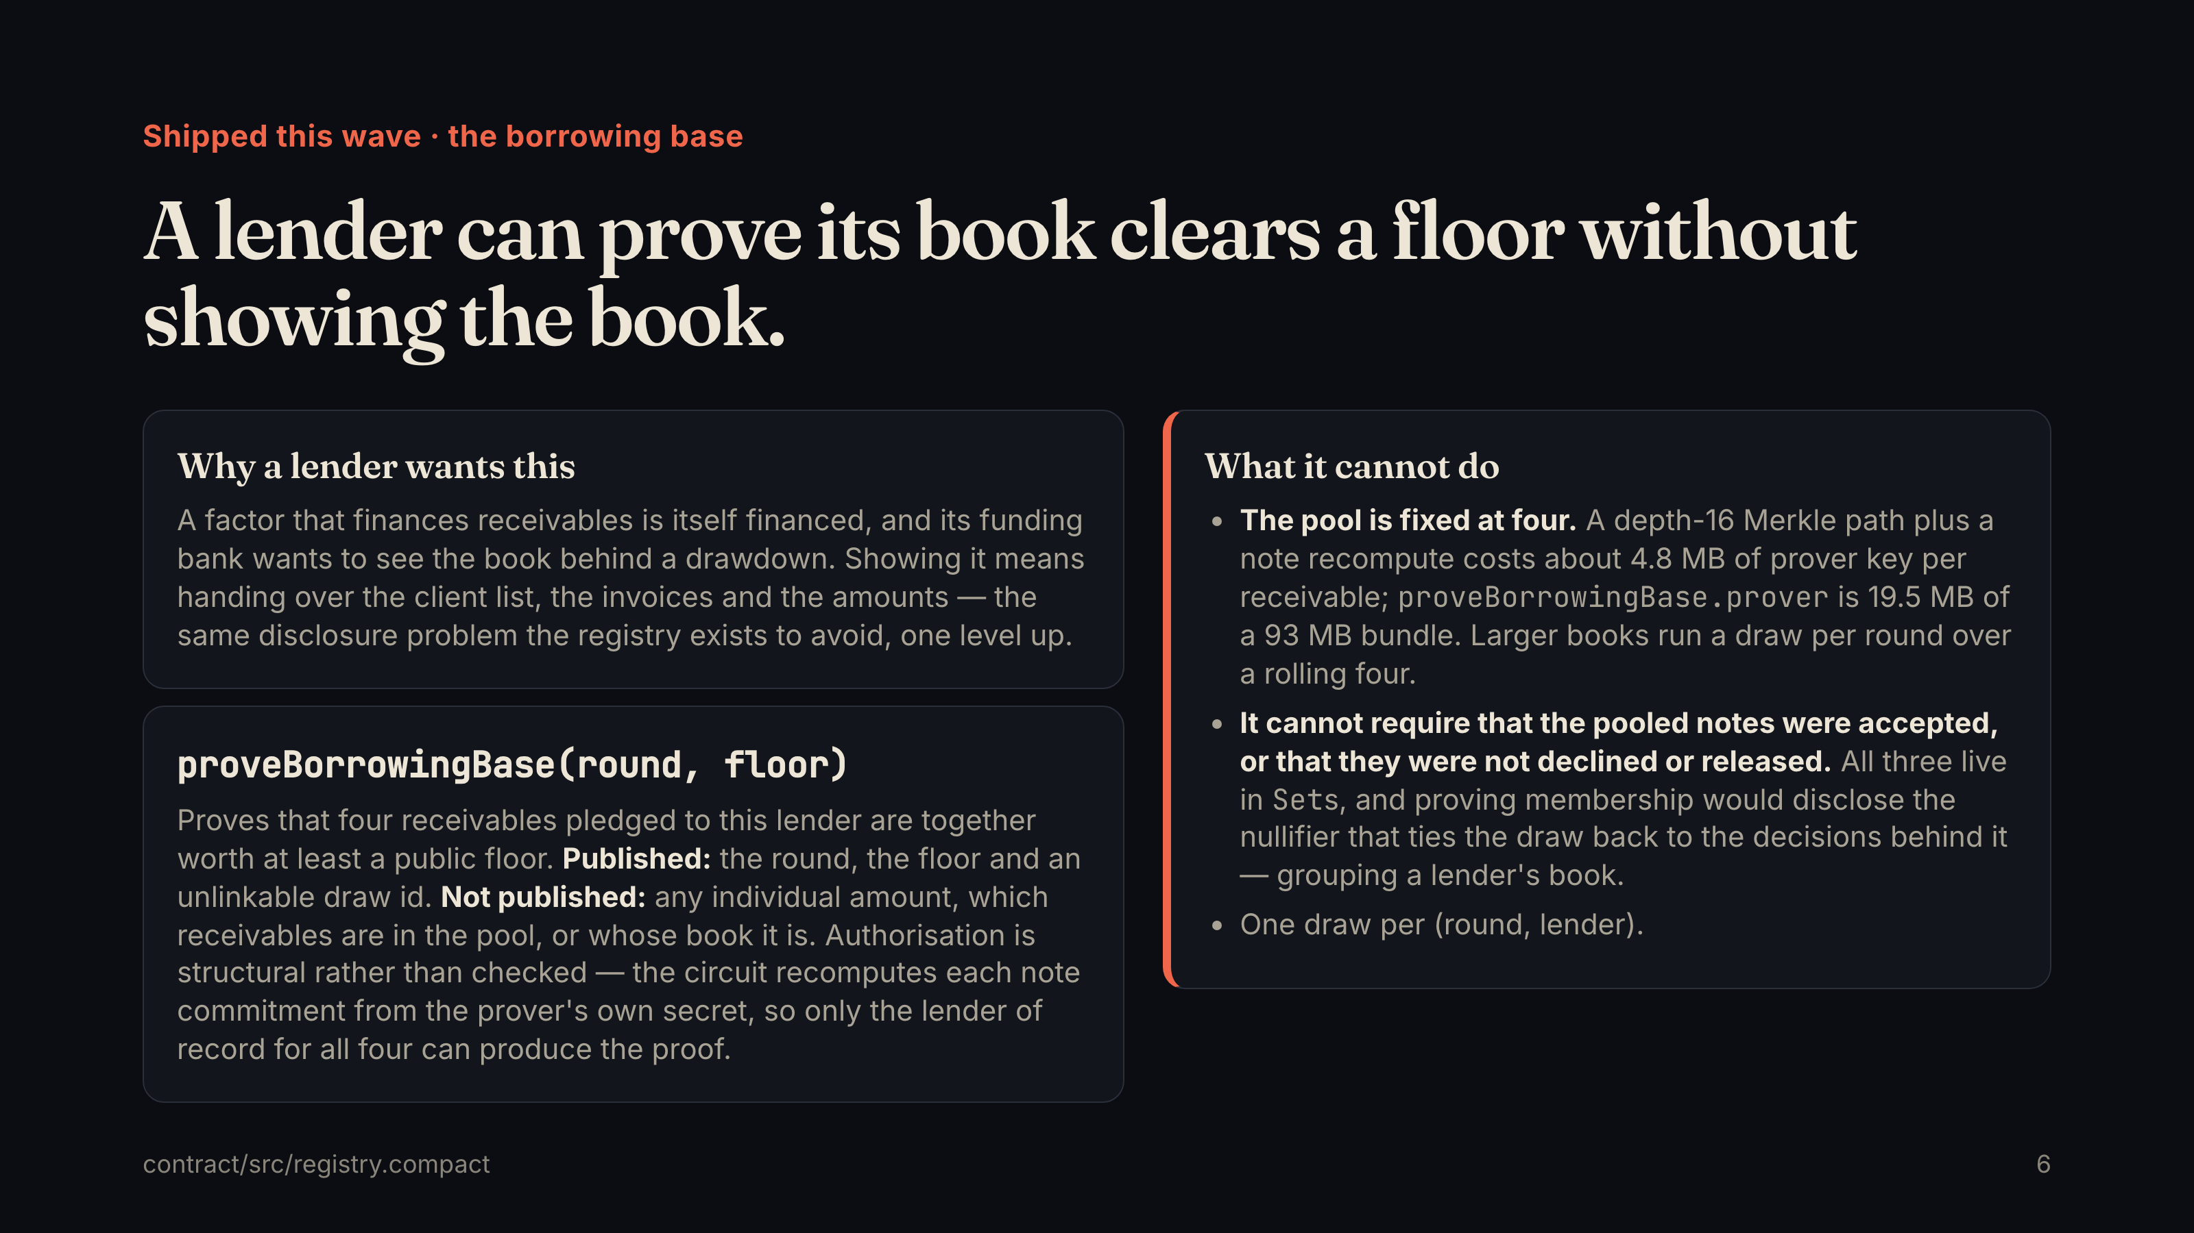
Notes:
Shipped this wave · the borrowing base A lender can prove its book clears a floor without showing the book. Why a lender wants this A factor that finances receivables is itself financed, and its funding bank wants to see the book behind a drawdown. Showing it means handing over the client list, the invoices and the amounts — the same disclosure problem the registry exists to avoid, one level up. proveBorrowingBase(round, floor) Proves that four receivables pledged to this lender are together worth at least a public floor. Published: the round, the floor and an unlinkable draw id. Not published: any individual amount, which receivables are in the pool, or whose book it is. Authorisation is structural rather than checked — the circuit recomputes each note commitment from the prover's own secret, so only the lender of record for all four can produce the proof. What it cannot do The pool is fixed at four. A depth-16 Merkle path plus a note recompute costs about 4.8 MB of prover key per receivable; proveBorrowingBase.prover is 19.5 MB of a 93 MB bundle. Larger books run a draw per round over a rolling four. It cannot require that the pooled notes were accepted, or that they were not declined or released. All three live in Set s, and proving membership would disclose the nullifier that ties the draw back to the decisions behind it — grouping a lender's book. One draw per (round, lender). contract/src/registry.compact 6

Slide 7
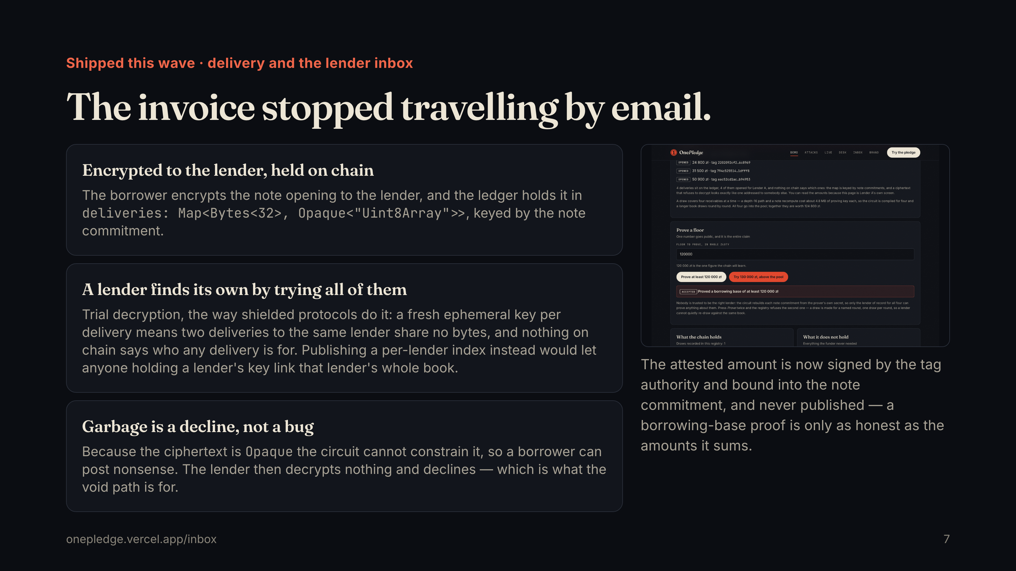
Notes:
Shipped this wave · delivery and the lender inbox The invoice stopped travelling by email. Encrypted to the lender, held on chain The borrower encrypts the note opening to the lender, and the ledger holds it in deliveries: Map<Bytes<32>, Opaque<"Uint8Array">> , keyed by the note commitment. A lender finds its own by trying all of them Trial decryption, the way shielded protocols do it: a fresh ephemeral key per delivery means two deliveries to the same lender share no bytes, and nothing on chain says who any delivery is for. Publishing a per-lender index instead would let anyone holding a lender's key link that lender's whole book. Garbage is a decline, not a bug Because the ciphertext is Opaque the circuit cannot constrain it, so a borrower can post nonsense. The lender then decrypts nothing and declines — which is what the void path is for. The attested amount is now signed by the tag authority and bound into the note commitment, and never published — a borrowing-base proof is only as honest as the amounts it sums. onepledge.vercel.app/inbox 7

Slide 8
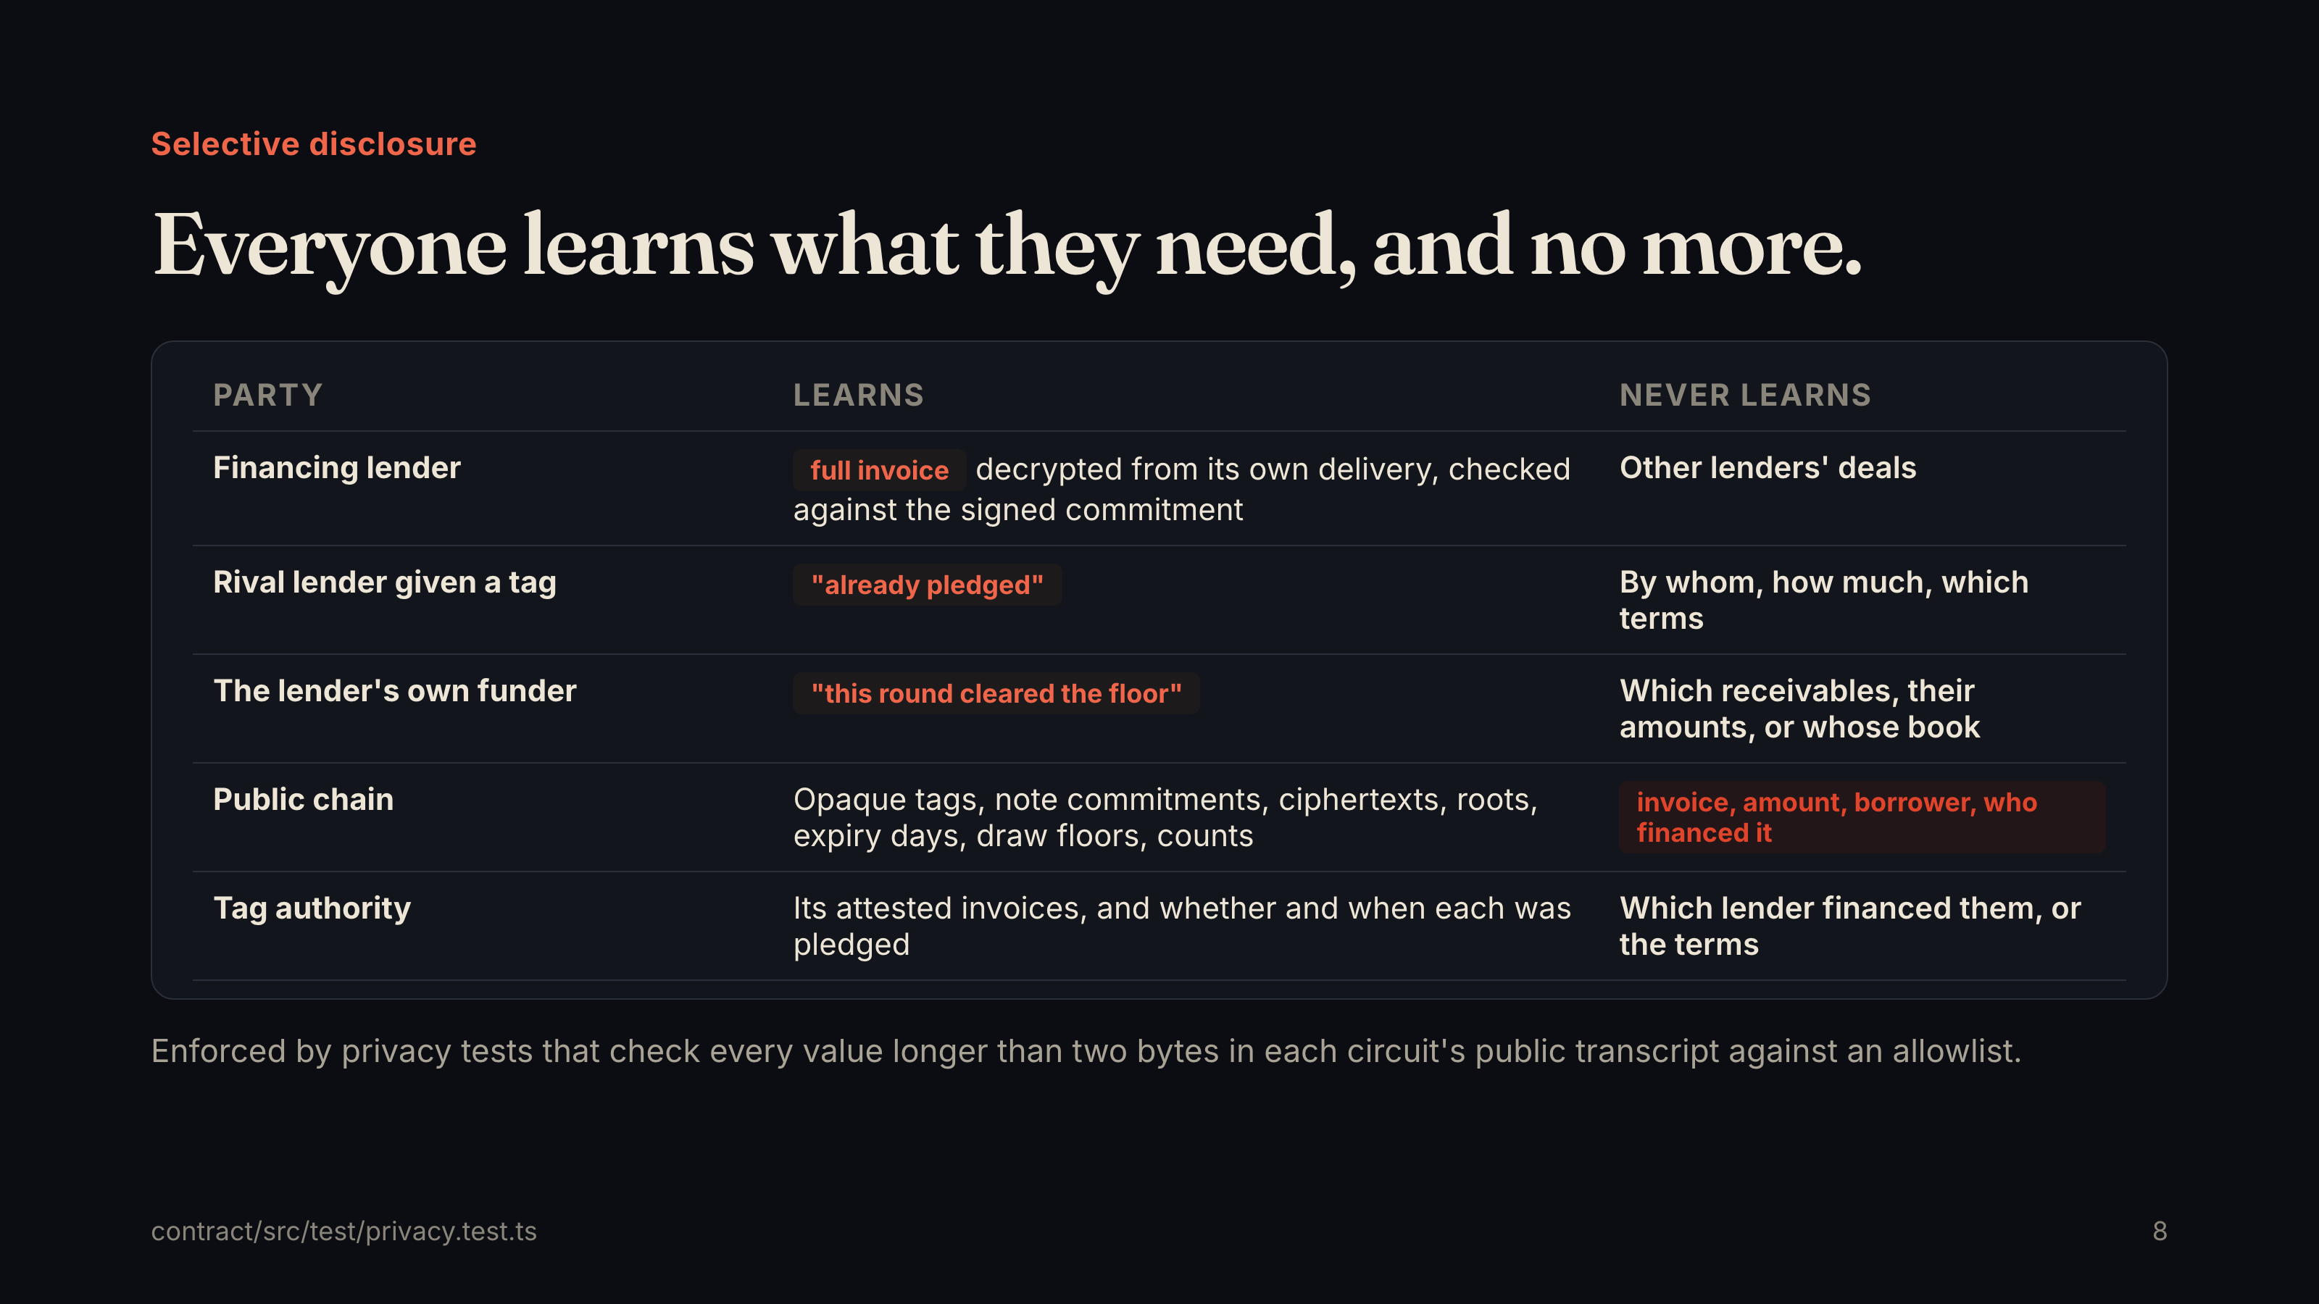
Notes:
Selective disclosure Everyone learns what they need, and no more. Party Learns Never learns Financing lender full invoice decrypted from its own delivery, checked against the signed commitment Other lenders' deals Rival lender given a tag "already pledged" By whom, how much, which terms The lender's own funder "this round cleared the floor" Which receivables, their amounts, or whose book Public chain Opaque tags, note commitments, ciphertexts, roots, expiry days, draw floors, counts invoice, amount, borrower, who financed it Tag authority Its attested invoices, and whether and when each was pledged Which lender financed them, or the terms Enforced by privacy tests that check every value longer than two bytes in each circuit's public transcript against an allowlist. contract/src/test/privacy.test.ts 8

Slide 9
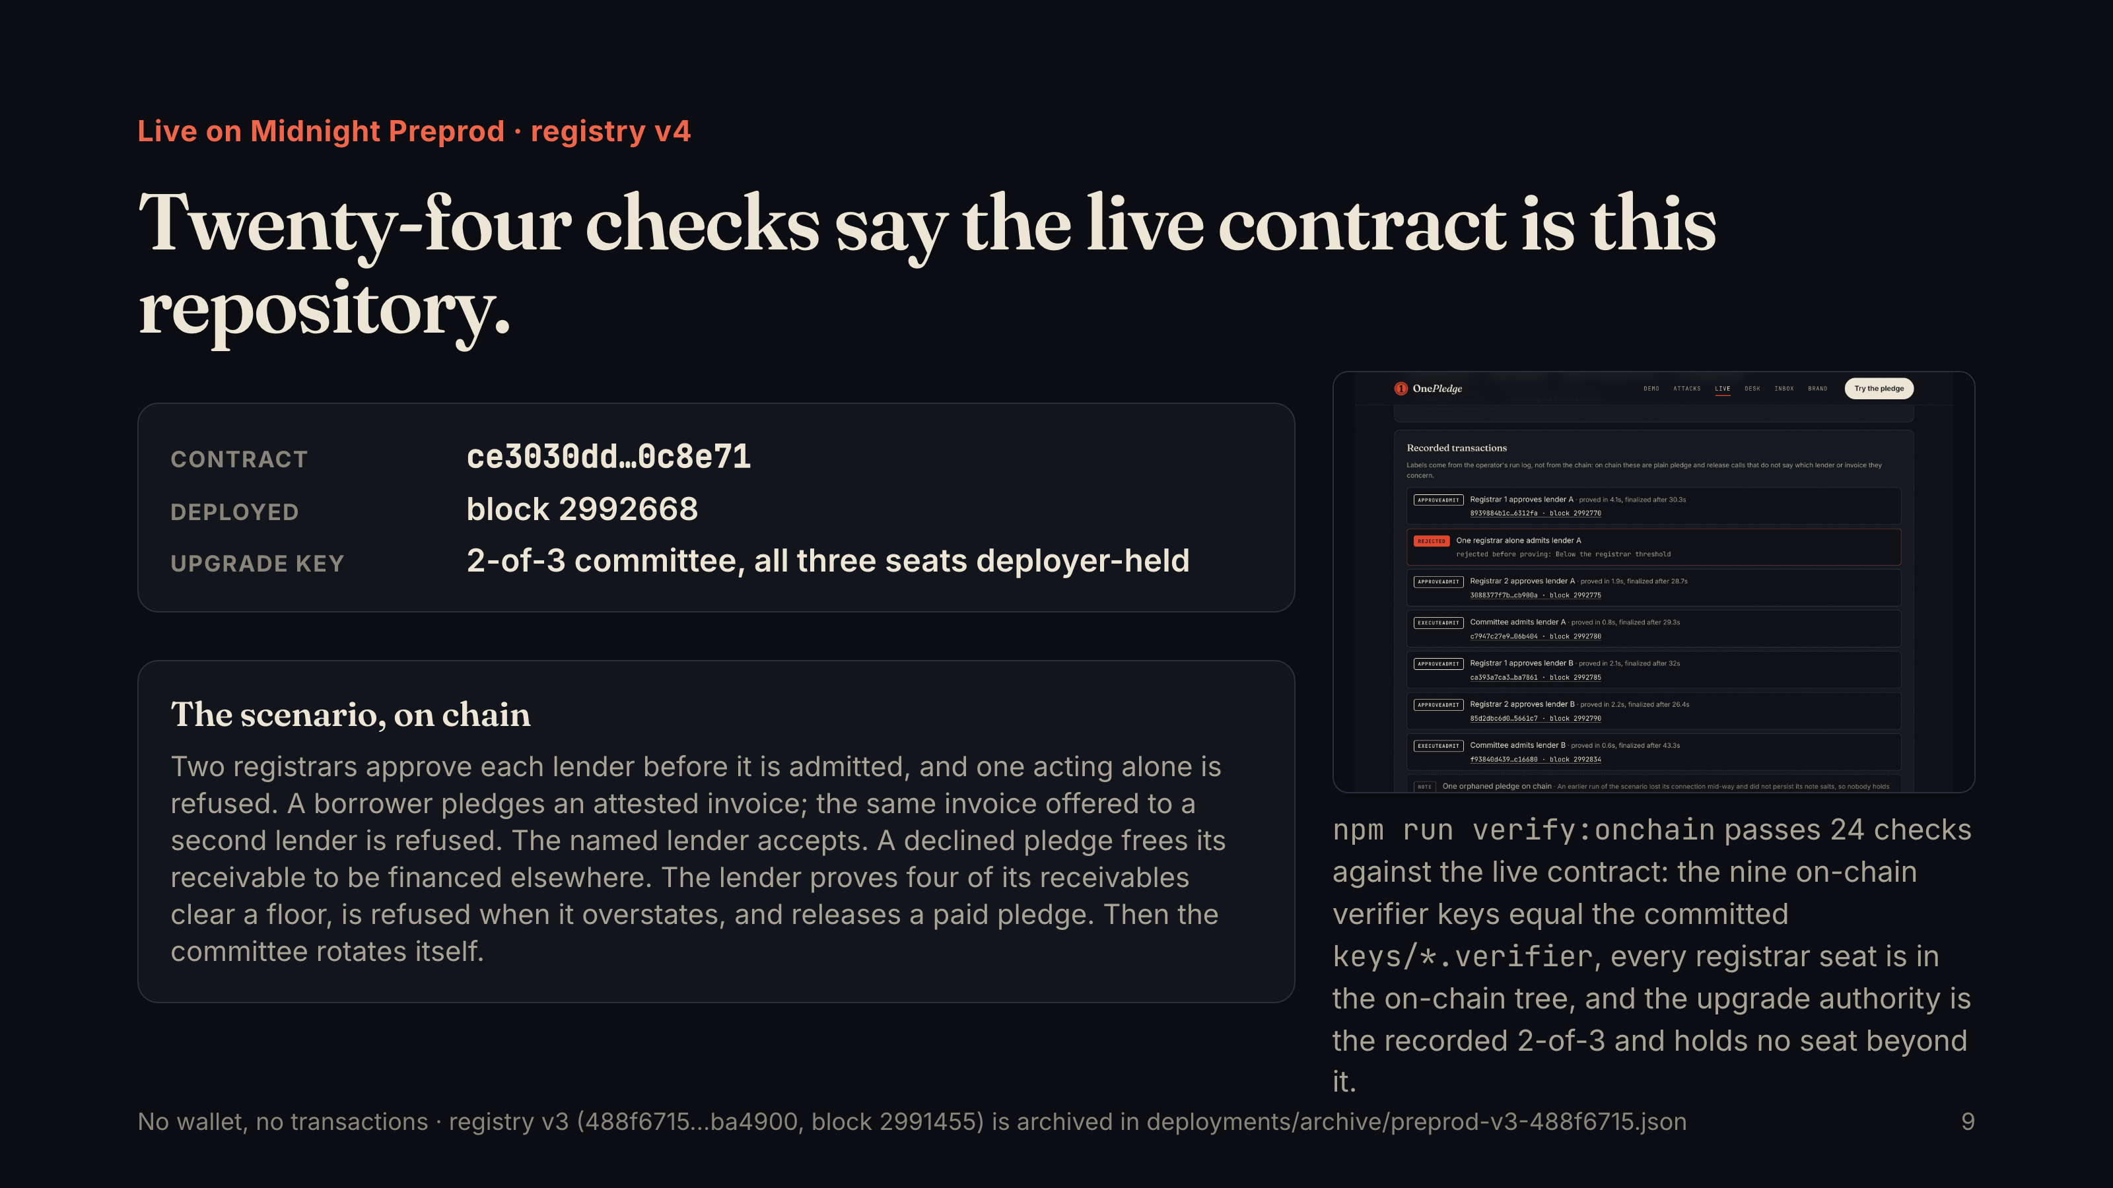
Notes:
Live on Midnight Preprod · registry v4 Twenty-four checks say the live contract is this repository. Contract ce3030dd…0c8e71 Deployed block 2992668 Upgrade key 2-of-3 committee, all three seats deployer-held The scenario, on chain Two registrars approve each lender before it is admitted, and one acting alone is refused. A borrower pledges an attested invoice; the same invoice offered to a second lender is refused. The named lender accepts. A declined pledge frees its receivable to be financed elsewhere. The lender proves four of its receivables clear a floor, is refused when it overstates, and releases a paid pledge. Then the committee rotates itself. npm run verify:onchain passes 24 checks against the live contract: the nine on-chain verifier keys equal the committed keys/*.verifier , every registrar seat is in the on-chain tree, and the upgrade authority is the recorded 2-of-3 and holds no seat beyond it. No wallet, no transactions · registry v3 (488f6715…ba4900, block 2991455) is archived in deployments/archive/preprod-v3-488f6715.json 9

Slide 10
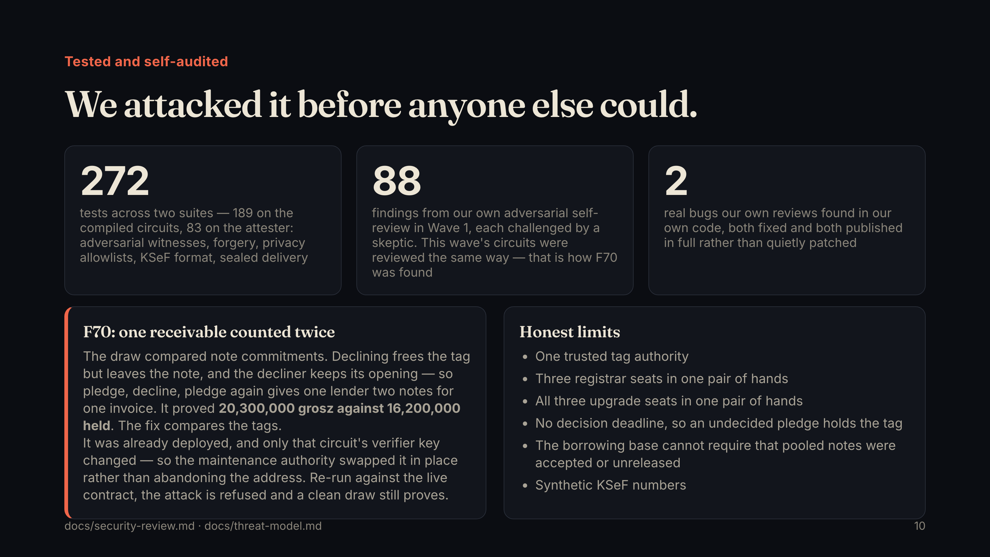
Notes:
Tested and self-audited We attacked it before anyone else could. 272 tests across two suites — 189 on the compiled circuits, 83 on the attester: adversarial witnesses, forgery, privacy allowlists, KSeF format, sealed delivery 88 findings from our own adversarial self-review in Wave 1, each challenged by a skeptic. This wave's circuits were reviewed the same way — that is how F70 was found 2 real bugs our own reviews found in our own code, both fixed and both published in full rather than quietly patched F70: one receivable counted twice The draw compared note commitments. Declining frees the tag but leaves the note, and the decliner keeps its opening — so pledge, decline, pledge again gives one lender two notes for one invoice. It proved 20,300,000 grosz against 16,200,000 held . The fix compares the tags. It was already deployed, and only that circuit's verifier key changed — so the maintenance authority swapped it in place rather than abandoning the address. Re-run against the live contract, the attack is refused and a clean draw still proves. Honest limits One trusted tag authority Three registrar seats in one pair of hands All three upgrade seats in one pair of hands No decision deadline, so an undecided pledge holds the tag The borrowing base cannot require that pooled notes were accepted or unreleased Synthetic KSeF numbers docs/security-review.md · docs/threat-model.md 10

Slide 11
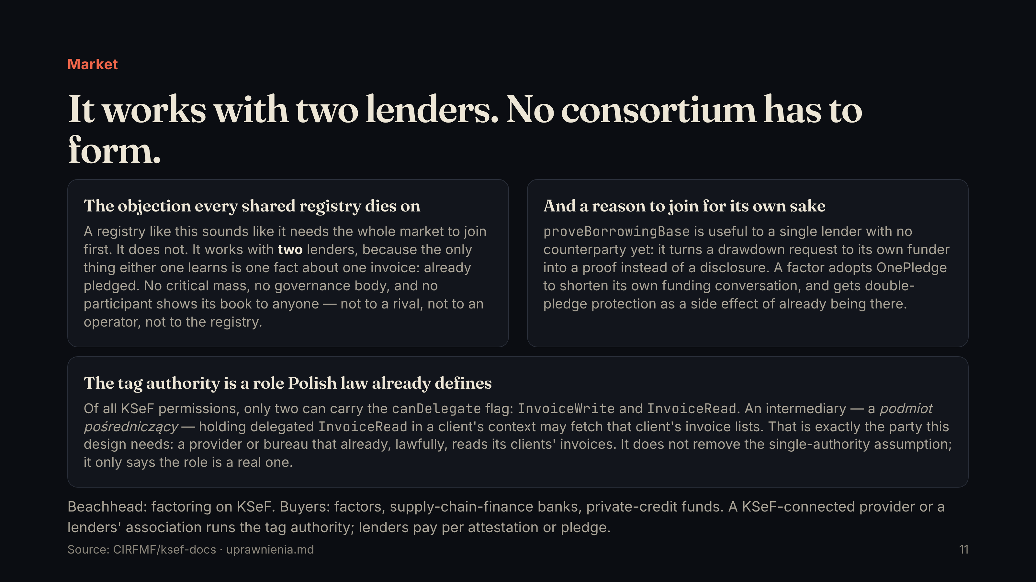
Notes:
Market It works with two lenders. No consortium has to form. The objection every shared registry dies on A registry like this sounds like it needs the whole market to join first. It does not. It works with two lenders, because the only thing either one learns is one fact about one invoice: already pledged. No critical mass, no governance body, and no participant shows its book to anyone — not to a rival, not to an operator, not to the registry. And a reason to join for its own sake proveBorrowingBase is useful to a single lender with no counterparty yet: it turns a drawdown request to its own funder into a proof instead of a disclosure. A factor adopts OnePledge to shorten its own funding conversation, and gets double-pledge protection as a side effect of already being there. The tag authority is a role Polish law already defines Of all KSeF permissions, only two can carry the canDelegate flag: InvoiceWrite and InvoiceRead . An intermediary — a podmiot pośredniczący — holding delegated InvoiceRead in a client's context may fetch that client's invoice lists. That is exactly the party this design needs: a provider or bureau that already, lawfully, reads its clients' invoices. It does not remove the single-authority assumption; it only says the role is a real one. Beachhead: factoring on KSeF. Buyers: factors, supply-chain-finance banks, private-credit funds. A KSeF-connected provider or a lenders' association runs the tag authority; lenders pay per attestation or pledge. Source: CIRFMF/ksef-docs · uprawnienia.md 11

Slide 12
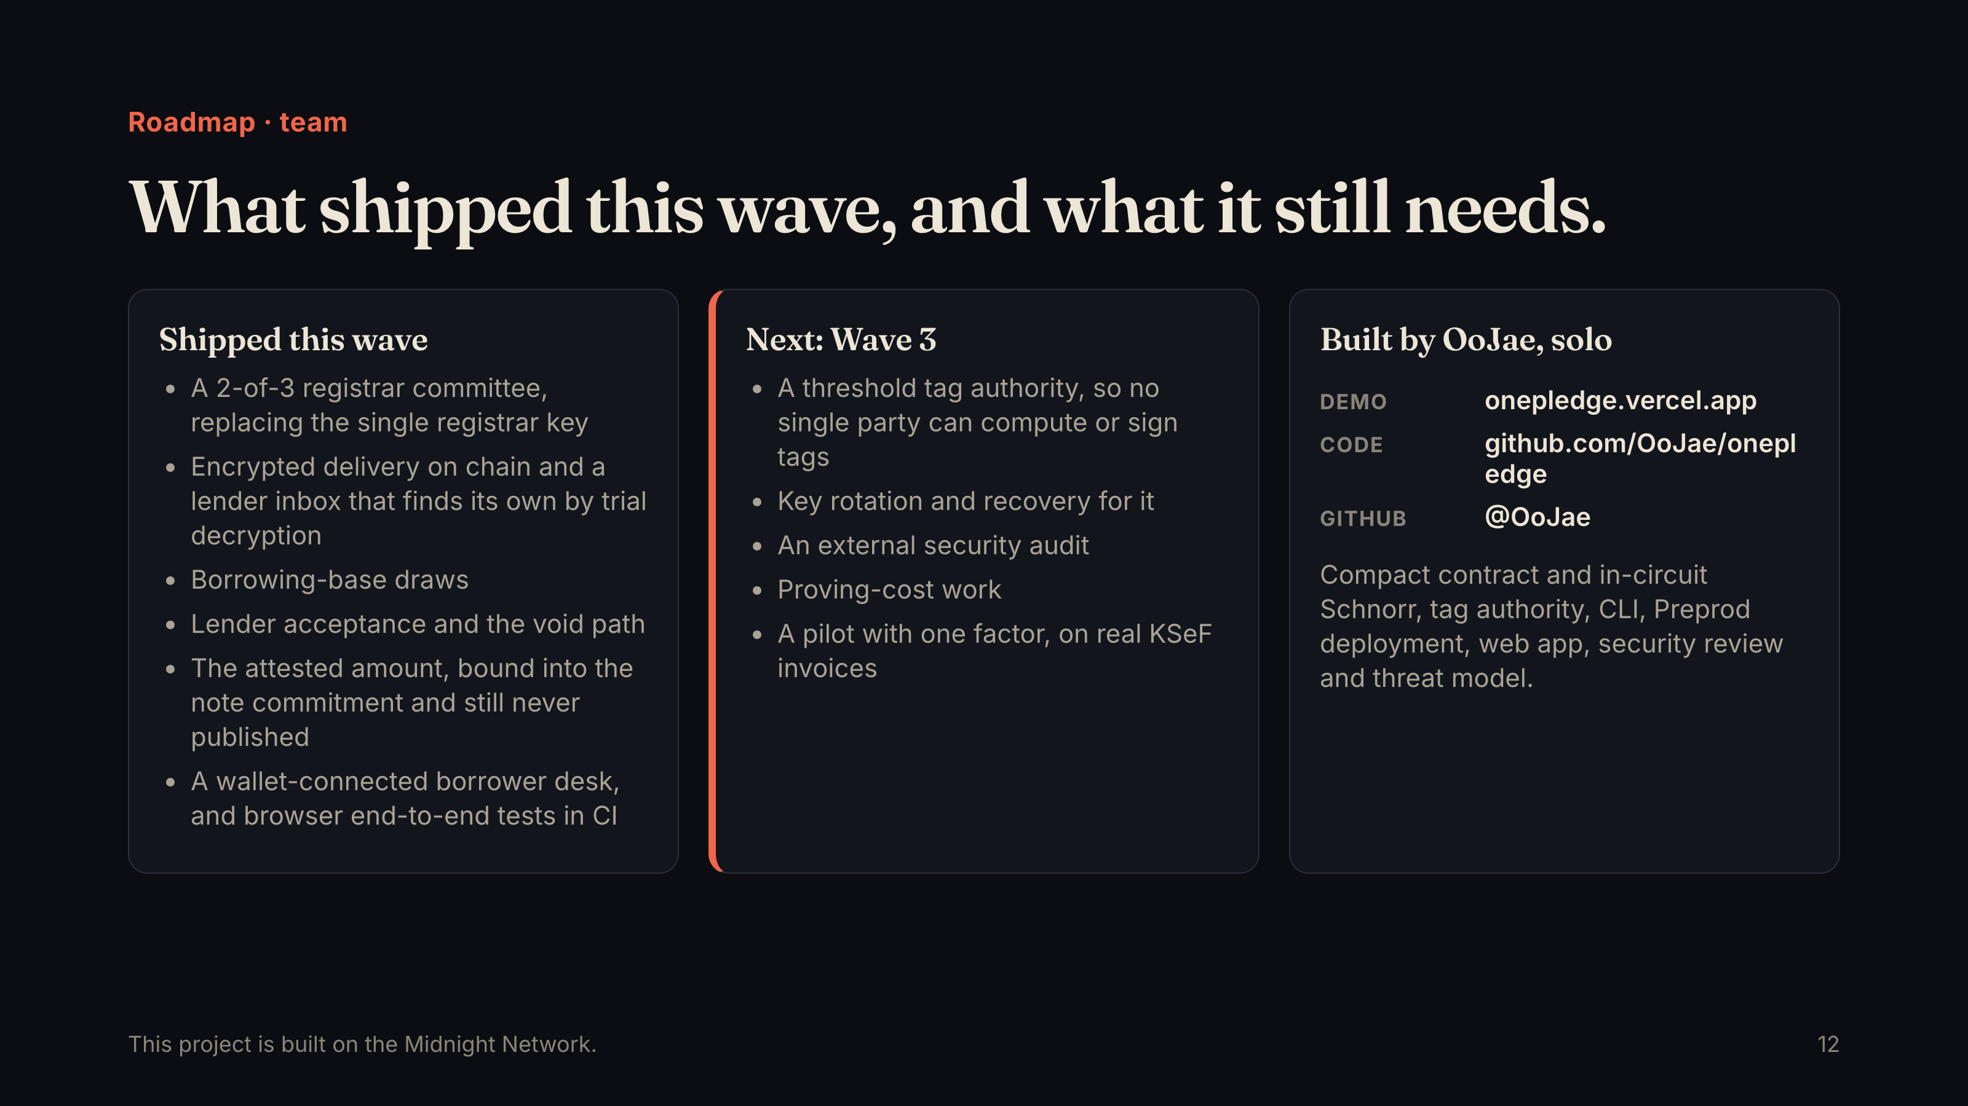
Notes:
Roadmap · team What shipped this wave, and what it still needs. Shipped this wave A 2-of-3 registrar committee, replacing the single registrar key Encrypted delivery on chain and a lender inbox that finds its own by trial decryption Borrowing-base draws Lender acceptance and the void path The attested amount, bound into the note commitment and still never published A wallet-connected borrower desk, and browser end-to-end tests in CI Next: Wave 3 A threshold tag authority, so no single party can compute or sign tags Key rotation and recovery for it An external security audit Proving-cost work A pilot with one factor, on real KSeF invoices Built by OoJae, solo Demo onepledge.vercel.app Code github.com/OoJae/onepledge GitHub @OoJae Compact contract and in-circuit Schnorr, tag authority, CLI, Preprod deployment, web app, security review and threat model. This project is built on the Midnight Network. 12

