Slide 1
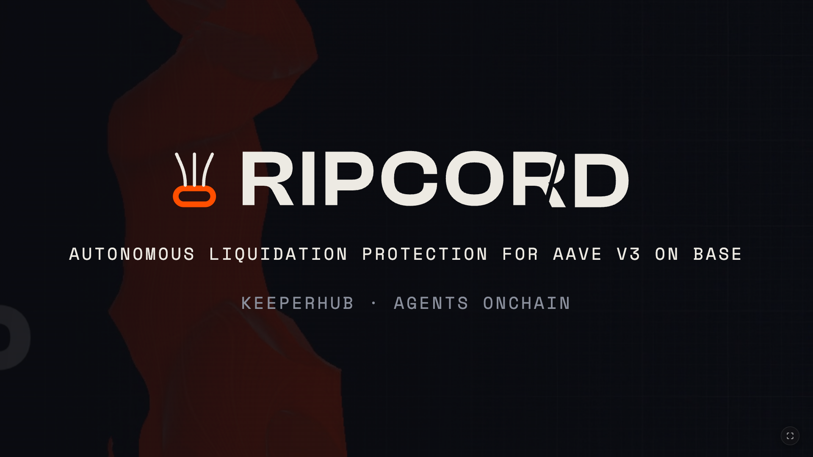
Notes:
0:00-0:20 - Hi, I'm Oluwademilade, and this is Ripcord: autonomous liquidation protection for Aave V3 on Base, built solo. What's breathing behind the logo is the real product - the live site. Everything in this deck happened on Base mainnet and is publicly auditable.

Slide 2

Notes:
0:20-0:45 - Every DeFi loan has one number that matters. The health factor. When it touches one point zero, your collateral gets sold - by a stranger, at a discount, automatically.

Slide 3
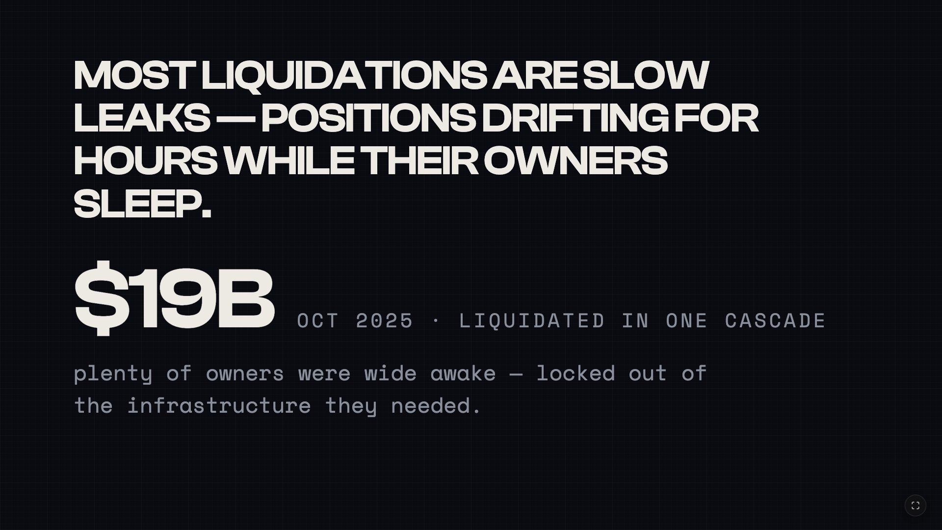
Notes:
0:45-1:15 - Most liquidations aren't lightning strikes. They're slow leaks - a position drifting for hours while its owner sleeps. And in October 2025, nineteen billion dollars liquidated in a single cascade - and plenty of owners were wide awake. They were locked out of the infrastructure they needed to save themselves. Every existing tool watches your position. Watching is not protection. Somebody has to pull.

Slide 4
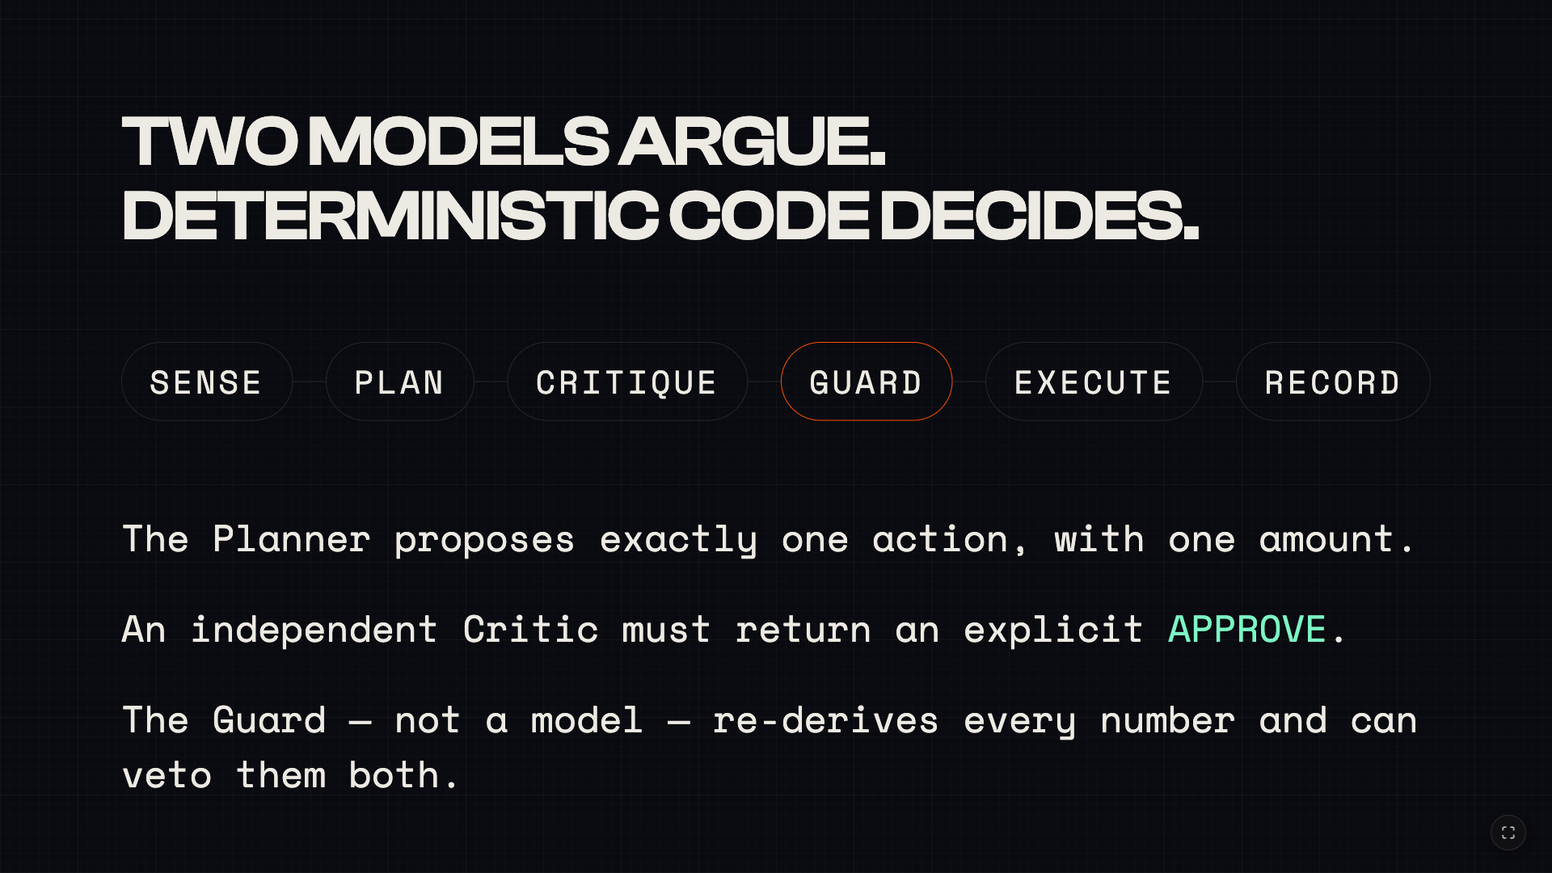
Notes:
1:15-1:50 - Ripcord is the part that acts, and this is the whole system on one line. A sensor reads the chain - reads only. A planner LLM proposes exactly one action. A second, independent LLM - the Critic - has to return an explicit APPROVE. And then the Guard, which is not a model, re-derives every number they claimed and can veto them both. Two models argue; deterministic code decides. Execution goes out through KeeperHub, and everything is recorded under one decision id.

Slide 5
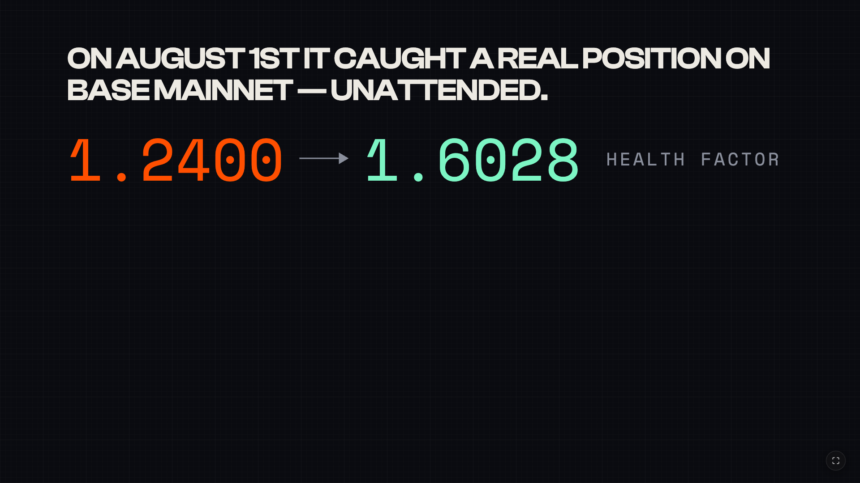
Notes:
1:50-2:25 - THE CENTERPIECE, SLOW DOWN. This is not a simulation. On the 1st of August, a real position on Base mainnet slid into the act band, and Ripcord caught it unattended. Health factor 1.24 back to 1.60. $6.78 repaid - the exact figure the Guard re-derived. 21 seconds from sensing the danger to the transaction landing. Gas 184,531, fully sponsored - the wallet needed no ETH for it. Guard: 12 of 12 checks, zero violations.

Slide 6
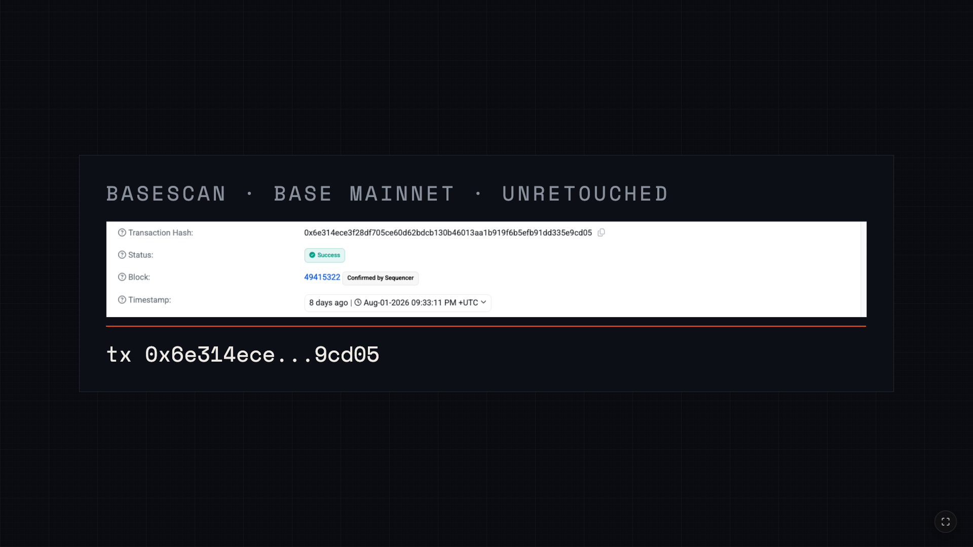
Notes:
2:25-2:40 - And here is the receipt. Basescan, unretouched. That hash is in the submission - you can check it while I talk.

Slide 7
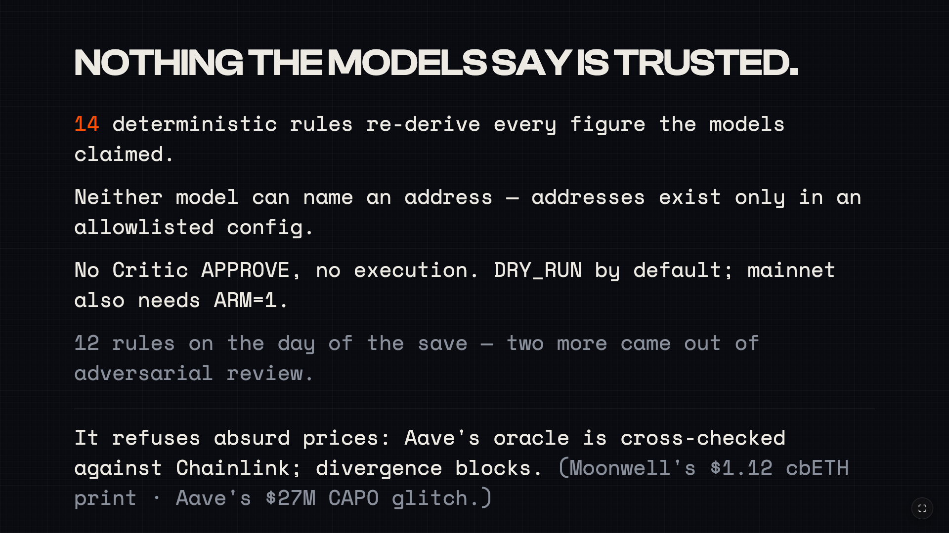
Notes:
2:40-3:20 - The reason to trust this is that nothing the models say is trusted. The Guard is 14 deterministic rules today - it was 12 on the day of the save; the other two came out of adversarial review. It re-derives the math. Neither model can name an address - addresses exist only in an allowlisted config. No APPROVE, no execution. DRY_RUN is the default, and mainnet writes need a separate arm flag. And one gate I want to call out: 2026's worst liquidations were bad PRICES, not slow drift - Moonwell's $1.12 cbETH print, Aave's $27M CAPO glitch. No poller out-races a block, but an agent can refuse to act on an absurd price. Ripcord cross-checks Aave's oracle against Chainlink and blocks on divergence.

Slide 8
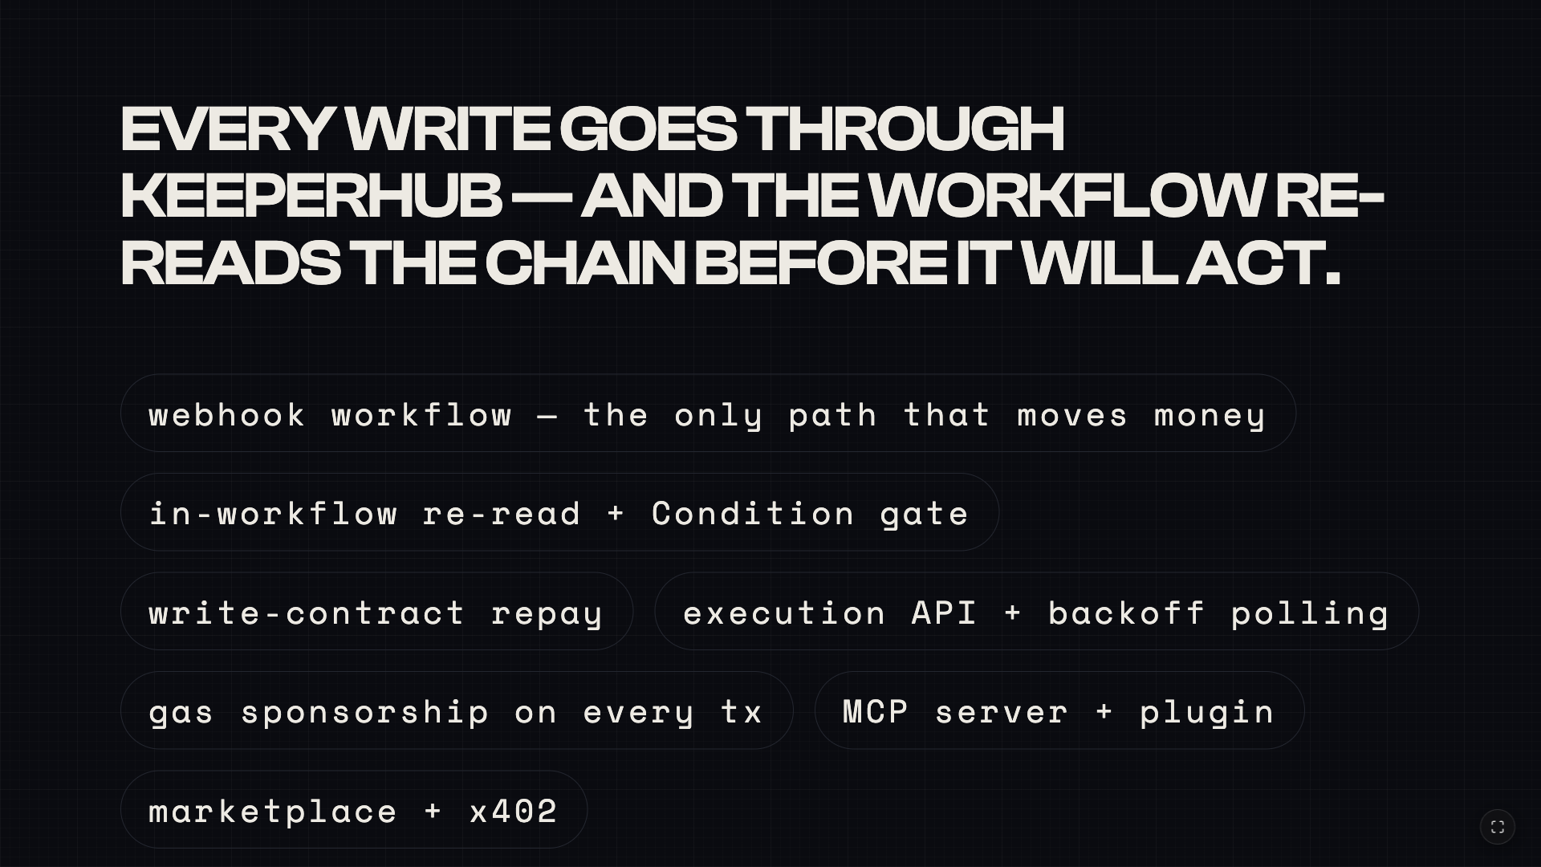
Notes:
3:20-3:50 - Every write goes through KeeperHub - the daemon holds no keys and viem is reads-only. The defend workflow re-reads the chain inside the workflow and gates on it, so even a compromised daemon can't push a stale defense through. Around it: the execution API with backoff polling, gas sponsorship on every transaction, the MCP server I built with, and the marketplace. This isn't KeeperHub as a webhook - it's KeeperHub as the execution layer.

Slide 9
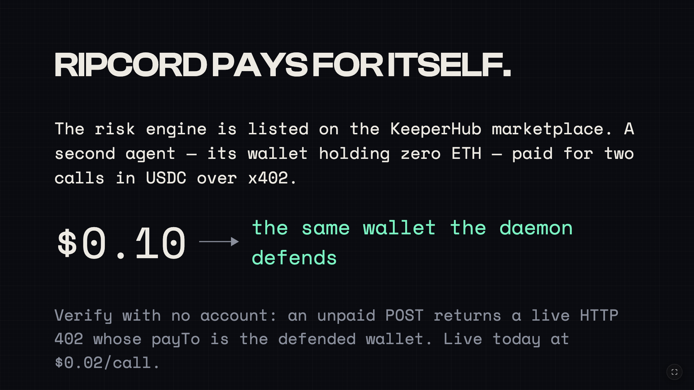
Notes:
3:50-4:20 - And it pays for itself. The risk engine is listed on the KeeperHub marketplace. A second, independent agent wallet - holding zero ETH - paid for two calls in USDC over x402, and that revenue, ten cents, landed in the same wallet the daemon defends. You can verify this with no account: an unpaid POST to the slug returns a live HTTP 402 whose payTo IS the defended wallet. It's live today at two cents a call.

Slide 10
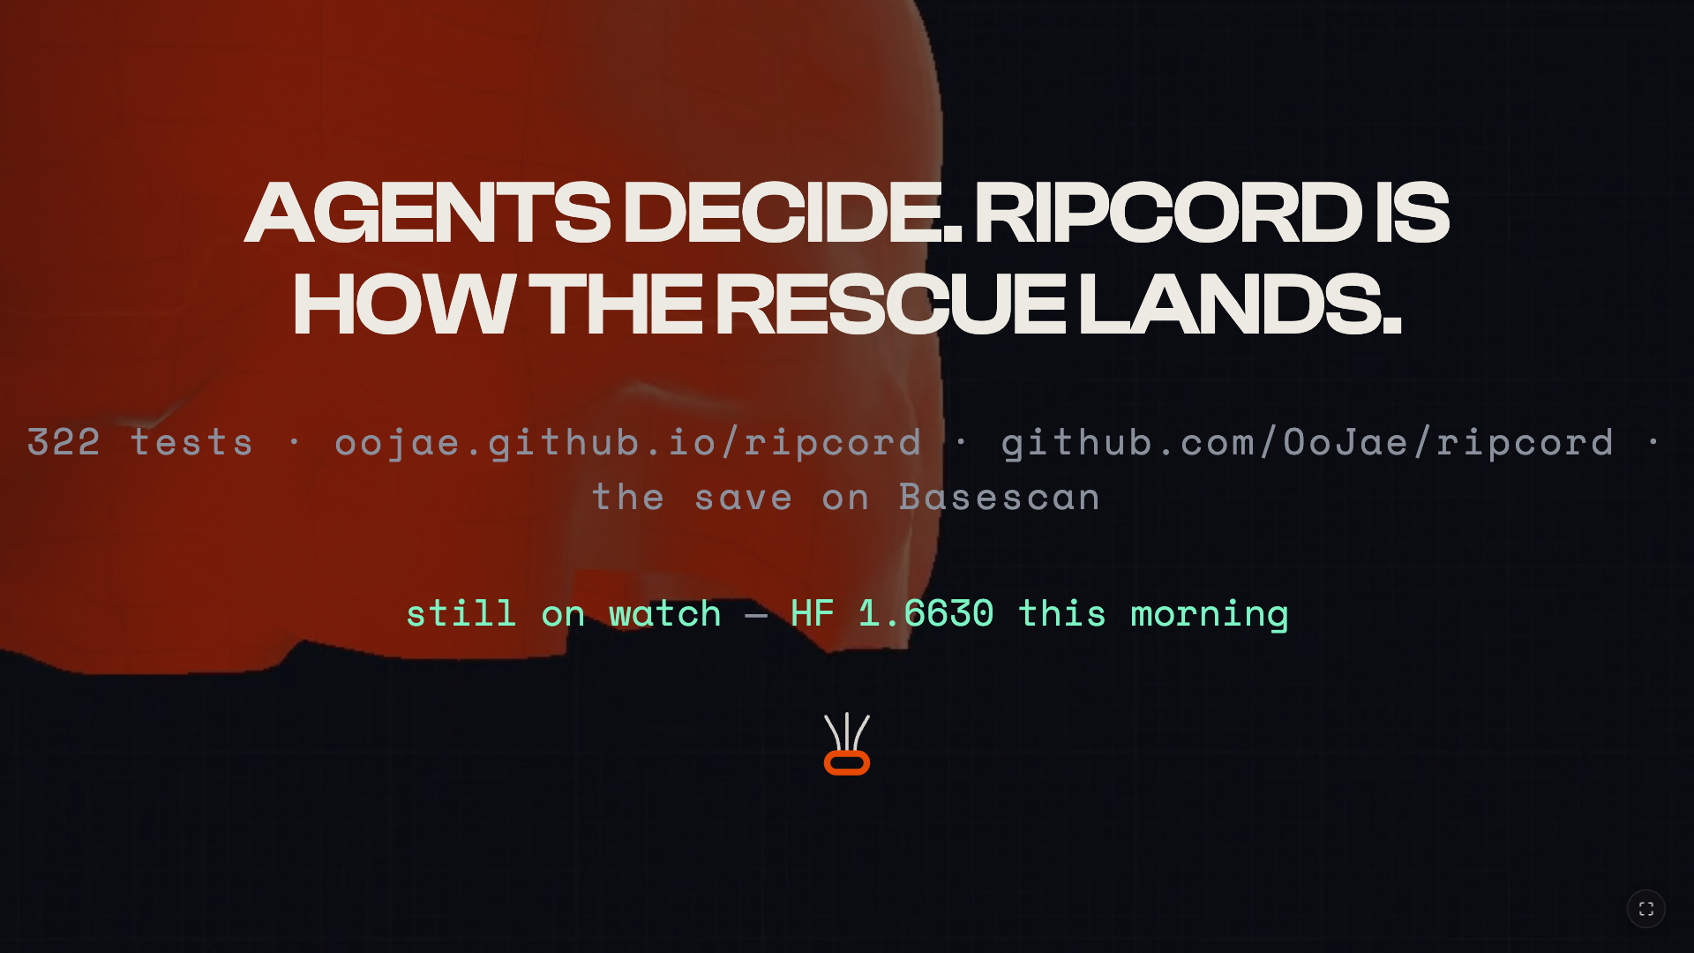
Notes:
4:20-5:00 - Agents decide. Ripcord is how the rescue lands. 322 tests, a live site, a 2-minute film, a transaction on Basescan - and it is still on watch: the position read one point six six this morning. Behind me, that is the canopy catching. I'm happy to take questions - and if you only open one link, make it FRICTION.md.

