Slide 1
CS 5513 Advanced Database Management Project Final Presentation
CS-5513-001 / Spring 2024
Team# 5

Slide 2
Team Members Team #5
Mounica Pragyna Ravilla
Oohasripriya Nandipati
Farhan Hussain Abedi Syed

Slide 3
Project Title:
EXTENDING THE TIME-STAMP ORDERING TECHNIQUE IN SQLITE OF HCTREE AND PERFORMING COMPARATIVE ANALYSIS.
YouTube Link to More details about Project:
https://www.youtube.com/watch?v=B7IhTgCkY-s
https://youtu.be/W9XFH14UGYE

Slide 4
Outline
Abstract
Introduction
Related Work
Proposed Work and Results
Conclusion and Future Work
Demo.

Slide 5
Abstract
In this project we propose an implementation of an algorithm for the basic timestamp-ordering concurrency control in centralized database system (SQLite) to improve the degree of concurrency. This project conducts comparative simulation experiments between Hctree, a specialized backend for SQLite, and SQLite itself, evaluating their respective performances alongside the timestamp ordering algorithm integrated within SQLite.

Slide 6
Introduction.
What is Concurrency Control?
Which Concurrency Control SQLite is using?
What is the Concept of HCtree ?
Why this project is important ?
What are we Comparing?

Slide 7
Related Work
Performance Analysis of an Optimistic and a basic Timestamp-Ordering Concurrency Control Algorithms in Centralized Database Systems :
This paper compares optimistic and Timestamp-Ordering concurrency control algorithms in centralized database systems, concluding that the optimistic approach is more suitable for retrieval-dominant transaction mixes. It provides insights into the functionality of the timestamp algorithm, pertinent to our project aimed at enhancing concurrency control in SQLite.

Slide 8
Scalable Timestamp Allocation for Deadlock Prevention in Two-phase Locking based Protocols:
This literature introduces Bamboo, a protocol extending 2PL Wound-Wait, but proposes decentralization methods like FairTID and RandID to mitigate the centralized counter bottleneck, achieving significant throughput improvements. While focused on 2PL optimization, our project diverges by employing timestamp ordering and conducting comparative analysis between SQLite and HCTree.

Slide 9
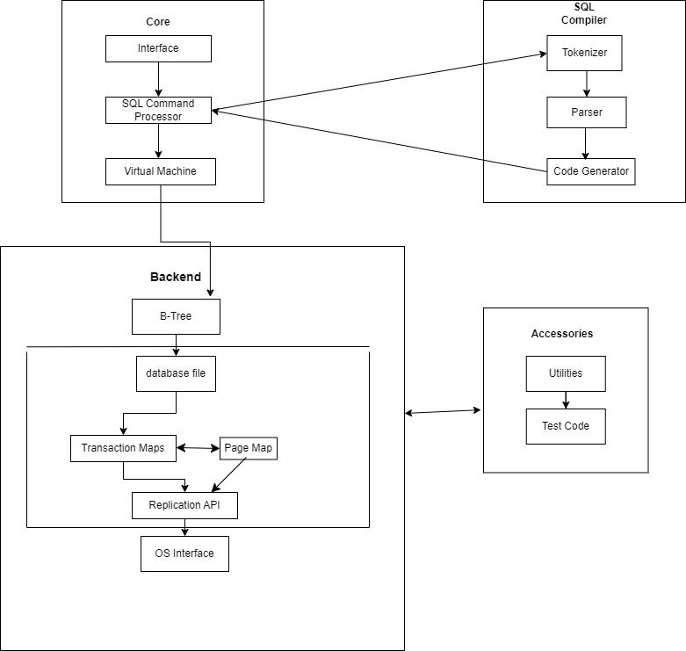
Proposed work
SYSTEM DIAGRAM OF SQLITE:

Slide 10
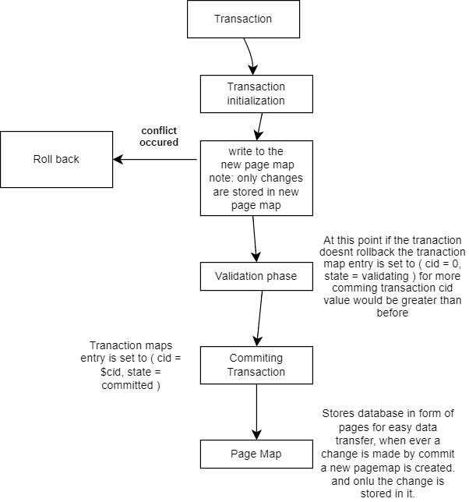
SQLite Transaction Process :

Slide 11
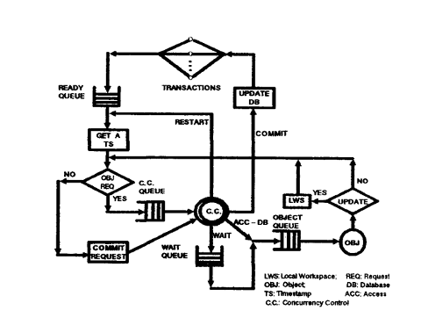
Logical Querying Model for the Timestamp:

Slide 12
Implementation
Modifying SQLite3:
Data Structure Changes
Key Functions Modified/Added:
●‘sqlite3BeginTransaction’ : Initializes the transaction timestamps.
●‘get_current_timestamp’: Fetches the current system time, converting it into an integer.
●‘can_proceed’: Checks the transaction timestamps against last modified timestamps to maintain data integrity.
●‘modify_data’: Enforces timestamp rules before data modification.
●‘sqlite3CommitTransaction’: Performs final checks against the transaction's timestamp
●‘sqlite3RollbackTransaction’: Reverts any changes made during the transaction
Integration Challenges:
Existing locking mechanism is hard to remove and it’s difficult to integrate new timestamp concurrency mechanism.

Slide 13
SQLite code changes
1.Function: sqlite3BeginTransaction:
Detail modifications to this function to include timestamp initialization.
void sqlite3BeginTransaction(sqlite3 *db) {
db->transactionTimestamp = get_current_timestamp();
}
2. Function: get_current_timestamp
Purpose: Generate a real-time timestamp when a transaction begins. int get_current_timestamp() {
return (int)time(NULL); // Returns the current system time as an integer.
}
3. Function: can_proceed:
Role: Ensure that a transaction can proceed based on its timestamp compared to data modification times.
int can_proceed(sqlite3 *db, int lastModifiedTimestamp) {
return db->transactionTimestamp > lastModifiedTimestamp;
}

Slide 14
Code changes
4. Function: modify_data:
Modifications to include timestamp checking before data changes are committed.
int modify_data(sqlite3 *db, int lastModifiedTimestamp, char* data) {
if (can_proceed(db, lastModifiedTimestamp)) {
// Data modification logic here
return 1; // Success
} else {
return 0; // Fail due to timestamp conflict
}
}
5. Function: sqlite3CommitTransaction:
Details on how timestamp checks are integrated into the transaction commit process.
int sqlite3CommitTransaction(sqlite3 *db) {
// Additional timestamp validation logic before committing
// Commit transaction if valid
}

Slide 15
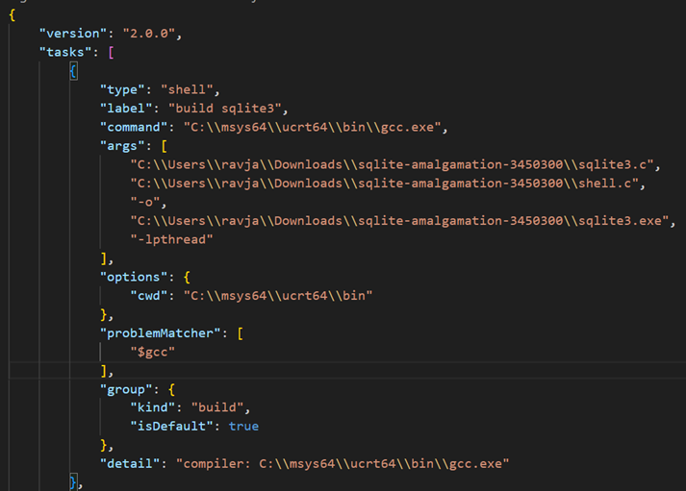
Build Process
Visual Studio Code compiles the sqlite3.c and shell.c to create an executable file.
GCC compiler is used.
Build tasks are written as follows

Slide 16
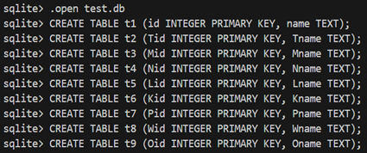
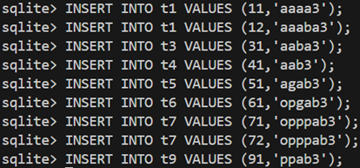
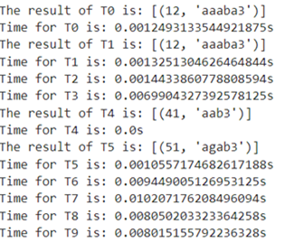
Test Process
●To test the SQLite execution a new database with tables are created.
●A python script is used to create multithreaded scenario to test the concurrency mechanism
●The results of this script test shows the time taken for execution

Slide 17
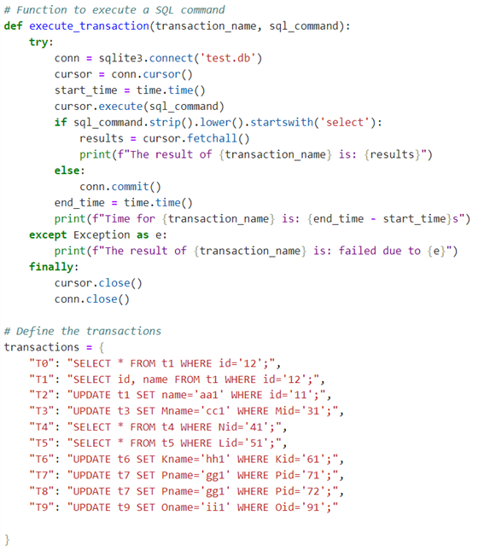
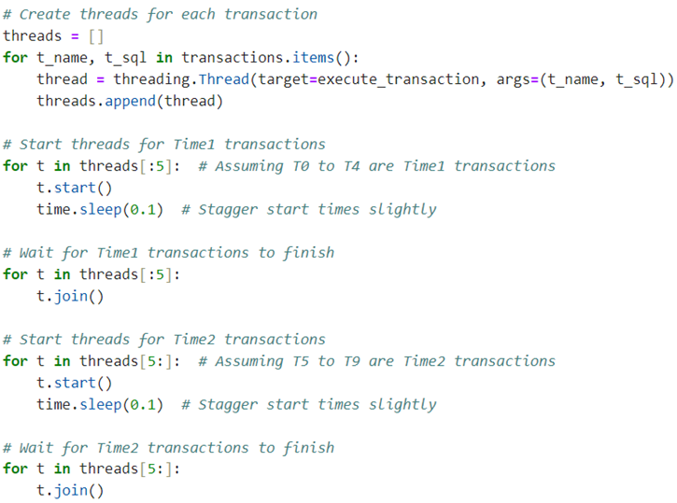
Python Script

Slide 18
Performing Benchmarks
We performed 2 tests that are for the following use:
Concurrency Test
Query Performance test
For Concurrency Test
Mptest.c
Config01.test
Multiwrite01.test
MPplot.py
For Query Performance Test
performanceTest.py
PerformancePlot.py

Slide 19
System that we used:
Hardware Specifications
Processor (CPU): Intel® Core™ i7-12700H Processor 2.3 GHz (24M Cache, up to 4.7 GHz, 6P+8E cores)
Memory (RAM): 16GB DDR5 SO-DIMM
Storage: 1TB M.2 NVMe PCIe 4.0 Performance SSD
Graphics Card: NVIDIA® GeForce® RTX™ 3060 Laptop GPU 6GB GDDR6
Network: Wi-Fi 6(802.11ax)+Bluetooth 5.0 (Dual band) 2*2
Software Specifications
Operating System: Windows 11 Home
Database System: SQLite 3.36.0
Programming Language: Python 3.9.5
Libraries and Dependencies: numpy 1.21.0, pandas 1.3.0, matplotlib 3.4.2

Slide 20
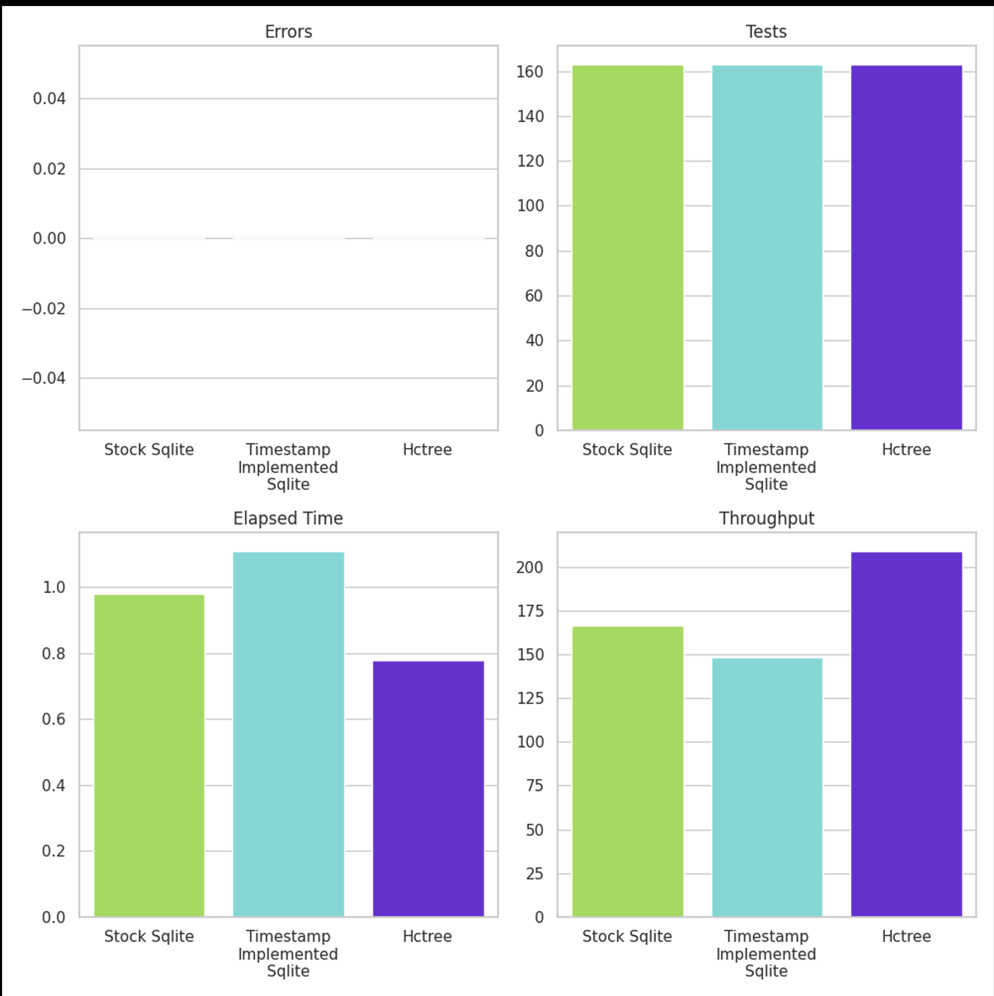
Outcome and Conclusion of Concurrency Test
Zero Errors in all the systems
HC tree had better results
Better Elapsed Time
Better Throughput
Sqlite with Timestamp Implementation has high Elapsed time and low Throughput
OUTCOME of Concurreny Test
In this case
Throughput is measured in Operations/Second
Elapsed Time is measured in seconds

Slide 21
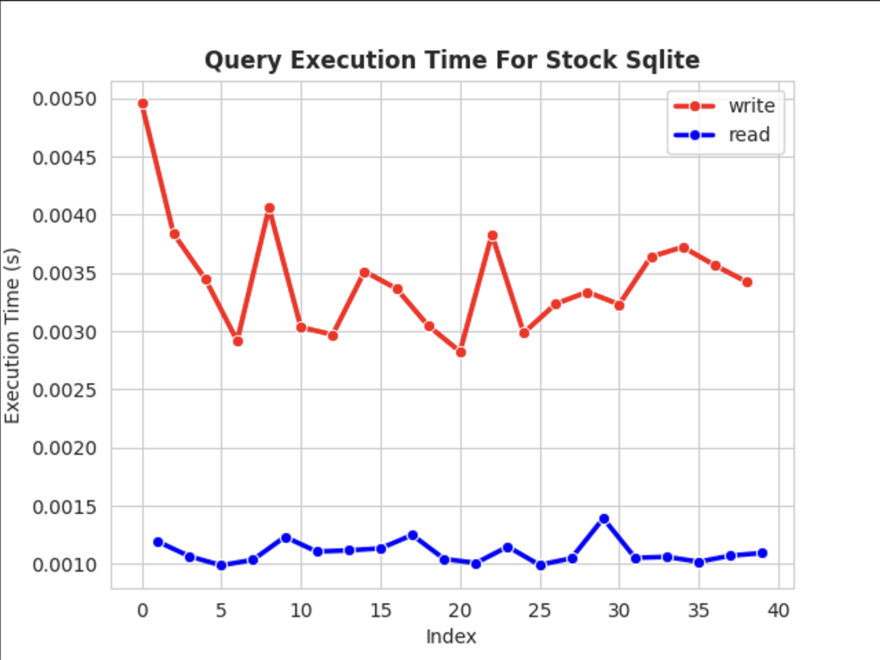
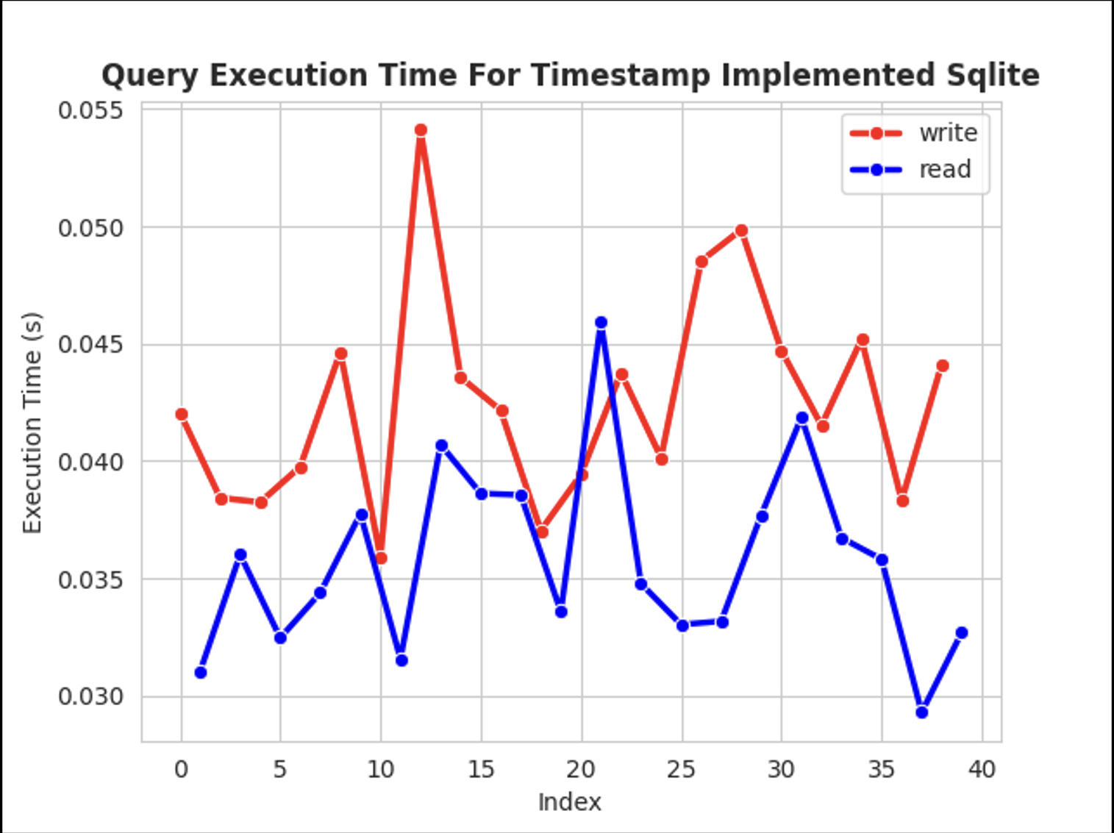
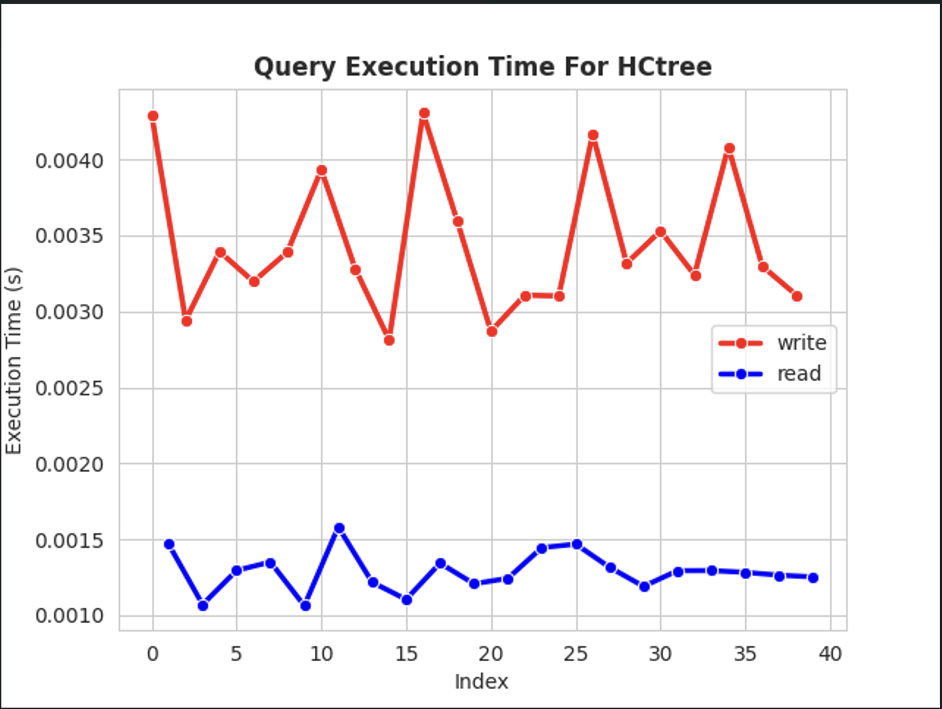
Performance Tests
X-axis: Number of threads
Y-axis: Time it took for queries to be executed

Slide 22
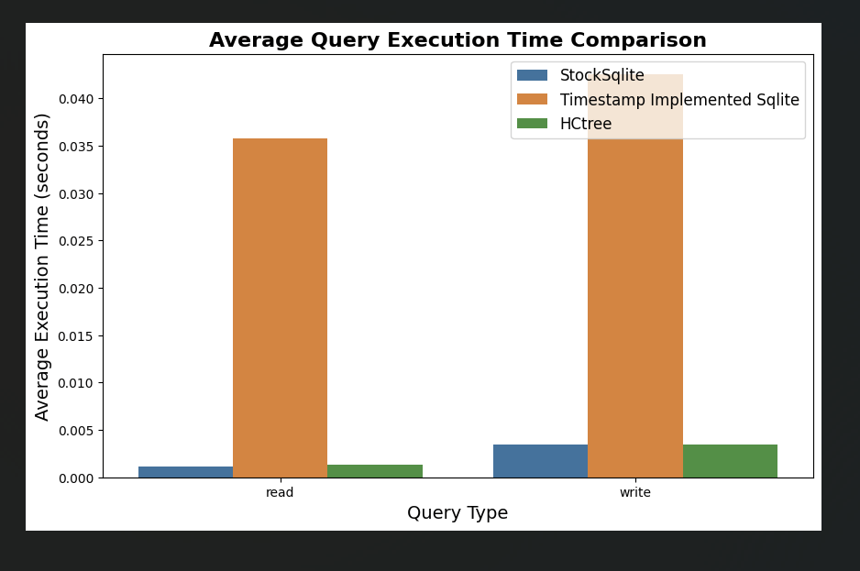
Outcome of Performance Test
Timestamp Implemented SQlite has the highest Average execution time for both read and write Operations.
In this case too, HCtree was relatively faster.

Slide 23
Overall Conclusion of Results
According to our Tests/Results:
Reliability/concurrency:
All the Three systems were reliable in terms of concurrency.
Performance:
HCtree consistently outperformed.
Hence, if speed is priority, HCtree might be good according to results
Regarding which is better at concurrency is hard to tell as all the systems showed no errors

Slide 24
Future Work
Future research aims to explore the two-version timestamp approach for further concurrency enhancements, potentially integrating and evaluating its performance within SQLite through comparative simulations against other concurrency control mechanisms.

Slide 25
Thank You
We would like to express our sincere gratitude to the entire team for their hard work and dedication in Starting this Advanced Database Management Course Project. And letting Professor Le Gruenwald for giving us this opportunity.
Team Members: TEAM #5
Mounica Pragyna Ravilla
Oohasripriya Nandipati
Farhan Hussain Abedi Syed

