Slide 1
Evaluating Biochar for the Removal of Pharmaceutical Pollutants from Wastewater
Harika Vengala
Oohasripriya Nandipati
Tolulope Okeowo
Date : 12-02-2024

Slide 2
What is Biochar?
Biochar is a super charcoal made by heating any biomass – for example, corncob, husk or stalk, potato or soy hay, rice or wheat straw – without oxygen. All of the cellulose, lignin and other, non-carbon materials gasify and are burned away(pylorysis) . What remains is pure carbon – 40% of the carbon originally contained in the biomass.
It is highly effective in removing organic and inorganic pollutants due to its unique properties, including large surface area, varied pore size distribution, surface functional groups, and cation/anion exchange capacity. These properties are influenced by the nature of the feedstock and the preparation method, such as pyrolysis. High-temperature pyrolysis typically produces hydrophobic biochars with higher surface area and micropore volume, making them ideal for organic pollutant adsorption. Conversely, low-temperature pyrolysis yields biochars with smaller pore sizes, lower surface area, and higher oxygen-containing functional groups, better suited for inorganic contaminants. The enhanced characteristics of biochar, such as its stable structure, rich carbon content, and adsorption capacity, make it an efficient material for removing heavy metals, dyes, and even pathogens from wastewater.

Slide 3
Dataset Features
Biomass : Raw material used to produce biochar.
TP : Type of Pollutant absorbed in the experiment.
Temp : Pylorysis Temperature
Time(min) : Pylorysis Time
PS : Pore Size of Biochar
BET : Surface area of Biochar
PV : Pore Volume of Biochar
C, H, N, O : Elemental composition.
Qm(mg/g) : Adsorption capacity

Slide 4
Project Objective
The purpose of this project is to evaluate the effectiveness of biochar as an adsorbent for removing pharmaceutical micro pollutants from wastewater. The project aims to predict biochar’s absorption capacity using machine learning models, optimize the conditions under which biochar performs best. Ultimately, the goal is to develop a sustainable, scalable method for removing pharmaceutical pollutants from wastewater, contributing to cleaner water sources and healthier ecosystems.
The primary question being addressed is: How effective is biochar as an adsorbent for pharmaceutical micro pollutants in wastewater, and what are the optimal conditions for its use in wastewater treatment? The project also explores how machine learning can predict biochar's performance under different conditions.

Slide 5
Who Benefits from this Project?
The stakeholders who benefit from this study include:
Environmental Agencies and Policy Makers: They will benefit from the development of a cost-effective and sustainable solution to manage pharmaceutical pollutants in wastewater, improving water quality and public health.
Agricultural Sector: Farmers and agriculturalists will benefit from the potential use of biochar as a soil enhancer, which could improve crop yields and contribute to carbon sequestration.
Water Treatment Facilities: These organizations will gain insights into more effective methods for managing pharmaceutical pollutants in wastewater.
Public Health and Communities: Reducing pharmaceutical pollutants in water will help safeguard public health and ecosystems from the harmful effects of these contaminants.
The project is being supervised by Professor Okolie Jude.

Slide 6
Data Ingestion
Sources for the Data
The dataset used for the project was provided by the faculty supervisor, Professor Okolie Jude. It contains data on more than 34 raw materials used to produce biomass for biochar production. The dataset consists of 12 features, including 11 predictors and one target variable.
The proposed problem is intrinsically linked to the theme of water security, a central focus of the Summer School 2024.
Difficulties Overcome in Getting the Data
The main difficulty in acquiring the data stemmed from the limited number of observations (86) in relation to the high number of features (12, with 11 predictors). Due to a smaller number of observations, there is a risk of underfitting during model training, which means the model might fail to generalize well to both the training data and unseen data

Slide 7
How to Overcome Underfitting?
What is Underfitting?
Occurs when the model has high bias (error on training data) and high variance (error on testing data).
The model fails to capture the underlying patterns in the data.
Solutions to Underfitting:
Use Ensemble Models: Combine multiple models to improve accuracy and reduce errors.
Add Model Complexity: Increase the number of parameters or layers to help the model learn more intricate patterns.
Increase Training Data Size: Provide the model with more data to learn from and enhance generalization.

Slide 8
Data Exploration and Preparation
Imputing Missing Values:
Numeric columns like Temp, Time, PS, BET, PV, C, H, N, O were imputed using linear forward selection interpolation to maintain continuity without bias.
Categorical columns (Biomass and TP) were imputed using forward filling method, only Biomass has 1 missing value
A box plot was created for each feature to visualize the presence of outliers in the dataset before applying any transformations.
Column names | Missing count
PS, PV | 1
C, O | 3
H | 4
N | 7

Slide 9
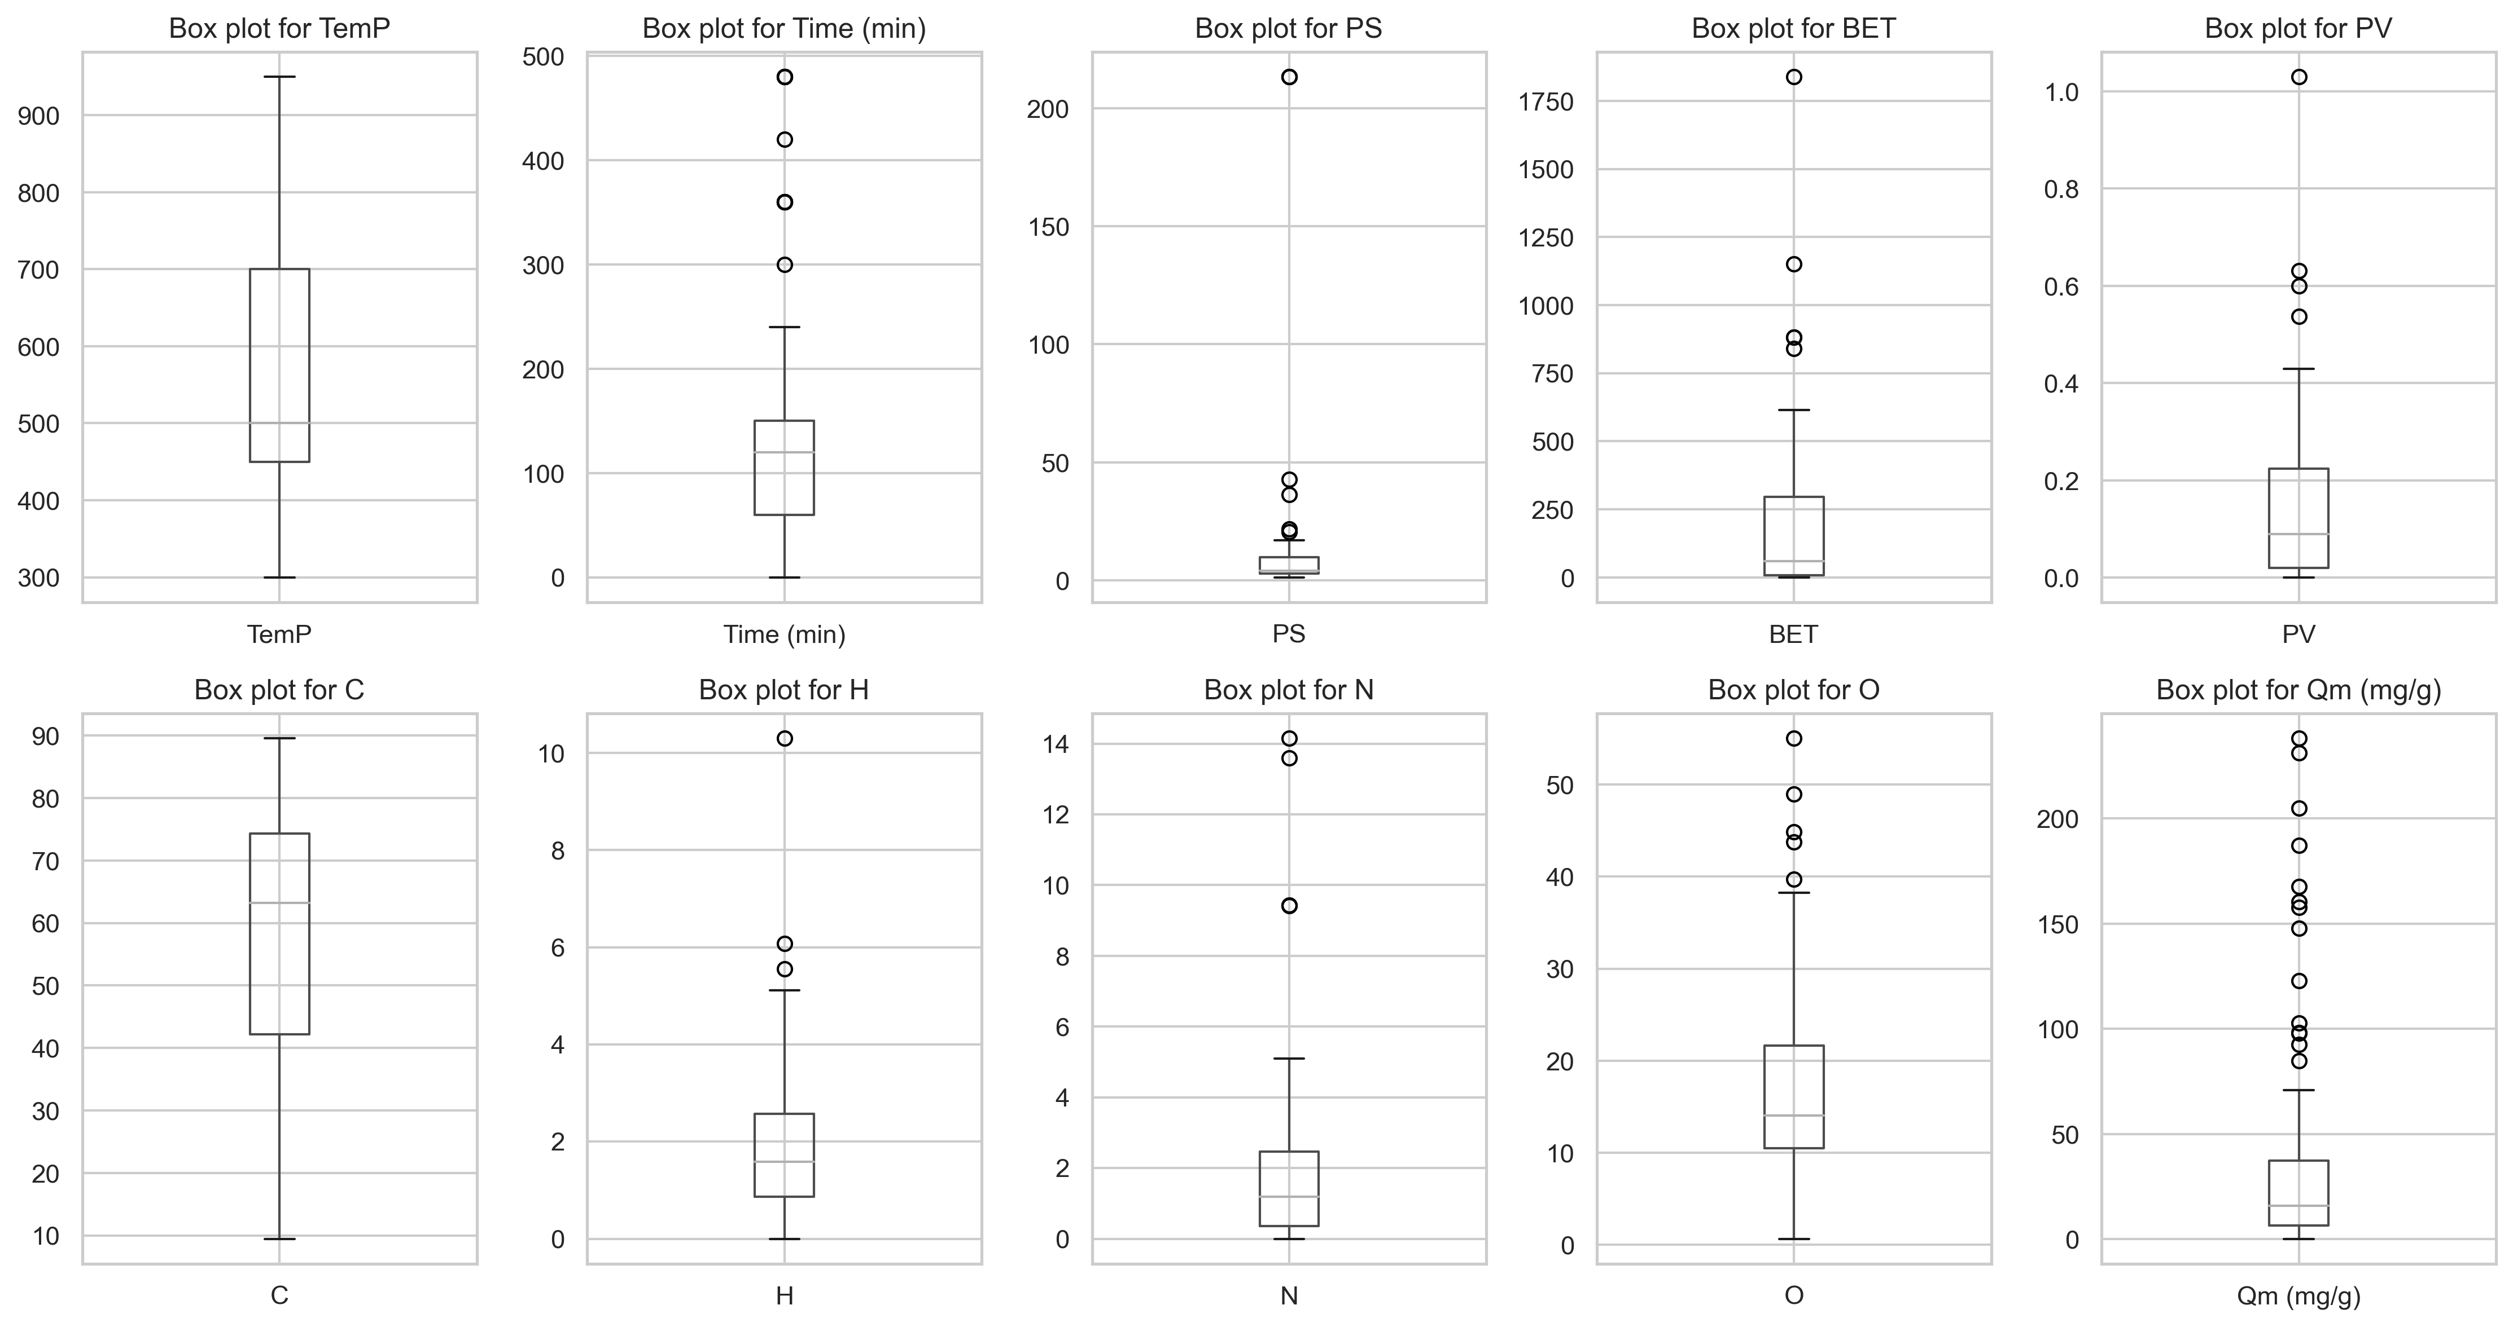
Boxplot For Each Feature

Slide 10
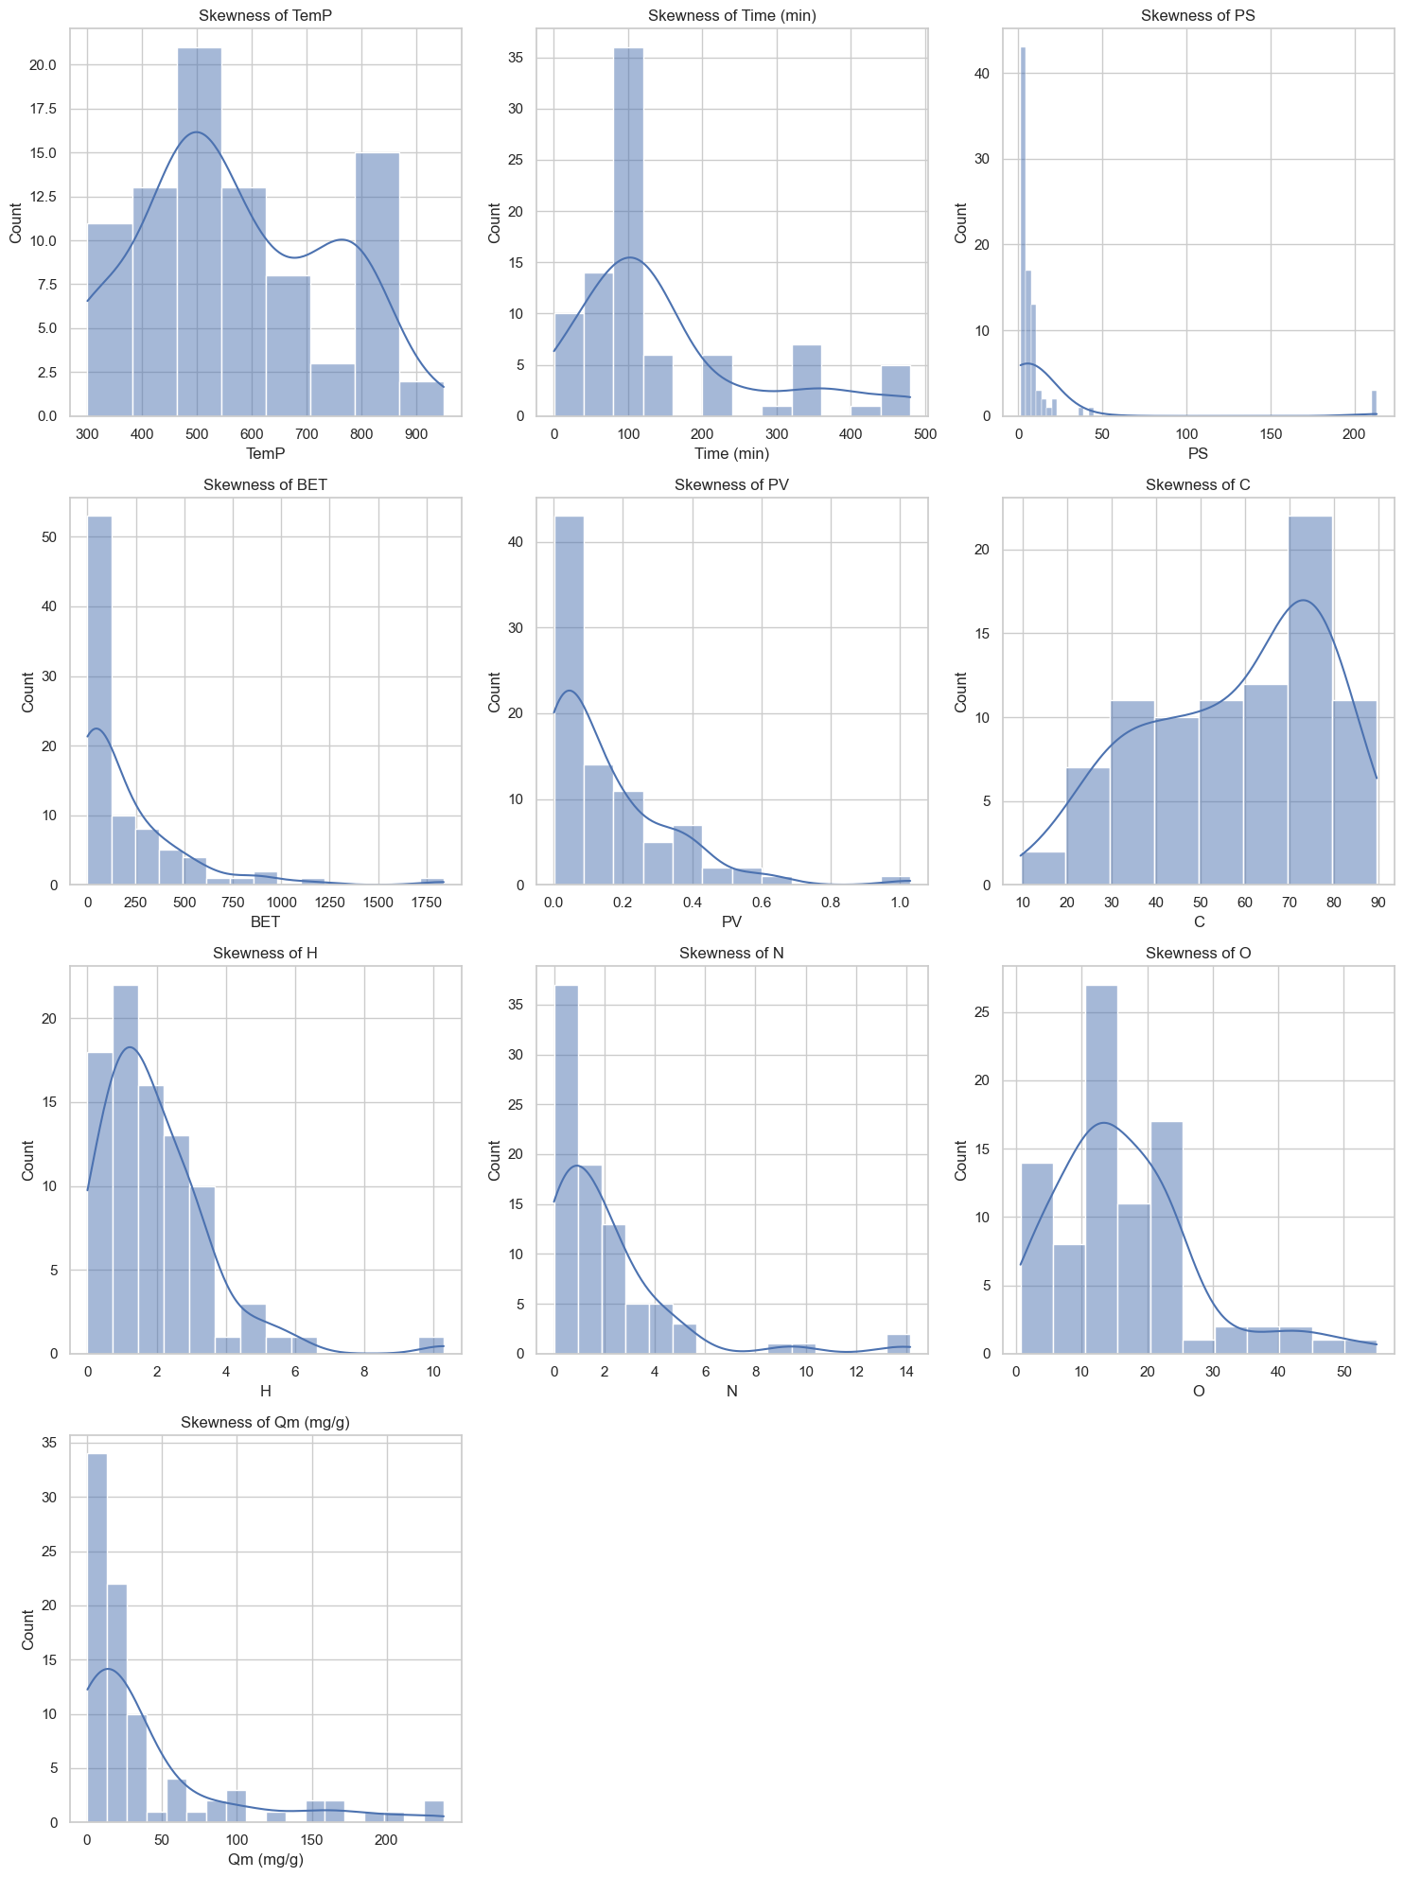
Data Exploration and Preparation
Features exhibiting right skewness (Time, PS, BET, PV) underwent log transformation to reduce skewness and achieve a more normal distribution. This step helps improve the performance of machine learning models.
Histograms were used to confirm the normalization effect of the log transformation.
Before Log Transformation

Slide 11
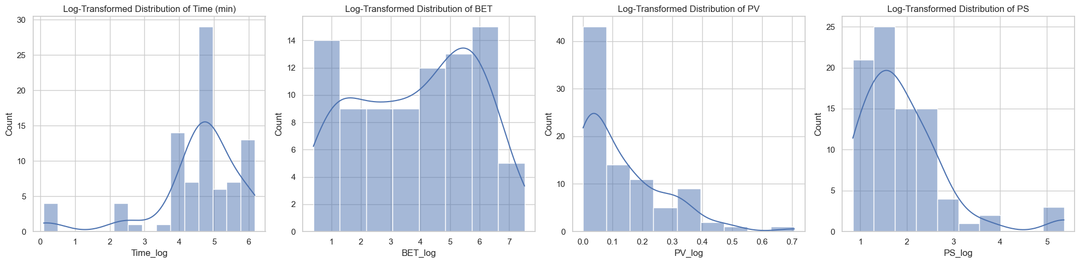
After Log Transformation

Slide 12
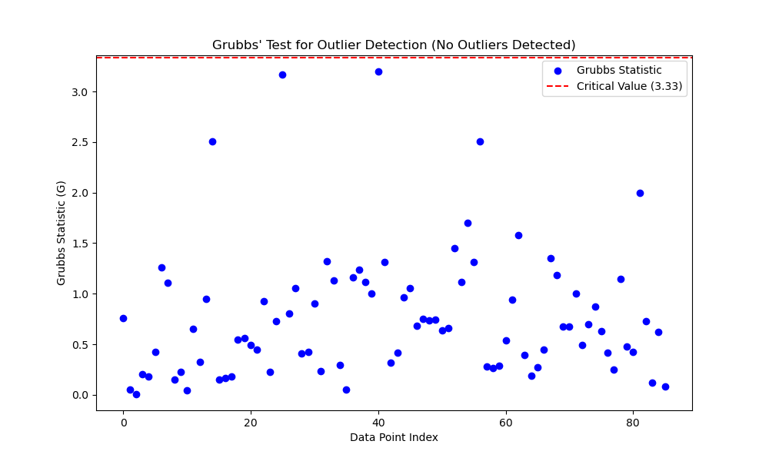
Grubb's Test
After applying log transformation, all features are approximately normally distributed.
Although a few outliers are observed in the boxplot, Grubbs' test was conducted to confirm their presence.
With 95% confidence, the test results indicate that all data points lie within the threshold, confirming the absence of outliers.

Slide 13
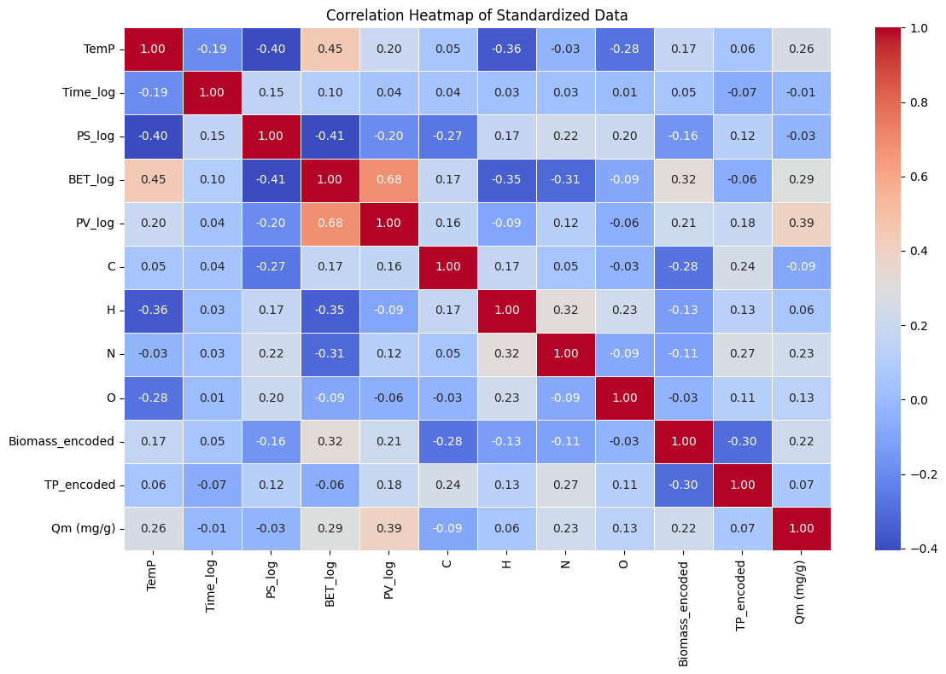
Data Exploration and Preparation
A correlation heatmap was used to analyze the linear relationships between variables.
Key Finding: BET and PV showed a positive correlation of 0.68.
Features with low positive correlations to the target variable (Qm (mg/g))—such as PV_log, BET_log, N, and O
However, features with lower correlation—like C, Time_log, and PS_log.
Low correlation does not necessarily mean these features are irrelevant. They may still contribute to the model through nonlinear relationships or interactions with other features.

Slide 14
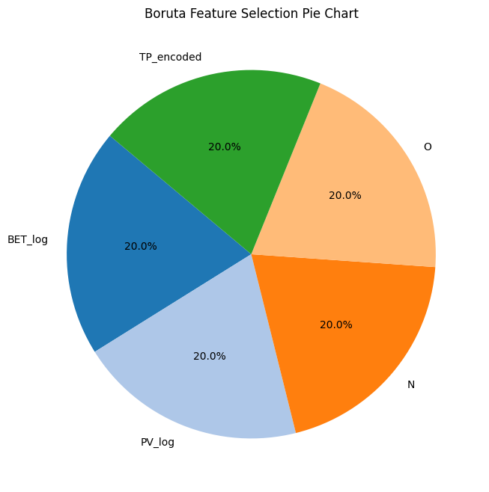
Feature Selection
Random Forest Setup: The RandomForestRegressor serves as the base model for Boruta.
BorutaPy: Automatically tunes the number of estimators (n_estimators='auto').
Feature Ranking: Boruta ranks features, where 1 indicates the most important ones.
Pie Chart Visualization: Displays only the selected features with ranks of 1.
Based on the Boruta feature importance pie chart, the features PV_log, BET_log, TP_encoded, N, and O have been identified as having high importance. Therefore, we are considering these features for building our machine learning models.

Slide 15
Why is Standardization not Required?
Purpose of Standardization: It ensures all variables have a mean of 0 and a standard deviation of 1, preventing the model from being biased toward features with larger scales.
Tree-Based Models: Since tree-based models construct decision trees using attribute conditions rather than scales of features, standardization is unnecessary for these models.

Slide 16
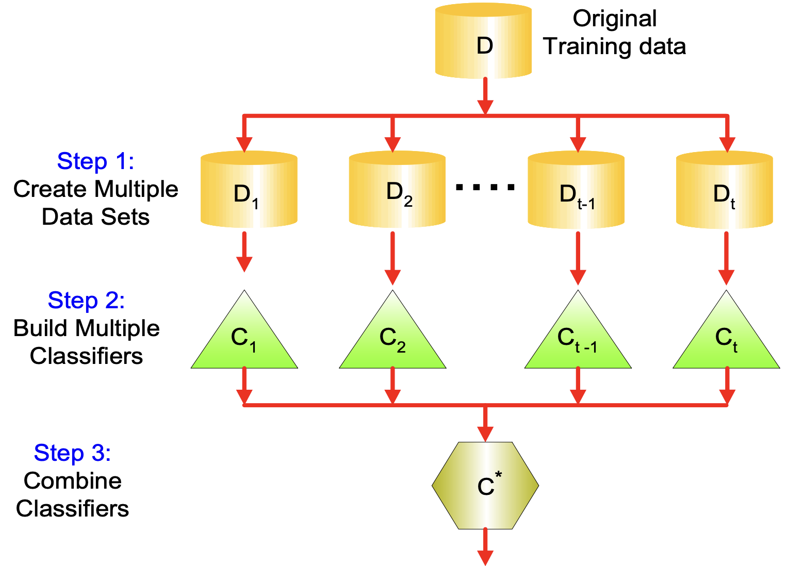
Ensemble Methods
Aim to improve regressor accuracy produced from using one single regressor.
Construct a set of regressors from the training data.
Predict target value of test records by combining the predictions made by multiple regressors.
Types of Ensemble Methods:
Bagging (Bootstrap Aggregating) , Boosting.

Slide 17
Bagging(Bootstrap Aggregating)
Sampling with replacement. Each bootstrap sample has the same size as the original data.
Some instances may appear several times. Others may be omitted.
Build regressor on each bootstrap sample. .
A bootstrap sample contains approximately 63% of the original training data.
It improves error by reducing the variance of the base regressors.
Its performance depends on the stability of the base regressor.
If a base regressor is unstable, bagging helps to reduce errors associated with random fluctuations in the training data.
If a base regressor is stable, bagging might not be able to improve error; it might degrade the regressor’s performance due to its use of 37% less training data.

Slide 18
Boosting
An iterative procedure to adaptively change the distribution of training data by focusing more on higher residual errors in regression tasks.
Initially, all N records are assigned equal weights.
Unlike bagging, weights may change at the end of each boosting round.
Used as a sampling distribution to draw a set of bootstrap samples.
Used by the base regressor to learn a model that is biased toward higher-weight examples.
Records that have high residual errors will have their weights increased.
Records that have less residual errors will have their weights decreased.

Slide 19
Model Design
This project is a regression model. The goal is to predict the adsorption capacity (Qm (mg/g)) of biochar needed to remove pharmaceutical pollutants.
We used decision tree, Random Forest Regressor , Gradient Boosting , XG Boosting techniques.
Why this models: We have chosen ensemble methods because they are particularly suitable as our dataset has a non-linear relationship between features, target and a small number of observations, requiring complex models that can generalize well by leveraging multiple learners to capture intricate patterns.
Decision Tree Regressor: This model predicts target values by splitting the dataset into smaller subsets based on feature thresholds, creating a tree-like structure of decision nodes and leaves. It follows a "divide-and-conquer" approach to minimize error at each split.
Random Forest Regressor: An ensemble method that builds multiple decision trees using different subsets of data and averages their predictions. It reduces overfitting by combining diverse trees and improves prediction accuracy.

Slide 20
Model Design
Gradient Boosting: A sequential ensemble method where each new tree corrects the errors of the previous one by focusing more on samples with higher residual errors. It builds a strong model by combining the predictions of many weak models.
XGBoost: An advanced form of Gradient Boosting, it improves efficiency and performance through techniques like regularization, handling missing data, and parallel computation, making it faster and more accurate in handling large datasets.

Slide 21
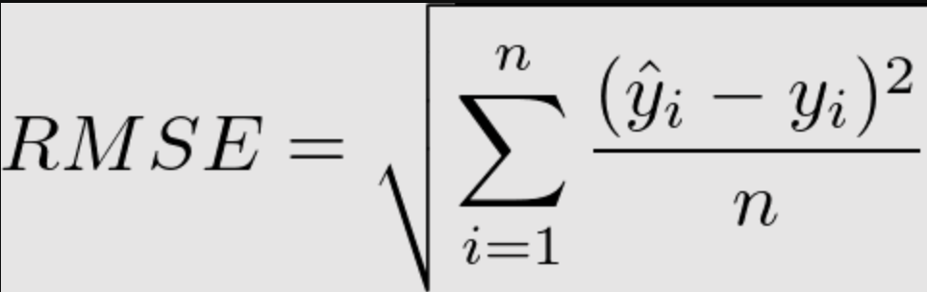
Model Design and Validation
The models were evaluated using key performance metrics:
RMSE (Root Mean Squared Error)
Yi = actual value
Ŷi = predicted value
N = number of observations.

Slide 22
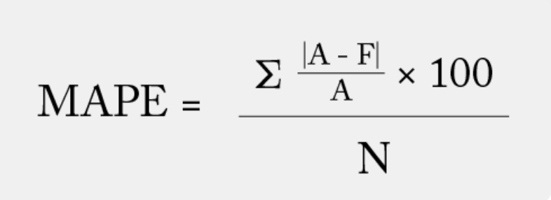
Model Design and Validation
MAPE(Mean Absolute Percentage Error)
A = actual value
F = predicted value

Slide 23
Model Results
K-Fold Cross-Validation is a resampling technique used to evaluate the performance of a model by splitting the dataset into K equal parts or folds. The model is trained on K-1 folds and tested on the remaining fold, repeating this process K times so that each fold serves as a test set once. The final performance is averaged across all folds, providing a more reliable estimate of the model's generalization ability. In our project, we used 5-Fold Cross-Validation.
Model Training, Validation, and Tuning
In this project, due to the limited dataset size (86 observations), a traditional train-test split was not employed. Instead, the entire dataset was utilized for model training and evaluation. To ensure robust validation and minimize underfitting risks, K-Fold Cross-Validation was implemented.
To tune our model, we used Grid Search Cross-Validation (Grid Search CV), a approach to hyperparameter optimization. Grid Search works by defining a grid of possible hyperparameter values and exhaustively searching through all combinations to find the best-performing parameters for the model.

Slide 24
Best Hyperparameters
Best Hyperparameters for Random Forest:​
max_depth: None​
min_samples_leaf: 2​
min_samples_split: 2​
n_estimators: 25​
Best Hyperparameters for XG Boost:​
learning_rate: 0.05​
max_depth: 3​
min_child_weight: 3​
n_estimators: 15​
Best Hyperparameters for Decision Trees:​
criterion: 'absolute_error'​
max_depth: 8​
max_features: None​
min_samples_leaf: 2​
min_samples_split: 6
Best Hyperparameters for gradient boosting:​
learning_rate: 0.01​
max_depth: 3​
min_samples_leaf: 2​
min_samples_split: 2​
n_estimators: 50

Slide 25
Evaluation
Un-tunned | Scoring | random forest | decision tree | Xgboost | Gradient Boost
0 | RMSE | 56.267906 | 67.723990 | 55.027539 | 65.980217
1 | MAPE | 5.493760 | 5.564909 | 3.696262 | 5.694297
Tunned | Scoring | random forest | decision tree | Xgboost | Gradient Boost
0 | RMSE | 53.809197 | 65.751368 | 55.175825 | 62.523164
1 | MAPE | 4.812242 | 5.243574 | 6.179778 | 6.530879
K Fold | Scoring | random forest | decision tree | Xgboost | Gradient Boost
0 | RMSE | 48.786340 | 52.314689 | 47.778119 | 53.265480
1 | MAPE | 4.525112 | 4.142943 | 5.229774 | 6.433223

Slide 26
Evaluation
Since the dataset involves scientific and practical evaluation of pollutant removal efficiency:
Use RMSE as the primary metric because it reflects the magnitude of prediction error in the same units as the target variable, which is critical for interpreting pollutant removal in mg/g.
Untuned:
Best Untuned Model: XGBoost with the lowest RMSE (55.03).
Worst Untuned Model: Decision Tree with the highest RMSE (67.72).
Tuned:
Best Tuned Model: Random Forest with the lowest RMSE (53.81). Tuning improved its performance significantly, making it more accurate than XGBoost.
Worst Tuned Model: Decision Tree, with an RMSE of 65.75 despite slight improvement from tuning.
K fold:
Best Model with K fold: XGBoost achieves the lowest RMSE (47.78), demonstrating the best predictive accuracy when validated robustly.
Second-Best Model: Random Forest, with a slightly higher RMSE (48.79).
Worst Model with K fold: Gradient Boosting with the highest RMSE (53.27).

Slide 27
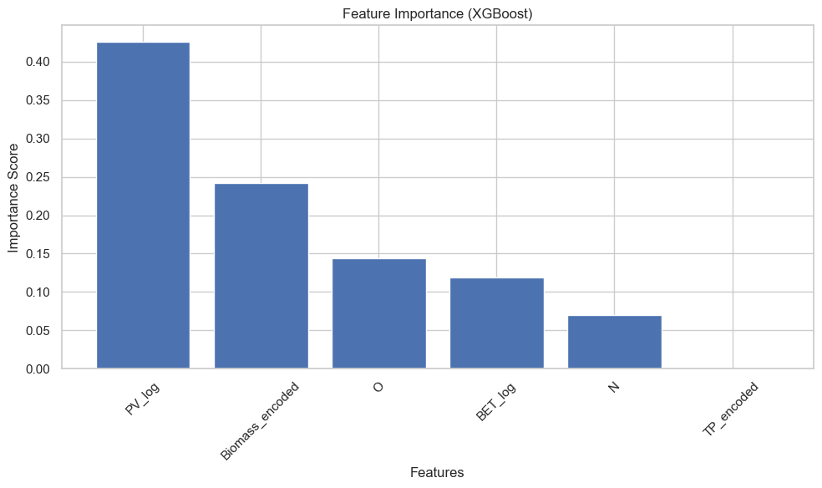
Feature importance
The feature importance results from your XGBoost model show the following values for each feature: PV_log: 0.4260
Biomass_encoded: 0.2415
O: 0.1436
BET_log: 0.1190
N: 0.0697
TP_encoded: 0.0
Most important features: PV_log, Biomass_encoded, and O are the key features affecting the target. These should be prioritized when interpreting the model and possibly used for further feature engineering or optimization.
Less important features: BET_log, N, and TP_encoded have lower importance.
TP_encoded: Is zero Importance.

Slide 28
MLFLOW
In our project, we used MLflow to track and manage the performance of our models ( Decision Tree, Random Forest, Gradient Boosting, and XGBoost). MLflow helped us log experiments, track hyperparameters, and record metrics, making it easier to compare and reproduce results. We also created an inference endpoint to our best model, which allows us to make predictions using the b model. This inference endpoint can also be deployed to cloud services for integration with applications, enabling real-time predictions.

Slide 29
Deployment
In our project, we used Streamlit to deploy our machine learning model, providing an interactive web application to visualize and make predictions. Streamlit allows for quick and easy deployment of machine learning models by transforming Python scripts into web apps. With Streamlit, we created an interface where users can input data and get predictions from our model in real-time. The app automatically handles the model's backend, making it simple to deploy and share without the need for complex configurations.
Link: https://biocharapp.streamlit.app/
The results help future research and production strategies for better performance in various environmental contexts to optimize the characteristics of biochar and enhance its efficiency in environmental applications.

Slide 30
Conclusion
Significance of the Project: This project contributes to sustainable wastewater treatment by leveraging biochar's potential to remove pharmaceutical pollutants, thus promoting cleaner water and healthier ecosystems.
Impact on Stakeholders: Stakeholders, including environmental agencies, wastewater treatment facilities, and agricultural sectors, benefit from the project's findings, which can lead to more effective pollution control and soil health improvement.
Recommendations for Future Researchers: Future researchers should explore larger datasets to improve model accuracy and consider advanced hyperparameter tuning methods for enhanced predictive performance. Additionally, investigating different types of biochar and other machine learning techniques could offer deeper insights.

Slide 31
Conclusion
What are the optimal conditions for maximizing biochar’s adsorption efficiency?
To maximize biochar's adsorption efficiency, the optimal conditions include ensuring a high surface area, as indicated by the parameter PV_log, which enhances the material's ability to adsorb contaminants. Additionally, selecting the appropriate biomass composition, represented by Biomass_encoded, plays a crucial role in determining the biochar's structural and chemical properties. Furthermore, maintaining sufficient oxygen content (O) is essential, as it significantly improves the adsorption capacity by facilitating better interaction between the biochar surface and the target substances.

