Slide 1
GPS TRAJECTORY
Group number:10
T.OOHA(S2017001067)

Slide 2
ABSTRACT
Aim of this project is to statistically analyse the dataset of GPS Trajectory. In this project I predicted rating of traffic using features like average speed, time, distance .Here we used go_track dataset.

Slide 3
Flow of project
1.Loading dataset
2.Null values check
3.duplicates checking
4.normality checking
5.outliers checking
6.Apply ordinal regression model
7. Feauture selection
8.Test of assumptions

Slide 4
Dataset Description
go_track_tracks.csv: a list of trajectories id_android - it represents the device used to capture the instance; speed - it represents the average speed (Km/H) distance - it represent the total distance (Km) rating - it is an evaluation parameter.
Evaluation the traffic is a way to verify the volunteers perception about the traffic during the travel,
in other words, if volunteers move to some place and face traffic jam, maybe they will evaluate 'bad’.
(3- good, 2- normal, 1-bad). rating_bus - it is other evaluation parameter.
(1 - The amount of people inside the bus is little, 2 - The bus is not crowded, 3- The bus is crowded. rating_weather - it is another evaluation parameter. ( 2- sunny, 1- raining). car_or_bus - (1 - car, 2-bus) linha - information about the bus that does the pathway

Slide 5
Contd…
go_track_trackspoints.csv: localization points of each trajectory id: unique key to identify each point latitude: latitude from where the point is longitude: longitude from where the point is track_id: identify the trajectory which the point belong time: datetime when the point was collected (GMT-3)

Slide 6
Analysis
Dataset contains 2 files(go_track__tracks.csv,go_track_trackpoints.csv).Second file contains infromtaion about trackid,latitude,longitude.Using second file, speed,distance,time features of first file are calculated

Slide 7
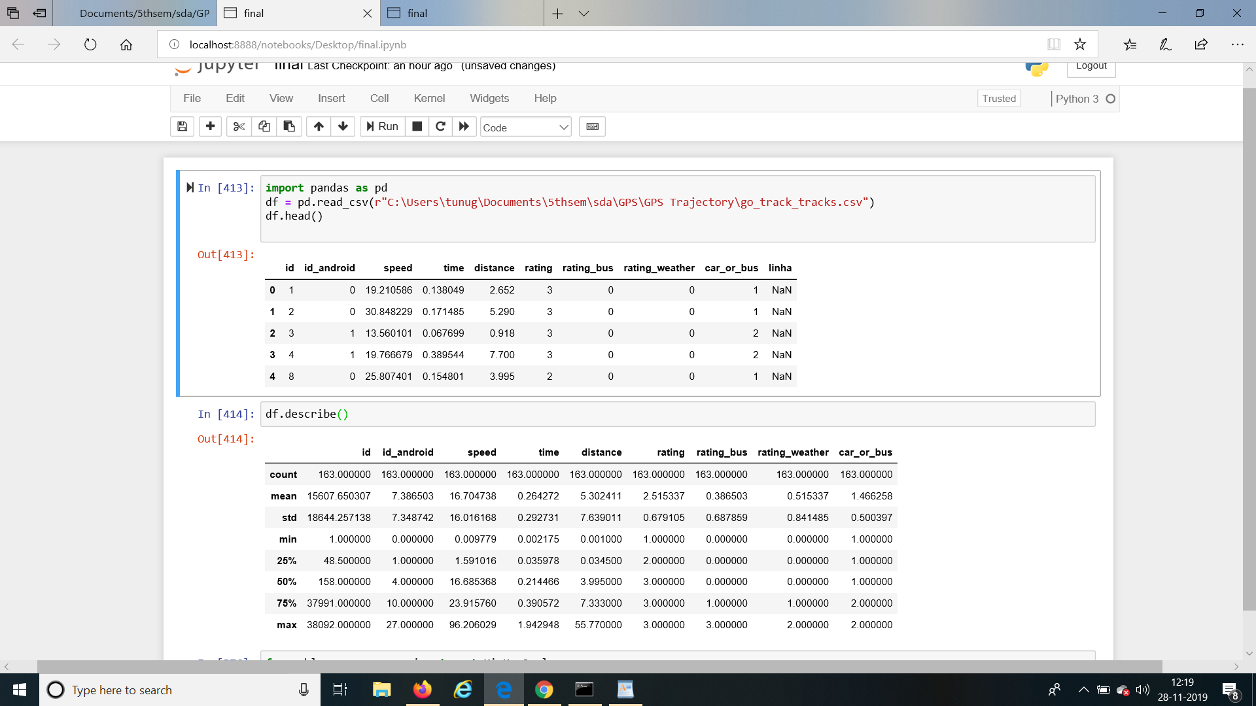
Sample data

Slide 8
Null values
Linha column has 80% null values.So removed the linha column.

Slide 9
Summary of data

Slide 10
Data types
Speed,distance,time:Continuous data
Rating_bus,rating:ordinal
Rating_weather,car_or_bus:categorical
So,categorical is converted using get dummies of pandas.

Slide 11
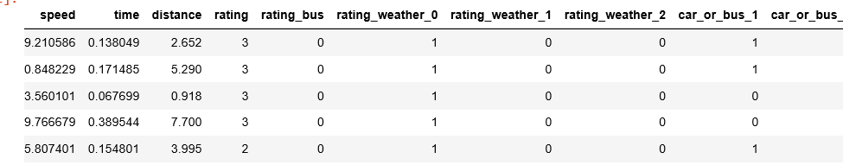
After converting categorical variables

Slide 12
Indpendantvariables:speed,distance,time,rating_bus,rating_weather_0,rating_weather_1,rating_weather_2,car_or_bus_1,car_or_bus_2
Dependant variables: rating
Drop duplicates:
Dataset contains duplicates .This was removed using pandas.drop_duplicates() function.

Slide 13
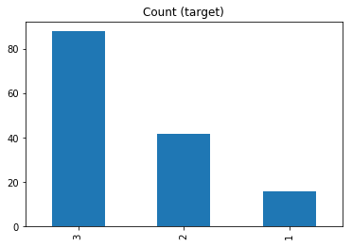
Imbalanced dataset
The target variables is imbalanced,That is less number of rating1 compared to other 2 as shown

Slide 14
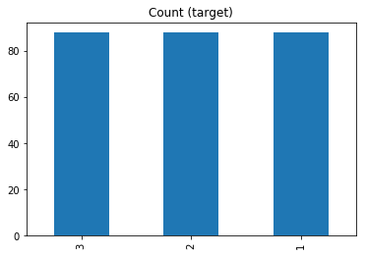
This problem is solved by oversampling of dataset using imbalanced library of python

Slide 15
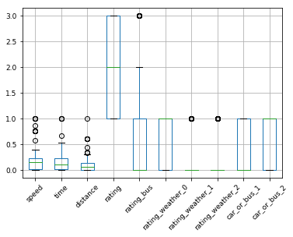
Outliers detection
By following boxplot we can observer outliers

Slide 16
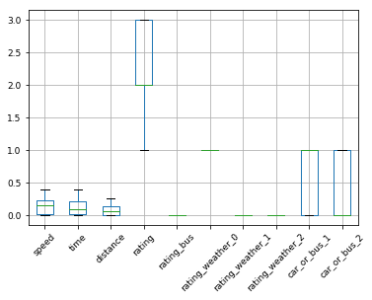
The outliers are removed by finding IQR range and removing points that are not in the IQR range

Slide 17
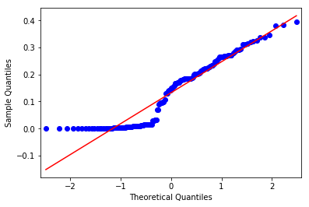
Normality of data(q-q plots)
SPEED:

Slide 18
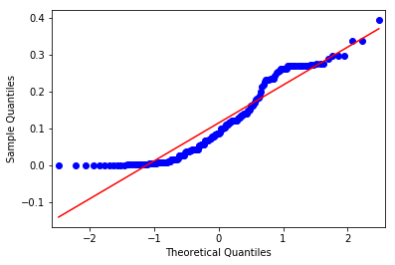
Time:

Slide 19
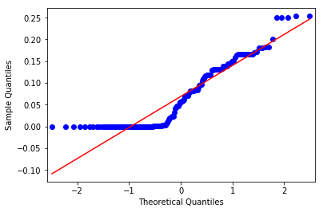
Distance:
From above graphs we can see that these are not linear.But ordinal regression doesn’t require data to be normally distributed.

Slide 20
Applying ordinal model
Since rating is ordinal ,ordinal regression .This is done using mord ligisticat function in python.
Results are as follows:
Goodness of fit :measured in terms of accuracy -0.41935483870967744
Coefficients:
[ 2.13960580e+00 -1.02190818e+00 -1.37202194e-02 0.00000000e+00
-1.43958306e-06 0.00000000e+00 0.00000000e+00 4.81319826e-01
-4.81321265e-01]
Confusion matrix:
[[ 0 0 0]
[ 6 12 12]

Slide 21
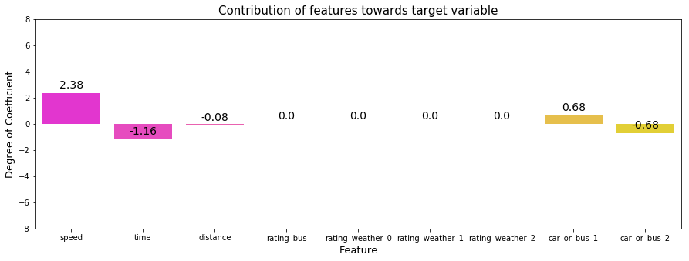

Slide 22
Feature selection:
From the above results,we see the coefficients of rating_bus, rating_weather_1, rating_weather_2 are zeros.
So we can remove these features.

Slide 23
Test of assumptions:
Note:logistic regression does not require a linear relationship between the dependent and independent variables. Second, the error terms (residuals) do not need to be normally distributed. Third, homoscedasticity is not required.
1. ordinal logistic regression requires the dependent variable to be ordinal.
This is satisfied since rating is ordinal data.

Slide 24
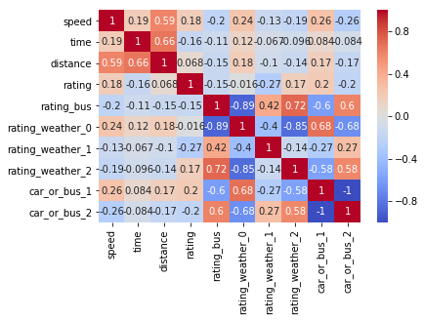
It requires there to be little or no multicollinearity among the independent variables. This means that the independent variables should not be too highly correlated with each other.

Slide 25
From the above correlation,we can see that car_or_bus_1,car_or_bus_2 are highly correlated.So remove car_or_bus_1.
3.It assumes linearity ofcontinuous independent variables and log odds. although this analysis does not require the dependent and independent variables to be related linearly, it requires that the independent variables are linearly related to the log odds. That is by plotting loglinear graphs if we observe some curve(S shape) this satisfies the assumption

Slide 26
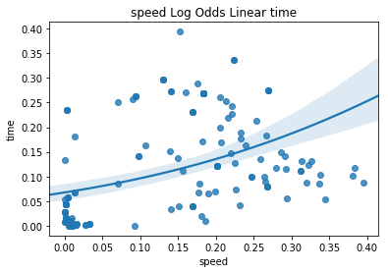

Slide 27
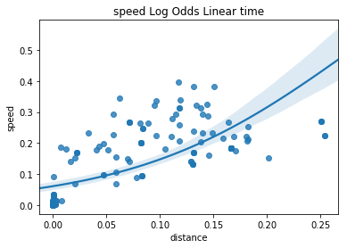

Slide 28
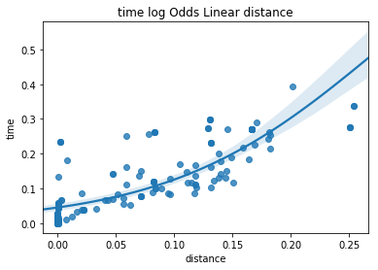
From the above graphs we can say that assumption is satisfied

Slide 29
So,after test of assumptions and feature selection we can remove rating_bus,rating_weather_1,rating_weather_2 ,car_or_bus_1.
So,again applying ordinal regression, these are results:
Accuracuy:0.41935483870967744
Coefficients:[ 2.16441633e+00 -9.99903774e-01 7.18855331e-04 -1.79099231e-06
-9.02924895e-01]
Confusion matrix:[[ 0 0 0]
[ 6 12 12]
[ 0 0 1]]
We can see that even after doing test of assumptions we found that accuracy is very less.
So applied different models like LogisticRegression CV,Random Forest classifier.

Slide 30
Logistic regression CV
Accuracy:0.6580645161290323
Coefficients:[[-5.52822551e+00 3.50113465e+00 3.17647802e+00 0.00000000e+00
6.16715464e-04 0.00000000e+00 0.00000000e+00 -5.08959471e-01
5.09576187e-01]
[-2.09515539e+00 9.53578685e-02 -1.04287583e+00 0.00000000e+00
-3.86861143e-03 0.00000000e+00 0.00000000e+00 -2.26950331e-02
1.88264216e-02]
[ 7.62338090e+00 -3.59649252e+00 -2.13360218e+00 0.00000000e+00
3.25189597e-03 0.00000000e+00 0.00000000e+00 5.31654504e-01
-5.28402608e-01]]
Intecepts:
[-0.59932287 1.14069747 -0.54137459]

Slide 31
Again performing feature selection and removing features having coefficient 0.Again applying logicregressioncv we get following results.
Accuracy:0.6580645161290323
Cofficients:[[-5.53074622e+00 3.49323103e+00 3.17347507e+00 5.11084927e-03
1.01217584e+00]
[-2.09559423e+00 9.71864392e-02 -1.04234458e+00 -6.62311676e-06
4.17469559e-02]
[ 7.62634046e+00 -3.59041747e+00 -2.13113049e+00 -5.10422615e-03
-1.05392279e+00]]
Intercepts:[-1.1085018 1.11311259 -0.00461079]

Slide 32
Random forestclassifier:
Using random forest classifier,got the following results:
Coefficients:[0.36447909 0.24805381 0.24221074 0. 0. 0.
0. 0.08956213 0.05569424]
Accuracy:0.8064516129032258
We can remove features having coeffficients 0.

Slide 33
RandomizedsearchCV
Perfoming feature selection and again applying randomizedsearchcv,
got following results:
randomized cv
confusion matrix:[[ 3 0 0]
[ 0 19 1]
[ 0 3 5]]
Accuracy:0.8709677419354839
So, randomizedsearchcv ,We got better results.(87% accuracy)

Slide 34
Summary
MODEL | ACCURACY
ORDINAL REGRESSION | 41%
LOGISTICREGRESSIONCV | 65%
RANDOM FOREST | 80%
RANDOMIZEDSEARCHCV | 87%

