Slide 1
C# Api
Azure SQL
React

Slide 2
Post
ID
User_ID
Time
Message
Vote
Emoijtag
User
ID
Name
Password
PasswordSalt
Follows

Slide 3
LandingPage
MoodValinta
PostList
App

Slide 4
Login
Create
LandingPage

Slide 5
MoodValinta

Slide 6
Message
Post
Valikko
PostList

Slide 7
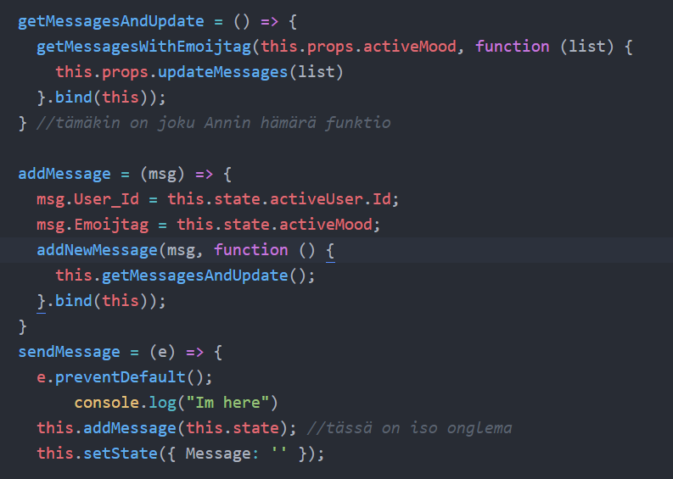

Slide 8
Vote
Post

Slide 9
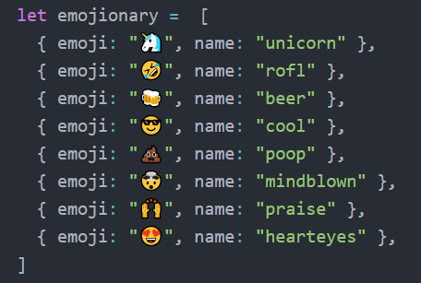
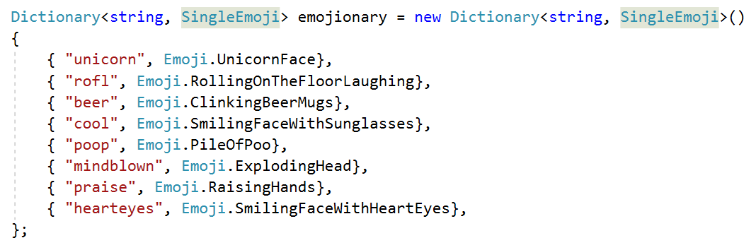

Slide 10
