Slide 1

By Eric Waldbaum
March 13, 2022
University of Washington UXVDES330 “Finding a Therapist”

Slide 2
About me
I’m a Quality Engineer Lead at Deloitte Digital
I have always been fascinated by User Experience Design
I have been disappointed by our mental health system and the challenge to find a matching therapist
I am excited to apply my knowledge from the University of Washington UX Design certificate program to show you how to help make this experience better

Slide 3

Table of contents
Product purpose
Wireframes & Low/mid-fidelity prototype
Brand visual identity statement
Moodboard
Style guide
UI Design
High-fidelity prototype
Next steps

Slide 4
Product Purpose
A solution to find a therapist that is the right fit for people’s individual needs
• Start with a tablet app since it’s easy to use and has a large screen which works well with large maps and multiple columns for searching
• Focus on helping solve the biggest pain points from archetypes created with user research
Help the “Stressed First-Timer” in the following ways:
• Find immediate and available help quickly
• Provide clear insurance and price information
• Provide a way to share their information with all therapists engaged rather than repeating themselves
• Provide information about therapist types to learn
Help “Proactive Professional” in the following ways:
• Help them find reliable, up-to-date therapist availability and information with many search options
• Provide live search result updates • Help them stay educated about mental health

Slide 5
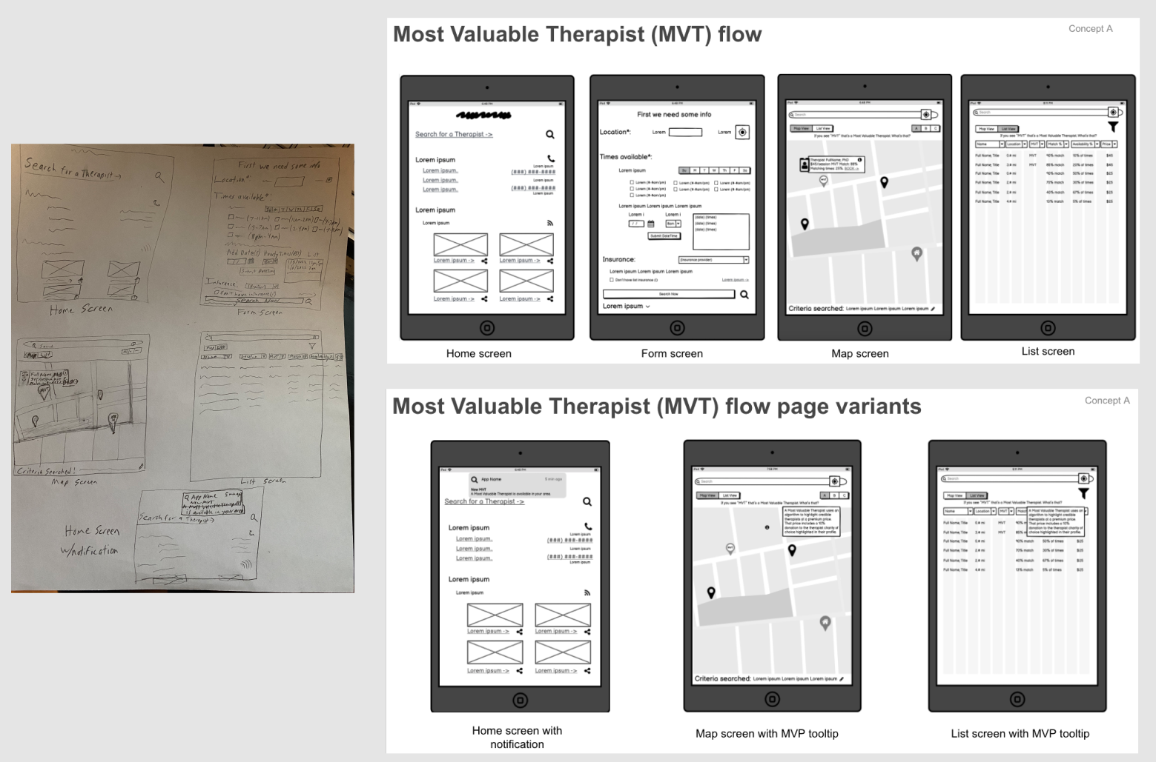
Wireframes & Low/Mid-fidelity Prototype
Figma Link

Slide 6
Brand visual identity statement
“To guide people to the optimal available therapist, enhance their mental health, and build a supportive community.”
Figma Link

Slide 7
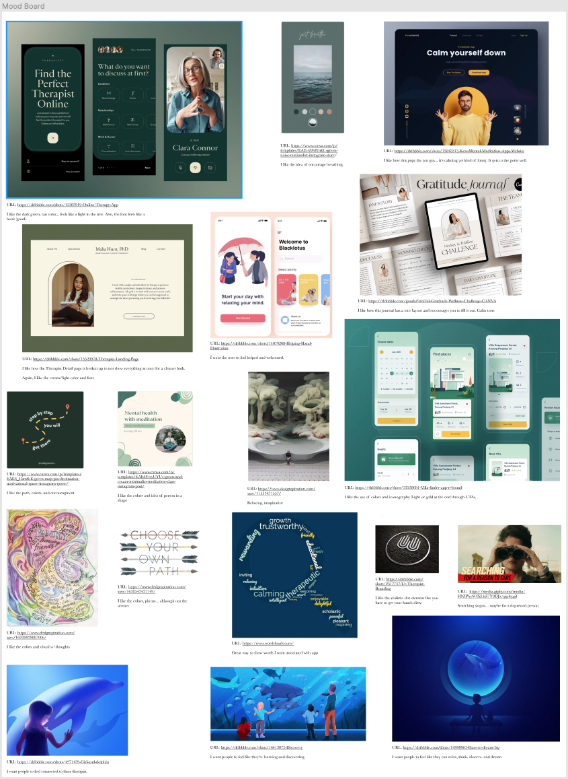
Moodboard
Figma Link

Slide 8
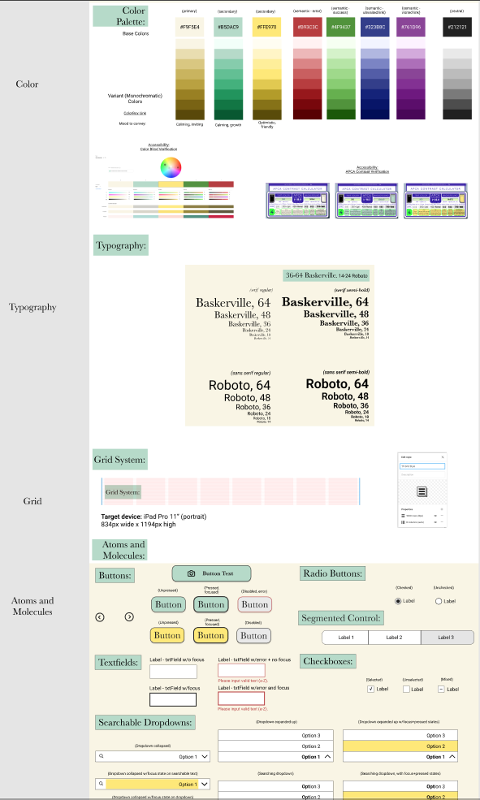
Style Guide
Figma Link

Slide 9
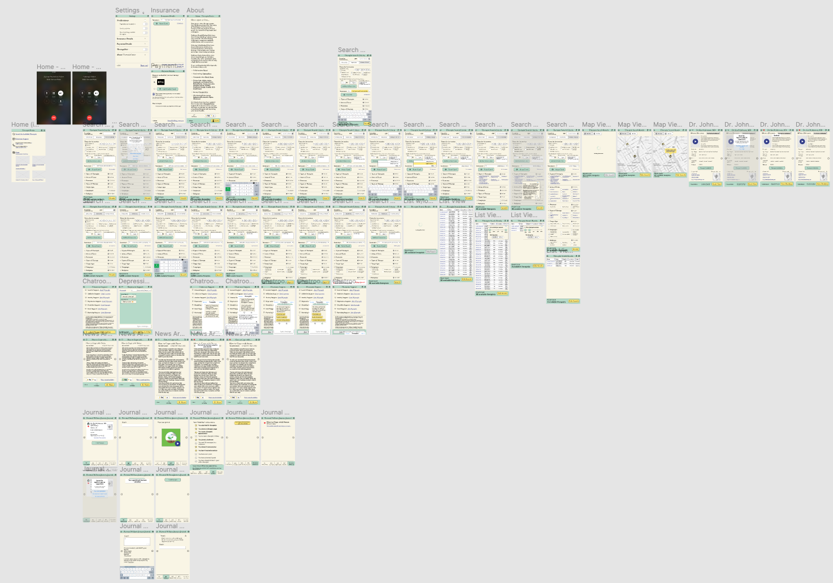
UI Design
Figma Link

Slide 10
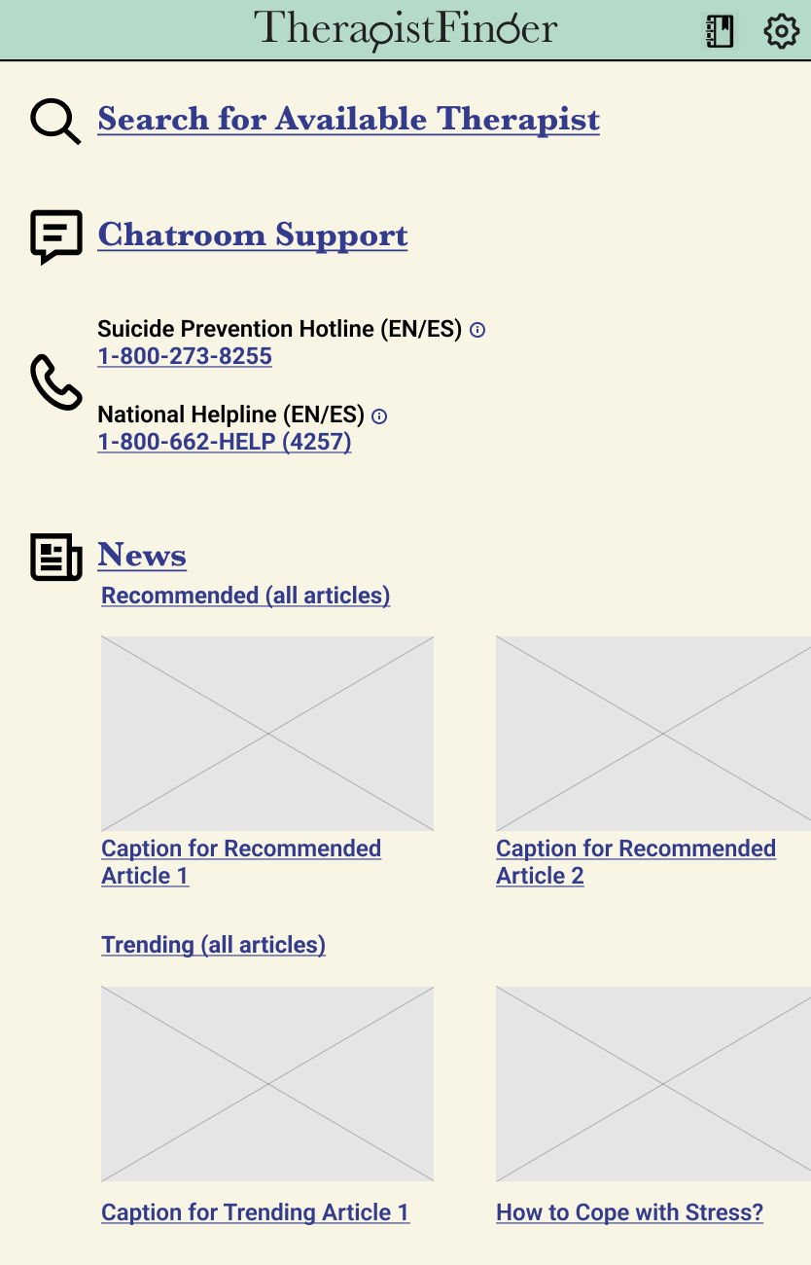
High-fidelity Prototype
Figma Link

Slide 11
Next steps
For the prototype:
“Therapist Availability” pop-up… to highlight up-to-date % availability with search
Have all the Info (i) icons tappable… I gave just one example
Cover scan card scenarios (insurance, credit card)
Cover remote therapy session scenario… was outside this coursework
Have a News main page with customizable topics/sources and recommended articles
Include incoming and achievement notifications
Show consistent height with status bar / iPad border*
Show landscape view
Explore result count animations
Show toggle behavior between Map and List views
Video tutorial?
Post-MVP features like: pleasant audio and visuals, Most Valuable Therapists, more targeted desired growth and history to share as desired, rating/review system, HealthKit and calendar integration, light / dark version
For me:
Create website with this project in the portfolio
* Accidently thought height was 1300px from mid-fidelity, but actually is 1194px

Slide 12

Thank you!
With some additional work I feel like this prototype could be turned into an app that will help anyone looking to find a matching therapist.

