Slide 1
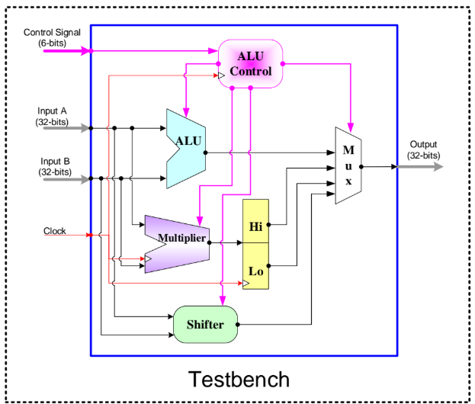
ALU CONTROL
ALU
MUX
MULTIPLIER
HI
LO
SHIFTER
TESTBENCH

