Slide 1
DATA ANALYTICS PROJECT
Airbnb Market Analysis: 10 Global Cities
Finding where demand, price and host quality concentrate in 5.4 million reviews across ten cities, and how COVID changed demand
Presented by Omprakash Balara
Tools: Python (Pandas), VS Code, Power BI (DAX)
Notes:
Portfolio case study on the public Inside Airbnb data via Maven Analytics: 10 cities, 279,712 listings, 182,024 hosts and 5.37 million reviews from 2008 to March 2021.

Slide 2
Agenda
OVERVIEW
1. Problem statement and objectives
7. Complete months and DAX approach
2. Project workflow
8. Analysis results
3. Understanding the dataset
9. The Power BI dashboard
4. Data cleaning in Python
10. Key findings and recommendations
5. Prices and feature engineering
11. Limits of the data
6. The star schema model
12. Tools, files and conclusion
Airbnb Market Analysis: 10 Global Cities

Slide 3
Problem statement and objectives
OVERVIEW
The problem
Business questions
Hosts, guests and analysts need answers the raw Airbnb data cannot give. Prices sit in nine currencies with zeros and outliers, the newest months are incomplete, and nothing shows where demand is concentrated, how COVID hit each city, or what really drives price. Hosts price by guesswork, guests overpay, and cities are compared unfairly.
Where is demand concentrated?
How did COVID hit each city, and who recovered?
When is the busy season?
What do guests pay, and what drives price?
Who hosts, and does it matter?
Do Superhosts and fast responders get more reviews?
Do ratings separate good listings from great ones?
The objective
Clean the raw files, build a star schema and use DAX to answer clear questions. Show the answers in a five-page dashboard. Each answer should help a guest, a host or an analyst decide something.
Airbnb Market Analysis: 10 Global Cities
Notes:
Raw listing and review rows do not show where demand is, how COVID hit each city, or what drives price.

Slide 4
Project workflow
OVERVIEW
The project follows six steps. Each step produces something the next step uses.
Step | What I did | Tool | Output
1. Collect | Downloaded Listings.csv and Reviews.csv from Maven Analytics | Browser | 279,712 listings, 5.37M reviews
2. Clean | Removed duplicate reviews, fixed types and bad values, flagged outlier prices | Python, Pandas | cleaning_report.txt
3. Enrich | Converted prices to USD, added bands, amenity flags and host types | Python, Pandas | 62-column dim_listing
4. Model | Built a star schema of six tables and set the relationships | Power BI | Star schema
5. Measure | Wrote DAX for COVID change, seasonality, price range and uplift | DAX | _Measures table
6. Visualize | Built a five-page dashboard and a hidden About page | Power BI | .pbix file
Airbnb Market Analysis: 10 Global Cities

Slide 5
Step 1: Understanding the dataset
DATA PREP
The data is the public Airbnb Listings and Reviews dataset from Maven Analytics, based on Inside Airbnb. One file has a row per listing, the other a row per review.
Column | Meaning
listing_id | Unique listing
host_id | Who runs the listing
city | One of the 10 cities
neighbourhood | Area inside the city
room_type | Entire place, private, hotel, shared
price | Nightly price, local currency
accommodates | Maximum guests
minimum_nights | Shortest booking
review_scores_rating | Overall rating, 20 to 100
date (Reviews file) | Day the review was written
279,712 listings and 33 columns
5,373,143 reviews from Nov 2008 to Mar 2021
10 cities: Bangkok, Cape Town, Hong Kong, Istanbul, Mexico City, New York, Paris, Rio de Janeiro, Rome, Sydney
Prices in each city's local currency
Scraped in Feb and Mar 2021, on a different day for each city
Source: Maven Analytics Airbnb Listings & Reviews, based on Inside Airbnb (public domain)

Slide 6
Step 2: What the raw files contained
DATA PREP
Raw input | Size | What I did
Listings.csv | 279,712 rows, 33 columns | Cleaned and flagged; built dim_listing, dim_host, dim_city and neighbourhood_summary
Reviews.csv | 5,373,143 rows | Removed duplicate ids; kept listing and date as fact_reviews
Review dates | Nov 2008 to Mar 2021 | Read with an explicit date format so day and month are never swapped
Prices | 9 currencies | Converted to USD at ECB rates of 26 Feb 2021
Why flag, not drop
Problem values are flagged, not deleted. Dropping a listing for one bad price would also drop its reviews.
Result
Listings: 279,712 in, 279,712 out. Reviews: 5,373,143 in, 5,372,983 out after 160 duplicates were removed.
Script: airbnb_cleaning_colab.py (run in VS Code)

Slide 7
Step 2: Data cleaning
DATA PREP
Issue found | Rows affected | fixes
Duplicate review ids (same review on two linked listings) | 160 | Removed, kept the first copy
Reviews with no matching listing | 0 | Checked, none found
Listing price of zero | 113 | Flagged, left out of price analysis
Listing price below $5 | 7 | Flagged, left out of price analysis
Price above the city's 99th percentile | 2,753 | Flagged as outliers, left out of price analysis
Minimum nights above 365 (placeholders like 9,999) | 96 | Capped at 365
Bedrooms above 10 | 372 | Capped at 10
Accommodates of 0 | 85 | Set to blank
Listings with no host details | 165 | Kept, shown as unknown
Result: 279,712 listings kept, none removed. 5,373,143 reviews became 5,372,983.
Why flag instead of drop? One bad price should not remove a listing and its reviews from every other comparison.
Script: airbnb_cleaning_colab.py (run in VS Code)

Slide 8
Step 3: Putting prices in one currency
DATA PREP
Price status | Listings | Share
Valid | 276,839 | 98.97%
Above city 99th percentile | 2,753 | 0.98%
Zero price | 113 | 0.04%
Below $5 | 7 | <0.01%
Why these rules
Each city lists in local currency. I converted all prices with one date's ECB rates, so differences show prices, not exchange moves.
A listing price is only used if it is not zero, at least $5, and not above its city's 99th percentile.
276,839 of 279,712 listings (99%) have a valid price.
Prices are listed nightly rates, not revenue.
The unfiltered USD price is kept in price_usd, and the checked one in price_usd_clean.
Typical price caps (USD)
New York $850, Sydney $1,337, Cape Town $1,474
Paris $727, Rome $727, Hong Kong $1,134
Mexico City $350, Bangkok $512, Istanbul $512
Prices: ECB euro reference rates, 26 Feb 2021. Caps: 99th percentile of local price per city.

Slide 9
Step 3: Feature engineering
DATA PREP
The raw data has no USD price, bands, amenity flags or host types, so I created them.
New column | How it is calculated | Why it is needed
price_usd_clean | Local price x ECB rate, valid prices only | One comparable price
price_per_guest_usd | price_usd_clean / accommodates | Compare small and large homes
price_tier | Quartile of price inside the city | Compare cities fairly
bedroom_group, rating_band | Cut into groups, like 28+ nights | Filters and charts
16 amenity flags | Text search of the amenities list (has_pool, has_wifi ...) | Amenity price uplift
host_type | Single, small multi-listing (2 to 9), professional (10+) | Compare host types
data_status | Complete or Partial month | Exclude partial months
*_order columns | A number for each text group | Correct sort order in Power BI
Doing this once in Python keeps every DAX measure short. A median price becomes a simple MEDIAN(price_usd_clean).
Output: six CSV tables (fact_reviews 5,372,983 rows; dim_listing 62 columns)

Slide 10
Step 4: The star schema
MODEL
Table | One row per | Rows | Columns
fact_reviews | Review | 5,372,983 | 2
dim_listing | Listing | 279,712 | 62
dim_host | Host | 182,024 | 16
dim_city | City | 10 | 9
dim_date | Day | 4,839 | 13
neighbourhood_summary | Neighbourhood | 660 | 9
How the tables connect
dim_date to fact_reviews on review date
dim_listing to fact_reviews on listing_id
dim_host to dim_listing on host_id
dim_city to dim_listing and neighbourhood_summary on city
Why a star schema: one filter on city or date flows to every chart. The date table is marked as a date table, so time measures work.
dim_host is filtered through dim_listing, so host measures are built from listings.
Relationships: all many-to-one, single direction

Slide 11
Why I use complete months only
MODEL
The problem in the data
All reviews (5,372,983)
Each city was scraped on a different day.
New York's last review is 5 Feb 2021. Istanbul's is 1 Mar 2021.
So February and March 2021 are incomplete.
A line chart through them drops towards zero.
Result: partial months look like a second collapse.
Mar 2021
last review date, including partial months
Complete months only
Jan 2021
The fix is a column, data_status, marking each month Complete or Partial. Trends use Complete months only. Seasonality uses 2015 to 2019, so COVID does not distort it.
last complete month, used for trends
Every monthly trend in the next slides uses complete months only

Slide 12
Step 5: DAX measure approach
DAX
I wrote measures in six groups. All of them live in one _Measures table.
Theme | What it answers | DAX used
A. Overview | Listings, hosts, reviews, rating per city | COUNTROWS, DISTINCTCOUNT, AVERAGE
B. COVID | Change and recovery by city | CALCULATE, DATESBETWEEN, DIVIDE
C. Demand | Growth, seasonality, weekday share | ALL, SWITCH, year filters
D. Pricing | Median price, typical range, entire-place premium | MEDIAN, PERCENTILE.INC
E. Amenities | Price with vs without an amenity | AVERAGEX, VALUES, SWITCH
F. Hosts and quality | Host types, Superhosts, sub-scores | DIVIDE, COUNTROWS, SELECTEDVALUE
Every figure in this deck was recomputed in pandas outside Power BI and matched the dashboard visuals.
File: Airbnb_dashboard_v2.pbix, _Measures table

Slide 13
Result 1: The market at a glance
RESULTS
Metric | Value
Cities | 10
Listings | 279,712
Hosts | 182,024
Total reviews | 5,372,983
Median nightly price | $73
Typical price range (middle half) | $41 to $121
Average rating (out of 10) | 9.34
Change in reviews, Mar to Dec 2020 vs 2019 | -67%
What this tells us
The market is large: 5.4 million reviews from 182,024 hosts.
Half of listings cost less than $73 a night, and the middle half sit between $41 and $121.
Ratings are high, so the average alone will not separate listings.
COVID cut reviews by two thirds in 2020.
One average hides a lot, so the next results split by city, year, month, price and host.
Overview page. Prices use the 276,839 listings with a valid price.
Notes:
Headline numbers for the whole dataset.

Slide 14
Result 2: Three cities hold 59% of reviews
RESULTS
Total reviews by city (millions)
59%
of the 5.37M reviews are in Paris, Rome and New York (3.17M).
41%
is shared by the other seven cities. Hong Kong has the fewest reviews (0.13M).
Reviews are a proxy for stays, so this is where guest activity concentrates in the data.
Paris and Rome each have more reviews than the bottom five cities combined (about 1.5M).
Total reviews by city, 2008 to March 2021

Slide 15
Result 3: Growth in 2019, collapse in 2020
RESULTS
Reviews by year (thousands)
+43%
reviews in 2019 vs 2018 (1.14M to 1.63M).
-54%
reviews in 2020 vs 2019 (1.63M to 0.76M).
Growth came from more listings, not busier ones: active listings rose from 84,658 to 118,371 in 2019.
Reviews per active listing barely moved (13.5 to 13.8).
Reviews per year, 2011 to 2020. 2021 is excluded because it is partial.

Slide 16
Result 4: The COVID shock and recovery
RESULTS
Fall in reviews, Mar to Dec 2020 vs 2019 (%)
Reviews in Jan 2021 as a share of Jan 2020
City | Recovery
Rio de Janeiro | 83%
Istanbul | 77%
Cape Town | 55%
Mexico City | 54%
New York | 54%
Hong Kong | 44%
Sydney | 36%
Paris | 34%
Rome | 8%
Bangkok | 5%
Bangkok and Rome fell most (85%) and recovered least. Rio de Janeiro and Istanbul fell least and recovered most.
Shown on the Overview page (COVID Change % card and scorecard columns). Mar to Dec 2020 vs 2019; recovery is Jan 2021 vs Jan 2020.

Slide 17
Result 5: Seasonality and weekdays
RESULTS
Share of reviews by weekday (%)
1.88x
more reviews in the peak month (October) than the quietest (February).
3.17x
New York is the most seasonal city.
1.36x
Hong Kong is the flattest across the year.
Sunday carries 20% of all reviews, against 12% on Wednesday and Thursday.
Reviews are written after a stay, so this reflects when guests check out more than when they book.
Seasonality uses 2015 to 2019 to avoid COVID. Weekday share is share of all reviews.

Slide 18
Result 6: Prices differ 3x across cities
RESULTS
Median nightly price by city (USD)
$73
median nightly price across all cities.
$41 to $121
typical range: the middle half of listings.
Median price per guest falls as groups grow, from about $36 for one guest to the low $20s for larger groups.
Rooms by type: entire place $91, hotel room $82, private room $45, shared room $24.
Median listed nightly price in USD (ECB rates, 26 Feb 2021). Listed prices, not revenue.

Slide 19
Result 7: Amenities and price
RESULTS
Price uplift by amenity (times)
2.02x
entire place vs private room (Sydney 2.57x, Bangkok 1.17x).
67%
of New York listings need a stay of 28+ nights (Hong Kong 33%).
Pools and hot tubs mark bigger, higher-end homes, so they are signals as much as causes.
Wi-Fi barely moves price (1.04x) because 93% of listings already have it.
Median price with the amenity divided by without, inside each city, averaged across cities. An association, not a cause.

Slide 20
Result 8: Who hosts, by city
RESULTS
Listings run by professional hosts (%)
39,608
listings run by professional hosts across all cities.
9.09 vs 9.42
average rating: professional hosts vs single-listing hosts.
Paris is the most individual market: only 9% of listings are professional.
6.5% of listings are hosted from abroad.
Professional host = 10 or more listings in the dataset. Share of each city's listings.

Slide 21
Result 9: Host quality and reviews
RESULTS
Average reviews per listing
3.6x
more reviews per listing for Superhosts (47 vs 13).
9.7 vs 9.2
average rating (out of 10): Superhost vs regular host.
Hosts who reply within an hour average 32 reviews per listing; slow repliers average 10.
Superhosts and quick responders may also run older, busier listings, so this is not proof that the label or speed causes the gap.
Reviews per listing are lifetime counts. Associations, not causes.

Slide 22
Result 10: Ratings cluster near the top
RESULTS
Listings by overall rating band (thousands)
9.34
average rating out of 10. Hong Kong is lowest at 8.97.
20.5%
of listings score a perfect 100, and 33% have no rating at all.
When almost everything scores above 9, the rating alone separates listings poorly.
That is why the dashboard also uses reviews per listing, sub-scores and host type.
Rating bands use the original 0 to 100 scale; the dashboard shows averages out of 10.

Slide 23
Step 6: The Power BI dashboard
DASHBOARD
Page | What it shows | Main visuals
1. Overview | KPIs, COVID change and recovery, ten-city scorecard | Cards, line chart, treemap, matrix with sparklines
2. Demand | Growth, seasonality and weekday patterns | Columns, heatmap matrix, combo charts
3. Pricing | Price by city, room type, amenity and stay length | Columns, stacked bars, line chart
4. Hosts and quality | Host types, Superhosts, ratings, sub-scores | Columns, tables, heatmap
5. Explore | Filters for a guest: price range, neighbourhoods | Histogram, decomposition tree, scatter, map
One rule on every page
How it is built
Slicers for city on every page, complete months only for trends, and titles that state the finding.
Power Query loads the six cleaned CSV files. DAX measures sit in one table, and slicers sync across pages.
File: Airbnb_dashboard_v2.pbix (Power BI Desktop)

Slide 24
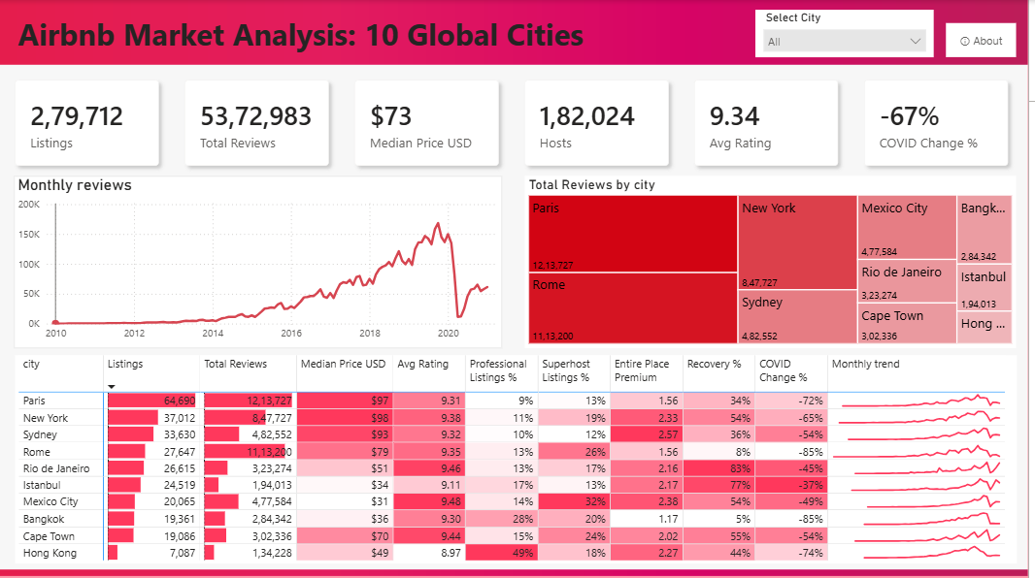
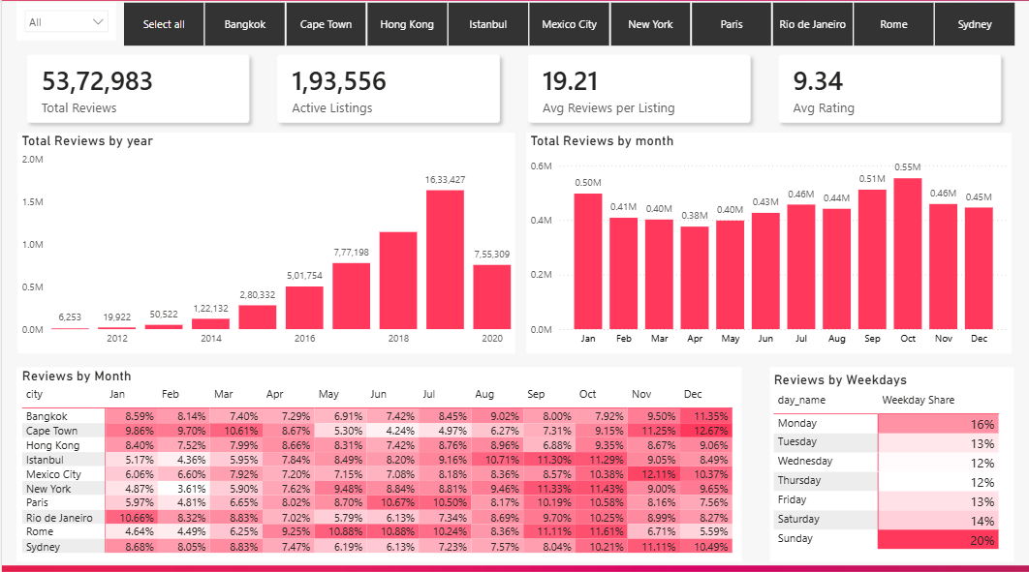
Dashboard pages 1 and 2
DASHBOARD
Page 1: Overview
Page 2: Demand
Six KPI cards with COVID change, a monthly trend, reviews by city, and a scorecard with COVID change and recovery per city.
City tiles, reviews by year and month, a seasonality heatmap and weekday share.
Power BI report, Airbnb_dashboard_v2.pbix

Slide 25
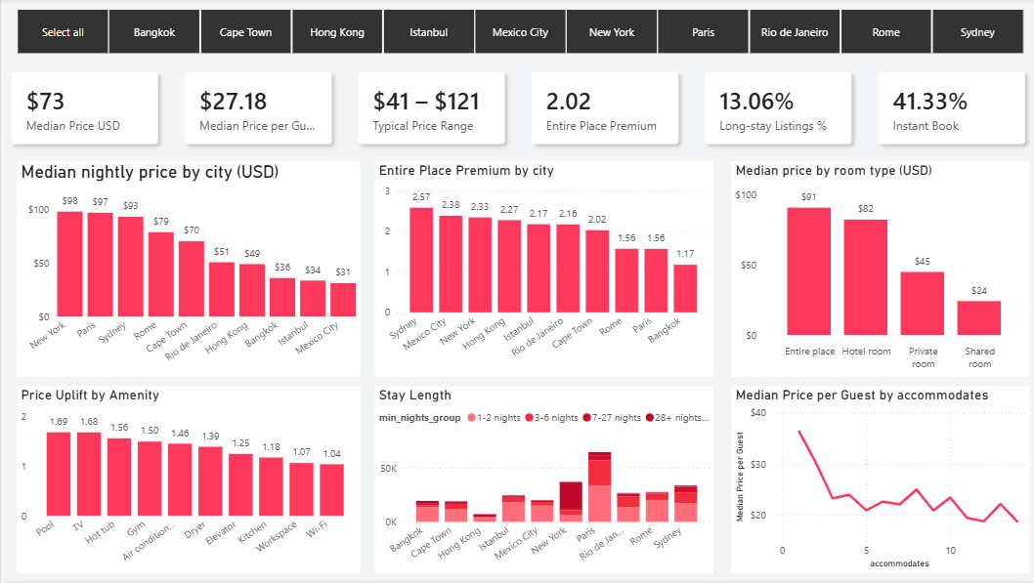
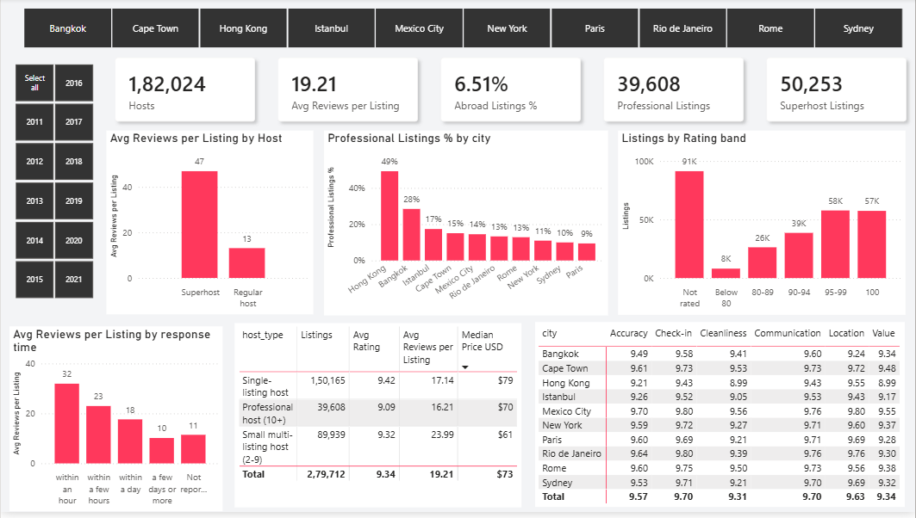
Dashboard pages 3 and 4
DASHBOARD
Page 3: Pricing
Page 4: Hosts and quality
Median price by city and room type, entire-place premium, amenity uplift and stay length.
Superhost and response-time effects, professional host share, rating bands and sub-scores.
Power BI report, Airbnb_dashboard_v2.pbix

Slide 26
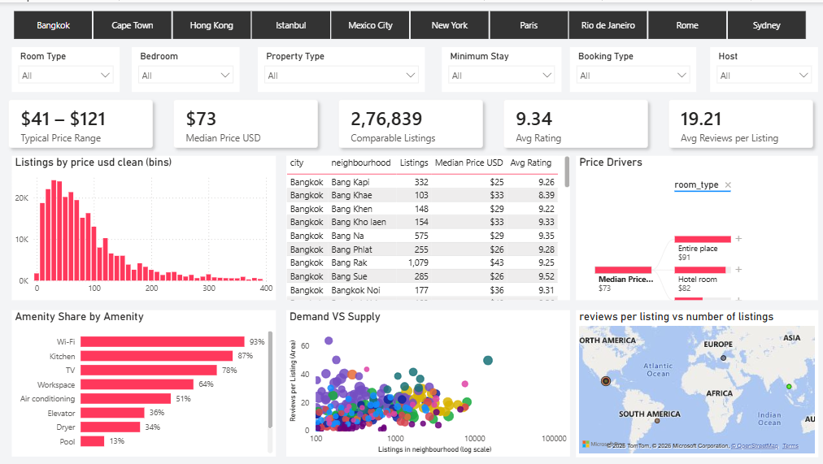
Dashboard page 5 and the About page
DASHBOARD
Page 5: Explore
Six filters, a price histogram, neighbourhood table, price drivers tree, amenity shares and map.
Power BI report, Airbnb_dashboard_v2.pbix

Slide 27
Limits of the data
FINDINGS
Reviews stand in for stays
Prices are listed rates
Not every guest reviews, so counts understate stays. Feb and Mar 2021 are partial and left out of trends.
Nightly USD at 26 Feb 2021 rates, not revenue. 276,839 of 279,712 listings have a valid price.
Associations, not causes
Hong Kong predates COVID
Superhost status, response time, amenities and the entire-place premium describe patterns, not effects.
Its decline began before March 2020. The data does not say why.
Airbnb Market Analysis: 10 Global Cities

Slide 28
Summary of key findings
FINDINGS
# | Finding | Evidence
1 | Demand is concentrated | Paris, Rome and New York hold 59% of 5.37M reviews
2 | 2019 growth came from supply | Reviews +43%; active listings 84,658 to 118,371
3 | COVID hit cities unevenly | -67% overall; Bangkok and Rome -85%, Istanbul -37%
4 | Demand is seasonal | October peak, 1.88x February; New York 3.17x; Sunday 20%
5 | Price follows city and space | New York $98 vs Mexico City $31; entire place 2.02x private room
6 | Amenities go with higher prices | Pool 1.69x, TV 1.68x, hot tub 1.56x; Wi-Fi 1.04x
7 | Hosting differs by city | Professional hosts: Hong Kong 49%, Paris 9%
8 | Host quality tracks reviews | Superhost 47 vs 13 reviews; reply within an hour 32 vs 10
9 | Ratings do not separate listings | 9.34 average; 20.5% score 100; 33% unrated
Put together: demand and price are set by city, season and space. Ratings say little, so reviews per listing and host behaviour are better signals.
All figures from the cleaned data; rates use listings with a valid price.

Slide 29
Recommendations
FINDINGS
Each recommendation comes straight from one of the findings.
# | Recommendation | Evidence behind it
1 | Plan price and availability around the season | October is 1.88x February; New York swings 3.17x
2 | Price by space first, then by city | Entire place is 2.02x private room; Sydney 2.57x, Bangkok 1.17x
3 | Test amenities before paying for them | Pool, TV and hot tub go with 1.6x to 1.7x prices, but may be signals of larger homes
4 | Reply fast | Within an hour: 32 reviews per listing; days or more: 10
5 | Do not rely on the rating alone | 20.5% of listings score 100 and 33% are unrated
6 | Judge recovery city by city | Rio de Janeiro 83% of Jan 2020; Bangkok 5%
If I had to start with one, it would be number 2. It explains the largest price gaps in the data.
Airbnb Market Analysis: 10 Global Cities

Slide 30
Tools and project files
WRAP-UP
Tool | What I used it for
Python, Pandas | Cleaning, price conversion, features, star schema files
VS Code | Running the cleaning script locally (the raw files were too large for Colab)
Power BI | Power Query, model, DAX measures, five pages and About
Inside Airbnb via Maven Analytics | Source data, public domain
Project files
airbnb-market-analysis/
|-- airbnb_cleaning_colab.py
|-- cleaning_report.txt
|-- data_dictionary_clean.csv
|-- Airbnb_dashboard_v2.pbix
|-- airbnb_clean/
| |-- fact_reviews.csv
| |-- dim_listing.csv
| |-- dim_host.csv
| |-- dim_city.csv
| |-- dim_date.csv
| `-- neighbourhood_summary.csv
The cleaned CSV files are too large for most repositories. Rerun the script on the raw files to recreate them.
Source: Inside Airbnb via Maven Analytics (public domain)

Slide 31
Conclusion
What I solved
I turned 5.4 million raw reviews and 279,712 listings into a clean star schema and a five-page Power BI dashboard that answers where demand, price and host quality sit across ten cities.
What I found
Three cities hold 59% of reviews, COVID cut reviews by 67% with very uneven recovery, and price follows city and space more than amenities. Ratings are too high to separate listings, so reviews and host behaviour are better signals.
Thank you
Omprakash Balara

