Slide 1
RESEARCH PROJECT
Parallel K-Means Clustering
Apache Spark implementation & performance evaluation
A research-inspired approach to faster clustering
Partition-level K-Means → candidate-center aggregation → distributed refinement
Chidiebere Abonyi • Anaelle Manzi • Dinh Nguyen • Abdul-Azeem Opakunle
CSCE 5300 / GROUP 7
01 / 23
Notes:
Introduce Group 7, the research topic, and the goal of evaluating parallel clustering performance.

Slide 2
PROBLEM & MOTIVATION
Why parallelize K-Means?
Repeated nearest-center calculations become costly as data grows.
The challenge
The opportunity
The question
Traditional K-Means iterates through assignment and center updates on the full dataset.
Partition-level computation can use multiple local worker threads to process data in parallel.
Can execution time decrease without changing the measured clustering quality?
CSCE 5300 / GROUP 7
02 / 23
Notes:
Explain why clustering matters in big data analytics and why execution time becomes important as datasets grow.

Slide 3
LITERATURE
Research foundation
Inspired by Liu et al. (2024), IEEE ICPECA, document 10470970.
Paper contribution
Our contribution
Partition-based local clustering, combined candidate centers, and iterative global refinement.
A custom Python / PySpark implementation with controlled experiments and a traditional K-Means baseline.
Research-inspired adaptation — not a line-by-line replication or a reproduction of the paper’s multi-node results.
CSCE 5300 / GROUP 7
03 / 23
Notes:
Identify the approved paper and distinguish its proposed method from the implementation developed for this course project.

Slide 4
ALGORITHM BASICS
Traditional K-Means in four steps
01 Initialize
02 Assign
Choose K starting centers
Find nearest center for each point
03 Update
04 Repeat
Recalculate cluster means
Stop when convergence is reached
Objective: minimize within-cluster sum of squared errors (SSE).
CSCE 5300 / GROUP 7
04 / 23
Notes:
Walk through the iterative K-Means procedure. Explain that lower SSE means observations are closer to their assigned centers, but comparisons must use the same dataset and conditions.

Slide 5
METHODOLOGY
Parallel K-Means pipeline
A visual summary of the nine-step implementation.
INPUT
PARTITION
LOCAL
Dataset + RDD
→
4 Spark partitions
→
K-Means in each
COLLECT
AGGREGATE
GLOBAL
Candidate centers
→
5 restarts
→
Distributed updates
Final output: global cluster centers, SSE, convergence status, and cluster counts.
CSCE 5300 / GROUP 7
05 / 23
Notes:
Explain the partition-level initialization and subsequent global refinement. Avoid claiming that this pipeline is identical to every step of the published paper.

Slide 6
ENGINEERING
Implementation architecture
Local computation
Global computation
mapPartitionsWithIndex
Custom K-Means++ initialization
Candidate-center generation
Broadcast current centers
reduceByKey cluster statistics
Iterate until SSE-change threshold
Custom implementation — not a call to Spark MLlib’s K-Means estimator.
CSCE 5300 / GROUP 7
06 / 23
Notes:
Describe the implemented software components and how Spark is used. Clarify that the tested local configurations run on one physical computer.

Slide 7
CONTROLLED STUDY
Experimental design
42
2
3
total runs
datasets
random seeds
36 Spark + 6 traditional
Synthetic + KDD99
42, 43, 44
Each sample has 1,000 records. Spark configurations: local[1], local[2], local[4]; 2 or 4 partitions.
CSCE 5300 / GROUP 7
07 / 23

Slide 8
EVALUATION
Historical synthetic scalability design
Historical repeated synthetic study: 10K and 50K records, 3 seeds, one machine.
DATASETS
FEATURES
CLUSTERS
10k / 50k
20
5
PARTITIONS
WORKERS
MEASURED RUNS
4
1 / 2 / 4
18
3 repetitions per configuration • seeds 42, 43, 44 • 1 unmeasured warm-up per Spark-master process
All tests ran on one Apple M2 MacBook Air (8 GB) in Spark local mode.
CSCE 5300 / GROUP 7
08 / 23
Notes:
Explain the controlled variables and the repeated experimental design. local[1], local[2], and local[4] represent local execution parallelism, not three separate cluster machines.

Slide 9
CONTROLLED PERFORMANCE
Within-Spark runtime speedup
1.698×
1.575×
Synthetic
KDD99
local[1] → local[4]
local[1] → local[4]
Four partitions. Speedup compares Spark local configurations—not Spark against traditional K-Means.
CSCE 5300 / GROUP 7
09 / 23

Slide 10
CONTROLLED QUALITY
Synthetic clustering agreement
1.000
1.000
0.910
Spark ARI
Spark NMI
Traditional ARI
local[4], p=4
local[4], p=4
mean baseline
Strong synthetic-label agreement; initialization and restart procedures differ across implementations.
CSCE 5300 / GROUP 7
10 / 23

Slide 11
CONTROLLED QUALITY
KDD99: weak label agreement
0.055
0.080
0.803
Spark ARI
Spark NMI
Spark purity
local[4], p=4
local[4], p=4
local[4], p=4
Low ARI/NMI indicate weak agreement with reference labels; purity alone can be misleading.
CSCE 5300 / GROUP 7
11 / 23

Slide 12
BASELINE COMPARISON
Traditional K-Means on small samples
0.0702 s
0.0736 s
Synthetic
KDD99
traditional mean
traditional mean
Traditional K-Means was faster on 1,000-record samples. Do not infer Spark is faster at this scale.
CSCE 5300 / GROUP 7
12 / 23

Slide 13
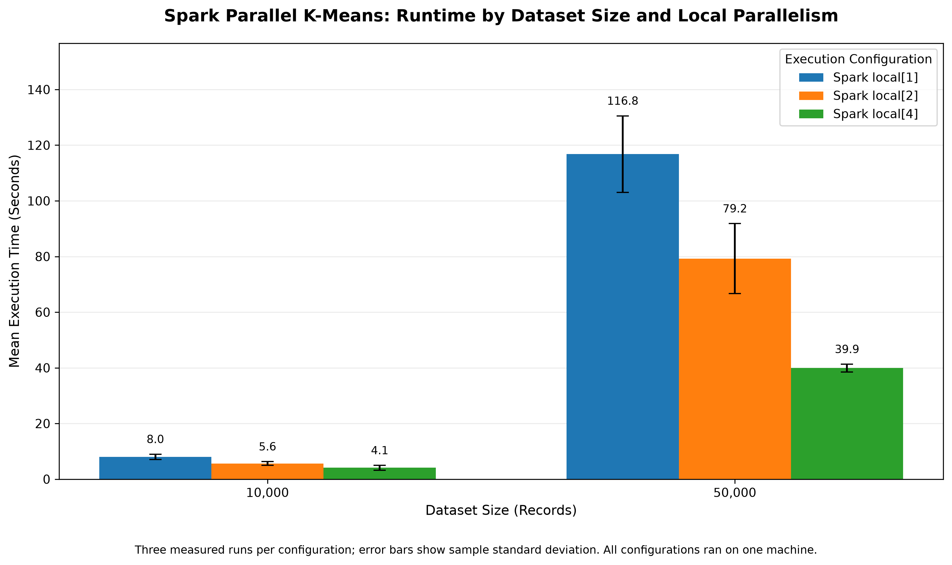
PERFORMANCE
Execution time falls with more workers
Mean clustering runtime across three measured runs.
10k: 8.033s → 4.090s | 50k: 116.765s → 39.918s
CSCE 5300 / GROUP 7
13 / 23
Notes:
Discuss the runtime figure and the reduction in measured execution time as local parallelism increases.

Slide 14
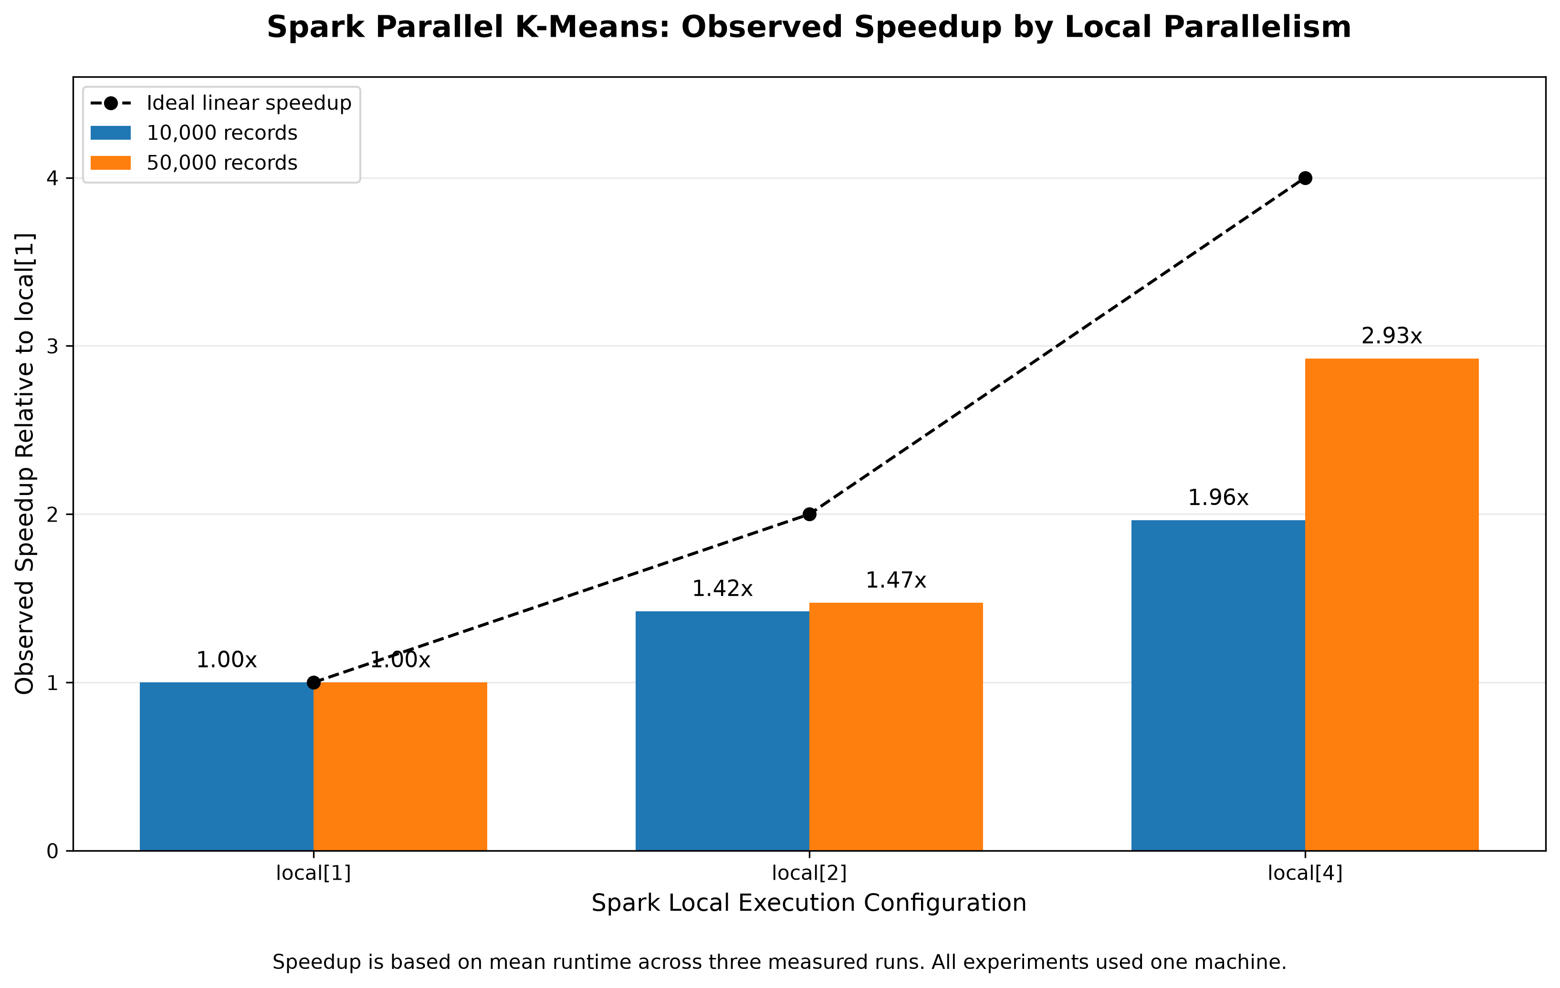
PERFORMANCE
Measured speedup
Speedup is measured relative to local[1].
local[4] achieves 1.964× at 10k and 2.925× at 50k.
CSCE 5300 / GROUP 7
14 / 23
Notes:
Explain the speedup calculation and why overhead, coordination, and hardware constraints can prevent perfect linear scaling.

Slide 15
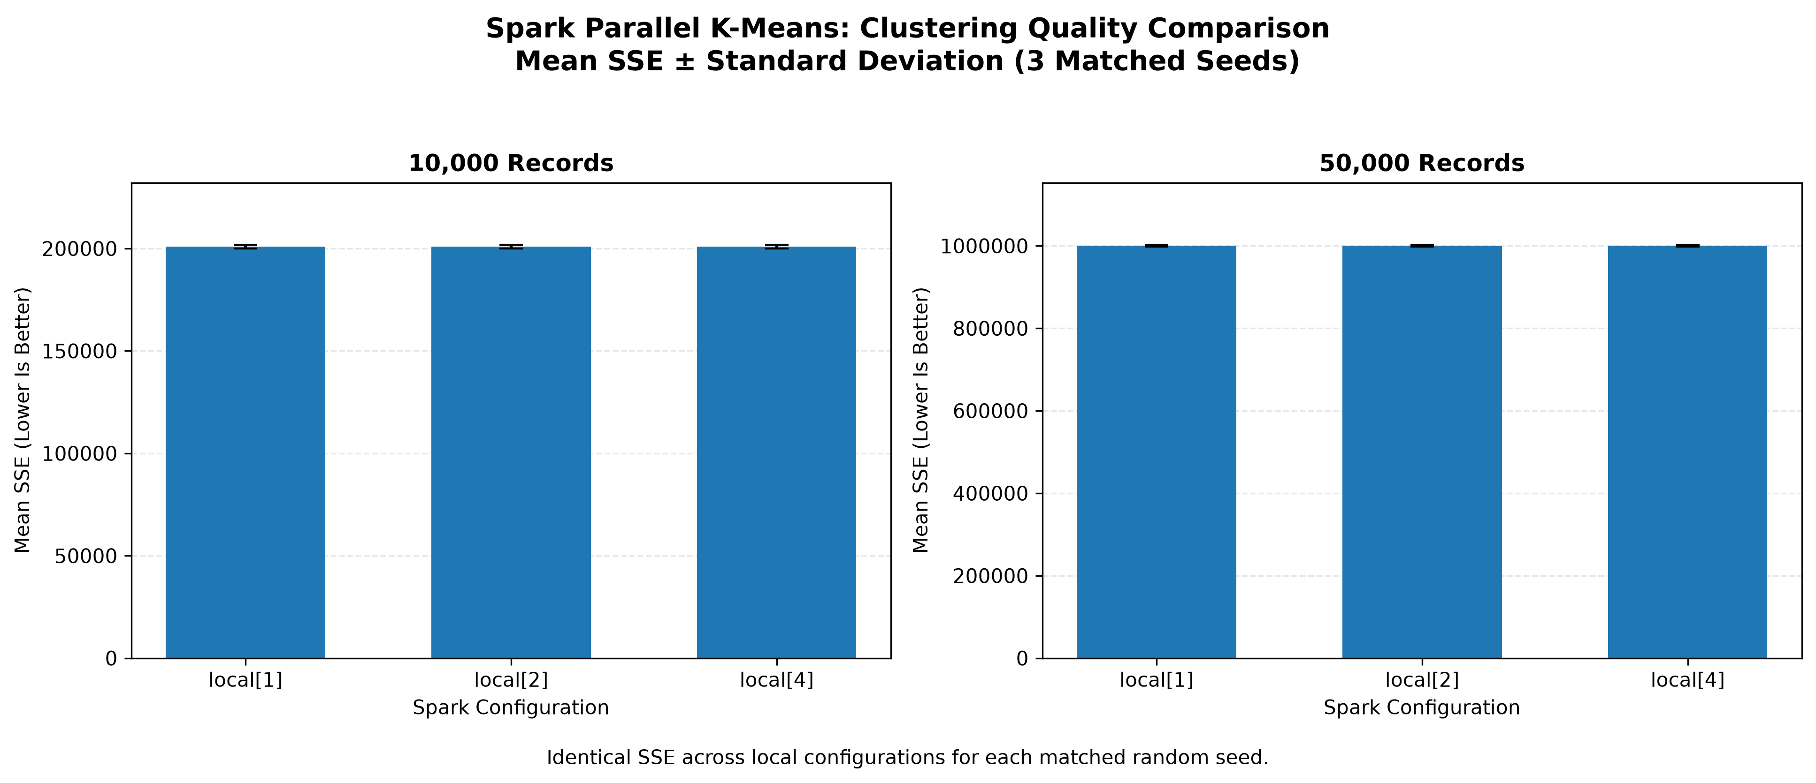
QUALITY
Clustering quality is consistent
Mean SSE is unchanged across local worker settings at each dataset size.
10k: 200,921.733 SSE | 50k: 1,000,547.881 SSE
CSCE 5300 / GROUP 7
15 / 23
Notes:
Explain SSE and why the consistency across worker settings matters. Do not infer that the larger dataset has inherently worse clustering solely from its larger total SSE.

Slide 16
HISTORICAL STUDY
Separate synthetic scalability evaluation
18
10K / 50K
2.925×
historical runs
records
50K speedup
not part of the 42
20 numerical features
local[1] → local[4]
Three seeds per configuration; single-computer Spark local mode, not a physical cluster.
CSCE 5300 / GROUP 7
16 / 23

Slide 17
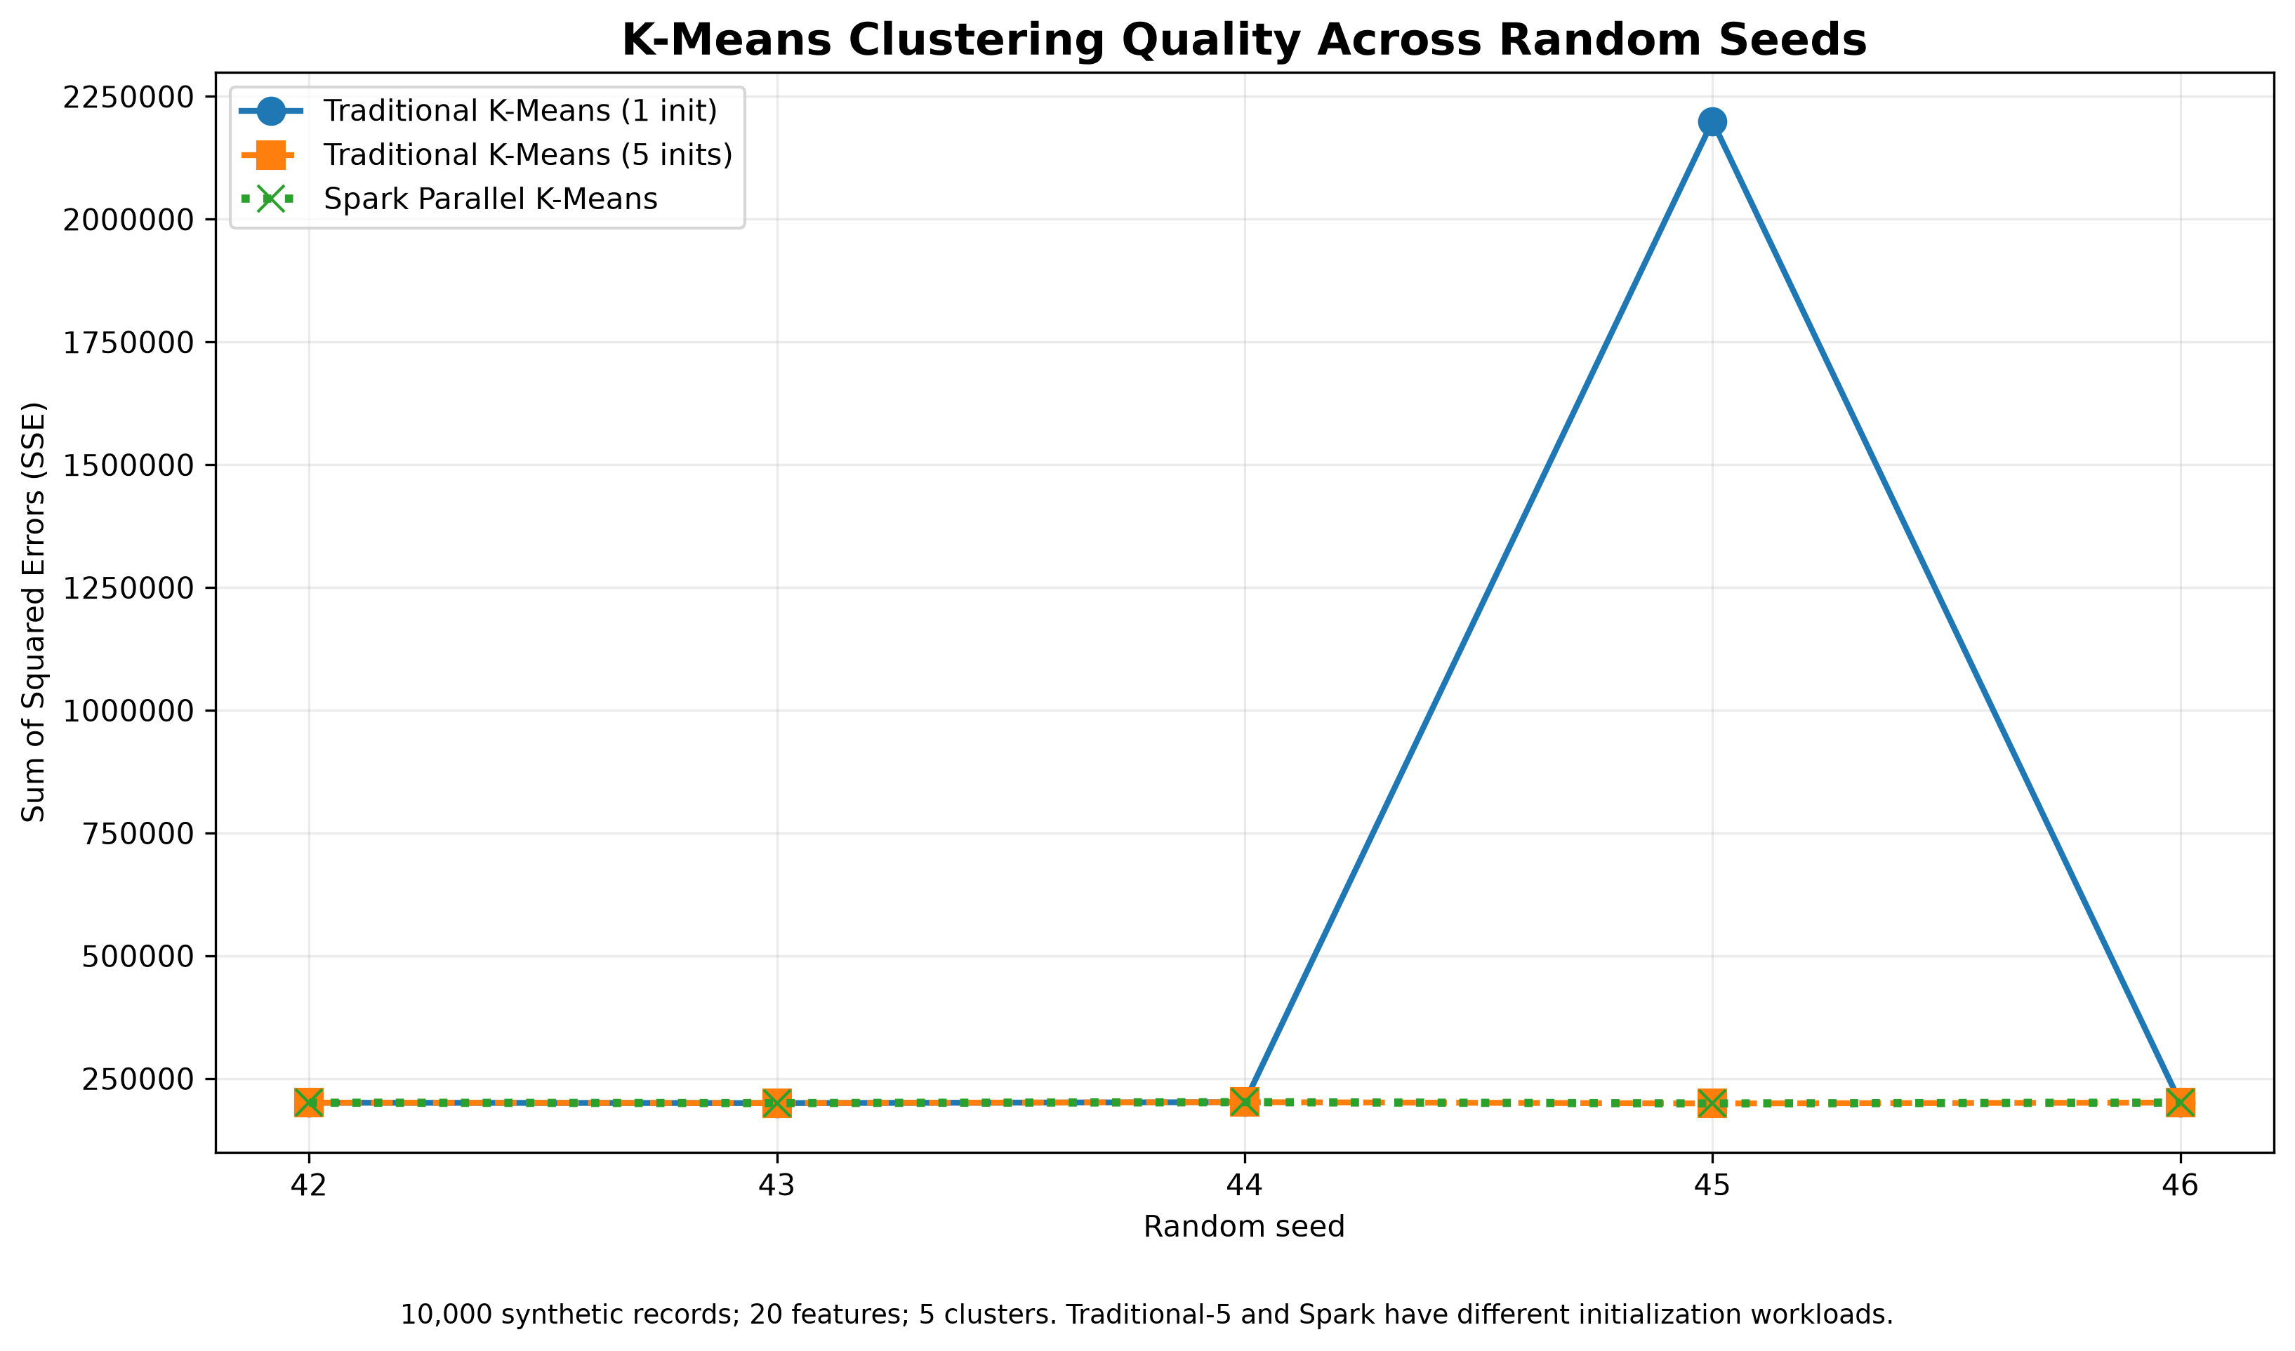
COMPARISON
Traditional baseline: initialization matters
Single versus multiple initializations on the same 10k-record baseline.
One seed produced higher SSE with a single initialization; multiple starts improved it.
CSCE 5300 / GROUP 7
17 / 23
Notes:
Review the baseline figure against the final report before presenting. Do not make numerical baseline claims that have not been verified from the original baseline data.

Slide 18
RESEARCH COMPARISON
Paper versus our implementation
Same high-level workflow, different experimental scope and design choices.
Dimension
Original research [1]
Our project
Execution
Distributed computing environment
Single-machine Spark local mode
Datasets
KDD Cup 99 and large synthetic data
10k / 50k synthetic records
Initialization
Partition-level initialization
Local K-Means++ and 5 aggregation restarts
Global update
Parallel assignment and aggregation
Broadcast + reduceByKey + SSE convergence
Raw runtime and SSE are not directly comparable across these two studies.
Scope: historical 10K/50K synthetic runs; controlled 1K synthetic + KDD99 runs.
CSCE 5300 / GROUP 7
18 / 23
Notes:
Make a careful qualitative comparison with the paper. Check the report's paper-comparison section before adding any quantitative claims about published results.

Slide 19
DEMONSTRATION
Live demo: show the algorithm working
Small input, clear output, predictable execution time.
1 Partition
2 Cluster
3 Interpret
Show how records are divided into Spark partitions.
Run a short Parallel K-Means demonstration.
Explain centers, convergence, and SSE.
Demo scripts: scripts/demo_partitioning.py • scripts/demo_parallel_kmeans.py
CSCE 5300 / GROUP 7
19 / 23
Notes:
Run a short, rehearsed demonstration. Confirm the exact command and expected output before presentation day.

Slide 20
RESEARCH CAVEATS
Limitations of the evidence
1
3
1K
computer
seeds
sample size
Spark local[n] only
limited uncertainty
controlled evaluation
Initialization differs across baselines. Historical and controlled studies remain separate. No exact IEEE reproduction claim.
CSCE 5300 / GROUP 7
20 / 23

Slide 21
KEY FINDINGS
Historical scalability findings
BEST OBSERVED SPEEDUP
RUNTIME REDUCTION
HISTORICAL RUNS
2.925×
65.81%
18 / 18
Evidence
Boundary
More local workers reduced runtime on both tested dataset sizes.
These findings do not establish multi-node or real-world scalability.
CSCE 5300 / GROUP 7
21 / 23
Notes:
Summarize the findings without claiming that local-mode experiments prove general distributed scalability.

Slide 22
SYNTHESIS
What the experiments demonstrate
1.698×
1.575×
0.055
Synthetic
KDD99
KDD99 ARI
controlled Spark speedup
controlled Spark speedup
weak label agreement
Local parallelism reduced Spark runtime; traditional remained faster at 1K. Larger synthetic runs showed stronger scaling.
CSCE 5300 / GROUP 7
22 / 23

Slide 23
CLOSING & REFERENCES
Thank you — Questions?
Parallel K-Means clustering using Apache Spark
Historical synthetic local[4] speedup: 2.925× at 50,000 records — with consistent mean SSE across local settings
[1] H. Liu et al., “Big data clustering method based on parallel K-means,” IEEE ICPECA, 2024.
[2] S. P. Lloyd, “Least squares quantization in PCM,” IEEE Trans. Inf. Theory, 1982.
[3] D. Arthur and S. Vassilvitskii, “k-means++,” SODA, 2007.
[4] B. Bahmani et al., “Scalable K-Means++,” PVLDB, 2012.
[5] Apache Software Foundation, “RDD Programming Guide,” Spark Documentation.
CSCE 5300 / GROUP 7
23 / 23
Notes:
Before submission, replace the abbreviated paper reference with the complete verified IEEE citation and add any references needed for slide-specific claims.

