Slide 1
RESEARCH PROJECT
Parallel K-Means Clustering
Apache Spark implementation & performance evaluation
A research-inspired approach to faster clustering
Partition-level K-Means → candidate-center aggregation → distributed refinement
Chidiebere Abonyi • Anaelle Manzi • Dinh Nguyen • Abdul-Azeem Opakunle
CSCE 5300 / GROUP 7
01 / 15
Notes:
Introduce Group 7, the research topic, and the goal of evaluating parallel clustering performance.

Slide 2
PROBLEM & MOTIVATION
Why parallelize K-Means?
Repeated nearest-center calculations become costly as data grows.
The challenge
The opportunity
The question
Traditional K-Means iterates through assignment and center updates on the full dataset.
Partition-level computation can use multiple local worker threads to process data in parallel.
Can execution time decrease without changing the measured clustering quality?
CSCE 5300 / GROUP 7
02 / 15
Notes:
Explain why clustering matters in big data analytics and why execution time becomes important as datasets grow.

Slide 3
LITERATURE
Research foundation
Inspired by Liu et al. (2024), IEEE ICPECA, document 10470970.
Paper contribution
Our contribution
Partition-based local clustering, combined candidate centers, and iterative global refinement.
A custom Python / PySpark implementation with controlled experiments and a traditional K-Means baseline.
Research-inspired adaptation — not a line-by-line replication or a reproduction of the paper’s multi-node results.
CSCE 5300 / GROUP 7
03 / 15
Notes:
Identify the approved paper and distinguish its proposed method from the implementation developed for this course project.

Slide 4
ALGORITHM BASICS
Traditional K-Means in four steps
01 Initialize
02 Assign
Choose K starting centers
Find nearest center for each point
03 Update
04 Repeat
Recalculate cluster means
Stop when convergence is reached
Objective: minimize within-cluster sum of squared errors (SSE).
CSCE 5300 / GROUP 7
04 / 15
Notes:
Walk through the iterative K-Means procedure. Explain that lower SSE means observations are closer to their assigned centers, but comparisons must use the same dataset and conditions.

Slide 5
METHODOLOGY
Parallel K-Means pipeline
A visual summary of the nine-step implementation.
INPUT
PARTITION
LOCAL
Dataset + RDD
→
4 Spark partitions
→
K-Means in each
COLLECT
AGGREGATE
GLOBAL
Candidate centers
→
5 restarts
→
Distributed updates
Final output: global cluster centers, SSE, convergence status, and cluster counts.
CSCE 5300 / GROUP 7
05 / 15
Notes:
Explain the partition-level initialization and subsequent global refinement. Avoid claiming that this pipeline is identical to every step of the published paper.

Slide 6
ENGINEERING
Implementation architecture
Local computation
Global computation
mapPartitionsWithIndex
Custom K-Means++ initialization
Candidate-center generation
Broadcast current centers
reduceByKey cluster statistics
Iterate until SSE-change threshold
Custom implementation — not a call to Spark MLlib’s K-Means estimator.
CSCE 5300 / GROUP 7
06 / 15
Notes:
Describe the implemented software components and how Spark is used. Clarify that the tested local configurations run on one physical computer.

Slide 7
EVALUATION
Controlled experimental design
Synthetic Gaussian clusters; fixed parameters across worker configurations.
DATASETS
FEATURES
CLUSTERS
10k / 50k
20
5
PARTITIONS
WORKERS
MEASURED RUNS
4
1 / 2 / 4
18
3 repetitions per configuration • seeds 42, 43, 44 • 1 unmeasured warm-up per Spark-master process
All tests ran on one Apple M2 MacBook Air (8 GB) in Spark local mode.
CSCE 5300 / GROUP 7
07 / 15
Notes:
Explain the controlled variables and the repeated experimental design. local[1], local[2], and local[4] represent local execution parallelism, not three separate cluster machines.

Slide 8
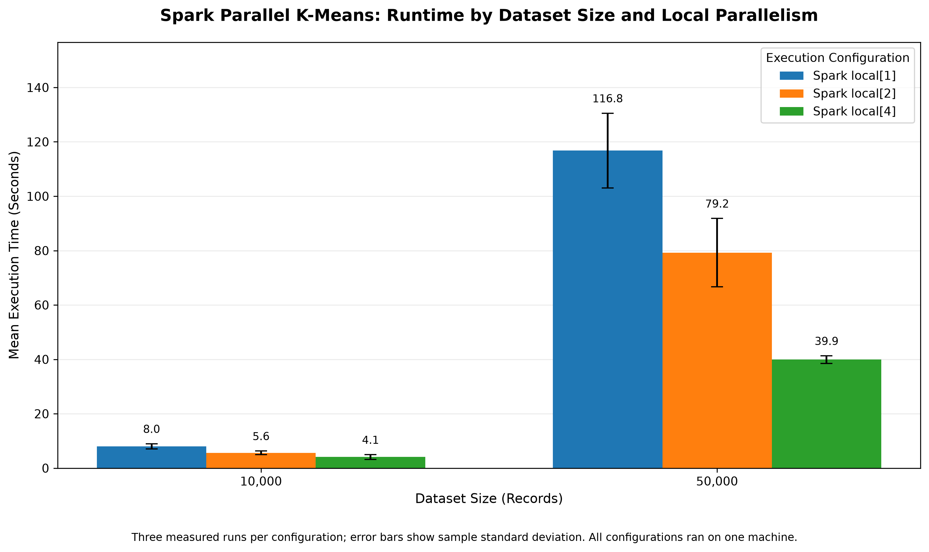
PERFORMANCE
Execution time falls with more workers
Mean clustering runtime across three measured runs.
10k: 8.033s → 4.090s | 50k: 116.765s → 39.918s
CSCE 5300 / GROUP 7
08 / 15
Notes:
Discuss the runtime figure and the reduction in measured execution time as local parallelism increases.

Slide 9
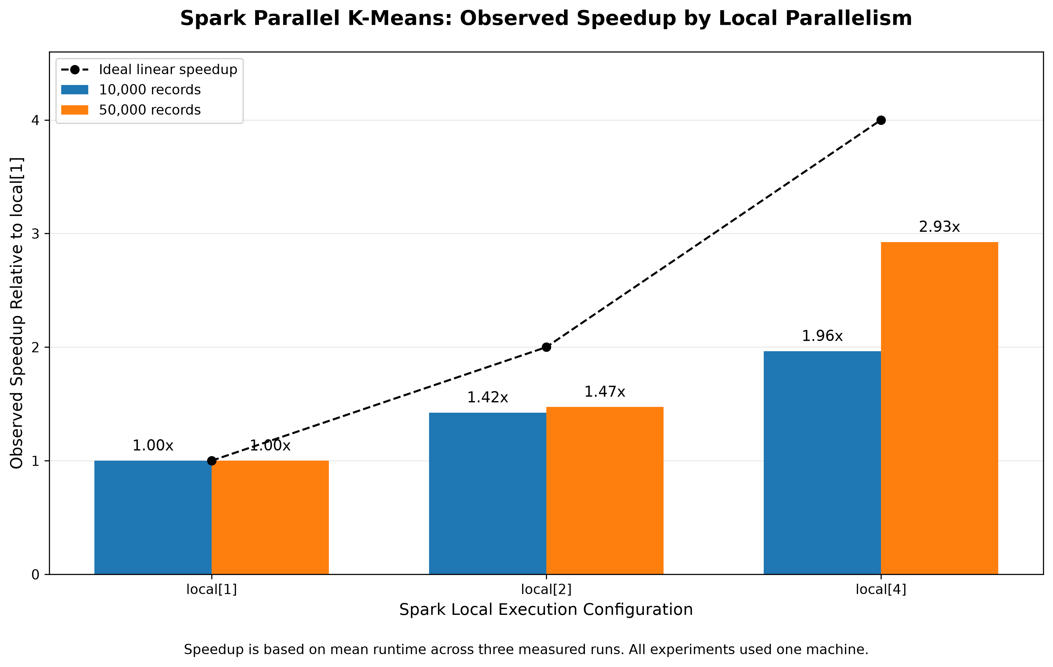
PERFORMANCE
Measured speedup
Speedup is measured relative to local[1].
local[4] achieves 1.964× at 10k and 2.925× at 50k.
CSCE 5300 / GROUP 7
09 / 15
Notes:
Explain the speedup calculation and why overhead, coordination, and hardware constraints can prevent perfect linear scaling.

Slide 10
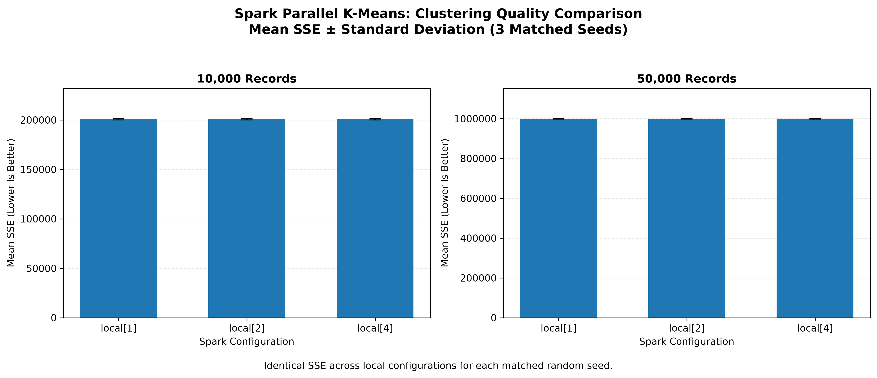
QUALITY
Clustering quality is consistent
Mean SSE is unchanged across local worker settings at each dataset size.
10k: 200,921.733 SSE | 50k: 1,000,547.881 SSE
CSCE 5300 / GROUP 7
10 / 15
Notes:
Explain SSE and why the consistency across worker settings matters. Do not infer that the larger dataset has inherently worse clustering solely from its larger total SSE.

Slide 11
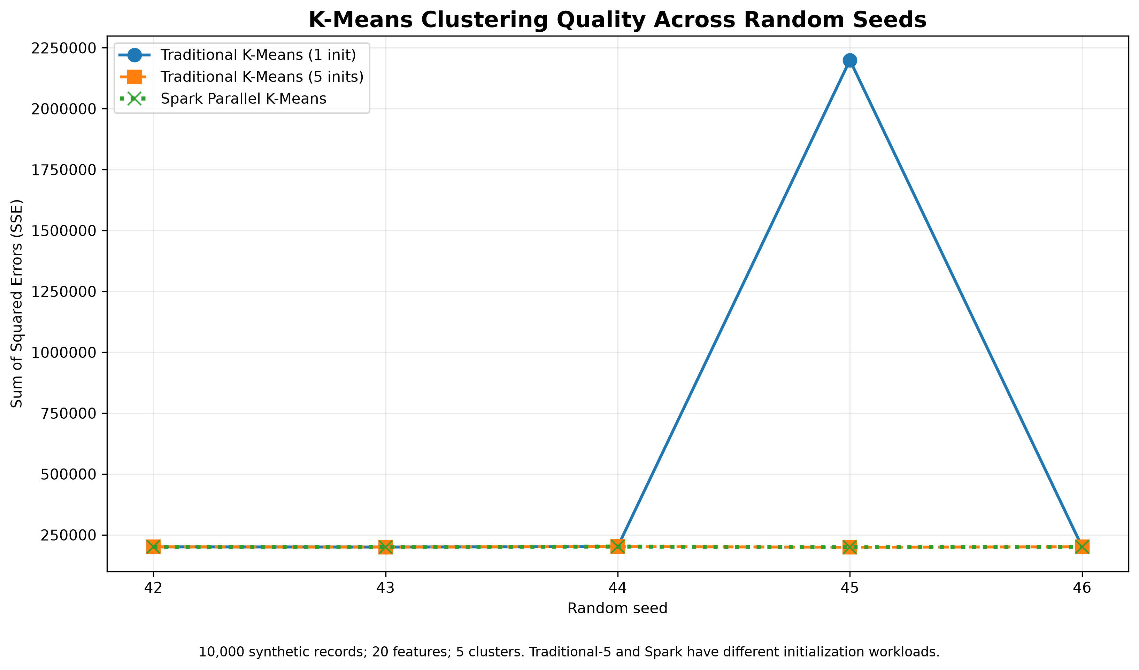
COMPARISON
Traditional baseline: initialization matters
Single versus multiple initializations on the same 10k-record baseline.
One seed produced higher SSE with a single initialization; multiple starts improved it.
CSCE 5300 / GROUP 7
11 / 15
Notes:
Review the baseline figure against the final report before presenting. Do not make numerical baseline claims that have not been verified from the original baseline data.

Slide 12
RESEARCH COMPARISON
Paper versus our implementation
Same high-level workflow, different experimental scope and design choices.
Dimension
Original research [1]
Our project
Execution
Distributed computing environment
Single-machine Spark local mode
Datasets
KDD Cup 99 and large synthetic data
10k / 50k synthetic records
Initialization
Partition-level initialization
Local K-Means++ and 5 aggregation restarts
Global update
Parallel assignment and aggregation
Broadcast + reduceByKey + SSE convergence
Raw runtime and SSE are not directly comparable across these two studies.
CSCE 5300 / GROUP 7
12 / 15
Notes:
Make a careful qualitative comparison with the paper. Check the report's paper-comparison section before adding any quantitative claims about published results.

Slide 13
DEMONSTRATION
Live demo: show the algorithm working
Small input, clear output, predictable execution time.
1 Partition
2 Cluster
3 Interpret
Show how records are divided into Spark partitions.
Run a short Parallel K-Means demonstration.
Explain centers, convergence, and SSE.
Demo scripts: scripts/demo_partitioning.py • scripts/demo_parallel_kmeans.py
CSCE 5300 / GROUP 7
13 / 15
Notes:
Run a short, rehearsed demonstration. Confirm the exact command and expected output before presentation day.

Slide 14
KEY FINDINGS
What the experiments demonstrate
BEST OBSERVED SPEEDUP
RUNTIME REDUCTION
SUCCESSFUL RUNS
2.925×
65.81%
18 / 18
Evidence
Boundary
More local workers reduced runtime on both tested dataset sizes.
These findings do not establish multi-node or real-world scalability.
CSCE 5300 / GROUP 7
14 / 15
Notes:
Summarize the findings without claiming that local-mode experiments prove general distributed scalability.

Slide 15
CLOSING & REFERENCES
Thank you — Questions?
Parallel K-Means clustering using Apache Spark
2.925× faster at 50,000 records — with consistent mean SSE across local settings
[1] H. Liu et al., “Big data clustering method based on parallel K-means,” IEEE ICPECA, 2024.
[2] S. P. Lloyd, “Least squares quantization in PCM,” IEEE Trans. Inf. Theory, 1982.
[3] D. Arthur and S. Vassilvitskii, “k-means++,” SODA, 2007.
[4] B. Bahmani et al., “Scalable K-Means++,” PVLDB, 2012.
[5] Apache Software Foundation, “RDD Programming Guide,” Spark Documentation.
CSCE 5300 / GROUP 7
15 / 15
Notes:
Before submission, replace the abbreviated paper reference with the complete verified IEEE citation and add any references needed for slide-specific claims.

