Slide 1
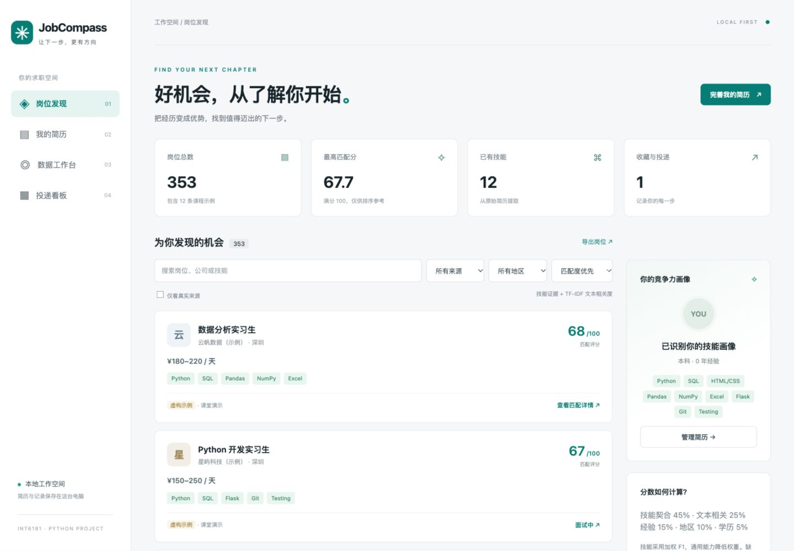
JobCompass intelligent job search
A local Python workspace for resume-based job discovery
The problem
Job information is scattered.
Requirements are inconsistent.
Application progress gets lost.
The application
Import a resume, compare jobs and record the next step.
JobCompass INT6181 1 / 5
Notes:
Time: 0:00-1:00. Explain the practical problem and show the local application. Core functionality remains available without AI. Screenshot uses an explicitly fictional candidate and fictional sample jobs. Sources: project README.md and working application. Group identification can be added after the group number and members are confirmed.

Slide 2
Python architecture and responsibilities
A modular service layer behind a browser GUI
Module | Responsibility | Python techniques
resume.py | File extraction and skill evidence | Regex, ZIP, XML, optional PDF
sources.py | Public API and local imports | HTTP, JSON, CSV, HTMLParser
matching.py | Deterministic ranking | Counters, TF-IDF, weighted F1
storage.py | Persistent jobs and applications | SQLite, transactions, SQL parameters
server.py + ai.py | GUI API and DeepSeek tasks | Classes, threads, validation
main.py is the entry point. SQLite and local ranking work offline.
JobCompass INT6181 2 / 5
Notes:
Time: 1:00-2:00. Describe separation of responsibilities and why it improves testability. A bounded ThreadPoolExecutor keeps external network operations away from the request flow. SQLite uses parameterized SQL and independent connections. Source: jobcompass modules and docs/SPECIFICATION.md.

Slide 3
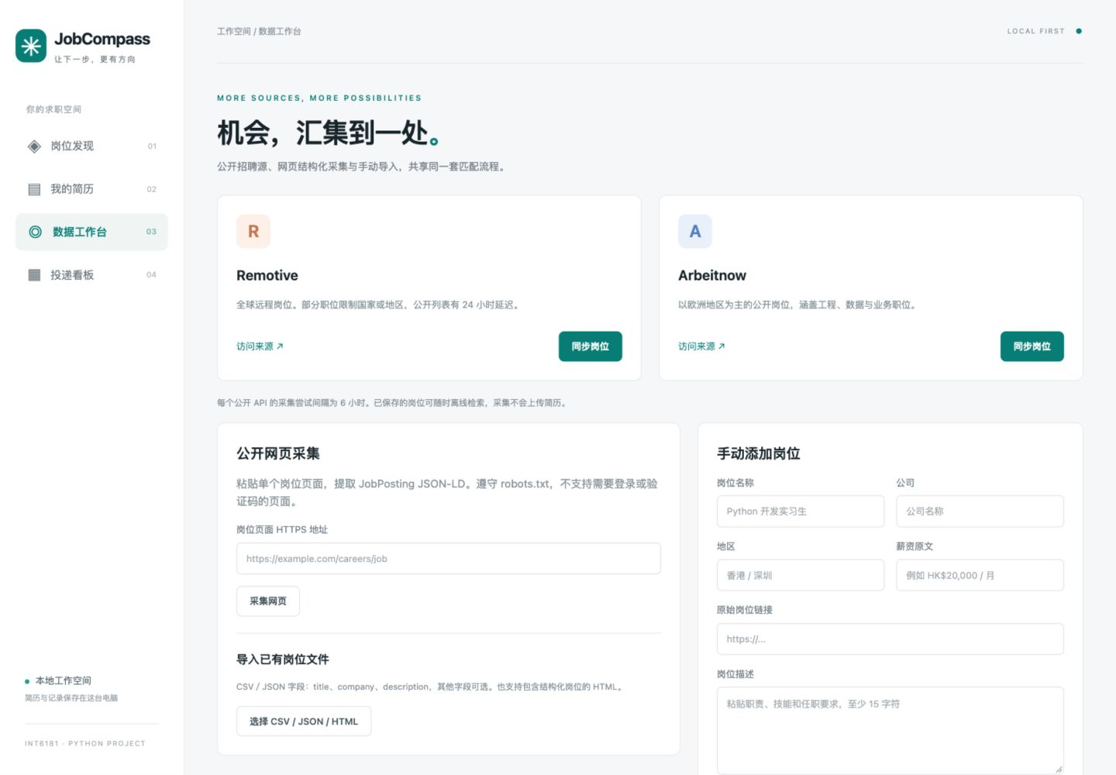
Public job sources and reliable imports
341 real jobs collected in the integration check
16 Remotive jobs
325 Arbeitnow jobs
Six-hour collection interval
Source attribution and original links
CSV, JSON, JSON-LD and manual entry
Geographic coverage is mainly overseas and remote. Restricted domestic sites require authorized imports.
JobCompass INT6181 3 / 5
Notes:
Time: 2:00-3:00. Show the two verified external sources and explain that data collection does not send the resume. Distinguish live sources from twelve fictional demo jobs. No claim is made to scrape authenticated domestic recruitment sites. Sources: docs/live_check.json, https://github.com/remotive-com/remote-jobs-api and https://www.arbeitnow.com/blog/job-board-api. Counts describe this test, not permanent availability.

Slide 4
Explainable matching with an AI assistant
A reproducible ranking score, with evidence for each component
Weighted skill F1
Generic skills carry less weight.
Unknown requirements stay unknown.
Remote does not mean worldwide.
DeepSeek improves explanations and resume wording. It does not set the ranking score.
Scores are ranking indicators, not hiring probabilities.
JobCompass INT6181 4 / 5
Notes:
Time: 3:00-4:00. Explain weighted precision and recall, cosine similarity, active-weight normalization and condition coverage. The generic-skills regression test catches unrelated writing jobs. AI calls require opt-in, use saved resume content and retain the original resume. Sources: matching.py, ai.py, docs/SPECIFICATION.md and https://api-docs.deepseek.com/guides/json_mode/.

Slide 5
Evaluation, demonstration and limitations
64 offline tests passed
Real collection and DeepSeek requests verified
1,200 sample jobs ranked in about 0.055 seconds
Precision@4 = 1.0 on 12 synthetic labelled jobs
What the evidence means
Live demonstration
Tests verify specified behavior. Synthetic labels do not establish real hiring accuracy. Cloud CI is configured but has not run.
Load a resume, inspect score components, generate an AI draft and move a saved job to the application board.
JobCompass INT6181 5 / 5
Notes:
Time: 4:00-5:00. Summarize validation honestly. The benchmark is a local run of repeated sample jobs; it is not a production performance guarantee. Show an invalid-input error if time permits. Explain that Codex assisted specification, implementation, tests, review and documentation. Each member must independently understand and report their real contributions. Sources: docs/test_results.txt, docs/evaluation.json, docs/live_check.json, docs/DEMO_SCRIPT.md.

