Slide 1
Airport Manager
Oparlescu Bogdan

Slide 2
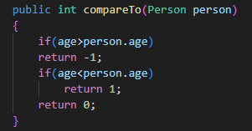
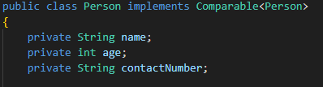

Passenger

Slide 3

Ticket
int ticketNumber: Unique identifier for the ticket
Passenger passenger: The passenger associated with the ticket.
Flight flight: The flight for which the ticket is issued.

Slide 4
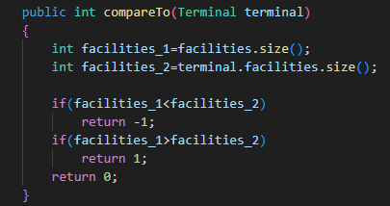

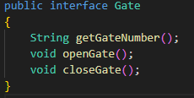

Terminal

Slide 5

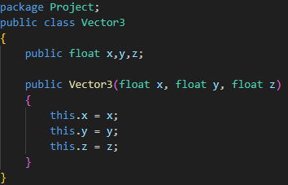
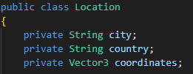
Flight
String flightNumber: Unique identifier for the flight.
String departureCity: City from which the flight departs
String destinationCity: City to which the flight is headed.

Slide 6
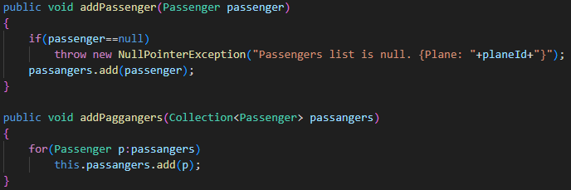
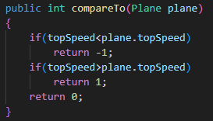
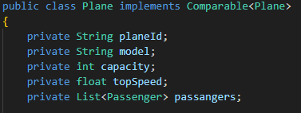
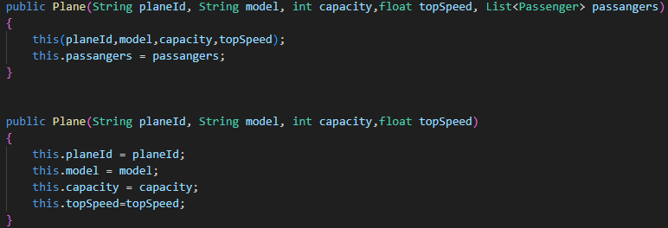
Plane

Slide 7
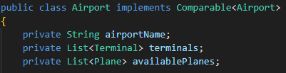
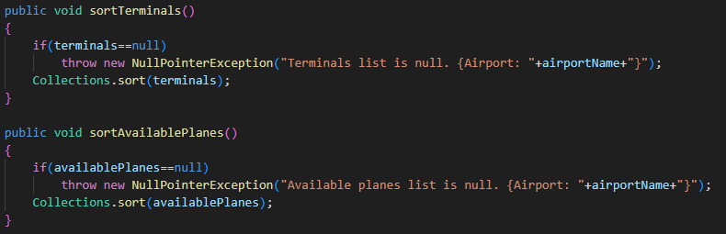
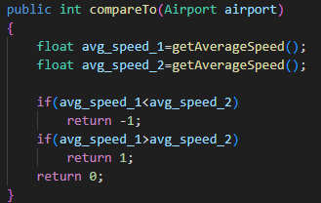
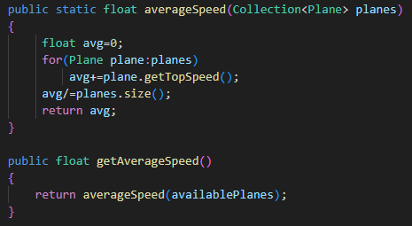
Airport

Slide 8
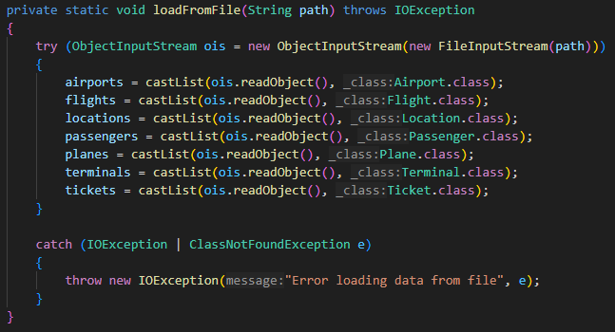
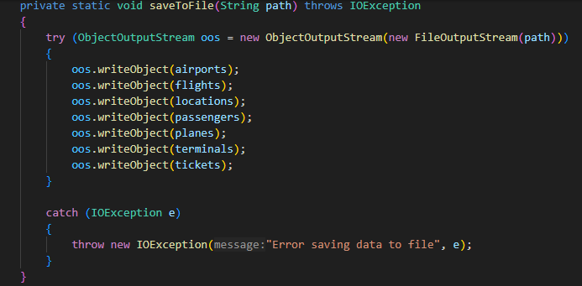
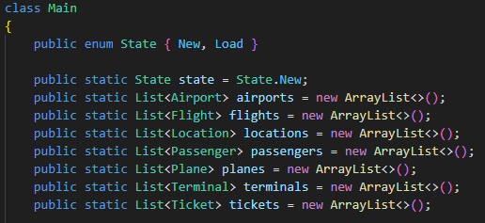
Main

Slide 9
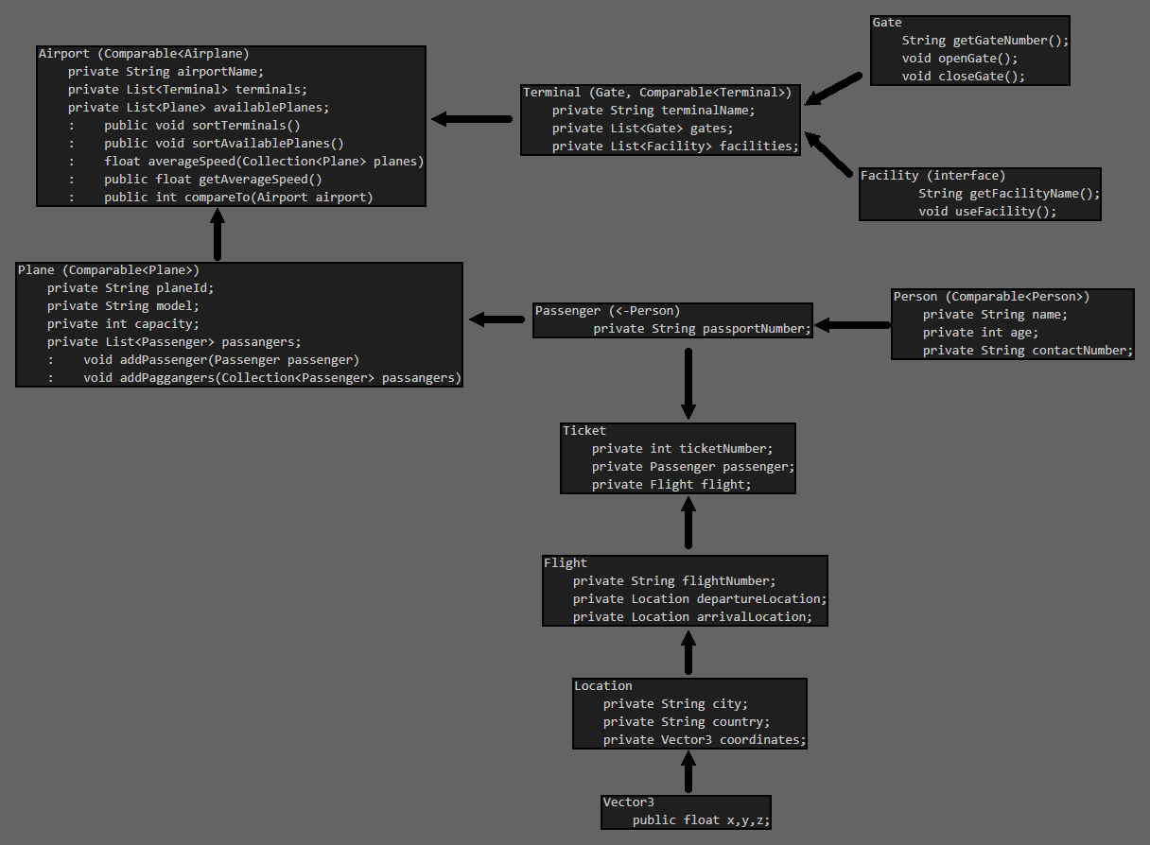

Slide 10
Use case
The airport management system I created serves as a one-stop solution for handling everything in airports—from passenger details and flight schedules to terminal assignments. It's designed to simplify the complexities of airport operations and ensure effective communication between different components.

Slide 11
Motivation:
I initialized this project mainly because I like planes. It was fun creating the class diagram and testing my programming skills with interfaces and exceptions.

Slide 13
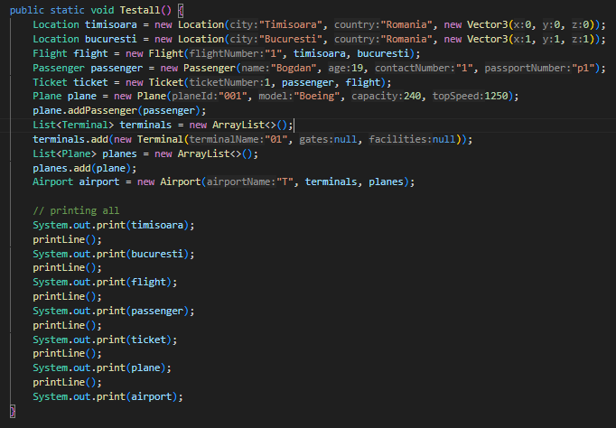
Constructor tests
Instantiating each class and testing functionality

