Slide 1
Can RL improve contacts-v1?
MarinFold experiment 237 — reinforcement learning on the <contacts-v1.multi> model
Ten reward designs · fifteen runs · 57 scored checkpoints · 8 × A100-80GB via SkyRL
issue #237 · PR #240
Notes:
exp237: does RL improve the contacts-v1.multi model from #230? Ten reward designs, 56 scored checkpoints.

Slide 2
Why #208 failed — a unit mismatch
Eleven scored runs, five reward designs, and none improved consensus R-precision
THE PROBLEM
THE CHANGE
The reward scored one rollout. The metric votes over 100 independent rollouts — an object no single rollout can see.
Under <contacts-v1.multi> one rollout emits ~22 contact sets in a single generation.
Making each rollout individually better made the hundred redundant. Consensus scoring cannot rank a pair that no rollout emits.
So a reward computed on one rollout's sections acts on the same kind of object the metric scores — and its credit assignment is inside the sequence, where the policy gradient can reach it.
That is the one hypothesis this experiment tests. It is falsifiable, and it is the only reason to expect a different outcome from #208.
Notes:
#208's reward acted on one rollout while the metric votes over 100 independent ones. The multi format puts the candidate set inside a single rollout.

Slide 3
What has to be beaten
R-precision (all), legacy 554 — every number from #230's scorer, unchanged
0.5896
0.5673
0.5342
plain, 22 rollouts voted
THE BAR — budget-matched
multi consensus
the #230 warm start
multi, ORACLE best section
a ceiling, not a result
Two facts shape every reward here
Consensus beats the ORACLE best single candidate in both regimes
0.5896 > 0.5680 and 0.5673 > 0.5342 — candidates carry complementary information, so a reward that exploits combinations has more to work with than best-of-N.
At matched budget, independent sampling still wins
22 independent rollouts cover 1,065 distinct pairs; 22 sections of one rollout cover 658. The multi format starts ~62% behind on explored space — closing that is what success looks like.
Notes:
The bar is 0.5896, plain sampling at matched budget. Consensus beats oracle-best in both regimes, so candidates are complementary.

Slide 4
The algorithm, precisely
GRPO — and its clipping never fires
What is actually applied
Why that is load-bearing
PPO clipped surrogate + group-relative baseline. No critic, no GAE.
k3 KL penalty to the frozen #230 reference, coefficient 0.001.
One inner epoch, one minibatch → the importance ratio is exactly 1.
Measured: clip_ratio = 0.0 at every one of 468 steps.
Nothing limits the step. There is no effective trust region, and kl_loss_coef 0.001 is far too weak to be one — terminal KLs of 0.09, 0.49 and 3.26 were all reached.
the dose–response is clean: KL grows freely, so each checkpoint honestly samples “policy at distance d”
two learning rates 3.3× apart agree to 0.002 at matched KL
the diversity gates had to do the stopping — nothing in the optimiser was going to
grad = −E[ A · ∇log π ] + 0.001 · ∇KL(π‖π_ref)
In effect: REINFORCE with a group baseline and a weak KL pull.
Notes:
GRPO with an inert clip. Nothing bounds the step, which is why distance moved orders every result.

Slide 5
Ten reward designs
Everything operates on the sections of one rollout, never on rollouts of a group
M-C
section k's marginal contribution to its own rollout's consensus
per-section
M-F
F1 of the last section — the selector
rollout scalar
M-B
F1 of the best section (ORACLE) — the ceiling
rollout scalar
M-BC
GRPO(best) + λ·GRPO(consensus)
rollout scalar
M-FC
GRPO(last) + λ·GRPO(consensus) — synthesis
rollout scalar
M-K
the rollout's own consensus R-precision — the deployed metric
rollout scalar
M-BP
M-B + a one-sided floor on the candidate count
rollout scalar
M-KS2
M-K + zero-sum shaping: credit a section for what it added
per-section
M-KP
M-K + per-pair shaping — sharpened, exactly as #208 predicts
per-token
M-0
M-C's reward at lr = 0 — the control
—
Notes:
Ten arms. Amber marks the two that produced gains: M-K and M-KS2.

Slide 6
The whole result, ordered by distance moved
R-precision (all), legacy 554 · 8 rollouts × 577 proteins
checkpoint
KL
consensus
best (ORACLE)
last
plain, 22 rollouts — THE BAR
—
0.5896
0.5680
—
M-K step-36
0.0162
0.5806
0.5602
0.5178
M-KS2 step-24
0.0225
0.5799
0.5677
0.5046
M-B step-18
0.0088
0.5763
0.5663
0.5108
M-C step-18
0.0072
0.5750
0.5578
0.5267
#230 warm start
0
0.5673
0.5342
0.4566
M-0, lr 0 (control)
0
0.5678
0.5364
0.4594
M-KB step-24 (4× batch)
0.0198
0.5475
0.5344
0.4878
M-KS3 step-12 (fragmented)
—
0.4627
0.3203
0.2755
Primary criterion NOT met — the best consensus is 0.0090 short of the bar. Rows sort by distance moved, and that ordering is close to the ordering by score: the experiment's central finding in one table.
Notes:
M-K step-36 is the best consensus at 0.5806. M-KS2 sets the best oracle-best at 0.5677.

Slide 7
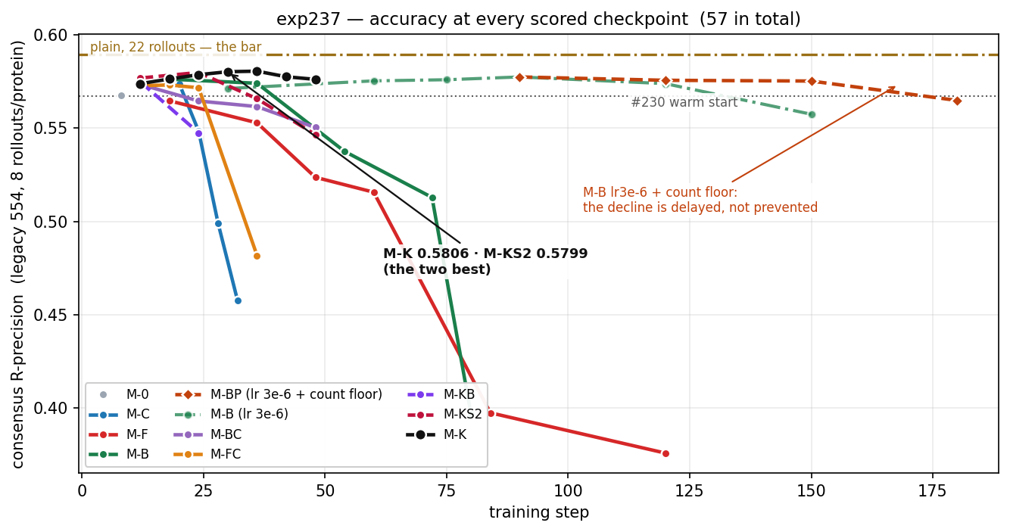
Every scored checkpoint
Five arms peak by step ~20 and fall away; M-K and M-KS2 peak later and higher
57 checkpoints · consensus R-precision on the 554-protein exp89 benchmark · noise floor 0.0023
Notes:
The full accuracy picture. Nothing crosses the bar.

Slide 8
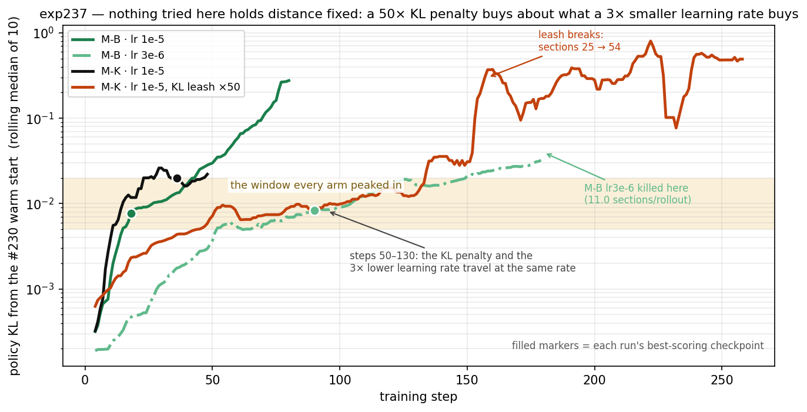
Finding 1 — distance decides, not schedule
#208's negative result is the far end of a dose–response, not a verdict
Consensus against distance moved
KL 0
0.5673
warm start
KL 0.016
0.5806
the peak
KL 0.031
0.5529
KL 0.486
0.3969
destroyed
Every reward here helps at small KL and damages at large. #208 ran its arms at KL 0.06–0.10 and to 3.96 — past the peak on every one — while its two smallest never moved at all.
Two runs at a 3.3× different learning rate agree to 0.002 at matched KL — so this is a property of distance, not of the schedule.
The window it needed lay between the two learning rates it tried.
Notes:
Outcome tracks KL from the warm start, not steps or learning rate.

Slide 9
Finding 2 — long trajectories do not win
Four interventions against the peak. None produced a checkpoint better than the peak it started from.
1
3× smaller learning rate
2
50× KL penalty
Killed at step 180, sections collapsed 20.2 → 11.0. Its four flat evals at steps 60–120 were a plateau in steps while KL climbed 0.0087 → 0.0397.
Does not hold distance — from step 50 to 130 it tracks the 3× lr run exactly. At matched KL, 3.3× the optimisation scored 0.0094 worse.
3
candidate-count floor
4
4× larger batch
Worked: fixed the collapse, +0.0178 over the unpenalised run at step 150. Then died 3 steps later of diversity collapse instead.
Cut per-batch noise 2.4×, and at matched KL came out 0.0301 WORSE. Gradient noise was implicit damping, not a constraint.
Each changed the size, direction or shape of the step. Whatever bounds this is not the step size, not the distance per step, not the candidate count, and not gradient noise.
Notes:
Four optimiser-side interventions, all failing the same way.

Slide 10
Finding 3 — noise was a protection
Arm M-KB: arm M-K at 4× the batch — 256 rollouts per step against 64
THE PREMISE HELD
THE CONCLUSION INVERTED IT
Per-batch noise fell on every instrument: sections/rollout 1.75 vs 4.20 (2.4×), consensus 0.036 vs 0.058, union pairs 64 vs 144. The gradient really was noise-dominated.
At matched distance (KL 0.0198 vs 0.0199), the cleaner gradient reads 0.5475 against 0.5776 — 0.0301 worse, 124 wins to 426 losses, CI excluding zero.
Noise partly cancels step to step, so the policy dithers. Average it away and the policy commits — to the direction its reward actually points, which is fewer and more similar candidates.
So the peak is not an artifact of a noisy estimate. The reward's own optimum is worse than the warm start — and better optimisation reaches it sooner.
Corollary: the next arm has to change the reward, not the optimiser.
Notes:
A 4x cleaner gradient is 0.03 worse at matched distance. Noise was damping.

Slide 11
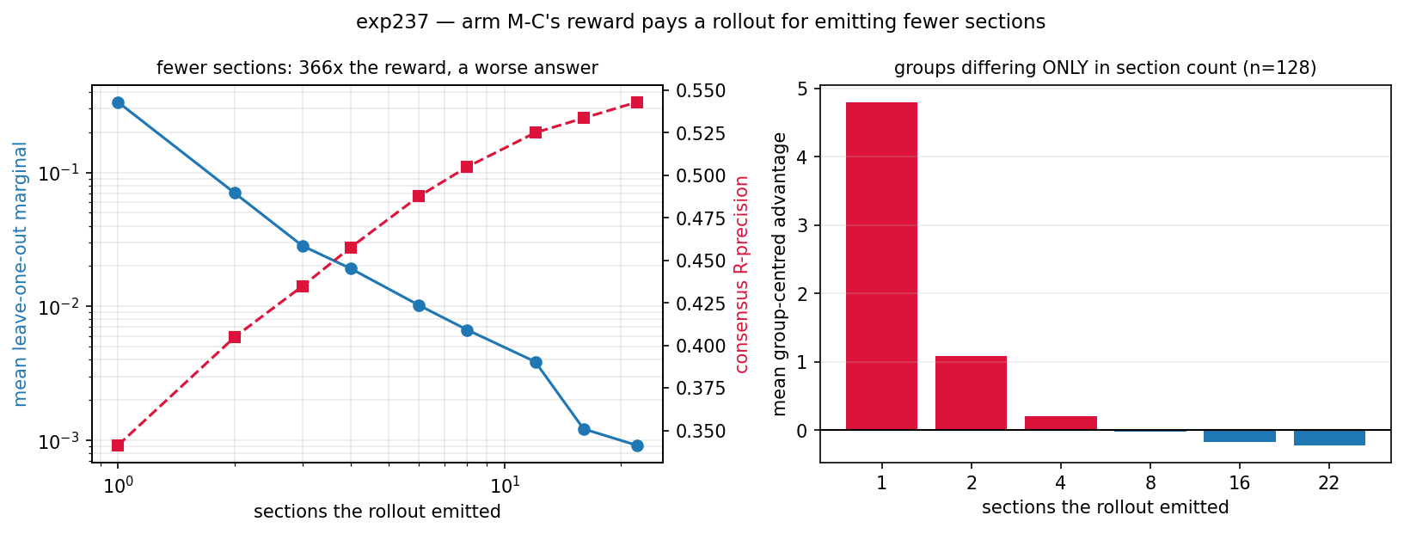
Finding 4 — E[r] = 0 does not bound scale
Arm M-C collapsed because its reward's SCALE depended on the candidate count
Group-centred advantage vs. sections emitted
sections
1
4
22
M-C leave-one-out
+4.79
+0.21
−0.22
causal prefix
+2.03
+0.48
−0.22
M-K C(all)
−1.37
−0.14
+0.79
M-C's marginal is 366× larger at one section than at 22 — it paid the policy to emit a worse answer — while E[A] = 0 held exactly, because the centring is computed inside the quantity being gamed.
“Scale-correct” means the reward's dependence on the candidate count has the same SIGN as the deployed metric's — not that it is invariant. It is checkable from a histogram before any GPU time.
Notes:
M-C's per-section marginal diverges as the count falls: 366x. M-K's base has the correct sign.

Slide 12
The shaping line — two failures, one success
Credit a section for what it ADDED, rather than reinforcing every section equally
M-KS
raw prefix marginal, centred within the rollout
Count COLLAPSE to 10.7 by step 21 — the fastest death here. Zero-sum bounded the rollout's LEVEL while leaving its SHAPE decaying in section index. A section owns the token that opens it, so that is a stop-early signal.
M-KS2
+ subtract the group's marginal at the same position
48 steps, no gate strike. ORACLE-best 0.5602 → 0.5677, +0.0074 with the CI excluding zero, at no cost to consensus. Quality shifted EARLIER in the rollout.
M-KS3
direct novelty: (new true − new false) / R
Count RUNAWAY to 102 by step 15, Jaccard 0.14 → 0.01. The false-pair term prices padding with junk but not SPLITTING — slicing the same content finer raises the mean 7.4× while the sum is invariant.
Both failures are the same bug: a per-section reward whose value depends on the PARTITION rather than the content. M-KS2 survives because its proxy is weak (r = 0.194) and partition-insensitive — sharpening it destroyed the property that made it safe.
Notes:
M-KS stop-early, M-KS3 fragment, M-KS2 in between and it is the one gain.

Slide 13
The one lever that moved a number
Arm M-KS2 step-24 vs arm M-K's own best checkpoint, paired per protein
+0.0074
−0.0007
+0.0121
ORACLE-best
[+0.0043, +0.0105] · 314/231
consensus — a tie
[−0.0032, +0.0018] · 291/248
second-to-last section
[+0.0084, +0.0159]
The signature the term was built to produce
second_last +0.0121 and last −0.0131, both CIs excluding zero — quality moved EARLIER in the rollout, toward the sections that had something to add.
0.5677 is the best ORACLE-best in the experiment, edging arm M-B's 0.5663 record (though that margin is inside noise).
It is the only arm here whose gain is in candidate QUALITY rather than in aggregation.
Notes:
M-KS2's gain is in candidate quality, not aggregation. Best oracle-best in the experiment.

Slide 14
Compute — the trainer is the bottleneck
8 × A100-80GB · measured over 468 training steps
generate
36.3 s
6 GPUs
39%
fwd_logprobs
21.8 s
2 GPUs
node utilisation
320 of 819 GPU-seconds
policy_train
40.1 s
1 GPU
sync_weights
2.3 s
8 GPUs
33%
The phases do not overlap — they sum to 100.5 s of a 102.4 s step.
MFU during policy_train
1.6% node-wide
61% of the step runs on one or two cards while six sit idle — and the policy is unsharded because #208 established SkyRL's sharding diverges from the inference engines and the first weight sync destroys the policy. Fixing that bug is worth roughly a 2x step-time improvement, more than any sampling change.
Notes:
39% node utilisation. The trainer is the bottleneck because the policy cannot be sharded.

Slide 15
What is portable beyond this experiment
Findings that outlive the specific reward designs
Match the reward to the metric
The arm whose reward IS the deployed metric won it. Within-sequence credit assignment — the hypothesis's own mechanism — turned out not to be needed.
E[r] = 0 does not bound scale
Centring is computed inside the quantity being gamed. Check the reward's dependence on the count from a histogram before booking GPU time.
Partition-invariance is a design requirement
A per-section reward whose value depends on how content is sliced will be gamed — by stopping early, or by fragmenting.
Gates written against the failure you have seen will miss the next one
All three original criteria were one-sided; M-F failed in a third direction that pushed every one AWAY from its threshold.
Selection is dominated by aggregation
An ORACLE selector of one draft reads 0.5646 where voting the same drafts reads 0.5750. A final section should synthesise its predecessors, not pick among them.
Notes:
Five portable findings.

Slide 16
Where it stands
0.5806
0.5677
0.5267
best consensus — M-K step-36
0.0090 short of the bar
best ORACLE — M-KS2 step-24
the last gain
best final section — M-C
> 0.4566 warm start
Primary criterion not met. Three secondary criteria met — by three different arms, none owning more than one.
What we know, and what is open
M-KP answered the last open question, and the answer is that #208's per-contact result TRANSFERS. Per-pair shaping on a scale-correct base still sharpened: precision 0.33 → 0.75 while predictions fell 11.4 → 4.4 per true contact, and the union shrank below R. It tripped the union/R gate at step 17 — the first time that criterion has fired in the whole experiment.
The peak itself is unexplained. Every arm hits it at KL 0.009–0.025, and four interventions that changed the optimiser only changed the approach to it.
The diversity gap is a corpus question, not an RL one: one rollout's sections cover 658 distinct pairs against 1,065 for 22 independent ones, and no reward here closed it.
Notes:
M-KP sharpened, confirming #208 transfers. The peak is the open question.

