Slide 1




Slide 2
CONTENTS
About me
Experience
Skills
Expectations
Future plan
Fundamentals of Materials Science

Slide 3
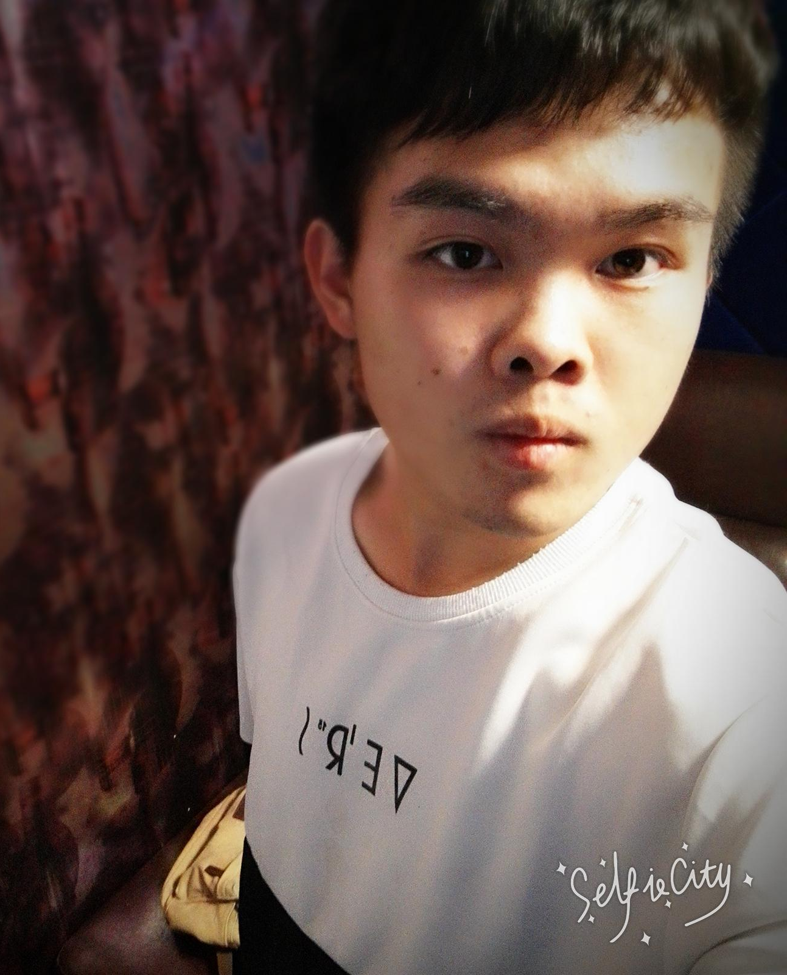
Basic information
About Me
Name：Liyang Xiao
Age：20
Class：150902
Telephone：13693032642
Email：1174276885@qq.com
Motto：
Tomorrow will be better

Slide 4
EXPERIENCE
University
(2015.9-2019.9)
Beijing University of Technology
major:Materials science and Engineering
position:
Monitor of Class150902
Minister of the Organization Department
Proprieter (Club of materials)
High school
(2012.9-2015.9)
Huairou No.1 High school
Position:Publicize committee

Slide 5
SKILLS
StrengthA
learning ability √
organization ability √
communication ability √
Strengths
＆
Weaknesses
Weaknes A
Strength B
Attention to detail ×
Expression ability ×
study hard √
work meticulously √
great curiosity √
Weaknes B
learning and work efficiency ×
suitable approach to problems ×

Slide 6
EXPECTATIONS
Fundamentals of Materials Science is the most basic course of material major which is the first course lead us to the Material field.I expect to learn about my major deeply by this course and Really understand the content and task of Materials Science.

Slide 7
undergraduate
learning
Complet two Experimental subjects.
Published an paper.
Take internships.
Academic
Prepare for the entrance examinations for postgraduates.
FUTURE
PLAN
Where there is a will,there is a way!

Slide 8


