Slide 1





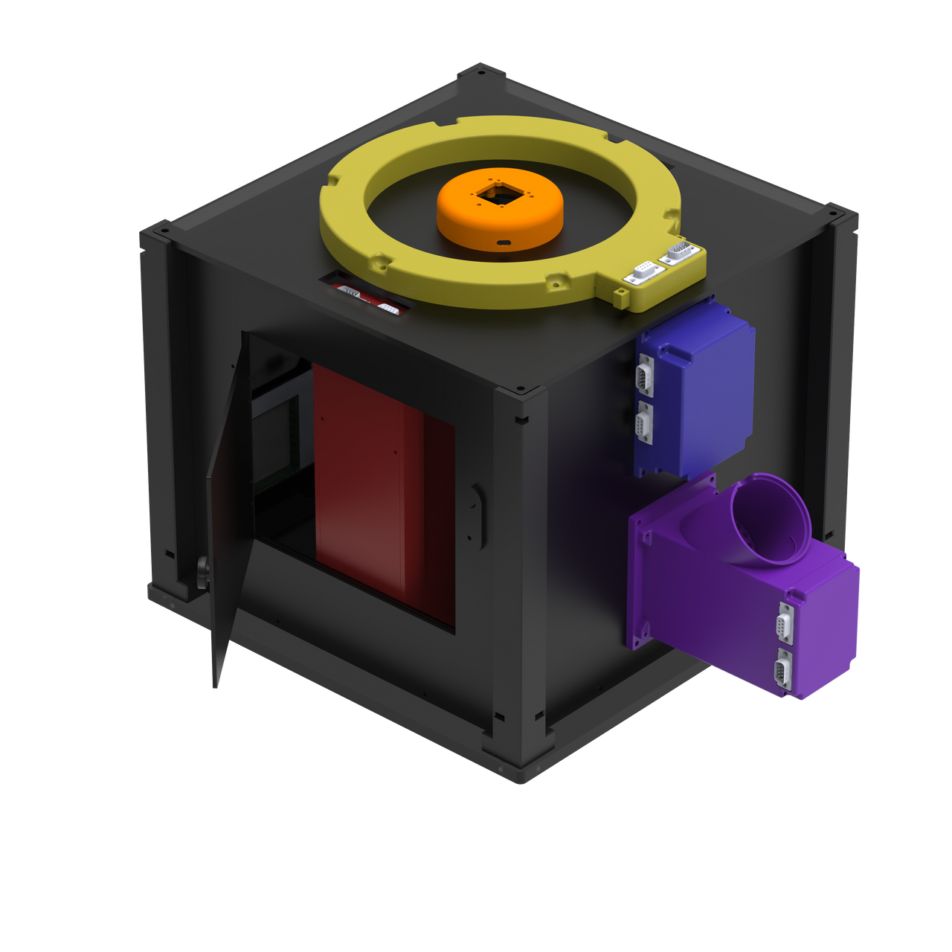





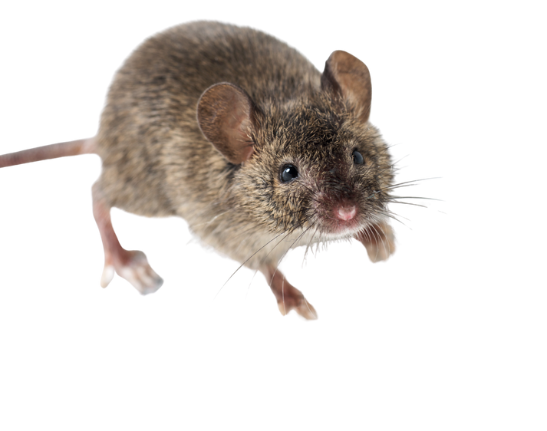
Open-BeatBox
NERB Lab
Open BEhavioural and AuTonomous Box
24/7 Home cage monitoring system
Scalable to complex behavioral tasks
Modular and customizable
Real-time experimental control
Analysis-ready
Ecological design
User friendly
Rapid setup
eric.burguiere@inserm.fr
https://open-beatbox.github.io

Slide 2
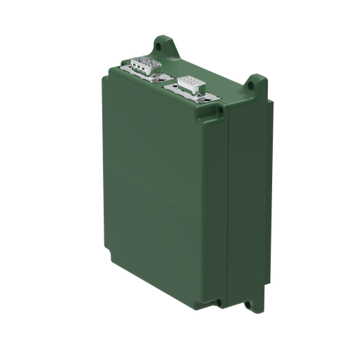
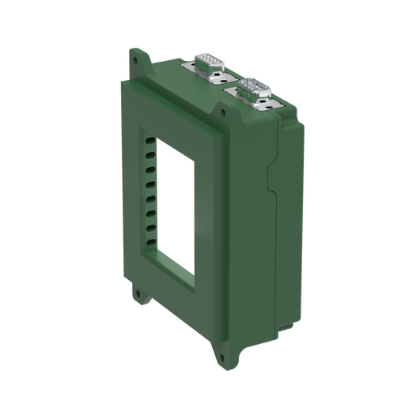
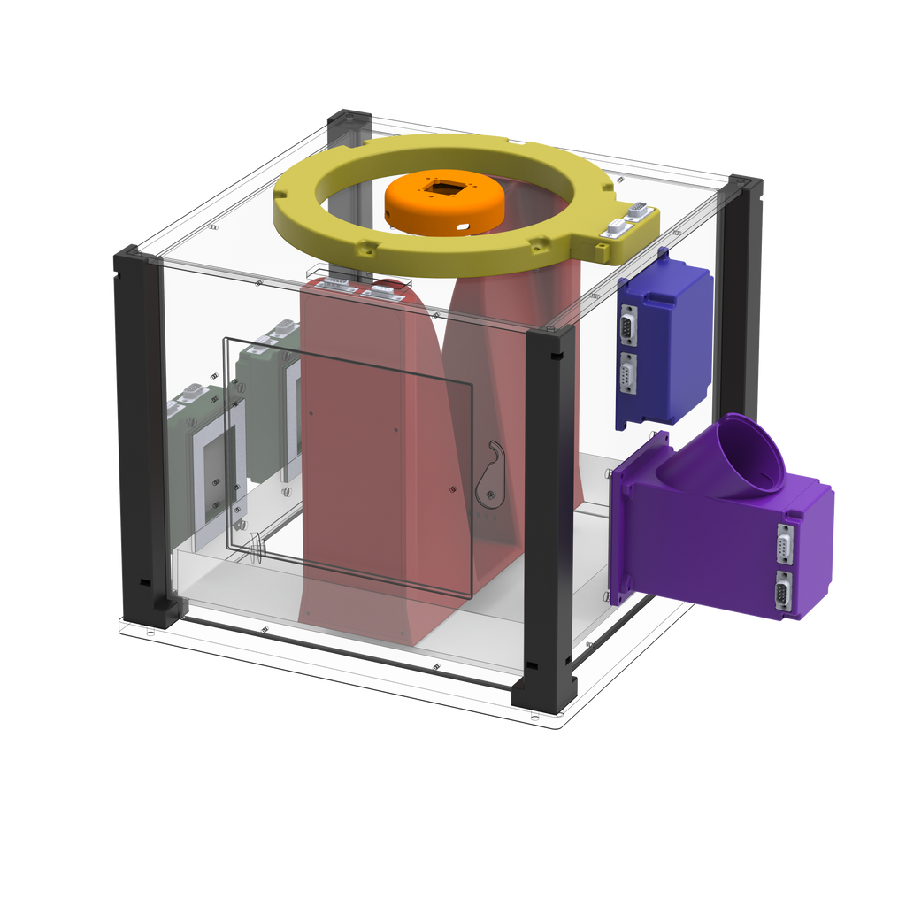
Stimulus + response in one surface
Precise touch logging (x/y location + timestamp per trial)
Closed-loop tasks (immediate feedback + adaptive next stimulus)
Features
Modular hardware platform
Interactive touch panel
Displays stimuli and records touch responses
https://open-beatbox.github.io

Slide 3
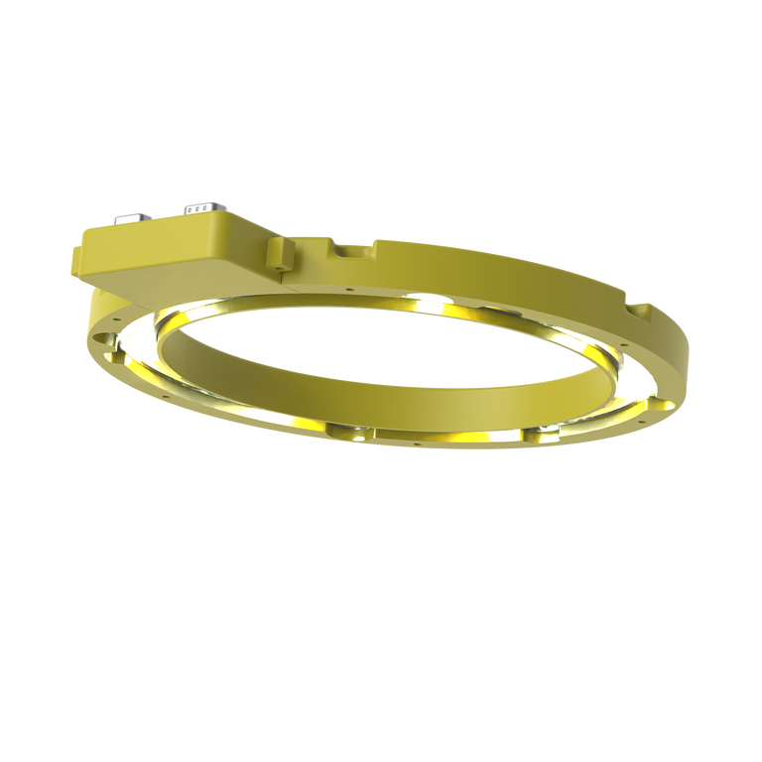
Stimulus + response in one surface
Precise touch logging (x/y location + timestamp per trial)
Closed-loop tasks (immediate feedback + adaptive next stimulus)
Features
Modular hardware platform
Full-cage tracking
Trajectories + zones
Interactive touch panel
Instant visual cues
Programmable lighting
Displays stimuli and records touch responses
Ceiling vision module
Overhead video acquisition for behavioral tracking
Contextual illumination module
Visual feedback and illumination for behavioral control
https://open-beatbox.github.io

Slide 4
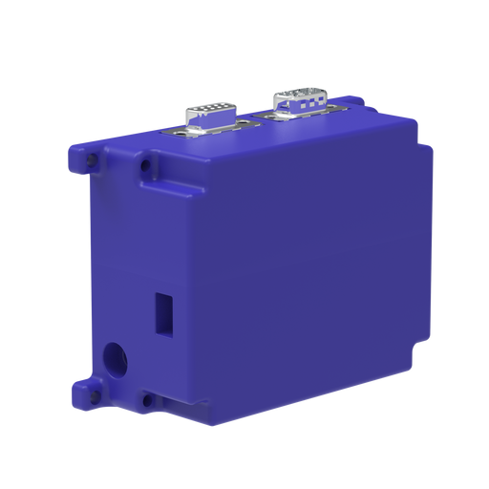
Stimulus + response in one surface
Precise touch logging (x/y location + timestamp per trial)
Closed-loop tasks (immediate feedback + adaptive next stimulus)
Features
Modular hardware platform
Full-cage tracking
Trajectories + zones
Interactive touch panel
Instant visual cues
Programmable lighting
Displays stimuli and records touch responses
Ceiling vision module
Overhead video acquisition for behavioral tracking
Modular & expandable: plug-and-play, add many modules as needed
CAN bus backbone: robust, noise-resistant communication over long runs
Scales cleanly: one shared bus, simple wiring, many devices supported
Contextual illumination module
Visual feedback and illumination for behavioral control
Master control module
Manages timing, com., and task logic across units
https://open-beatbox.github.io

Slide 5
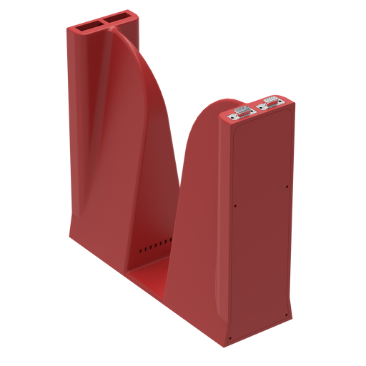
Stimulus + response in one surface
Precise touch logging (x/y location + timestamp per trial)
Closed-loop tasks (immediate feedback + adaptive next stimulus)
Features
Modular hardware platform
Full-cage tracking
Trajectories + zones
Interactive touch panel
Instant visual cues
Programmable lighting
Displays stimuli and records touch responses
Ceiling vision module
Overhead video acquisition for behavioral tracking
Modular & expandable: plug-and-play, add many modules as needed
CAN bus backbone: robust, noise-resistant communication over long runs
Scales cleanly: one shared bus, simple wiring, many devices supported
Contextual illumination module
Visual feedback and illumination for behavioral control
Master control module
Manages timing, com., and task logic across units
Crossing detection module
Reliable side-transition detection
Event-driven contingencies (trigger rules on crossing)
Precise timestamps for clean trial logic and analysis
Detects side transitions and task contingencies
https://open-beatbox.github.io

Slide 6
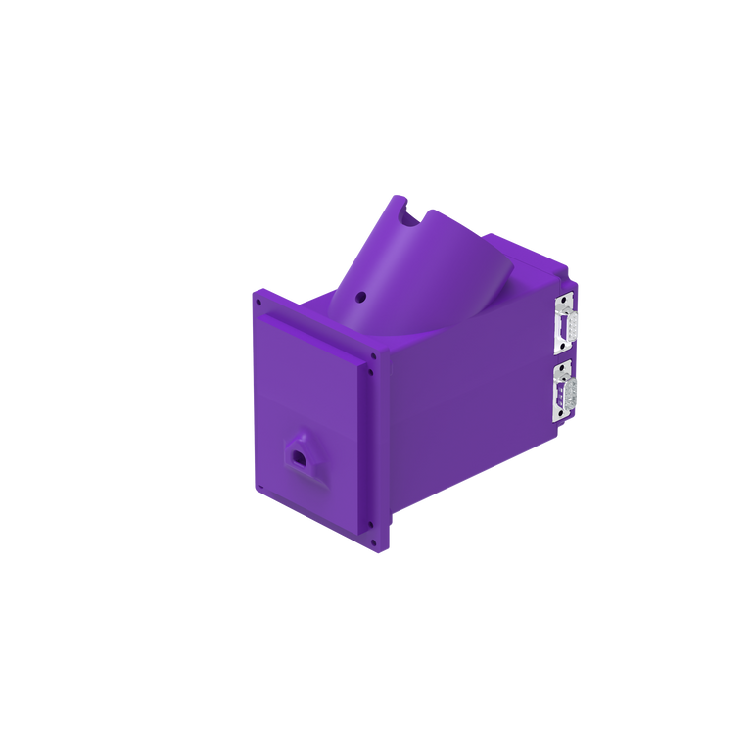
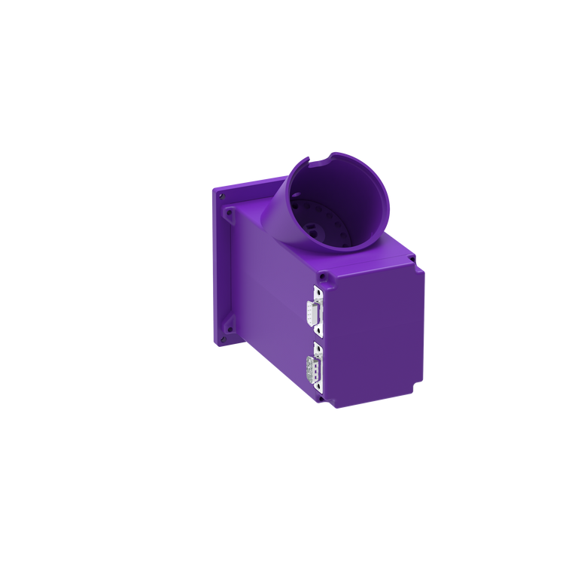
Stimulus + response in one surface
Precise touch logging (x/y location + timestamp per trial)
Closed-loop tasks (immediate feedback + adaptive next stimulus)
Features
Modular hardware platform
Full-cage tracking
Trajectories + zones
Interactive touch panel
Instant visual cues
Programmable lighting
Displays stimuli and records touch responses
Ceiling vision module
Overhead video acquisition for behavioral tracking
Modular & expandable: plug-and-play, add many modules as needed
CAN bus backbone: robust, noise-resistant communication over long runs
Scales cleanly: one shared bus, simple wiring, many devices supported
Contextual illumination module
Visual feedback and illumination for behavioral control
Master control module
Manages timing, com., and task logic across units
Crossing detection module
Reliable side-transition detection
Event-driven contingencies (trigger rules on crossing)
Precise timestamps for clean trial logic and analysis
Detects side transitions and task contingencies
Programmable feeder module
Automated or manual reward delivery with retrieval monitoring and feeder alerts
Flexible reward delivery (auto or manual)
Retrieval monitoring (confirm reward taken)
Feeder alerts (less downtime)
https://open-beatbox.github.io

Slide 7
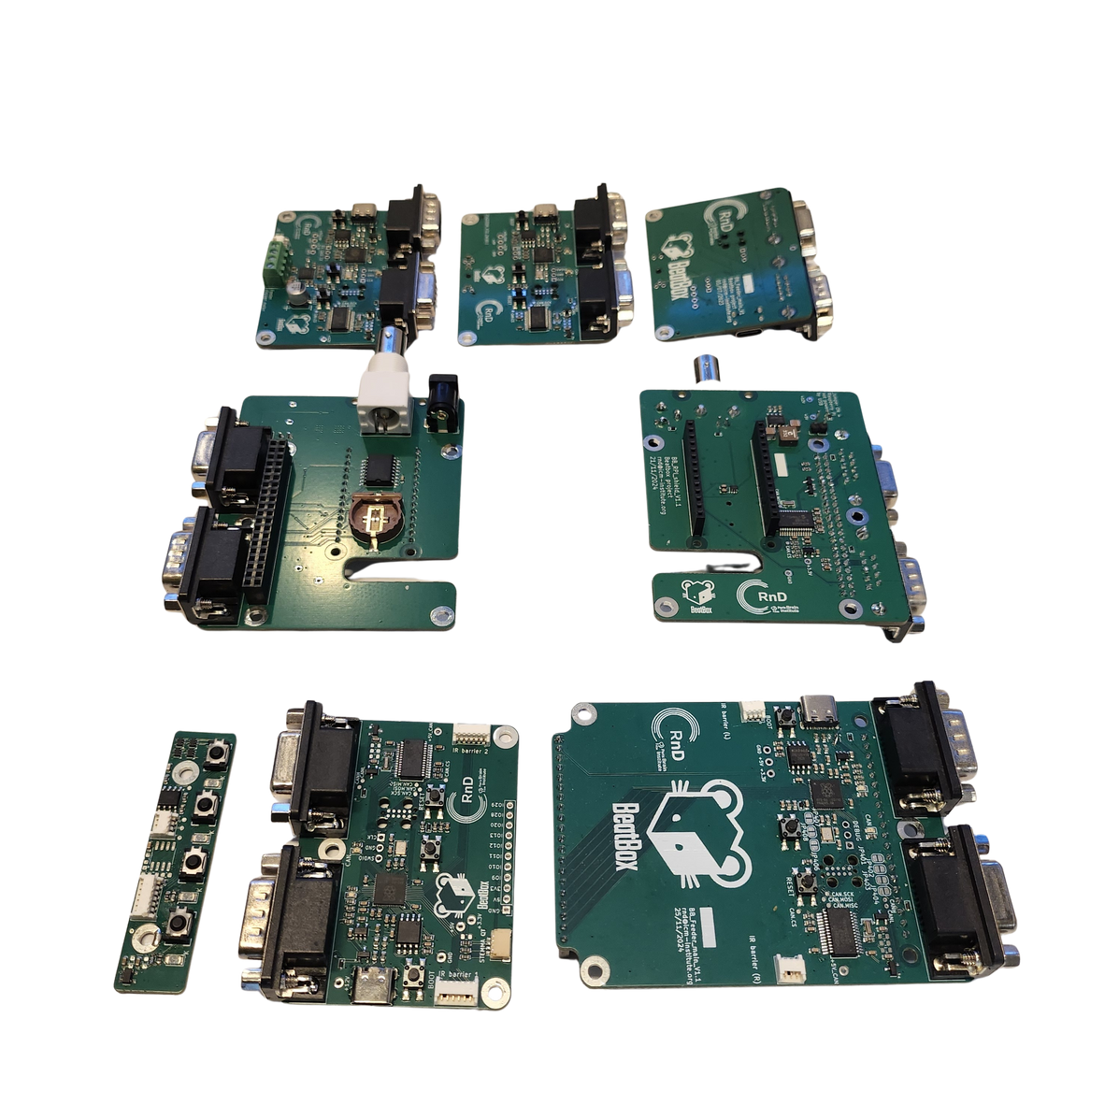
Features
Modular CAN architecture
Subsystem nodes with a robust, noise-tolerant field bus.
Fabrication-ready electronics
Production-tested PCB design, ready to manufacture and deploy.
Expansion-first design
Spare I/O + open headers enable plug-and-play add-ons and future modules.
Modular electronic platform
Interactive touch panel
Ceiling vision module
Contextual illumination module
Master control module
Crossing detection module
Programmable feeder module
https://open-beatbox.github.io

Slide 8


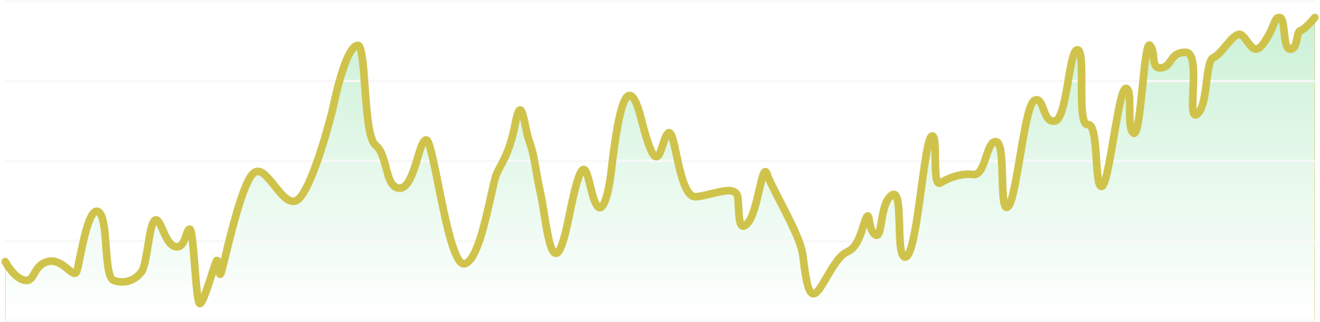
Scalable Multi-Cage System
SYNCHRONIZED MULTI-CAGE CONTROL
Open-BeatBox
High-throughput
One host can run and monitor many cages.
Box 1
Box 2
Box 3
Box 4
Synchronized
Shared timing across units enables aligned events and analysis.
Scalable
Add cages as nodes with minimal hardware/software changes.
Box 1
Box 2
Box 3
Box 4
Centralized
Single control point for task launch, status, and logging.
https://open-beatbox.github.io

Slide 9

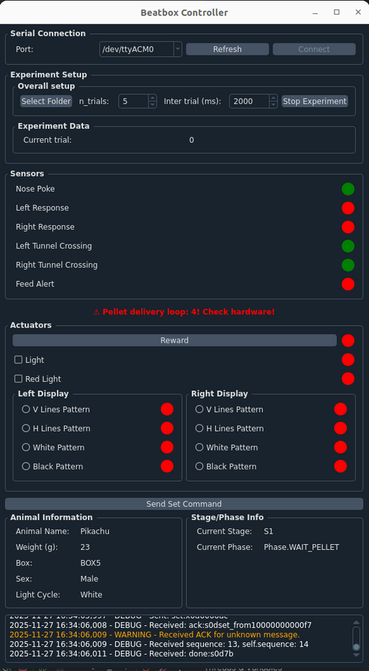

Software and firmware
SYNCHRONIZED MULTI-CAGE CONTROL
Open-BeatBox
Box 1
Box 2
Box 3
Box 4
Individual sensor and actuators testing for improved experimental reliability
Box 1
Box 2
Box 3
Box 4
Controller GUI
Real-time sensor/actuator status.
Live task stage and logging at a glance.
https://open-beatbox.github.io

Slide 10
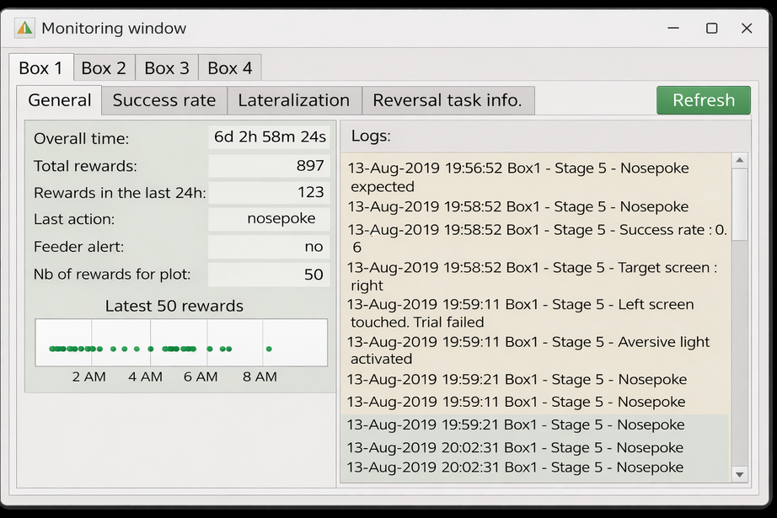
Software and firmware
SYNCHRONIZED MULTI-CAGE CONTROL
Open-BeatBox
Box 1
Box 2
Box 3
Box 4
Box 1
Box 2
Box 3
Box 4
Monitoring window
https://open-beatbox.github.io

Slide 11
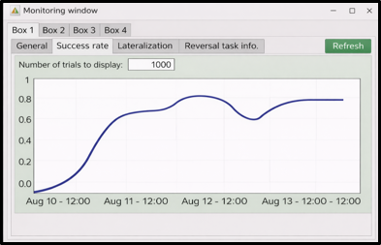
Software and firmware
SYNCHRONIZED MULTI-CAGE CONTROL
Open-BeatBox
Box 1
Box 2
Box 3
Box 4
Box 1
Box 2
Box 3
Box 4
Live performance dashboards
https://open-beatbox.github.io

Slide 12
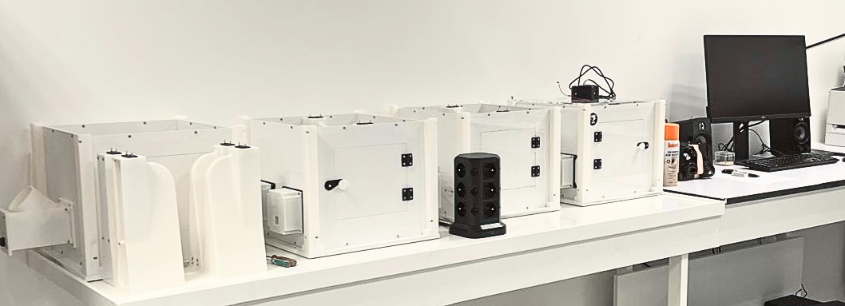
NERB LAB
From bench to box
https://open-beatbox.github.io
Beatbox started as a lab necessity, then got stronger by being used and passed through many hands, improving its hardware robustness, task logic, logging, usability, so the system evolved through actual practice.
Built in the lab. Proven by experiments. Shared for science

Slide 13
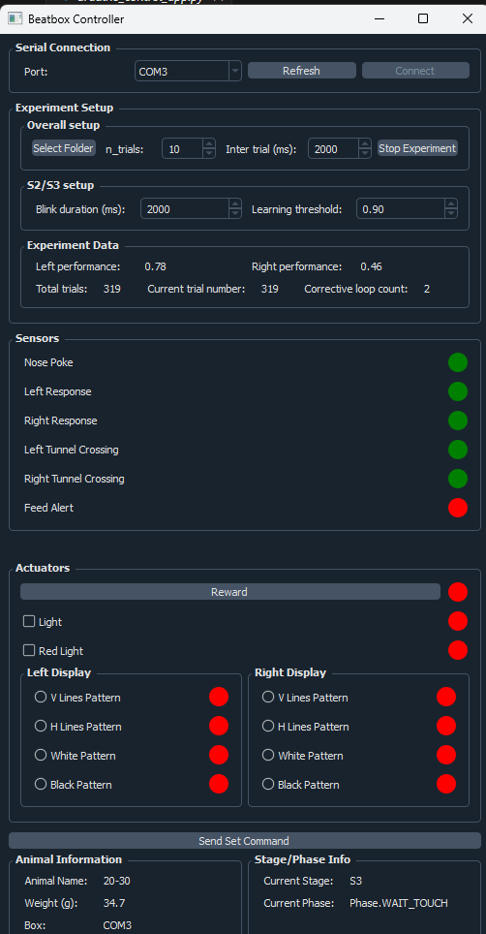
Use demo case using Bonsai
https://open-beatbox.github.io
Real-time task related information
Real-time video-based tracking over long periods of time
output
output
User case example by Daniela Domingues

Slide 14






Open-science, validation and scope
Open, validated continuous operant platform; with defined boundaries
01
02
03
04
05
06
Open by default
Community-driven
Standardized outputs
Validated in practice
Clear scope
Extensible
Hardware + software are fully open.
Designed for reproducibility & community extension.
Continuous event logs + synchronized sensor streams.
Multi-week stability and learning curves across animals.
Complements video tracking; not pose/ethogram replacement.
Open headers/I/O enable new modules and sensors.

Slide 15




What the BEATBOX enables
The scientific gain
Before:
Now:
01
Episodic sessions (conventional operant)
VS
Longitudinal learning (days - weeks)
01
02
Handling / context stress
VS
Dense within-subject data (less inter-individual noise)
02
Problem: conventional operant
Beatbox
03
Limited scalability & reproductibility
VS
Standardized automation (better reproducibility, fewer animals)
03
From episodic testing to Continuous behavioural phenotyping

Slide 16


System architecture
Modular hardware >> real-time control>> analysis-ready data.
Open-BeatBox
Swappable operant modules, removable panels
Embedded environmental sensing + audio
01
Hardware
(modular)
Sense & Act
Real-time monitoring (sensor/actuator states, task stage)
Operator actions (start/stop, parameter tweaks, overrides)
02
Live control
Decide
03
Deterministic task timing
Autonomous outputs (rewards/cues + safety handling)
Execution
04
Data
(analysis ready)
Live streaming
Timestamped logs (JSON/CSV)
Stream & Analyze
05
Connectivity
Data streaming to a local PC or server

Slide 17

THE DREAM TEAM BEHIND IT
PROJECT LEAD AND VISION
Software & firmware
DOCUMENTATION & OPEN REPOSITORY
Eric Burguière
Zenneddine Ajili
Guillaume Penderia
Charlie Rousseau
Damien Huzard
SCIENTIFIC CONCEPTION AND CONTRIBUTIONS
WEB PLATFORM
ALL VERSIONS INCLUDED
Eric Burguière
Marine Euvrad
Daniela Domingues
Nabil Benzina
Electronics
Damien Huzard
S. Lizbeth Mondragon-Gonzalez
Pierre Tissier
Pierre Pavlov
VALIDATION & BETA TESTING
MECHANICAL DESIGN
GRAPHIC DESIGN
Marine Euvrad
Daniela Domingues
Eliana Lousada
Oriana Lavielle
Anne Lorenz
Youenn Travert
Christianne Schreiweiss
Pierre Tissier
Lucile Lebegue
S. Lizbeth Mondragon-Gonzalez

