Slide 1
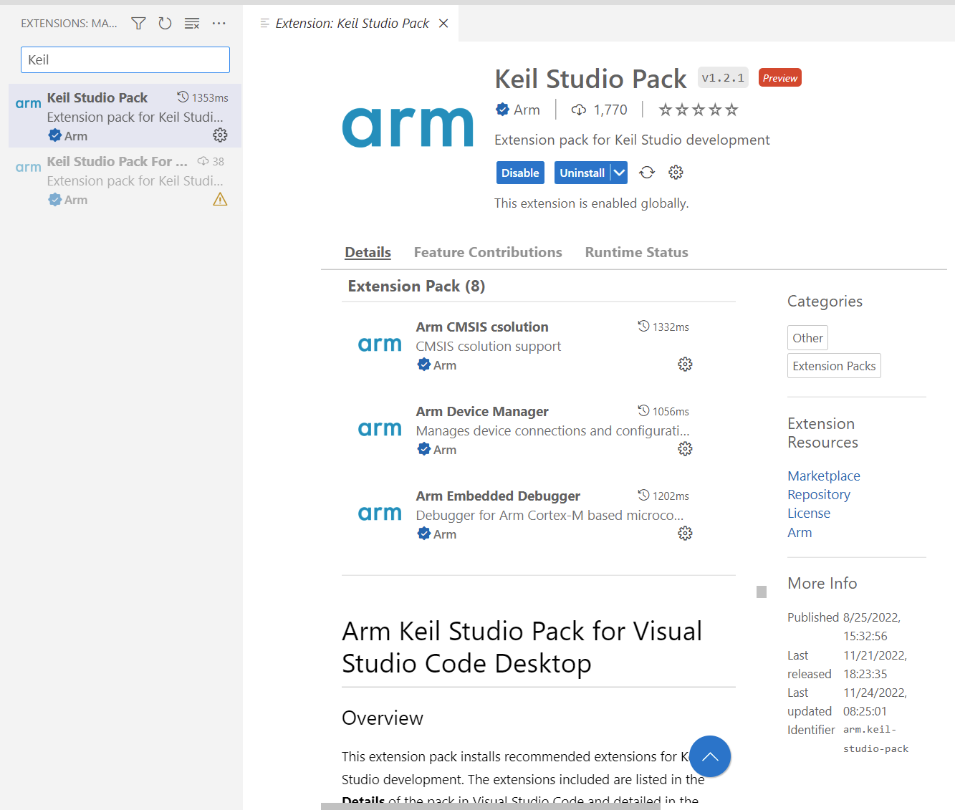
CMSIS-Toolbox: Basis for next generation software tooling
Keil MDK – Version 6
Command-line workflow
Visual Studio Code IDE
csolution project
Software Packs
Best-in-class embedded development system for Cortex-M microcontrollers
Command-Line and IDE workflows based on CMSIS-Toolbox
Arm C/C++ Compiler with FuSa certification
Based on CMSIS software standards
Host Support: Windows, Linux, Mac OS – and Cloud
*.csolution.yml Target and Build Parameters
Device/Board Generic Software
*.cproject.yml source files and SW components
CMSIS-Toolbox
cbuild: Build Invocation
Arm Virtual Hardware
Arm Virtual Hardware – FVPs
Resources
microNPU
Test scripts
CI/CD integration
Precise simulation models of Cortex-M device sub-systems
Designed for complex software verification and testing
Enables test automation of diverse software workloads
Part of CI/CD and MLOps development flows
Supports A/B performance comparisons using CMSIS-View Event Recorder timing statistics
Cortex-M0..M85
SIMD, Helium
Ethos-U55/U65
microNPU
Memory
DMA
Peripherals
Ethernet, UART,…
Integrations
Cloud Service
GitHub
Desktop tools
Virtual I/O
Data Streaming
Debug Interface
Event Recorder

Slide 2
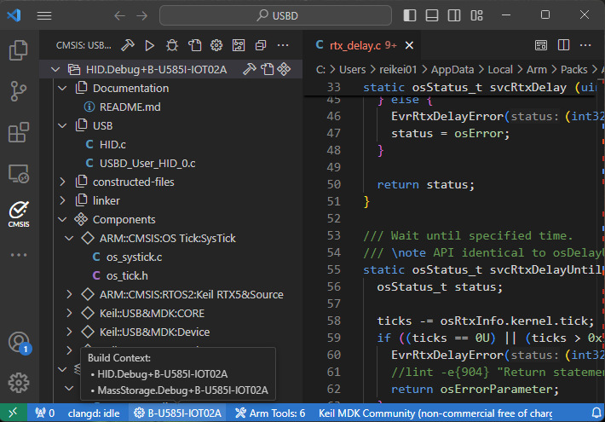


Developer require flexibility
Command-Line and IDE Workflow + DevOps, MLOps, Config Tools, Git, …
Command-line workflow
VS Code – CMSIS Solution Extension
csolution project
Software Packs
*.csolution.yml Target and Build Parameters
Device/Board Generic Software
*.cproject.yml source files and SW components
CMSIS-Toolbox
cbuild: Build Invocation
Host Support: Windows, Linux, Mac OS – and Cloud
Compiler of choice: Arm Compiler 6, IAR, GCC, LLVM
Multiple IDEs: Keil uVision, IAR EW-Arm, NXP MCUXpresso, …

Slide 3
1
Software Packs
*.cdefault.yml Global Settings (Toolchain)
Generic Software Packs with drivers, middleware, etc.
Input Files
Output Files
2
Board Support Pack (BSP) Defines board properties
*.csolution.yml Target (Device, Board) Build (Debug, Release)
Project Build Files *.cprj for CMSIS-Build
Device Family Pack (DFP)
Defines device properties
3
*.cproject.yml Manages independent projects
CMSIS Project Manager
Run-Time Environment (RTE) (*.c / *.h files with config information)
*.rzone (optional) Defines system resources
4
*.clayer.yml Defines re-usable project parts
Project Resource Files *.fzone for template engines

Slide 4
1
Software Packs
*.cdefault.yml Global Settings (Toolchain)
Generic Software Packs with drivers, middleware, etc.
Output Files
legacy
Input Files
Project Build Files *.cprj for CMSIS-Build
2
Board Support Pack (BSP) Defines board properties
*.csolution.yml Target (Device, Board) Build (Debug, Release)
future extension
csolution CLI tool
Project Resource Files *.fzone for template engines
Device Family Pack (DFP)
Defines device properties
3
*.cproject.yml Manages independent projects
future extension
*.rzone (optional) Defines system resources
4
*.clayer.yml Defines re-usable project parts
*.cbuild.yml Build information
Generator
*.genlayer.yml Defines generated project parts
Run-Time Environment (RTE) (*.c / *.h files with config information)

Slide 5
Software Packs
csolution project
Default options for AC6, GCC, IAR, LLVM
Output Files
Generic Software Packs with drivers, middleware, etc.
*.csolution.yml Target (Device, Board) Build (Debug, Release)
cdefault.yml Global Toolchain Settings
*.cbuild-idx.yml *.cbuild.yml
Build Information
Board Support Pack (BSP) Defines board properties
*.cproject.yml Manages independent projects
csolution CMSIS Project Manager
*.cbuild-run.yml Configuration for programmer and debugger
Device Family Pack (DFP)
Defines device properties
*.clayer.yml Defines re-usable project parts
Reproducible builds on different hosts
Run-Time Environment (RTE) (config files*.c / *.h)
*.cbuild-pack.yml Pack version locking
Note: Optionally memory information for Linker Scatter Files is generated.

Slide 6
Generator Information
Generator Output
*.ioc Generator Project
*.cbuild-gen-idx.yml
cbridge Generator Bridge
CubeMX Generator
*.c/*.h generated source files
<project>. cbuild-gen.yml
<project>. cgen.yml Import data for CMSIS-Toolbox

Slide 7
Debugger
csolution CMSIS Project Manager
cbuild-set.yml Project context set
Flash Programmer
OTA/Cloud Service

Slide 8
Software Packs
csolution project
Default compiler options for AC6, GCC, IAR
Output Files
Generic Software Packs with drivers, middleware, etc.
*.csolution.yml Target (Device, Board) Build (Debug, Release)
cdefault.yml Global Toolchain Settings
*.cbuild-idx.yml *.cbuild.yml Build information
Board Support Pack (BSP) Defines board properties
*.cproject.yml Manages independent projects
cbuild CMSIS Project Manager
Run-Time Environment (RTE) (config files*.c / *.h)
Device Family Pack (DFP)
Defines device properties
*.clayer.yml Defines re-usable project parts
*.cbuild-idx.yml *.cbuild.yml Build information
Note: Optionally memory information for Linker Scatter Files is generated.

Slide 9
1
Software Packs
*.cdefault.yml Global Settings (Toolchain)
Generic Software Packs with drivers, middleware, etc.
Output Files
legacy
csolution project
Project Build Files *.cprj for CMSIS-Build
2
Board Support Pack (BSP) Defines board properties
*.csolution.yml Target (Device, Board) Build (Debug, Release)
future extension
csolution CLI tool
Project Resource Files *.fzone for template engines
Device Family Pack (DFP)
Defines device properties
3
*.cproject.yml Manages independent projects
future extension
*.rzone (optional) Defines system resources
4
*.clayer.yml Defines re-usable project parts
*.cbuild.yml Build information
Generator
*.cgen.yml Defines generated project parts
Run-Time Environment (RTE) (*.c / *.h files with config information)

Slide 10
Software Packs
[default.]csettings.yml Global Settings (Toolchain, Device)
Generic Software Packs with drivers, middleware, etc.
csolution project
Output Files
Board Support Pack (BSP) that defines Board Properties
*.csolution.yml Defines Target Application
Project Files *.cprj for CMSIS Build
Read previous *.cprj files to check for config file version changes
Device Family Pack (DFP)
that defines Device Properties
*.cproject.yml Manages independent projects
CMSIS Project Manager
Run-Time Environment (RTE) (*.c / *.h files with config information)
*.rzone (optional) that defines System Resources
*.clayer.yml Defines re-usable project parts
Project Resource Files *.fzone for template engines
Control config file versions in case of updated software packs
Read Software Packs and csolution project files
Process data
Read previous *.cprj file to identify the config file versions previously used
Compare versions of “config” files, notify if updates are made (define rename process of config files)
Check if new *.cprj file is different from old config files; if it differs rename existing *.cprj to backup version; write new *.cprj file
Q: do we need a status file, perhaps for an IDE flow?

Slide 11
Multi-Project Build Process: IDE and CLI
Introduce `context-set`: defines the selected context for application
csolution command-line defines context-set:
csolution convert HelloWorld.csolution.yml --context HelloWorld_cm0plus.Debug+FRDM-K32L3A6 --context -HelloWorld_cm4.Release+FRDM-K32L3A6
csolution Project setup: defines tools, target, components, files, and current list of context that should be build.
Items are stored in csolution project files
toolchain
device, board,
build-type, target-type
components
files
options
csolution project
*.csolution.yml Defines Target Application
When setup in context manager is changed (or items modifed), csolution is called
cbuild (CLI)
Invokes csolution
When csolution project files are newer (context-set of *.cbuild-idx.yml defines scope) Invokes cbuild-gen for build process
Build Control Files
IDE
*.cbuild-set.yml Defines context set of Application
cbuild-gen
Build Process: uses the build control files to generate the output (via CMake, …)
When build is invoked, cbuild-gen is called.
<context>.cbuild.yml Build information for a project context

Slide 12
Application Software – from Virtual to Physical Hardware
Provide evidence of correctness on Arm Virtual Hardware Target and Physical Hardware
Unit & Integration Testing on Virtual Hardware or Physical Hardware Boards
Deployment and System Testing on Production Hardware
User Application Code
User Application Code
User Application Code
IoT/ML Software Platform
IoT/ML Software Platform
IoT/ML Software Platform
More Software
Virtual Layer
Board Layer
Target Layer
Virtual Drivers
HW Drivers
HW Drivers
More Drivers
Device SDK with configuration
Device SDK with configuration
Simulated I/O via Python scripts and stimuli files
Real I/O via test equipment
Real I/O via user peripherals
Event Log file
Event Log file
Event Log file
Essentially the same event logs are generated across the different deployments. This ensures correctness.
Notes:
Potential key customer: DSP Concepts. See email exchange:
From: Paul Beckmann <pbeckmann@dspconcepts.com> Sent: Wednesday, April 7, 2021 9:05 PM To: Reinhard Keil <Reinhard.Keil@arm.com> Subject: Re: Compiler comparison / Feedback on Audio API interface
Hi Reinhard,
We are our testing with MDK V5.31.0.0. Here is the detailed info:
For IAR, we used v8.50.1. For GCC, it was the version included with the ST tools. Not sure exactly which version this was.
We have done further benchmarking across different signal processing operations. I picked this one because it was a recent issue with a customer and highlights how GCC can be slow. For other kernels, the cycle counts are comparable.
Being able to run on the FVP would be very interesting for us. I see several advantages:
We can optimize and profile for cores before they are publicly available. For example, we are getting requests for M55 performance numbers but there are no announced CPUs.
Get accurate measurements of system level issues. Caching and memory accesses have a huge impact.
Could fit with our continuous integration plans so that we don't have to (always) test on external hardware.
We are speaking with Reed Hinkel about "cloud based profiling". I would like our customers to create a design in Audio Weaver and then upload the design to our website for profiling. They can select which processors to run on and then get detailed results showing where resources are consumed. The VFP would be ideal for this.
I also had one of my firmware engineers review the SAI interface. I'll provide all of his comments and you can see what is relevant:
It is well written and to make sure I understand it, low-level drivers must be written depending on the device.
You have to kickstart the driver with calls to ARM_SAI_Receive() or ARM_SAI_Send() which are non-blocking.
A callback function is registered during init called ARM_SAI_SignalEvent(event) which is called when the above completes with respective bits in the parameter "event" for each.
ARM_SAI_Receive() or ARM_SAI_Send() mention that DMA is typical, but I am not sure if those two calls can be one time only and then the guts of the driver can provide calls to ARM_SAI_SignalEvent(event) on each DMA interrupt afterward. If yes, then it can work with our BSP's.
The protocols cover about everything with User Defined Protocol allowing for generic TDM configuration.
They are missing specification of left or right adjusted data and now to save captured data in memory. For instance if the data is 24-bits, is it saved right adjusted with sign extension or left adjusted?
In general, you may capture even 16-bit data and want to save it in 32-bit memory left or right adjusted.
The same API and supported protocols should include PDM (DMIC) input. The RT685 and NXP PDM IP in general have a means to convert to I2S, but that may not be on all parts and should not be necessary.
Most devices have multiple stereo PDM ports that can capture data and send to two different DMA channels (left and right).
This API seems to support single stream, interleaved, not multi-stream from one device. Is that correct?
The documentation is not clear how you mask the TX event, bot allow the RX event and so on. Guessing it is in there.

Slide 13
Multi-Project Requirements
Separate projects independently developed; combined in a multi-project workspace
Processor #2
Processor #1
Project A
Project B
Project D
UX Graphic
ML Library
Security
Control Algorithm
User Application
Cloud
Connector
Secure Network
Interface
Crypto
Project C
Images
ML Data
Storage
Attestation
RTOS
Secure Boot
Device / Board HAL

Slide 14
Software Layers Group Pre-configured Software Components
IoT for Cortex-M – reference examples for many evaluation kits
App Layer
Example Application Code
Cloud Connector + Security
User Code
TrustZone Security
Socket Layer
Module Layer
IoT Socket + Communication Stack
WiFi
Trusted Firmware-M (TF-M)
implements Security
Board Layer
RTOS Layer
Crypto
CMSIS-Driver
SPI, UART, (Ethernet)
CMSIS-Driver-VIO
Virtual I/O
CMSIS-RTOS2
Storage
Device SDK with configuration
FreeRTOS, RTX, …
Attestation
MCU
Secure Boot
Peripherals covered by real CMSIS-Driver or VIO (Virtual I/O)
Specialized Peripherals
SPI
I2C
USART
WiFi
Board
LED
Sensor inputs
Display
Timers
Analog
...

Slide 15
Scenarios to consider
Projects that share a layer with common configuration
Layers that partly share a common configuration
csolution
csolution
cproject #1
cproject #2
cproject #1 runs on CPU #1
cproject #2 runs on CPU #2
clayer for common board settings
clayer #1 for board API
clayer #2 for board API
RTE settings (includes generator files)
common RTE settings (includes generator files)

Slide 16
CubeMX location of generated files
“Simple” Projects that share a layer with common configuration
TrustZone or Multicore projects
csolution
csolution
csolution
csolution
cproject #1 runs on CPU #1
cproject #2 runs on CPU #2
cproject directory
cproject #1
cproject #2
./RTE/Device/$D contains generated files
clayer directory
Require common directory for
generated files
./RTE/Device/$D contains generated files

Slide 17
CubeMX location of generated files
TrustZone or Multicore projects
csolution
cproject #1 runs on CPU #1
cproject #2 runs on CPU #2
clayer directory
clayer CPU #1
clayer CPU #2
Require common directory for
generated files

Slide 18
CSolution / CBuild: Generator Workflow
Steps for component selection and configuration
User selects components
in `*.cproject.yml` under `components:`
When this are components that require generation, user is notified about the requirement to run a generator and users the CSolution Run command.
Run a “Generator” for a list of components.
CSolution generates `*.cgen.yml` that provides the list of user-selected components.
User runs Generator
`*.cgen.yml` provides the input to the Generator with a list of selected components
Configuration is done.
Interactive mode (where a settings file is generated)
Remote mode (where a settings file is an input)
Generator creates the “myGen.gpdsc” that informs the CSolution tool about (a) the fact that a component is configured and has generated code, (b) additional components that are the result of some user configuration.
Discussion: is a component list or a dependency list
Generator might be VS Code plugin or web based.
User creates CBuild output with CSolution
Both `*.cproject.yml` “myGen.gpdsc” and read by Csolution and create the complete list of selected components.
If “myGen.gpdsc” does not contain component information about a component with `genId` that is selected in `*.cproject.yml` the generator configuration is incomplete. This can happen when a component is added at a later step.
Likewise the Generator should remove components that are no longer required. An indicator is needed. (NOT SOLVED YET)

Slide 19
IoT Workshop Example - Structure
Reference Application Framework: map many applications to many boards
IoT Reference Application using RTOS Kernel
SW Building Blocks
Should come from multiple vendors. Requirement for standardized interface between the components (Open-CMSIS-CDI)
Reference Application: should be tested with a CI system against a standardized CDI framework
Should run (within reason) on many different existing v8M and v7M devices (TrustZone optional)
Should include OTA services with standardize interfaces
Future variants of the Framework should also support other application types (DSP, ML, Graphics)
Designed for `csolution` tool
Examples use Open-CMSIS-Pack and the csolution workflow with layers
Layer type names should be descriptive, i.e. board, socket, security
Examples are used to fine-tune the csolution workflow (see next slide)
Interface requirements between cproject/clayer files should be described
Final design is that layers are provided by software packs
Other Requirements:
Defined Startup/Call Sequence (see https://github.com/MDK-Packs/CB_Lab4Layer/tree/master/layer)
Example: https://github.com/MDK-Packs/CB_Lab4Layer/blob/master/layer/Board/MIMXRT1064-EVK/main.c
IoT Socket API
Security Firmware
Socket Layer (IoT Socket -> WiFi or Ethernet)
PSA Interface
CMSIS-Driver API
Device/Board Abstraction Layer
Objectives
Re-use existing packs from AWS and NXP
provide feedback when required
Define the overall structure of CMSIS-Packs, i.e. for
TF-M
mbedTLS
AVH Corstone-300 BSP
Board BSP (exemplified on STM32U5, NXP)

Slide 20
Opportunity: Packs give flexibility to the SW Eco-system
Flexible Development Workflows with Open-CMSIS-Pack
Standard Software exposed to developers:
Web portals
Inside IDEs
CLI Tools
Support: Win/Linux/Mac
Integrate with: VS Code, Keil Studio Cloud
AVH Integrates into:
CI, DevOps, MLOps systems (i.e. GitHub)
Keil MDK, Arm DS, IAR EW-Arm
Keil Studio Cloud
AVH Supports:
CI Validation
Evaluation
Training
Catalog of software packs
+
Arm Virtual Hardware
MyProject *.csolution.yml *.cproject.yml
CMSIS Toolbox
+
Compiler support
GCC
Arm Compiler
IAR Compiler
Boards or Devices
Platform for Reference Applications:
Many different boards???
Confidential software
Git repo for development
Released software with versioning
Private software packs
Other tool integrations:
Arm DS, Keil MDK, IAR EW-Arm, Eclipse
NXP?
ST?
github.com/Open-CMSIS-Pack

Slide 21
Linker Script File and Startup Code (Toolchain independent)
A Linker Script File can be provided using the `linker:` node.
If no Linker Script File is provided, compiler specific script file templates from .\ect directory of CMSIS-Toolbox are used.
Linker Script File
A <regions>.h file specifies the available memory.
If this file does not exist, it is generated based on information in the software packs.
<regions>.h Device (and Board) Memory Definitions
C Preprocessor
Final Linker Input Script

Slide 22
Linker Script Management for Multi-Project Applications
The template linker scripts are pre-processed to represent the final memory layout for each project.
Template Linker Script for Project A
Final Linker Script for Project A
#define A_cproject
Template Linker Script for Project B
Final Linker Script for Project B
#define B_cproject
<solution-name>+<target-name>.regions.h defines the memory layout for a complete solution. The file is in the folder .cmsis
This is a multi-project application specified in one *.csolution.yml file.
<solution-name>+ <target>.regions.h
Global Memory Definitions
Template Linker Script
A toolchain specific linker script template is initially copied into the project .\RTE directory. The copy allows project-specific customization.

Slide 23
csolution project
*.cbuild-set.yml context configuration
Project Area
*.cbuild-idx.yml Overall description with project index
*.default.yml Compiler selection and toolchain default settings
cbuild2cmake tool called by cbuild
*.cbuild-pack.yml pack journal / lock
*.cbuild.yml Build Information
*.csolution.yml Target (Device, Board) Build (Debug, Release)
csolution tool
RTE Directory
RTE_ components.h
*.cproject.yml Manages independent projects
Software Packs
*.pdsc Pack Metadata
Pre-include Files
*.clayer.yml Defines re-usable project parts
Component Config Files
Component Config Files

Slide 24
*.cprj Build Information
cbuildgen
cmakeLists.txt
CMake
build.ninja
Ninja
compiler_name. <version>.cmake

Slide 25
cbuild
csolution project *.csolution.yml
*.cproject.yml
*.clayer.yml
cpackget
Build Information list of source files, packs, tool options, etc.
csolution
Software Packs Device Family Pack
Board Support Pack
Generic Software Packs
cbuild2cmake
Run and Debug Configuration for a complete target application
User source code Configuration files Linker Scripts
CMake
Build Output Elf/Dwarf files Map files
etc.
Ninja

Slide 26
Arduino Shield
Digital
Analog
D21
SCL
Communication
D20
SDA
I2C
AREF
NC
GND
SCK
IOREF
D13
CIPO
Reset
D12
COPI
SPI
+3V3
D11
SS
+5V
D10
GND
D9
GND
D8
VIN
D7
A0
D14
D6
A1
D15
D5
A2
D16
D4
A3
D17
D3
SDA
A4
D18
D2
I2C-Alt
SCL
A5
D19
D1
TXD
UART
D0
RXD

Slide 27
Distribution of Reference Applications
Example: Sensor SDK Pack (github.com/RobertRostohar/NXP_Sensor_SDK) that contains:
Agnostic middleware for a sensor that is configurable (part of the Reference Application)
Board/Device agnostic examples that use this middleware (part of the Reference Application)
One or more Shield layers that provides configuration settings for the agnostic middleware
Board Layers are provided by a Board Support BSP Pack that is board specific
Sensor SDK Pack
Sensor SDK Pack PDSC:
<example> describes Reference Application
<clayer> describes <shield-name>.clayer.yml
BSP Pack PDSC:
<clayer> describes <board-name>.clayer.yml
Reference Application (<sensor>.csolution.yml / <sensor>.cproject.yml)
BSP Pack
Shield-specific API
Driver APIs
Layer Type: Board (<board-name>.clayer.yml)
Layer Type: Shield (<shield-name>.clayer.yml)

Slide 29
IoT Workshop Example - Structure
Reference Application Framework: map many applications to many boards
Reference Application (*.cproject.yml)
IoT Socket API
CMSIS-RTOS2 API
Data Stream API
Layer Type: Socket Network Connectivity
Layer Type: RTOS RTOS Functionality
Layer Type: Stream Sensor Middleware
Security Firmware
PSA Interface
Security Boundary
CMSIS-Driver API
Shield-specific API
Layer Type: Board (<board-name>.clayer.yml)
Layer Type: Shield (<shield-name>.clayer.yml)

Slide 30
Roadmap H1’2023 – CMSIS-Toolbox 2.0
Review proposals and agree on implementation timeline (until 15. Feb 2023)
Identify missing features for integration into VS Code
Work on Installer that (a) is stand-along for Linux, (b) installs CMSIS-Toolbox to VS Code
Define an overall multi-project workflow that starts from *.cbuild-idx.yml (as cbuild input file)
Complete Generator Workflow
Implement Gaps:
csolution list config #142,
Out of scope (todo later in 2023)
CMSIS-Zone integration and resource management proposal
Command for batch delete #143

Slide 31
Software Application
csolution Project Manager
*.csolution.yml Target and Build Parameters
Software Packs
*.cproject.yml source files and SW components
Device/Processor Information
Software Building Blocks

Slide 32
Unit & Integration Testing on Virtual Hardware or Physical Hardware Boards
Deployment and System Testing on Production Hardware
User Application Code
User Application Code
User Application Code
IoT/ML Software Platform
IoT/ML Software Platform
IoT/ML Software Platform
More Software
Virtual Layer
Board Layer
Target Layer
Virtual Drivers
HW Drivers
HW Drivers
More Drivers
Device SDK with configuration
Device SDK with configuration
Target Hardware Abstraction
Simulated I/O via Python scripts and stimuli files
Real I/O via test equipment
Real I/O via user peripherals
Event Log file
Event Log file
Event Log file
Essentially the same event logs are generated across the different deployments. This ensures correctness.
Notes:
Potential key customer: DSP Concepts. See email exchange:
From: Paul Beckmann <pbeckmann@dspconcepts.com> Sent: Wednesday, April 7, 2021 9:05 PM To: Reinhard Keil <Reinhard.Keil@arm.com> Subject: Re: Compiler comparison / Feedback on Audio API interface
Hi Reinhard,
We are our testing with MDK V5.31.0.0. Here is the detailed info:
For IAR, we used v8.50.1. For GCC, it was the version included with the ST tools. Not sure exactly which version this was.
We have done further benchmarking across different signal processing operations. I picked this one because it was a recent issue with a customer and highlights how GCC can be slow. For other kernels, the cycle counts are comparable.
Being able to run on the FVP would be very interesting for us. I see several advantages:
We can optimize and profile for cores before they are publicly available. For example, we are getting requests for M55 performance numbers but there are no announced CPUs.
Get accurate measurements of system level issues. Caching and memory accesses have a huge impact.
Could fit with our continuous integration plans so that we don't have to (always) test on external hardware.
We are speaking with Reed Hinkel about "cloud based profiling". I would like our customers to create a design in Audio Weaver and then upload the design to our website for profiling. They can select which processors to run on and then get detailed results showing where resources are consumed. The VFP would be ideal for this.
I also had one of my firmware engineers review the SAI interface. I'll provide all of his comments and you can see what is relevant:
It is well written and to make sure I understand it, low-level drivers must be written depending on the device.
You have to kickstart the driver with calls to ARM_SAI_Receive() or ARM_SAI_Send() which are non-blocking.
A callback function is registered during init called ARM_SAI_SignalEvent(event) which is called when the above completes with respective bits in the parameter "event" for each.
ARM_SAI_Receive() or ARM_SAI_Send() mention that DMA is typical, but I am not sure if those two calls can be one time only and then the guts of the driver can provide calls to ARM_SAI_SignalEvent(event) on each DMA interrupt afterward. If yes, then it can work with our BSP's.
The protocols cover about everything with User Defined Protocol allowing for generic TDM configuration.
They are missing specification of left or right adjusted data and now to save captured data in memory. For instance if the data is 24-bits, is it saved right adjusted with sign extension or left adjusted?
In general, you may capture even 16-bit data and want to save it in 32-bit memory left or right adjusted.
The same API and supported protocols should include PDM (DMIC) input. The RT685 and NXP PDM IP in general have a means to convert to I2S, but that may not be on all parts and should not be necessary.
Most devices have multiple stereo PDM ports that can capture data and send to two different DMA channels (left and right).
This API seems to support single stream, interleaved, not multi-stream from one device. Is that correct?
The documentation is not clear how you mask the TX event, bot allow the RX event and so on. Guessing it is in there.

Slide 33
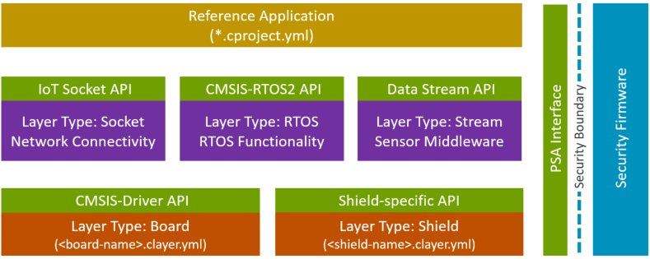
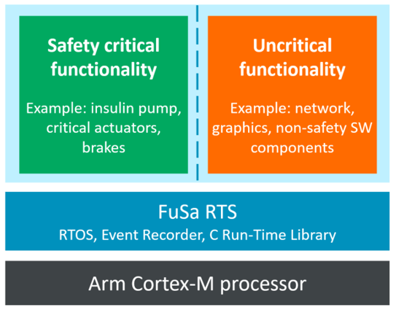
Target Hardware Abstraction
Target Hardware Abstraction

Slide 34
Software components
Provided Interfaces
Interfaces to user application or other software components
Software component
API headers
User code templates
Configuration files
Source code/
libraries
Documentation
Debug view
description
Required Interfaces
Interfaces to device peripherals or other software components
A software component encapsulates a set of related functions.
Components should be substitutable by other components at design time.
Components can have dependencies on other components.
Notes:
Requires you to think about the API of the software component

Slide 35
- component: <1>
- component: <1>
API header
API headers
Configuration files
Source code/
libraries
Configuration files
Source code/
libraries
Documentation
- component: <2>
Central API definition
API header
API headers (Definition)
Documentation of API
Configuration files
Source code/
libraries
- component: <2.A>
- component: <2.B>
- component: <2.C>
Source code/
libraries
Source code/
libraries
Source code/
libraries
Implementation #1
Implementation #2
Implementation #3
Source code/
libraries
Source code/
libraries
Source code/
libraries
Notes:
Requires you to think about the API of the software component

Slide 36
Application example: TCP/IP network
Using network stack on STM32F407IG with internal MAC
Network:Socket:TCP
CMSIS:CMSIS-RTOS
Network:Interface:ETH
Network:CORE
CMSIS:CORE
CMSIS Driver: Ethernet MAC
Middleware Pack
CMSIS Pack
Device:Startup
CMSIS Driver: Ethernet PHY
External Driver Pack
Device Family Pack

Slide 37
Class / Pack view
IoT Client
IoT Utility - pack MDK-Pack:IoT-Socket
Network - pack: lwIP::lwIP
CMSIS-Driver - pack vendor::HAL-Interface
CMSIS:RTOS2 RTOS&FreeRTOS - pack Arm::CMSIS-FreeRTOS
Device - pack vendor::DFP
CMSIS - pack Arm::CMSIS
CMSIS-Driver - pack Arm::CMSIS-Driver

Slide 38
Software components – Taxonomy
Software component have these attributes that are used to identify them:
Component Class (Cclass): examples are CMSIS, Device, File System
Component Group (Cgroup): examples are CMSIS:RTOS, Device:Startup, File System:CORE
Component Version (Cversion): the version number of the software component
Optionally, a software component may have additional attributes:
Component Sub-Group (Csub): examples are CMSIS:RTOS:MyRTOS, Device:Driver USBD:Full-speed
Component Variant (Cvariant): a variant of the software component: RTOS:FreeRTOS
Component Vendor (Cvendor): the supplier of the software component
Notes:
Requires you to think about the API of the software component

Slide 39
Bundles
A bundle is a variant on the Cclass level.
It specifies the attributes Cclass, Cversion and optionally Cgroup and Cvendor for a collection of interdependent components.
Components within a bundle inherit the attributes set by the bundle and must not set these attributes again.
Bundles ensure consistency of attributes across multiple interworking components and restrict the mix and match of components within a Cclass from different solutions.
Bundle
Component A
Component B
Component C
Component X
Component Y
Component Z
Notes:
Requires you to think about the API of the software component

Slide 40
Bundles
In case multiple inter-dependent components that belong to the same Cclass form part of a solution, these can be grouped into a bundle (Cbundle).
A Cbundle specifies identical attributes Cclass, Cversion and optionally Cgroup and Cvendor for several components.
Components within a bundle inherit these attributes set by the bundle and cannot alter these attributes (for example component version).
Bundles ensure consistency of attributes across multiple interworking components and restrict the mix and match of components within a Cclass from different software packs.

Slide 41
Relationships of packs and software components
Packs can require other packs to be available:
Components can have dependencies on other components; either from the same or from other packs:
Pack A
Version n
Pack B
Version m
Pack A, Version n
Pack B, Version m
Component A
Component B
Component C
Component A
Component B
Component C

Slide 42
Central API Interface definition for software components
Interfaces
A common problem: API headers evolve over time.
A central API definition shares header file and documentation of an API interface across multiple other software components to ensure consistency.
The API interface is distributed separate or as part of the software component that consumes this interface. The API header file is therefore.
An example is the CMSIS-Driver pack that contains various Ethernet and Flash drivers – all compatible with the CMSIS-Driver APIs that are published in the CMSIS Pack.
Software
component
API headers
Source code/
libraries
Central API definition
API headers (Definition)
Documentation of API
Implementation #1
Implementation #2
Implementation #3
Source code/
libraries
Source code/
libraries
Source code/
libraries
Notes:
Requires you to think about the API of the software component

Slide 43
API components
An API is a special form of a software component that only defines a C/C++ Application Programming Interface (API).
An API does not contain the actual implementation (usually provided by source code or library files) and cannot be selected in a development tool. One example is the CMSIS-RTOS API, which is specified as part of CMSIS. However, the actual RTOS implementation is provided by different vendors.
An API consists of a name, a brief description as well as one or more header files. It references a document containing the specification of the API.

Slide 44
Application example: TCP/IP network
Using network stack on STM32F407IG with internal MAC
Network:Socket:TCP
CMSIS:CMSIS-RTOS
Network:Interface:ETH
Network:CORE
CMSIS:CORE
Ethernet MAC
Middleware Pack
CMSIS Pack
Device:Startup
Ethernet PHY
External Driver Pack
Vendor 1 Pack

Slide 45
Application example: TCP/IP network
Using network stack on an NXP LPC54108 without MAC
- component: Network:Socket:TCP
- component: CMSIS:CMSIS-RTOS2:RTX
- component: Network:Interface:ETH
- component
Network:CORE
- component: CMSIS:CORE
Ethernet MAC and PHY
- pack: Middleware Pack
- pack: CMSIS Pack
Device:Startup
CMSIS-Driver SPI
- pack: External Driver Pack
- pack: Device Family Pack

Slide 46
Managing software components in a project
Pack manager creates RTE_Components.h header file
RTE_Components.h is an inventory file that contains:
CMSIS_device_header #define for generic access to the selected device’s header file
All defines that are generated out of components from PDSC files:
<component Cgroup="Core" Cversion="10.0.1" condition="FreeRTOS"> <description>Core components API (Kernel, Tasks, Semaphores, Mutexes, Queues)</description> <RTE_Components_h> #define RTE_RTOS_FreeRTOS_CORE /* RTOS FreeRTOS Core */ </RTE_Components_h> . . . </component>
Is added to the RTE_Components.h file:
/* * Auto generated Run-Time-Environment Component Configuration File * *** Do not modify ! *** */ #ifndef RTE_COMPONENTS_H #define RTE_COMPONENTS_H /* Define the Device Header File: */ #define CMSIS_device_header "ARMCM3.h“ #define RTE_RTOS_FreeRTOS_CORE /* RTOS FreeRTOS Core */ #endif /* RTE_COMPONENTS_H */

Slide 47
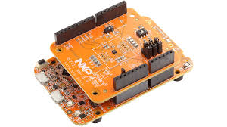
Distribution of Reference Applications
Example: Sensor SDK Pack (github.com/RobertRostohar/NXP_Sensor_SDK) that contains:
Agnostic middleware for a sensor that is configurable (part of the Reference Application)
Board/Device agnostic examples that use this middleware (part of the Reference Application)
One or more Shield layers that provides configuration settings for the agnostic middleware
Board Layers are provided by a Board Support BSP Pack that is board specific
Sensor SDK Pack
Reference Application (<sensor>.csolution.yml / <sensor>.cproject.yml)
Sensor SDK Pack PDSC:
<example> describes Reference Application
<clayer> describes <shield-name>.clayer.yml
BSP Pack PDSC:
<clayer> describes <board-name>.clayer.yml
BSP Pack
Shield-specific API
Driver APIs
Layer Type: Board (<board-name>.clayer.yml)
Layer Type: Shield (<shield-name>.clayer.yml)

Slide 48
Distribution of Reference Applications
MDK Middleware Pack
Reference Application Example
connections:
- connect: USB Device HID
consumes:
- CMSIS_USB_Device
- CMSIS_VIO
USB Device
RTOS
HID Class
CMSIS-View
connections:
- connect: Board with USB
provides:
- CMSIS_USB_Device
- CMSIS_VIO
BSP Pack
Driver APIs
Layer Type: Board (<board-name>.clayer.yml)

Slide 49
Header File Structure
Reference Application
Reference Application
CMSIS_target_header Driver configuration
CMSIS-Driver API header files
CMSIS_target_header Driver configuration
CMSIS-Driver API header files
CMSIS_shield_header Shield configuration
Hardware Abstraction
Driver implementation
CMSIS_shield_header Shield configuration
Driver API Shim Interface
STM32 HAL Drivers
CMSIS_device_header Processor and Peripherals
CMSIS_device_header Processor and Peripherals
Device Registers
Device Registers

Slide 50
Reference Application
CMSIS_target_header Driver configuration
CMSIS-Driver API header files
MX_Device.h
configuration information
CMSIS_shield_header Shield configuration
Driver API Shim Interface
STM32 HAL Drivers
CMSIS_device_header Processor and Peripherals
*.c/*.h generated source files
Generator Bridge
Device Registers
CubeMX Generator

Slide 51
Generator Information
Generator Output
*.ioc Generator Project
*.cbuild-gen-idx.yml
cbridge Generator Bridge
CubeMX Generator
*.c/*.h generated source files
<project>. cbuild-gen.yml
<project>. cgen.yml Import data for CMSIS-Toolbox

Slide 52
Configuration of Reference Applications
Initially contains empty target-type setting
solution:
cdefault:
target-types:
# Step 1: Specify your board, for example with: # - type: LPCXpresso54114
# board: NXP::LPCXpresso54114
# Step 2: Run `cbuild setup` and use cbuild-idx.yml to identify variables
# variables:
# - Board-Layer: ./layer/board/frdmk22f/frdmk22f.clayer.yml
# - Shield-Layer: ./layer/shield/agmp03/agmp03.clayer.yml
build-types:
- type: Debug
:
- type: Release
:
projects:
- project: ./freefall/fxls8962_freefall.cproject.yml
- project: ./freemaster_demo/fxls8962_freemaster_demo.cproject.yml
- project: ./interrupt/fxls8962_interrupt.cproject.yml
- project: ./normal/fxls8962_normal.cproject.yml
- project: ./normal_spi/fxls8962_normal_spi.cproject.yml
Command-line workflow:
User enters target type and specifies board in `csolution.yml`
User runs `cbuild setup` command, this generates `cbuild-idx.yml` with variable settings
This command installs a potential missing BSP and DFP pack
It delivers one or more potential configurations with variable settings
User selects on configuration and copies variable settings in `csolution.yml` which adds the layers
Note: layers are not copied in this scenario and may be taken from pack location
IDE workflow:
User selects a reference example and specifies a board
IDE runs `cbuild setup` command, this generates `cbuild-idx.yml` with variable settings
This command installs a potential missing BSP and DFP pack
IDE shows one or more potential configurations
User selects a configuration
IDE copies variable settings from `cbuild-idx.yml` to `csolution.yml` which adds the layers
Note: layers may be copied to csolution workspace and paths adjusted
IDE runs again `cbuild setup` command which completes the example configuration
IDE shows the `settings` required for the example

Slide 53
cbuild-idx.yml – variable settings
Potential content of cbuild-idx.yml for user configuration
build-idx:
generated-by: csolution version 2.4.0
cdefault: cdefault.yml
csolution: fxls8962.csolution.yml
configurations:
- configuration:
variables:
- Board-Layer: ./layer/board/frdmk22f/frdmk22f.clayer.yml
- Shield-Layer: ./layer/shield/agmp03/agmp03.clayer.yml
settings: - Board-Layer:
- set: Bus.SPI (FXLS8962 SPI Bus - Jumper configuration: I2C/SPI=SPI)
- set: Bus.SPI (FXAS21002 SPI Bus - Jumper configuration: I2C/SPI=SPI)
- configuration:
variables:
- Board-Layer: ./layer/board/frdmk22f/frdmk22f.clayer.yml
- Shield-Layer: ./layer/shield/fxls8962/fxls8961.clayer.yml

Slide 54
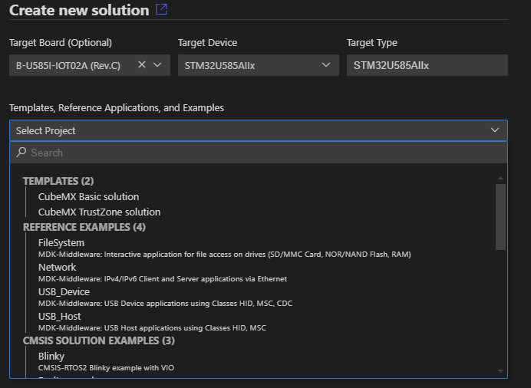
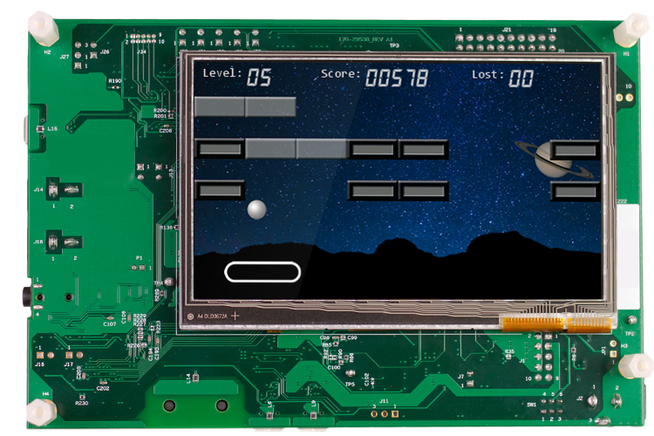
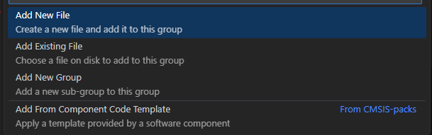
Developers want project examples
Kick start application development with easy to access usage examples
Device Family Pack (DFP)
Device Specific Template Projects
Example projects that run on eval boards
A csolution project may group similar examples
Examples for a board can be in different packs
Template projects are user application stubs
Pre-configured for different use cases
Code Templates for software components
Shows how to use a software component
Reference Applications - hardware agnostic
Require HAL driver interfaces to run
Board Layer with HAL drivers
Provides HAL driver interfaces
Board Support Pack (BSP)
Examples that run on a board
Board specific Template Projects
Board Layer with HAL drivers
Generic Software Pack (GSP)
Examples that run on a board
Reference Applications
Code Templates for components
RTOS
Graphic
CANopen
Notes:
Today, developers rely on example projects to kick start their application development. In the Open-CMSIS-Pack system, we pay a lot of attention on meaningful examples that are easy to access.
All of this is based on CMSIS-Packs. There are different flavors that can provide various types of examples.
Device family pack can provide device specific template projects.
Board support packs obviously contain examples that run on on a specific board. But also board specific template projects that are preconfigured for different application types. BSPs can also have board layers with driver interfaces for certain use cases.
Middleware packs contain preconfigured examples that run out of the box on a give board for software such as an RTOS, or a graphics pack that we show today. IN the next we episode of this series, we will be looking at the CANopen stack from EmSA. Reference applications are hardware agnostic and require driver interfaces that are provided via board layers. Packs can also contain user code templates which give you a starting point for using a software component.
To make it easy, we have several ways. On the website you can see all the different packs. And the boards that they support along with examples.
In VS Code, us the Create-new-solution flow. Once you select a board, it shows the examples available.
You have also access to templates or reference applications. You can also have several csolution examples that run directly on this board. It’s really easy to get started.
For the user code templates, we have a similar way. You add a new file and choose the option “code template”.
BTW, all of this works in VS Code and µVision similarly and Embedded Wizard will now show how example examples show the rich feature set of their graphics middleware and how they help customers with a starting point for their own projects.
Manuel, Tim, the stage is yours.

Slide 55

csolution project
Software Packs
*.dbgconf Device configuration for Debug/Trace
My.csolution.yml Target and Build Parameters
Device/Board Generic Software
output
My+target. cbuild-run.yml Run and Debug Configuration
Run
pyOCD VSCode Extension
CMSIS-Debug
*.cproject.yml source files and SW components
CMSIS-Toolbox
cbuild: Build Invocation
VSCode Extension
CMSIS-Solution
ELF/DWARF HEX/binary files
Debug
Open-CMSIS Tools
Published software packs
User created input files
Generated output files

Slide 56

csolution project
Software Packs
*.dbgconf Device configuration for Debug/Trace
My.csolution.yml Target and Build Parameters
Device/Board Generic Software
output
My+target. cbuild-run.yml Run and Debug Configuration
Run
pyOCD VSCode Extension
CMSIS-Debug
*.cproject.yml source files and SW components
CMSIS-Toolbox
cbuild: Build Invocation
VSCode Extension
CMSIS-Solution
ELF/DWARF HEX/binary files
Debug
Zephyr Project Managed with KConfig
West / CMake
ELF/DWARF HEX/binary files

Slide 57

Run and Debug Management: pyOCD implementation
A single file `*cbuild-run.yml` contains all relevant information for run and debug of an application.
csolution project
Software Packs
*.dbgconf Device configuration for Debug/Trace
My.csolution.yml Target and Build Parameters
Device/Board Parameters
output
My+target. cbuild-run.yml Run and Debug Configuration
Run
pyOCD VSCode Extension
CMSIS-Debug
CMSIS project or West build Application Images
CMSIS-Toolbox
cbuild: Build Invocation
VSCode Extension
CMSIS-Solution
ELF/DWARF HEX/binary files
Debug
Open-CMSIS Tools
Published software packs
User created input files
Generated output files
pyOCD command-line
> pyocd list --cbuild-run MyProject+TargetHW.cbuild-run.yml // details of debug connection (scan JTAG, SWD)
> pyocd gdbserver --cbuild-run MyProject+TargetHW.cbuild-run.yml // start debug server, load command: flash
> pyocd load --cbuild-run MyProject+TargetHW.cbuild-run.yml // flash and run application
> pyocd erase --cbuild-run MyProject+TargetHW.cbuild-run.yml // erase image on device

Slide 58
Application
Test Case Project
Test Case Project
Test Case Project
Board Layer for STM32F746G Disco
Board Layer for Production
Hardware
Layer for Hardware Board
Layer for Simulation Model

Slide 59
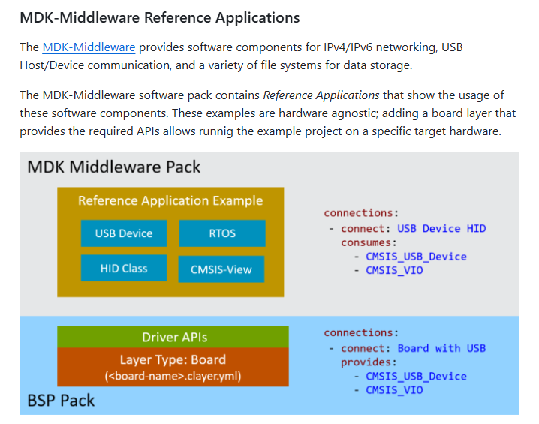
Using Layers for Middleware Examples
MDK Middleware Example
Board Layer for STM32F746G Disco
Board Layer for CustomHW
Notes:
Thank you Hans for this interesting demo. Let me recap what he did. This is the Manual section of the CMSIS Toolbox that talks about the MDK Middleware Reference Applications. As has did explain several Board Support packs contain such layers. The CMSIS Toolbox uses connections to identify compatible layers.
You can see here, the connections of the Reference example and the board layer match. This makes it possible to use this board layer to run the example application. The board layer can however have more connections, which allows you to use this layer for many other different applications. This is how we scale in future our example projects to different evaluation boards.
All you need as a board vendor is to ship a board layer with the right scope of connections in a board support pack.
Now, Hans used the STM32F746G Disco board, and the tool gave him the right layer for his example. He could have then development the application software by still using the evaluation kit.
This speeds up development as you need not to wait for the production hardware. But once this custom hardware arrives, you may just add another board layer to your application.
Now you can continue using both the evaluation kit and the custom hardware for software development.
But with this layer concept you can do a lot more.

Slide 60
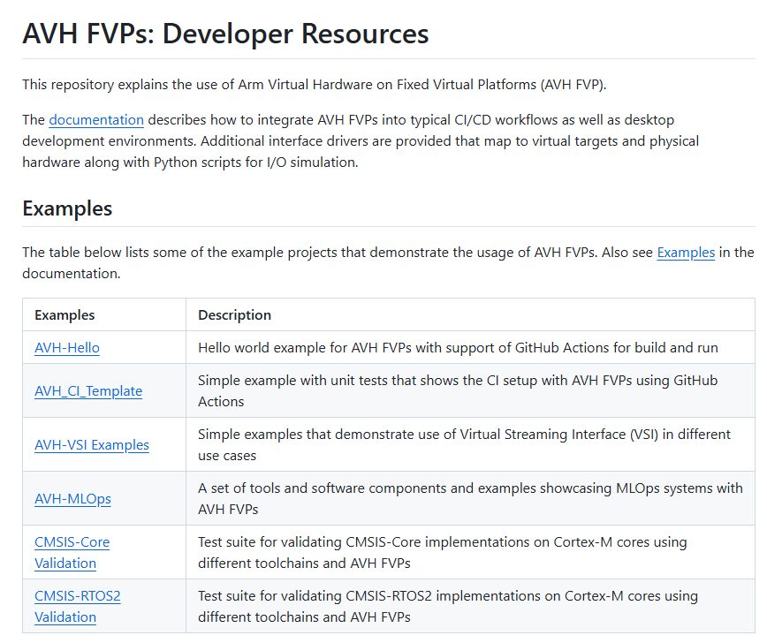
Using Layers for test automation
Unit test and software test on hardware or simulation models
github.com/Arm-software/AVH
Test Case Project
Test Case Project
Test Case Project
Layer for Hardware Board
Layer for Simulation Model
Notes:
Layers provide flexibility for many different use cases.
This diagram shows the structure of a test case project that uses layers to run on hardware or simulation models. Both layers provide effectively the same API interface. The difference is that the layer for the simulation model provides virtual interfaces that allow you for example to connect to I/O streams. Using the Virtual Streaming Interface gives you for example access to sensor data, audio or video files.
We provide several examples as developer resources for our Arm Virtual Hardware that you can find on GitHub. Here is a list of examples that includes a simple Hello World, a CI template to create own unit test projects, or VSI examples. We are using CI tests for many CMSIS components and also these repositories are public.
Potentially show AVH github + MQTT github

Slide 61
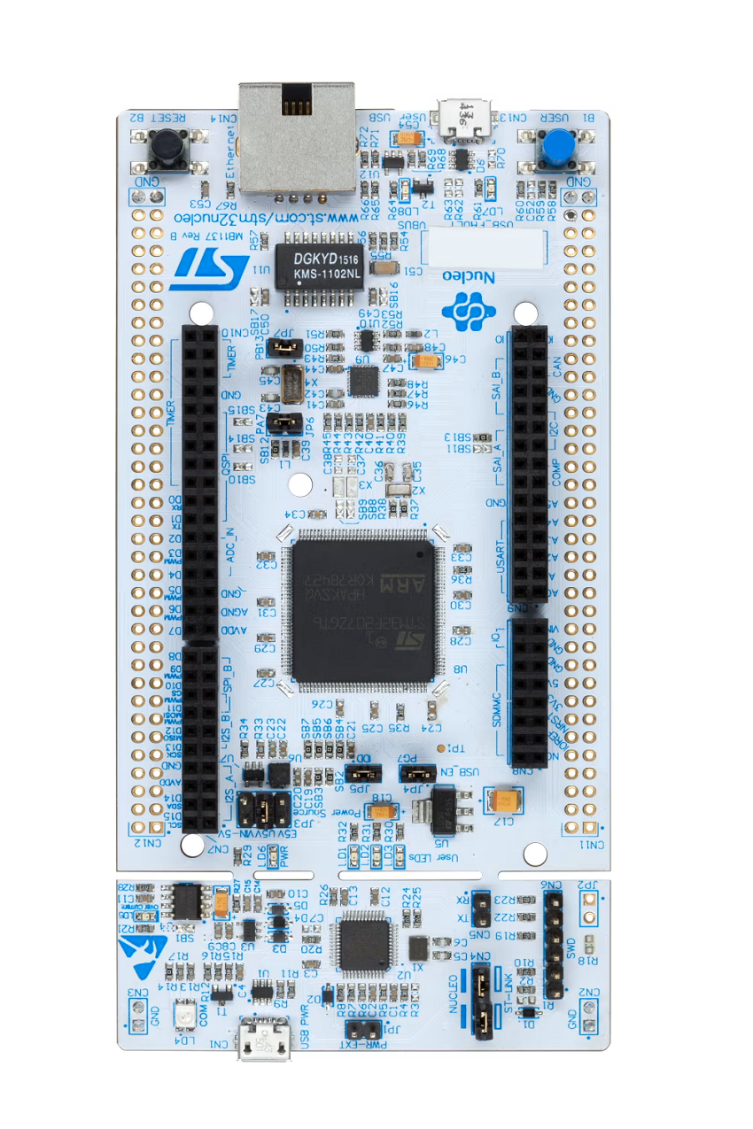
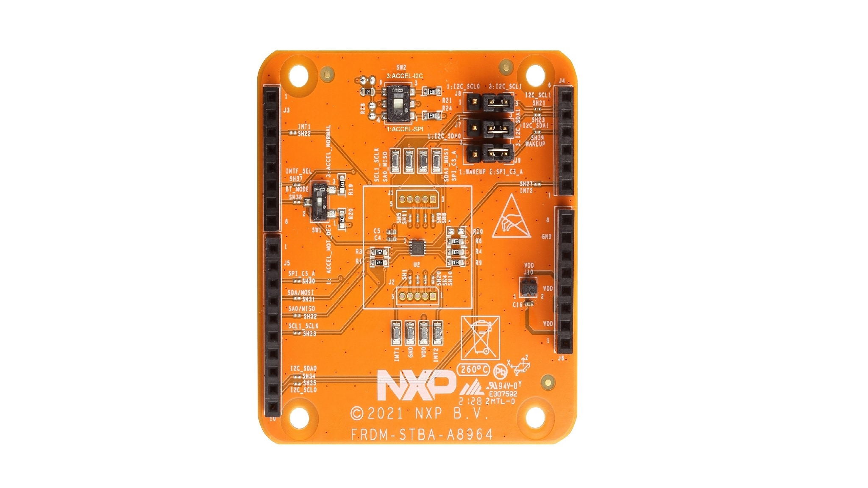
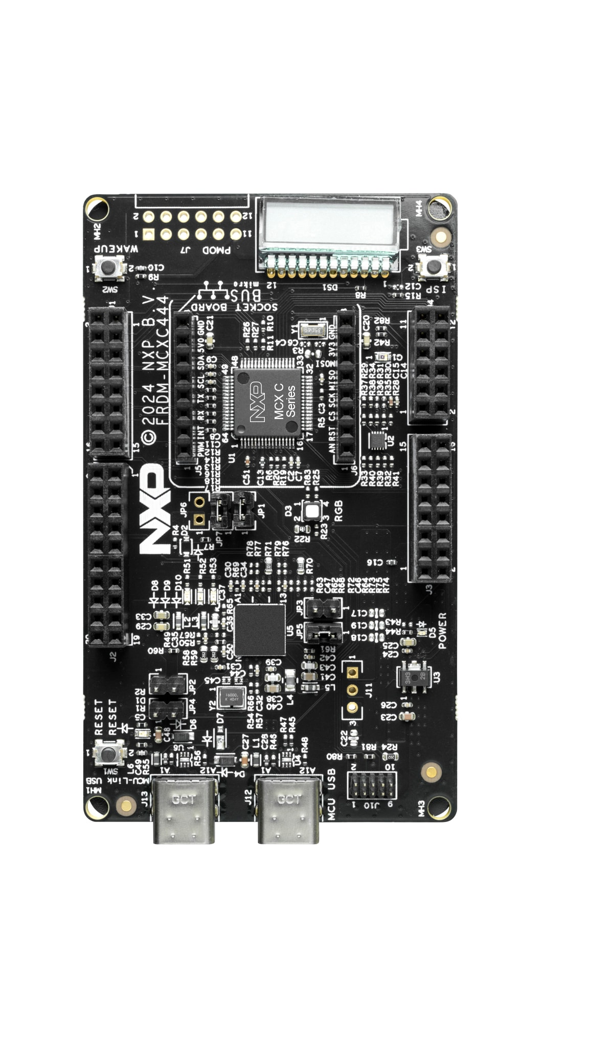
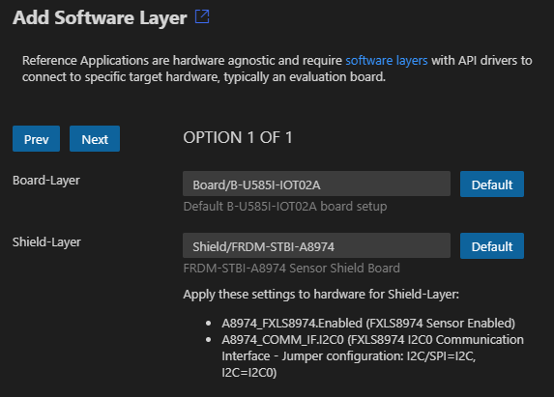
Using Layers to add Hardware Shields
MEMS Sensor
The VS Code – CMSIS Solution combines layers for you
Sensor SDK Pack
Reference Application (<sensor>.csolution.yml / <sensor>.cproject.yml)
BSP Pack
Shield-specific API
Driver APIs
Layer Type: Board (<board-name>.clayer.yml)
Layer Type: Shield (<shield-name>.clayer.yml)
github.com/Open-CMSIS-Pack/Sensor-SDK
Notes:
Layers can also simplify evaluation of hardware. Here we show an NXP Sensor Arduino shield. Obviously, the hardware connects easily to microcontroller boards that offer Arduino connectors. But how can we offer evaluation software for many different boards?
The VS Code CMSIS solution helps here. It can combine the software part of a Sensor SDK that contains a reference application for the sensor with a Board layer of an evaluation kit that supports Arduino interfaces. The tool picks for you the right layers and even provides information about jumper settings that you should apply to make it work.
The software itself is retargeted using the Shield layer that provides effectively a header file with the pin mapping of the Arduino shield. If you want to use the same software components on production hardware without Arduino connector – all you need is a different pin mapping header file in your layer.
Again, we provide this example on GitHub.

Slide 62
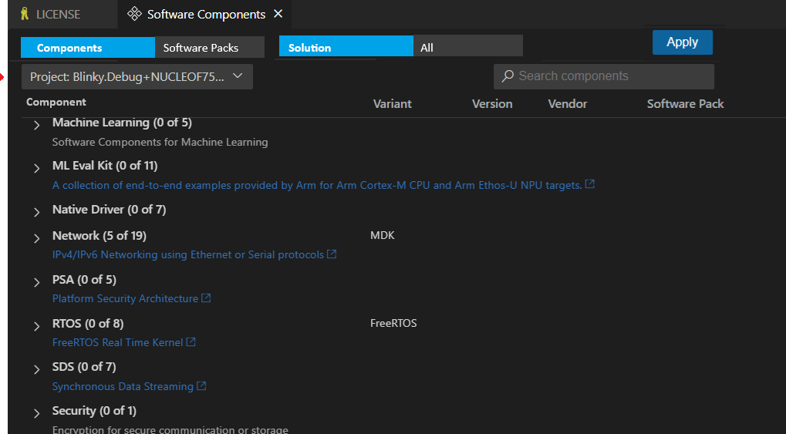
csolution project
Software Packs
My.csolution.yml Target and Build Parameters
Device/Board Generic Software
*.cproject.yml source files and SW components
csolution Server Mode

Slide 64
Each processor core is assigned to one GDB Server Port
SoC
GDB Server (i.e. pyOCD)
GDB Server Port Processor core #1
Debug Adapter CMSIS-DAP JLink
Etc.
Cortex Processor core #1
JTAG SWD
GDB Server Port Processor core #2
Cortex Processor core #2

