Slide 1
OPEN CODING SOCIETY
OCS Intelligence
A distributed AI infrastructure, built and owned by students, serving free coding models to every OCS student.
8× GTX 1070 × 2 RIGS
NETBIRD
LLAMA.CPP
QWEN3.8-27B
Prepared for Open Coding Society Presented to Eddie Revollo, Mentor · Prometheus
OCS INTELLIGENCE · 01 / 36
Notes:
Yash

Slide 2





SYSTEM ARCHITECTURE
One request, six hops
→
→
→
→
Student
AWS Relay
Broker
NetBird
GPU Rig
HTTPS
NGINX / TLS
FastAPI
private overlay
llama-server
RDS holds durable state — users, sessions, history.
Redis holds fast state — worker registry, queues, locks.
OCS INTELLIGENCE · 02 / 36
Notes:
Mihir

Slide 3
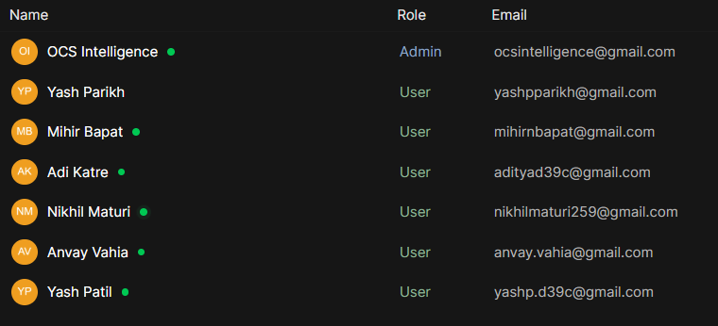
EVIDENCE
Live, on our own hardware
Local chat demo — served entirely from the OCS rack, model tag qwen3.8:27b, no external API calls.
OCS INTELLIGENCE · 03 / 36
Notes:
Yash

Slide 4
TEAM
Who leads, who reports
Mr. Eddie Revollo
Mr. John Mortensen
MENTOR · PROMETHEUS
TEACHER
Yash Parikh
oversees
Nikhil Maturi
PRIMARY TEAM LEAD
SECONDARY TEAM LEAD
Mihir Bapat
Anvay Vahia
Yash Patil
Adi Katre
REPORTS TO YASH
REPORTS TO YASH
REPORTS TO NIKHIL
REPORTS TO NIKHIL
Nikhil's pod — also overseen by Yash
Direct report
Oversight — Yash oversees the whole team, including Nikhil and his pod
OCS INTELLIGENCE · 04 / 36

Slide 5


MISSION
What we're building
A public, authenticated platform that turns a pile of secondhand GPUs into a coding assistant students can reach from anywhere — on infrastructure we own end to end.
01
02
03
Free & open-source
Private & secured
Built by students
Qwen3.8 27B, GGUF-quantized, no subscription cost to students.
A public endpoint out front, a private NetBird overlay behind it — never direct student access to raw compute.
Every layer — hardware, networking, serving, scheduling — designed, built, and owned by the team.
OCS INTELLIGENCE · 05 / 36
Notes:
Adi

Slide 6



WHY THIS EXISTS
The problem
OCS students want a real coding assistant — but frontier AI tools cost real money per seat, and a single shared password doesn't scale to a whole class.
Cost
Network
Hardware
Per-seat AI subscriptions don't scale to a whole class, let alone a whole district.
The district network actively fingerprints and blocks the obvious ways to expose a server to the internet.
We're running old, secondhand GPUs — real constraints, not a modern datacenter stack.
OCS INTELLIGENCE · 06 / 36
Notes:
Nikhil

Slide 7
ARCHITECTURE SPLIT
Control plane vs. compute plane
CONTROL PLANE
COMPUTE PLANE
Decides what happens, where
Actually does the work
Users, roles, authentication
Public API (FastAPI + NGINX)
Broker / scheduler logic
RDS — durable state
Redis — live worker & queue state
GPU Rig 1 — production inference
GPU Rig 2 — development & test inference
llama.cpp / llama-server systemd services on each rig
Students never touch the compute plane directly — every request is mediated by the broker over a private network.
OCS INTELLIGENCE · 07 / 36
Notes:
Anvay

Slide 8


DATA DESIGN
Three kinds of state
A Client should never be the only machine that knows a student's permanent history — so we split state by how long it needs to live.
Durable
Users, sessions, history, project refs
Must survive restarts & machine failure
RDS
Fast / live
Worker registry, job queue, locks, availability
Needs very fast reads/writes, changes constantly
Redis
Working
Context, recent files, temp cache
Useful while active, disposable & rebuildable
GPU Rigs
OCS INTELLIGENCE · 08 / 36
Notes:
Yash

Slide 9
FULL STACK · END TO END
Every layer a request touches
Target path shown. Live today: Open WebUI (Docker) → Ollama over NetBird; the broker, Redis and RDS are being built (P2–P3).
CLIENT
CLOUD EDGE · AWS EC2
PRIVATE NETWORK
COMPUTE · 2 GPU RIGS
llama-server
systemd · OpenAI-style API
llama-server
systemd · OpenAI-style API
Student
browser · chat UI
NGINX + TLS
HTTPS in · per-IP limits
FastAPI broker
auth · queue · scheduling
NetBird
private overlay
GGUF model
Qwen3.8 27B · Q4_K_M
GGUF model
Qwen3.8 27B · Q4_K_M
CUDA + NVIDIA driver
Ubuntu host
CUDA + NVIDIA driver
Ubuntu host
RDS
durable: users, history
Redis
live: registry, locks
ASUS B250 mining board
PCIe risers · PSU
ASUS B250 mining board
PCIe risers · PSU
8× GTX 1070
8 GB VRAM each
8× GTX 1070
8 GB VRAM each
RIG 1 · PRODUCTION
RIG 2 · DEV & TEST
← tokens stream back along the same path ←
software
hardware
OCS INTELLIGENCE · 09 / 36

Slide 10


CONNECTIVITY
Three tools, two dead ends
The district network doesn't block “servers” — it fingerprints known tunneling products. Every tool below was tried against this exact network.
LIVE TODAY
ABANDONED
ABANDONED
NetBird + AWS relay
Cloudflare Tunnel
ngrok
Already running for SSH access before this ever started — not a recognized tunneling signature to the network's filtering.
Outbound port 7844 blocked network-wide, both TCP and UDP. Not configurable from our side.
DNS sinkholed, then a CRL check blocked on port 80, then Ollama itself 403'd on the Host header. Three stacked failures.
OCS INTELLIGENCE · 10 / 36
Notes:
Mihir

Slide 11
METHOD
“It doesn't work” is a starting point, not a diagnosis
Every dead end looked like the same symptom — a failed connection — until we isolated which layer actually owned it.
Symptom | Test | Root cause
Connection times out | Connectivity pre-check per port | Port-level block (7844)
Connects, wrong server | dig against an outside resolver | DNS sinkholing of tunnel hostnames
Real server responds with an error | curl with an explicit Host header | Ollama's DNS-rebinding protection
The insight: fix at the layer that actually owns the failure. NetBird worked because it was already crossing this network for SSH — it never triggered the fingerprint that caught the other two.
OCS INTELLIGENCE · 11 / 36
Notes:
Adi

Slide 12

CURRENT STATE
What's actually live right now
→
→
→
→
OCS Students
AWS EC2 Relay
NetBird
Open WebUI
8× GTX 1070
NGINX + TLS
private link
(Docker) → Ollama
Qwen3.8 27B
Model: Qwen3.8 27B, GGUF Q4_K_M — sized for Pascal-era compute.
Lesson learned: a container's localhost is not the host's localhost — fixed with host.docker.internal.
OCS INTELLIGENCE · 12 / 36
Notes:
Mihir

Slide 13

DEMO
Demo — talk to our model
WHAT STUDENTS SEE
WHAT'S BEHIND IT
WHERE IT'S GOING
A normal chat UI, model picker, streaming replies — no card, no login wall to a paid provider.
Zero paid API calls. Every token is generated on hardware sitting in our own room.
Same request path, routed through our own broker and scheduler instead of talking to Ollama directly.
OCS INTELLIGENCE · 13 / 36
Notes:
Nikhil

Slide 14
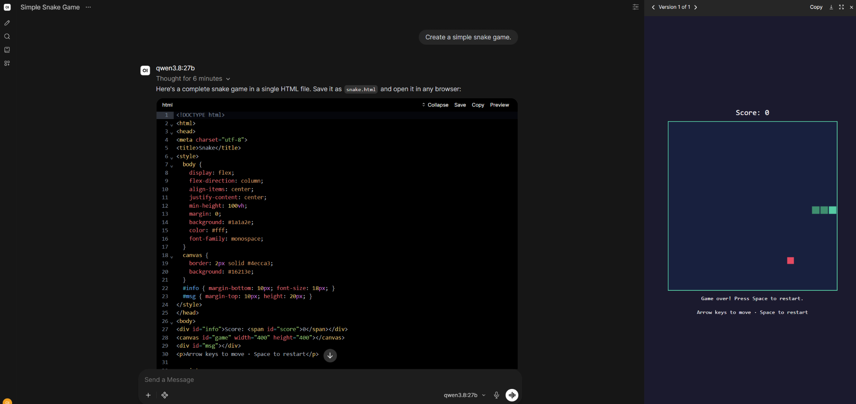
EVIDENCE
Live, on our own hardware
Local chat demo — served entirely from the OCS rack, model tag qwen3.8:27b, no external API calls.
OCS INTELLIGENCE · 14 / 36
Notes:
Mihir

Slide 15
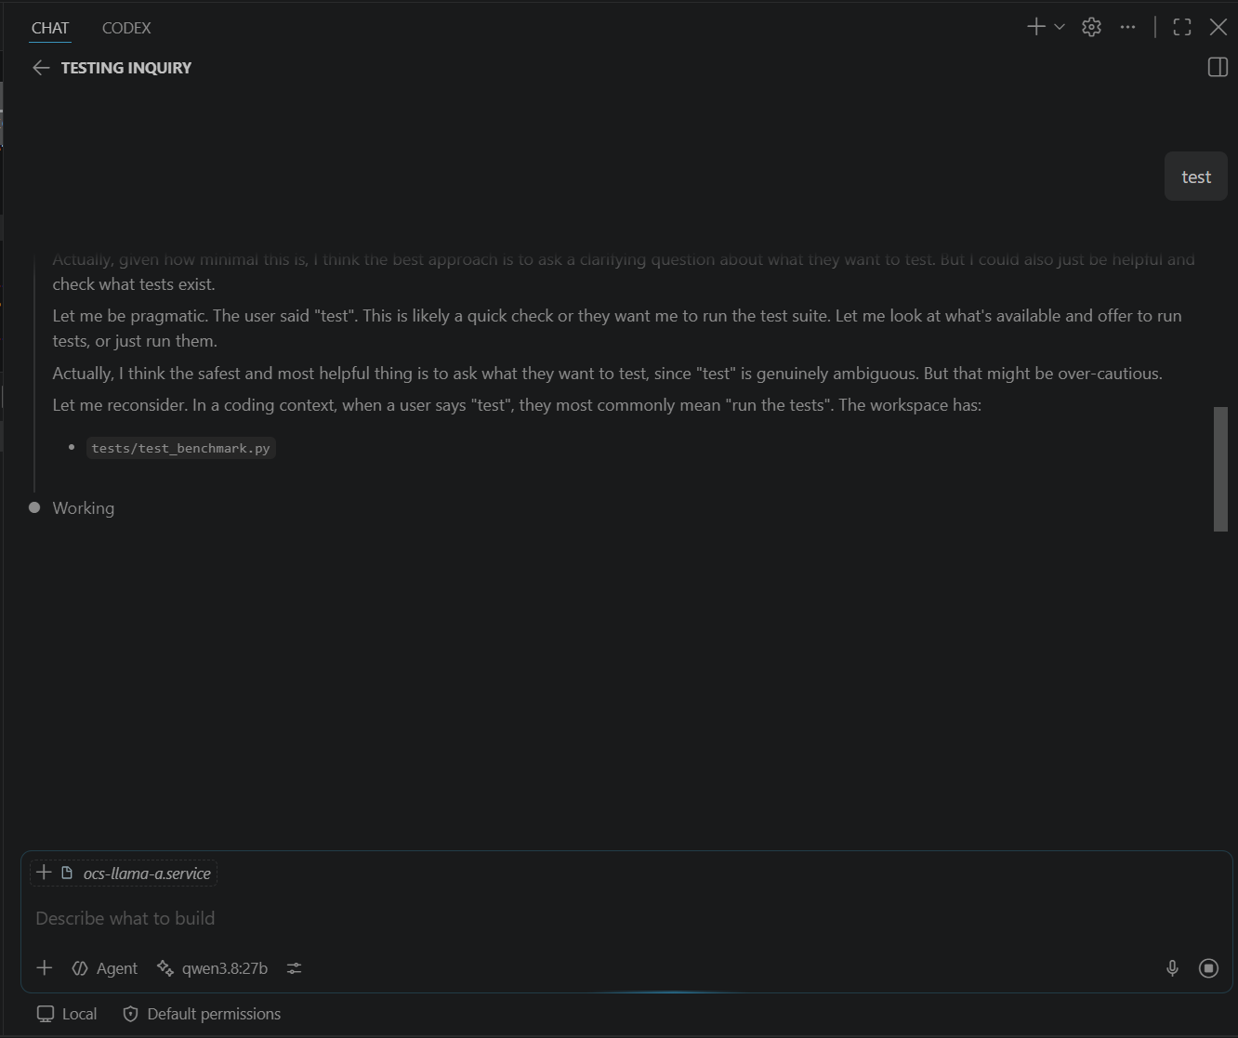
EVIDENCE
Live, on our own hardware
Local chat demo — served entirely from the OCS rack, model tag qwen3.8:27b, no external API calls.
OCS INTELLIGENCE · 15 / 36
Notes:
Adi

Slide 16
HARDWARE
The hardware: two rigs, sixteen Pascal-era cards
Why this matters: GTX 1070 is Pascal-generation. We can't assume a modern CUDA build or serving stack works cleanly — every layer of the runtime is its own research question.
8×
8×
Rig 1 — Production
Rig 2 — Dev & Test
GTX 1070, serving student traffic today
GTX 1070, built from secondhand parts for scheduler & model testing
8 GB VRAM per card — caps model size & quantization
No NVLink — cross-GPU splits run over PCIe
Used parts — no ground truth, every card proven individually
OCS INTELLIGENCE · 16 / 36
Notes:
Yash Parikh

Slide 17




REBUILD
Building Rig 2 from used parts
1
2
3
4
5
→
→
→
→
Clean & inspect
Assemble
Power on &
Verify all
Install serving
every part
chassis + GPUs
troubleshoot
8 GPUs stable
stack
Used hardware has no ground truth
Eight cards is a power problem first
A card that looks fine can have dried thermal paste and throttle under load. The test isn't “does it fit” — it's whether it survives sustained load and stays enumerated.
Rail distribution, riser quality, connector ratings, and wall draw — a rig can be assembled perfectly and still fail under full load.
OCS INTELLIGENCE · 17 / 36
Notes:
Yash Patil

Slide 18
MODEL DECISION
Picking the model: we pushed back
PROPOSED v1
WHAT WE'RE BUILDING
One small model per GPU
Fewer, larger, sharded replicas
Qwen 7–8B, Llama 8B, Phi, DeepSeek 7B — one full copy per card.
Qwen3.8-27B class, split across multiple GPUs per replica instead of one small copy per card.
Also split gemma4 12b or a4b on a single card
Our call: too weak for real coding-agent work and heavier assignments.
Trade-off flagged: the 1070s have no NVLink, so the tensor split runs over PCIe via ASUS B250 Mining Motherboard.
Selection isn't arbitrary — candidate models get a head-to-head bake-off under identical conditions before we commit to a winner and a fallback.
OCS INTELLIGENCE · 18 / 36
Notes:
Adi

Slide 19
PERFORMANCE
Poor metrics aren't failures — they're diagnostics
CURRENT → TARGET TPS
COLD START TTFT
WARM START TTFT
~12 → 60+
2m 27s
2s
GPU compute is not yet fully utilized
model loading dominates the first response
a 75× difference once the model is loaded
The methodology: measure → analyze bottleneck → research a technique → test on hardware → remeasure → document → decide keep or revert.
OCS INTELLIGENCE · 19 / 36
Notes:
Nikhil

Slide 20




R&D
Four techniques under research
Model warming
Speculative decoding
Keep the model loaded in VRAM across requests. Target: cold start under 30s.
Cheap draft tokens, target model accepts/rejects — multiplies effective throughput.
Quantization strategy
YaRN context scaling
Test Q4/Q5/Q6 GGUF levels — balance VRAM, speed, and coding-quality benchmarks.
Rope scaling so a large context window doesn't blow past available VRAM.
Every optimization ships with a before/after measurement — never guesswork.
OCS INTELLIGENCE · 20 / 36
Notes:
Nikhil

Slide 21
SCHEDULING
The broker: two scheduling problems, not one
WHICH GPU?
Which GPUs are healthy & free?
Is the model already loaded there?
Wait, or route to a different rig?
What if a whole rig disappears?
MVP rule: filter to healthy workers → filter to capable ones → prefer an already-loaded model → pick least-busy → queue if nothing's free → log the decision. Smarter policies get benchmarked against this baseline, never assumed.
OCS INTELLIGENCE · 21 / 36
Notes:
Anvay

Slide 22
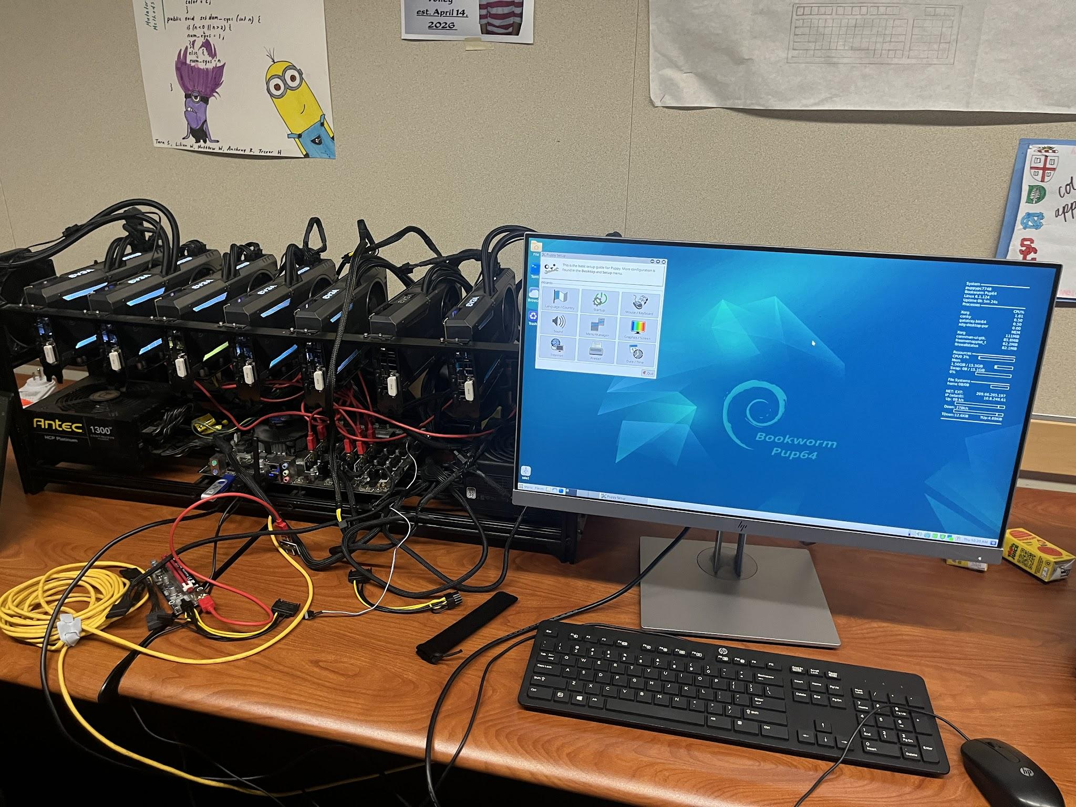
SCHEDULING
What it looks like
OCS INTELLIGENCE · 22 / 36
Notes:
Yash

Slide 23
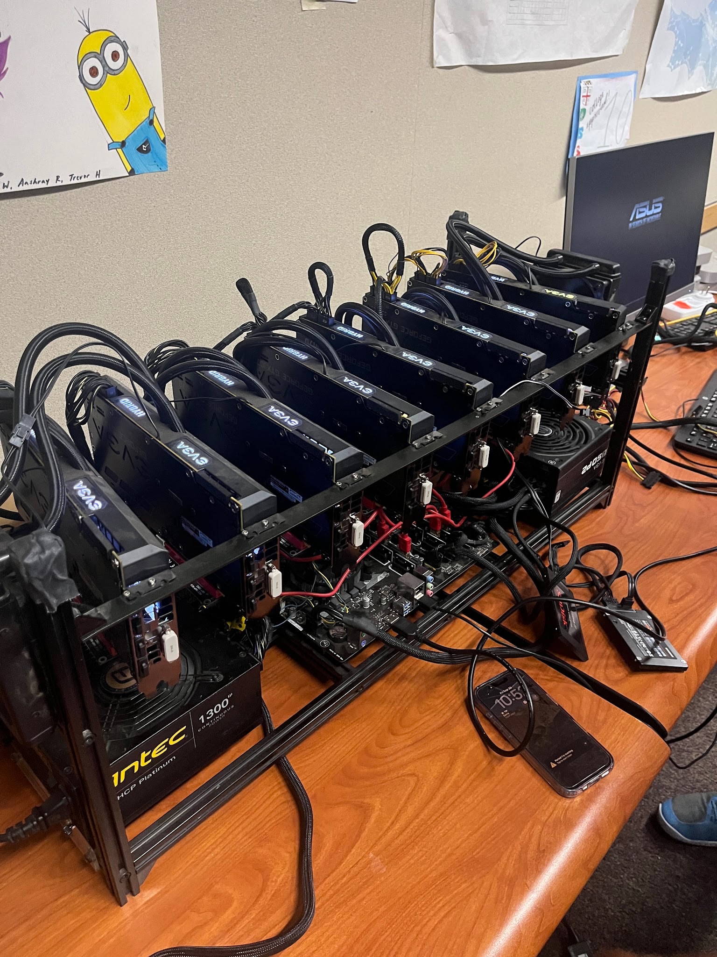
SCHEDULING
What it looks like
OCS INTELLIGENCE · 23 / 36
Notes:
Yash

Slide 24
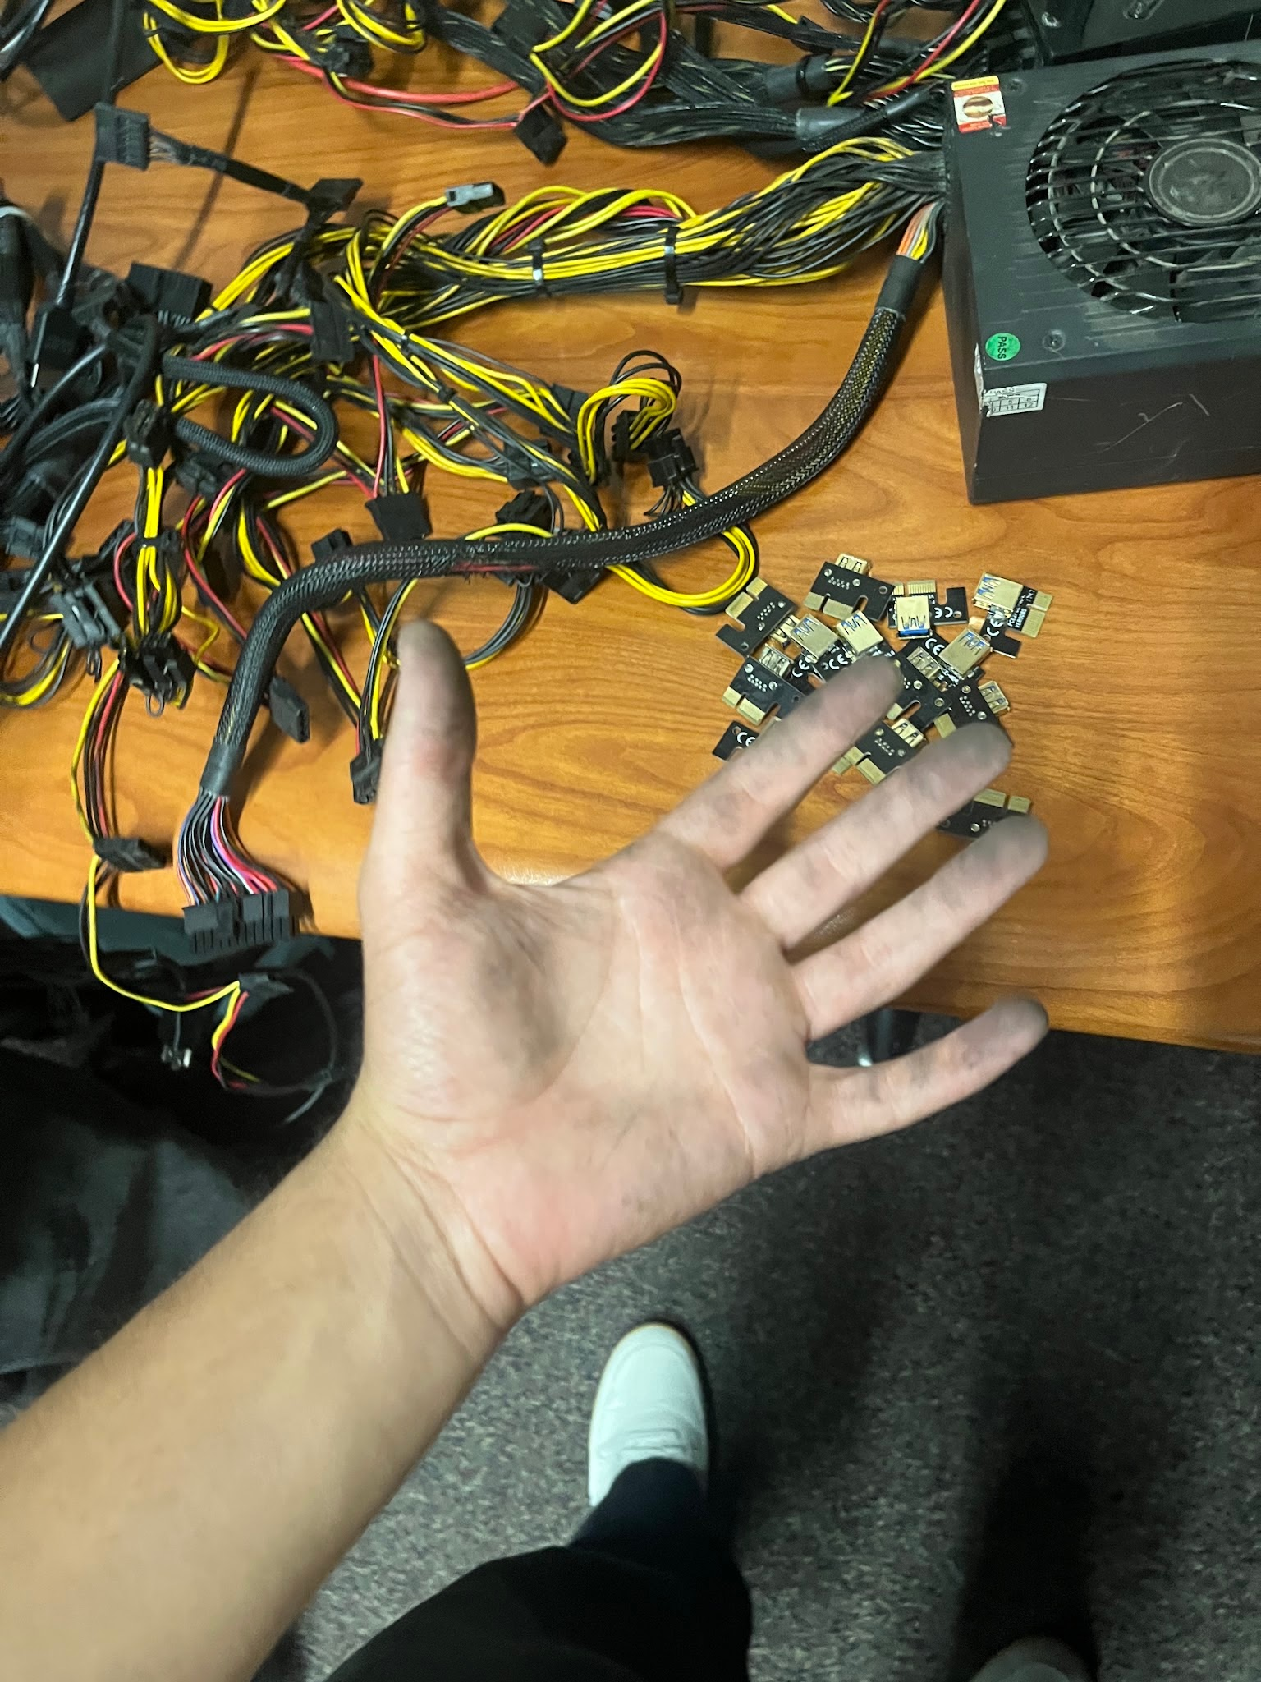
SCHEDULING
What it looks like
OCS INTELLIGENCE · 24 / 36
Notes:
Yash

Slide 25
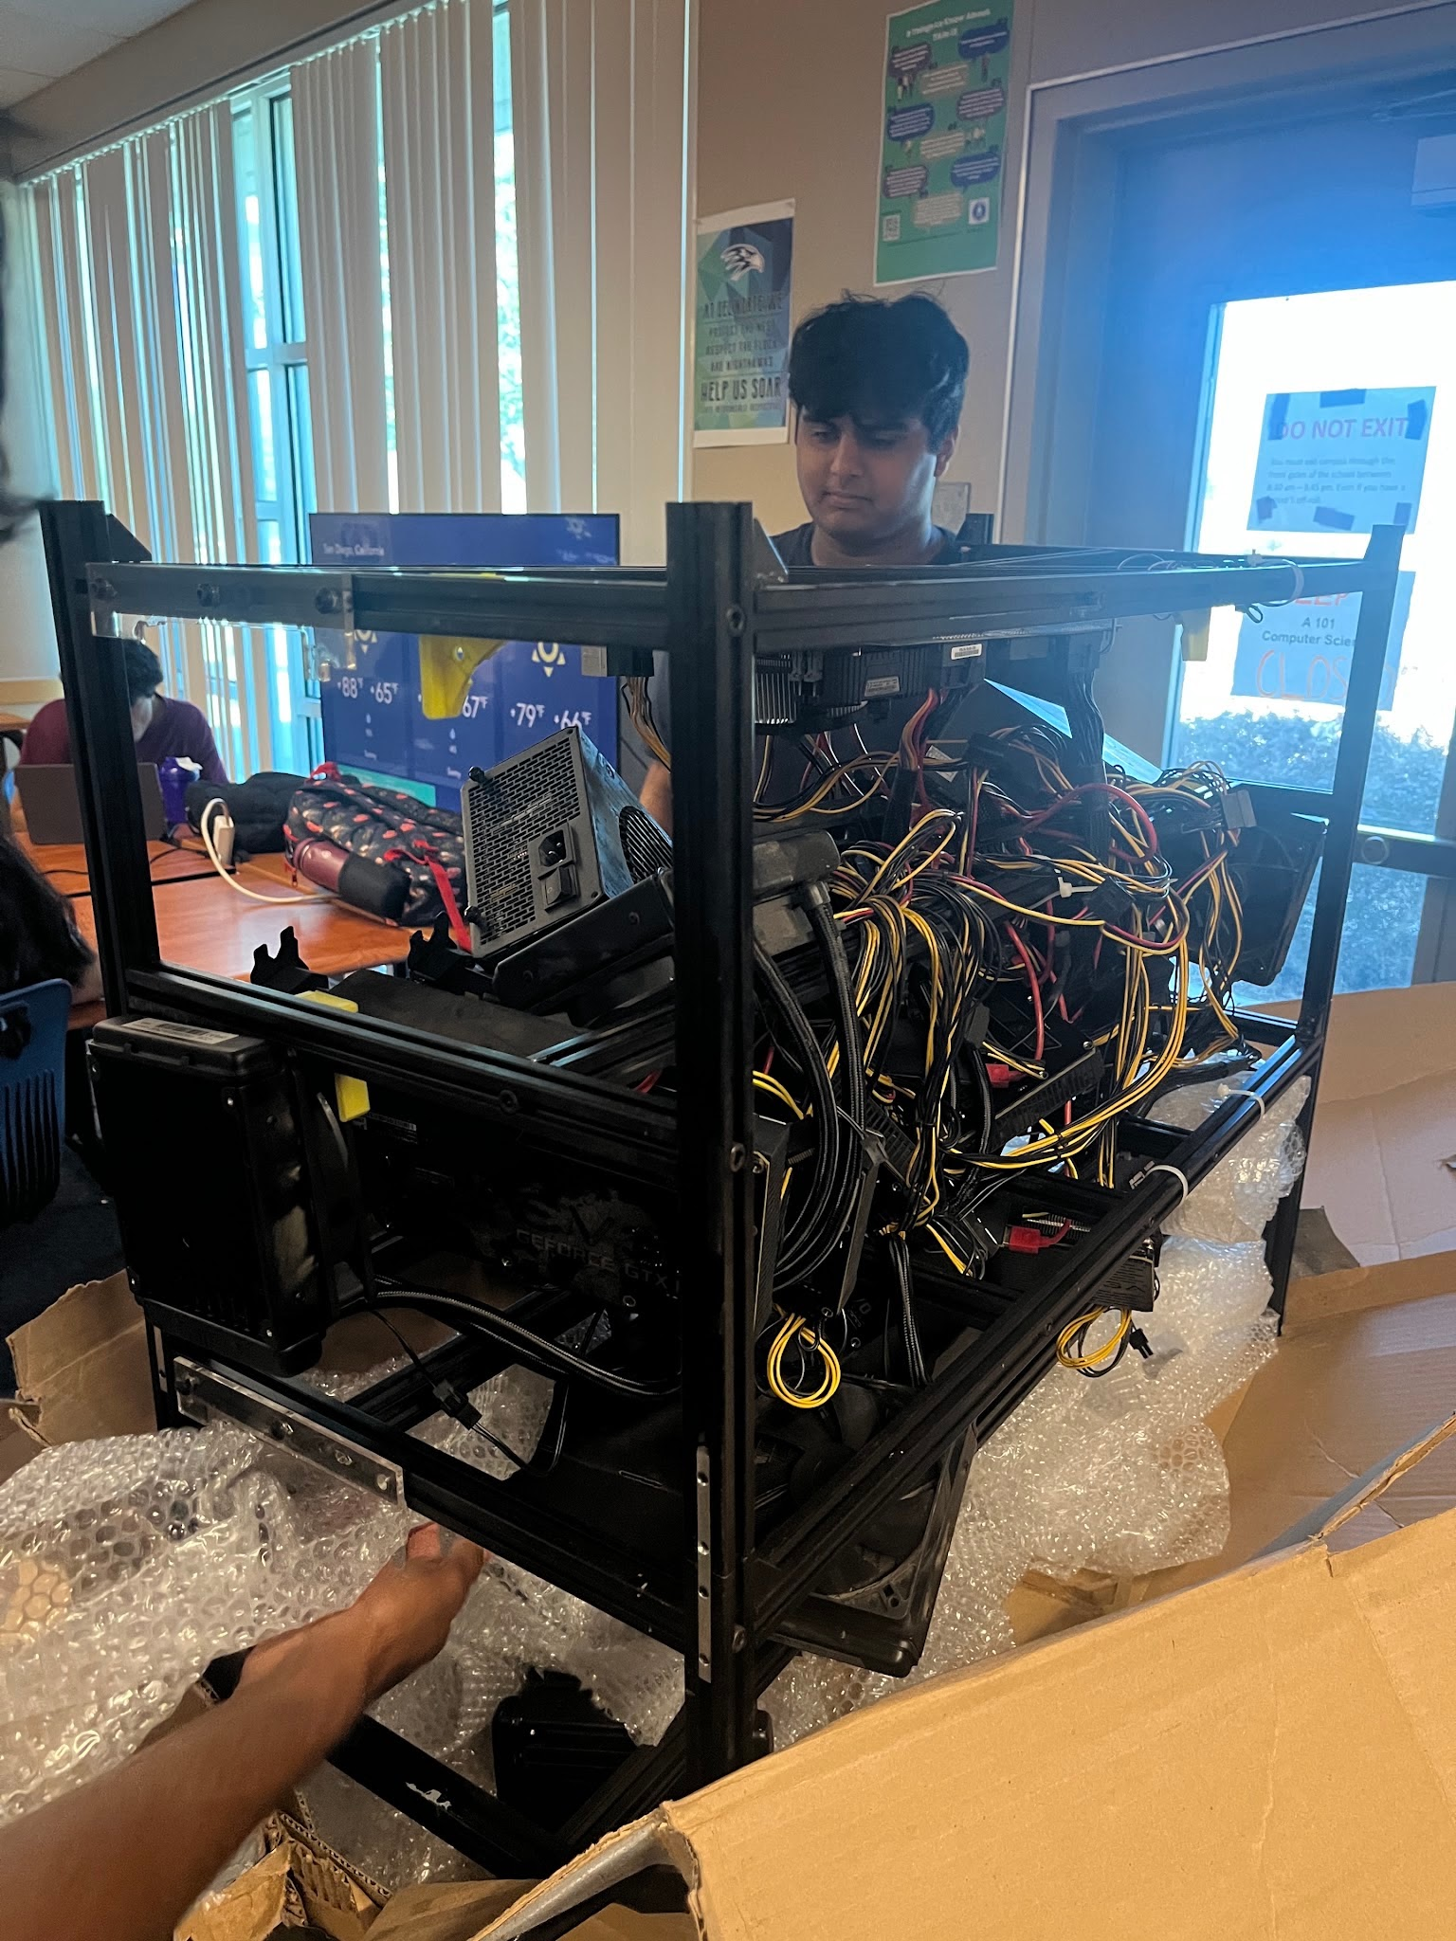
SCHEDULING
What it looks like
OCS INTELLIGENCE · 25 / 36
Notes:
Yash

Slide 26
TEAM STRUCTURE
Seven workstreams, one architecture
Workstream | Responsibilities
Cloud / API | EC2, NGINX, FastAPI, authentication, public endpoint
Networking | NetBird deployment, peer connectivity, P2P vs. relay testing
GPU runtime | Drivers, CUDA, llama.cpp, model benchmarks, rig builds
Broker / scheduler | Worker registry, queues, session & GPU assignment, failover
Observability | Health checks, logs, queue depth, latency, GPU utilization
Docs / testing | Issues, setup guides, architecture diagrams, experiment results
Core contributors across the sprint: Mihir B, Aditya K, Nikhil M, Yash P, Yash Patil, Anvay V
OCS INTELLIGENCE · 26 / 36
Notes:
Anvay

Slide 27
ROADMAP
The six-week pilot campaign
Week | Goal | Done when
0 | Authorize discovery | Gate 0 packet signed
1 | Prove one lane end-to-end | Reinstall from scratch; baseline numbers recorded
2 | Pick the model | Bake-off decision record; winner + fallback chosen
3 | Scale up, lock down | Gateway, keys, quotas, health checks live
4 | Observe and attack | No critical issue still open
5 | Pilot with a limited cohort | Pilot evidence complete, N@TM package frozen
6 | Decide, then showcase | Continuity drill, sponsor review, N@TM gallery night
OCS INTELLIGENCE · 27 / 36
Notes:
Yash

Slide 28




TESTING
Breaking it on purpose
Testing runs smoke → baseline → sustained → burst → soak → abuse, plus five named failure simulations before anything reaches students.
SPECTER
FORGE
RED TEAM
SOVEREIGN
ORACLE
Capacity — push load past the limit
Component loss — kill a rig mid-request
Prompt injection & adversarial input
Governance — decision & sign-off drill
Continuity — recovery after a stop
Quality bar: a frozen 56-task test set, blind-graded by two reviewers, before we call any model a pass.
OCS INTELLIGENCE · 28 / 36
Notes:
Yash

Slide 29
SAFETY
Safety isn't an afterthought
CONTROLS IN FRONT OF THE ENDPOINT
KILL & PIVOT CONDITIONS
Auth gate + strict account controls
Open signups disabled
Per-IP rate limiting at NGINX
Shared secrets rotated before multi-replica rollout
Hard stop-immediately triggers, defined up front
Pivot path if the model class can't do the job
Pivot path if the rack can't sustain load
No fine-tuning during the six-week campaign
All code is open-sourced; ownership of the build stays with the students. Principal & CTE specialist briefed directly as our sign-off path.
OCS INTELLIGENCE · 29 / 36
Notes:
Mihir

Slide 30
STATUS
Where we actually are
PHASE 0
PHASE 1
PHASE 2
PHASE 3
PHASE 4–6
Architecture
Smallest E2E proof
Health & registration
Queue & scheduling
Sessions, scale, prod/dev split
Done
Live
Next
Planned
Planned
Live today: the public serving path (NetBird + relay + Open WebUI). Still ahead: broker, scheduler, and worker health.
OCS INTELLIGENCE · 30 / 36
Notes:
Adi

Slide 31
MILESTONE
Ground Zero, closed out
16
1
2
GTX 1070s assembled and verified across two rigs
Public HTTPS endpoint live, serving real student traffic
Tunneling dead-ends documented so nobody repeats them
0
27B
7
Dollars spent on per-seat AI subscriptions
-parameter model chosen and running, not just planned
Workstreams scoped with owners, not one undivided task
OCS INTELLIGENCE · 31 / 36
Notes:
Nikhil

Slide 32
BACKLOG
Immediate next-sprint backlog
P0
Prove the GPU runtime
Driver + llama-server + one GGUF model → one documented API response, benchmarked.
P1
Prove private connectivity
NetBird across control node, and GPU node — P2P vs. relay, RTT recorded.
P2
Build one EC2 worker
Identity, /health, heartbeat, job state, and a forward path to llama-server on each rig.
P3
Minimal broker
FastAPI + Redis registries, a job queue, and least-busy healthy-worker scheduling.
P4
First end-to-end demo
One prompt crosses client → broker → GPU → back, with logs at every hop.
OCS INTELLIGENCE · 32 / 36
Notes:
Yash

Slide 33


NEXT STEPS
Make the rigs legible
Anyone walking up to the rack should know which rig is which, which cards are alive, and exactly where a failure is — without SSH-ing in.
01
02
03
Label the rigs
Label every GPU
Split rigs into subgroups
Clear physical labels on Rig 1 and Rig 2 so Mr. Mortensen knows which rig is where — and what each one does.
Each card tagged functional and active, so the state of all sixteen cards is visible on the rack itself.
Group cards by physical location so a failure points to an exact spot — and we can show what each rig does and the impact it creates.
IN PROGRESS
Playbooks for Week 0 and Week 1
DRAFTED
Full-stack E2E flowchart — slide 9
OCS INTELLIGENCE · 33 / 36

Slide 34
NEXT STEPS · HOW WE SCALE
Crawl, walk, run
Start slow while we learn, get better as we do more, then deploy — each stage earns the next.
CRAWL
WALK
RUN
Learn it by hand
→
Make it visible
→
Deploy and self-heal
Week 0 & Week 1 playbooks
Every fix done manually and written down
Labeled rigs, labeled GPUs
Subgroups that pinpoint physical failures
One E2E map of the whole stack
Autonomous agentic AI in a self-healing loop
Very high uptime without constant human intervention
THE LOOP
Open question: how does the agent keep uptime very high without a human in the loop for every fault?
Detect
→
Diagnose
→
Repair
→
Verify
→
Log
↻
OCS INTELLIGENCE · 34 / 36

Slide 35


VISION
Beyond the pilot
VR build tutorial & visualizer
Multi-GPU / multi-rig scale
Full observability stack
A Quest 2 walkthrough of assembling the rig, plus a live 3D view of a request lighting up from client to card.
Rig 1 promoted to production, Rig 2 as standby & overflow, with tested failover between them.
GPU exporter → Prometheus → Grafana, replacing “SSH in and read logs” with real dashboards.
Week 6 closes with a continuity drill and sponsor review — then the frozen demo package goes on display at Night at the Museum, our schoolwide gallery showcase.
OCS INTELLIGENCE · 35 / 36
Notes:
Yash Patil

Slide 36

Thank you
Questions?
github.com/Open-Coding-Society · OCS-Intelligence
OCS Intelligence — built by students, running on hardware we own, serving free coding models to every OCS student.
OCS INTELLIGENCE · 36 / 36
Notes:
Everyone

