Slide 1
Disentangling mixed-effects models.
R Users
04/19/21
Dan A. Greenberg

Slide 2
Mixed-effects models (also termed hierarchical or multi-level models) allow one to formally incorporate and distill the variance in our data that arises from non-independence and correlation structures that are inherent to our sampling designs
Eg…
Multiple samples collected among sites
Sites sampled from different regions or ecosystems
Samples collected at different periods of time
Repeated measures taken on the same individual or population
Samples from different species among different taxonomic groups
For data collected in nature - there are almost always these hierarchical sources of variance

Slide 3
Dealing with non-independence
If you have data that is clustered - eg. multiple samples from different sites or time periods or species - how can we achieve independent and unbiased estimates in an analysis?

Slide 4
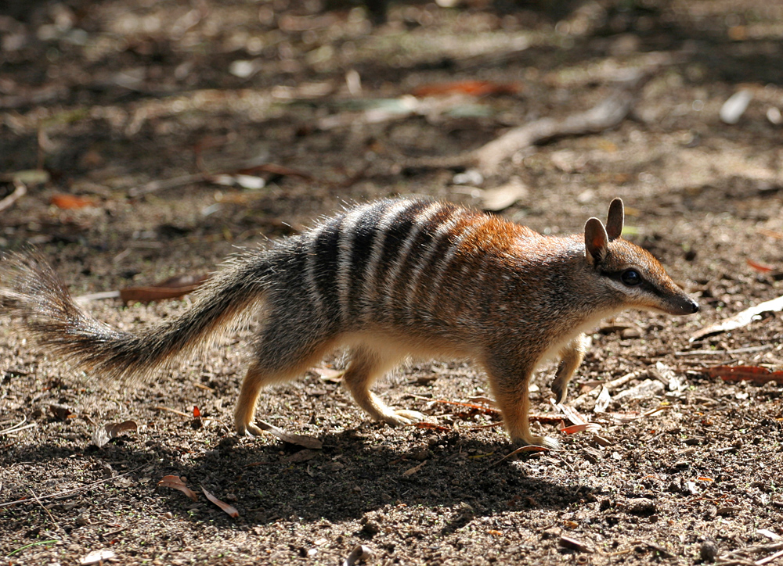
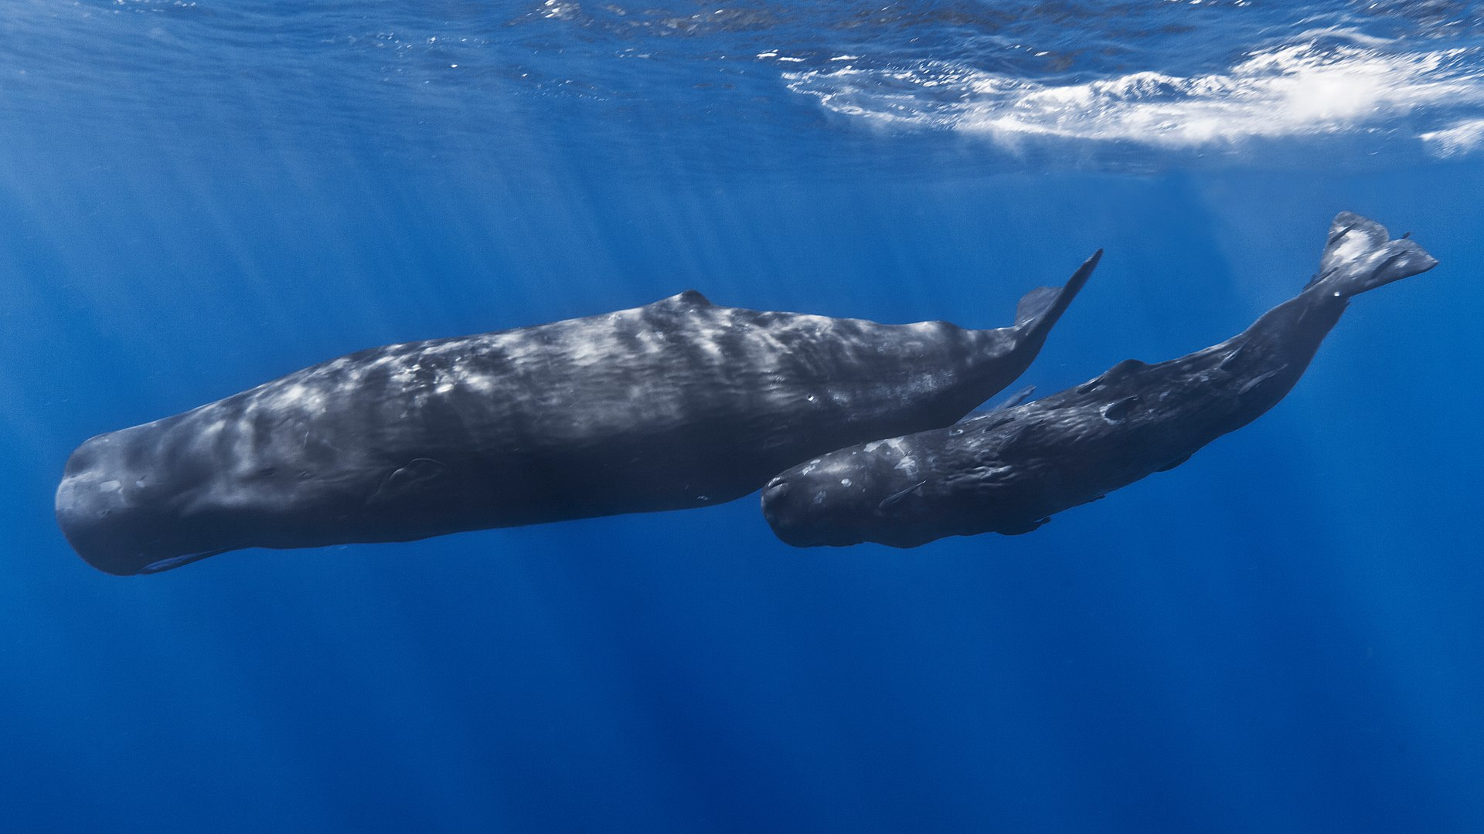
Example dataset:
Mammal life history data – Myhrvold et al. 2015 (https://esajournals.onlinelibrary.wiley.com/doi/abs/10.1890/15-0846R.1)
We’ll fit variations of the simple linear regression
Yi = ɑ + β*Xi + 𝜀 𝜀 ~ N(0, 𝜎)
Or
Yi ~ N(ɑ + β*Xi, 𝜎)
In this case we will examine how longevity scales
with body size among 12 mammal orders:
log(longevity) ~ N(ɑ + β*log(body size), 𝜎^2)

Slide 5
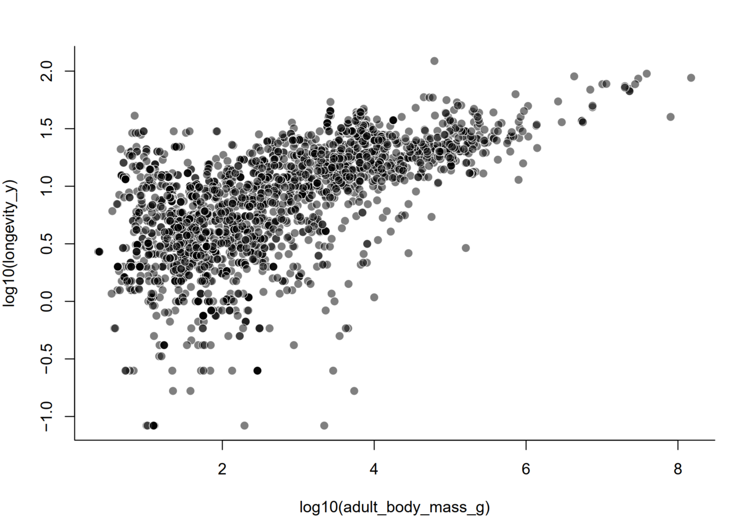
How does longevity vary with respect to body size among 12 orders and ~2500 species of mammals?

Slide 6
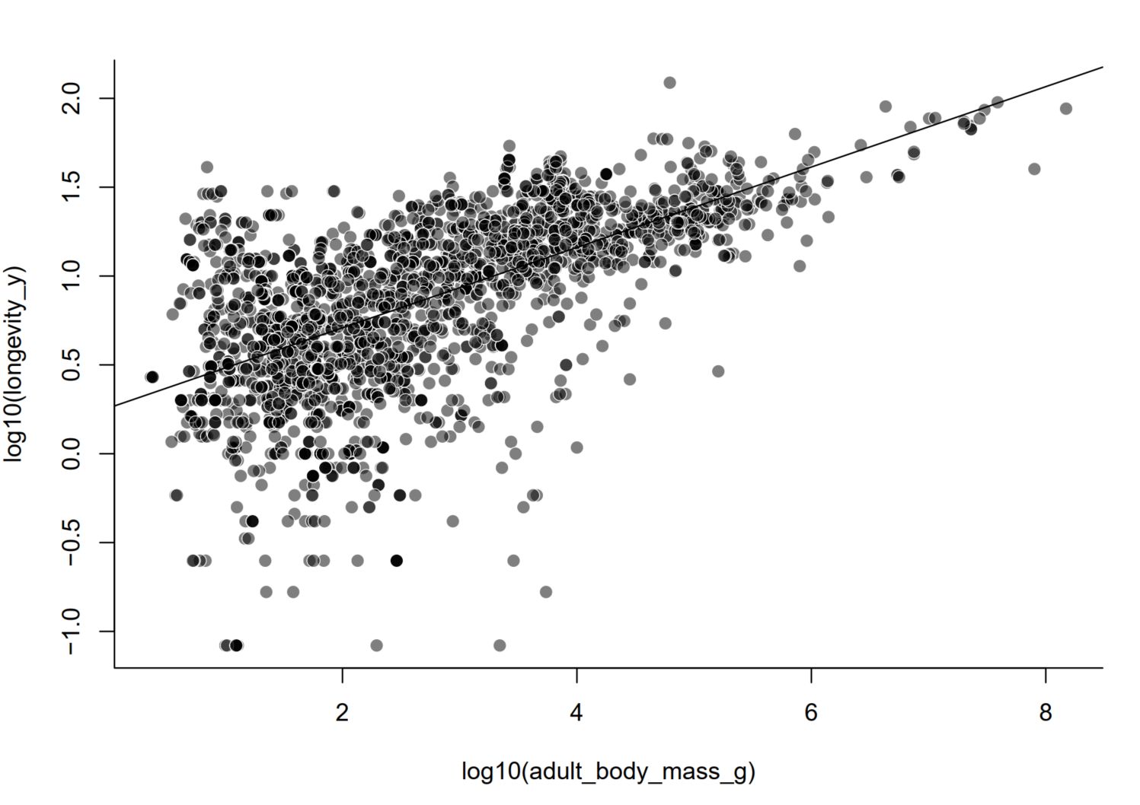
How does longevity vary with respect to body size among 12 orders and ~2500 species of mammals?

Slide 7
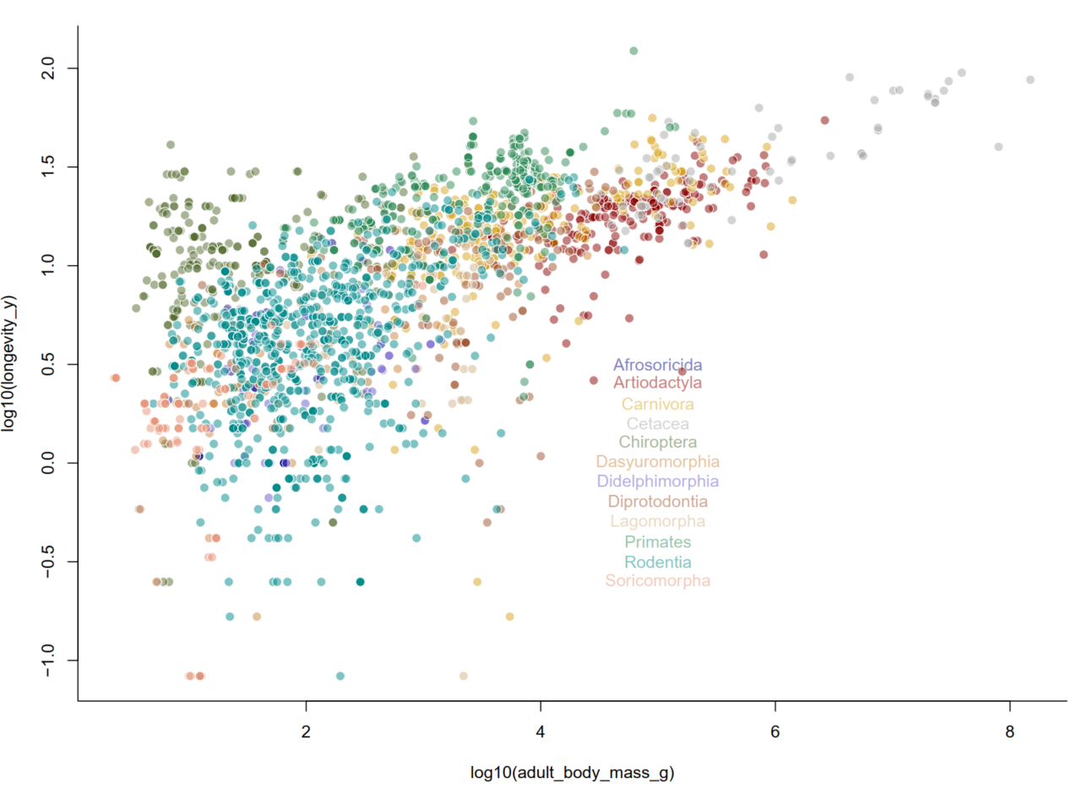
How does longevity vary with respect to body size among 12 orders and ~2500 species of mammals?

Slide 8
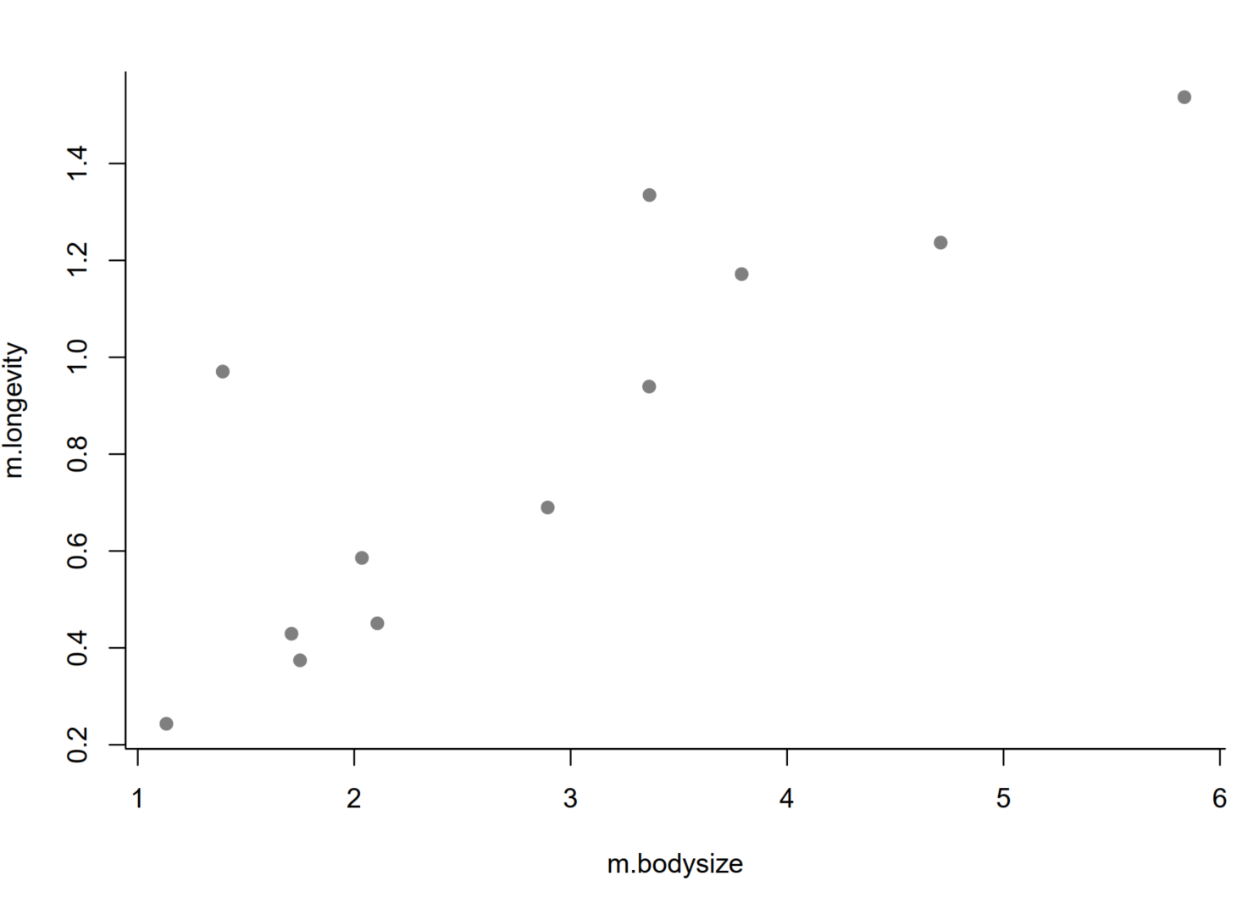
Option 1: one solution is to simply take the mean longevity and body size for each order, and now you have independent samples
This results in a large loss of information and lower power (reduction in sample sizes)

Slide 9
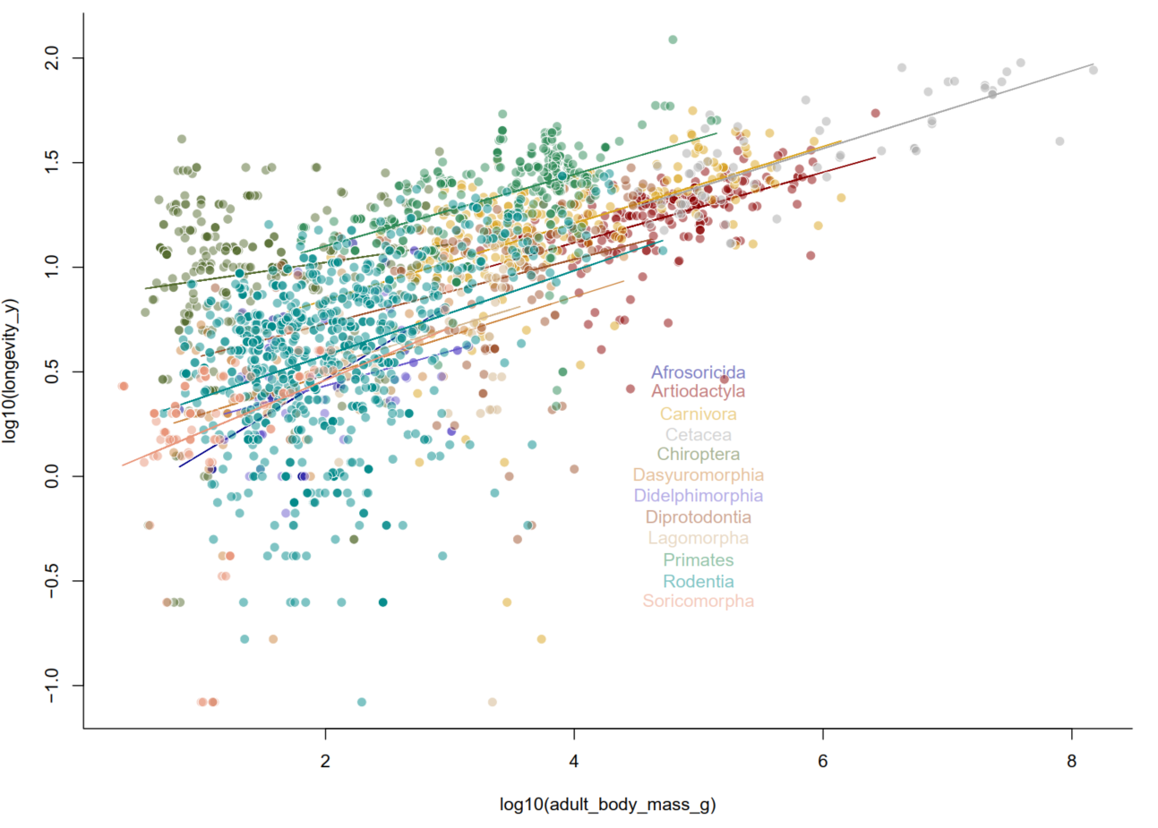
Option 2: Run separate models for each order

Slide 10
Option 3: Why you’re here, mixed-effects model.
What does it mean when your effects are mixed...
Random effect - a parameter that deviates (randomly) according to a given subject (eg. group, population, etc.)
Fixed effect - a parameter that does not vary (ie. it is always the same for all observations)

Slide 11
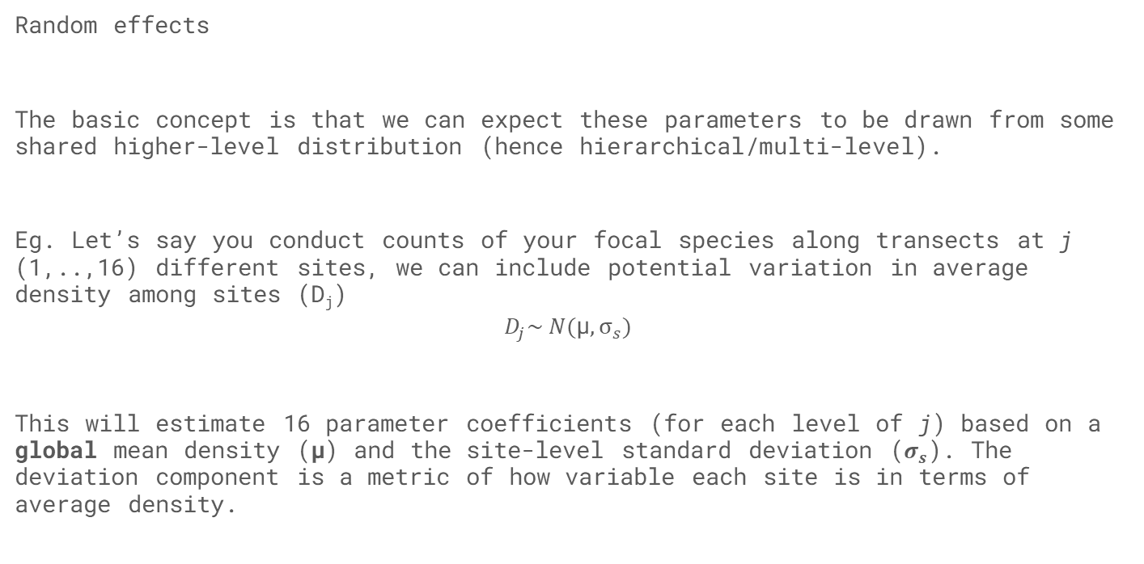
Random effects
The basic concept is that we can expect these parameters to be drawn from some shared higher-level distribution (hence hierarchical/multi-level).
Eg. Let’s say you conduct counts of your focal species along transects at j (1,..,16) different sites, we can include potential variation in average density among sites (D_{j})
$$D_{j}\sim N(\text{μ}, σ_{s})$$
This will estimate 16 parameter coefficients (for each level of j) based on a global mean density (μ) and the site-level standard deviation ($σ_{s}$). The deviation component is a metric of how variable each site is in terms of average density.

Slide 12
Partial pooling and shrinkage
Practically this means that estimates from group 1 are informative for groups 2, 3,...n. This concept relates to partial pooling of variance.
For random effects, because they are assumed to be randomly drawn from a shared distribution, the information from one group is informative for others.
This results in estimates being drawn towards the global mean (shrinkage) – groups with smaller sample sizes will have experience more shrinkage. Why do this? You’ll get a better prediction (James-Stein paradox)

Slide 13
R. McElreath (Statistical Rethinking):
Many statistical models also have anterograde amnesia. As the models move from one cluster—individual, group, location—in the data to another, estimating parameters for each cluster, they forget everything about the previous clusters. They behave this way, because the assumptions force them to. Any of the models from previous chapters that used dummy variables to handle categories are programmed for amnesia. These models implicitly assume that nothing learned about any one category informs estimates for the other categories—the parameters are independent of one another and learn from completely separate portions of the data. This would be like forgetting you had ever been in a café, each time you go to a new café. Cafés do differ, but they are also alike.

Slide 14
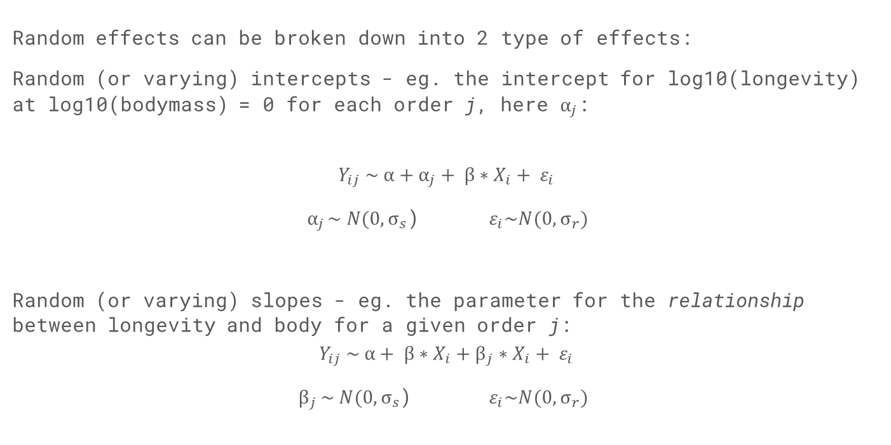
Random effects can be broken down into 2 type of effects:
Random (or varying) intercepts - eg. the intercept for log10(longevity) at log10(bodymass) = 0 for each order j, here $α_{j}$:
$$Y_{ij} \sim α+α_{j}+ β∗X_{i}+ ε_{i}$$
${ α}_{j }\sim N(0, σ_{s}$) $ε_{i}\sim N(0, σ_{r})$
Random (or varying) slopes - eg. the parameter for the relationship between longevity and body for a given order j:
$$Y_{ij} \sim α+ β∗X_{i}+β_{j}∗X_{i}+ ε_{i}$$
$β_{j }\sim N(0, σ_{s}$) $ε_{i}\sim N(0, σ_{r})$

Slide 15
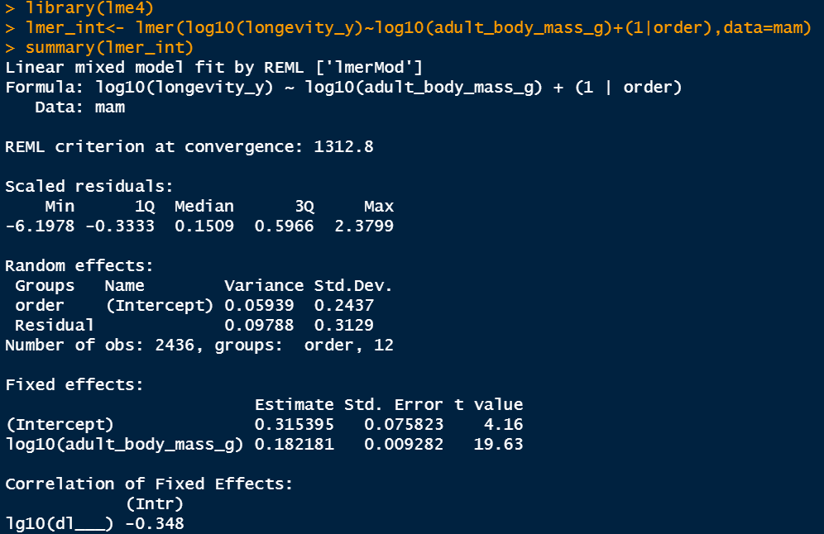
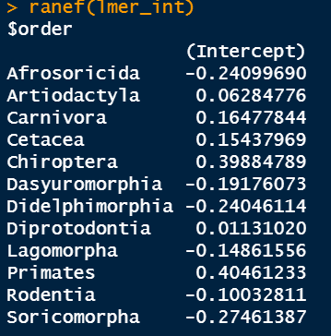

Slide 16
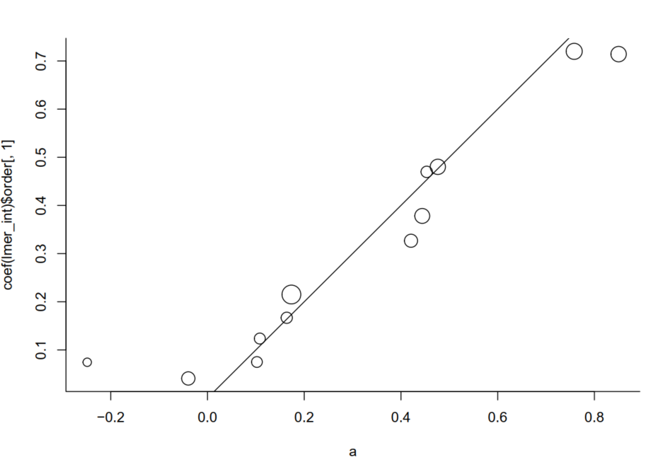
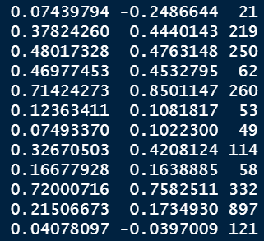
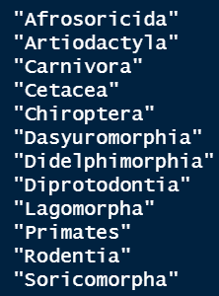
Comparing fixed vs. random intercepts for order...

Slide 17
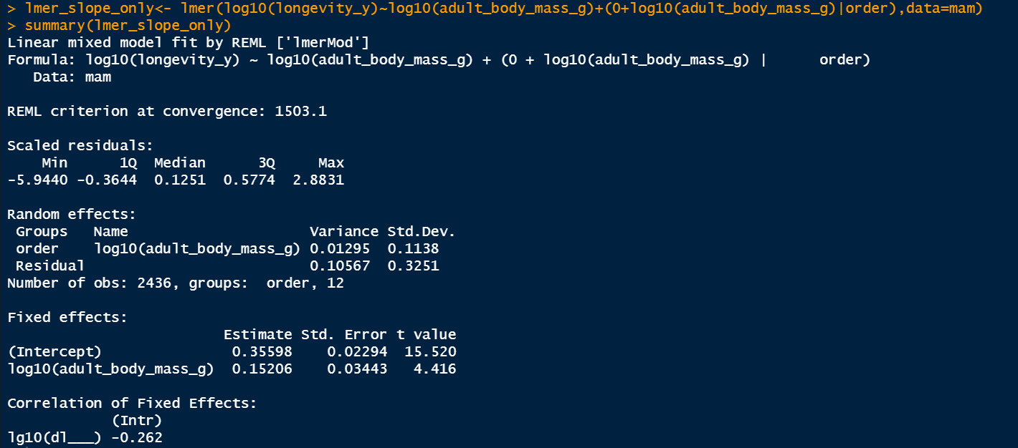
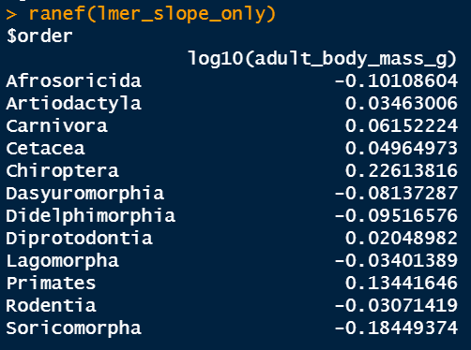
Random slopes only

Slide 18
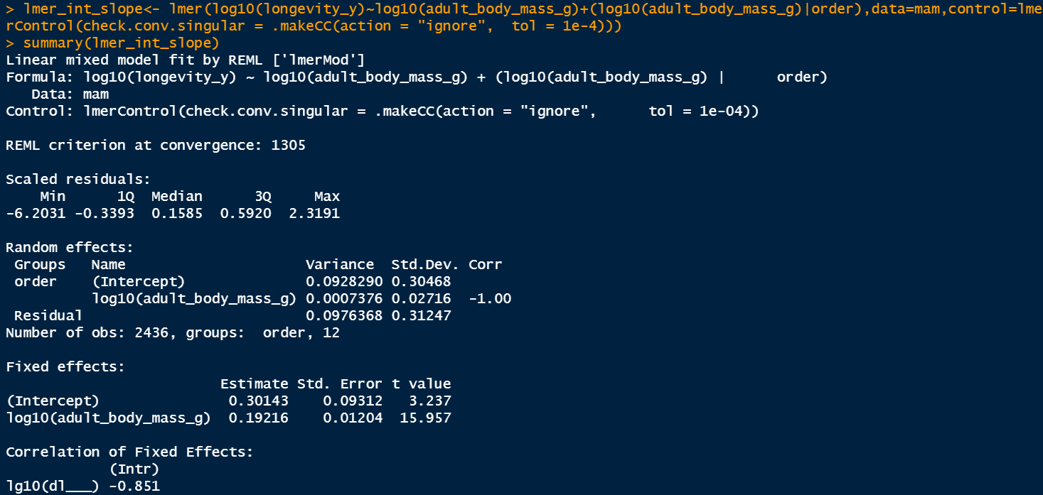
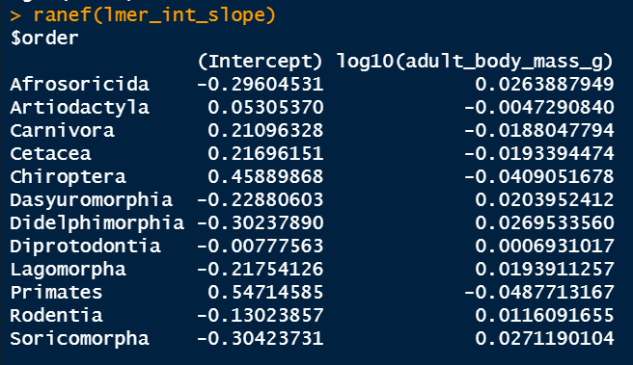
Random intercepts and slopes…

Slide 19
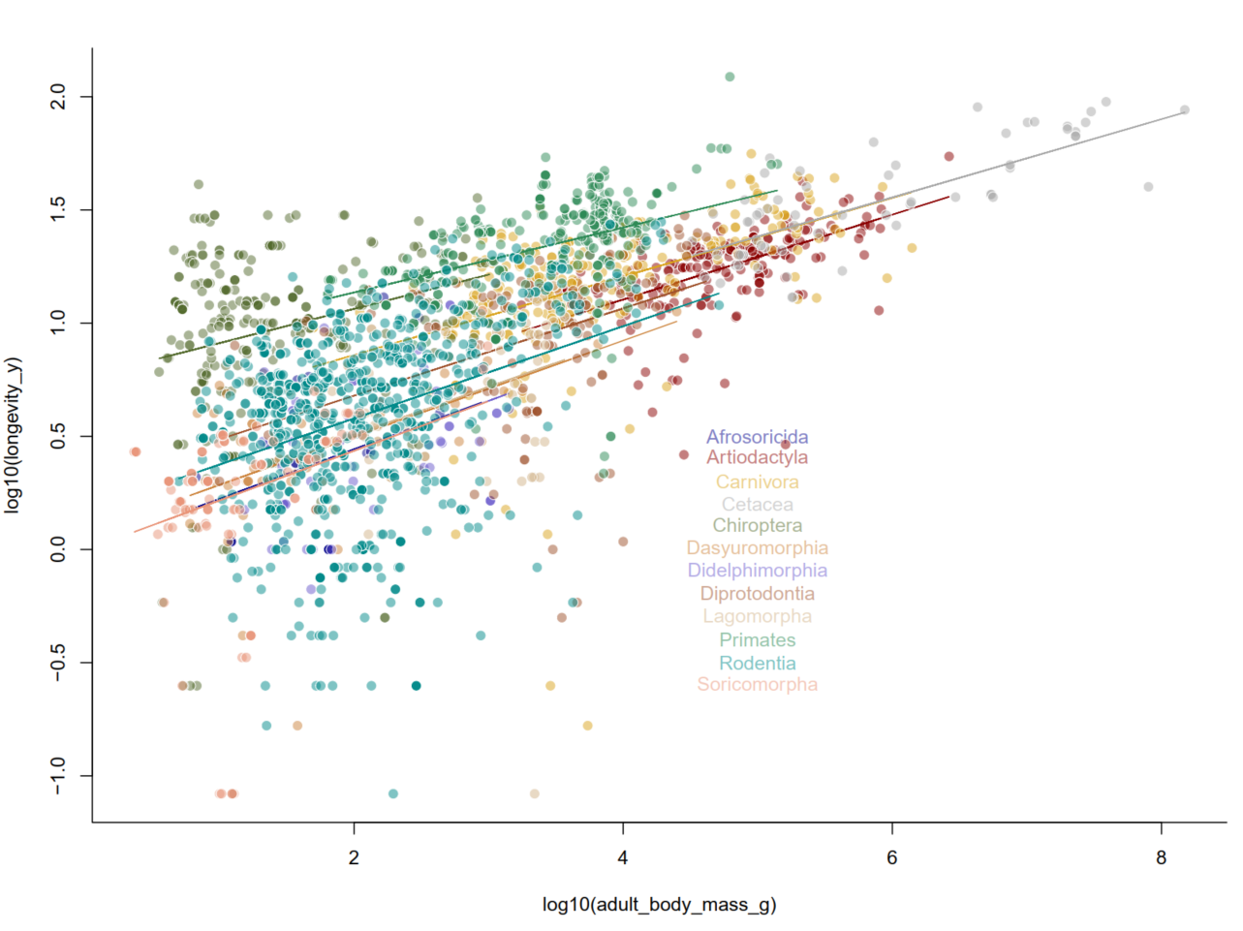

Slide 21
Variance partitioning
We can breakdown all the sources of variance in the data from our model
These can be:
Variation explained by fixed effects
Variation explained by higher level groups (ie. random effects)
Residual variation

Slide 22
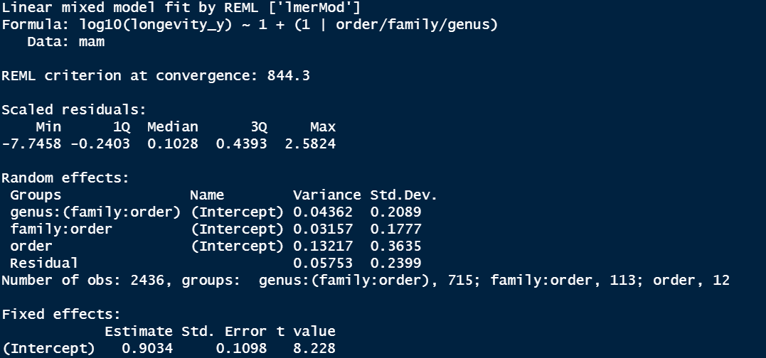
Variance partitioning

Slide 23
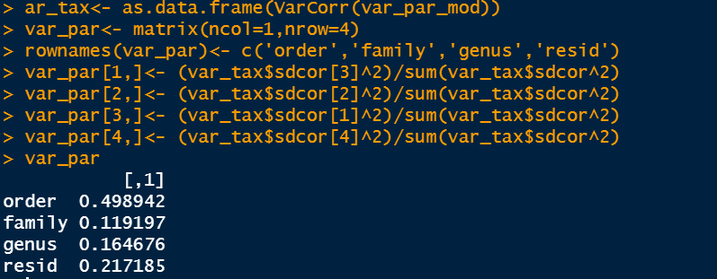
Variance partitioning

Slide 24
Final thoughts
Nested vs. Cross random effects:
Nested – inherent hierarchy to the random effect levels, e.g. site within a region = (1|region/site); month within a year (1|year/month)
Crossed – multiple measurements over multiple grouping variables – e.g. different observers visiting different sites: (1|observer) + (1|site)
Sample sizes for random effect levels – the foundation of random effects is that the effect of group j is drawn from a normal distribution. To characterize a normal distribution you generally need a minimum number of levels (5+).

Slide 25
Take home
Mixed-effects models are extremely useful to account for the sources of variation that structure our data in nature
Random (varying) effects allow one to draw information among groups to improve our estimates and provide robust ‘global’ effects after accounting for group differences
You can also break down the sources of variation in your model, which can be useful for to understand how variation scales across the hierarchy

