Slide 1
COMODO2
L. Andolfato
17/09/2020

Slide 2

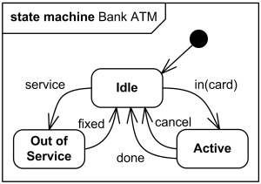



Model Transformations
Transformation
ModelToModel (M2M) or ModelToText (M2T)
Endogenous or Exogenous
Unidirectional or Bidirectional
…
Model
Abstract (few details)
Platform Independent
Graphical or Textual
General Purpose or Domain Specific Language
Generated Artifacts
Concrete (more details)
Platform Dependent
Textual
General Purpose to be compiled or interpreted
Assumptions

Slide 3
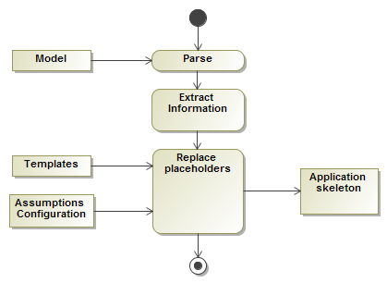
Creating M2T Transformations
STEP 1
Parse the model
Validate model (optional)
STEP 2
Extract/search information
STEP3
Replace in the templates the placeholders using information from the model, configuration, assumptions
There are specialized programming languages to
Validate Model: Check, …
Efficiently navigate models (graphs): Xtend, Xtend2, …
Write templates and replace placeholders: Xpand, Xtend2, Acceleo, JET, …
EELT INS Application Skeleton

Slide 4
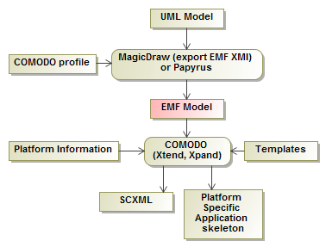
COMODO
Platform independent toolkit for model transformation to generate SCXML model and platform specific application skeleton.
It supports different target platforms: SCXML, ELT-RAD, VLT, ACS, Java+RabbitMQ, Java+JavaPathFinder
COMODO profile allows to model:
Modules and components
State Machines
Command and pub/sub Interfaces
Data structures
Deployment

Slide 5
Motivation for COMODO2
COMODO tool was developed using:
Application Structure and Config: plain Java
Model Transformation Workflow: MWE (interpreted DSL)
Model Representation: EMF (Ecore & UML2, Java)
Model Validation: Check (DSL transformed to Java)
Model Navigation: Xtend (DSL transformed to Java)
Templates: Xpand (DSL transformed to Java)
Xpand, Xtend, Check declared obsolete -> replaced by Xtend2 (a “better” Java)
MWE obsolete (since long) -> replaced by MWE2

Slide 6
COMODO2v1
Replaced Xpand, Xtend, Check with Xtend2 (~2 weeks for SCXML, MAL, RAD).
Model Validation: disabled
With Xtend2 (or Check), it is easy to validate the whole model.
Now the tendency is to work with large models but only few packages are for code generation -> we need to validate only some packages
Model Validation is more effective when Modeling (use MagicDraw validation rules)
Very few rules
Model Transformation Workflow: MWE -> MWE2
Model Navigation: Xtend -> Xtend2
Templates: Xpand -> Xtend2
COMODO Profile: minor changes for CII/MAL Exception + Types

Slide 7
COMODO2v2
Replaced Xtend2 with Java (~1 week, still some work).
Xtend2:
DSL on-the-fly transformed to Java and then compiled to jar (2 steps).
Xtend and Xtend2 require some learning (functional programming).
Generated Java code not optimal.
Model Validation: disabled
Model Transformation Workflow: MWE -> MWE2
Model Navigation: from Xtend -> Xtend2 -> Java (using directly Google Guava)
Templates: from Xpand -> Xtend2 -> Java + TemplateString (or multiline string)
COMODO Profile: minor changes for CII/MAL Exception

Slide 8
COMODO2
GIT: https://gitlab.eso.org/ifw/comodo2
COMODO2 can be compiled and installed with “waf install” on ELT DevEnv
COMODO2 can be used within Eclipse (as it was the case for COMODO)
COMODO Profile is on MD Teamwork Cloud (Common Profiles and Libraries/comodoProfile)
COMODO2 supports the following target platforms:
SCXML (scxml-model.xml)
ELT-MAL (MAL-ICD.xml)
ELT-RAD (scxml-model.xml, MAL-ICD.xml, C++ RAD application)
Do we need support for other targets?

