Slide 1
SysML in Telescope Modeling
Credit to members of the ESO, OMG, INCOSE, and the MBSE initiative to use some of their material
Notes:
C

Slide 2
Agenda
Introduction to Model Based Systems Engineering (MBSE)
Overview of the SysML
INCOSE's MBSE Vision & Initiative
Challenge team for Telescope Modeling

Slide 3
Introduction to Model Based Systems Engineering
Notes:
MBSE-Online-Summit Proceeding II 2009

Slide 4
MBSE Definitions
Model-based systems engineering (MBSE) is the formalized application of modeling to support system requirements, design, analysis, verification and validation activities beginning in the conceptual design phase and continuing throughout development and later life cycle phases (INCOSE-TP-2004-004-02, Version 2.03, September 2007).
A model is an approximation, representation, or idealization of selected aspects of the structure, behavior, operation, or other characteristics of a real-world process, concept, or system (IEEE 610.12-1990), i.e. an abstraction.
A model usually offers different views in order to serve different purposes. A view is a representation of a system from the perspective of related concerns or issues (IEEE 1471-2000).
Notes:
A Systems Engineer takes care of seven major tasks: State the problem, Investigate alternatives, Model the system, Integrate, Launch the system, Assess performance, and Re-evaluate. Those tasks are defined by the International Council On Systems Engineering (INCOSE) which was established in the beginning of the 1990's in response to the ever increasing complexity of modern systems and the need to recognize systems engineering as a profession.
Its mission is to advance the state of the art and practice of systems engineering in industry, academia, and government by promoting interdisciplinary, scalable approaches to produce technologically appropriate solutions that meet societal needs. As part of this mission several strategic initiatives have been started, where one is the Systems Engineering Vision defining a 15 years view of the evolution of the systems engineering discipline.
MBSE-Online-Summit Proceeding II 2009

Slide 5

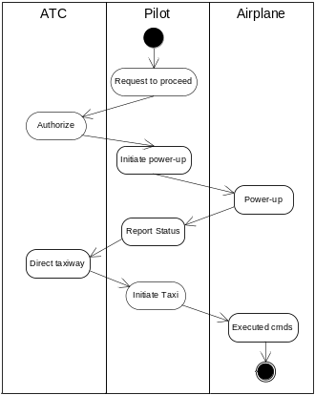
Past
Future
Specifications
Interface requirements
System design
Analysis & Trade-off
Test plans
Moving from Document centric to Model centric
Notes:
This initiative addresses several areas. The relevant area for this paper is Model-Based Systems Engineering (MBSE). It is considered one of the main means to tackle problems of current and future systems development.

Slide 6
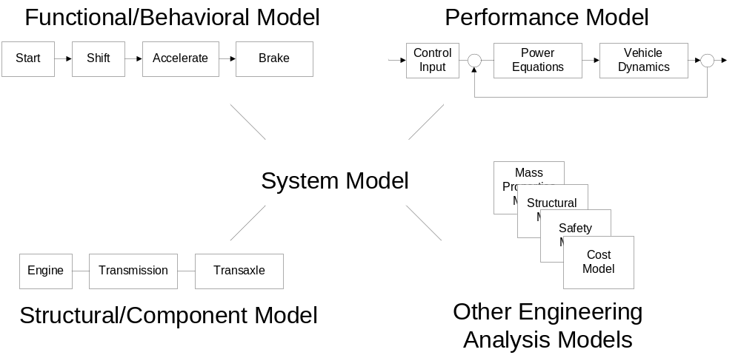
Requirements
Integrated System Model Must Address Multiple Aspects of a System
Notes:
The products of engineering fields cannot be designed and built standalone as they influence each other mutually and an optimal balance is to be found. In particular the interfaces cannot be conceived independently. Integrated and simultaneous engineering has to take place with the goal of designing an overall integrated system. The system has to be partitioned and the tasks distributed. A consistent integration of different system aspects and views is needed - a model. A set of models or aspects is considered consistent if they are abstractions of the same object, i.e. if at least one implementation exists of which the models are abstractions.
The main objective of a model is to provide the systems engineer the means to state the system problems comprehensively, to ensure that all requirements for a system are satisfied throughout the life cycle of the system and to develop a model on the basis of which a real system can be built, developed or deployed.
Taxonomy of models
Engineers in every field have always used models: physical models, architectural drawings specifications, prototypes, shop drawings, etc. In order to cope with complexity different models are required at different times. They can be classified in three basic categories:
Prescriptive Models: a predefined framework that serves as the basis for constructing a model of a system. They are the foundation for Descriptive Models.
Descriptive Models: a model used to depict the behavior or properties of an existing system or type of system; for example, a scale model or written specification used to convey to potential buyers the physical and performance characteristics of a computer (IEEE Std 610.3-1989).
Predictive Models: a mathematical model that predicts how some aspect(s) of a system will perform against specified boundary and initial conditions. They refer to all kinds of simulations (hardware in the loop, wind tunnel tests, etc.).

Slide 7
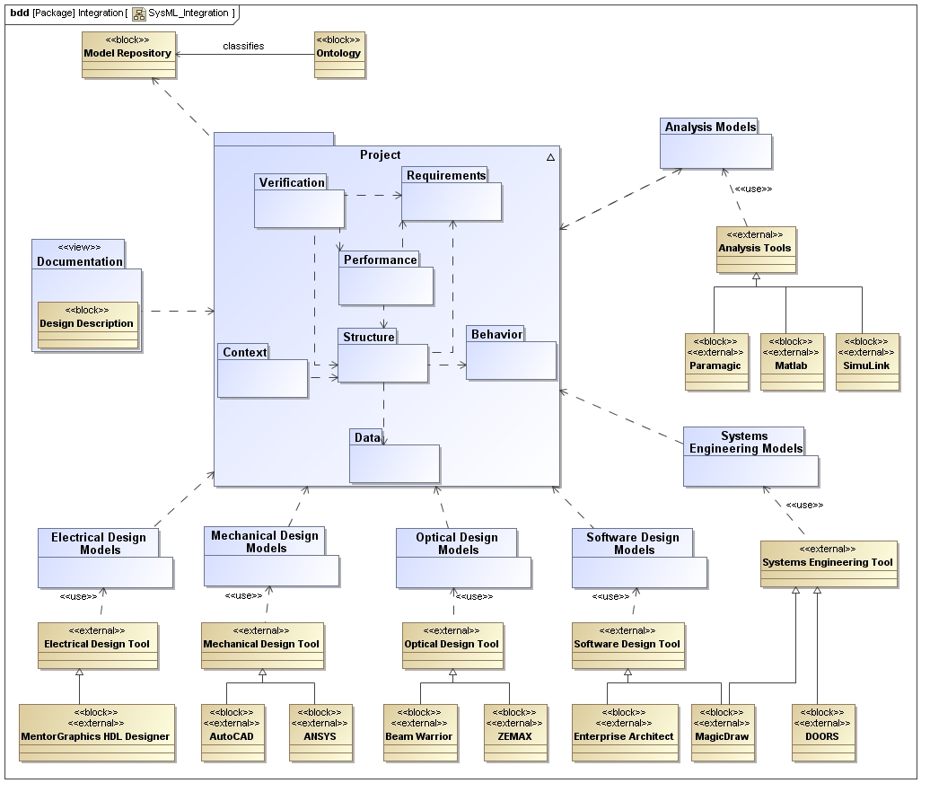
Notes:
The basic tasks of systems engineering, namely to focus on the system as a whole (its total operation), leading the concept development and bridging the traditional engineering disciplines, is also reflected in the model. A system model supports the understanding of the system as a whole, its operational objectives, and how all its parts work together.
Basic Requirements for MBSE:
Facilitate communication with client and builder and among builders.
Help to reduce and control uncertainty and maintain system integrity.
Support the process of scoping, aggregation, partitioning, integration, certification, and performance prediction.
Provide a consistent integration of a multiplicity of system aspects, views and models for mechatronic systems.
Provide an overview of high complexity systems
The models must be understood without extensive education or experience.
Everything expressed in the model must have a single, defined and obvious meaning.
Reduce ambiguities in particular in cross-cultural, cross-language projects (e.g. outsourcing activities) and natural language.
Provide conceptual overview to support all (sub-) contracting activities (for suppliers it is important to know what they are working for, otherwise innovation is restricted. A model helps to ensure a common understanding among them).
Provide to system maintenance the necessary understanding of how the parts of the system contribute to its mission.
MBSE-Online-Summit Proceeding II 2009

Slide 8
Overview of the Systems Engineering Modeling Language (SysML)

Slide 9
What is SysML?
Graphical modelling language for Systems Engineering
Supports the specification, analysis, design, verification, and validation of systems that include hardware, software, data, personnel, procedures, and facilities
Is a visual modeling language that provides
  Semantics = meaning
  Notation = representation of meaning
Is not a methodology or a tool
  SysML is methodology and tool independent
SysML is Critical Enabler for Model Driven SE
Notes:
SysML is only a graphical language. It defines a set of diagrammatics, modeling elements, a formal syntax and semantics. As any language (formal or informal) it can be used in many different ways and many wrong ways too. Most notably the creation of nonsense models is possible.

Slide 10
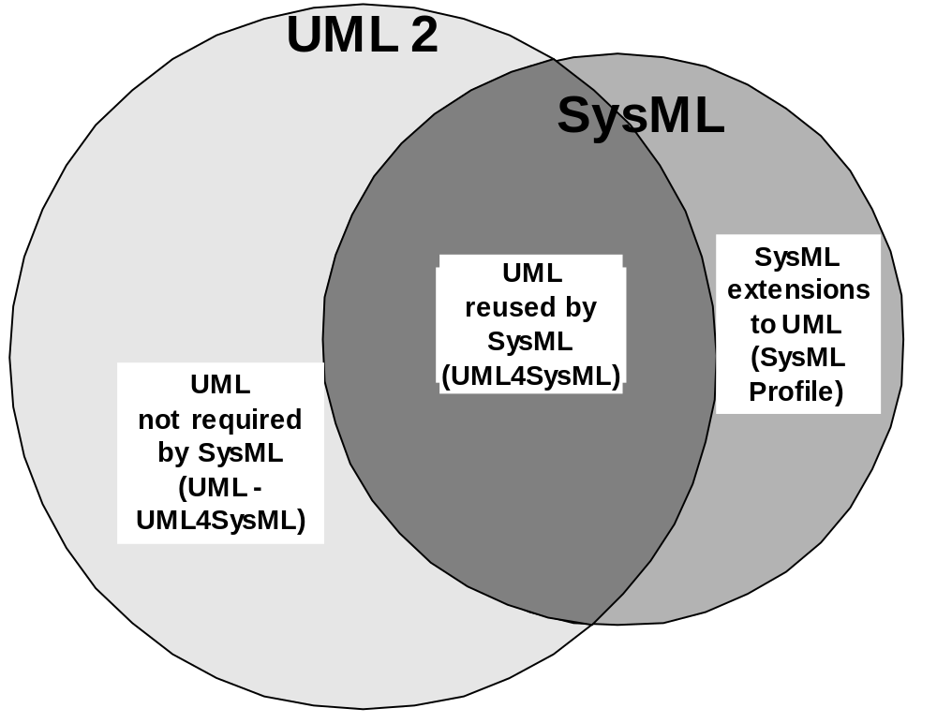
Relationship Between SysML and UML
SysML Extensions
Blocks
Item flows
Value properties
Allocations
Requirements
Parametrics
Continuous flows
…

Slide 11


Unified Modeling Language
Structure of notation (similar to database)
model is defined via diagrams
model consists of views and
modeling elements
model exists independant of
diagrams
relationship between
modeling elements can be
investigated dynamically
model
Use Case
Diagrams
class
diagrams
Sequence
diagrams
object
diagrams
<<block>>
Aufzug
<<block>>
Fahrkorb
n
+ / steuerungProt~
+ / fahrkorbProt
+ / lastkontrollPort~
Communication
diagrams
<<block>>
Lastkontrolle
+ / lastkontrollProt
Artifact
diagrams
+ / antriebProt
<<block>>
Antrieb
+ / steuerungProt~
State
diagrams
Activity
diagrams
Deployment
diagrams
modeling
elements
views

Slide 12
INCOSE’s MBSE Vision & MBSE Initiative
*Reference: SYSTEMS ENGINEERING VISION 2020
INCOSE-TP-2004-004-02, Version 2.03, September 2007
Notes:
INCOSE’s mission is to advance the state of the art and practice of systems engineering in industry, academia, and government by promoting interdisciplinary, scalable approaches to produce technologically appropriate solutions that meet societal needs.
Model-based systems engineering (MBSE) is the formalized application of modeling to support system requirements, design, analysis, verification and validation activities beginning in the conceptual design phase and continuing throughout development and later life cycle phases.
The main objective of a model is to provide the systems engineer the means to state the system problems comprehensively, to ensure that all requirements for a system are satisfied throughout the life cycle of the system and to develop a model on the basis of which a real system can be built, developed or deployed.
The products of engineering fields cannot be designed and built standalone as they influence each other mutually and an optimal balance is to be found. In particular the interfaces cannot be conceived independently. Integrated and simultaneous engineering has to take place with the goal of designing an overall integrated system.

Slide 13
MBSE Initiative Background
INCOSE held a series of workshops to formulate the MBSE Vision as part of the overall SE Vision 2020
Established MBSE Initiative to help realize the MBSE Vision
  Workshops, Articles, Webinars
Promote, advance, and institutionalize the practice of MBSE to attain the MBSE 2020 Vision through broad industry and academic involvement in:
  Research, Standards, Processes, Practices, & Methods, Tools & Technology, Outreach, Training & Education

Slide 14
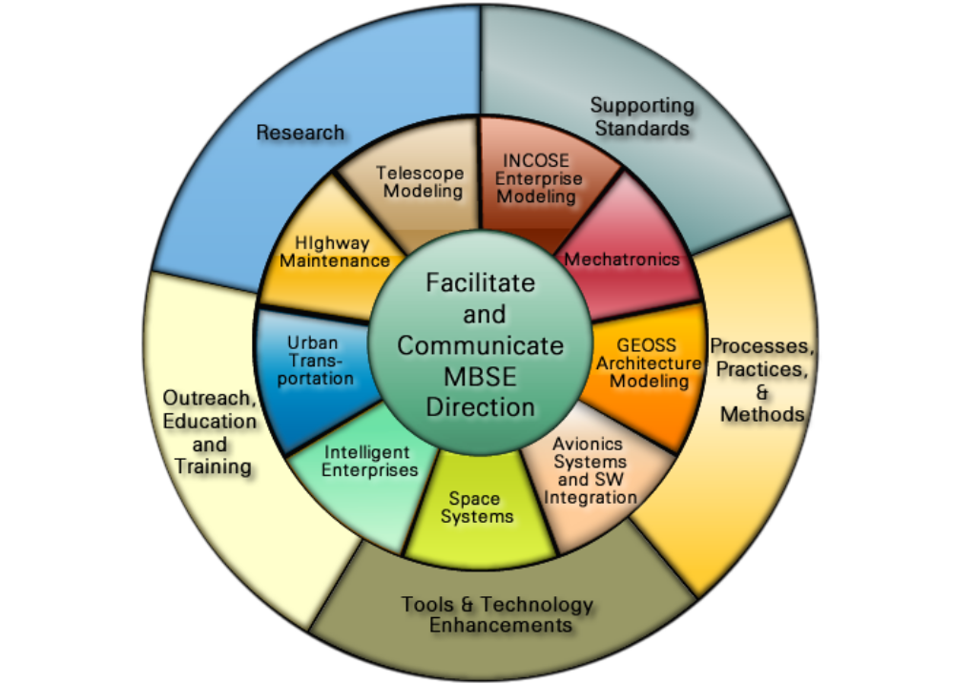
MBSE Initiative
Challenge Teams & Activities
Notes:
In this framework the European Southern Observatory (ESO) is collaborating with the German Chapter of INCOSE to form of a “MBSE Challenge” team.
The task is to demonstrate solutions to "challenging" problems using MBSE. The Active Phasing Experiment (APE), a European Union Framework Program 6 (FP6) project, has been offered as subject to the SE^2 Challenge team. There are several other active challenge teams and general roadmap activities.
MBSE-Online-Summit Proceeding II 2009

Slide 15
Challenge team for Telescope Modeling

Slide 16
About SE^3
Notes:
GfSE TdSE 2008, Bremen 13./14.Nov. 2008
Change team members

