Slide 1
Systems Engineering Concept Model (SECM)
Status 03/17/2016
John Watson

Slide 2
System Engineering Concept Model Agenda
Background
SECM High Level Approach
SECM Industry Reference Model
SECM – SysML V2 RFP
Approach
Expert Core Teams
Property and Expressions - SE Needs and Core Team
Interfaces - SE Needs
Notes:
Over all goal is to tell what we have done, what we are working on now and to say what’s next.

Slide 3
Resources - SECM Team
Contributors
Yves Bernard
Roger Burkhart
Sandy Friedenthal
Chas Galey
Rick Steiner
John Watson
Meet Weekly, Tuesday’s 11AM ET
Systems Engineering Concept Model Wiki
Tools
MagicDraw Modeling Tool
Teamwork Server
Team collaboration tool
Server and licenses provided by No Magic

Slide 4
SECM-Domain Goals and Overview
Task objective
Derive a data model that captures the core Systems Engineering concepts and vernacular
Derive the system modeling language requirements that will be used in the SysML V2 RFP
Use Cases
Systems engineers and other discipline engineers contribute to the development and maintenance of a system model throughout the lifecycle to support the system specification, design, analysis, and verification activities
MoE
The SysML V2 RFP requirements are clear and concise, and reflect the core Systems Engineering concepts and vernacular
High Level Intent/Driving Requirement:
(R1) The next-generation modeling language must express the core systems engineering concepts. This requires definition of a robust data model that reflects these concepts. The requirements that drove SysML derive from the original Systems Engineering Conceptual Model, jointly developed by the INCOSE/OMG/AP233 WG requirements team. Modifications and refinements to this model will occur in light of lessons learned over the last several years, and as necessary to express the core systems engineering concepts.

Slide 5


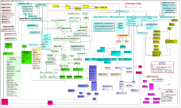


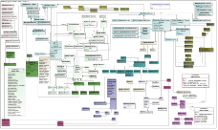
Systems Engineering Concept Model (SECM) Approach
INCOSE Systems Engineering Handbook V4
ISO/
IEC/IEEE 15288:
2015
V 1.5
SEBoK
V 0.5 Model
SECM – 2015 Industry Reference
SysML V2 Service Requirements
Other
OMG
Specs
Other Industry Ontologies
SECM - SysML V2 RFP
SysML V2 Spec
Meta-model
Profile
Libraries
SysML V2 RFP
SECM – 2003 Industry
Reference
*
Service Spec
(Standardized API)
User Interface
Guidelines
UML 4SE RFP
SysML V1.X Spec
* Joint INCOSE/AP233/OMG, Led by Dave Oliver

Slide 6
SECM - Industry Reference

Slide 7
SECM: 2015 Industry Reference
217 Concept Terms have been captured and defined in the model
23 Concept Diagrams Produced and Reviewed
2 additional Concept Diagrams are Under Construction
Review HTML Model Extracts are available on the Wiki

Slide 8
Examples of Diagrams Available
System Hierarchy
System Architecture
Environment
Configuration Management
Systems Thinking
System Thinking – Principles
Architecture Models
SEBoK Structure
Disciplines
Generic Life Cycle Model
Life Cycle
Requirement Traceability
SE Processes
Complexity and Emergence
Work Products

Slide 9
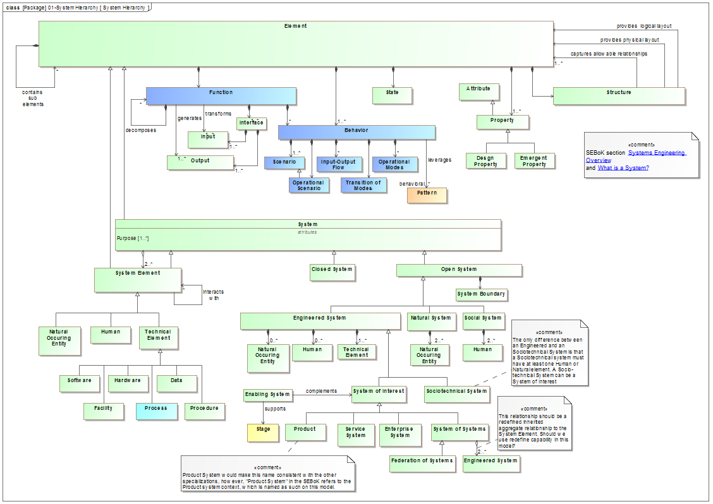
System Hierarchy

Slide 10
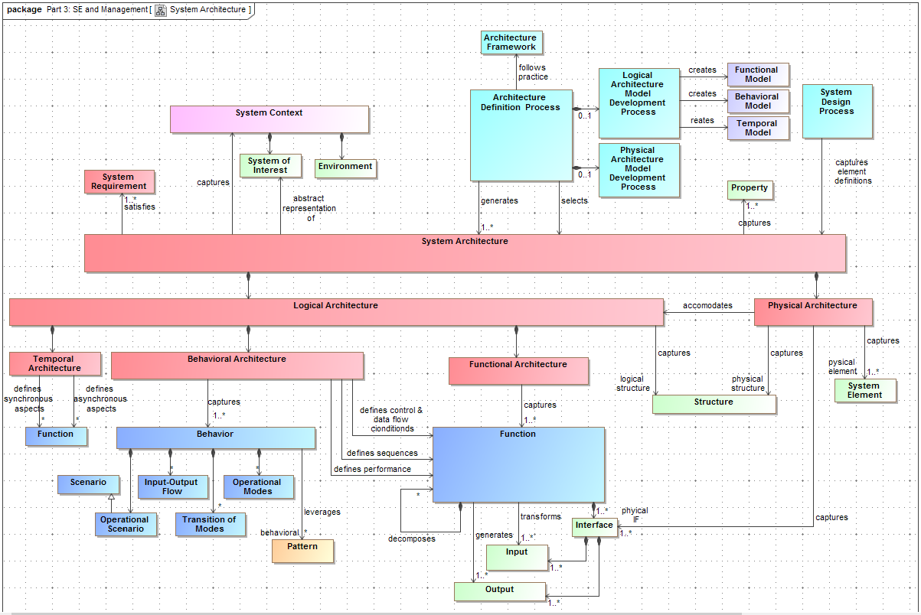
System Architecture
Notes:
To see more diagrams go to our wiki

Slide 11
SECM – SysML V2 RFP

Slide 12
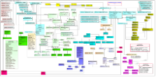
“SECM – SysML V2 RFP” Approach
SECM – 2015 Industry Reference
SE Concepts
Topic Core
Team
Related Papers
Produce “SE Needs”
Refine with Top Industry Experts
Requirements & Concepts
Example Models
Other Industry Ontologies
SE Needs Document
SECM - SysML V2 RFP
UML 4SE RFP
Notes:
Same as our SE Process, Needs analysis followed by requirements to drive the solution

Slide 13
Topic Core Teams
Properties and Expression Core Team
Launched 22 January 2016
“SE Needs” resources provided;
Concept Diagrams
SE Needs Document
Extension Wiki from the SECM Wiki
Their status being provided today
Interface Core Team
Planned to be launched soon
Potential Future Topics
Function and Structure
Behavior
Variants
Requirements

Slide 14
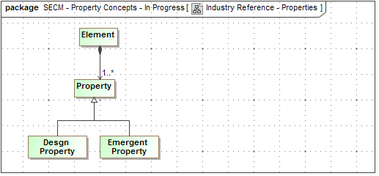
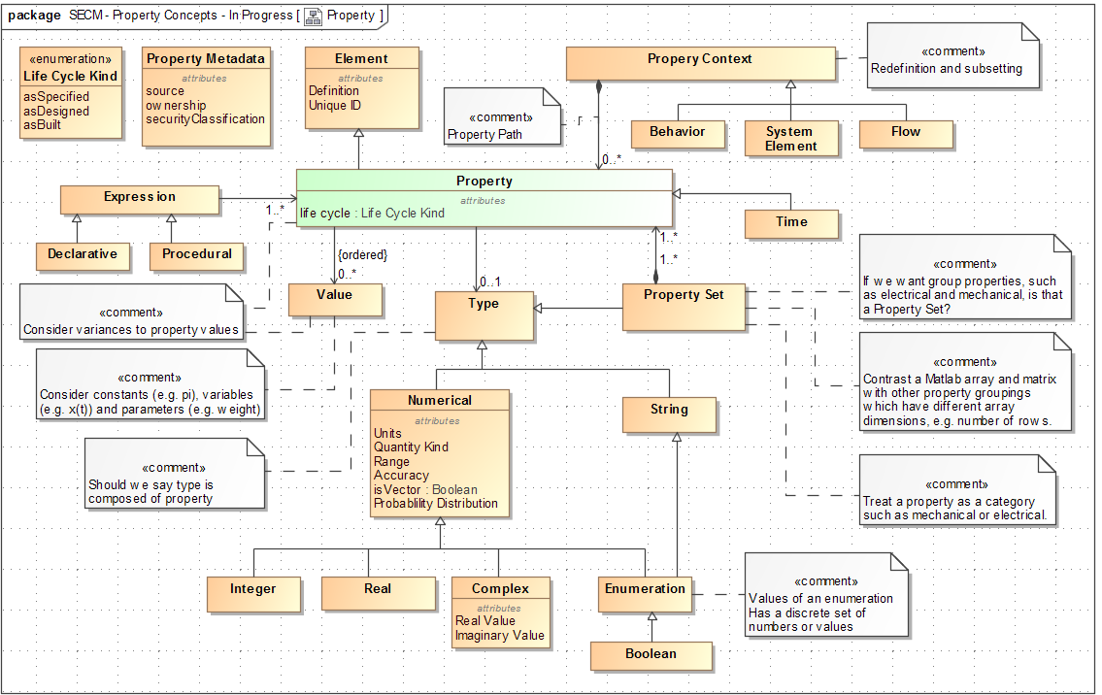
SE Needs – Property and Expressions

Slide 15
SECM – SysML V2 RFP SE Needs - Interface

Slide 16
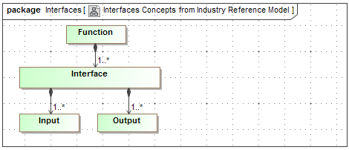
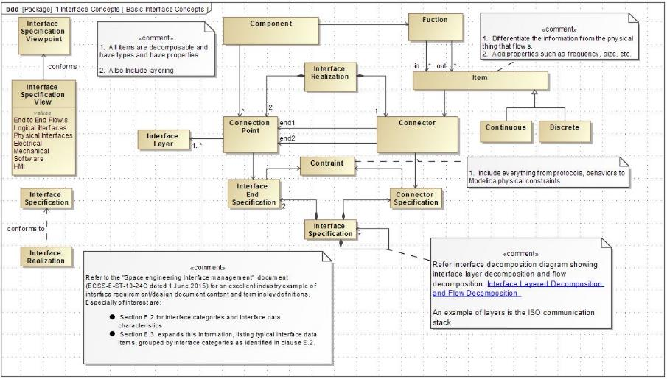
Interface Needs Concepts

Slide 17
Definitions for this “SE Needs” Exercise
Interface
At least two interface ends (Connection Point) and a connector
Interface End
One side of the interface representing the point of connection
Interface Specification
Specification for all ends and connectors.
The information content is equivalent to traditional interface design and requirement specification documents
Interface
Interface End
Interface End
Connector

Slide 18
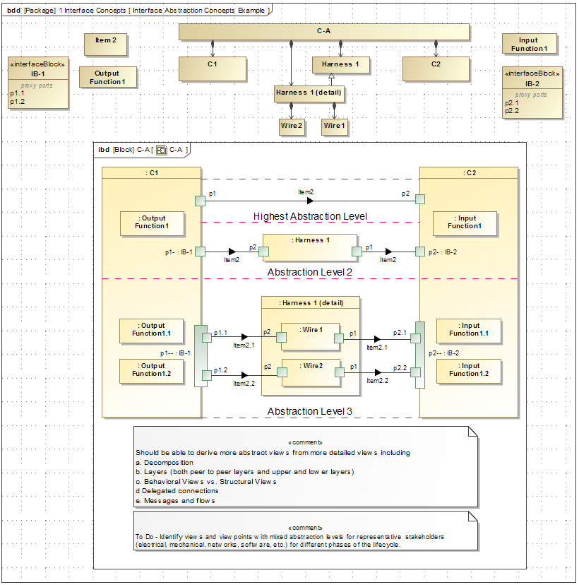
Interface Abstraction Levels

Slide 19
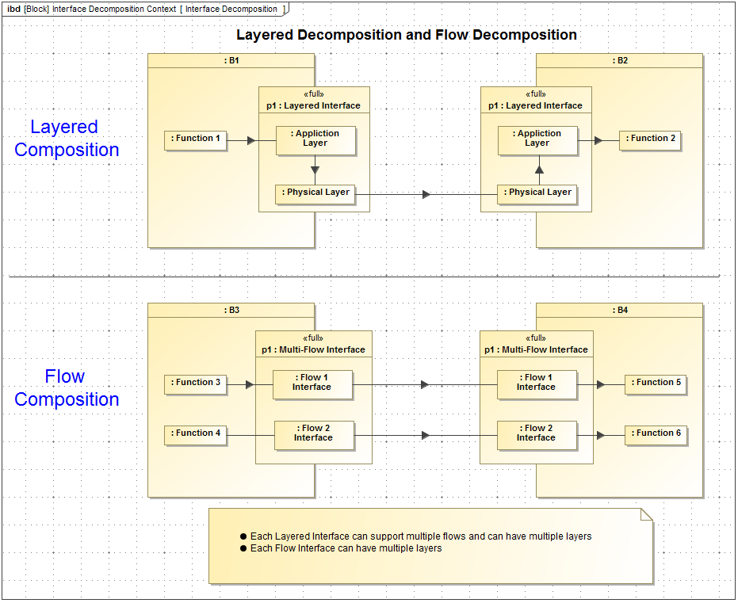
Interface Decomposition

Slide 20
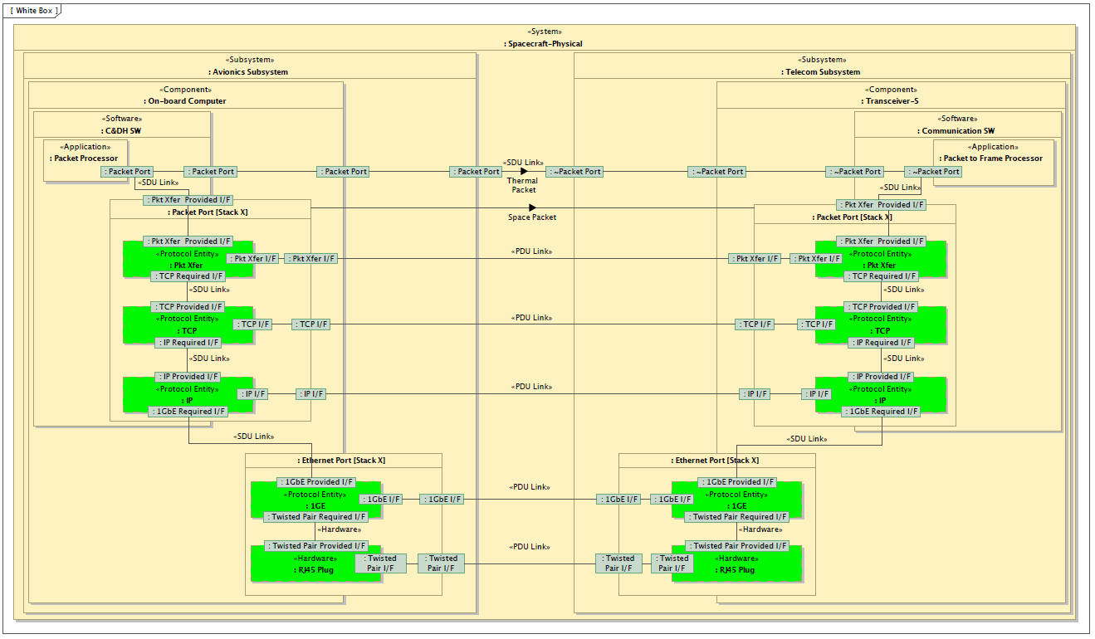
TCP/IP Protocol Stack Spacecraft Example
“A Representative Application of a Layered Interface Modeling Pattern”, Shames, Sarrel, Friedenthal

Slide 21
Example Models of Interfaces

Slide 22
Example Models of Interfaces
Examples include:
Tractor to Implement (3-point Hitch Interface )
Power Plug/Receptacle Interface
Door Hinge Interface
PC Mouse
Intent of such examples
Show interface concepts such as the Interface specification concept and the interface end specification concept
Identify where we are having trouble expressing our needs
Is it easy to capture the artifacts necessary to specify the interface
Is the resulting description intuitive and easy to understand
The intent is not to specify solutions but to use the existing modeling capabilities to demonstrate where improvements would helpful

Slide 23
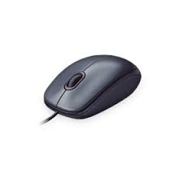
PC Mouse Example
Why the PC Mouse model?
Wide variety of layered interfaces
Electrical, mechanical, optical, messaging, etc.
The mouse and its interfaces are very familiar
Each interface can be represented in varying degrees of complexity
PC Mouse Review
Provide a quick overview
Overview of observed difficulties
Any other areas of difficulties?

Slide 24
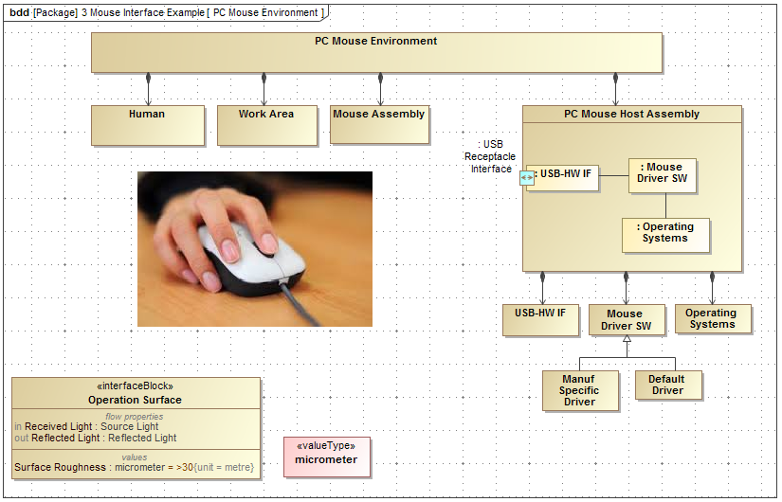
PC Mouse Environment - BDD

Slide 25
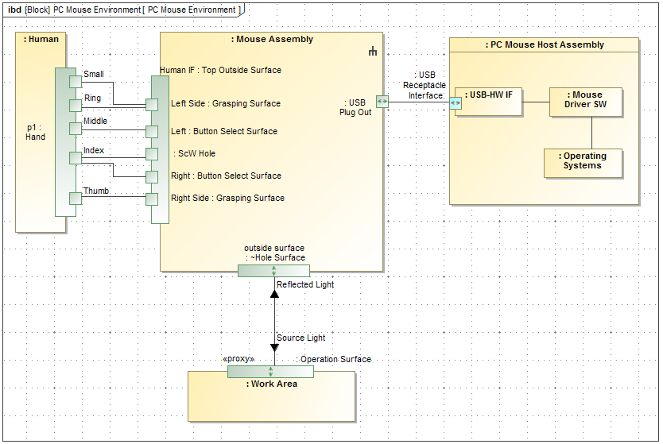
PC Mouse Environment - IBD

Slide 26
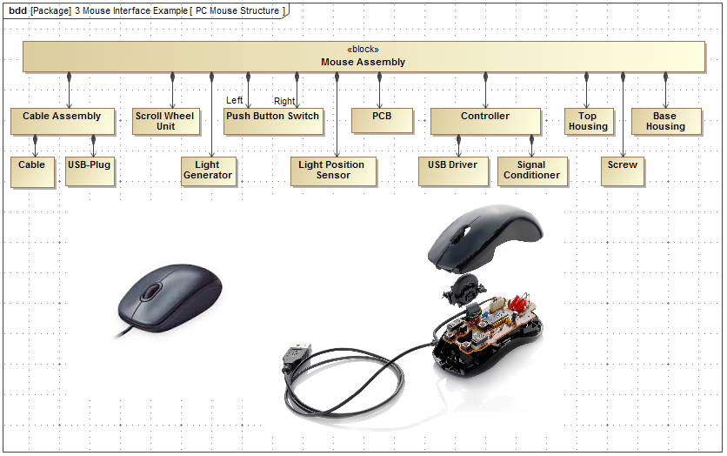
The Parts of a Mouse
Notes:
1. The Mouse example reveals a variety of Mechanical, Electrical, optical, and messaging interfaces. Some interesting interfaces;
Light projecting through a hole in a housing
Difficulty simply declaring a hole through the object vs. a specified depth
A physical object projecting through a housing
Human Interface
Connecting two mechanical devices together.
In this example it shows using a screw but how about a snap together connection, or two surfaces glued together, etc.
The same application data passing through a variety of physical interfaces
2. Created many elements for the mouse example
7 diagrams, 120+ Blocks and Interface Blocks, 60 ports
Many additional blocks because Full ports were used and they can not be conjugated.
Established Interface libraries would simplify this
How are such libraries created, maintained and made available?

Slide 27
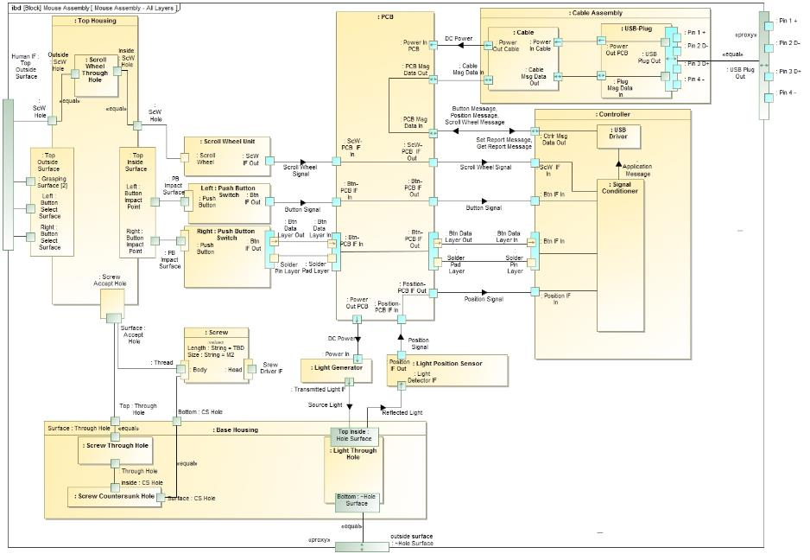
Notes:
1. Connecting to internal ports, the proxy on the higher level should be automatic vs. creating a new elements and the connector
Full Ports are a part on the owning edge. Should be able to move it to show as an edge port or part. The semantics should be the same when it is on the edge or not
3. Showing mechanical interconnections using ports is difficult and the result is not very intuitive
Show a Screw through a hole in one mechanical part and connecting to another mechanical part in an intuit way
Have ability to show shapes, geometry and projections (exploded views) maybe with dotted lines showing mating points
Maybe another diagram type, i.e.. Mechanical, like electrical schematics and mechanical representations

Slide 28
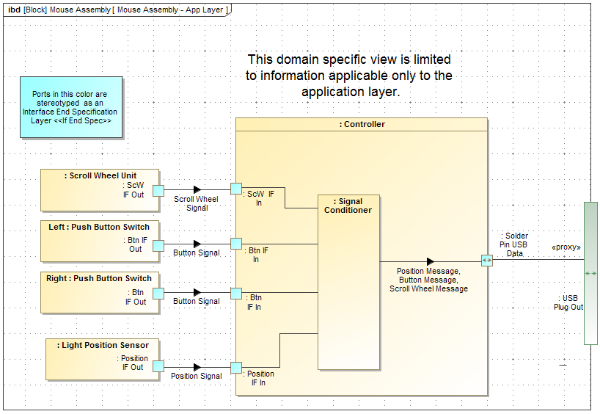
Domain Specific View Example
In this view:
If a application layer transformation takes place, the elements are included.
All other lower layers elements and transformations are removed

Slide 29
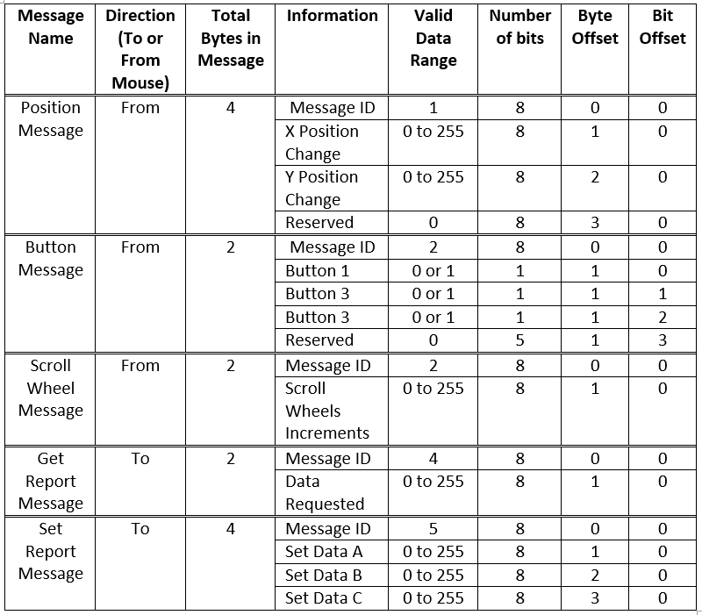
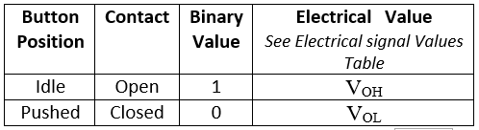
Free Form Tables to View and Enter Values
Notes:
Free Form Tables are often a simple and intuitive means of viewing related information
Very useful for describing layer transformations, application information, to signaling, to electrical and sometimes physical.
They represent the values for a value property.
The values may be references to other specifications

Slide 30
Conclusions
SECM Industry Reference
Provides a solid anchor to SE Vernacular
Good Progress
More will be added as needed
SECM – SysML V2 RFP
Selecting Topics, deriving needs, create expert topic teams
Properties and Expression first team
Interface is planned second team
Potential Future topics
Function and Structure
Behavior
Variants
Requirements

Slide 31
Backup

Slide 32
“A Representative Application of a Layered Interface Modeling Pattern”, Shames, Sarrel, Friedenthal

