Slide 1

Model-based Systems Engineering (MBSE) 101
Moderated by
Elyse Fosse,
Jet Propulsion Laboratory,
California Institute of Technology
Presented at Board Meeting
25 January / 26 January 2014
©2014 California Institute of Technology. Government sponsorship acknowledged

Slide 2
Agenda
Objective
Acknowledgements
FAQ list
FAQ answers
JPL MBSE Lessons Learned
Additional questions from Day 1
Audience participation encouraged throughout

Slide 3
Objective
Provide answers to frequently asked MBSE questions
Answers are from a Jet Propulsion Laboratory (JPL)-centric view
Will use a list of FAQs as a starting point
Audience provided questions/interactions are encouraged

Slide 4
Acknowledgements
The FAQs and answers included have been collected from the presentations and experiences of:
Todd Bayer
Daniel Dvorak
Sanford Friedenthal*
Steve Jenkins
Chi Lin
Sanda Mandutianu
Louise Anderson
Elyse Fosse
Bjorn Cole
Chris Delp
*JPL, Lockheed

Slide 5
FAQ (1 of 2)
What is MBSE?
What SE problems does MBSE address?
What is SysML?
What is a system model?
What are typical purposes of modeling?
What are the different types of models
How are the different types of models integrated?

Slide 6
FAQ (2 of 2)
8. How can models help a SE effort?
9. What does MBSE mean for projects?
10. How does MBSE Compare to Traditional SE?
11. How good is a model?
12. What is an ontology?
13. Why are ontologies relevant?

Slide 7
FAQ 1: What is MBSE?

Slide 8

MBSE Definition
“Model-Based Engineering (MBE): An approach to engineering that uses models as an integral part of the technical baseline that includes the requirements, analysis, design, implementation, and verification of a capability, system, and/or product throughout the acquisition life cycle.”
Final Report, Model-Based Engineering Subcommittee, NDIA, Feb. 2011
“Model-based systems engineering (MBSE) is the formalized application of modeling to support system requirements, design, analysis, verification and validation activities beginning in the conceptual design phase and continuing throughout development and later life cycle phases.”
INCOSE SE Vision 2020 (INCOSE-TP-2004-004-02, Sep 2007)

Slide 9
MBSE Motivation
Systems Engineering requires structural, behavioral, physics and simulation-based models representing the technical designs which evolve throughout the life-cycle, supporting trade studies, design verification and system V&V.
Current practice tends to rely on standalone (discipline-specific) models whose characteristics are shared primarily through static documents.
MBSE moves toward a shared system model with remaining discipline-specific models providing their characteristic information in a mathematically rigorous format. All disciplines “view” a consistent system model.
Notes:
Various models(currently standalone) are used to represent technical specifications of a System. MBSE moves toward integration.

Slide 10
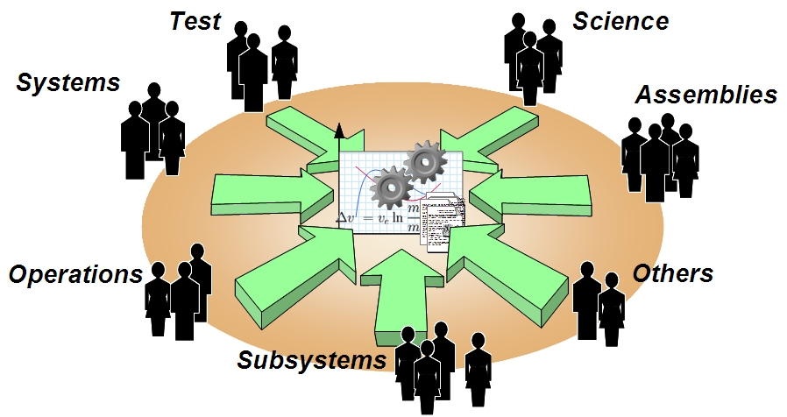
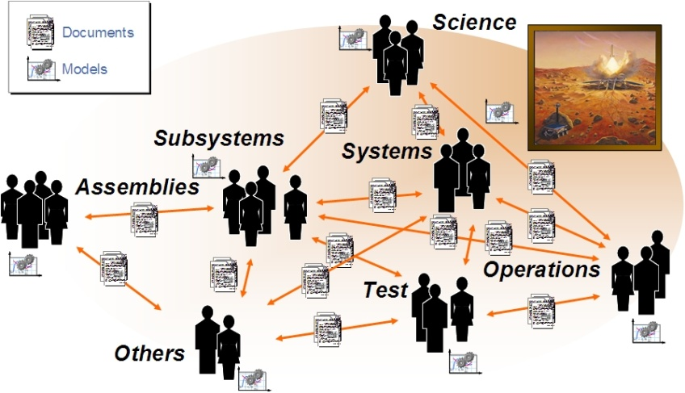
Current Practice to Future Practice
Today: Standalone models related through documents
Future: Shared system model with multiple views, and connected to discipline models

Slide 11
FAQ 2: What SE Problems does MBSE address?

Slide 12
JPL-Identified Problems in SE
Mission complexity is growing faster than our ability to manage it
…increasing mission risk from inadequate specification & incomplete verification
System design emerges from the pieces, not from an architecture
…resulting in systems which are brittle, difficult to test, and complex and expensive to operate.
Knowledge and investment are lost at project lifecycle phase boundaries
…increasing development cost and risk of late discovery of design problems.
Knowledge and investment are lost between projects
…increasing cost and risk; damping the potential for true product lines
Technical and programmatic sides of projects are poorly coupled
…hampering effective project decision-making; increasing development risk.
JPL IOM-3100-09-040, "The Need for an Integrated Model-Centric Engineering Environment at JPL", 24 Oct 2009, Todd Bayer

Slide 13
Industry-Identified Problems in SE
Poor integration of models across the life cycle*
…hard to get coherent, checkable model of the whole system (at some level of abstraction)
Limited reuse of models between programs*
…paying for similar engineering work over and over
Variation in modeling maturity and integration across Engineering Disciplines (e.g., systems, software, mechanical , electrical, test, maintainability, safety, security)*
…Mechanical/Electrical CAD/CAE fairly mature
…Systems/Software/Test fairly immature
* NDIA Final Report, Model Based Engineering Subcommittee

Slide 14
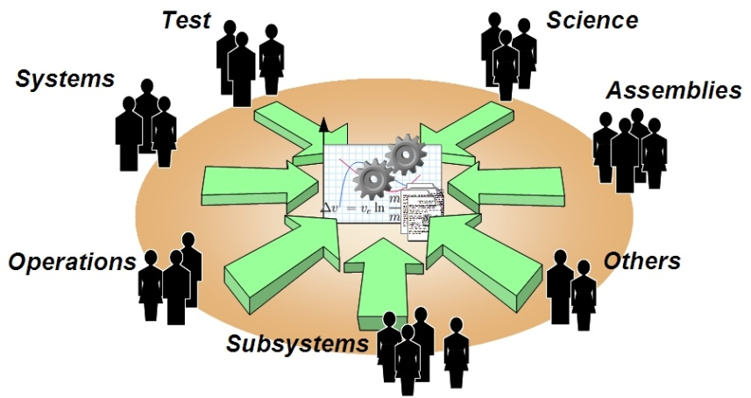
How MBSE Addresses Problems
Structural Model
Operations Plan
Power Model
Mass Roll-up
Thermal Model
Software Model

Slide 15
FAQ 3: What is SysML?

Slide 16
SysML Defined
The OMG Systems Modeling Language (OMG SysML™) is a general-purpose graphical modeling language for specifying, analyzing, designing, and verifying complex systems that may include hardware, software, information, personnel, procedures, and facilities.
It provides graphical representations with a semantic foundation for modeling system
Requirements
Behavior
Structure
Parametrics
It extends a subset of OMG Unified Modeling Language (OMG UML™) version 2
First version (1.0) released September 2007
Current version (1.3) released June 2012
Notes:
Both human- and computer- understandable
NOT a methodology or a tool
Supports the practice of MBSE
Facilitates systems-software communication within projects

Slide 17
SysML Development
The SysML specification is a product of the Object Management Group (OMG)
an international, open membership, not-for-profit computer industry consortium
SysML development is performed under the auspices of a Revision Task Force
SysML v1.3 RTF has just concluded
SysML v1.4 RTF now under way
NASA is a member of OMG
JPL has strong influence on both RTFs
Nicolas Rouquette represents NASA at OMG and serves on UML and SysML RTFs
Sanford Friedenthal chairs the Systems Engineering Domain Special Interest Group and consults for JPL

Slide 18
What SysML Is Not
SysML enables MBSE, but MBSE doesn’t equal SysML; MBSE typically uses SysML as a standard visual modeling language and lingua franca, but is not limited to it
SysML is not intended to replace current investment in modeling in the other engineering disciplines. (Nor could it.)
It is intended that SysML-based models be the framework for interoperating with these discipline models, thus enabling integrated model-centric engineering
SysML is not a methodology or a tool
SysML is a language
SysML is methodology- and tool-independent

Slide 19
FAQ 4: What is a System Model?

Slide 20
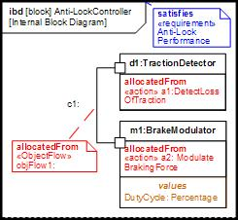
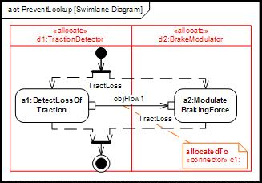
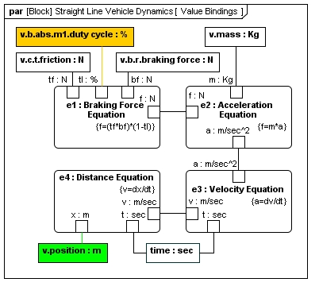
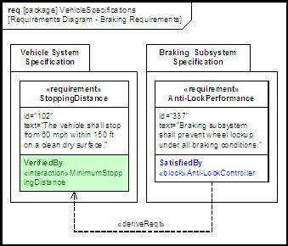
System Model Defined
1. Structure
2. Behavior
A system model is an interconnected set of model elements that represent key system aspects including structure, behavior, requirements, and parametrics
allocate
value binding
satisfy
Verify
3. Requirements
4. Parametrics

Slide 21
System Model and Other Models
The system model exchanges information with discipline specific models to form the authoritative, up-to-date source of information at the system level
Requirements Repository
Analysis Models
Verification Models
System Model
Hardware Models
Software Models
Notes:
SysML enables MBSE, but MBSE doesn’t equal SysML; MBSE typically uses SysML as a standard visual modeling language and lingua franca, but is not limited to it
SysML is not intended to replace current investment in modeling in the other engineering disciplines. (Nor could it.)
It is intended that SysML-based models be the framework for interoperating with these discipline models, thus enabling integrated model-centric engineering
SysML is not a methodology or a tool
SysML is a language
SysML is methodology- and tool-independent

Slide 22
FAQ 5: What are typical purposes of modeling

Slide 23
Model Purposes (1 of 2)
To align interests and share understanding
The mission systems are usually created by people with different interests and skills who must work together.
A common model enables effective collaboration and helps to develop common understanding.
To balance competing priorities to maximize stakeholder value
Offers a foundation for the systems to evolve, reuse, or integrate without substantial rework
Standard way of representing data across missions and it can be easily understood by the stakeholders
The modeling offers process discipline by supporting small, iterative steps that can demonstrate incremental value and get early and continuous feedback
The model of a mission is built by composing common functions that can be re-used across missions
Increased efficiency of the system engineering process
Increased reliability (common modules already proven)
The model supports the addition of very specific functions without impact on the common modules

Slide 24
Model Purposes (2 of 2)
To describe a design in durable form
Almost anything can be used for that
To communicate a design to a set of stakeholders
A common notation and familiar presentation idioms
Standards (e.g., SysML) cover most of that
To Relate analyses to design
In general, a much harder problem
Largely outside the scope of SysML, except to provide language extension mechanisms that allow you to do this
If done automatically, software tools to reason about models
This is also outside the scope of SysML, but some SysML modeling tools provide some help
Modeling is supported by software tools that minimize the modeling efforts

Slide 25
FAQ 6: What are different types of models?

Slide 26
Model Types (High Level)
Different models render the system from different perspectives
Physical vs. abstract
Domain-specific vs. domain-independent
And in different manners
Formal vs. informal
Descriptive vs. procedural

Slide 27
Model Types (More Detailed)
Models apply to a wide range of domains (e.g., systems, software, electrical, mechanical, human behavioral, logistics, manufacturing, business, socio-economic, regulatory)
Computer-interpretable computational model
Time varying (e.g., performance simulations, structural dynamic analysis)
Static (e.g., reliability prediction model)
Deterministic or stochastic (e.g., Monte Carlo)
May interact with hardware, software, human, and physical environment
Includes input/output data sets
Human-interpretable descriptive models (e.g., architecture/design such as UML, SysML, UPDM, IDEF, electrical schematic, 3D CAD geometry, DODAF 2.0)
Symbolic representation with defined syntax and semantics
Repository based (i.e., the model is stored in structured computer format)
Supporting metadata about the models including assumptions, versions, regions of validity, etc.
MBE can also include the use of physical models (e.g., scale models for wind tunnels or wave tanks)

Slide 28
FAQ 7: How are different types of models integrated?

Slide 29
Integration By a System Model
Requirements Repository
Analysis Models
Verification Models
System Model
Hardware Models
Software Models
Notes:
SysML enables MBSE, but MBSE doesn’t equal SysML; MBSE typically uses SysML as a standard visual modeling language and lingua franca, but is not limited to it
SysML is not intended to replace current investment in modeling in the other engineering disciplines. (Nor could it.)
It is intended that SysML-based models be the framework for interoperating with these discipline models, thus enabling integrated model-centric engineering
SysML is not a methodology or a tool
SysML is a language
SysML is methodology- and tool-independent

Slide 30
FAQ 8: How Can Models Help an SE Effort?

Slide 31
Reasoning About Models
We can use models to answer questions
The questions may be about the system itself
What is it?
How does it work?
Is the performance adequate?
What happens if something breaks?
The questions may be about the model
Is it complete?
Is it consistent?
Does it support required analyses?
The questions may be about the design artifacts
Are all required documents present?
Does each document contain all required content?
We call answering these kinds of questions reasoning
It doesn’t necessarily mean exotic, artificial intelligence

Slide 32

Reasoning About Completeness
«component» spacecraft
What components perform no function?
«component» ground system
«function» transmit telemetry
«function» receive telemetry
«performs»
«sends»
«message» telemetry packet
«receives»

Slide 33
Reasoning About Consistency
«component» spacecraft
Are there illegal or meaningless relationships in the model?
«component» ground system
«sends»
«sends»
«performs»
«function» transmit telemetry
«function» receive telemetry
«performs»
«sends»
«sends»
«message» telemetry packet
«receives»

Slide 34
Reasoning About Design
Rule: Reserve mass m_{r} of any component with parts is the difference between its m_{a} and the sum of m_{a} of its parts
«component» spacecraft
m_{e}: 95 kg
m_{a}: 130 kg
«component» spacecraft
m_{e}:
m_{a}: 130 kg
m_{r}: 15 kg
«contains»
Rule: CBE mass m_{e} of any component with parts is the sum of m_{e} of its parts
«component» telecom
m_{e}: 27 kg
m_{a}: 35 kg
«component» propulsion
m_{e}: 68 kg
m_{a}: 80 kg
«component» telecom
m_{e}:
m_{a}: 35 kg
«component» propulsion
m_{e}:
m_{a}: 80 kg
m_{r}: 5 kg
m_{r}: 7 kg
Policy: m_{e} < m_{a} for every component
«component»
amplifier
m_{e}: 8 kg
m_{a}: 10 kg
«component»
antenna
m_{e}: 19 kg
m_{a}: 20 kg
«component»
tank
m_{e}: 38 kg
m_{a}: 44 kg
«component»
thruster
m_{e}: 30 kg
m_{a}: 29 kg
✖
m_{e}: estimated mass
m_{a}: allocated mass

Slide 35
FAQ 9: What Does MBSE Mean For Projects?

Slide 36
MBSE implications for projects
How does MBSE affect…
deliverables?
project schedule/milestones?
project organization?
processes (e.g. design, reviews, CM, model mgmt, methodology…)?
infrastructure?
metrics?

Slide 37

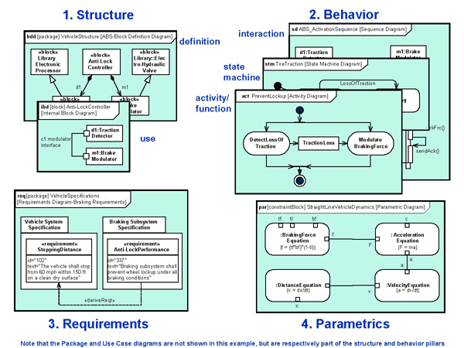
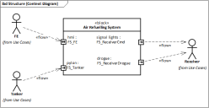
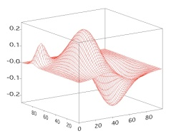

MBSE and Deliverables
Project still has to produce deliverables for each review
Some documents may be generated automatically from system model
This ensures that design and documents are kept in sync
Reports
Model
Transformers
HTML
Web Pages
Simulation &
Analysis
Ex: Mathematica
System Model
Audits

Slide 38
MBSE and Schedule
Projects will need to schedule time and resources to deploy infrastructure and train workforce
Model development becomes infused within the product development schedule

Slide 39
MBSE and Project Organization
Everyone needs training, but not to the same depth
Different levels of training for different levels of modeling
EVERYONE
Understand and express concepts using SysML standard notation
SysML Models
MOST SEs including leadership
Collaborate and develop models with help from core team
Applies best practices, contributes to production models
CORE TEAM

Slide 40
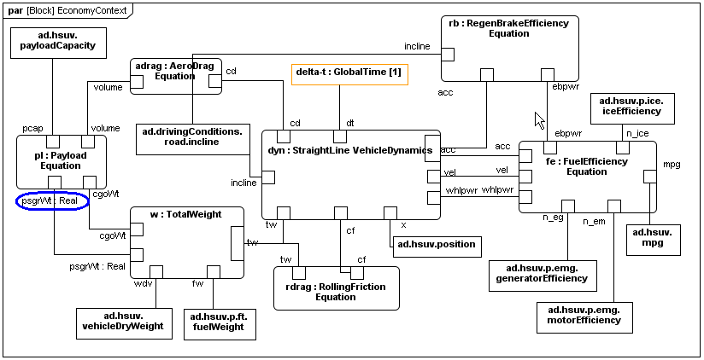

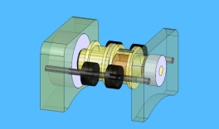
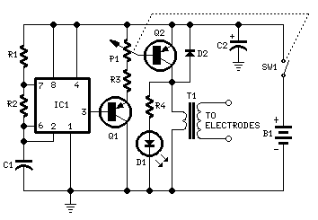
MBSE and Project Reviews
It can affect reviews, but doesn’t have to
Leverage the model by reviewing the model itself
Stakeholders focus on the views of the system model that address their concerns
Reviewers
Models

Slide 41
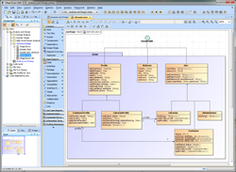
MBSE and Infrastructure
Need:
System modeling tool(s)
Training (in modeling and in tool usage)
Standards (modeling style guide, model management)
Methodology*
SysML Modeling Guide
IMCE Team
Version: 9/24/11
* See “Survey of Model-Based Systems Engineering (MBSE) Methodologies”, J. A. Estefan, 2008, INCOSE.
http://www.omgsysml.org/MBSE_Methodology_Survey_RevA.pdf

Slide 42
MBSE and Project Metrics
Easier to get data from models and update metrics
Example metrics
Quality of design
Mass margin, power margin, data margin, cost, …
Progress of design and development effort
Completeness of component specs, # use case scenarios, …
Estimated effort to complete design and development
Constructive Systems Engineering Cost Model (COSYSMO) gets inputs from system model (# requirements, # use cases, etc.)
Others:
Number of critical TBDs
Stability of requirements and design changes over time
Potential defect rates

Slide 43
FAQ 10: How does MBSE Compare to Traditional SE?

Slide 44
A Historical Perspective on SE and MBSE
Way back when, systems and subsystems were on equal footing
Over time, computers allowed pretty much all the domains - except systems - to build rigorous modeling capabilities.
Systems is the last to get this rigor because it’s the broadest, most conceptual, and has by definition the full complexity of the system to deal with. So it’s the hardest one to get rigorous about.
SE has been at a disadvantage because of this
Lacking this quantitative rigor, SE has had to rely too heavily on intuition, overemphasizing the Art and neglecting the Science
Systems needs to claim the rigor of its domain to restore balance
Otherwise our systems will continue to be assemblages of components whose performance and behavior must be discovered after assembly.
MBSE provides this rigor
Source: Todd Bayer (JPL)
Notes:
Way back when, no one had computers and everyone, systems and subsystems, were kind of on equal footing as far as what they could assert about the design. Over time, computers allowed pretty much all the domains - except systems - to build rigorous modeling capabilities which they could use to make strong assertions about their part of the design. But that state of affairs meant that the subsystems accreted most of the authority in discussing the design and design changes. They are able to drive the design to a place favorable for their subsystems because they can ‘prove’ why they need to do so. Systems is more or less a bystander to this discussion because about all they can do is put an experienced person at the table who can talk about the issue, but not contribute any authoritative, rigorous analysis to show why a different point in the overall design space is better for everyone. (Prof. Heinz Stoewer suggests that systems engineering is really concerned with two things: synthesis and control. This is probably a good way to think of what’s meant by rigor in this case).
MBSE is the thing which can provide this rigor to systems engineering. This would help restore the ‘balance of power’ between systems and subsystems. Systems will be able to have more impact on the design up front -- when it matters -- rather than be in the mode of trying to catch up and track all the changes after they’re made.
Systems is the last to get this rigor because it’s the broadest, most conceptual, and has by definition the full complexity of the system to deal with. So it’s the hardest one to get rigorous about.
Until Systems Engineering can speak rigorously about the system, the spacecraft we launch will continue to be not much more than collections of subsystems, patched together by systems engineers playing catch-up. This means that MBSE is not just good. We are convinced that for the future of Systems Engineering and of the systems we build, MBSE is essential and urgent.

Slide 45
MBSE: Consistency and Continuity
Transition to a rigorous system model ensures consistent modeling across disciplines and continuous access to this system model between system levels and across the life cycle
_{Past}
Specifications
Interface requirements
System design
Analysis & Trade-off
Test plans
_{Future}
Revision by GIT; Original Source: OMG SysML Tutorial (June 2008). Reprinted with permission. Copyright © 2006-2008 by Object Management Group.
Notes:
Focus on what MBSE brings to the table – don’t attack the “document” straw man

Slide 46
Modeling in Traditional Systems Engineering
“Models have been used as part of document-based systems engineering approach for many years, and include functional flow diagrams, behavior diagrams, schematic block diagrams, N² charts, performance simulations, and reliability models, to name a few.” *
“However, the use of models has generally been limited in scope to support specific types of analysis or selected aspects of system design. The individual models have not been integrated into a coherent model of the overall system.” *
* A Practical Guide to SysML. Friedenthal, Moore and Steiner.

Slide 47
What’s New About MBSE
Modeling is not new
Flight projects have a strong legacy of modeling (structural, thermal, circuit design, mission design…)
Systems Engineering uses models also, though typically limited in scope and duration. A set of requirements, an excel spreadsheet, and a PowerPoint drawing are all models.
What is new is …
the availability of a formal modeling languages which can describe systems, and
the information engineering standards and tools which enable integration of a system model with existing discipline models.
Notes:
FIX ANIMATION

Slide 48
MBSE Benefits (1 of 2)
MBSE enables overall better quality, lower cost, and lower risk for the following reasons …
Modern modeling languages have clearer semantics than common boxes-and-lines diagrams, reducing miscommunication
Consistent, single source of information keeps team on same page and reduces time spent getting answers
Earlier detection of inconsistencies because models can be analyzed with respect to calculations, policies, rules, patterns, etc.
Documents are kept up-to-date because they can be auto-generated from the system model

Slide 49
MBSE Benefits (2 of 2)
System model supports multiple views to address different stakeholder concerns, but all views refer to same model elements, so changes in an element appear on all views
Model-based simulation of state machines enables debugging and refinement of behavioral requirements
System model evolves across life-cycle and may guide similar future projects
System model helps to better manage complexity
Summary
Formal systems models offer these benefits because they introduce additional consistency and continuity, and because they are both human- and computer-understandable, and logically verifiable

Slide 50
Comparison Summary
MBSE doesn’t replace traditional SE Rather, MBSE formalizes part of SE
MBSE combines traditional methods and best practices with rigorous modeling techniques
MBSE uses modeling languages that support rigorous modeling techniques and integration of various systems engineering disciplines (structural, electrical, mechanical, software, etc.) and stakeholders

Slide 51
FAQ 11: How good is a model?

Slide 52
Some Objectives of Modeling
To describe a design in durable form
You can use almost anything for that
To communicate a design to a set of stakeholders
Now you need (at least) a common notation and familiar presentation idioms
Standards (e.g., SysML) cover most of that
To organize and relate analyses of a design
This is, in general, a much harder problem
You have to make sure that every element that could affect an analysis is present, properly identified, and consistently related to appropriate other elements
This is largely outside the scope of SysML, except to provide extension mechanisms that allow you to define the rules
You also need software to reason about your models
This is also outside the scope of SysML, but some tools do
Analysis operates on facts

Slide 53
Questions to Ask When Evaluating a System Model
Meaning of the model
Is the modeling notation expressive enough for the domain?
Does it convey the conventional domain wisdom?
Is the semantics of the model elements unambiguous?
Can pertinent questions about the domain be answered?
Model generic logical correctness
Does it support “reasoning” about the model?
Is the model complete?
Does it support the required analyses?
Does it support reasoning about the design?
Does it support reasoning about the programmatic aspects?

Slide 54
Is This A Model?
spacecraft
ground system
transmit telemetry
receive telemetry
telemetry packet
Sure, why not?

Slide 55
Is It A Good Model?
spacecraft
ground system
transmit telemetry
receive telemetry
telemetry packet
Not so much.

Slide 56
What’s Wrong With It?
spacecraft
ground system
transmit telemetry
receive telemetry
Same symbol for different kinds of things
telemetry packet
Same symbol for different kinds of relationships

Slide 57
Better?
spacecraft
ground system
transmit telemetry
receive telemetry
Not much. Essential distinctions are merely suggested--they should be explicit.
telemetry packet

Slide 58
Making Distinctions Explicit
Rather than merely hinting at distinctions with shapes or colors, we could devise a set of types or classes to be applied to model elements
The set of types is application-dependent
Systems engineers talk about different things from chefs
The distinctions are whatever matters for your application
Is red wine a different type from white, or is is merely a property of wine?
It depends on what you want to say about wine
What kinds of things do systems engineers talk about?
Component, Interface, Function, Requirement, Work Package, Product, Process, Objective, Message, etc.
Let’s apply some classes to our model
For now, every element has
one type, denoted like this: «type»
one name, which identifies an individual of that type

Slide 59
Model With Typed Elements
«component» spacecraft
«component» ground system
«function» transmit telemetry
«function» receive telemetry
«message» telemetry packet
Much better.

Slide 60
Answering Questions (1 of 2)
«component» spacecraft
«component» ground system
What components are present?
«function» transmit telemetry
«function» receive telemetry
«message» telemetry packet

Slide 61
Answering Questions (2 of 2)
«component» spacecraft
«component» ground system
What functions are present?
«function» transmit telemetry
«function» receive telemetry
«message» telemetry packet

Slide 62
Add Typed Relationships
«component» spacecraft
«component» ground system
«performs»
«function» transmit telemetry
«function» receive telemetry
«performs»
«sends»
«message» telemetry packet
«receives»
Note that relationships are now directed.

Slide 63
More Questions and Answers (1 of 4)
«component» spacecraft
What component performs the function transmit telemetry?
«component» ground system
«performs»
«function» transmit telemetry
«function» receive telemetry
«performs»
«sends»
«message» telemetry packet
«receives»

Slide 64
More Questions and Answers (2 of 4)
«component» spacecraft
What functions does the component ground system perform?
«component» ground system
«performs»
«function» transmit telemetry
«function» receive telemetry
«performs»
«sends»
«message» telemetry packet
«receives»

Slide 65
More Questions and Answers (3 of 4)
«component» spacecraft
What messages does the function transmit telemetry send?
«component» ground system
«performs»
«function» transmit telemetry
«function» receive telemetry
«performs»
«sends»
«message» telemetry packet
«receives»

Slide 66
More Questions and Answers (4 of 4)
«component» spacecraft
What components perform a function that sends or receives the message telemetry packet?
«component» ground system
«performs»
«function» transmit telemetry
«function» receive telemetry
«performs»
Alternatively, what component designs may be affected if the definition of telemetry packet changes?
«sends»
«message» telemetry packet
«receives»

Slide 67
A Good Model
Describes a system design clearly and transparently
In particular, it shows a flawed design to be flawed
Communicates a system design effectively to an incompletely bounded audience
In particular, it uses standard, well-defined vocabulary and notation
Lends itself to automated reasoning for
validation in modeling domain (well-formedness, etc.)
validation in engineering domain (performance, etc.)
validation in programmatic domain (cost, schedule, etc.)
Lends itself to automated transformation into
analysis specifications for discipline-specific tools
documents or other information products
Narrows the risky and expensive gap between describing a design and analyzing it

Slide 68
FAQ 12: What is an ontology

Slide 69
Presentations Versus Facts
Presentation
Facts
«component» spacecraft
spacecraft is a «component»
transmit telemetry is a «function»
spacecraft «performs» transmit telemetry
«performs»
«function» transmit telemetry
SysML is (among other things) a presentation standard
We need other standards for our facts

Slide 70
Facts and Ontologies
The field that deals with facts and reasoning is logic
The subset of logic that deals with facts and their meaning is ontology
Ontologies contain axioms:
Definitions of concepts and their specializations
e.g., a Spacecraft is a Flight Component, which is a Component
These are sometimes called classes
Definitions of attributes of individuals of a class
e.g., mass is a property of Flight Component
These are sometimes called data properties
Definitions of relationships among individuals
e.g., a Component performs a Function
These are sometimes called object properties
Restrictions
e.g., a Function isPerformedBy at most one Component
Facts about individuals using these concepts and properties

Slide 71
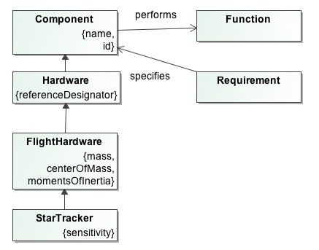
Ontology Definition
Ontologies provide descriptions of concepts and their relationships for a domain of interest
Ontologies are agreements on usage, more than a dictionary or a taxonomy
Formal ontology standards provide powerful mechanisms for automatic domain specific reasoning
Notes:
Ontology is originally a branch of philosophy that deals with the nature and the organization of reality. It tries to answer questions like "what is existence", "what properties can explain the existence" etc.
In practice, ontology can be intended as the theory of the distinctions, which can be applied independently of the state of the world. In particular, we are interested in distinctions:
among the entities of the world (physical objects, events, regions...)
among the meta-level categories used to model the world (concept, property, quality, state, role, part...)
The research of ontology in this philosophical sense is relevant for knowledge based systems. Ontology forms a base for knowledge used in such systems.
Although it is required from an ontology to be formally defined, there is no common definition of the term "ontology" itself. The definitions can be categorized into roughly three groups:
Ontology is a term in philosophy and its meaning is ``theory of existence''.
Ontology is an explicit specification of conceptualization.
Ontology is a body of knowledge describing some domain, typically common sense knowledge domain.

Slide 72
Some Simple Ontology Reasoning Examples
Type | Given this input | A reasoner concludes
Consistency Determine whether individuals do not violate descriptions and axioms | “has mass” is a functional property. Curiosity is a HardwareComponent. Curiosity has mass 850 kg. Curiosity has mass 900 kg. | Inconsistent: at least two facts are mutually contradictory.
Rules Entailment (satisfiability, subsumption) | Every Spacecraft is a Component. Every Orbiter is a Spacecraft. | Every Orbiter is a Component. (therefore, all Component rules apply to Orbiter.)
Facts Entailment (satisfiability, subsumption) | Every Spacecraft is a Component. MSL Rover (an individual, not a class) is a Spacecraft. | MSL Rover is a Component.
These examples are given in “equivalent” natural language, not OWL. The purpose is to show the kinds of problems for which reasoning is useful, not to demonstrate the mechanics.
Notes:
These examples are given in “equivalent” natural language, not OWL. The purpose is to show the kinds of problems for which reasoning is useful, not to demonstrate the mechanics.
Entailment ~ inference
Reasoning – deriving facts that are not expressed in ontology explicitly
All the formalisms were created with the outlook of automatic processing but due to their properties such as decidability or computational complexity or even due to the level of formality it is not always possible.
Description logics are created with the focus on tractable reasoning. A few examples of tasks required from reasoner are as follows.
Satisfiability of a concept - determine whether a description of the concept is not contradictory, i.e., whether an individual can exist that would be instance of the concept.
Subsumption of concepts - determine whether concept C subsumes concept D, i.e., whether description of C is more general than the description of D.
Consistency of ABox with respect to TBox - determine whether individuals in ABox do not violate descriptions and axioms described by TBox.
Check an individual - check whether the individual is an instance of a concept
Retrieval of individuals - find all individuals that are instances of a concept
Realization of an individual - find all concepts which the individual belongs to, especially the most specific ones

Slide 73
Ontologies as Integrating Standards
We use a lot of discipline-specific tools and terminology in space flight systems engineering
e.g., trajectory synthesis, radiation effects modeling
SysML supports the broad discipline of systems engineering, but we need a unifying vocabulary that can relate these disciplines to each other
This problem is not unique to space flight (nor to systems engineering)
Lots of people have been working on it for years.
There is a set of international (W3C) standards for defining and using ontologies
All related to the Web Ontology Language (OWL)
Can build OWL ontologies for disciplines of interest

Slide 74
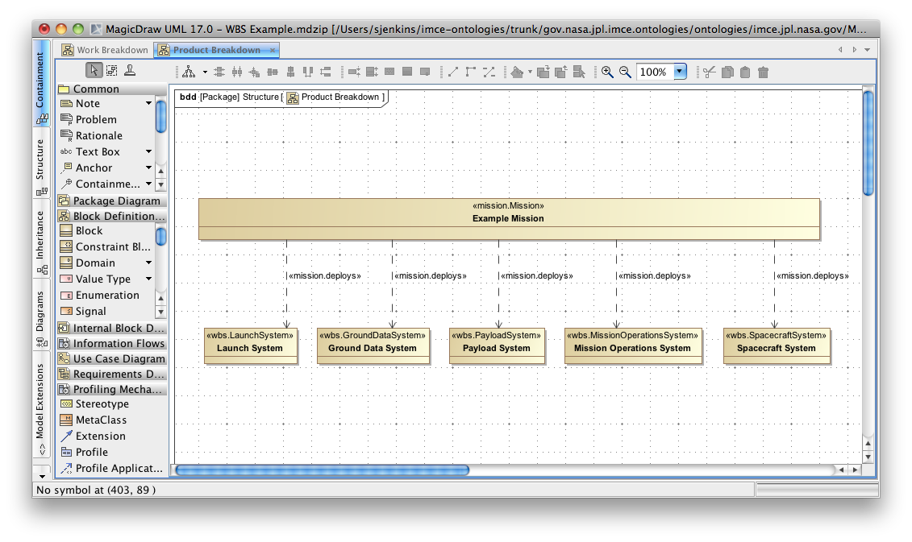
Example of SysML Profile Application

Slide 75
FAQ 13: Why are ontologies relevant?

Slide 76
Why Do We Care about Ontology?
There is a well-developed body of theory that can
help us avoid undecidable questions
i.e., not solvable in principle
help us avoid intractable questions
i.e., solvable in principle but not in practice
There is a body of tools that can
help us edit our ontologies
validate our ontologies
i.e., tell us if they’re well-formed, consistent, and satisfiable
compute inferences
i.e., Blah is a Spacecraft and Spacecraft is a Component implies Blah is a Component
these are sometimes called entailments
answer a large class of questions about facts
i.e., What Components perform a Function that sends or receives the particular Message?

Slide 77
Ontologies and SysML – which one?
Ontology languages can be used to validate extensions to SysML to address ambiguities
SysML and its ontology extensions can be translated to ontology languages.
Disambiguate semantics of the modeling language
Support automated checking and reasoning
Ontology languages enable modelers to design better and more reliable models
This doesn’t mean that the systems engineers need to learn ontology languages

Slide 78
Lessons Learned-Flight Project A

Slide 79
Lessons Learned* (1 of 2)
Investment is crucial
Project investment in tools, modeling environment, and training
Unity of leadership is essential
Management must be willing to pay the startup costs and give time for the effort to pay dividends
Best way to start modeling is to hire people who already know how to do it
Later infusions will benefit from an experienced pool of engineers
Team organization matters
3-tiers: small set of core modelers, larger set of modeling-savvy SEs, within larger set of project personnel
Everyone needs training, but not to the same depth
* Source: Todd Bayer (JPL)

Slide 80
Lessons Learned* (2 of 2)
Best way to figure out how to apply MBSE: do it for real
“Shadow pilots” would not have been helpful
Pressure to deliver real engineering products forces discovery and resolution of problems not likely encountered in a shadow
Keep the focus on project deliverables, and model only as far as you need to answer the questions
This may need to be constantly reinforced
Description first, then analysis
Just describing something in a formal model language immediately improves communication and understanding
Separate models from analyses
Mass analysis script is independent of system details
Real examples are powerful
Much more effective at conveying understanding and building support
* Source: Todd Bayer (JPL)

Slide 81
Lessons Learned-Flight Project B

Slide 82
Lessons Learned* (1 of 2)
SE First- System Engineering needs/products dictate modeling efforts
Incremental development – Build and evolve the model incrementally, adding value to the project needs and products at each increment
Focus on changes – Focus first on project/system aspects that will most likely change or will be affected by change (e.g., greater focus on components that interface with outside entities)
Leverage any and all tool development/modeling environment, and training available

Slide 83
Lessons Learned* (2 of 2)
5. Get the experts involved-cross training new-to-modeling SEs with new to SE mbSEs allows for an ease in the adoption of new practices (both are learning new things)
6. Separate concepts, from the model, from analyses- the patterns used to populate the system model should be coupled to the system model in an adaptable manner. Similarly with analysis models
7. Have to receive management buy in by showing them the SE job is not negatively affected by the new methodology (takes no more time than usual to generate SE products—hopefully less time)
8. Model validation rules help ease the fear to newcomers that they are going to “mess up” the model.

Slide 84
Appendix
Breakout Day 1 Additional Questions:
What tools are available?
How would you implement Agile development with MBSE?

Slide 85
Available Tools
OMG provides a list of vendors:
http://www.omgsysml.org/#Vendors
SysML forum also provides a list of vendors:
http://www.sysmlforum.com/tools/
Recommendations for tool comparison:
http://www.sysmltools.com/article/selecting-a-sysml-tool/

Slide 86
Agile Environment
Agile:
Deliverable based
Incremental approach
Iterative
Stakeholder driven

Slide 87
Integrated Model-based Engineering Environment (MBEE)
System Model
Stakeholders: System/Sub-System Domain Experts, Project Managers…
Deliverables: Model-generated document artifacts, view artifacts, System model
Metamodel
Stakeholders: System Model Team, System/Sub-System Domain Experts
Deliverables: SysML extended language, Domain specific patterns, Viewpoints
Software Infrastructure
Stakeholders: Metamodel Team, System Model Team
Deliverable: Model transformations, Repository infrastructure

Slide 88
Agile MBEE
System Model
1x
Stakeholders: System/Sub-System Domain Experts, Project Managers…
Deliverables: Model-generated document artifacts, view artifacts, System model
Metamodel
2x
Stakeholders: System Model Team, System/Sub-System Domain Experts
Deliverables: SysML extended language, Domain specific patterns, Viewpoints
Software Infrastructure
3x
Stakeholders: Metamodel Team, System Model Team
Deliverable: Model transformations, Repository infrastructure

