Slide 1
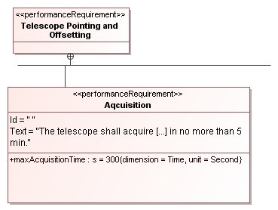
Notes:
The telescope has to get ready for observing within a certain time. This consists of a number of actions e.g. move to a certain position in the sky.

Slide 2
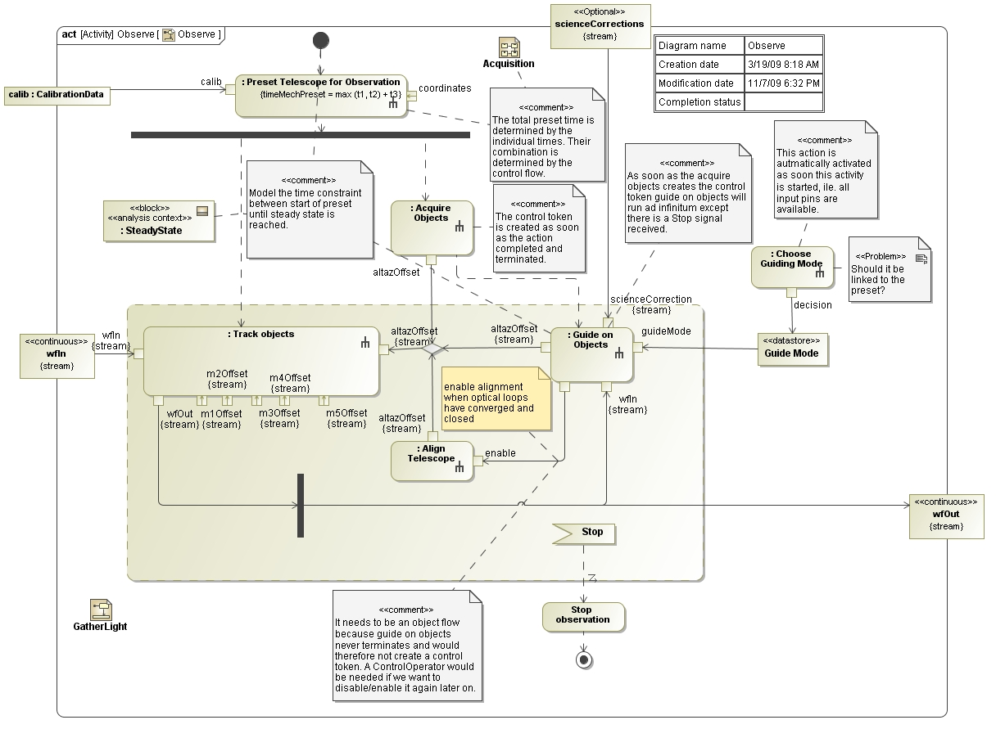
Notes:
Those actions are described by activities diagram and consist of a part which simply executes a number action (sequentially and in parallel) and a part which is completed as soon as a certain performance condition is reached. The latter is described by a continuous collaboration of actions which have to converge until the so-called steady state is reached. The time from the start until reaching steady state is constrained by a requirement. This steady state has to be maintained during observation.
The time those actions need to execute is determined by certain system properties, e.g. how fast the telescope can move, and on the control flow (sequential or parallel).
The total time, which has to meet the requirement, needs to be determined. This total time depends on one hand on the activities and on the other hand on relations among system properties (dynamic or static).
Consequently, activity diagrams and parametric diagrams are needed to model the needed time. Not only that, they are very closely related.
For example, parameters of activities should be used in constraint expressions, constraints should be used to describe relations of activities, etc.

Slide 3
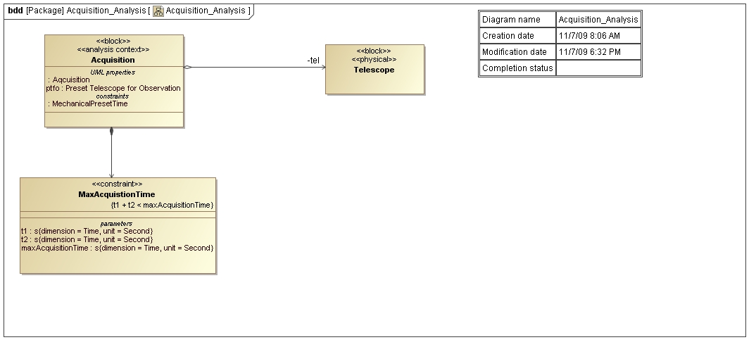
Notes:
This is the BDD which provides the analysis context for the highest (telescope) level of the acquisition.

Slide 4
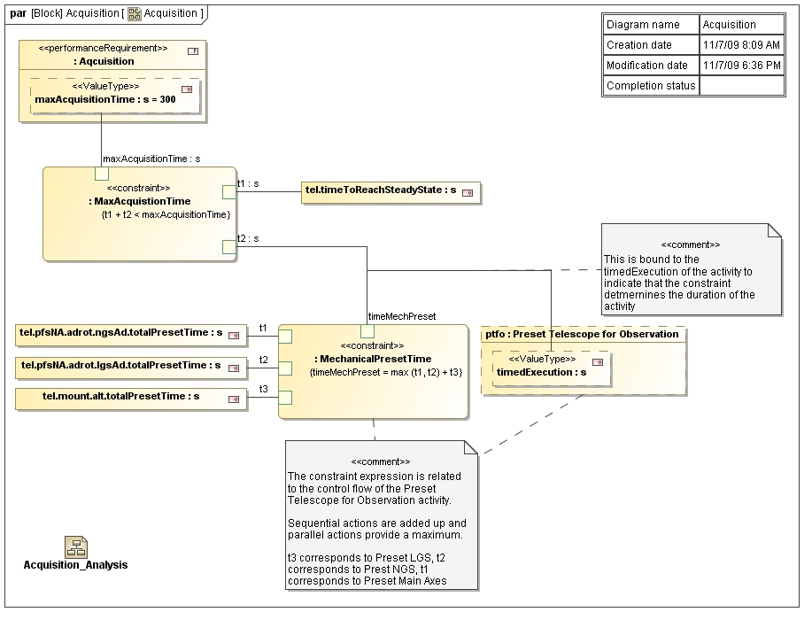
Notes:
This parametric diagram binds the parameter of the requirement Acquisition to a constraint which ties together the two major parts of the preset, the purely control flow related one and the dynamic part which waits for a certain condition.
The constraint MechanicalPresetTime uses three value properties (e.g. tel.mount.alt.totalPreset) which in fact describe the time needed for certain actions in the activity diagrams, i.e. “Preset Telescope for Observation”.
Instead of binding attributes directly to constraints it has to use value properties “storing” the values, e.g. tel.mount.alt.totalPreset

Slide 5
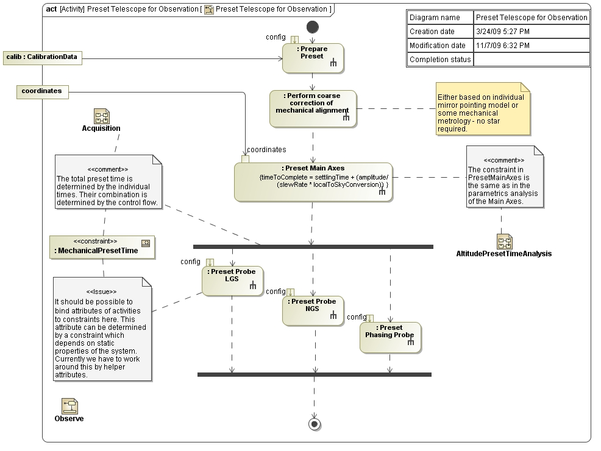
Notes:
This activity diagram describes the “static” part of the acquisition. The time for each activity is determined by subsequent parametric diagrams but their combination determine the time at the next higher level. Those times have to be used in the higher level parametric diagrams.

Slide 6
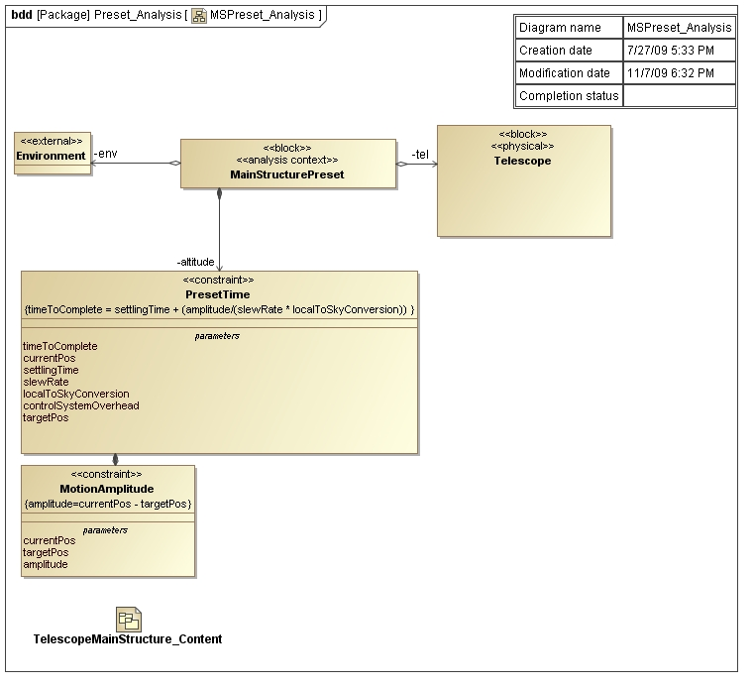
Notes:
This is the BDD describing the analysis context for one of the activities in the “static” part of the acquisition, i.e. Preset Main Axes.

Slide 7
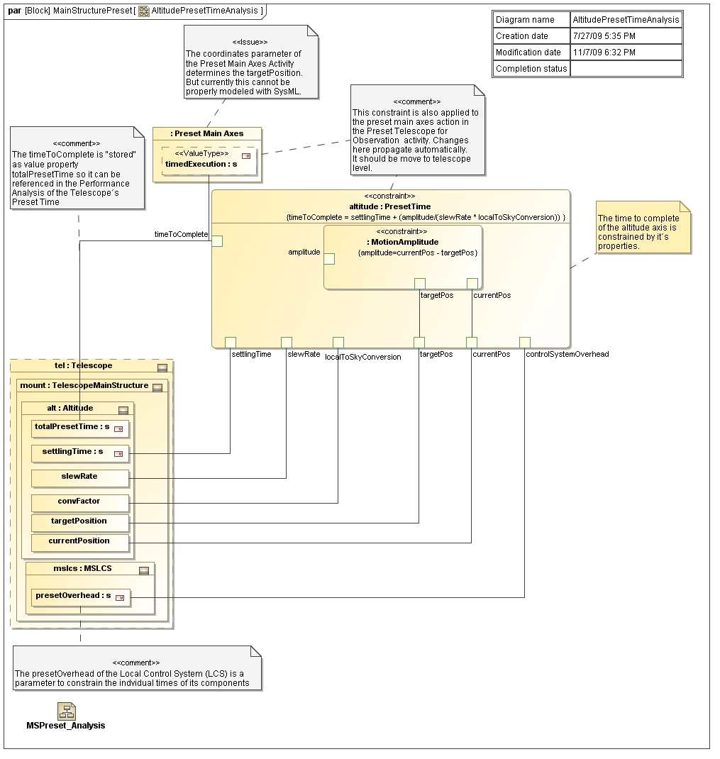
Notes:
This parametric diagram describes how the time for the activity “Preset Main Axes” is constituted.
Here we would need to bind parameters of some activities to constraints like coordinates which determine in this case the targetPosition of the telescope.

Slide 8
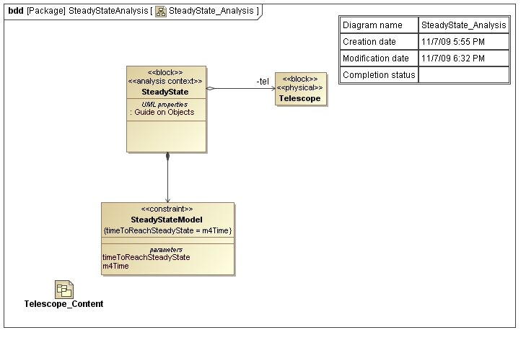
Notes:
This BDD describes part of the analysis context of the “dynamic” part of the acquisition, i.e. reaching the steady state.

Slide 9
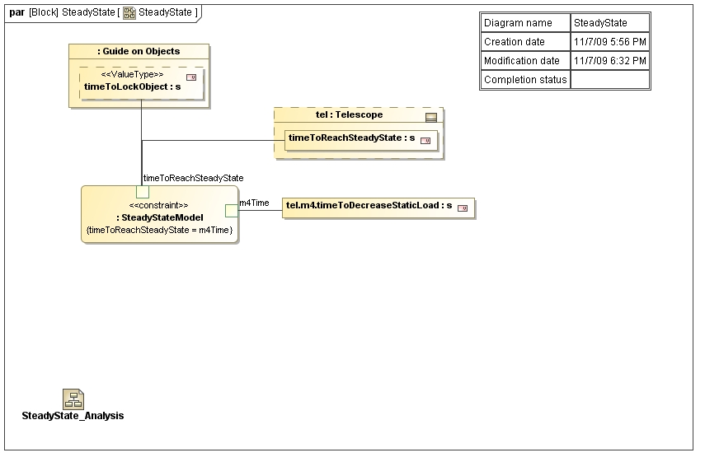
Notes:
This IBD describes part of the analysis context of the “dynamic” part of the acquisition, i.e. reaching the steady state.

Slide 10
Collapse Activity and parametric diagrams
Parametric diagrams should be able to describe relationships between actions/activities and system properties as well.
Parameters/Pins should be bound to constraints and be visible in parametric diagrams.
Actions should “inherit” the attributes of Call-behaviors so they can be bound to constraints.
Constraints should be put in Activity diagrams

