Slide 1
Error budget analysis with SysML
Parametrics
2007-12-02

Slide 2
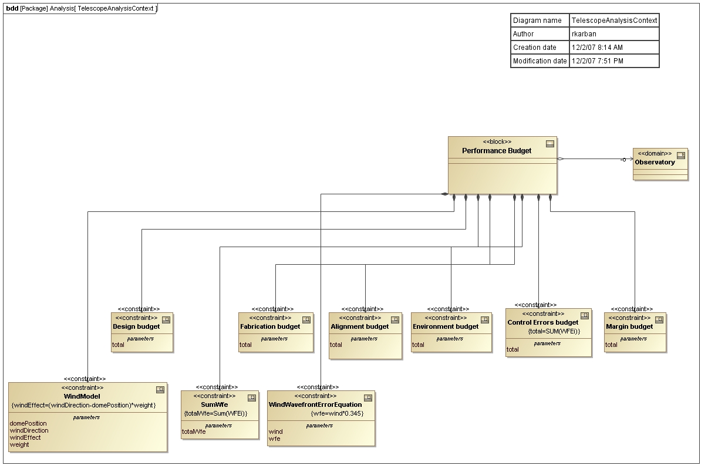

Slide 3
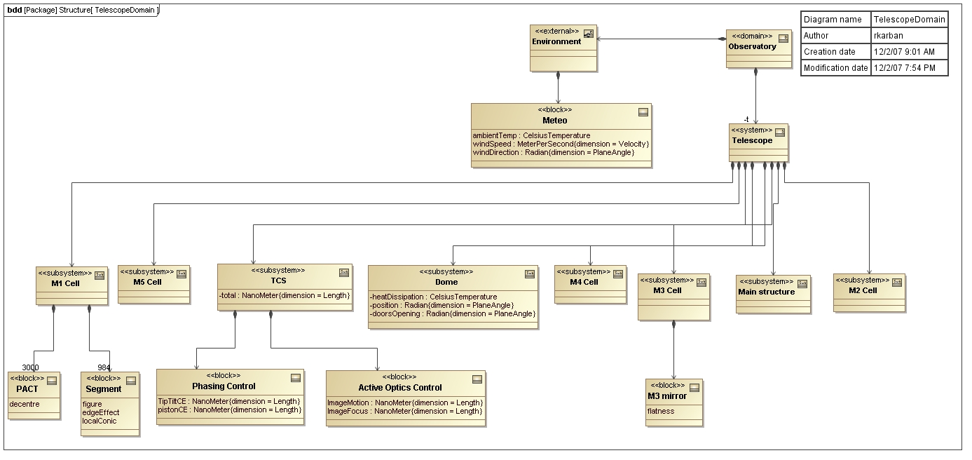

Slide 4
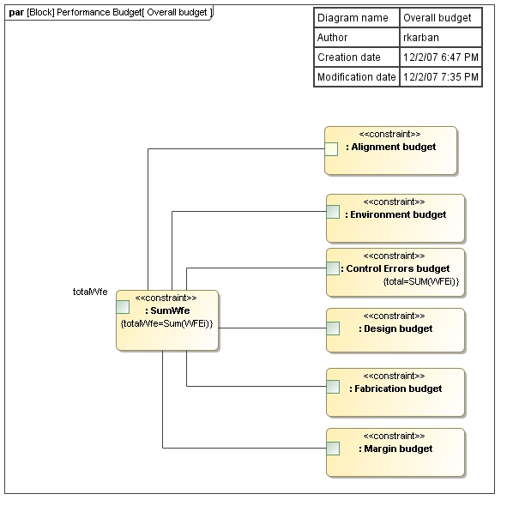

Slide 5
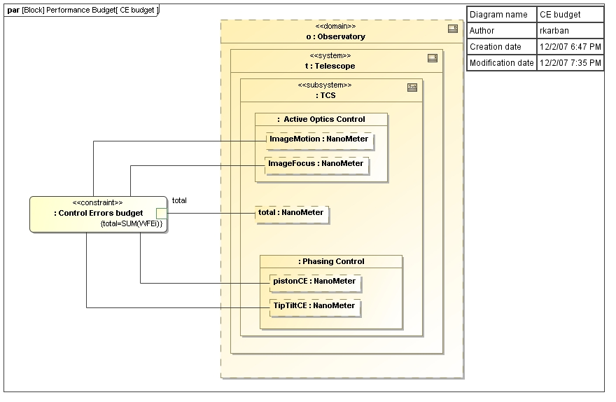

Slide 6
