Slide 1
How do I model Protocol suites and physical plugs?
Dec 2013

Slide 2
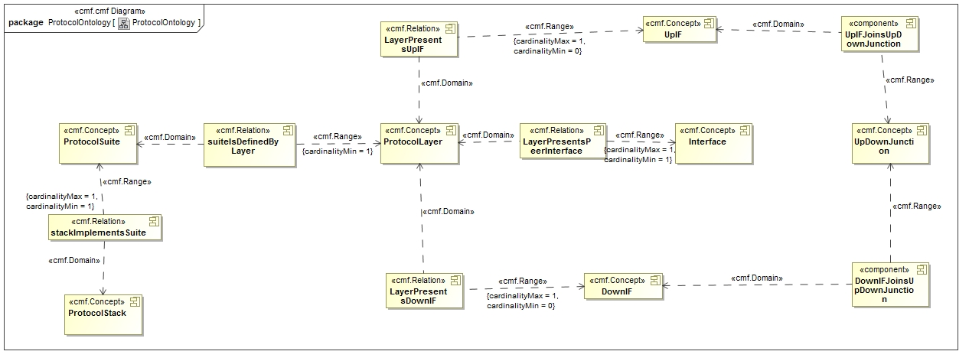
Protocol Ontology

Slide 3
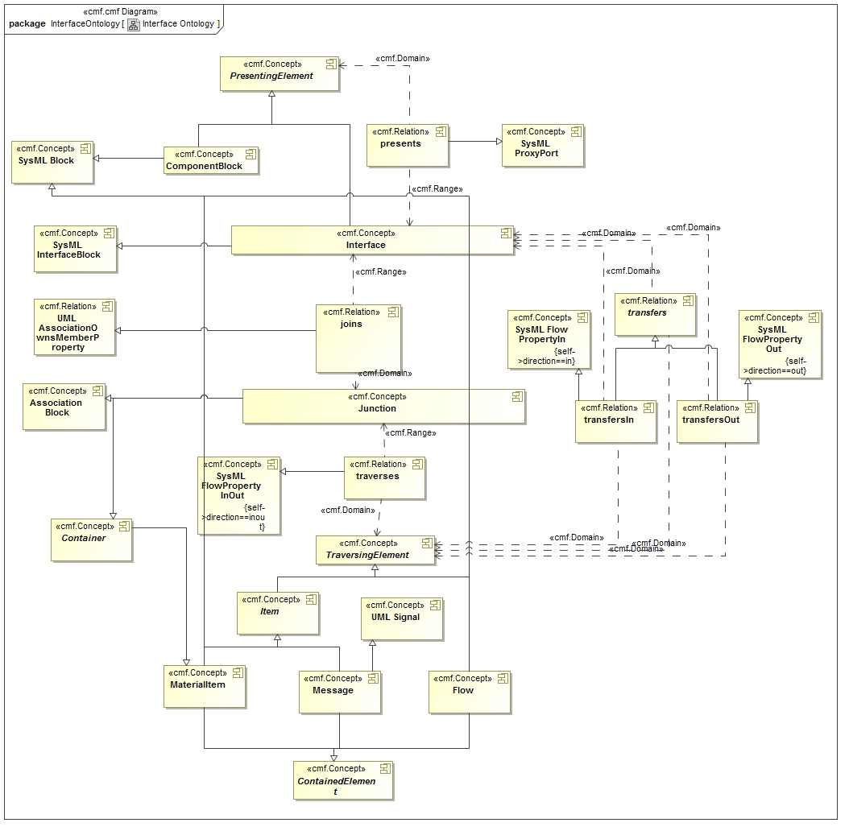
Interface Ontology

Slide 4
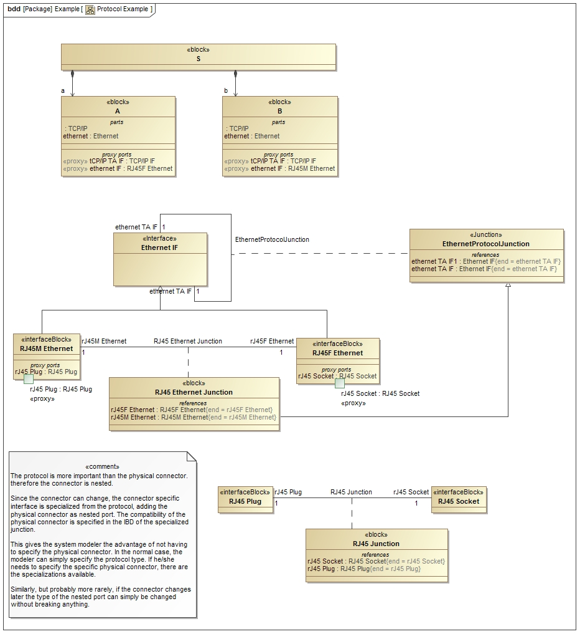
Example BDD

Slide 5
Rationale
The protocol is more important than the physical connector. therefore the connector is nested.
Since the connector can change, the connector specific interface is specialized from the protocol, adding the physical connector as nested port. The compatibility of the physical connector is specified in the IBD of the specialized junction.
This gives the system modeler the advantage of not having to specify the physical connector. In the normal case, the modeler can simply specify the protocol type. If he/she needs to specify the specific physical connector, there are the specializations available.
Similarly, but probably more rarely, if the connector changes later the type of the nested port can simply be changed without breaking anything.

Slide 6
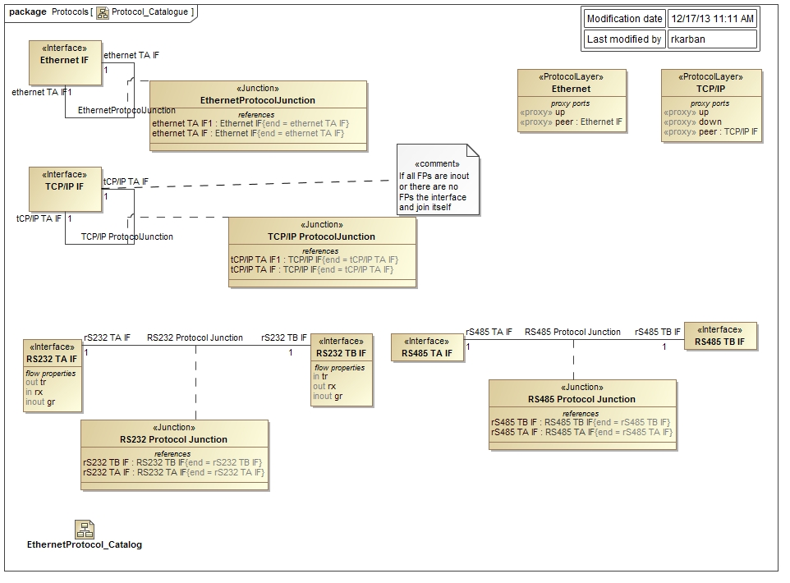
Interface and Protocol BDD

Slide 7
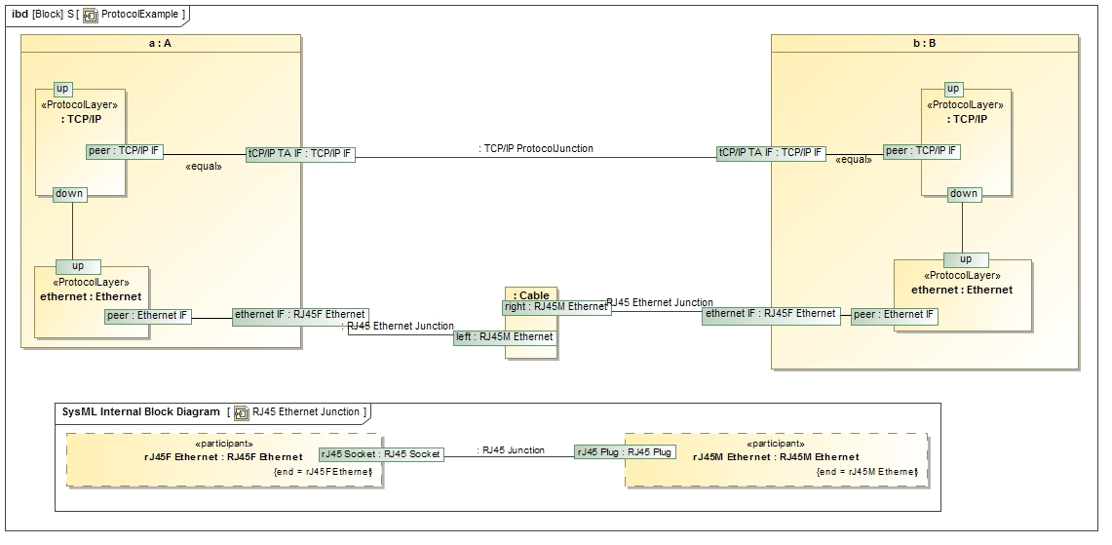
Example IBD

