Slide 1
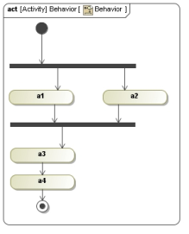
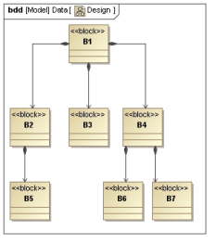
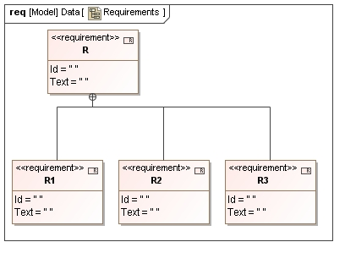
Analyze
Physical/Buildable
Design(s)
Logical/Functional
Design(s)
Requirements
realizes
<<satisfy>>
realize
experience
as-is
as-is
experience &
State Analysis
realize
to-be
present to-be
Manage obsolescence
realize
future as-is
future to-be
WHAT do we need?
WHAT to do to satisfy needs?
HOW to do?
Notes:
GfSE SysML User Forum 2008, Hamburg 26.Sept. 2008

