Slide 1
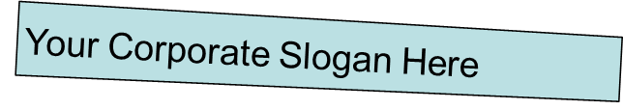
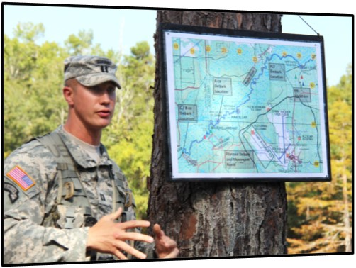
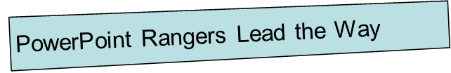
SysML for the PowerPoint Ranger
MBSE Usability Team
Bjorn Cole
Others to come

Slide 2

SysML Doesn’t Have to Be Scary
This walkthrough will show a new approach for creating models to gently guide new users from current illustrating practice (like in PowerPoint) into a more modeling-oriented practice
The new “modeling” ideas are actually straightforward logic, they just get muddled up in the jargon of the language and heritage from object-oriented software

Slide 3
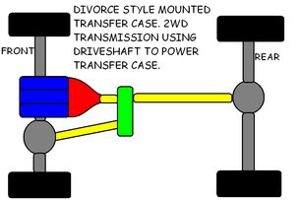
Let’s Start with An Example

Slide 4
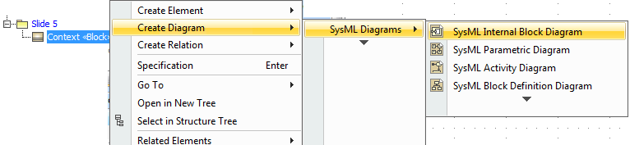
Make Your Canvas
In order to reproduce the drawing, you need a canvas to draw in. Two steps in MagicDraw:
  Make the Block (“Context”) to be your canvas
  Create the appropriate drawing (“Internal Block Diagram”) to do the actual drawing.

Slide 5
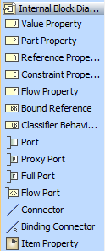
Just Like When You Were a Kid – Start By Tracing
You can copy and paste pictures into MagicDraw. Just do the Ctrl-C, Ctrl-V thing on the new diagram window.
We will trace over the diagram using boxes and lines.
The box to use in this diagram is called a “part property.” The boxes will then represent parts of the system.
We want this one!

Slide 6
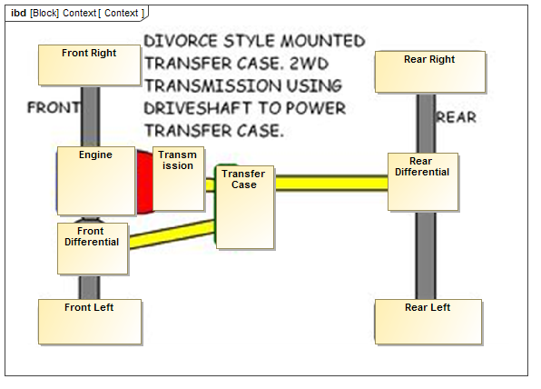
Trace It Out with Parts
We identify the parts of the car by drawing boxes on top of our image in MagicDraw.
Feel free to stretch them to the size you need.

Slide 7
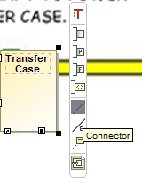
Now add the connections
The parts now need to be linked to make the car complete. Let’s do that.
Two ways in MagicDraw: use the context menu by clicking a box or use the side palette.
We want this one!

Slide 8
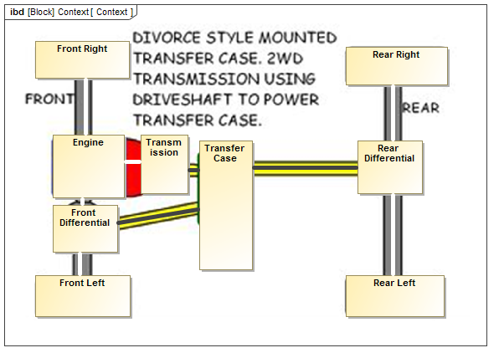
Connecting the Parts
Once the connectors are drawn, we have a reproduction of the drawing from the illustration.
You can use Symbol Properties in MagicDraw to make it prettier, but it doesn’t change the model

Slide 9
So What is in the Model Now?
The meaning of the illustration is now in the model
Problem is, there isn’t much meaning in the illustration (and this is why we are working on system modeling!)
  We do know that there are some pieces with relationships, which is important!

Slide 10
Some Basic Questions
Do “Front Right,” “Front Left”, etc. have anything to do which each other?
What about the line colors: do they mean anything?
What is being sent on the lines between the boxes?
We have no answers to these questions in the model right now, and this is where we go deeper… But the beauty is you don’t have to if you don’t need to answer these questions!

Slide 11
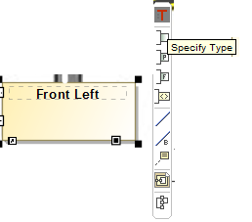
Step 1: Classification
Classification, n., the act or process of putting people or things into groups based on ways that they are alike (Merriam-Webster)
In formal classification, we use a criteria to establish the class and then judge whether or not suggested individuals are in fact members of that class
Unfortunately in UML / SysML, “Classifier” and “Type” are used interchangeably – just think “Classifier” whenever you see “Type.”

Slide 12
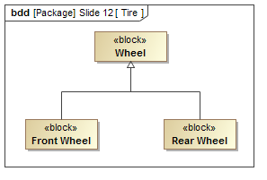
The Classification Diagram: The Block Definition Diagram
There is a diagram made especially for this, and this is where the new concept comes in.
In the diagram, “Wheel,” “Front Wheel,” and “Rear Wheel” are all Classifiers (Block is a special Classifier).
The arrow is called “Generalization” and tells us that Front Wheel and Rear Wheel define subsets of Wheel, but we don’t know anything about the overlap
There are ways in SysML to be more specific about this, but we’ll leave that for later
Wheel is not itself a set, it just defines the rules for being one. We didn’t define any rules yet but we did say that they also apply to Front and Rear Wheels
Wheels
Front Wheels
Rear Wheels
?

Slide 13
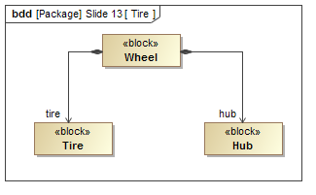
A Basic Rule
We can now add a rule. The black diamond says that all Wheels must have two parts called “tire” and “hub.” There is only one of each.
At the same time, we said that there is a Classifier called Tire (defines a set containing all tires for now) and one called Hub.
The final statement – the “tire” part must be a Tire and the “hub” part must be a Hub!

Slide 14
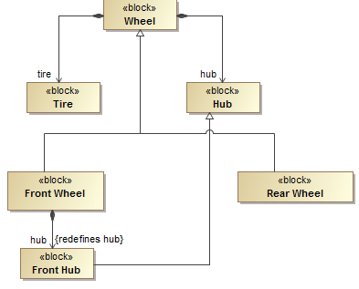
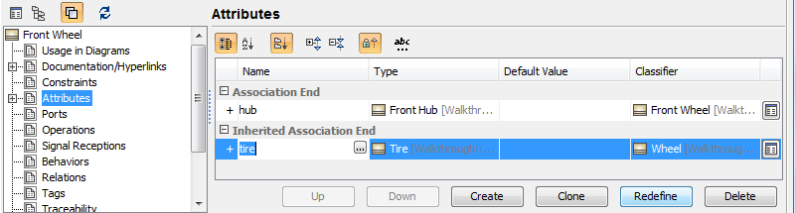
A Slightly more
Complicated Rule
To get some conceptual separation between the Wheels, let’s add one more rule. This says that a Front Wheel is different from a normal Wheel. The “hub” part is not required to be a Hub, it is required to be a Front Hub (a sub-Classifier to Hub). This new part description redefines the original from the Wheel.
MagicDraw has a button for Attributes in the Specification window called “Redefine” to do the bookkeeping.

Slide 15
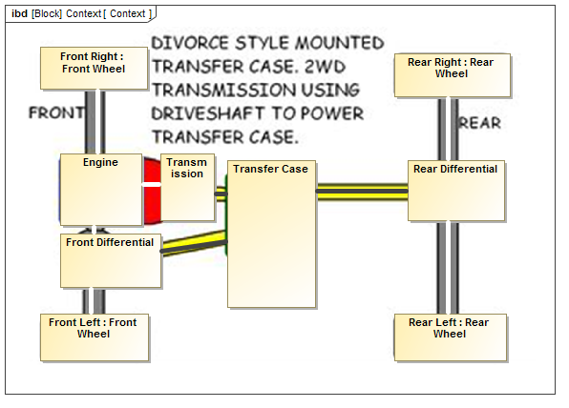
Back to Our Drawing
Now let’s go back to the diagram and use our new Wheel Classification scheme.
In MagicDraw, you can click on the box and then the red type to apply the type.
Now the model knows that we have two Front Wheels and two Rear Wheels that must be part of every Context.

Slide 16
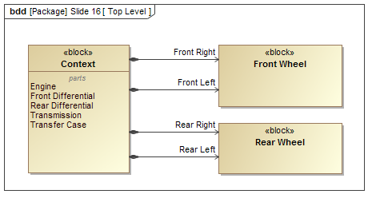
Looking back at the Block Definition
Four-Wheel Drive Car
We can look at our diagram from the Block Definition side now. We originally had our canvas called Context. However, now that we know we were drawing a car, it might be better to use something more descriptive like Four-Wheel Drive Car.
What the above diagram says (with correction) is that Four-Wheel Drive Cars have parts called “Engine,” “Front Differential,” “Real Differential,” etc. In addition, “Front Right” and “Front Left” must be individuals from within the “Front Wheel” Classifier’s defined set.

Slide 17
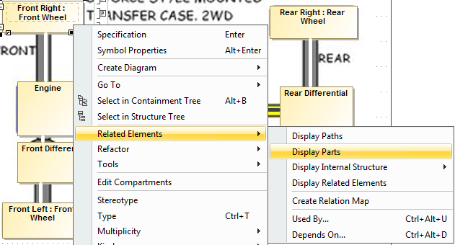
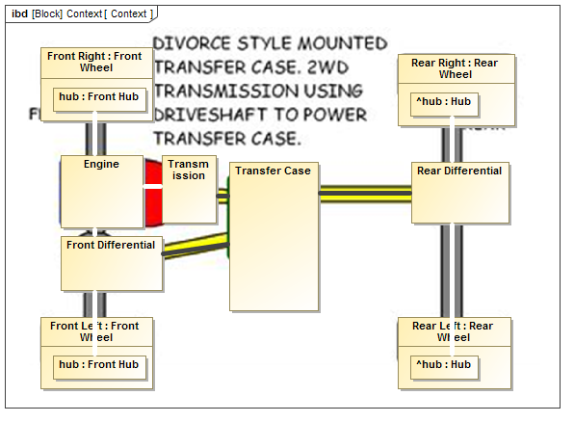
Our Model Lets Us Do Something New!
Now that the Wheels have been classified, we can do a new trick. Rather than just blindly connecting the wheel to the differential, we can be a little more specific and connect it to our Hub.
MagicDraw allows you to query the model for areas where there might be detail you didn’t show. This is done in the “Related Elements” menu.
And now we have a little more information captured in our model. More and more detail could be added over time like this.

Slide 18
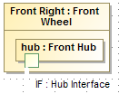
Step 2: Interfacing with Ports
The next addition we can make to our model is to define some specific interfaces via Ports.
There is a difference between the Classifier for a Port and for a part. The Port Classifier provides a place for us to set rules on things that can satisfy the interface.

Slide 19
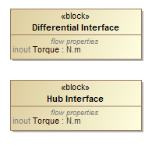
Adding Flow Properties
Most interfaces have something move across them (energy, information, matter). SysML allows you to capture this.
The “Flow Property” is where you can define the type of something that can move across the interface represented by a Port. In this case, the rule says that all Differential and Hub Interfaces admit Torque to flow in and out.

Slide 20
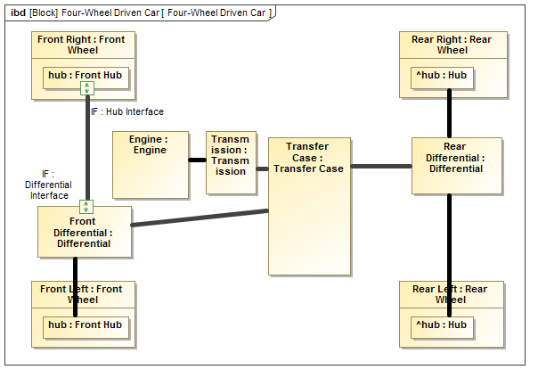
Original Drawing with Some Ports
Our drawing now has some ports, focusing on transmitting the front side Torque.
Some rearranging can now be done to make it a little cleaner from the original.

Slide 21
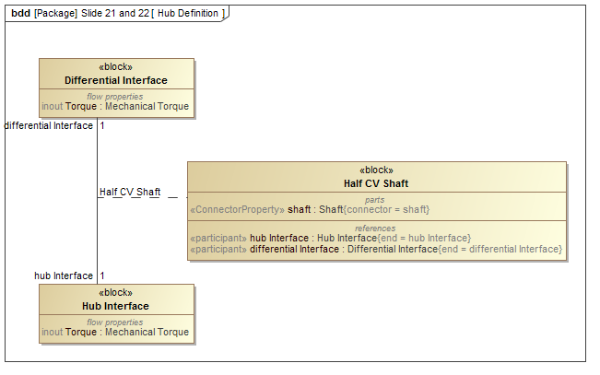
Step 3: Defining Connections
The last thing we can do is add some definition to the connections. This is done with Association Blocks, which are Classifiers for connections. They can hold properties as well as have definitions for what connects to what. There is a lot of detail available here and we won’t go into that here.

Slide 22
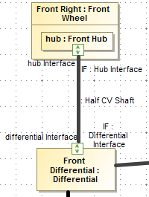
Applying the Definition
Connectors can be typed (Classified) just like parts, using the red T from MagicDraw’s context menu.
We know have a full Classification of the connection between the Front Differential (Classified by Differential) and the Front Right’s hub (Classified by Front Hub). The Connector is Classified by Half CV Shaft, which can have rules of its own for how Torque is transmitted.
These rules give us a way to check individual configurations of differentials and front wheels to see if they meet the constraints we have set in the model.

Slide 23
So What Did We Actually Achieve?
The original drawing showed a number of boxes, some with names, some without, and notional connections.
We took those boxes and added some background. For example, are the front wheels and rear the same? We decided no. But the two front wheels are the same. I didn’t point it out, but I also decided that the Differentials were of the same Classification, meaning any individual differential could fill either role.
We took a notional cartoon and started to apply some systems engineering. What are the interfaces? How do these interfaces support interaction in the larger whole? What are the properties of the connection (torque) that we care about?
By the way – incomplete models are totally fine! It’s all part of the process of slowing adding more detail and resolving issues. The hope for this approach is that it shows how to do that detail adding, rather than having to define everything up front before using it.

Slide 24
Reading Further
This introduction should make you ready to dive into more in-depth resources as well as initial discussions on modeling best practices.
If your institution or company has modeling capabilities already, then this should help you start with their suggested practices.
If not, this should get you thinking (along with textbook material) about what problems you need to start connecting to systems modeling practices.

Slide 25
Acknowledgements
General slide flow inspired by conversations with Nerijus Jankevicius from NoMagic regard improvements to usability for SysML 17.0.5 plugin

