Slide 1
Background on mounting an instrument on a telescope
A telescope provides power and mechanical interfaces (among others) for attaching instruments
Power interfaces are bundled in Service Connection Points (SCP)
SCPs are distributed around the telescope’s main structure and dome
Instruments are mounted with their flange on a rotator flange which is part of the main structure, using reference pins
Instrument electronics are screwed to the main structures platform
The rotator flange, platform, and SCPs are parts of the Main structure
From the Instrument point of view the Telescope is seen as a black box with certain exposed interfaces (<<proxy>>)
There are maximum power and load requirements for instruments

Slide 2
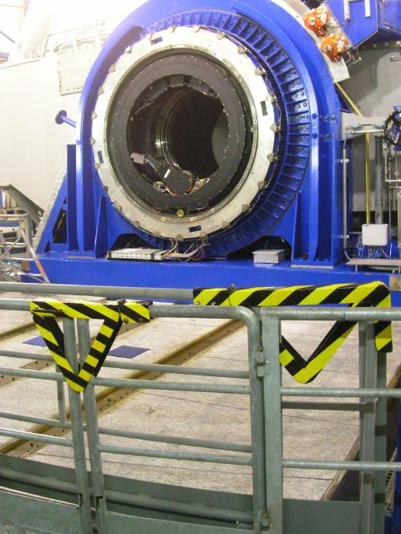
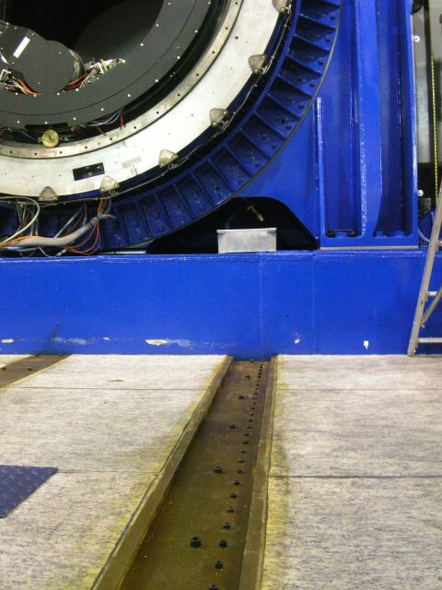
Platform and rails

Slide 3
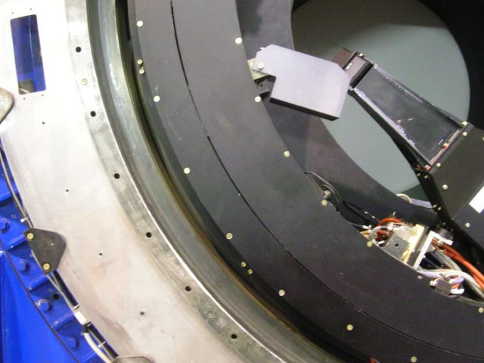
Mounting flange

Slide 4
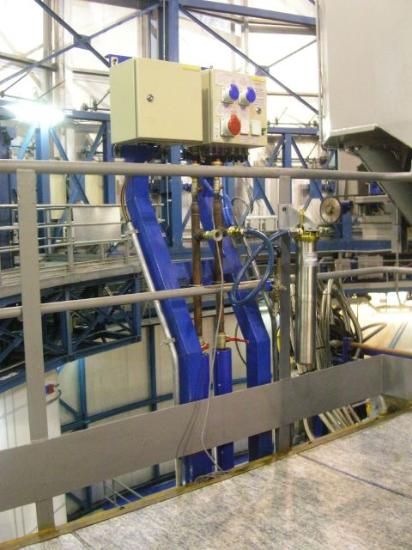
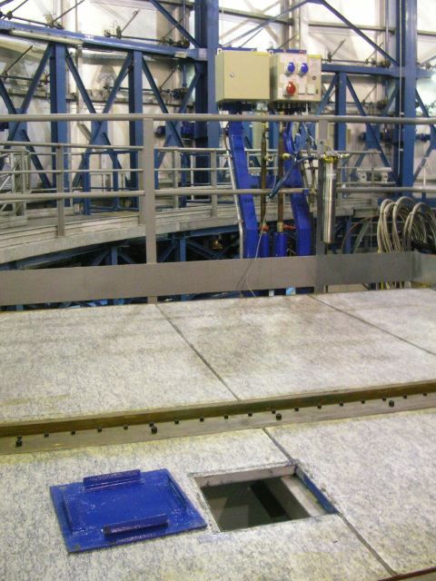
SCP on Nasmyth platform and Wiring holes
SCP -A

Slide 5
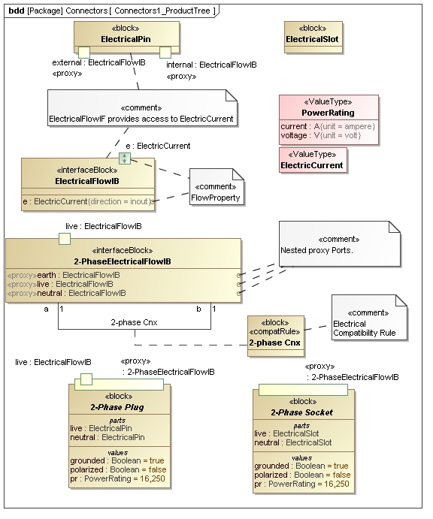
Definition of 2-Phase Plugs and associated Electrical Flows

Slide 6
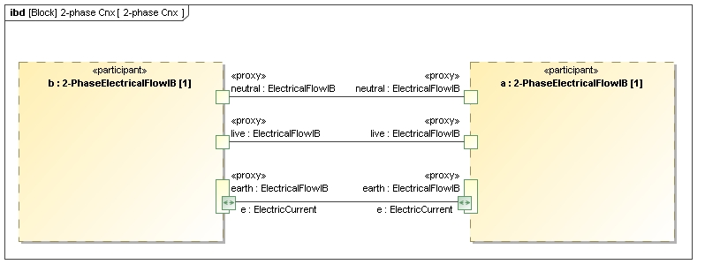
2-phase Cnx electrical compatibility rule

Slide 7
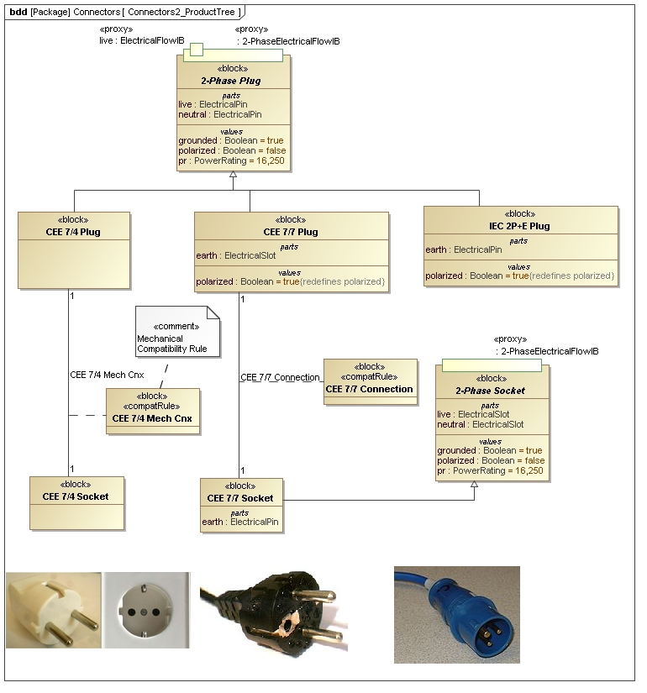
Definition of 2-Phase Plugs

Slide 8
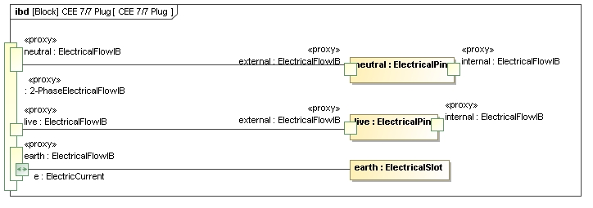
Internals of a Plug

Slide 9
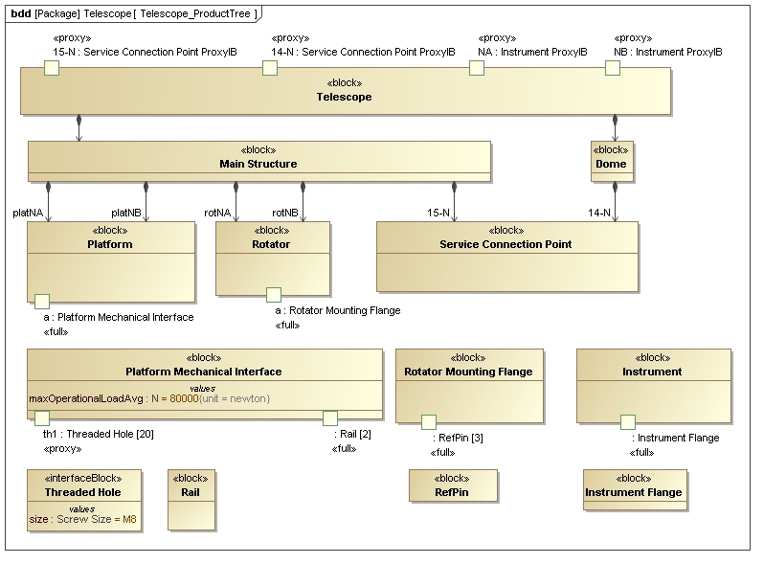
Telescope external Interfaces for an attached Instrument (Power and Mechanical)

Slide 10
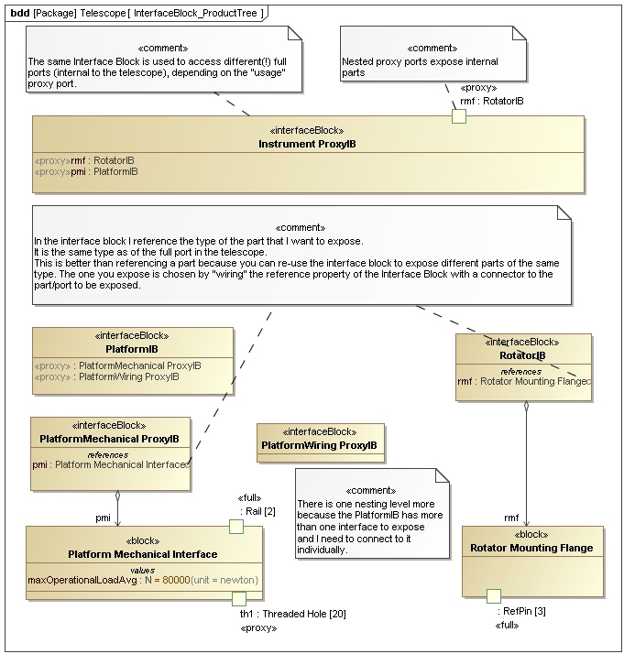
Telescope external Interfaces for an attached Instrument (Power and Mechanical)

Slide 11
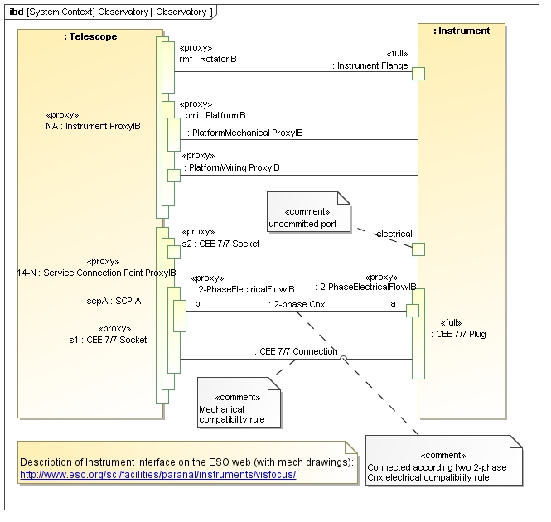
Black box view of telescope

Slide 12
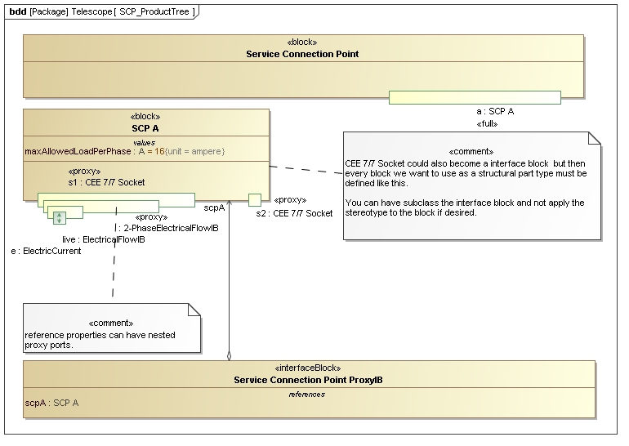
Definition of Telescope Service Connection Point Part A for Power

Slide 13
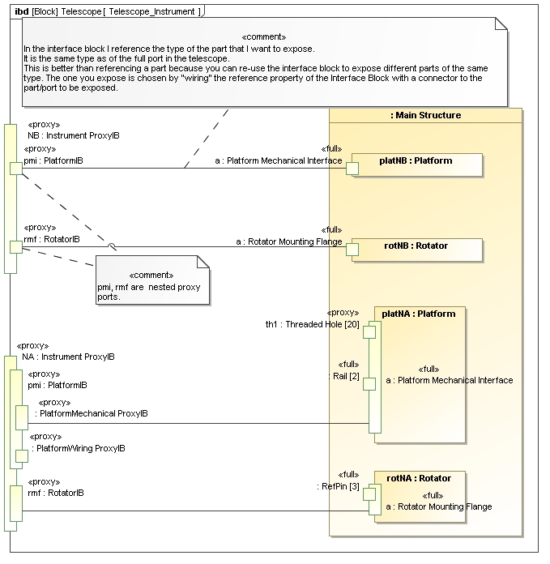
Connection External Mechanical Telescope Interfaces to its internal Interfaces

Slide 14
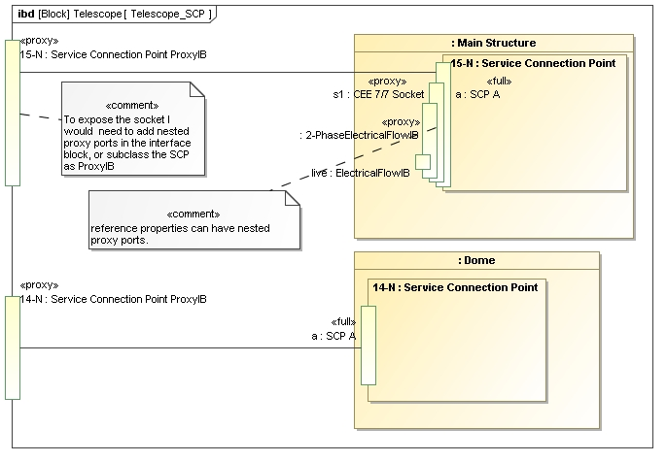
Connection External SCP Telescope Interfaces to its internal Interfaces

Slide 15
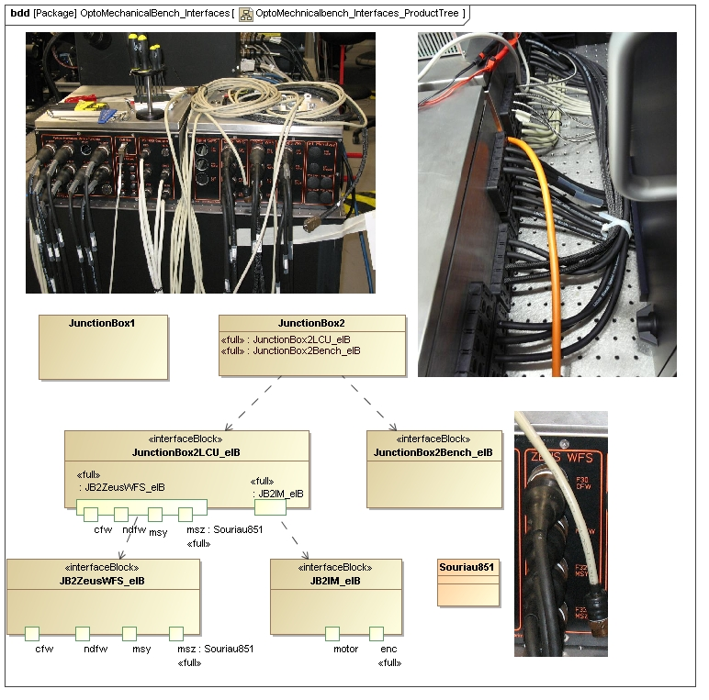
Grouping Interfaces

Slide 16
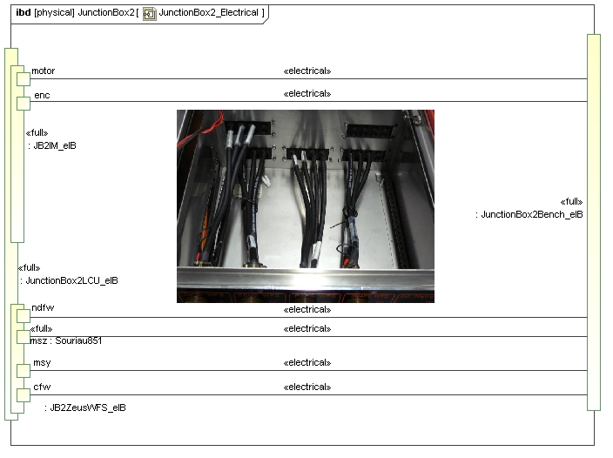
Grouping Interfaces

Slide 17
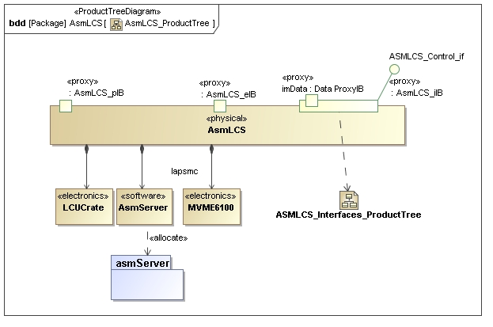
Data and Command Interfaces

Slide 18
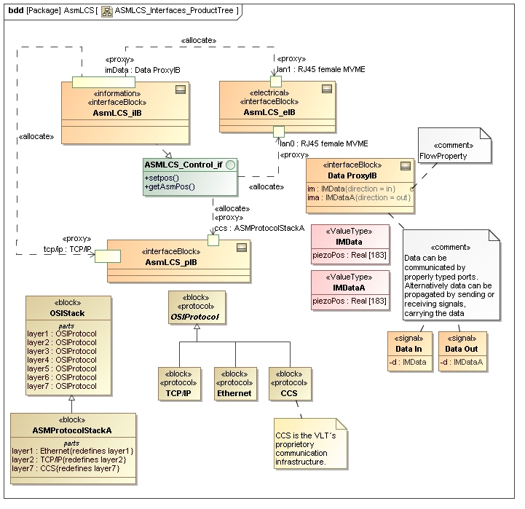
Allocation of Data, Command, Protocol and Electrical Interfaces

Slide 19
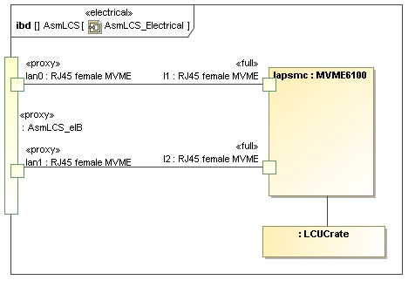
Mapping access to structural

Slide 20
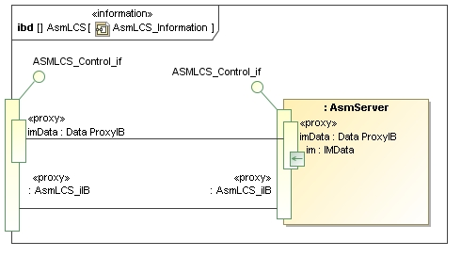
Mapping access to access

Slide 21
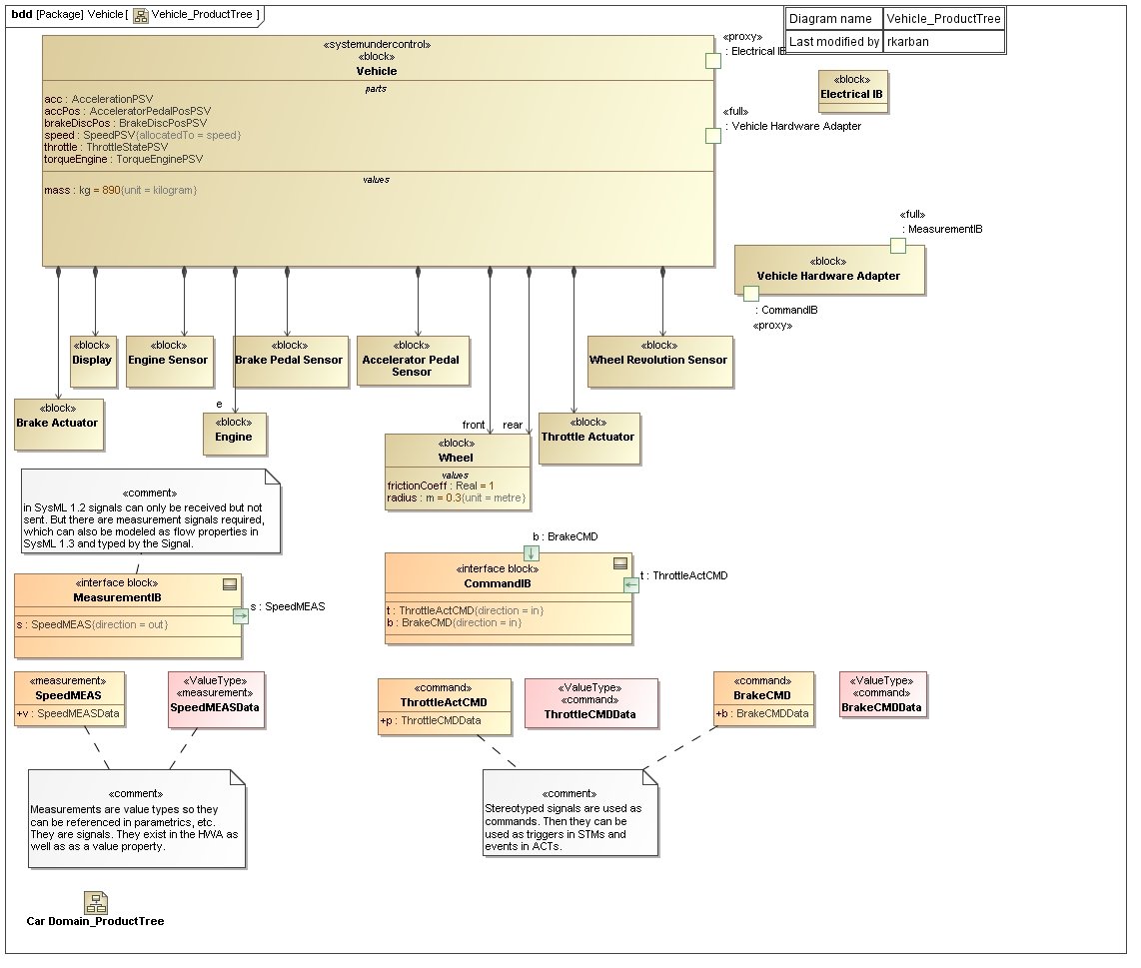
Cruise Control Product Tree – State Analysis Method

Slide 22
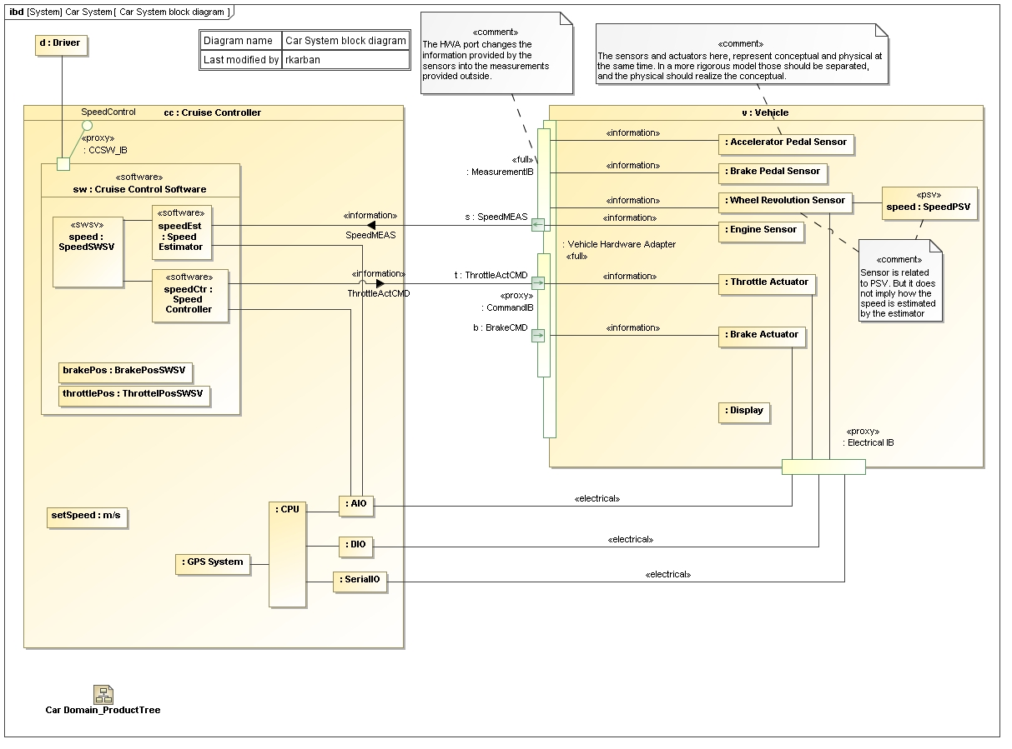
Cruise Control Block Diagram – State Analysis Method

Slide 23
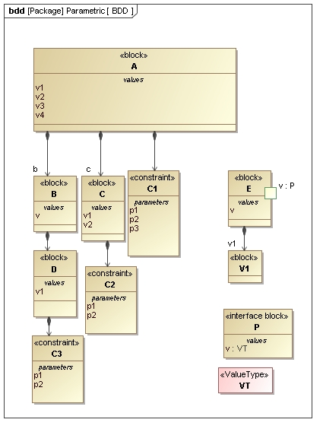
Generic Parametric Example

Slide 24
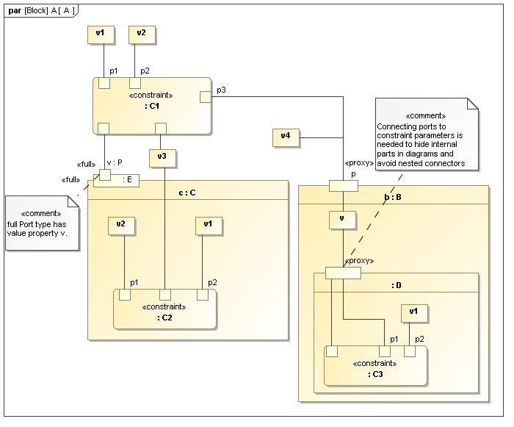
Generic Parametric Example

