Slide 1
K
A wide spectrum language for modeling, specifying, and implementing
Joint work with Klaus Havelund, chris delp, Bradley clement

Slide 2
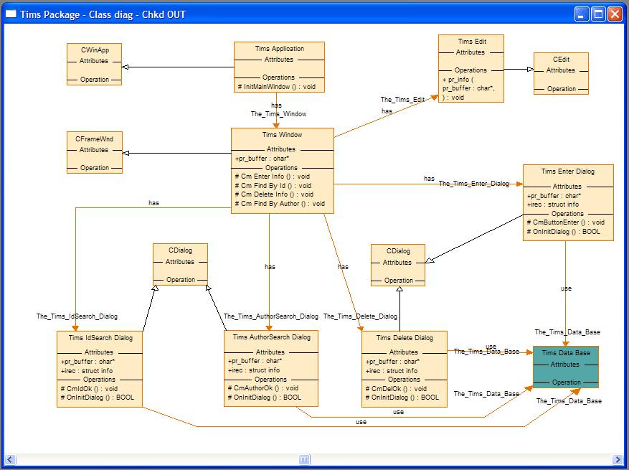

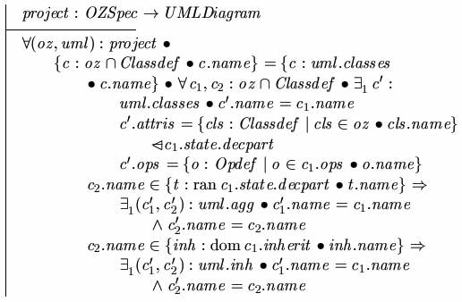
Motivation
Model based engineering community
UML, SysML
Visual languages
Semantics difficult to find/use
Formal methods community
Model checking, static analysis, testing
Formal and Textual languages
Semantics clearly defined

Slide 3
But the goal is really the same
Create models
Analyze for correctness
Discover problems at each level
Eventually produce implementations
Rinse and repeat…
model
implementation

Slide 4
Some Observations
MBE users are starting to perform analysis
Most diagrams are class diagrams, which show structure
Some diagrams are state machines or other forms of behavior
Looking to encode a lot of requirements or constraints
Formal methods community is all about analysis
Static and dynamic analysis
Semantic and syntactic analysis
Automated theorem proving
Our job is to make these worlds become one!

Slide 5
K Language Constructs
Packages
Class
Properties
Functions
Constraints
Association
Multiplicities
Modifiers: part, ordered, unique, source, target
Annotations
Extensible keyword set
Collections (Seq, Bag, Set)

Slide 6
Salient Points
Relational view
Sets of atomic objects
Relations between objects
Easily specify constraints, functions, behaviors
Extensible using
Keyword extension
Libraries
Rich expression language: Predicate logic, OCL, Set theories, General programming
Analysis

Slide 7
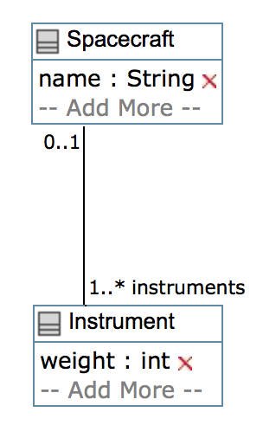
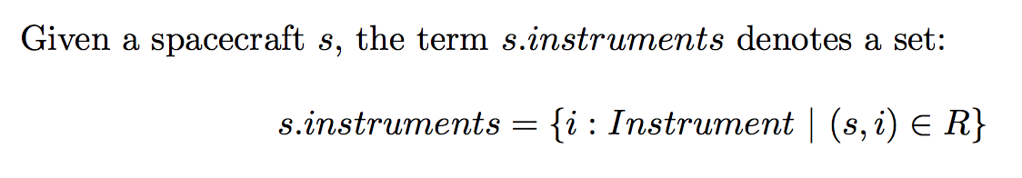
Properties
Class Spacecraft is said to have the property “instruments”.
However, it is not exactly a “field” in the class in the Java sense.
MBE refers to this as a “relation”
FM refers to this as a “field”
R

Slide 8
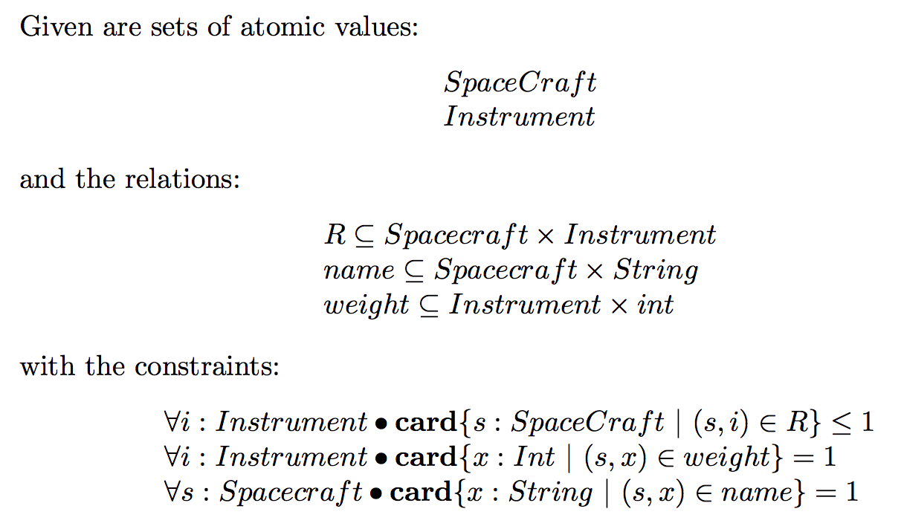
Relational View
R

Slide 9
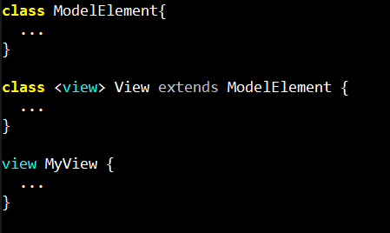
Extensible Keywords
“view” is now a new keyword that can be used in the model!

Slide 10
Extensible Keywords
You can use view instead of class.
This is the same as writing
class MyView extends View {

Slide 11
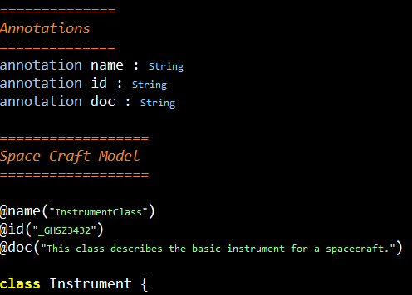
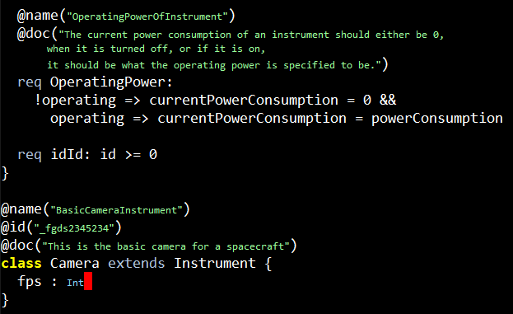
Annotations

Slide 12
Domains
Domain specific information encoded in K libraries
For example:
SysML can now be completely encoded in SysMl.k, which can be used as and when needed
Examples of other domains:
UML
Physics
Mechanical
…
Libraries
SysML
Mechanical
...
Europa

Slide 13
Analysis
K Model
Parsing √
Conversion to AST √
Type Checking √
Custom syntactic checking
Formal analysis
Solving
to SMT √
to BAE
to <your favorite solver ☺>
Function proofs
Class consistency √
Model checking
Domain specific rules
User defined rules
Concrete Execution

Slide 14
Examples and Demo

Slide 15
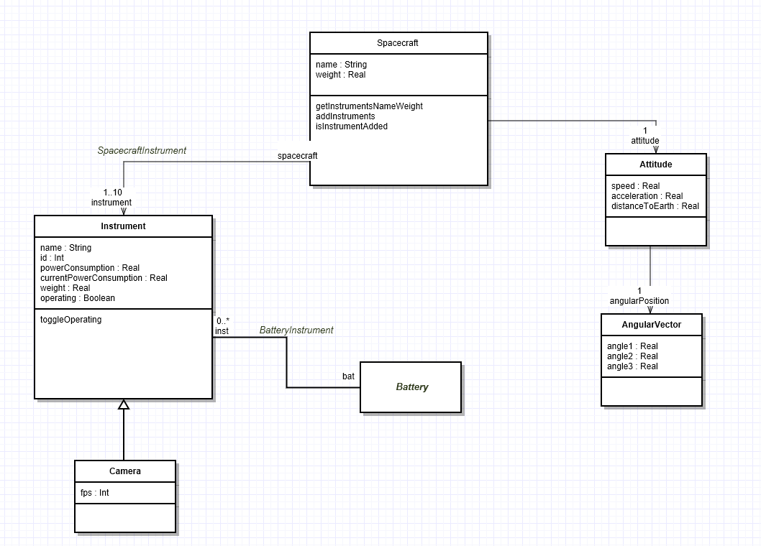
Spacecraft Example

Slide 16
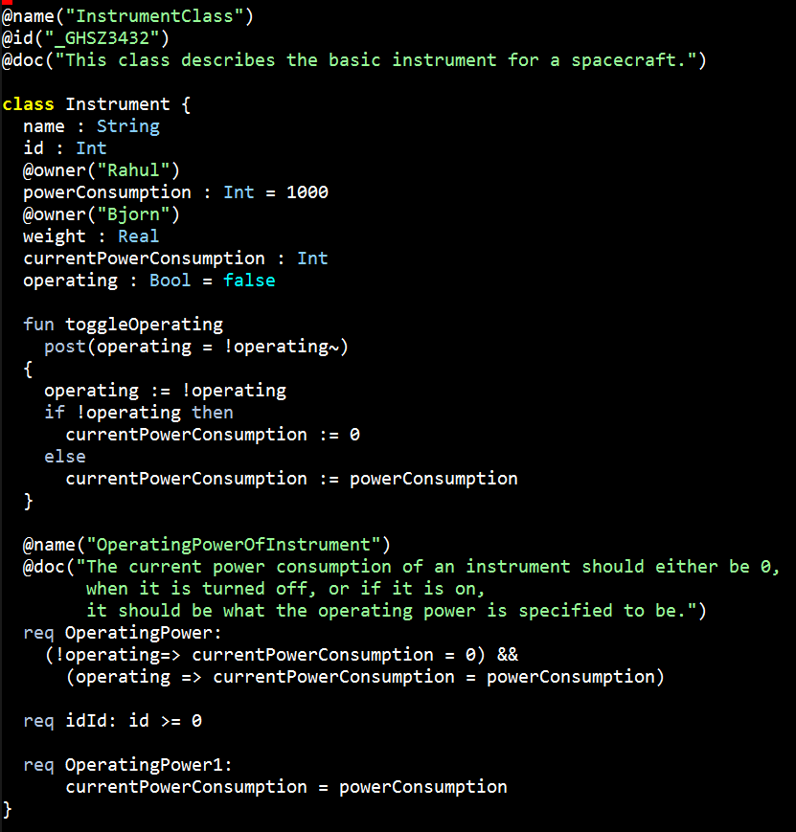
Spacecraft Example

Slide 17
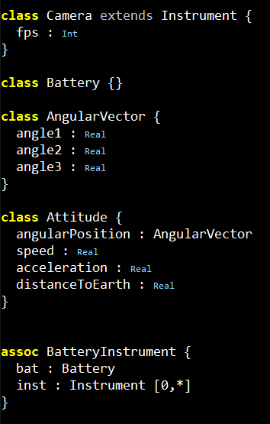
Spacecraft Example

Slide 18
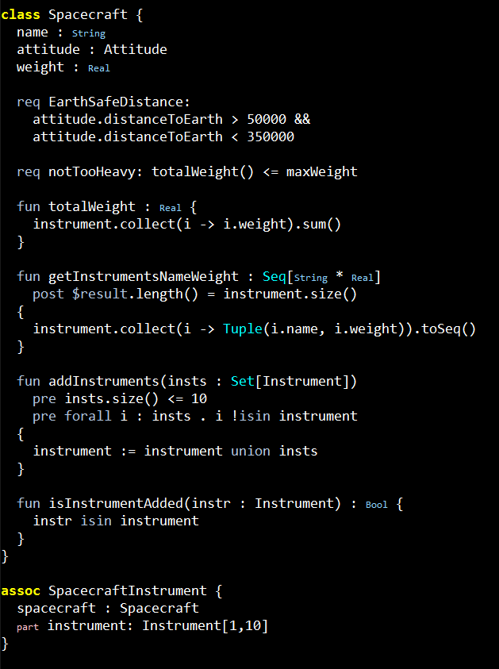
Spacecraft Example

Slide 19
Shapes
Right Triangle
(one angle at 90º)
Equilateral Triangle
(three sides equal)
Isosceles Triangle
(two sides equal)
Square
Rectangle
(all sides equal)
Rectangle
(two sides equal)
Check class consistency using K. Properties of shapes encoded as constraints.
Sum of angles in triangle is 180º

Slide 20
State machine
turn_on
fire
off
ready
firing
turn_off

Slide 21
State machine
turn_on
5
fire
4
2
3
0
off
ready
firing
1
turn_off

Slide 22
State machine
turn_on
5
fire
4
Defect 1
A modeler introduces a transition that takes the state machine from ready to off position when a fire command is issued. This makes the state machine non-deterministic, which is caught by K.
2
3
0
off
ready
firing
fire
4
turn_off
1

Slide 23
State machine
turn_on
5
fire
4
Defect 2
Due to a miscommunication between modelers, it was thought that when the rocket is turned off from the firing state, it will go back to the ready state. Again, the state machine becomes non-deterministic, which is caught by K.
2
3
0
off
ready
firing
turn_off
1
turn_off
1

Slide 24
Scheduler
Only specify partial order for a timeline.
establish_clock
init_evr
boot
evr_service_start
power_off_cameras
Not together
power_on
pick_boot_image
mount_flash
power_on_star_sensor
power_on_navigation

Slide 25
Continuity…
Been challenging so far, but… we are
integrating with the ViewEditor and MMS for Europa
starting to perform analysis on Europa models using our K infrastructure
develop domain specific libraries
Improving our language and infrastructure as needed

Slide 26
Questions
Thank you for your time and attention!

