Slide 1
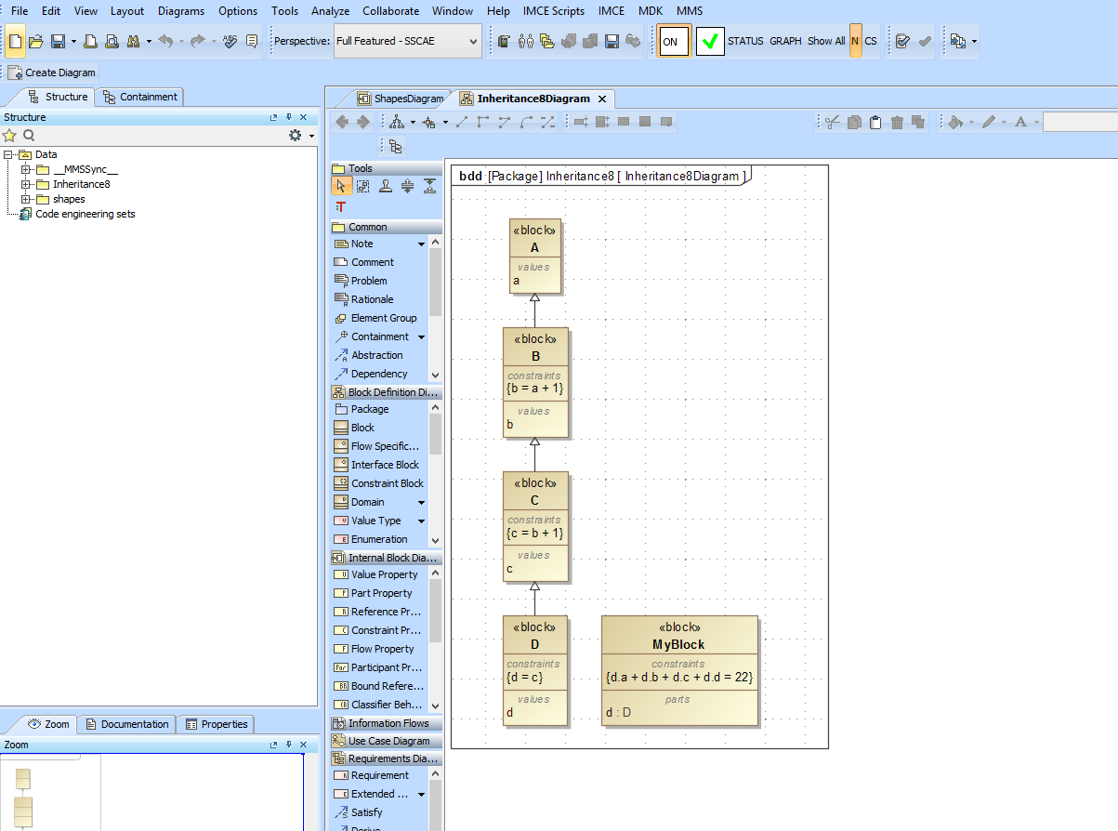
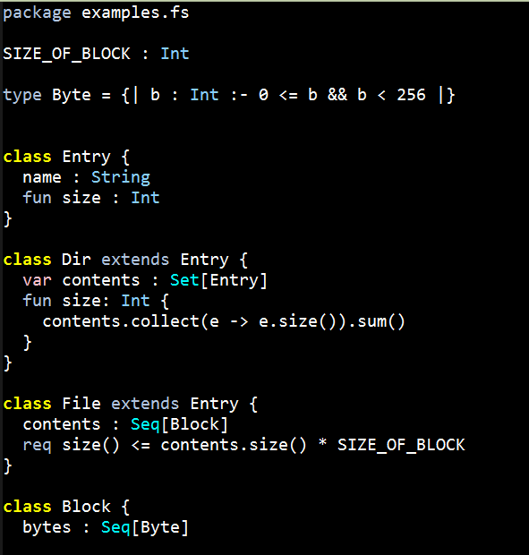
DB
JSON
K
ANTLR Grammar
ANALYSIS
Scala
JSON Visitor
Type
Checker
AST
Scala
ANTLR
ANTLR
Parser
JAVA
Visitor Interface
Scala
Visitor
SMT Analysis

